Slide 1
A N
At the movies

Slide 2
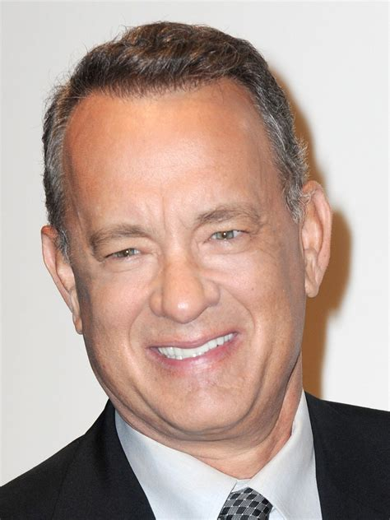
Movie Quiz
A N
I won Oscars for “Philadelphia” in ’93 and “Forrest Gump” in ’94. Who am I?
Tom Hanks

Slide 3
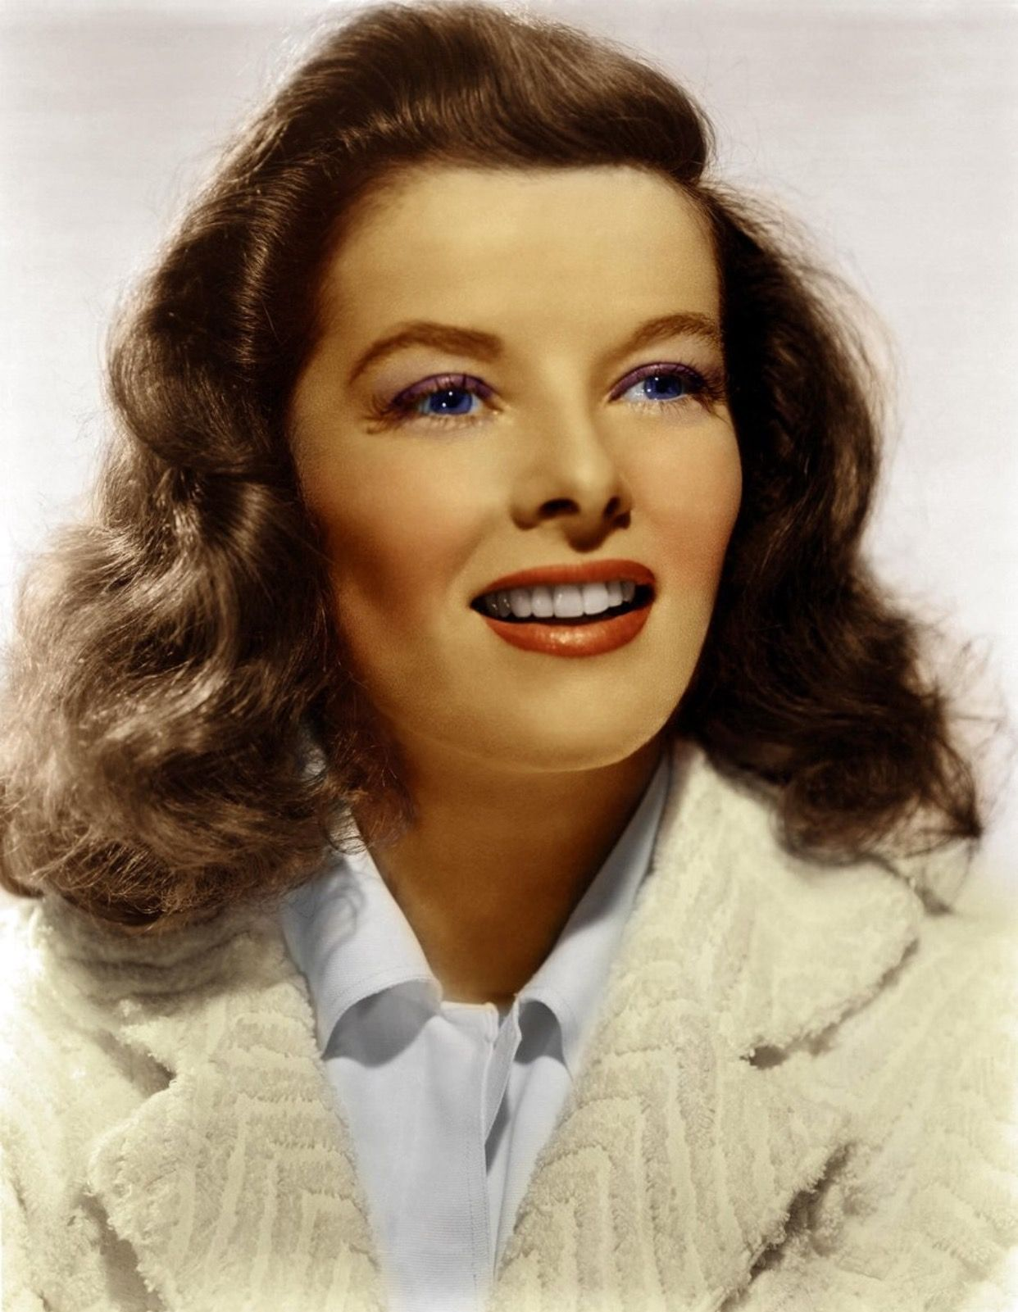
Movie Quiz
A N
My first name is Katharine and I have received a record 12 Oscar nominations? Who am I?
Katherine Hepburn

Slide 4
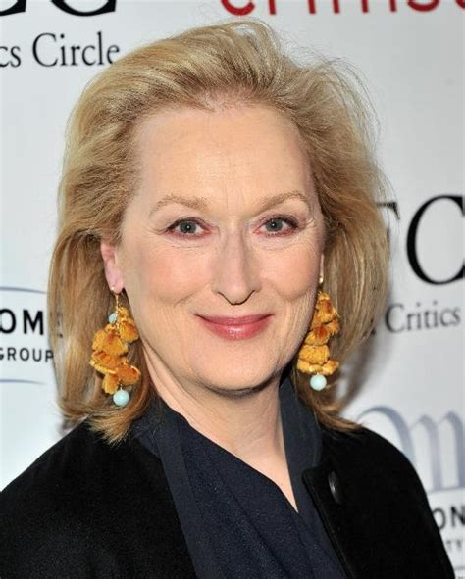
Movie Quiz
A N
Who was the female Kramer in “Kramer vs Kramer”?
Meryl Streep

Slide 5
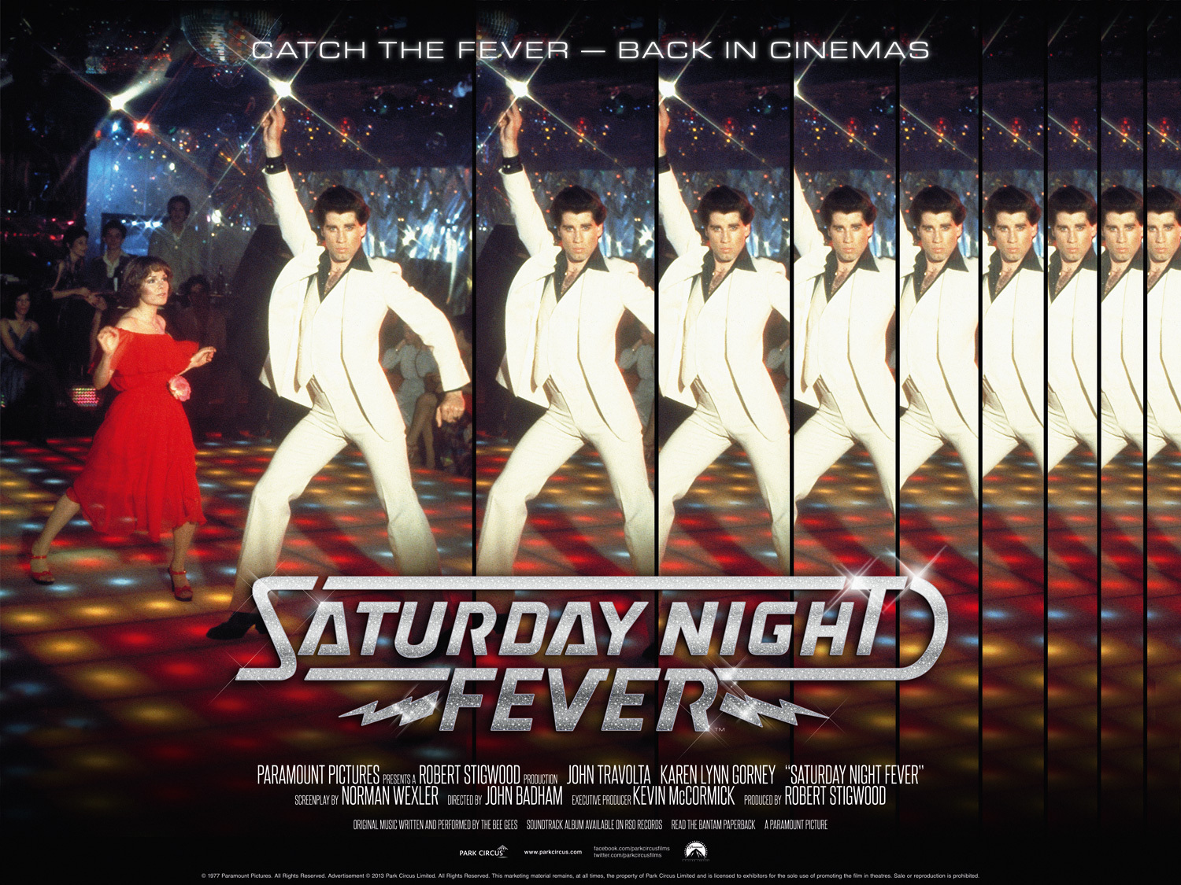
Movie Quiz
A N
What Night was there Fever in the movie with John Travolta?
Saturday Night Fever

Slide 6
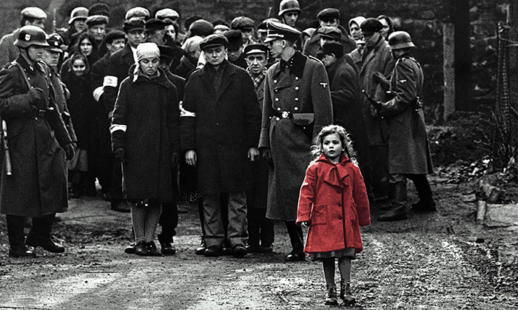
A N
Did you know?
In the movie Schindlers List, to gather costumes for 20,000 extras, the costume designer took out advertisements seeking clothes. As economic conditions were poor in Poland, many people were eager to sell clothing they still owned from the 1930s and '40s.

Slide 7
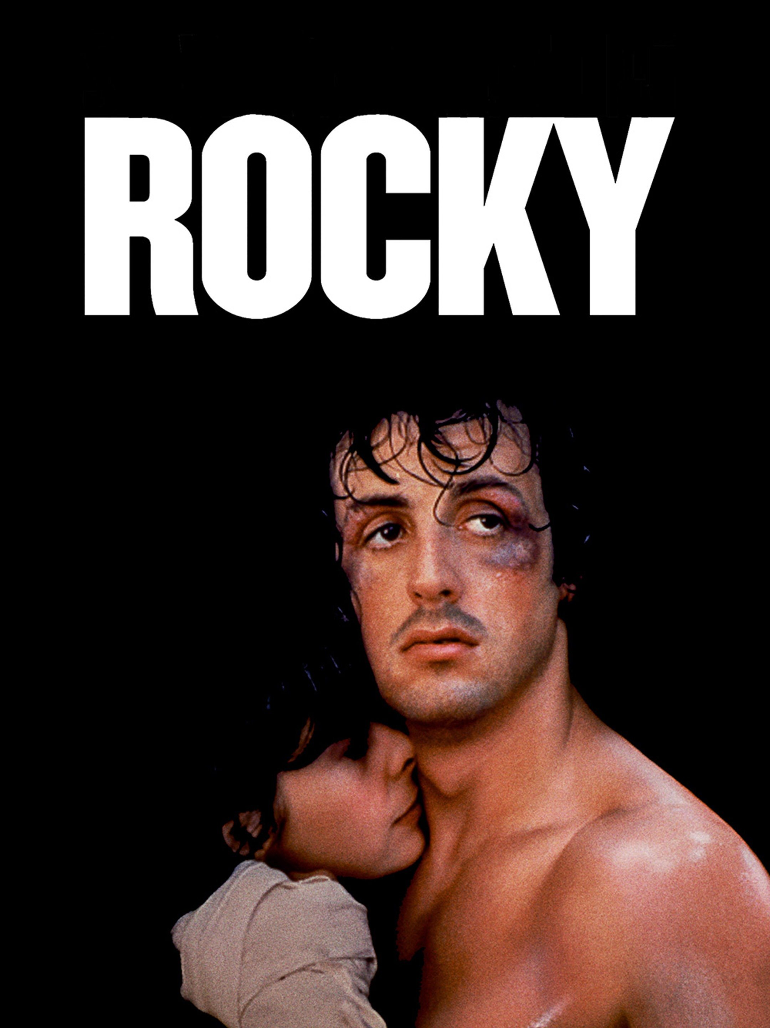
Movie Quiz
A N
Which boxer did Sylvester Stalone play in a movie?
Rocky

Slide 8
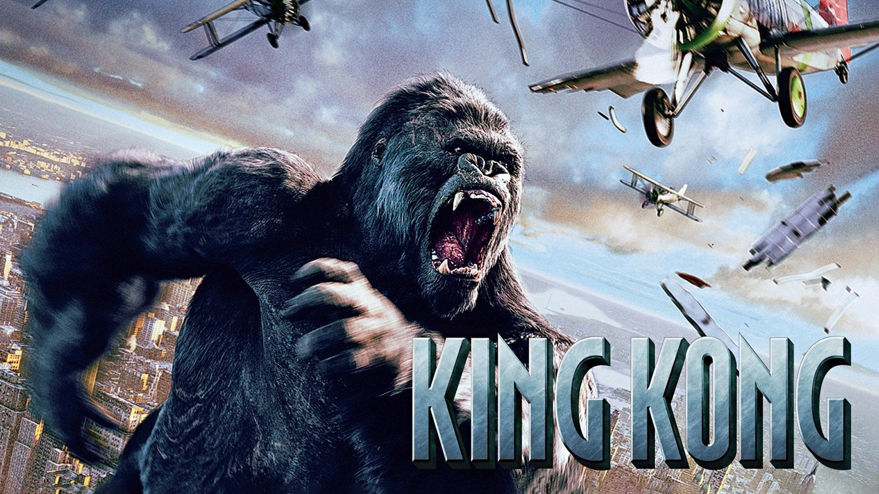
Movie Quiz
A N
Which 1970s film about a giant ape was a remake of a 1933 movie?
King Kong

Slide 9
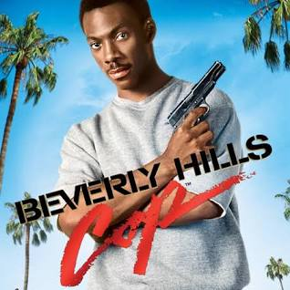
Movie Quiz
A N
Where was Eddie Murphy a Cop in the film series?
Beverly Hills

Slide 10
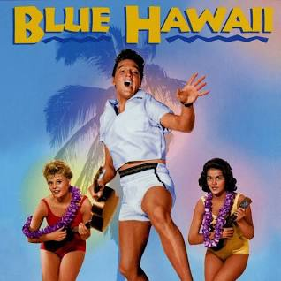
Movie Quiz
A N
Elvis Presley stars as Chad Gates in the musical ‘Blue Hawaii’, what type of company does Chad’s father want him to work at?
A fruit company

Slide 11
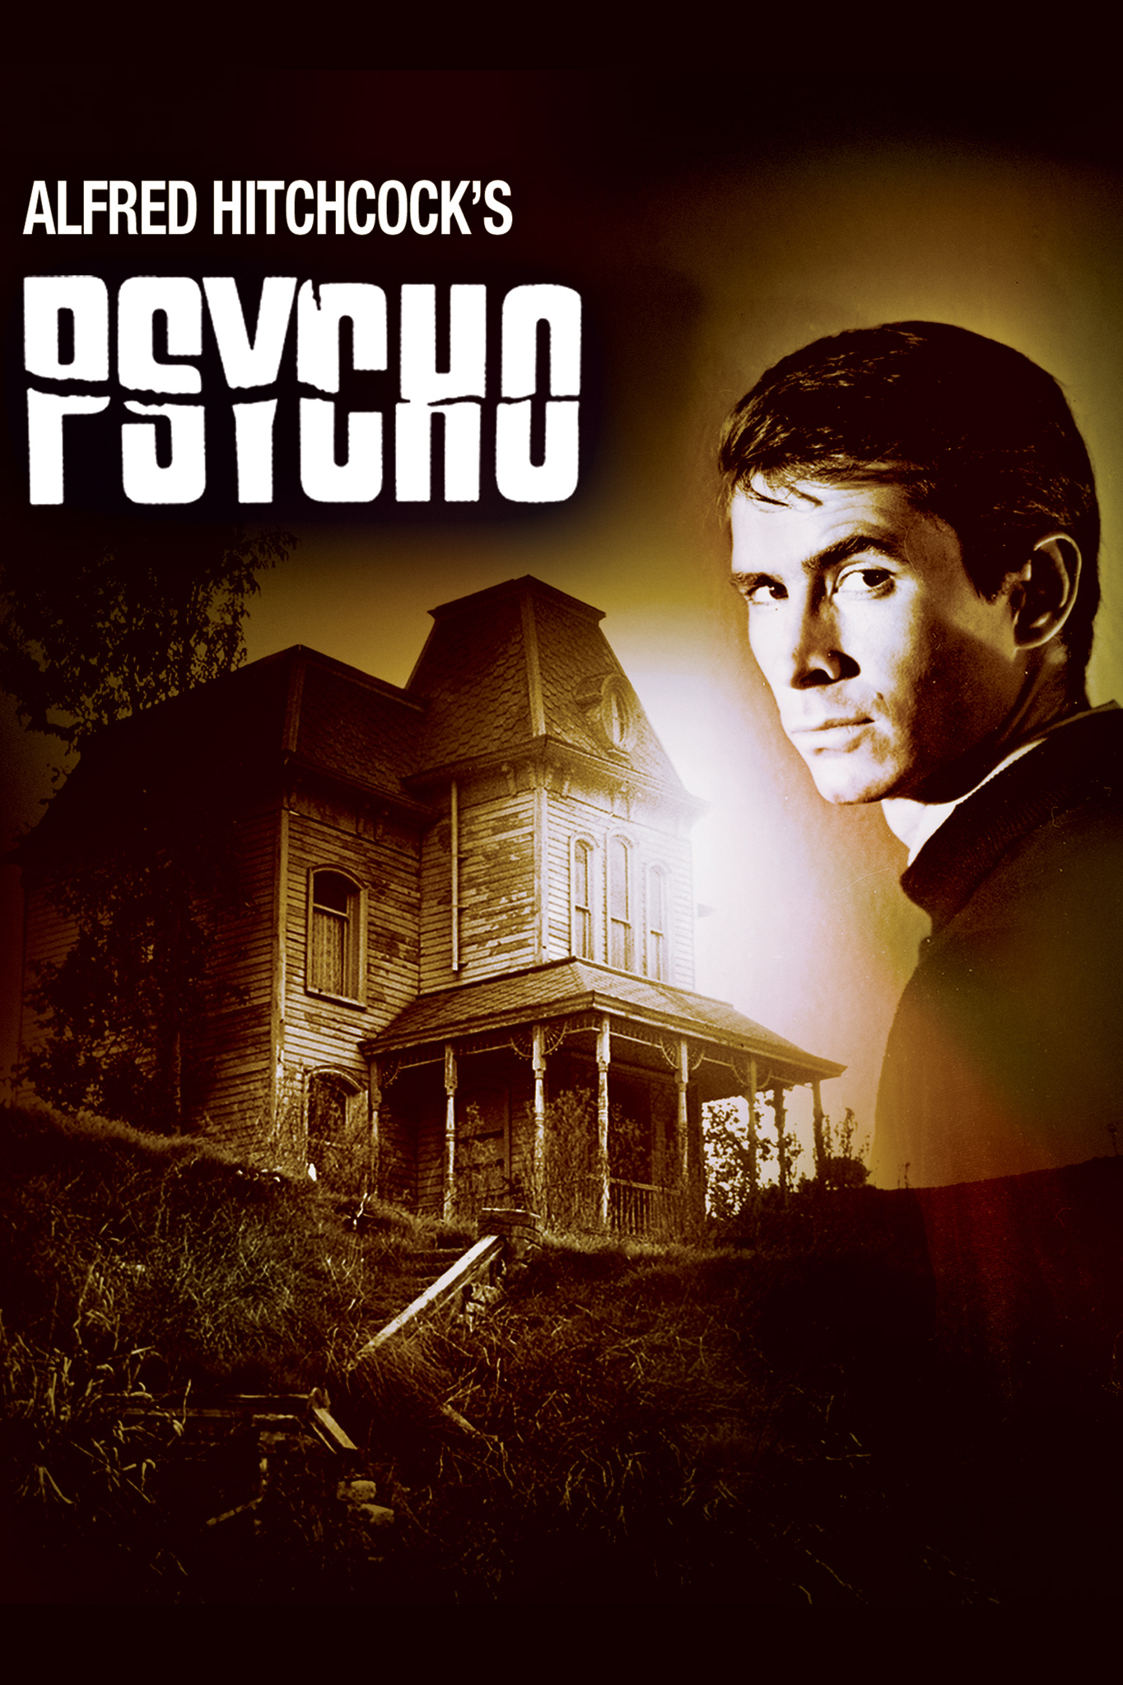
Movie Quiz
A N
Alfred Hitchcock’s 1960 classic ‘Psycho’ was the first American film to show what?
A flushing toilet
A skeleton
Nude breasts
A running shower
Flushing toilet

Slide 12
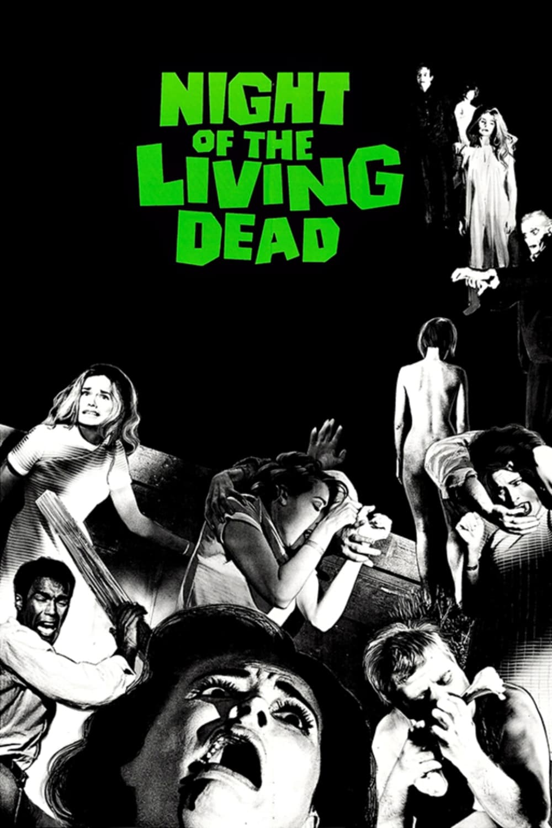
Movie Quiz
A N
1968 brought us the horror tale of ‘Night of the Living Dead’, but what caused the deceased to rise from their graves?
Radiation From A Fallen Satellite
A Witch's Song
A Full Moon
Radiation From A Fallen Satellite

Slide 13
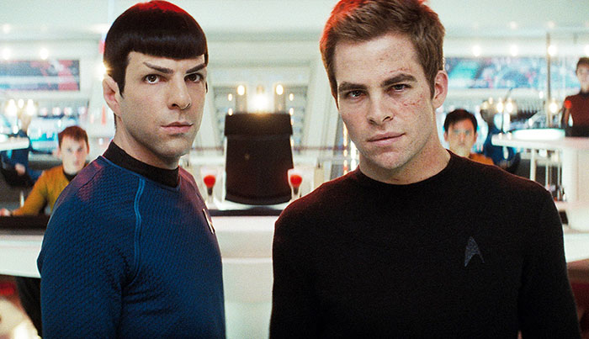
A N
Did you know?
In the movie Star Trek, the sound of the automatic doors opening on the U.S.S. Enterprise, is a Russian train's toilet flushing.

Slide 14
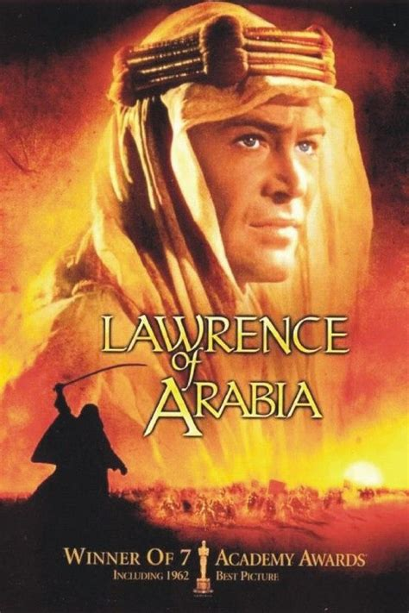
Movie Quiz
A N
How is Lawrence killed in the opening scenes of 'Lawrence of Arabia’?
Shot
Motor cycle accident
Thrown from a horse
Helicopter crash
Motor Cycle accident

Slide 15
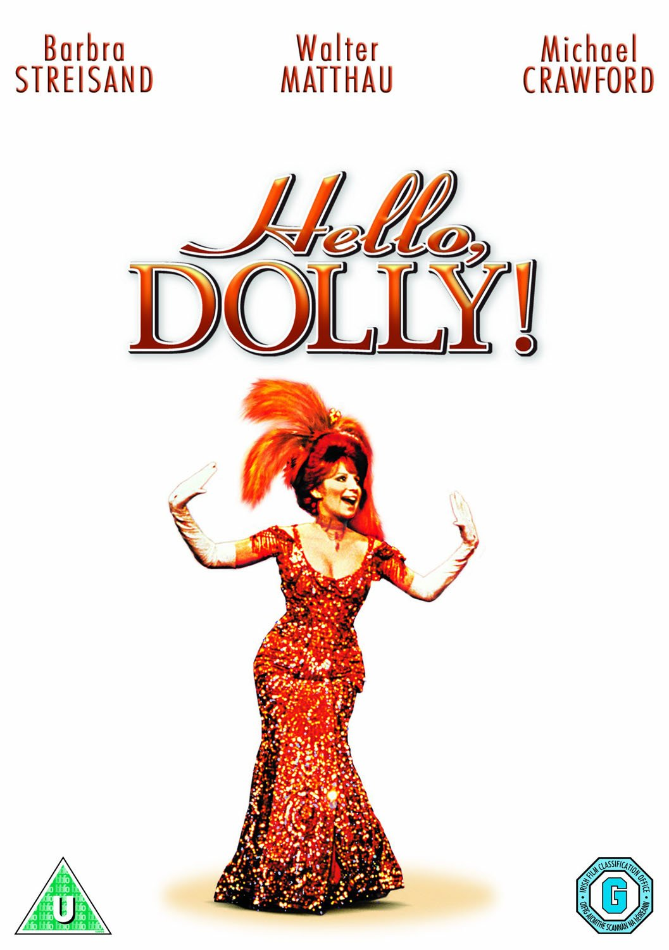
Movie Quiz
A N
How does Dolly, played by Barbra Streisand, make her money in the 1969 musical 'Hello, Dolly!’?
Hair dresser
Florist
Model
Matchmaker
Matchmaker

Slide 16
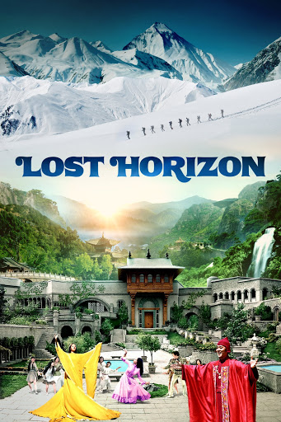
Movie Quiz
A N
In the movie 'Lost Horizon' (1973), what are the main characters escaping from?
India
Sri Lanka
China
Iran
China

Slide 17
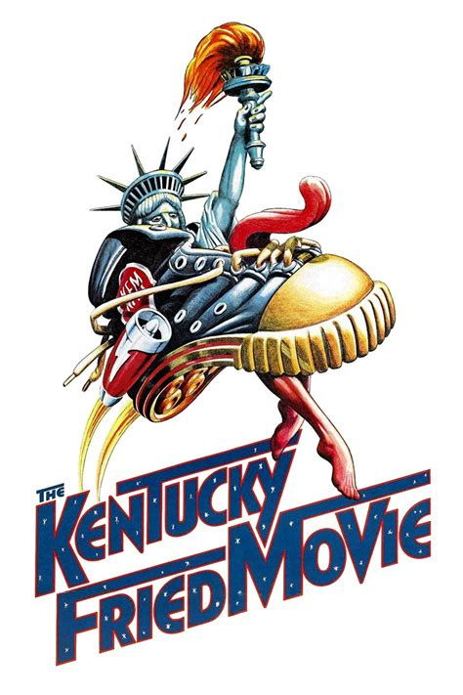
Movie Quiz
A N
Cleopatra Schwartz is a character in which movie?
a) Zardoz' (1974)
b) The Message' (1976)
c) The Kentucky Fried Movie' (1977)
c) Kentucky Fried Movie

Slide 18
Movie Quiz
A N
In which 1989 movie does English teacher John Keating, played by Robin Williams, urge his students to “seize the day?”
Dead Poets Society

Slide 19
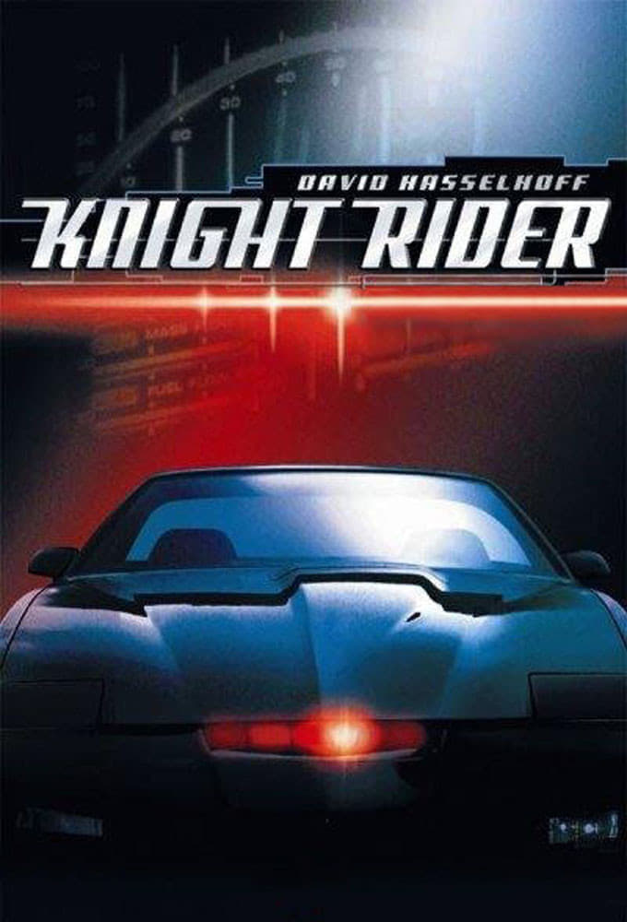
Movie Quiz
A N
In the 1980s film "Knight Rider," what was the name of David Hasselhoff's talking car?
Kitt

Slide 20
A N
Did you know?
Popcorn was integral to early 16th century Aztec Indian ceremonies.

Slide 21
A N
Did you know?
In the movie Slumdog Millionaire, Director Danny Boyle placed the money to be paid to the 3 lead child actors in a trust that is to be released to them upon their completion of grade school at 16 years of age. The production company has set up for an auto-rikshaw driver to take the kids to school everyday until they are 16 years old.

Slide 22
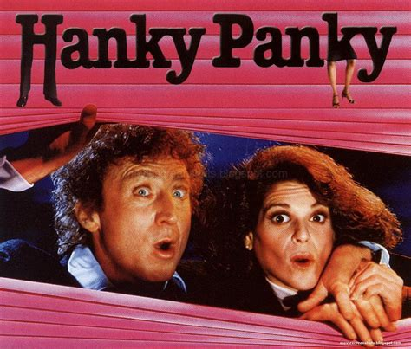
Movie Quiz
A N
Real-life couple Gene Wilder and Gilda Radner met (and perhaps did a little canoodling) on the set of which 1982 comedic mystery movie directed by Sidney Poitier?
Hanky Panky

Slide 23
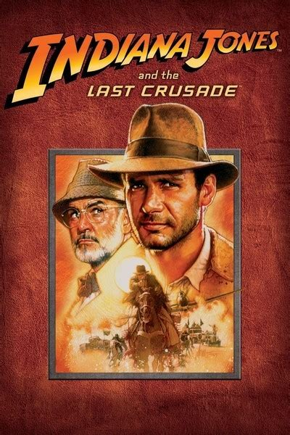
Movie Quiz
A N
Henry Jones Senior, a character in a 1989 action-adventure film who accompanies his son on a quest to find the Holy Grail, was played by which "Untouchable" Oscar-winning actor?
Sean Connery (in Indiana Jones and the Last Crusade)

Slide 24
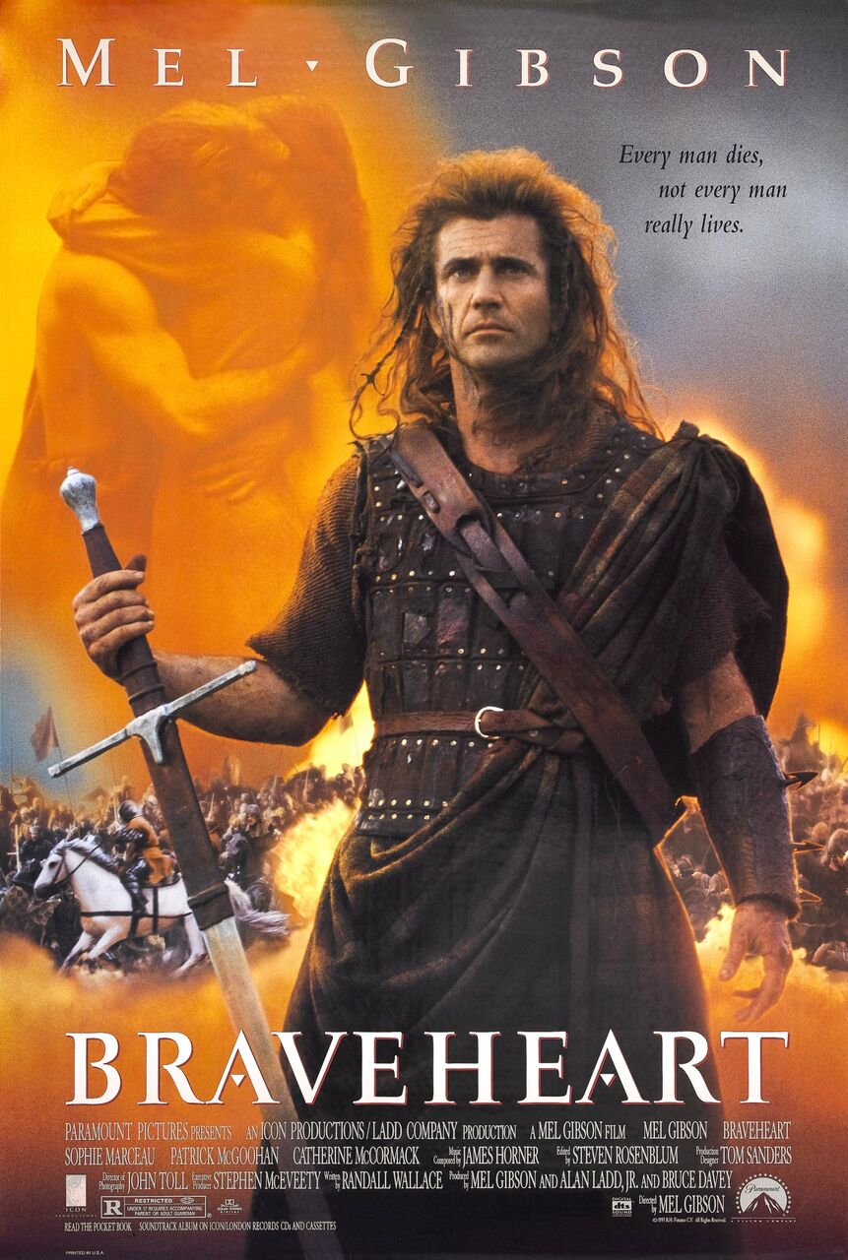
Movie Quiz
A N
Who portrays William Wallace in Braveheart?
Mel Gibson

Slide 25
Movie Quiz
A N
Who directed Jurassic Park?
Steven Spielberg

Slide 26
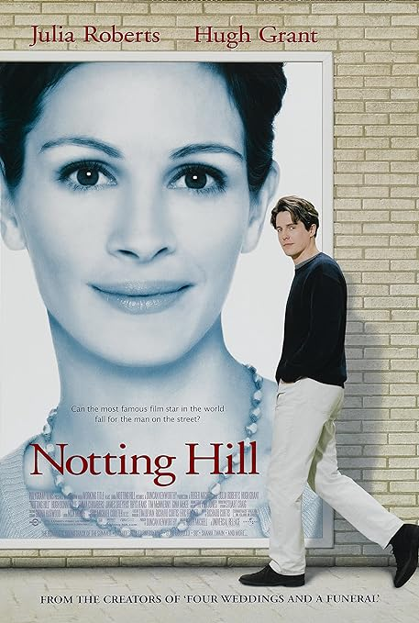
Movie Quiz
A N
What is William’s job in Notting Hill?
Book seller

Slide 27
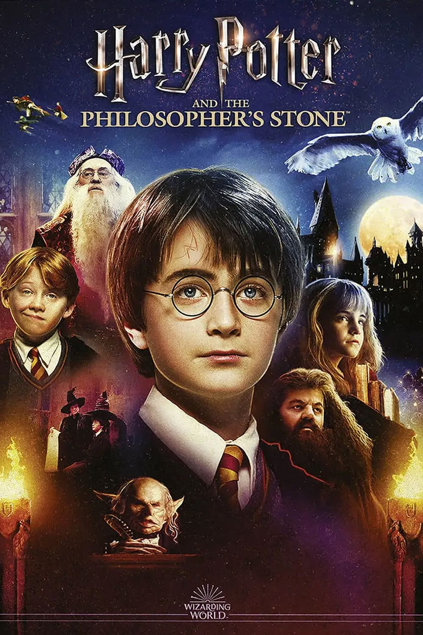
Movie Quiz
A N
Harry Potter and the Philosopher’s Stone is a 90s movie.
a) True
b) False
False 2001

Slide 28
A N
Did you know?
In that poppy-field scene in Wizard of Oz, the snow coming down is calming to Dorothy. But they should probably have been far less relaxed as these were actually asbestos-based fake snowflakes —
a popular Christmas decoration throughout the United States and Europe at the time.

Slide 29
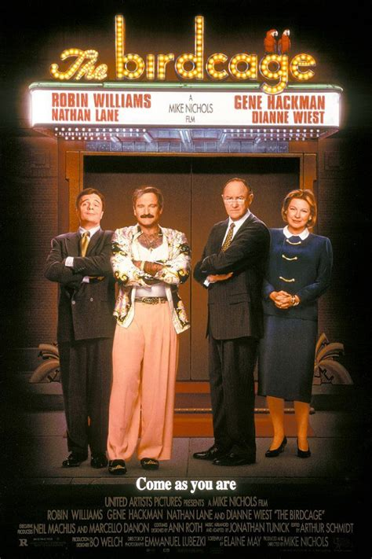
Movie Quiz
A N
In which city is the nightclub in The Birdcage?
Miami

Slide 30
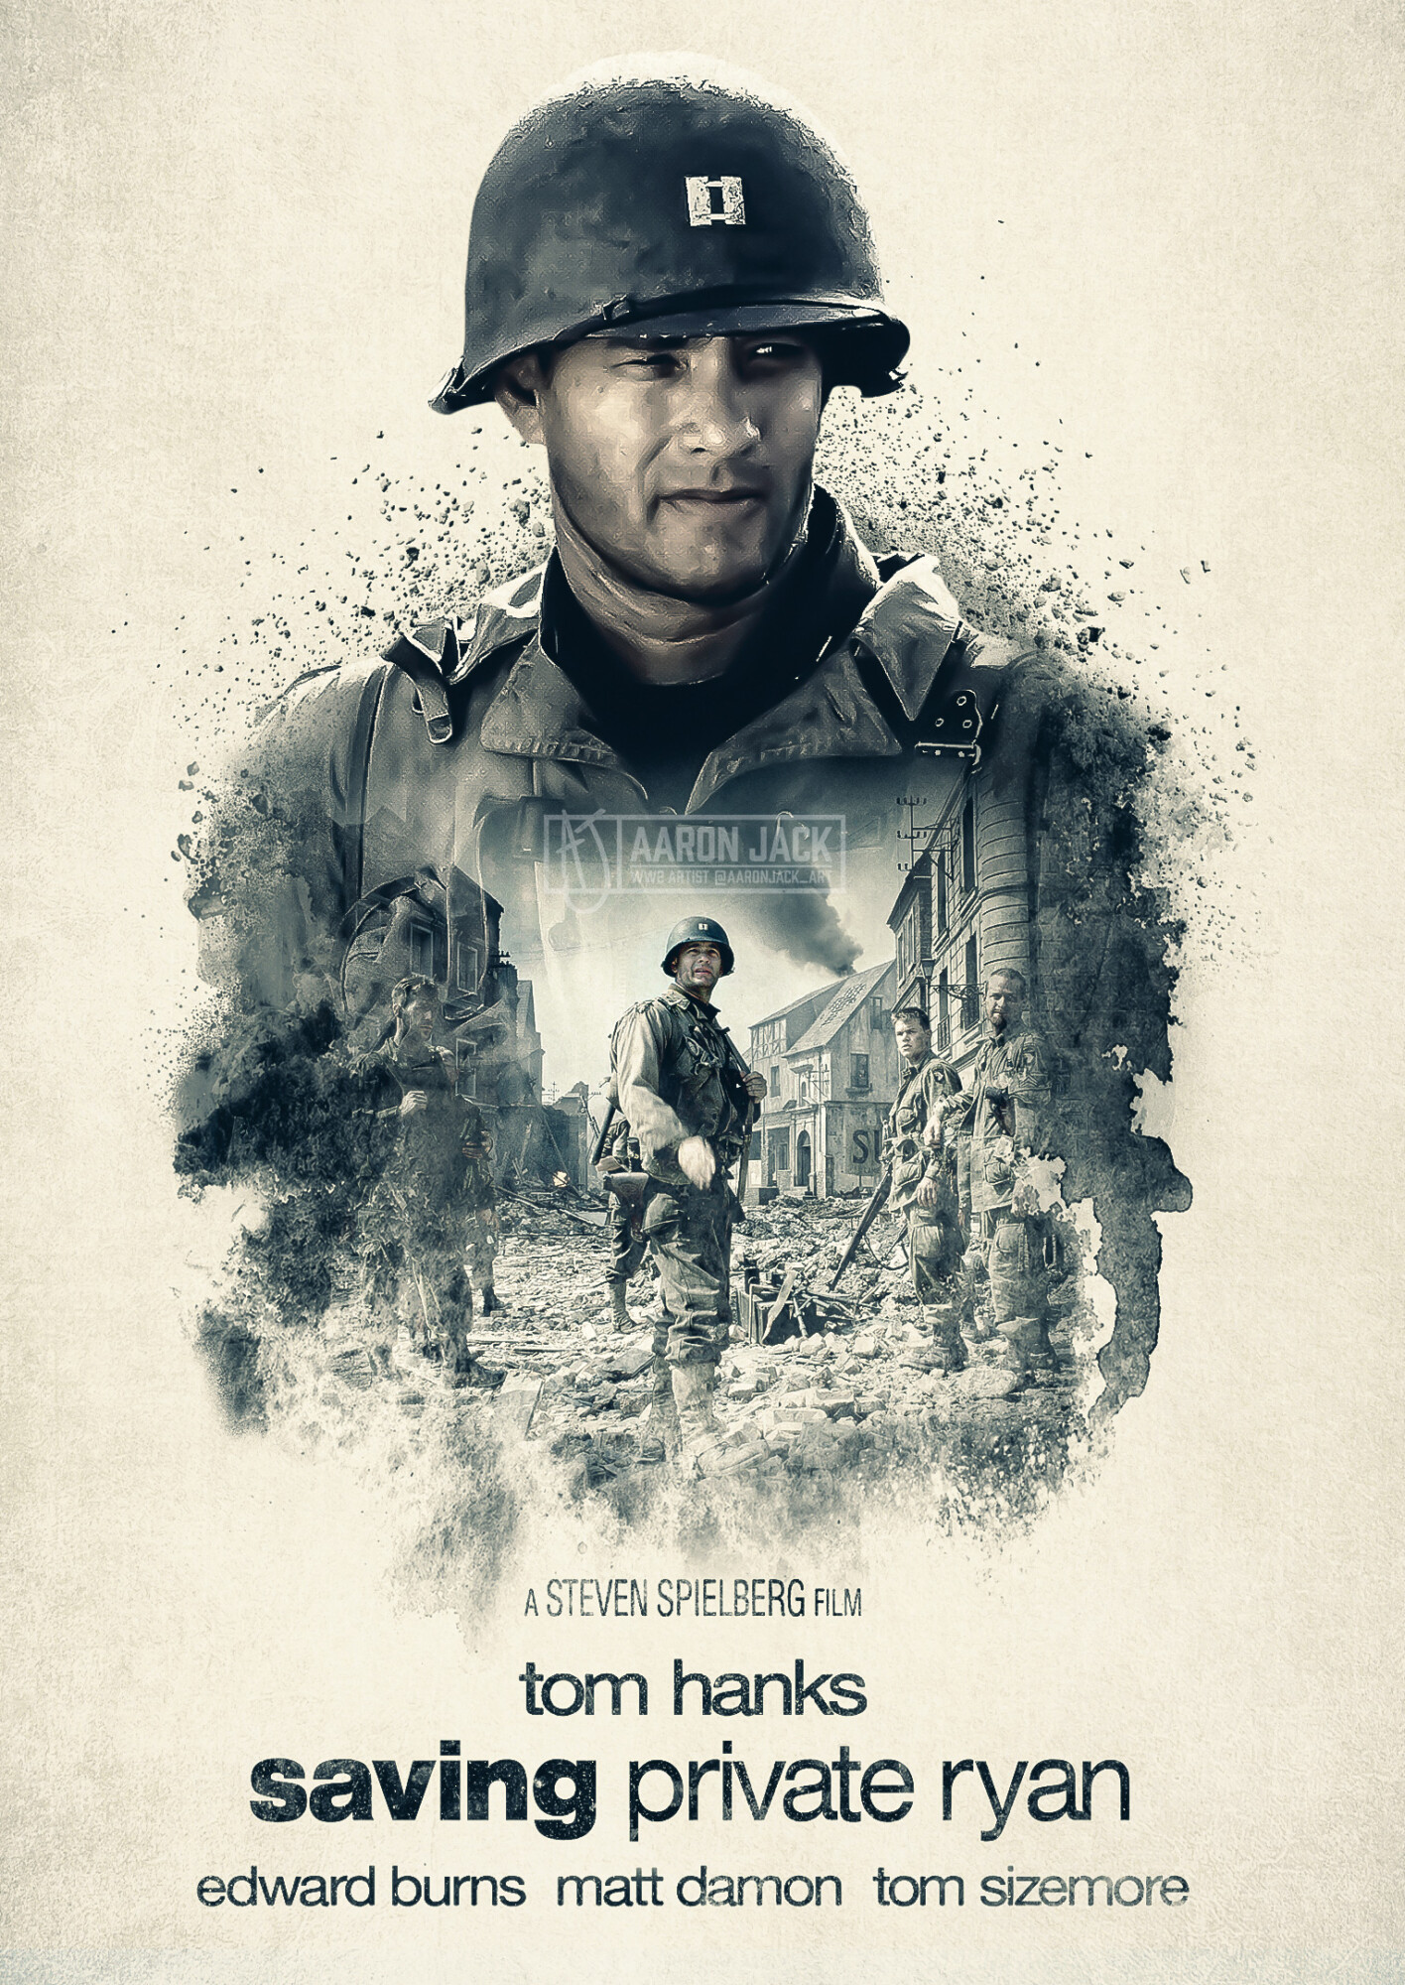
Movie Quiz
A N
In which French region is Saving Private Ryan set?
Normandy

Slide 31
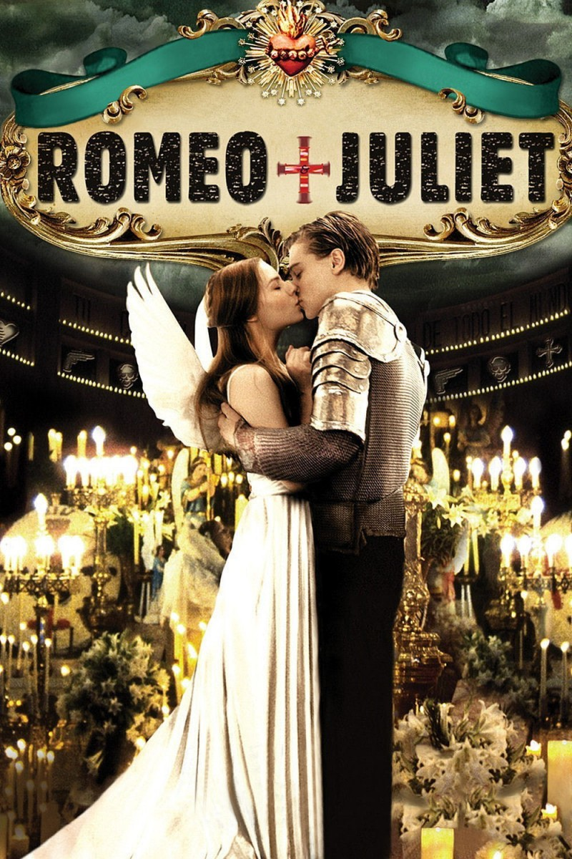
Movie Quiz
A N
Who portrayed Romeo in Romeo + Juliet (1996)?
Leonardo DiCaprio

Slide 32
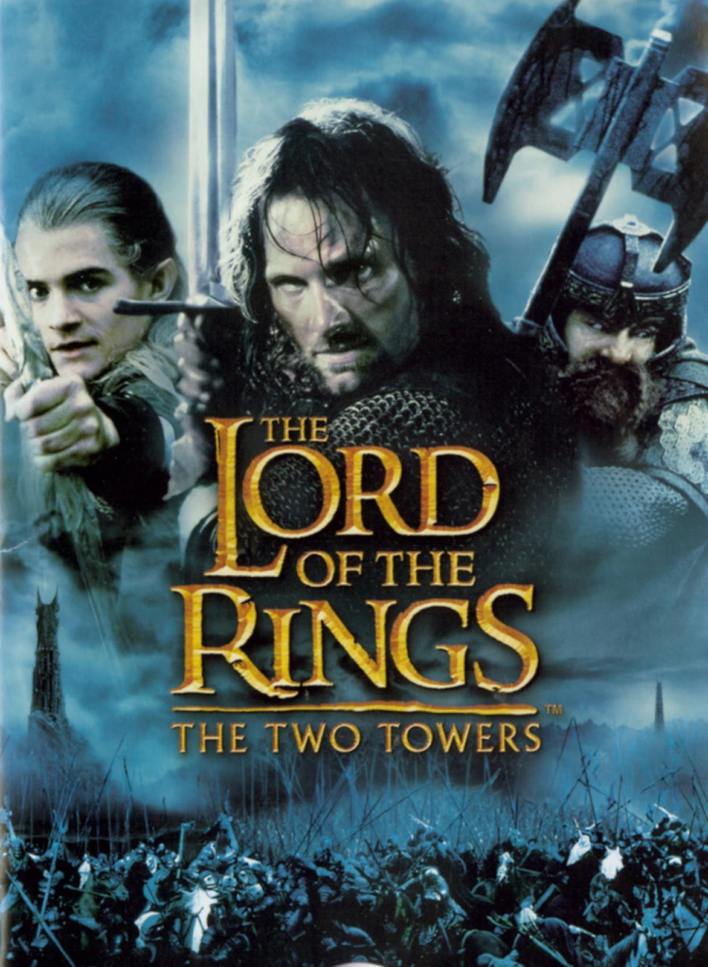
Movie Quiz
A N
In which series of films can you see a character named Frodo Baggins?
Lord of the Rings

Slide 33
A N

