Slide 1
A N
At the movies
Quiz

Slide 2
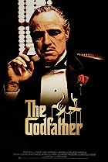
Movie Quiz
A N
In this 1972 movie, the aging patriarch of an organized crime dynasty transfers control of his clandestine empire to his reluctant son.
Starring Marlon Brando
Who am I?
The Godfather

Slide 3
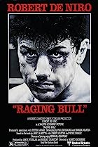
Movie Quiz
A N
The life of boxer Jake LaMotta, whose violence and temper that led him to the top in the ring destroyed his life outside of it.
Director: Martin Scorsese -
Stars: Robert De Niro, Cathy Moriarty, Joe Pesci
What’s my name?
Raging Bull

Slide 4
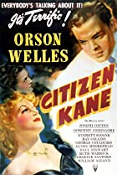
Movie Quiz
A N
In this famous 1941 movie, following the death of publishing tycoon Charles Foster Kane, reporters scramble to uncover the meaning of his final utterance: 'Rosebud.’
What’s my name?
Citizen Kane

Slide 5
Movie Quiz
A N
In the movie Citizen Kane, who played the lead role?
(It was in the poster of the last slide)
Orson Welles

Slide 6
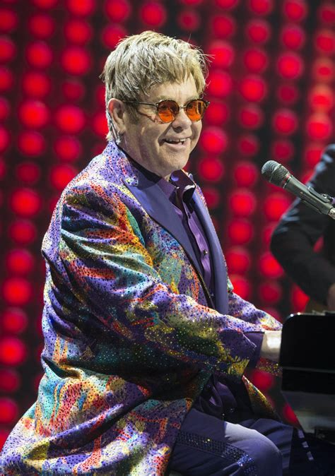
Movie Quiz
A N
The song “The Circle of Life” was written by Elton John, with lyrics by Tim Rice for a movie.
Elton also sang a pop version with slightly different lyrics, scoring a hit of his own.
What was the film?
The Lion King

Slide 7
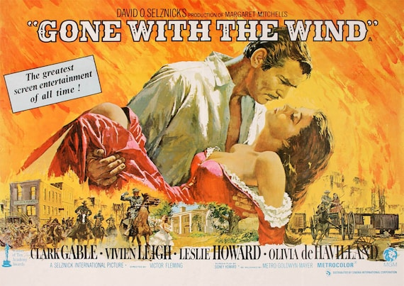
Movie Quiz
A N
What is the name of this 1939 movie starring Clark Gable and Vivien Leigh, that was about a sheltered and manipulative Southern belle and a roguish profiteer facing off in a turbulent romance.
Gone With The Wind

Slide 8
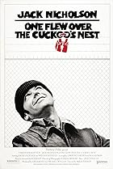
Movie Quiz
A N
Winning 5 Oscars, this movie set in the Autumn of 1963, a Korean War veteran and criminal pleads insanity and is admitted to a mental institution, where he rallies up the scared patients against the tyrannical nurse.
One flew over the cuckoo’s nest

Slide 9
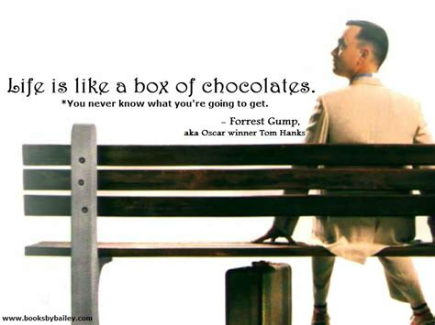
Movie Quiz
A N
Who said “Life is like a box of chocolates” in a 1994 movie?
Forrest Gump

Slide 10
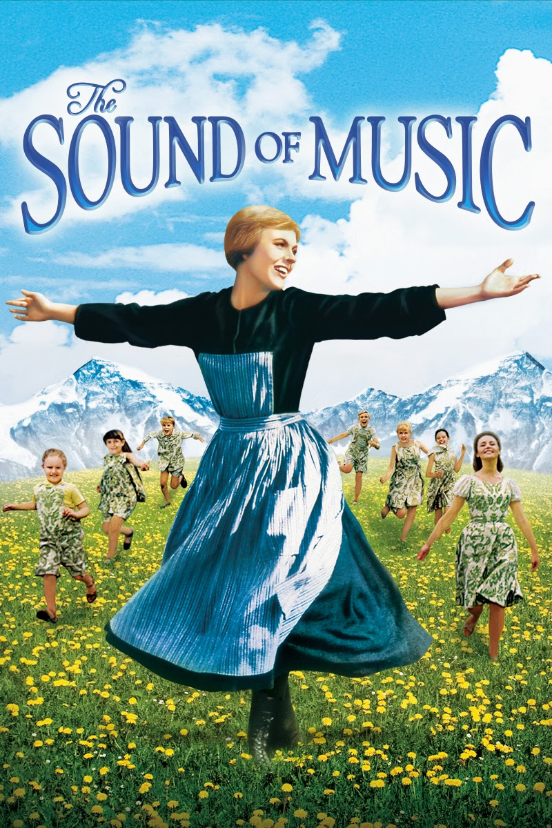
Movie Quiz
A N
The 1965 film “The Sound of Music won 9 Oscar nominations. How many Oscars did it win?
3; 4; 5 or 6
5
Best sound; Best film editing; Best musical; Best picture; Best director

Slide 11
Movie Quiz
A N
Also winning 5 Oscars, in this 1961 movie a young F.B.I. cadet must receive the help of an incarcerated and manipulative cannibal killer to help catch another serial killer, a madman who skins his victims.
The Silence of the Lambs

Slide 12
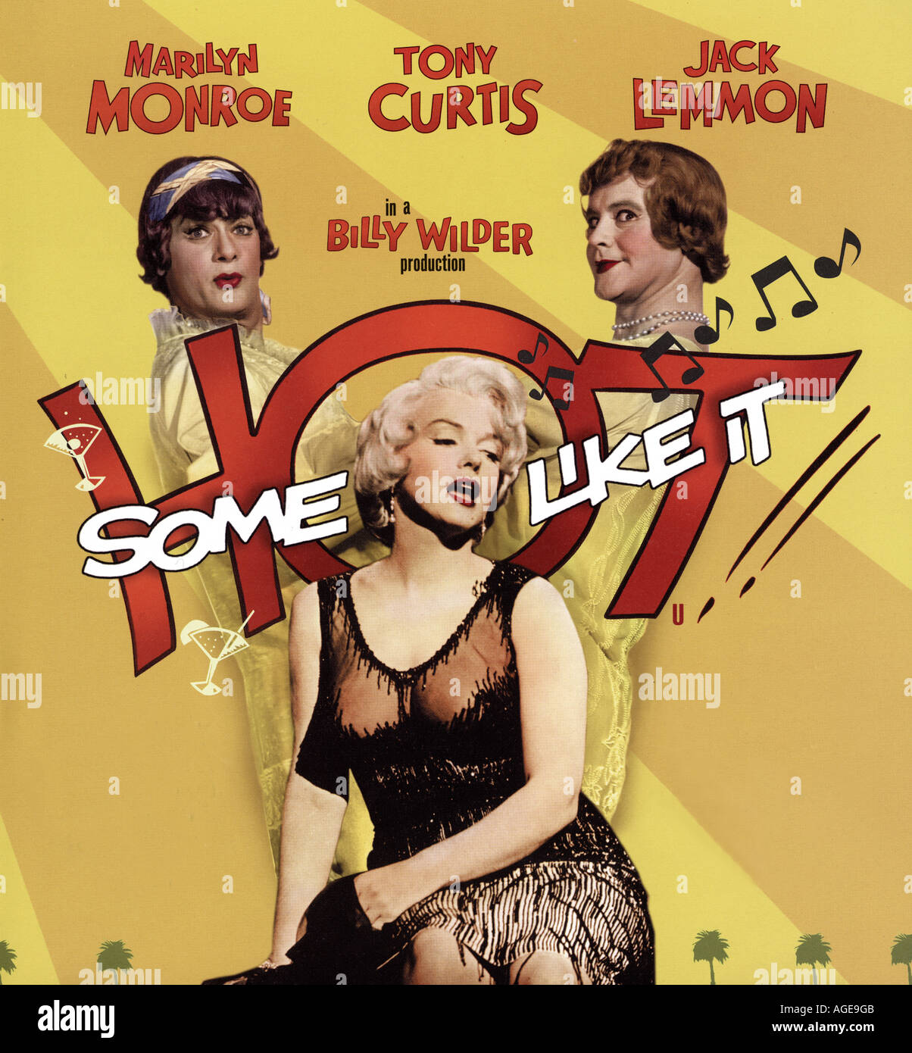
Movie Quiz
A N
In this 1959 movie starring Marilyn Monroe, Tony Curtis, Jack Lemmon and George Raft, two male musicians witness a mob hit, they flee the state in an all-female band disguised as women, but further complications set in.
Some like it Hot

Slide 13
Movie Quiz
A N
This 1997 movie starring Leonardo DiCaprio, Kate Winslet, Billy Zane, Kathy Bates most certainly never sank winning 11 out of 14 Oscar nominations
Titanic

Slide 14
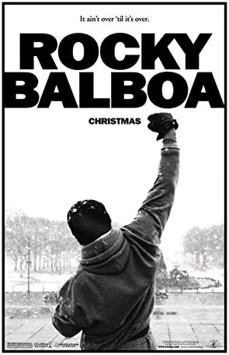
Movie Quiz
A N
In this 1976 movie starring Sylvester Stallone, a small-time Philadelphia boxer gets a supremely rare chance to fight the world heavyweight champion in a bout in which he strives to go the distance for his self-respect.
Rocky

Slide 15
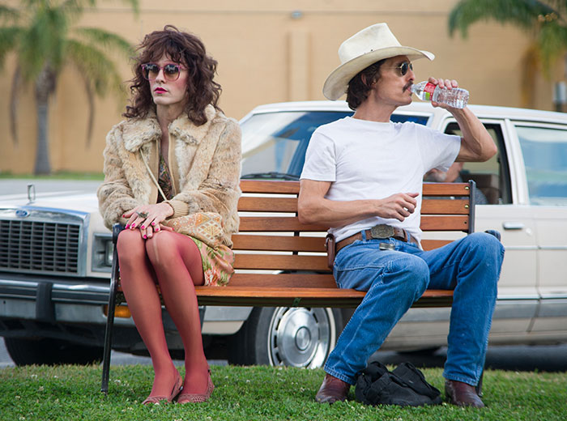
A N
Did you know?
Dallas Buyers Club - The film's budget was so low that the makeup budget was $250. The film's artists were able to work with that, and the film's Makeup and Hairstyling won an Oscar.

Slide 16
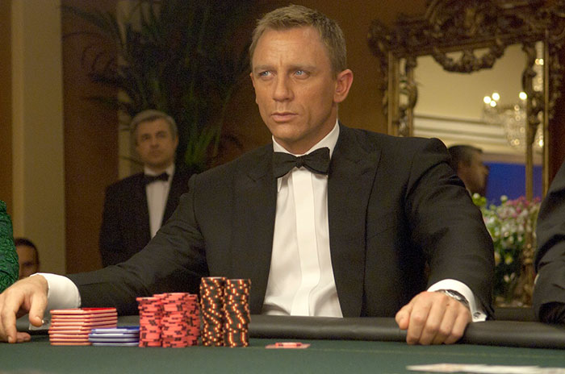
Movie Quiz
A N
Daniel Craig lost the two front teeth while filming a fight scene in Prague (the first action scene to be shot), and his dentist had to fly from London to replace them.
In which film
Casino Royale

Slide 17
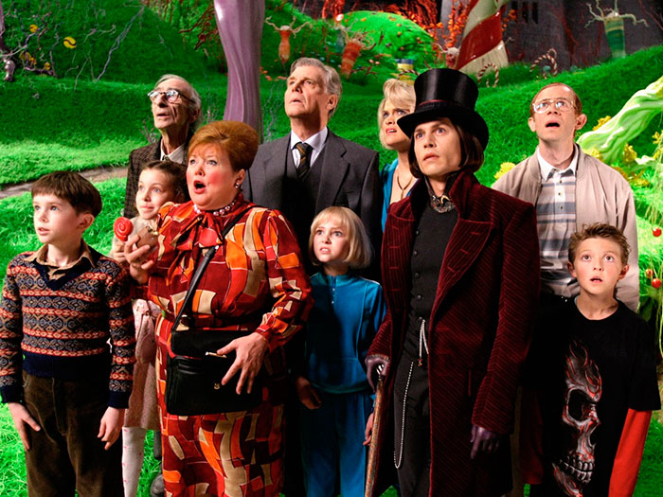
Movie Quiz
A N
Nestlé provided 1,850 bars of real chocolate for this film?
Charlie And The
Chocolate Factory

Slide 18
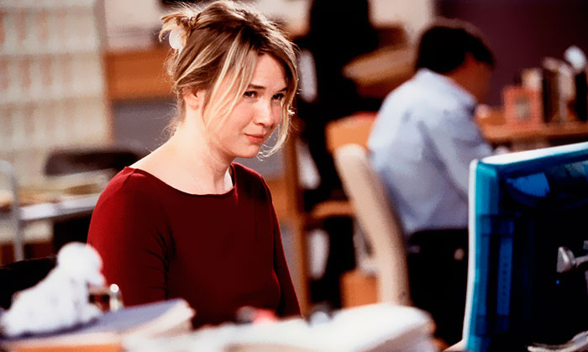
Movie Quiz
A N
To prepare for the role in what movie, Renée Zellweger gained 25 pounds, and then actually worked at a British publishing company for a month in preparation for the role.
She adopted an alias as well as her posh accent and was apparently not recognized. On her desk in this office she kept a framed picture of then boyfriend Jim Carrey.
Bridget Jones's Diary

Slide 19
Movie Quiz
A N
Stanley Kubrick destroyed almost all of his props and sets from 2001: A Space Odyssey because he didn't want them to be used in any lesser science fiction films.
What film was this?
2001: A Space Odyssey

Slide 20
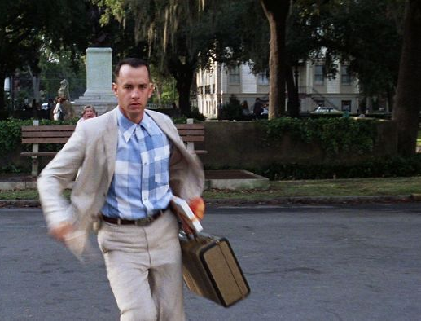
A N
Did you know?
Forrest Gump
Tom Hanks was not paid for this film. Instead, he took percentage points which ultimately netted him in the region of forty million dollars.

Slide 21
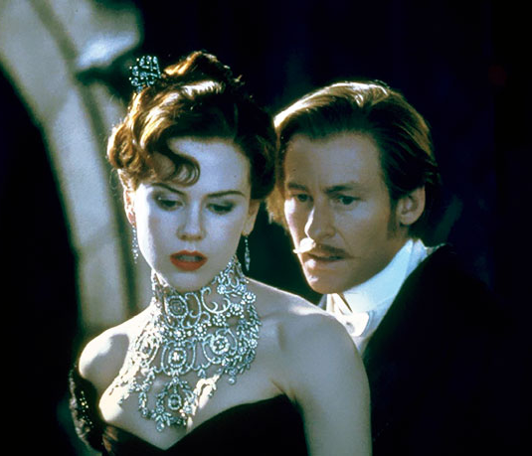
Movie Quiz
A N
In what movie was the necklace worn by Nicole Kidman made of real diamonds and platinum and was the most expensive piece of jewelry ever specifically made for a film.
The Stefano Canturi necklace was made with 1,308 diamonds, weighing a total of 134 carats and was worth an estimated U.S. $1 million.
Moulin Rouge!

Slide 22
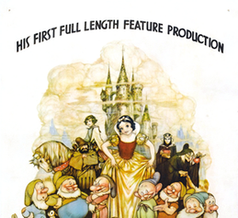
Movie Quiz
A N
What was the first feature-length animated movie ever released?
Snow White and the Seven Dwarfs

Slide 23
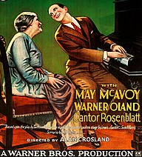
Movie Quiz
A N
What 1927 musical was the first "talkie"?
The son of a Jewish Cantor must defy the traditions of his religious father in order to pursue his dream of becoming a jazz singer.
The Jazz Singer

Slide 24
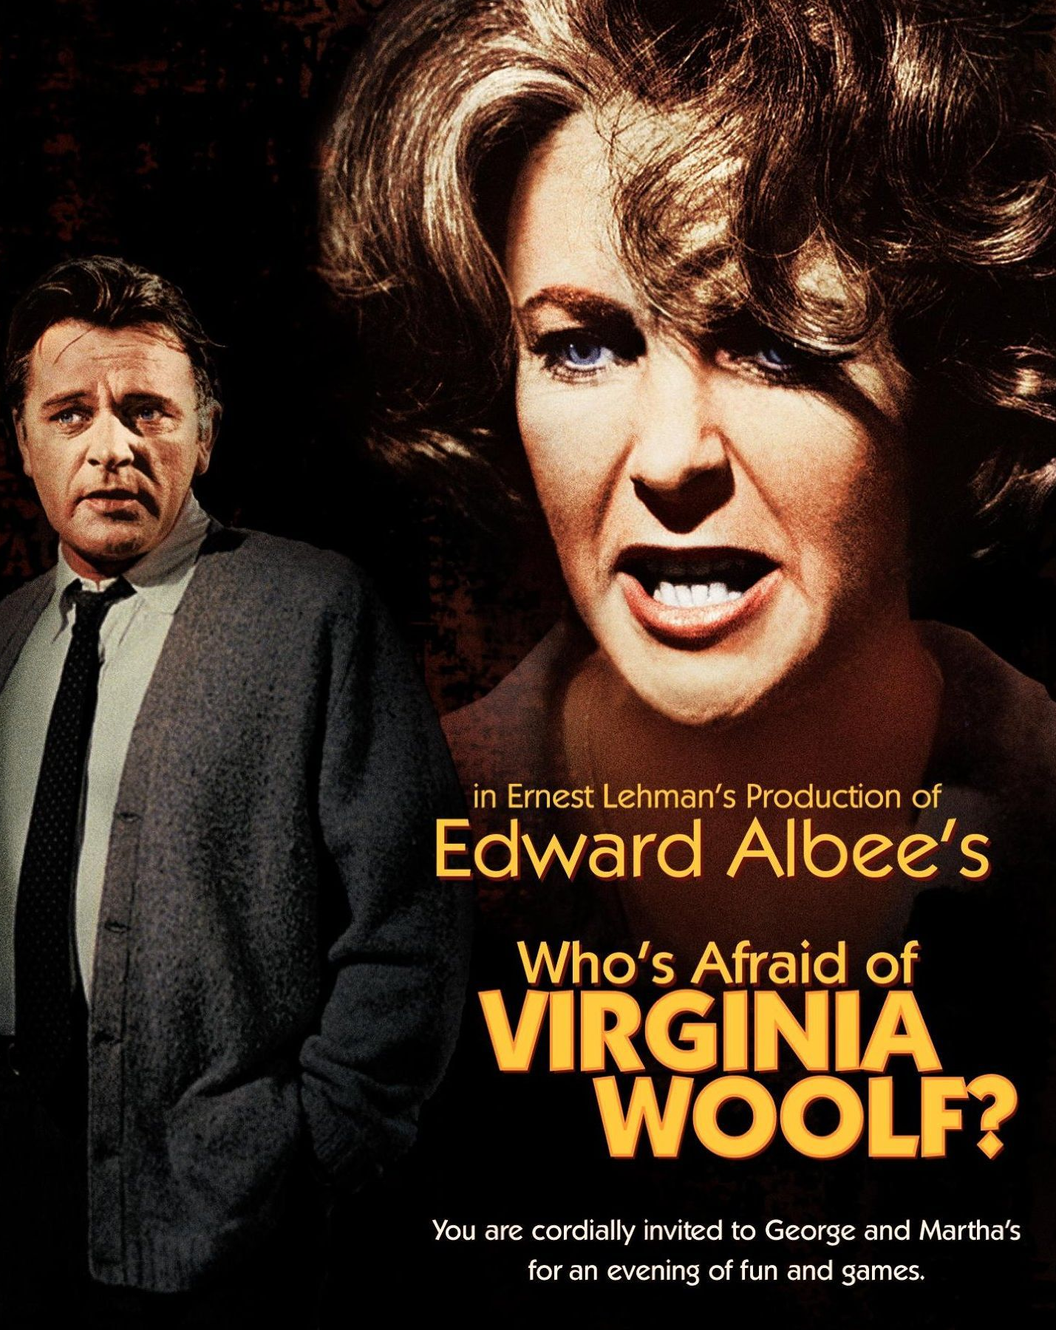
Movie Quiz
A N
What real-life on-again off-again Hollywood power couple starred in the film Who's Afraid of Virginia Woolf?
Elizabeth Taylor and Richard Burton

Slide 25
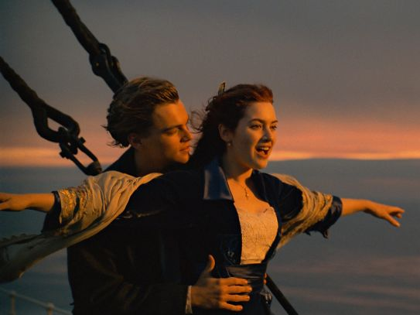
A N
Did you know?
Titanic
The scenes set in 1912, i.e. the whole movie except the present-day scenes and the opening and ending credits, have a total length of two hours and forty minutes, the exact time it took for Titanic to sink.
Also, the collision with the iceberg reportedly lasted 37 seconds, which is how long the collision scene is in the movie.

Slide 26
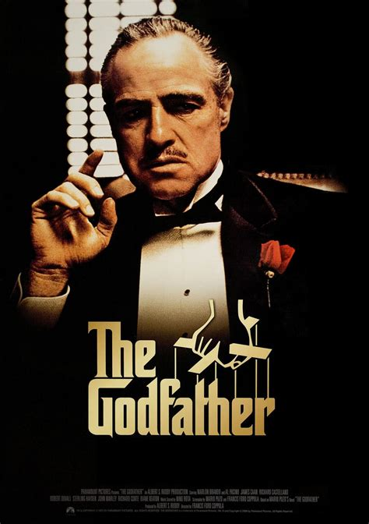
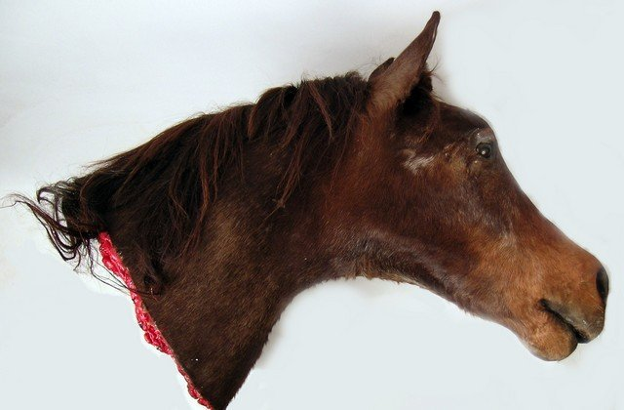
Movie Quiz
A N
The head of what kind of animal is front-and-center in an infamous scene from The Godfather?
A horse

Slide 27
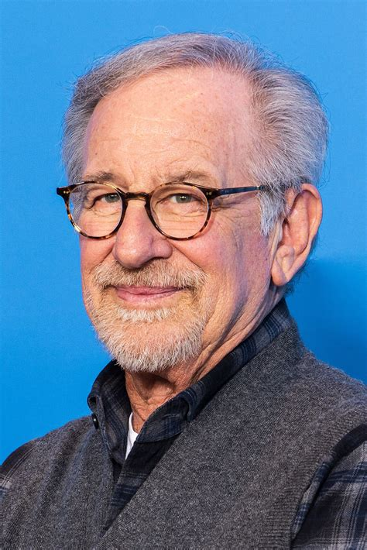
Movie Quiz
A N
For what movie did Steven Spielberg win his first Oscar for Best Director?
Schindler's List

Slide 28
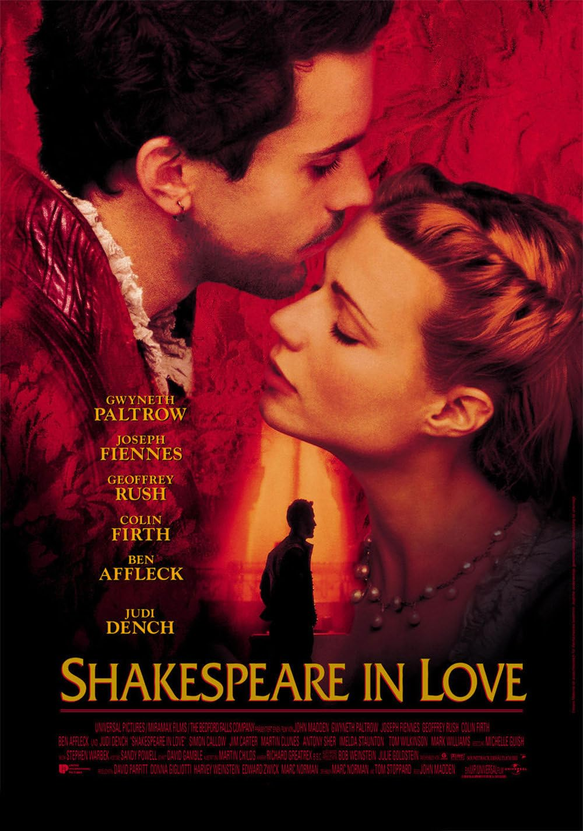
Movie Quiz
A N
Who won a Best Supporting Actress for Shakespeare in Love despite having only eight minutes of screen time?
Judi Dench

Slide 29
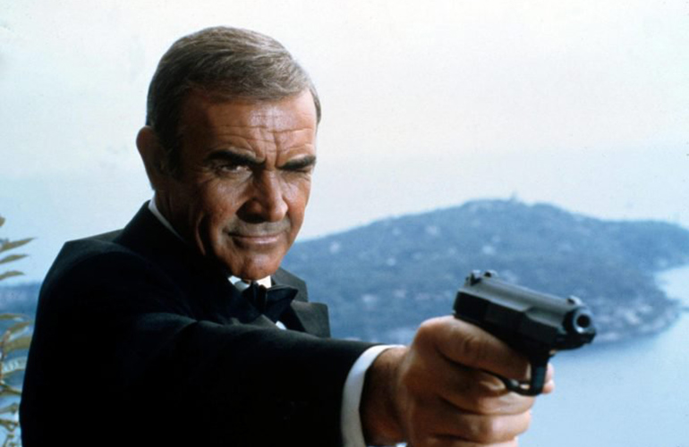
A N
Did you know?
Sean Connery wore a toupee in every James Bond movie.
If you think the dreamy 007 seemed too good to be true, you’re right. Sean Connery started balding at age 17.

Slide 30
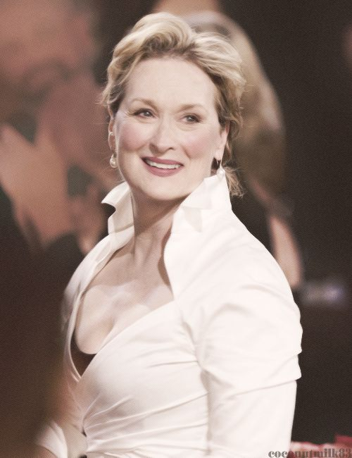
Movie Quiz
A N
Meryl Streep been nominated for 21 Oscars. How many has she won?
2; 3; 4 or 5
Three

Slide 31
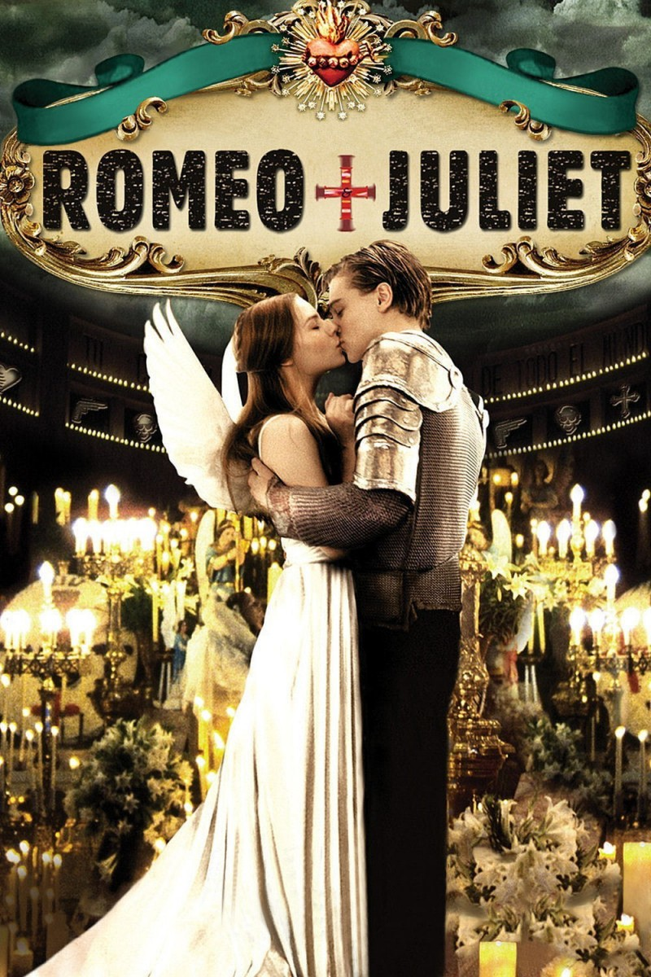
Movie Quiz
A N
Who portrayed Romeo in Romeo + Juliet (1996)?
Leonardo DiCaprio

Slide 32
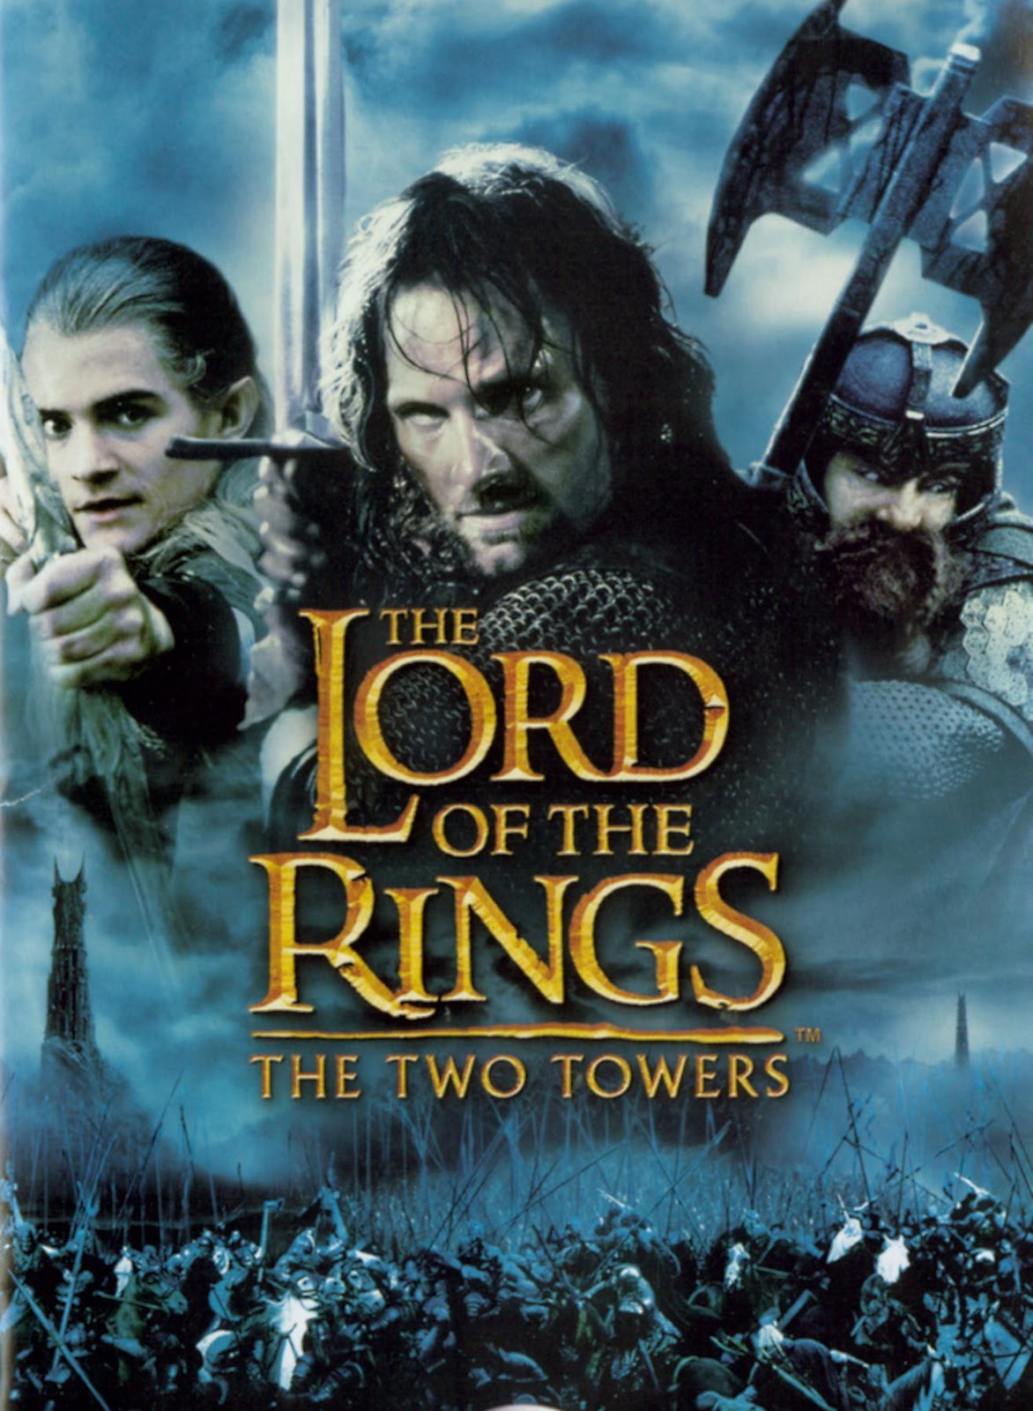
Movie Quiz
A N
In which series of films can you see a character named Frodo Baggins?
Lord of the Rings

Slide 33
Movie Quiz
A N
Not only was Dolly excellent in this comedy film from 1980, but she recorded the song that the film is best known for, and it still sounds amazing.
Nominated for an Oscar and winner of two Grammys, it became one of Dolly's most beloved tracks.
9 to 5

Slide 34
A N

