Slide 1
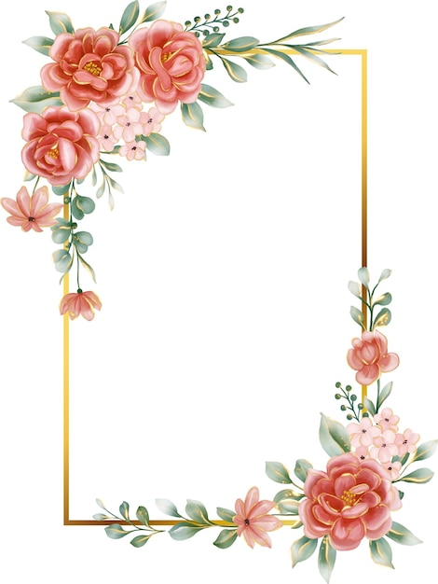
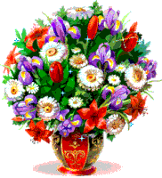
Quiz about all things floral
AN

Slide 2
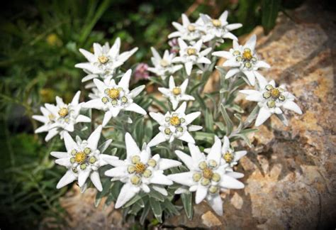
What is the name of the central European flower can be directly translated as ‘noble white’ in English?
Edelweiss
AN

Slide 3
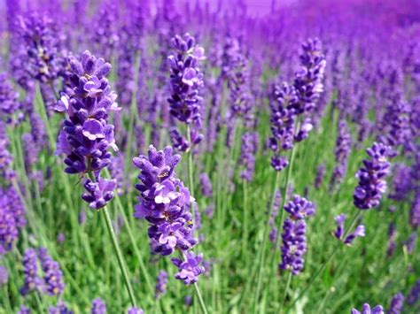
The oil of which flower is often used in aromatherapy to improve sleep quality?
Lavender
AN

Slide 4
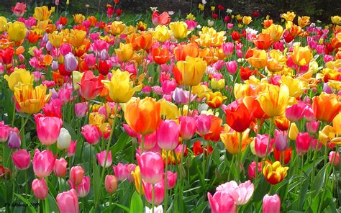
Name This Plant
Tulip
AN

Slide 5
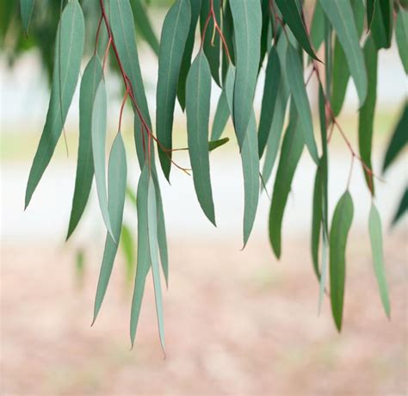
Most species of eucalyptus are native to which country?
Australia
AN

Slide 6
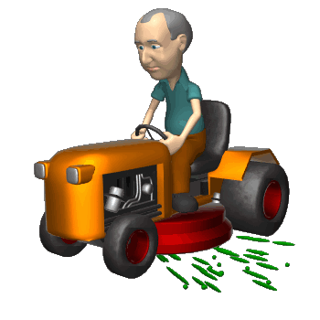
Did you know?
The smell of freshly-mown grass is actually a plant distress call.
AN

Slide 7
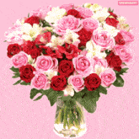
Ikebana is the Japanese art of what?
Flower Arranging
AN

Slide 8
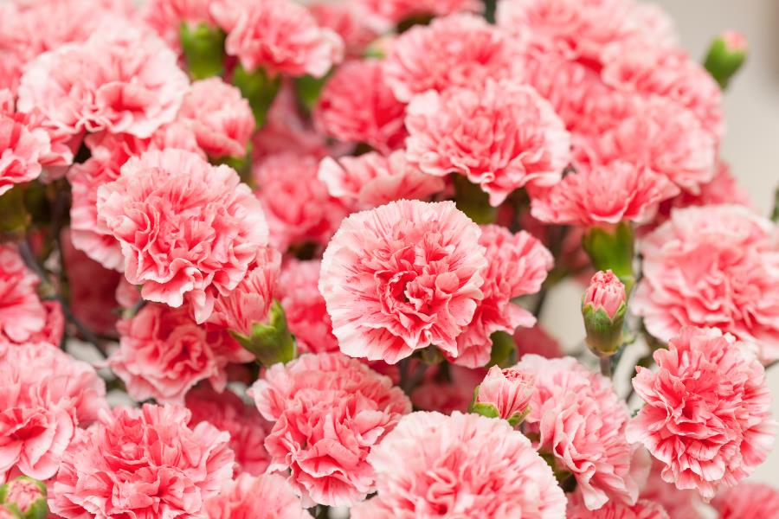
Name This Plant
Carnation
AN

Slide 9
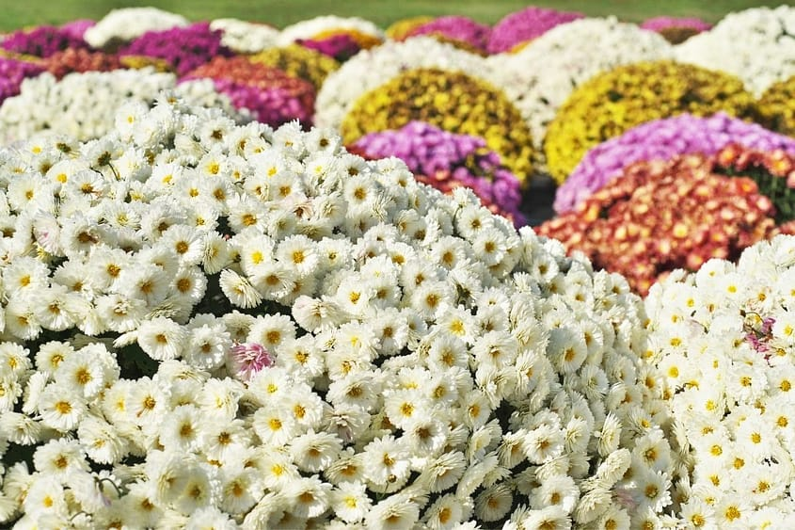
Name this flower and name the country of which this is the national flower
Chrysanthemum / Japan
AN

Slide 10
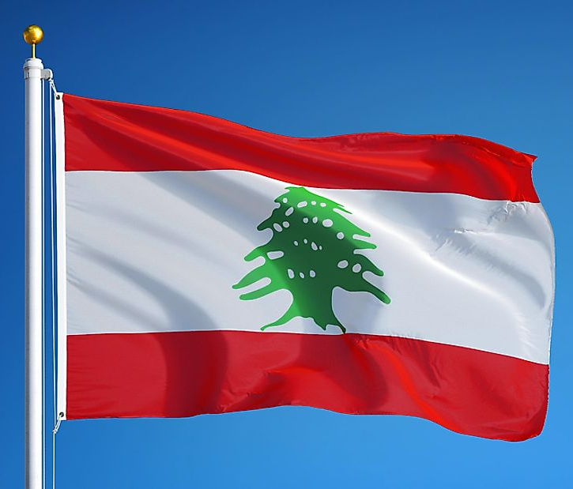
This country’s national flag features a tree
Lebanon
AN

Slide 11
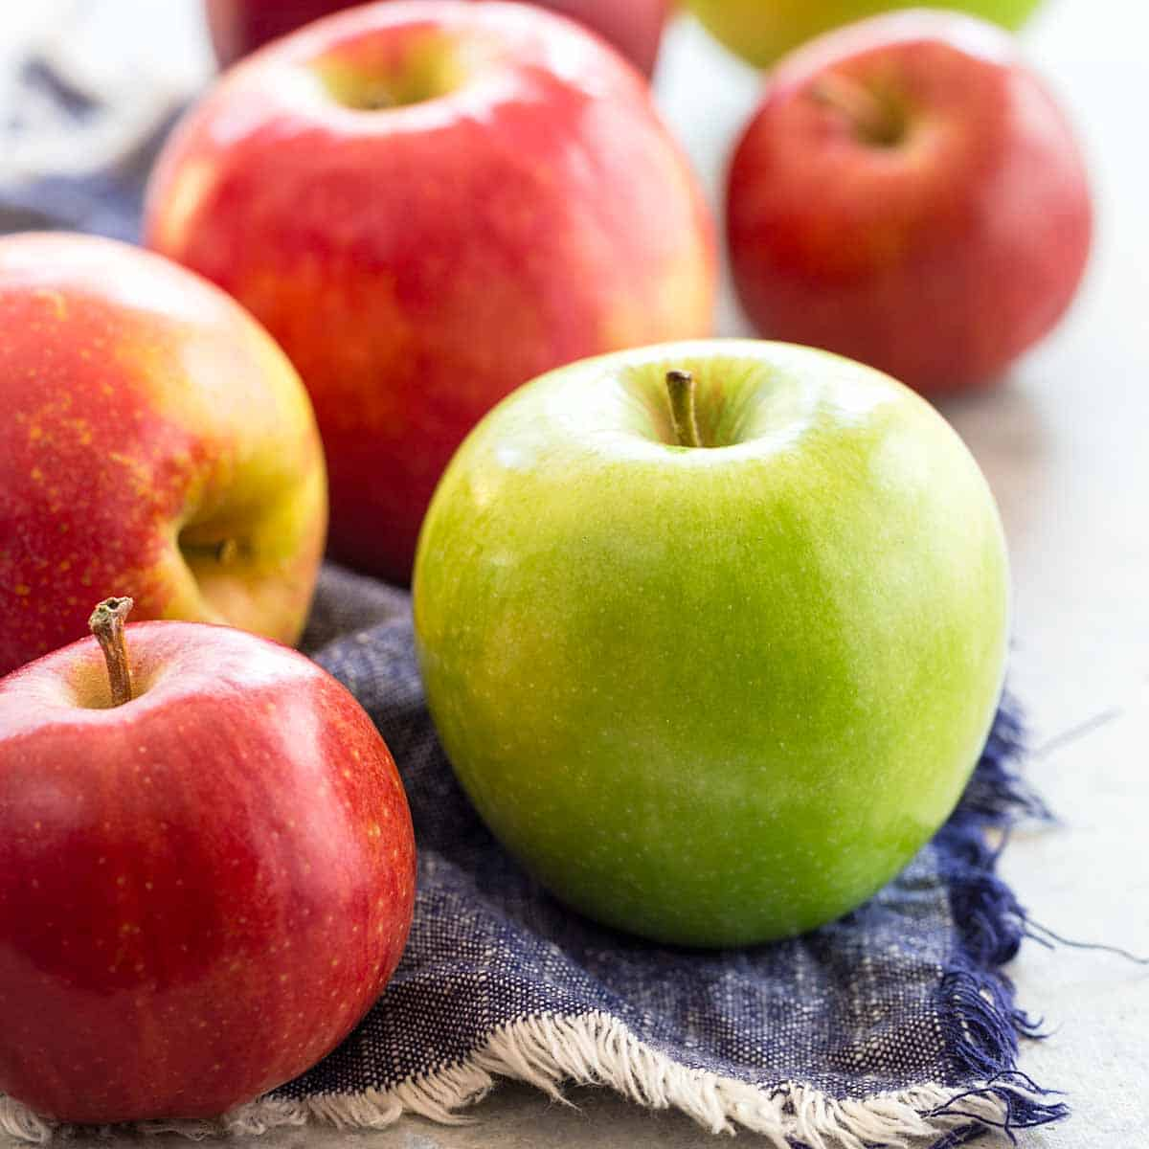
Apples, pears, plums, apricots, and peaches are members of what family of flowering plants?
Rose (or rosaceae)
AN

Slide 12
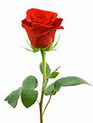
What did the flowers do when the bride walked down the aisle?
They rose.
A budding comedian

Slide 13
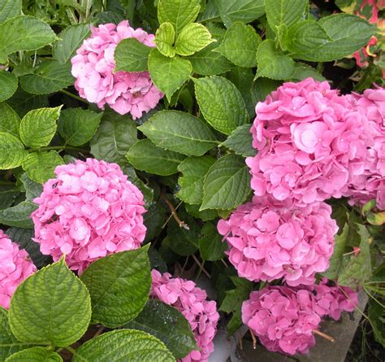
What flower’s name comes from the Ancient Greek for ‘water jar’?
Hydrangea
AN

Slide 14
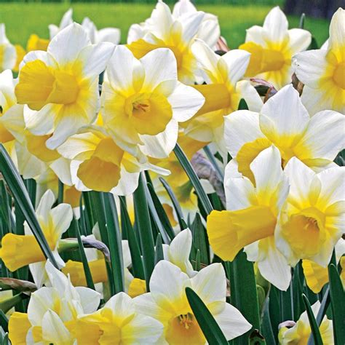
Which character from Greek mythology
stared at his reflection in a pool for so
long that he turned into a flower?
Narcissus
AN

Slide 15
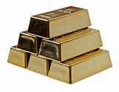
Which flower was once more costly than gold and has bulbs which can replace onions in some recipes?
Tulips
AN

Slide 16
Did you know?
The first wine grapes were cultivated some 8,000 years ago in Mesopotamia.
AN

Slide 17
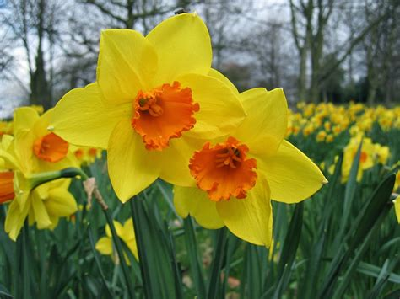
Name This Plant
Daffodil
AN

Slide 18
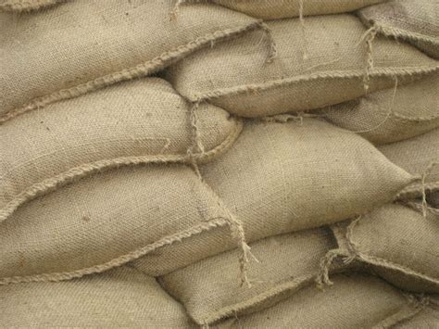
What is the most produced grain plant in the world?
A. Rice
B. Corn
C. Wheat
Corn
AN

Slide 19
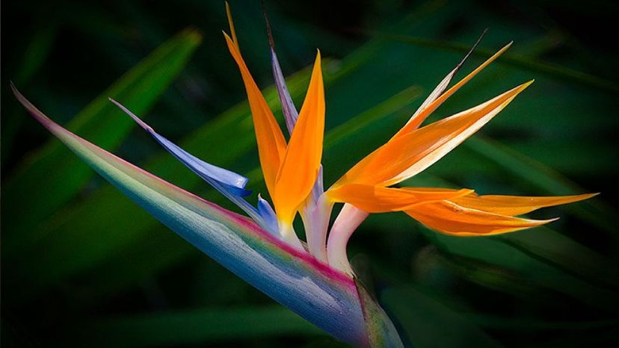
This tropical flower is also called the crane flower. What's the more common name for it?
Bird-of-paradise
AN

Slide 20
What is the name or the art of drying and pressing plants.
Oshibana
AN

Slide 21
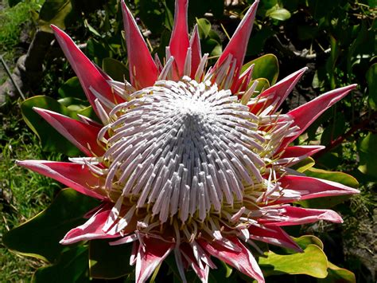
King Protea is native to what country? It is also their national flower
South Africa
AN

Slide 22
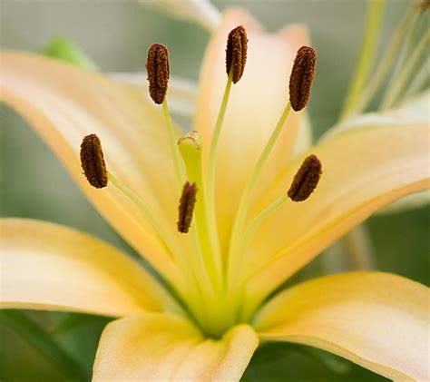
What is the name of the male part of a flower?
Stamen
AN

Slide 23
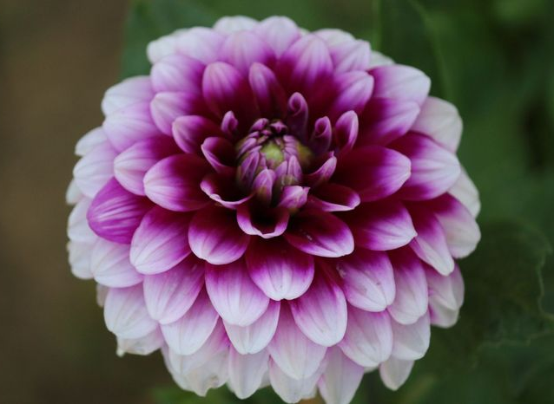
What's the name of this flower, a member of the aster family?
Dahlia
AN

Slide 24
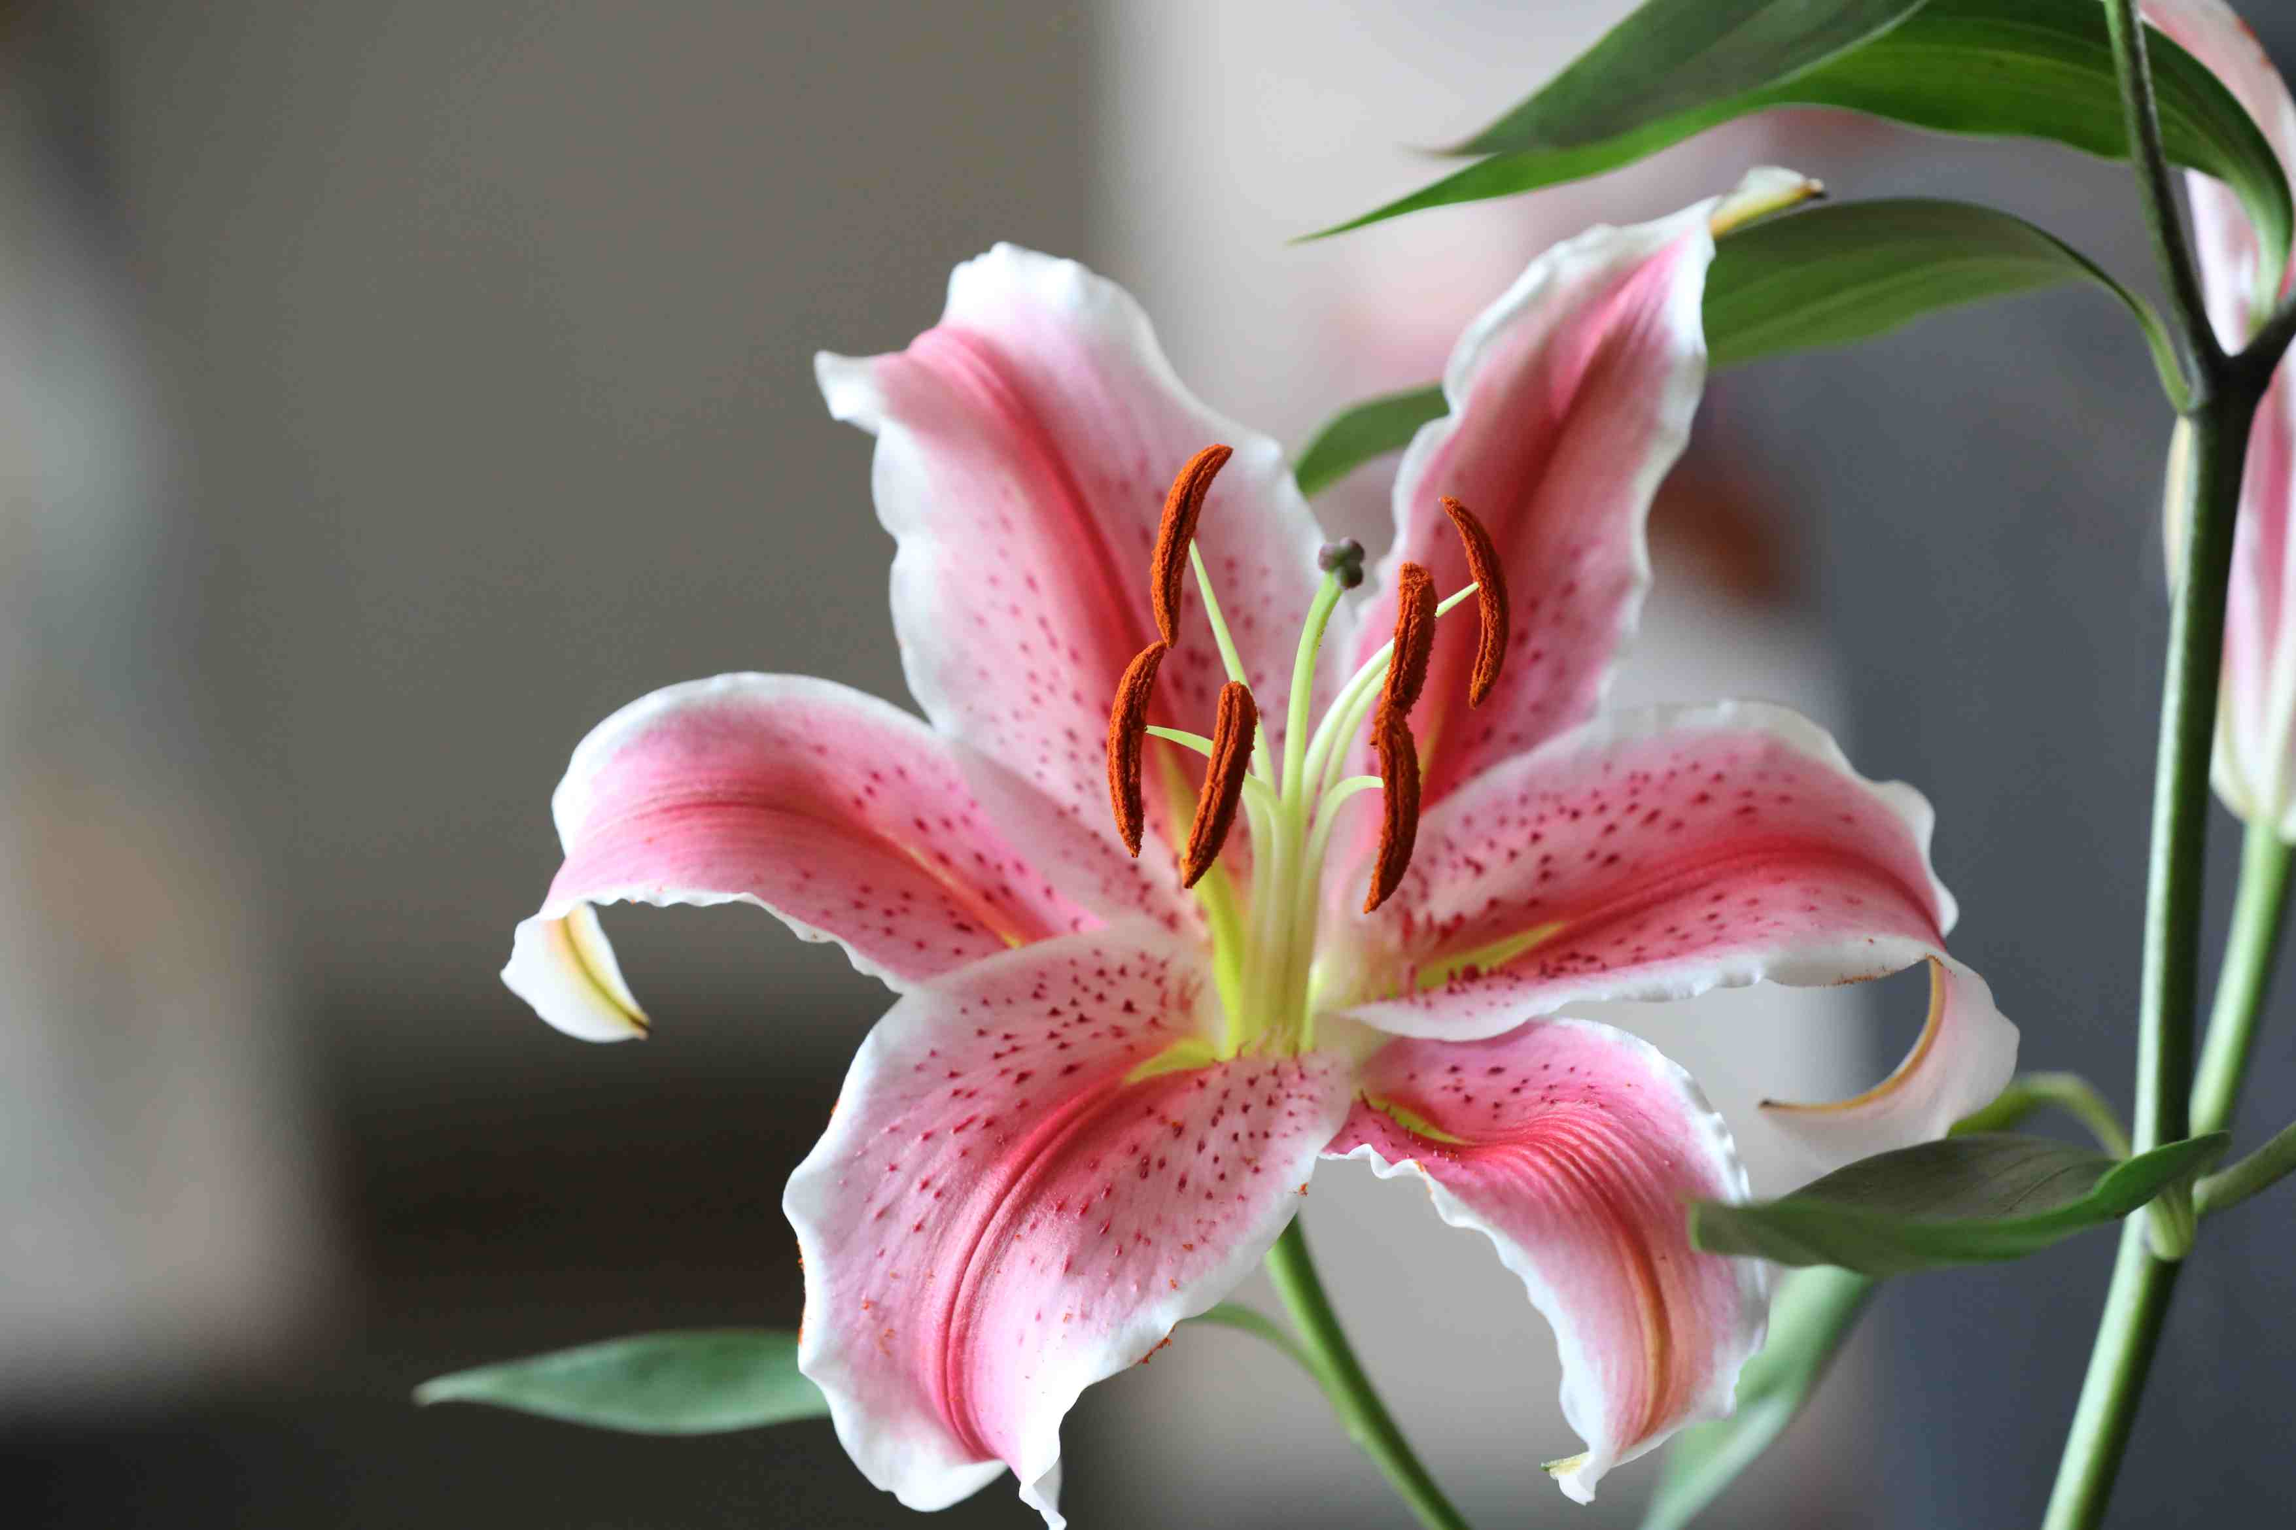
What does it mean if a plant is Dioecious
Plants capable of producing either male or female flowers.
AN

Slide 25
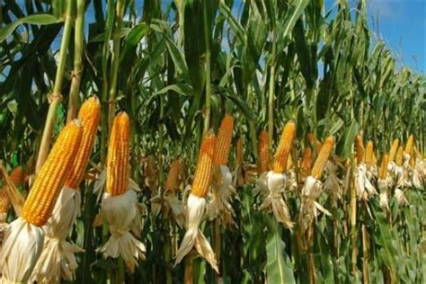
What does a flower therapist ask her patients?
“Are you feeling bouquet?”
Corny

Slide 26
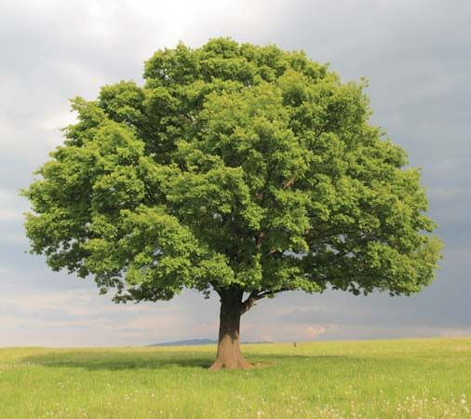
Did you know?
Oak trees are struck by lightning more than any other tree.
AN

Slide 27
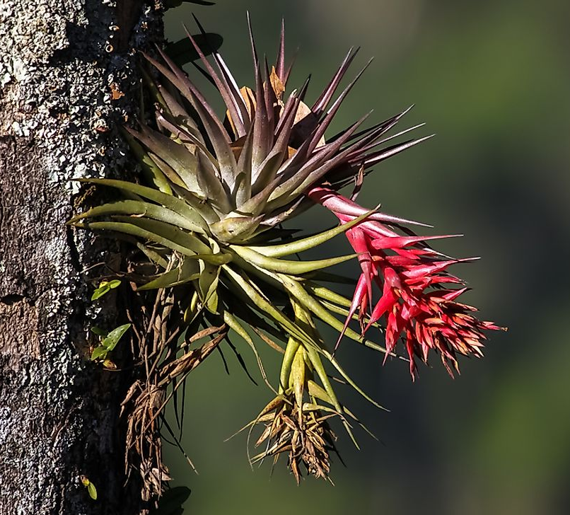
A plant that grows on the surface of another plant is called what.
Epiphyte
AN

Slide 28
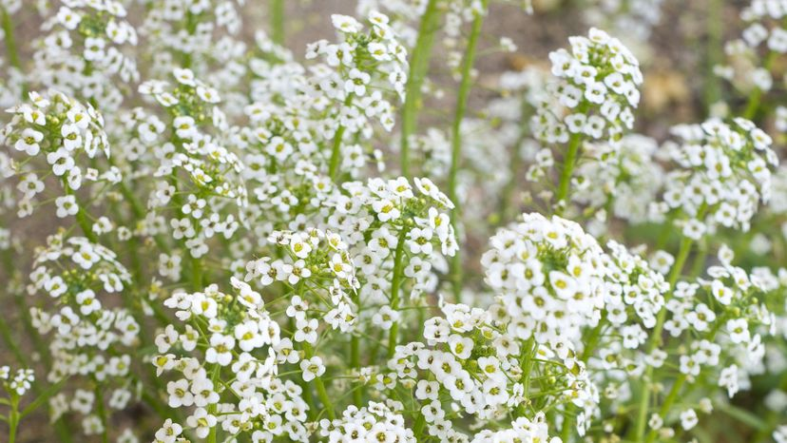
What is this flower, which is used as an ornamental flower in bouquets and named after the gulps of an infant, called?
Baby's breath
AN

Slide 29
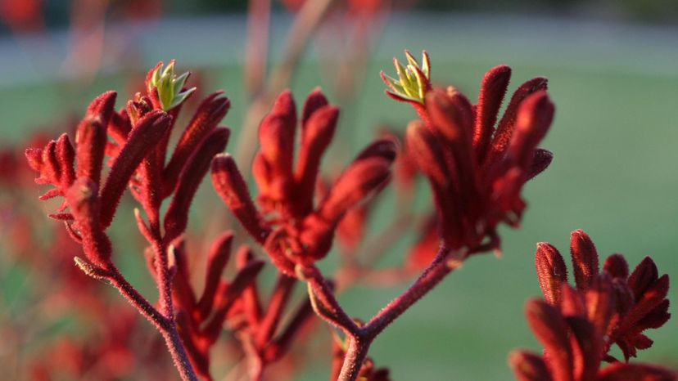
What is the name of this Aussie plant.
Kangaroo paw
AN

Slide 30
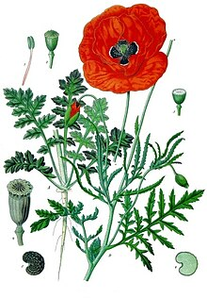
The red poppy is the national flower of which European country?
(Not Belgium)
Poland
AN

Slide 31
This herb was a snobby hotel owner in an 1970’s British sitcom, played by John Cleese.
Basil Fawlty - of Fawlty Towers
AN

Slide 32
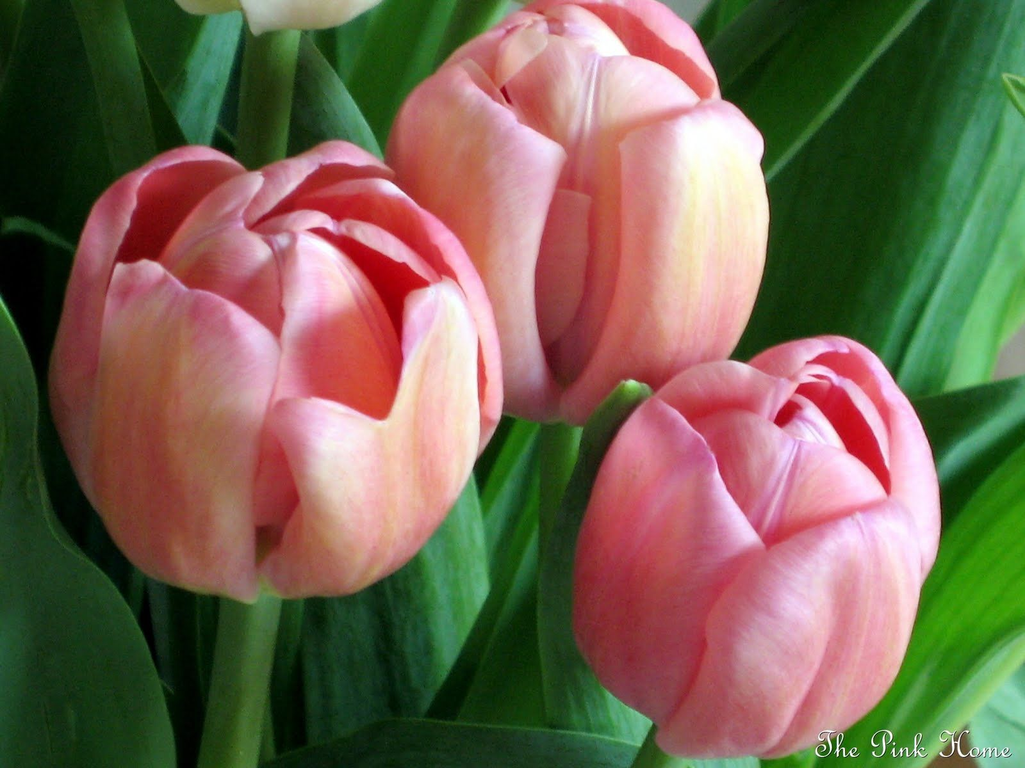
The tulip is the national flower of Holland and three other countries.
Can you name one of these?
Afghanistan; Turkey; Hungary
AN

Slide 33
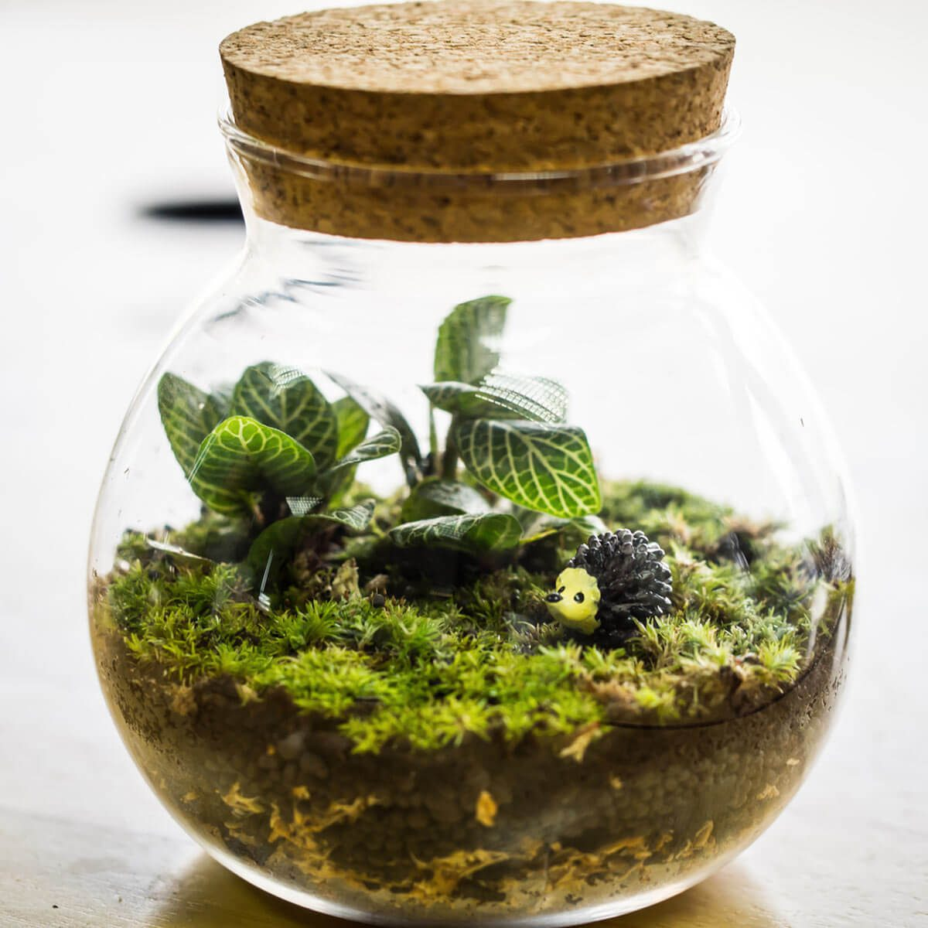
What do you call plants growing in a glass jar.
Terrarium
AN

Slide 34
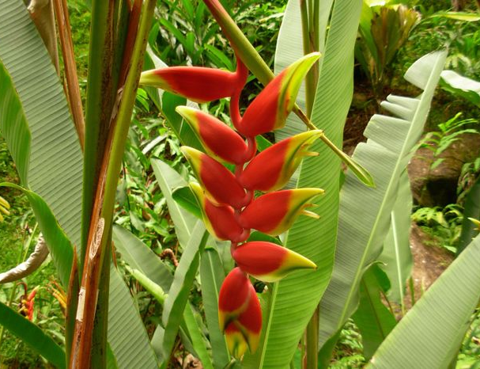
Over 190 species of this tropical flower exist. What is its name?
Heliconia
AN

Slide 35
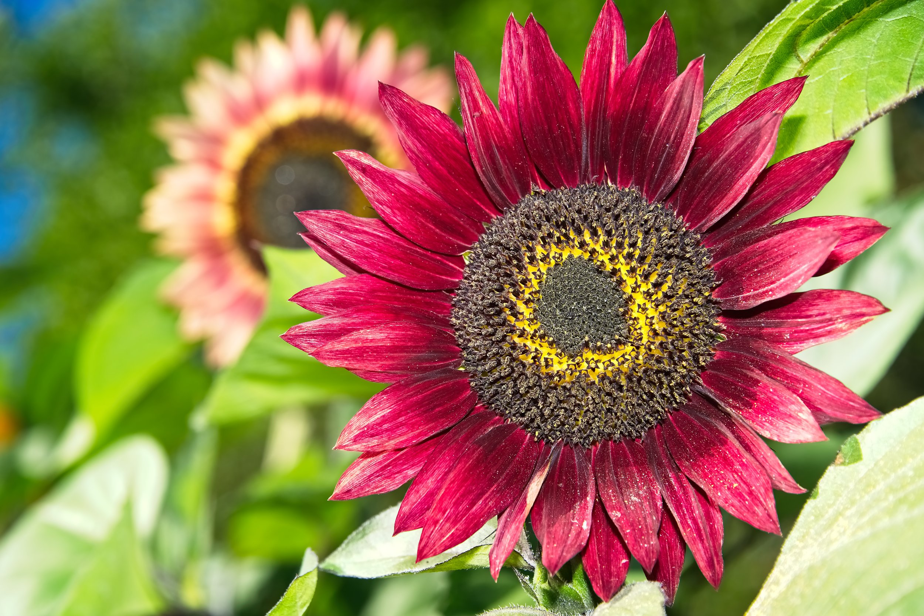
What does it mean if a plant is a heirloom plant?
Any open pollinated plant that has remained the same for 50 or more years.
AN

Slide 36
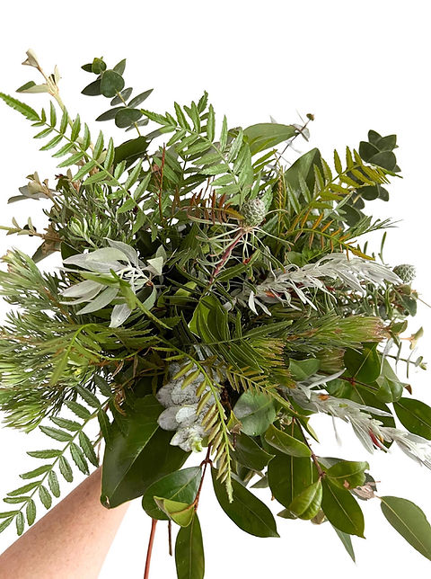
What does a flower say when they’re offering you a job?
“Take it or leaf it.”
Ha Ha

Slide 37
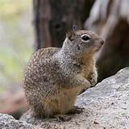
Did you know?
Russian scientists were able to germinate 32,000-year-old seeds of narrow-leaved campion (Silene stenophylla) that had been stored frozen in a ground squirrel hibernation burrow under the permafrost in Siberia. The plants grew, bloomed and produced viable seed.
AN

Slide 38
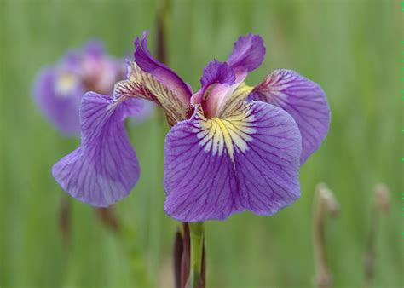
This flower has the same name as a part of your eye
Iris
AN

Slide 39
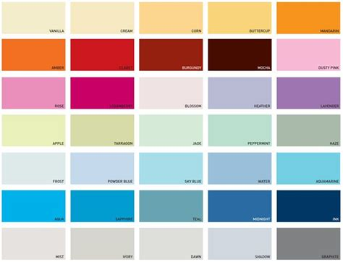
Which flower’s colour depends on the amount of acid in the soil?
Hydrangeas
AN

Slide 40
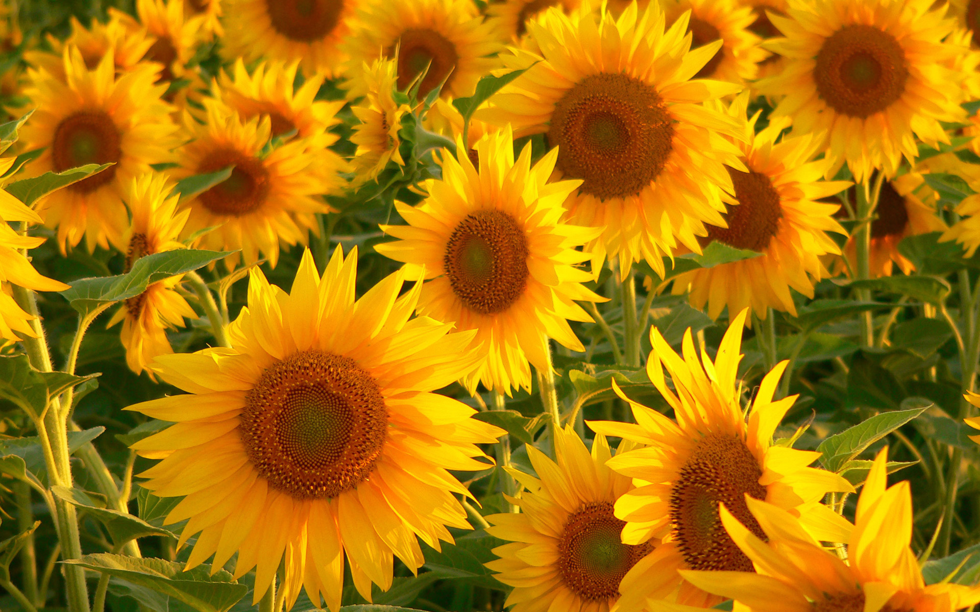
The head of a sunflower moves during the day.
East to west
West to east
East to west
AN

Slide 41
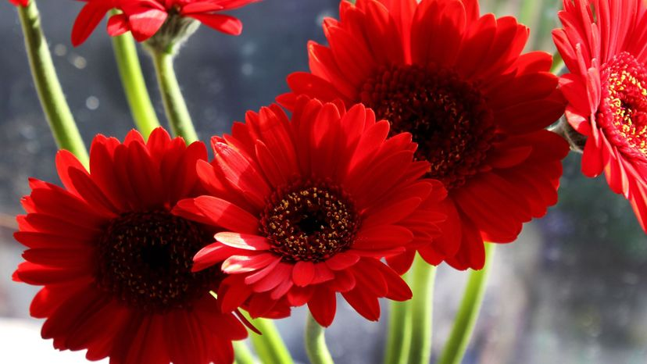
While it's known to many as the African daisy, what other name does this flower go by?
Gerbera
AN

Slide 42
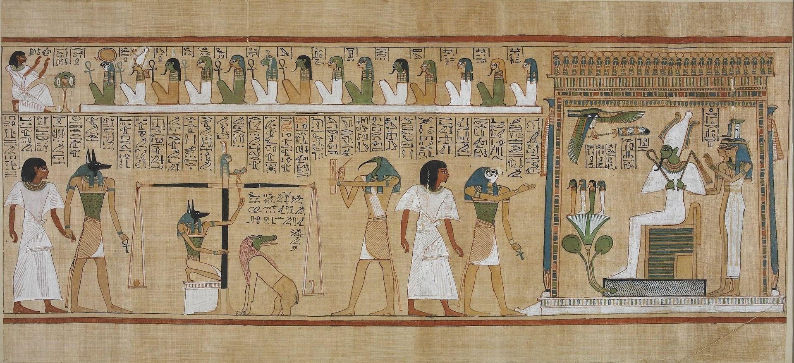
Paper was originally made from which of the following plants?
A. Papyrus
B. Bamboo
C. Rice
Papyrus
AN

Slide 43
What kind of succulent plant is often used to treat sunburn?
Aloe Vera
AN

Slide 44
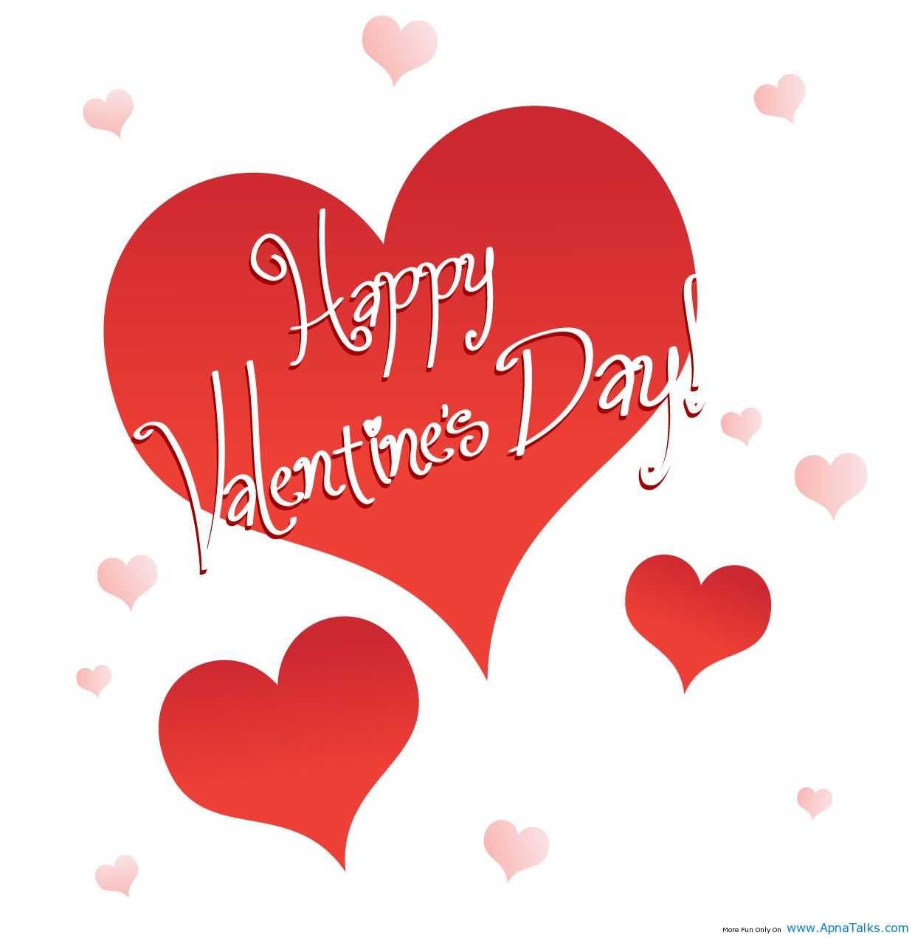
What is the most sold flower on Valentines day
Roses
AN

Slide 45
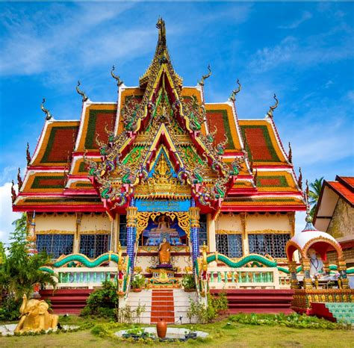
In Buddhism, which flower is a symbol of enlightenment
Water lily
Daisy
Sunflower
Water Lilly
AN

Slide 46
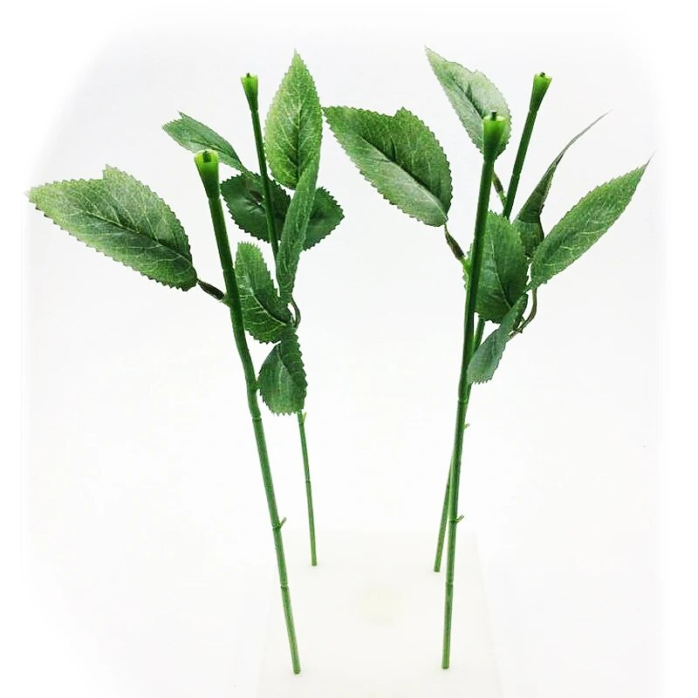
For Valentine’s Day, I received a bunch of flowers with the heads cut off.
I think I was being stalked.
Groan

Slide 47
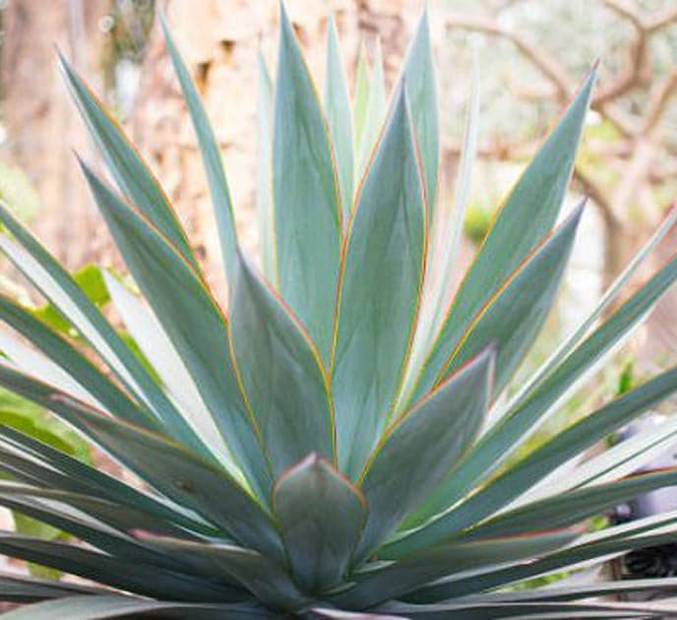
Did you know?
Agave flowers bloom only once Aptly named “the century plant,” the agave plant can flourish for years without producing any flowers. Then, the plant produces a single flower at the end of its life, after which it dies
AN

Slide 48
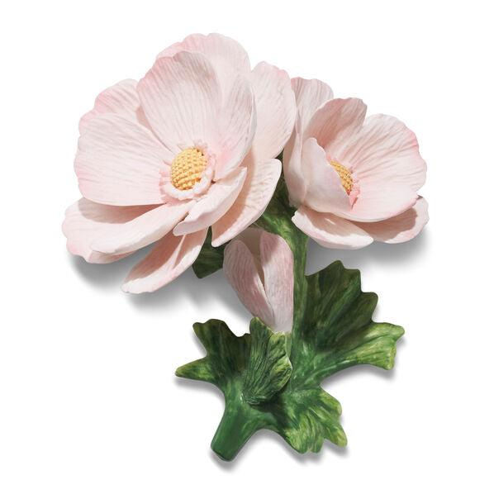
Did you hear about one flower who went on a date with another flower?
It’s a budding romance.
Groan

Slide 49
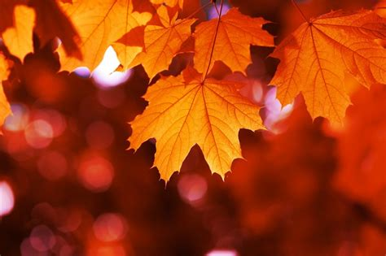
Maple Leaf is the national emblem of what country
Canada
AN

Slide 50
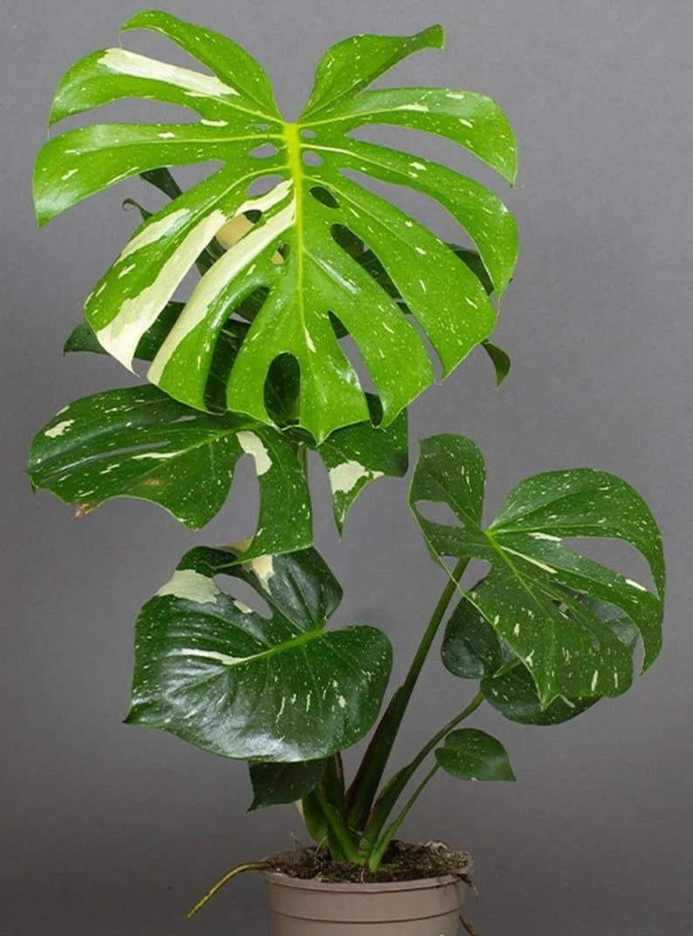
What is monstera deliciosa better known as?
1) Parmesan plant
2) Mozzarella plant
3) Cheddar plant
4) Swiss cheese plant
4) Swiss cheese
AN

Slide 51
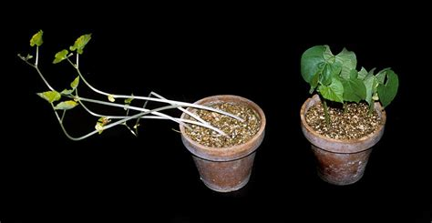
The last question
What does it mean if a plant is suffering from Etiolation
Weak, pale, “leggy,” or tall growth caused by insufficient sunlight.
AN

Slide 52
What do you call a half price bunch of daffodils?
A daffodeal!
This is ‘blooming awful’

Slide 53
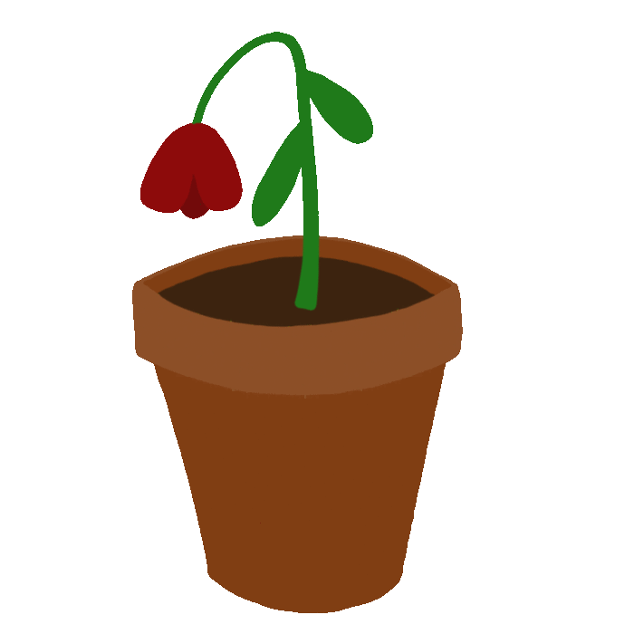
The end
AN

Slide 54
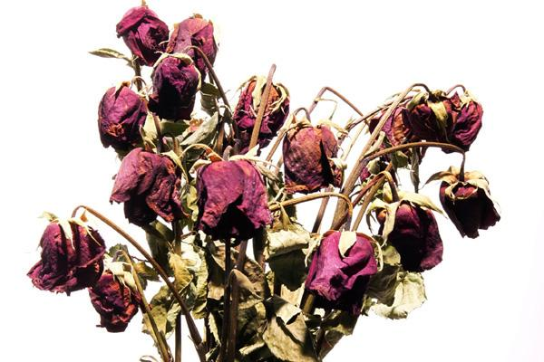
The end

