Slide 1
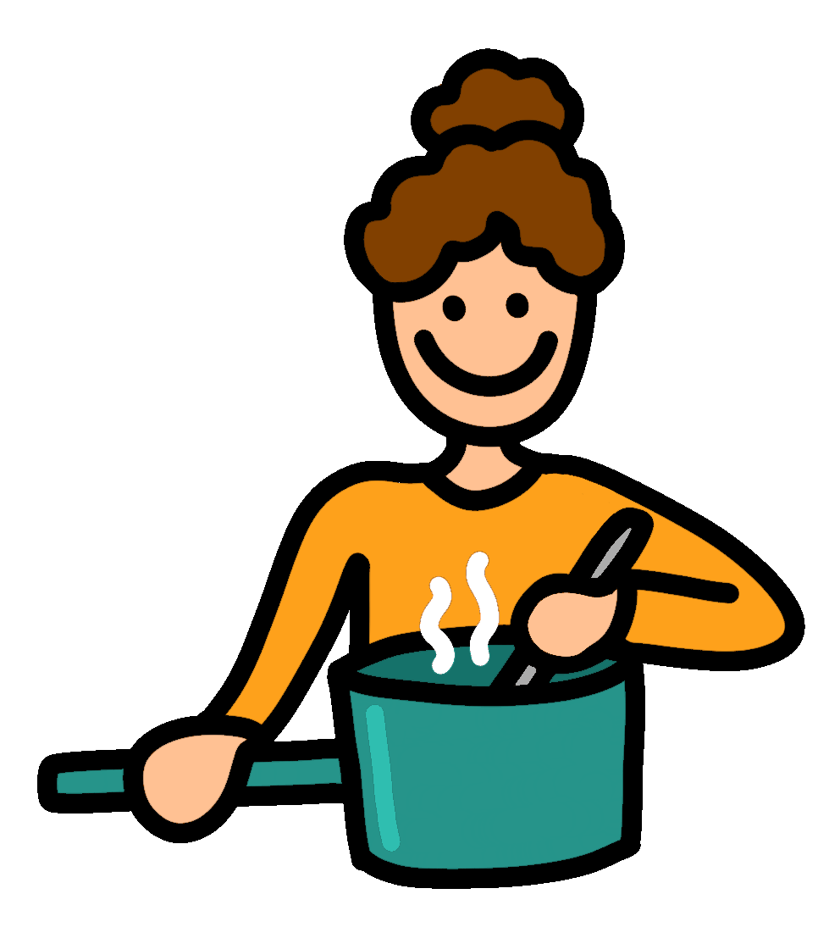
Food Quiz
Food Quiz
Let’s Start
A.N.

Slide 2
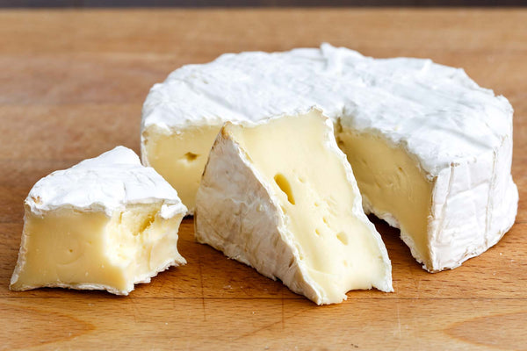
Food Quiz
Which country does brie cheese originate from?
France
Brie is a soft cow's-milk cheese named after Brie, the French region from which it originated. It is pale in color with a slight grayish tinge under a rind of white mould.
A.N.

Slide 3
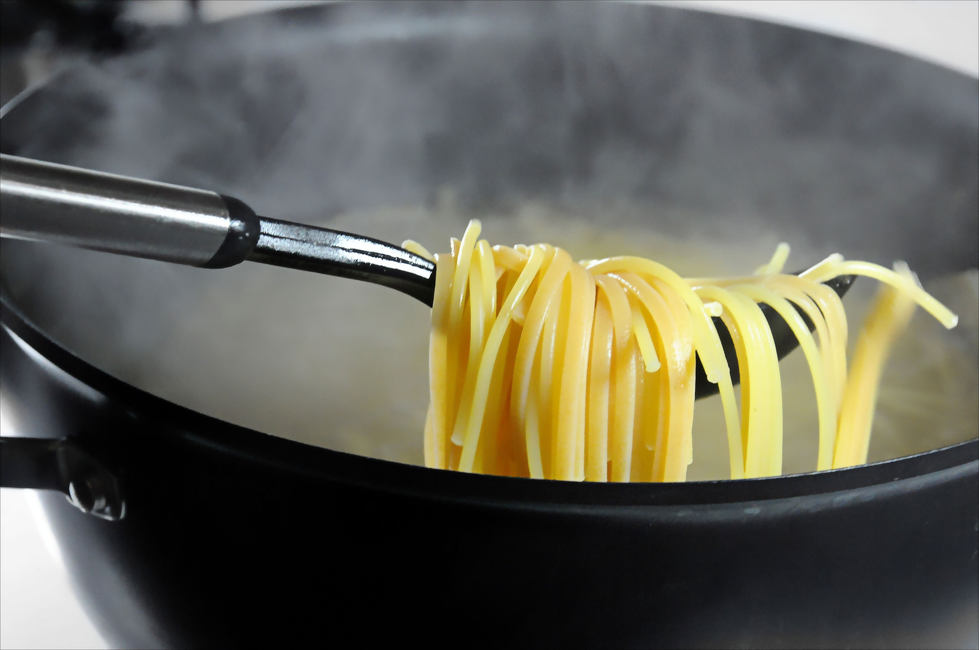
Food Quiz
What is meant by the term 'al dente', in Italian cooking?
To be cooked and firm to the bite.
The phrase al dente literally translates from Italian to mean “to the tooth.” It describes the texture of cooked pasta when it’s tender but firm and chewy when you bite into it.
A.N.

Slide 4
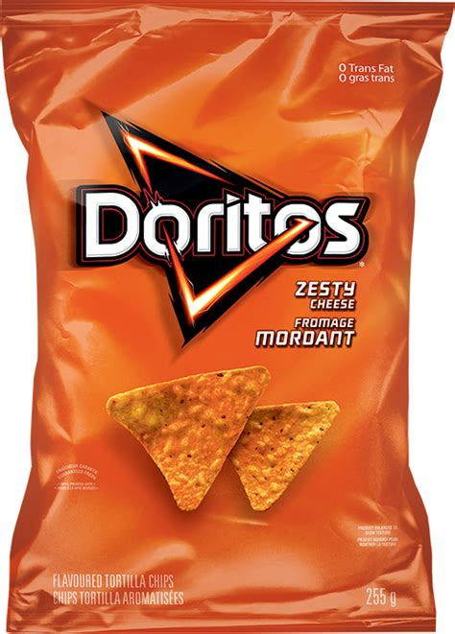
Food Quiz
What does ‘Dorito’ actually mean?
‘Little golden things’.
Doritos is an American brand of flavored tortilla chips produced by Frito-Lay, a wholly owned subsidiary of PepsiCo. The concept for Doritos originated at Disneyland at a restaurant managed by Frito-Lay in 1966.
A.N.

Slide 5
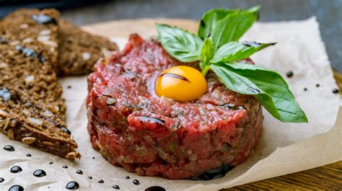
Food Quiz
How is steak tartare cooked?
‘It’s served raw’.
Steak tartare or tartar steak is a French dish of raw ground beef. It is usually served with onions, capers, mushrooms, pepper, Worcestershire sauce, and other seasonings, often presented separately, to be added to taste.
A.N.

Slide 6
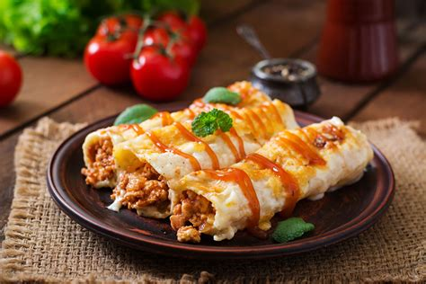
Food Quiz
An enchilada is from which cuisine?
Mexican
An enchilada is a Mexican dish consisting of a corn tortilla rolled around a filling and covered with a savory sauce. Enchiladas can be filled with various ingredients, including meats, cheese, beans, potatoes, vegetables, or combinations.
A.N.

Slide 7
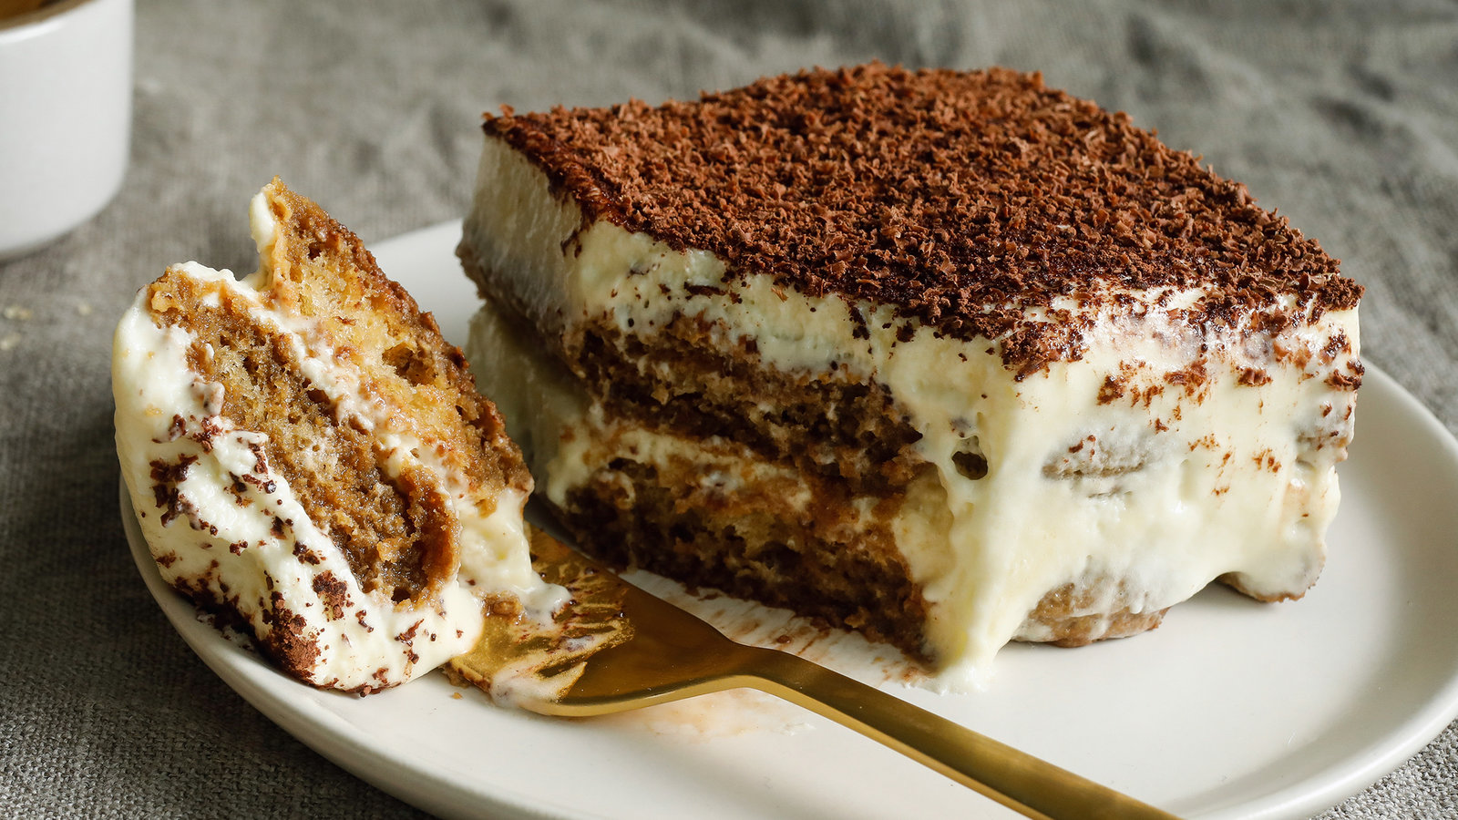
Food Quiz
What is the name of the Italian dessert that translates to 'pick me up'?
Tiramisu.
Tiramisu is an Italian dessert made of ladyfingers dipped in coffee, layered with a whipped mixture of eggs, sugar and mascarpone and flavoured with cocoa. The recipe has been adapted into many varieties of cakes and other desserts.
A.N.

Slide 8
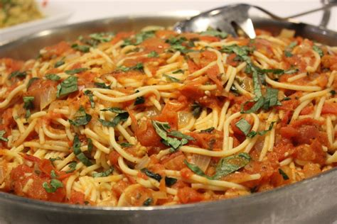
Food Quiz
What is the name of the Italian pasta dish that translates to 'little worms'?
Vermicelli.
Vermicelli is a traditional type of pasta round in section similar to spaghetti. In English-speaking regions it is usually thinner than spaghetti.
A.N.

Slide 9
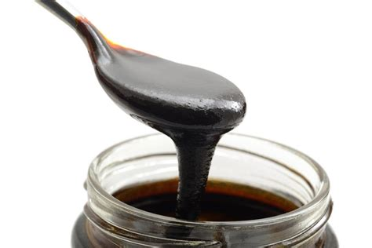
Food Quiz
What is the sweet, sticky syrup made from boiled sugarcane juice called?
Molasses.
Molasses is a viscous substance, principally obtained from the refining of sugarcane or sugar beet juice into sugar. Molasses varies in the amount of sugar, the method of extraction and the age of the plant. Molasses is a major constituent of fine commercial brown sugar.
A.N.

Slide 10
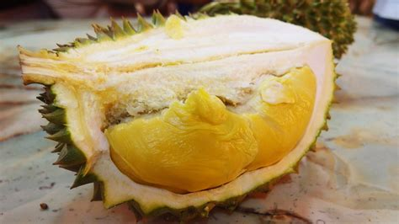
Food Quiz
Which Asian Fruit Has The Nickname ‘King Of Fruits’ And Is Known For Its Distinctive Smell?
Durian.
Researchers sequenced durian’s genome to reveal not only the source of its distinctive stench, but also the fact that it shares family ties with cacao—the plant that gives us fragrant joy in the form of chocolate.
A.N.

Slide 11
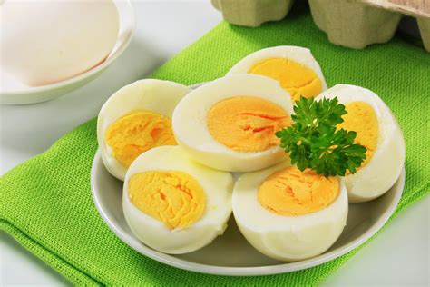
Food Quiz
Which Vitamin Is The Only One That You Will Not Find In An Egg?
Vitamin C
Eggs have small amounts of every vitamin and mineral (like calcium, iron, and zinc) that our body needs except for Vitamin C
A.N.

Slide 12
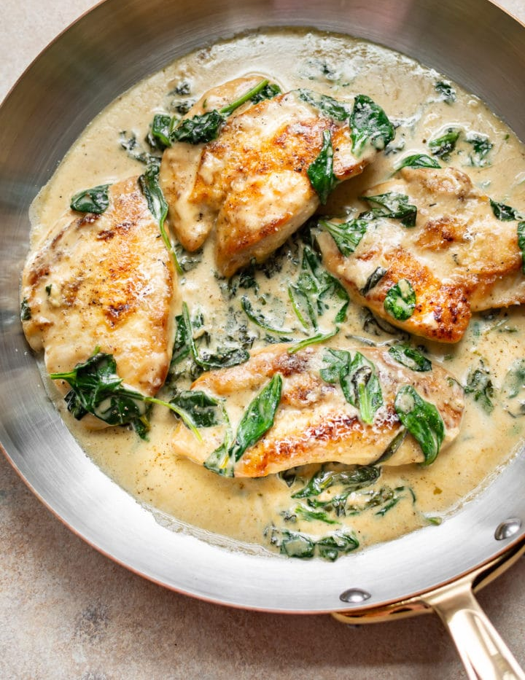
Food Quiz
What ingredient is included in food in a Florentine style?
Spinach.
Florentine or à la Florentine is a term from classic French cuisine that refers to dishes that typically include a base of cooked spinach, a protein component and Mornay sauce. Chicken Florentine is the most popular version.
A.N.

Slide 13
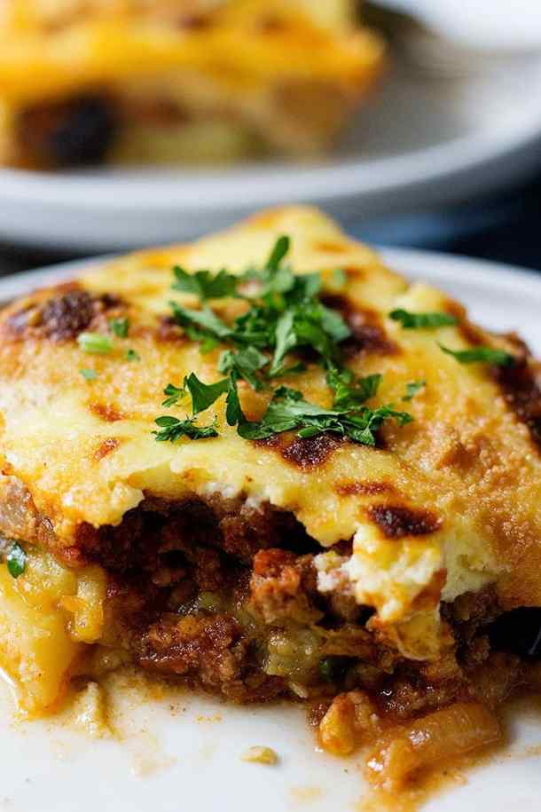
Food Quiz
What is the main vegetable ingredient of moussaka?
Aubergines
(Eggplant = aubergine = brinjal = baigan)
Moussaka is an eggplant- or potato-based dish, often including ground meat, which is common in the Balkans and the Middle East, with many local and regional variations. The modern Greek variant was created in the 1920s by Nikolaos Tselementes.
A.N.

Slide 14
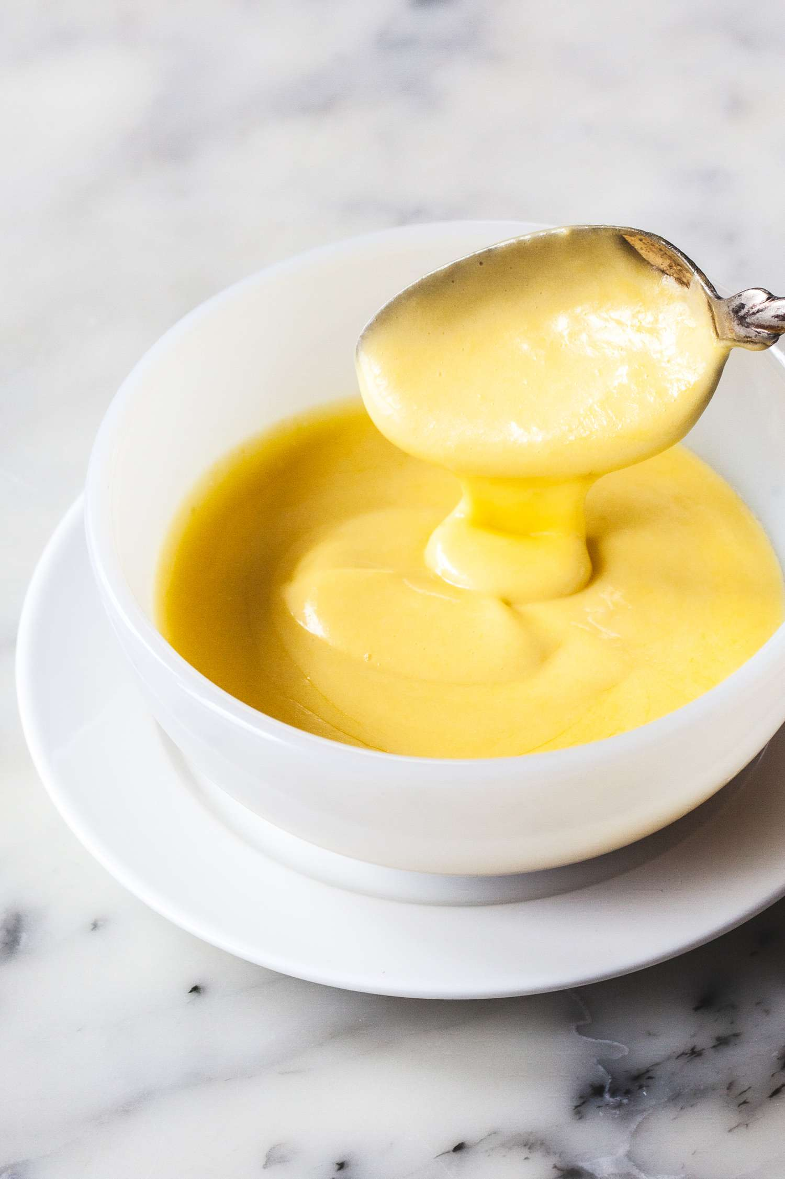
Food Quiz
What are the two main ingredients of a Hollandaise sauce?
Egg yolks and butter
Hollandaise sauce, meaning Dutch sauce in French, is a mixture of egg yolk, melted butter, and lemon juice. It is usually seasoned with salt, and either white pepper or cayenne pepper.
A.N.

Slide 15
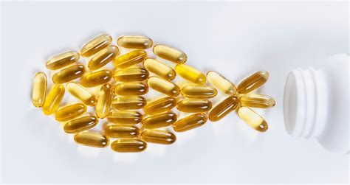
Food Quiz
Which fatty acid is found in many fish and considered to be of a major health benefit?
Omega 3
They are widely distributed in nature, being important constituents of animal lipid metabolism, and they play an important role in the human diet and in human physiology.
A.N.

Slide 16
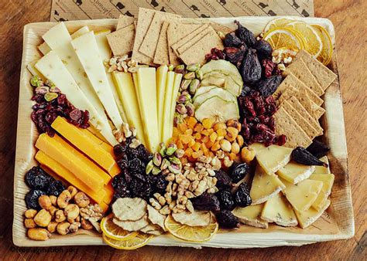
Food Quiz
What does ‘artisan’ mean when describing food?
Made by small-scale producers with traditional methods
Artisanal food encompasses breads, cheeses, fruit preserves, cured meats, beverages, oils, and vinegars that are made by hand using traditional methods by skilled craftworkers, known as food artisans. The foodstuff material from farmers and backyard growers can include fruit, grains and flours, milks for cheese, cured meats, fish, beverages, oils, and vinegars.
A.N.

Slide 17
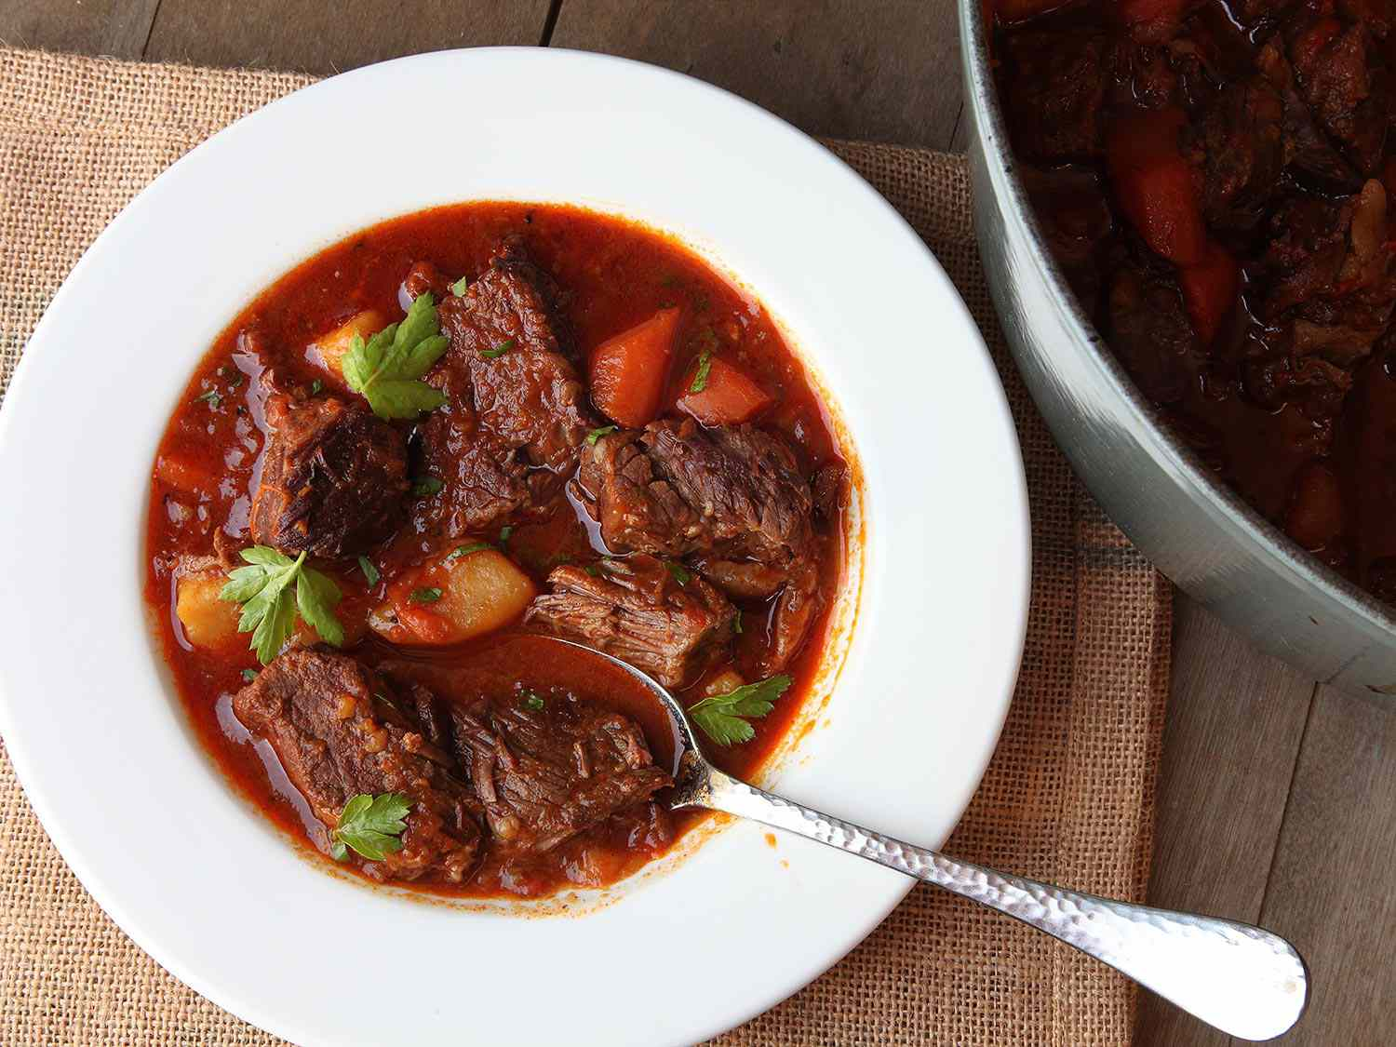
Food Quiz
Which spice provides the main flavouring and colouring of goulash?
Paprika
Goulash is a soup or stew of meat and vegetables seasoned with paprika and other spices. Originating in Hungary, goulash is a common meal predominantly eaten in Central Europe but also in other parts of Europe.
A.N.

Slide 18
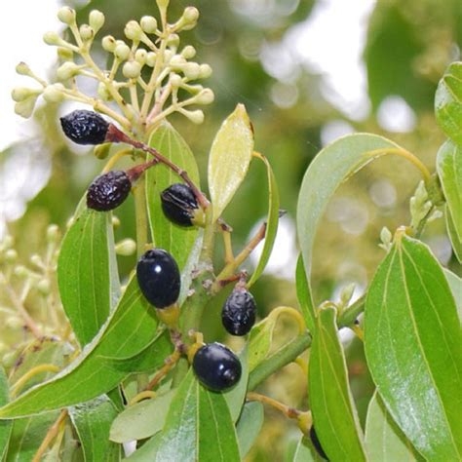
Food Quiz
Cinnamon is the inner part of what?
A tree – it is part of the inner bark
Cinnamon is a spice obtained from the inner bark of several tree species. Cinnamon is used mainly as an aromatic condiment and flavouring additive in a wide variety of cuisines, sweet and savoury dishes, breakfast cereals, snack foods, bagels, teas, hot chocolate and traditional foods.
A.N.

Slide 19
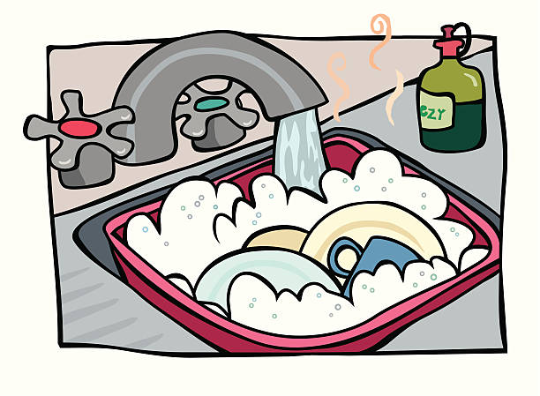
Food Quiz
The End
A.N.

