Slide 1
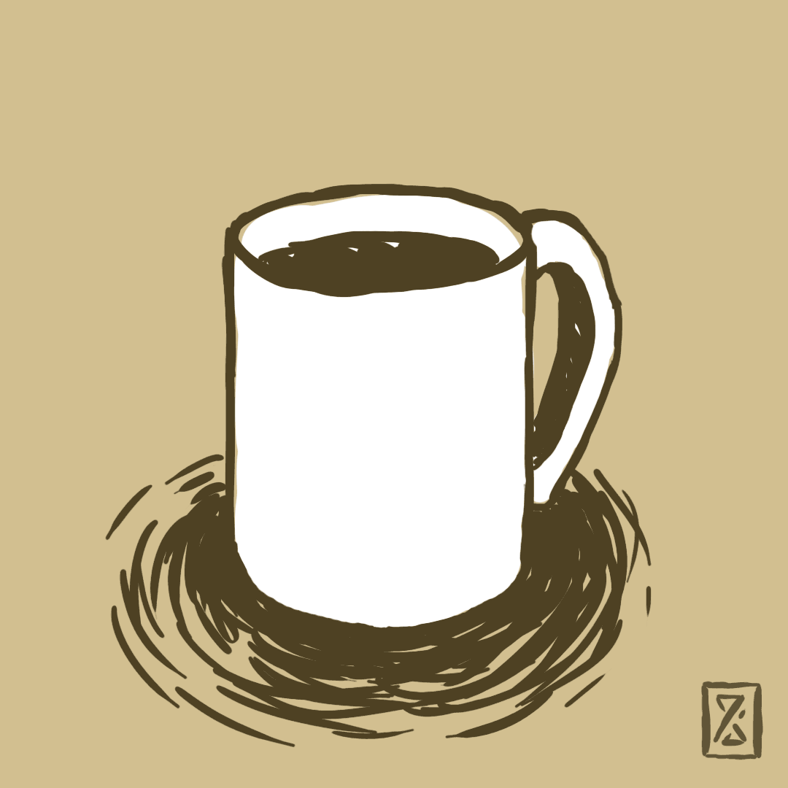
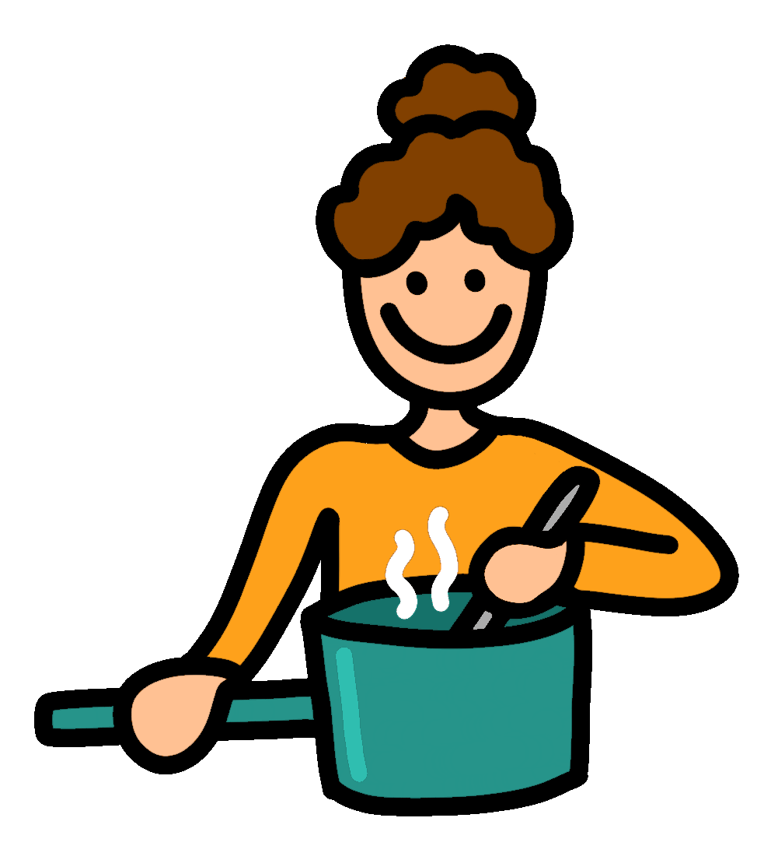
Food Quiz
Food Quiz
Let’s Start
A.N.

Slide 2
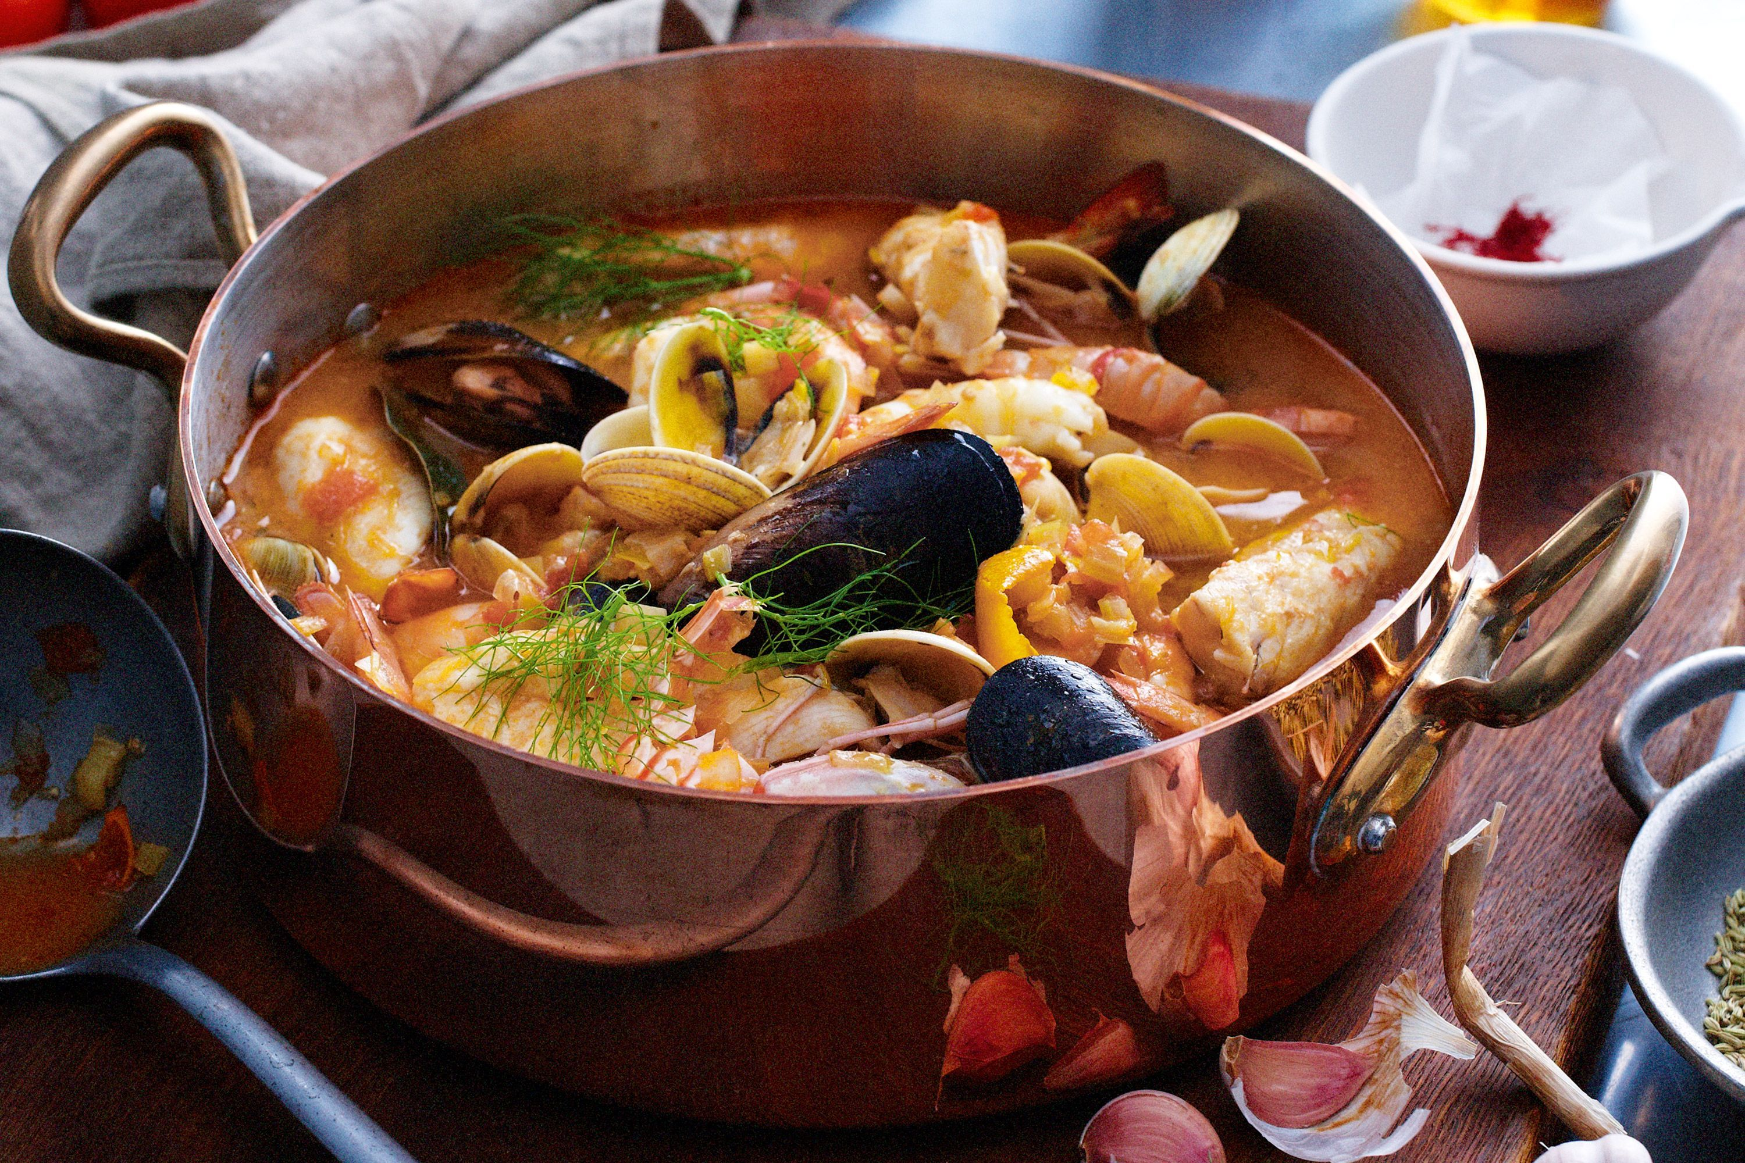
Food Quiz
If you ordered a ‘bouillabaisse’, what would you expect to eat?
Seafood
Bouillabaisse is a traditional Provençal fish soup originating in the port city of Marseille. The word is originally a compound of the two Provençal verbs bolhir and abaissar.
A.N.

Slide 3
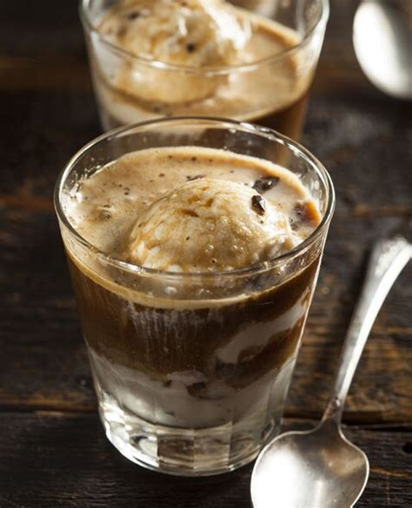
Food Quiz
If you order an ‘affogato’, what would you get?
Vanilla ice cream with a shot of espresso
An affogato, more traditionally known as "affogato al caffè", is an Italian coffee-based dessert. It usually takes the form of a scoop of plain milk-flavored or vanilla gelato or ice cream topped or "drowned" with a shot of hot espresso.
A.N.

Slide 4
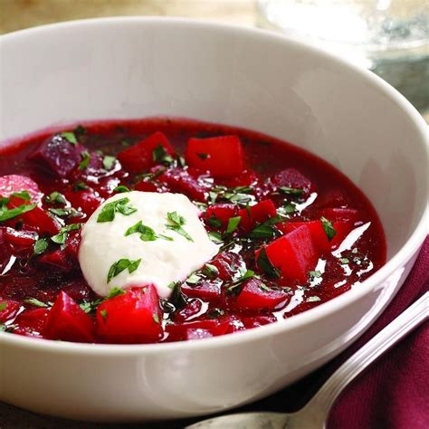
Food Quiz
Borscht is a popular soup in Europe. What is it made out of?
Beetroot
In English, the word "borscht" is most often associated with the soup's variant of Ukrainian origin, made with red beetroots as one of the main ingredients, which give the dish its distinctive red color.
A.N.

Slide 5
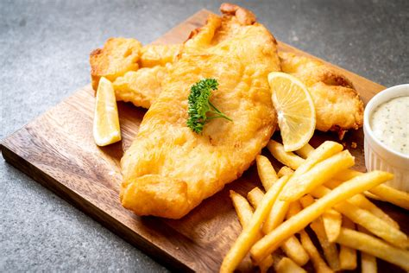
Food Quiz
Which country invented fish and chips?
United Kingdom
You could have your photograph in the newspaper today, and tomorrow it would be used to wrap your take away fish and chips.
A.N.

Slide 6
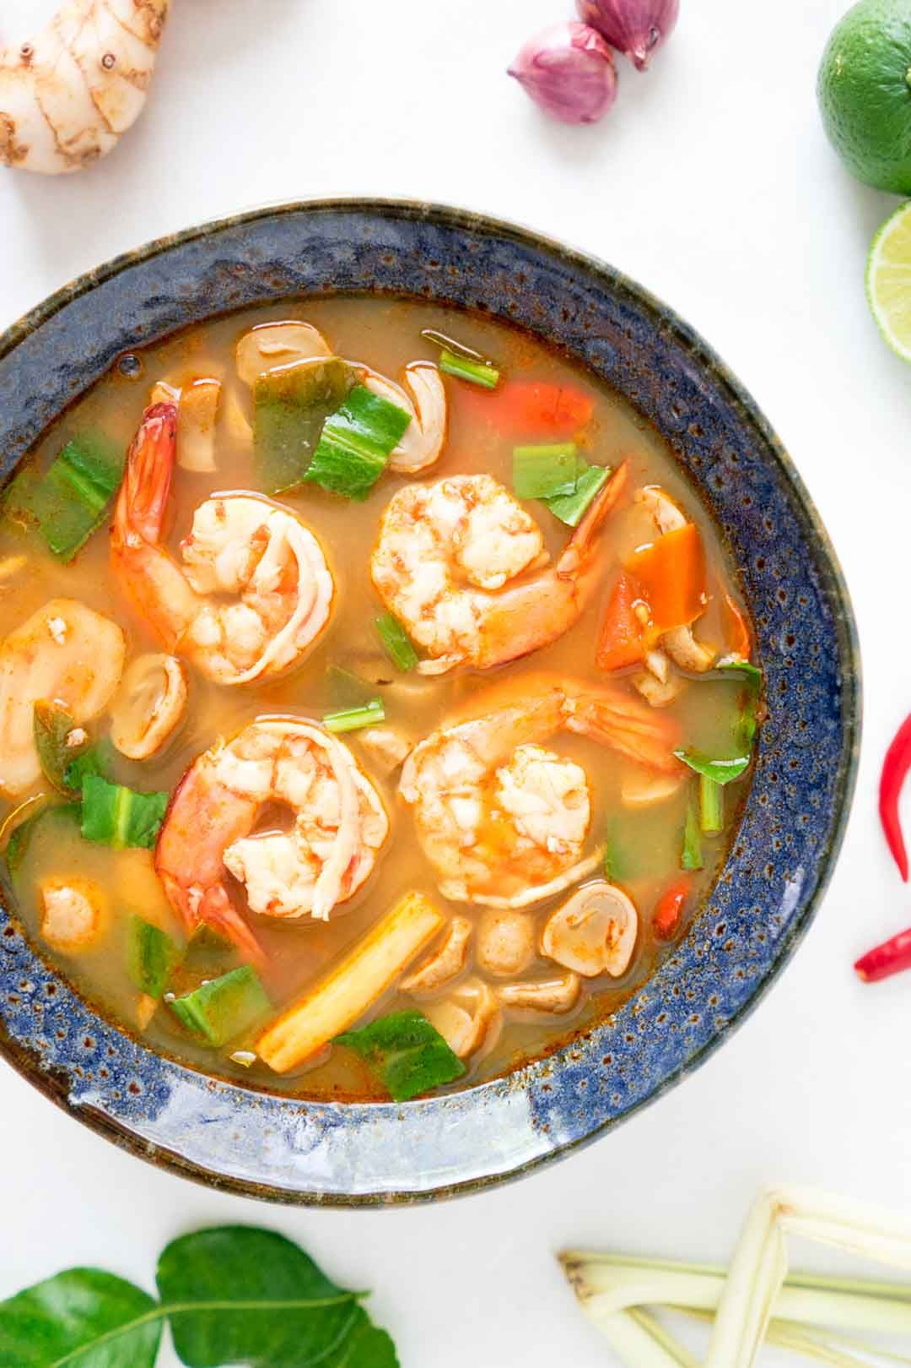
Food Quiz
Where would you find Tom Yum soup?
Thailand
Tom yum or tom yam is a family of hot and sour Thai soups. It is a soup that normally includes shrimp. Tom refers to the boiling process, while yam means 'mixed'.
A.N.

Slide 7
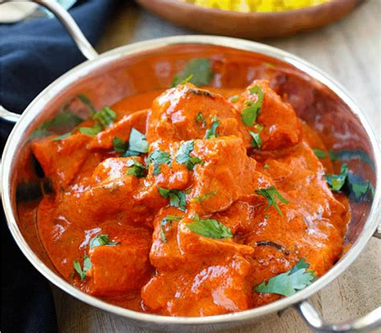
Food Quiz
Where was the popular curry, the chicken Tikka Masala invented?
Scotland
it is believed to have been invented in the 1970s by a Bangladeshi chef in Glasgow, Scotland, who, in order to please a customer, added a mild tomato-cream sauce to his chicken tikka, which is pieces of boneless chicken marinated in yogurt and curry spices.
A.N.

Slide 8
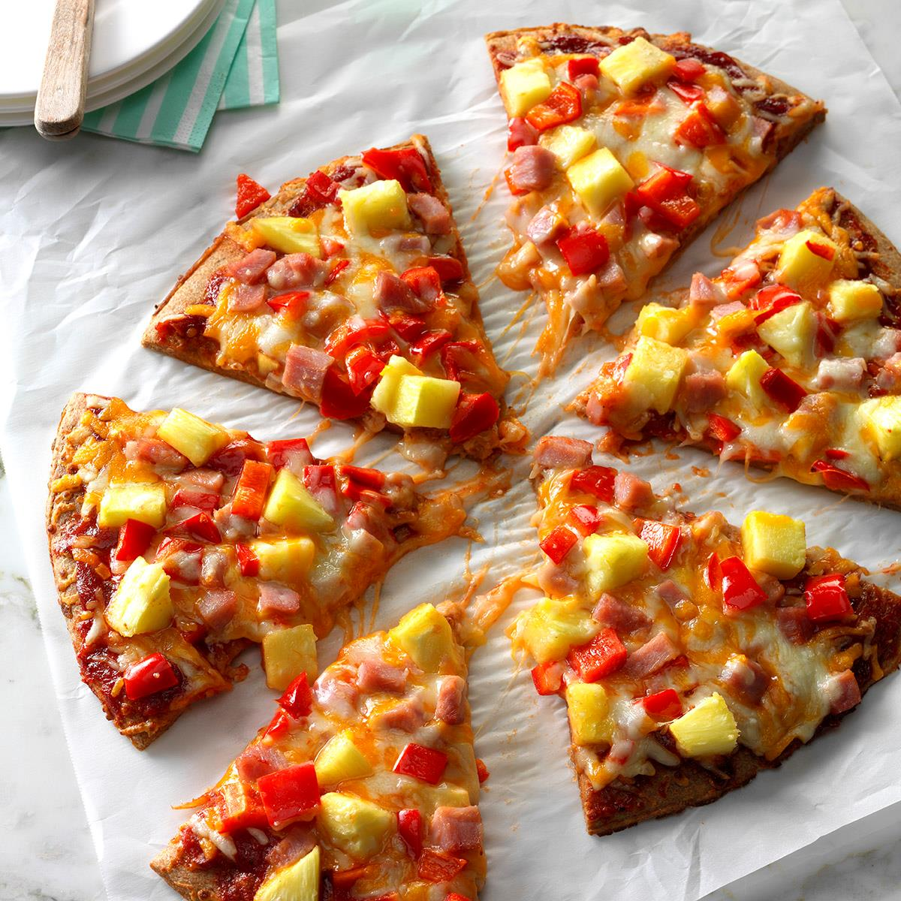
Food Quiz
Where was the Hawaiian pizza invented?
Canada
Hawaiian pizza is a pizza originating in Canada, traditionally topped with pineapple, tomato sauce, Mozzarella cheese, and either ham or bacon.
A.N.

Slide 9
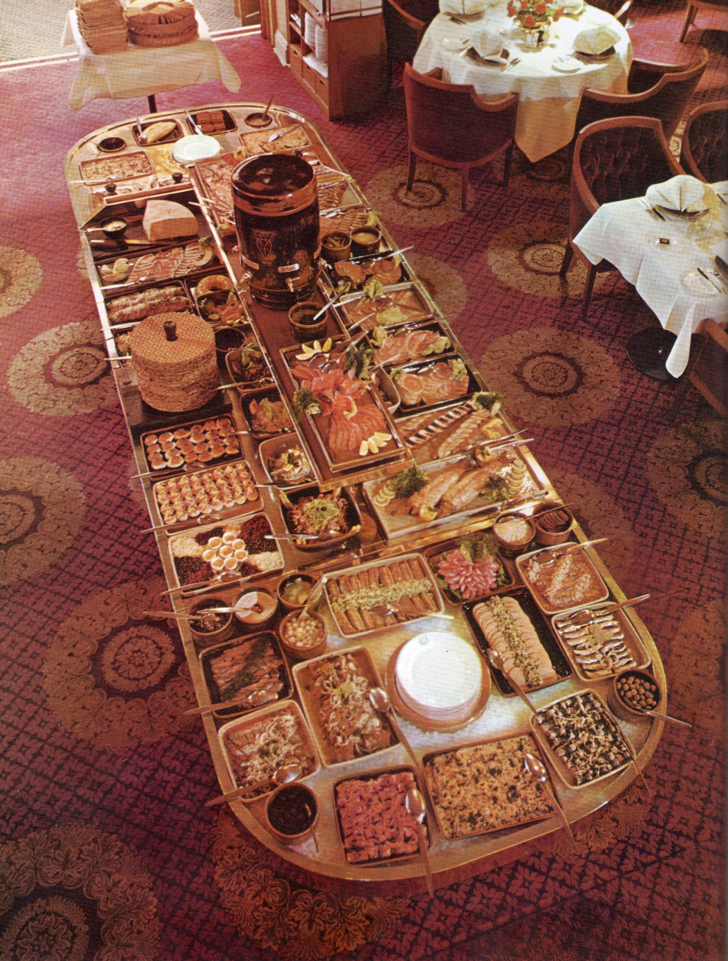
Food Quiz
If you were served a variety of hot and cold dishes in Sweden, what would you call it?
A smorgasbord
Smörgåsbord became internationally known at the 1939 New York World's Fair when it was offered at the Swedish Pavilion's Three Crowns Restaurant. It is typically a celebratory meal and guests can help themselves from a range of dishes laid out for their choice.
A.N.

Slide 10
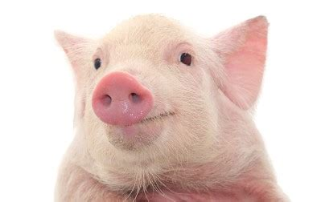
Food Quiz
What Additives Consist Of The Skin And Bones Of Animals?
Gelatin
The collagen in gelatin is extracted from the skin and bones of animals such as chicken and pigs.
A.N.

Slide 11
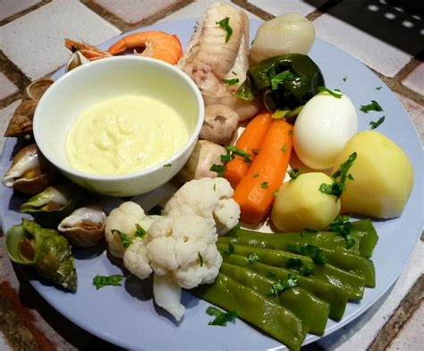
Food Quiz
What is the main flavour of aioli?
Garlick
Aioli, allioli or aïoli is a cold sauce consisting of an emulsion of garlic and olive oil; it is found in the cuisines of the northwest Mediterranean. The names mean "garlic and oil" in Catalan and Provençal.
A.N.

Slide 12
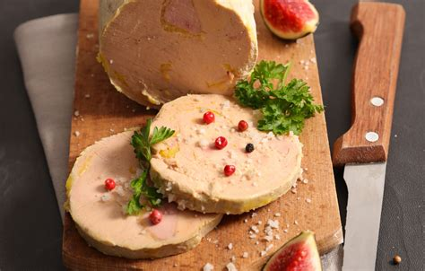
Food Quiz
What famous (and expensive) French delicacy is made of duck liver?
Foie Gras
According to French law, foie gras is defined as the liver of a duck or goose fattened by gavage. Foie gras is a popular and well-known delicacy in French cuisine. Its flavour is rich, buttery, and delicate, unlike an ordinary duck or goose liver. Gavage means force-feeding - the practice of feeding a human or animal against their will.
A.N.

Slide 13
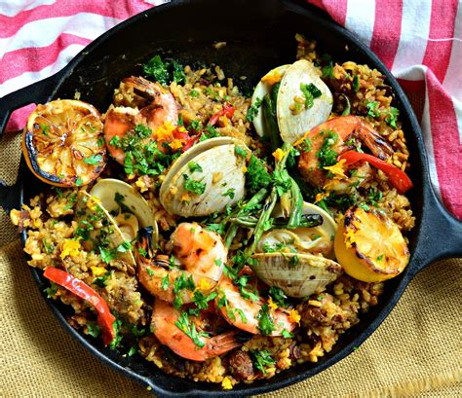
Food Quiz
How does paella get its name?
From the pan that it’s cooked in
Paella is a rice dish originally from the Valencian Community. Paella is regarded as one of the community's identifying symbols. It is one of the best-known dishes in Spanish cuisine. Paella being the word for a frying pan in Valencian/Catalan language.
A.N.

Slide 14
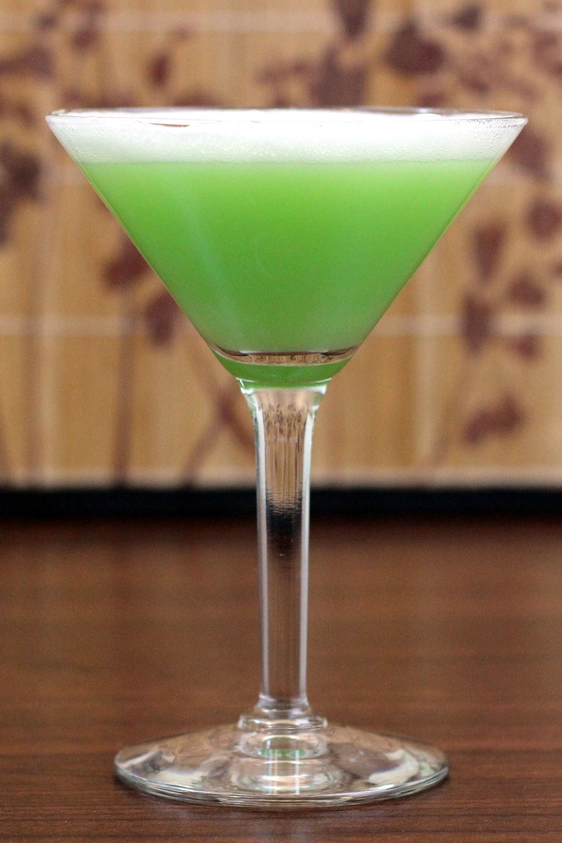
Food Quiz
Which drink is nicknamed “the green fairy”?
Absinthe
Absinthe is an anise-flavored spirit derived from several plants, including the flowers and leaves of Artemisia absinthium, together with green anise, sweet fennel, and other medicinal and culinary herbs.
A.N.

Slide 15
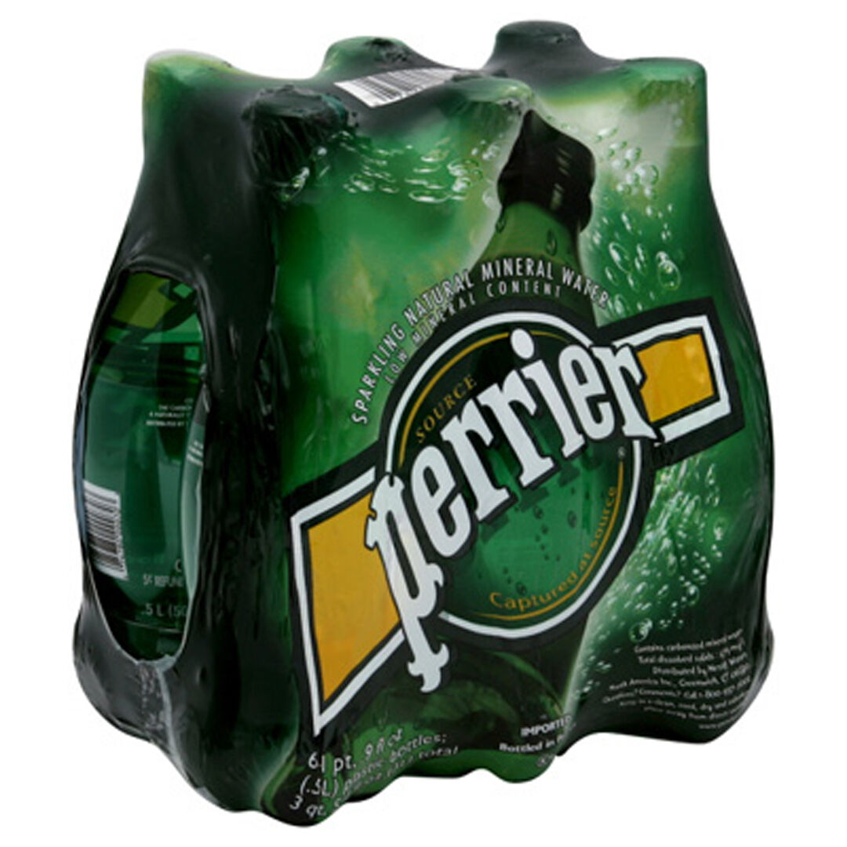
Food Quiz
What type of drink is Perrier?
Sparkling water
Perrier is a French brand of natural bottled mineral water obtained at its source in Vergèze, located in the Gard département. Perrier is known for its carbonation and its distinctive green bottle.
A.N.

Slide 16
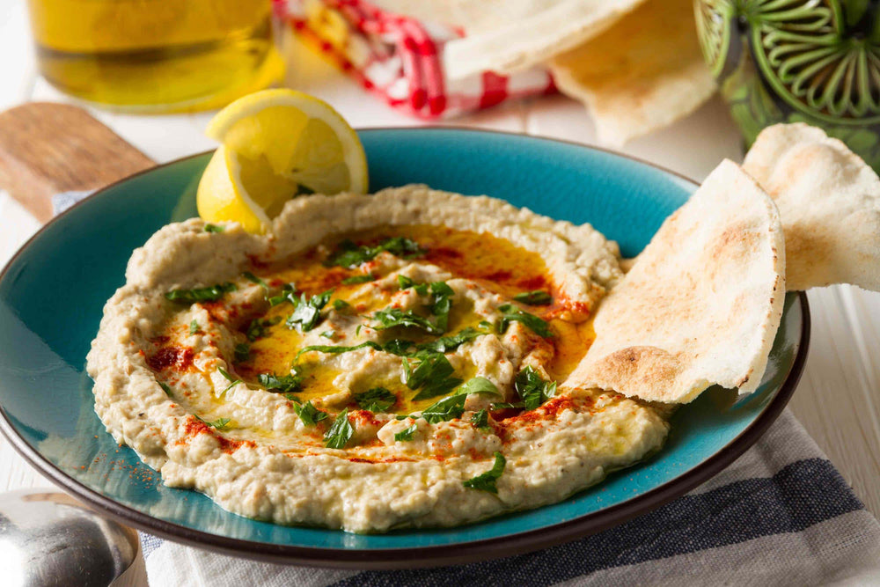
Food Quiz
What is the primary ingredient in the Middle Eastern dip baba ghanoush?
Eggplant/Aubergine
A Levantine appetizer consisting of finely chopped roasted eggplant, olive oil, lemon juice, various seasonings, and tahini. The eggplant is traditionally baked or broiled over an open flame before peeling, so that the pulp is soft and has a smoky taste.
A.N.

Slide 17
Food Quiz
What is the name of the sweet, tangy fruit used to flavour Worcestershire sauce?
Tamarind
Worcestershire sauce or Worcester sauce is a fermented liquid condiment invented by the pharmacists John Wheeley Lea and William Henry Perrins in the city of Worcester in Worcestershire, England, during the first half of the 19th century.
A.N.

Slide 18
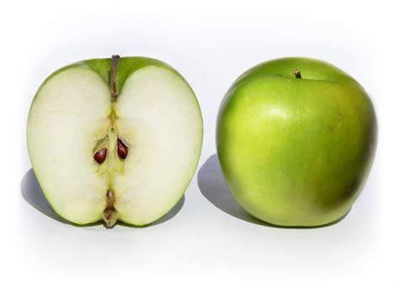
Food Quiz
In what country did Maria Ann Smith, the person behind the name ‘Granny Smith’ own an orchard?
Australia
The Granny Smith, also known as a green apple or sour apple, is an apple cultivar that originated in Australia in 1868. It is named after Maria Ann Smith, who propagated the cultivar from a chance seedling.
A.N.

Slide 19
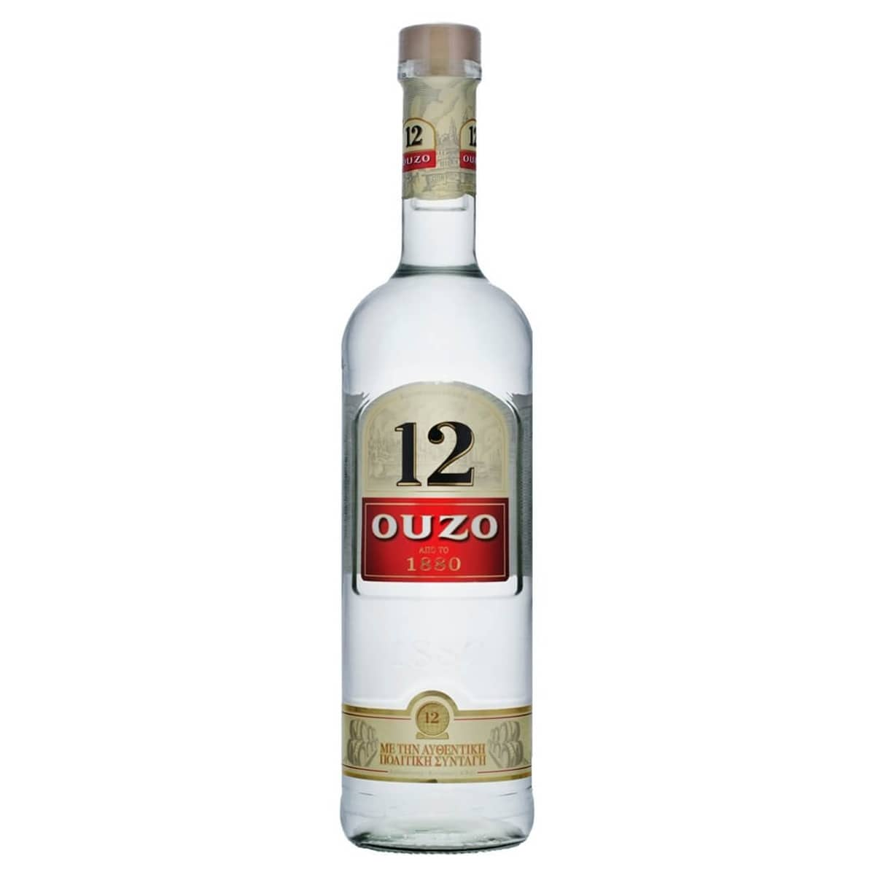
Food Quiz
Which country is the drink Ouzo from?
Greece
Ouzo is a dry anise-flavored aperitif that is widely consumed in Greece. It is made from rectified spirits that have undergone a process of distillation and flavoring. Its taste is similar to other anise liquors like pastis, sambuca, rakı and arak.
A.N.

Slide 20
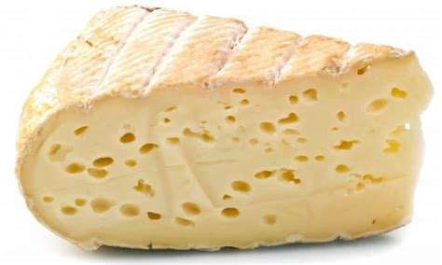
Food Quiz
What is the name of the Swiss cheese that has a nutty flavour and is often used in fondue?
Gruyere
Gruyère is a hard Swiss cheese that originated in the cantons of Fribourg, Vaud, Neuchâtel, Jura, and Berne in Switzerland. It is named after the town of Gruyères in Fribourg. Whether melted into fondue, grated over French onion soup, or simply savored on its own, Gruyère is a versatile delight that never fails to impress.
A.N.

Slide 21
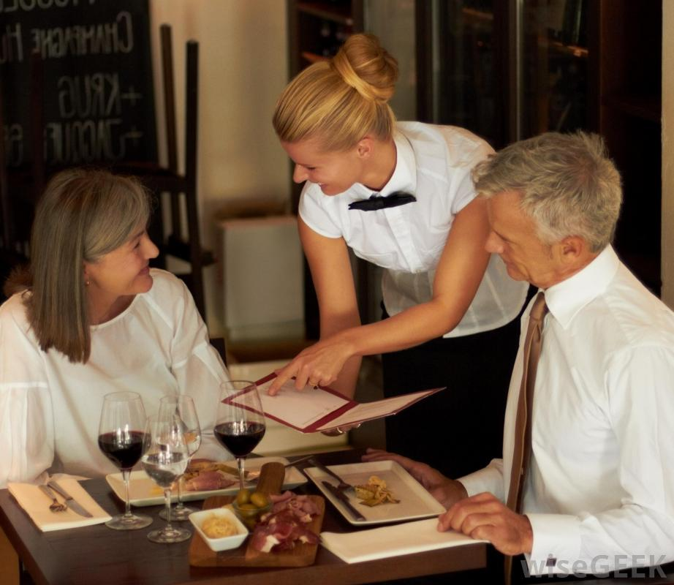
Food Quiz
A taxi
I’d like gluten free, lactose free, organic and vegetarian. What do you suggest?
A.N.

Slide 22
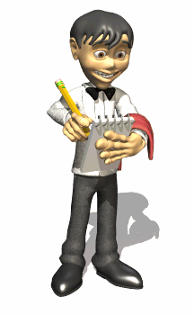
Food Quiz
How did we do madam?
A.N.

