Slide 1
General Knowledge Quiz
Let’s Start
A.N.

Slide 2
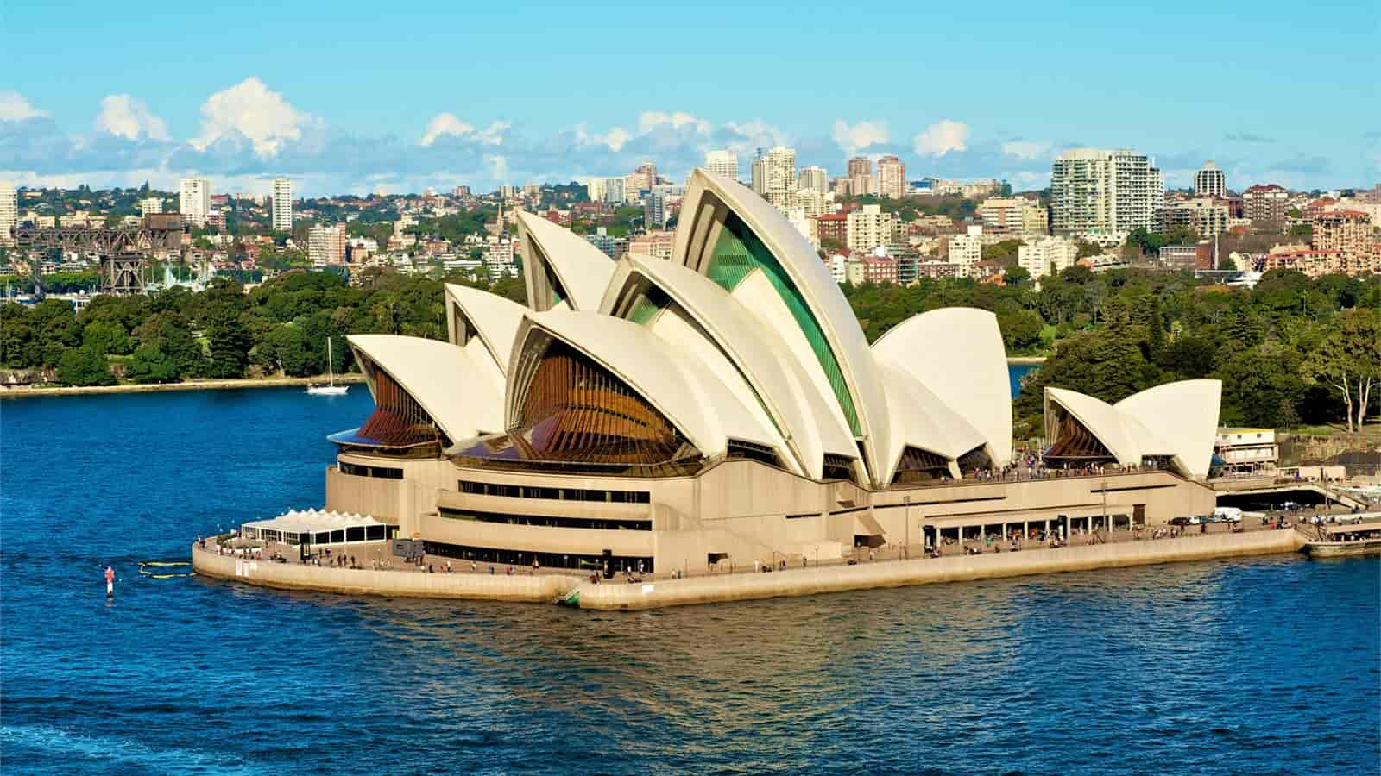
A.N.
General Knowledge Quiz
What was the name of the architect of the Sydney Opera House?
Jørn Utzon.
Jørn Oberg Utzon was a Danish architect. In 1957, he won an international design competition for his design of the Sydney Opera House in Australia. Utzon's revised design, which he completed in 1961, was the basis for the landmark, although it was not completed until 1973.

Slide 3
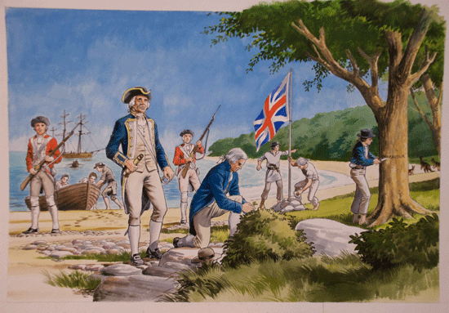
A.N.
General Knowledge Quiz
In which bay did Captain Cook land for the first time in Australia?
Botany Bay.
In 1770, the HMB Endeavour with Lieutenant (later Captain) James Cook and his crew landed at Botany Bay’s Inscription Point. The crew stayed in the area for 8 days and had a dramatic impact on Australian history.

Slide 4
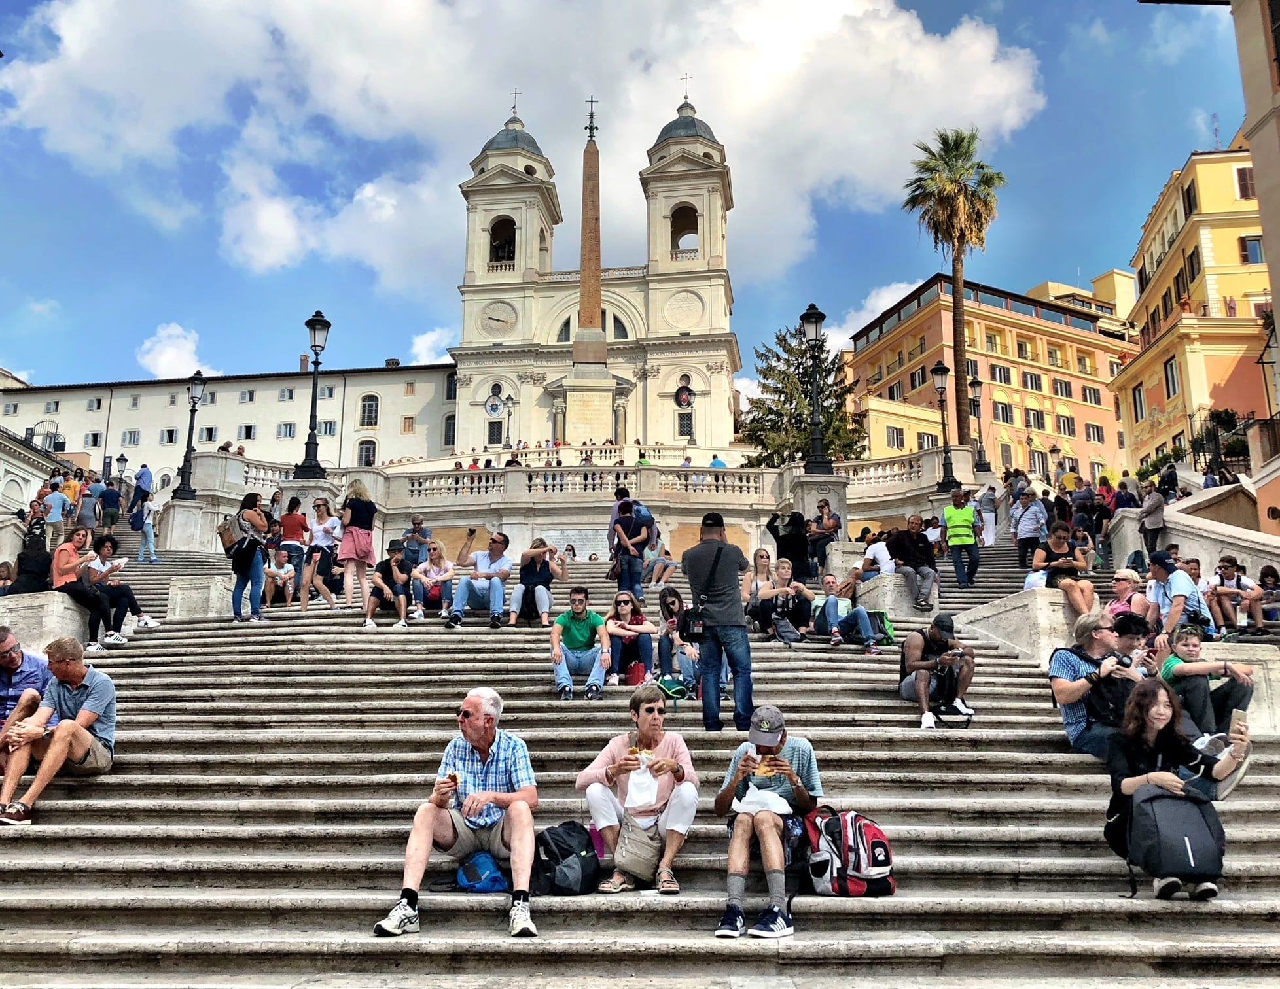
A.N.
General Knowledge Quiz
Where would you be if you were standing on the Spanish Steps?
Rome
The ‘Spanish’ part of the name refers to the Spanish Embassy to the Holy See, which was located on Piazza di Spagna (literally ‘Spanish Square’) at the base of the monument.

Slide 5
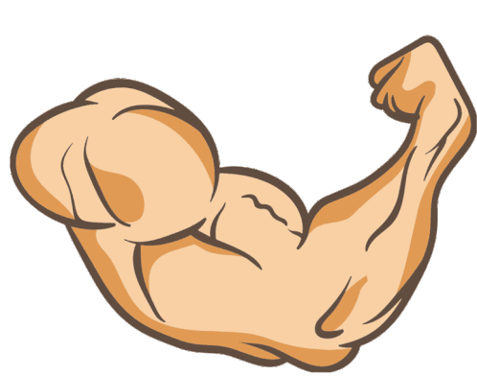
A.N.
General Knowledge Quiz
Where is the strongest human muscle located?
Jaw
The human body comprises over 630 muscles. The ‘masseter’ (jaw muscle) is believed to be the strongest muscle.

Slide 6
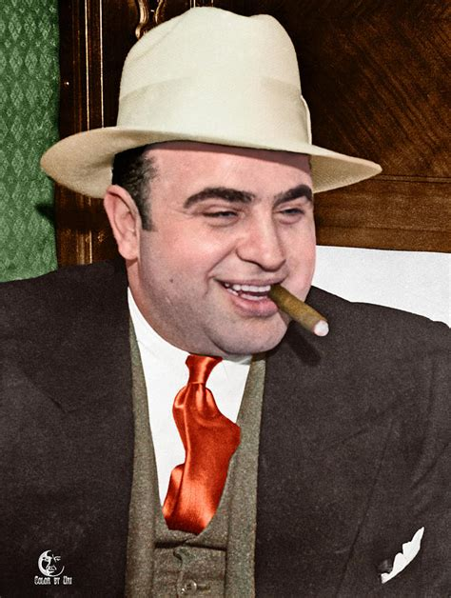
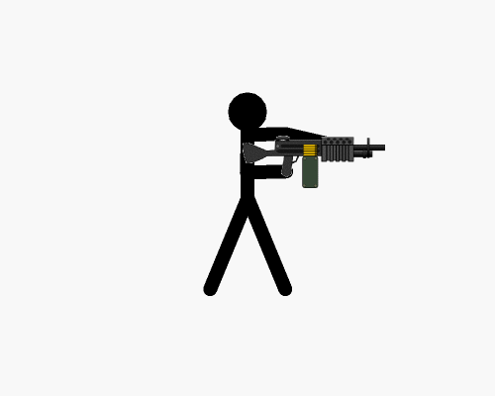
A.N.
General Knowledge Quiz
What was the name of the crime boss who was head of the feared Chicago Outfit?
Al Capone
Alphonse Gabriel Capone, sometimes known by the nickname "Scarface", was an American gangster and businessman who attained notoriety during the Prohibition era as the co-founder and boss of the Chicago Outfit from 1925 to 1931

Slide 7
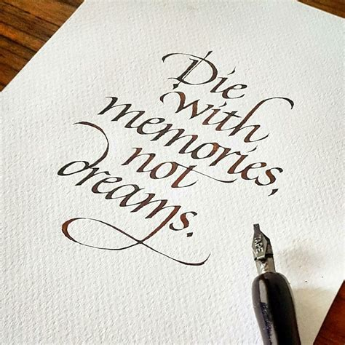
A.N.
General Knowledge Quiz
What art form is described as "decorative handwriting or handwritten lettering"?
Calligraphy
Calligraphy is a visual art related to writing. It is the design and execution of lettering with a pen, ink brush, or other writing instrument. Contemporary calligraphic practice can be defined as "the art of giving form to signs in an expressive, harmonious, and skillful manner".

Slide 8
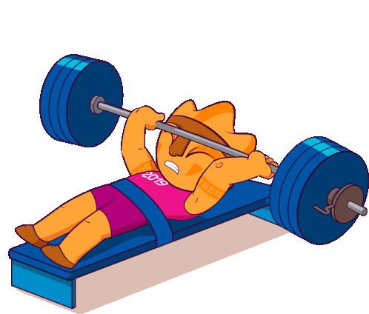
A.N.
General Knowledge Quiz
Compared to their body weight, what animal is the strongest - Dung Beetle, Elephant, Ant, or Cow?
Dung Beetle
Many dung beetles, known as rollers, roll dung into round balls, which are used as a food source or breeding chambers. Others, known as tunnelers, bury the dung wherever they find it.

Slide 9
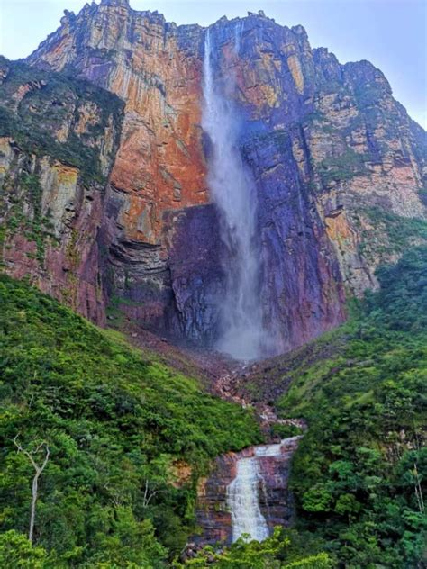
A.N.
General Knowledge Quiz
Where is Angel Falls, the world’s largest waterfall, located?
Venezuela
Angel Falls is the world's tallest uninterrupted waterfall, with a height of 979 metres, and a plunge of 807 m. The waterfall drops over the edge of the Auyán-tepui mountain in the Canaima National Park’

Slide 10
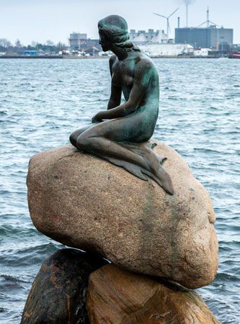
A.N.
General Knowledge Quiz
In what capital city would you find The Little Mermaid statue?
Copenhagen
It is a bronze statue by Edvard Eriksen, depicting a mermaid becoming human. The sculpture is displayed on a rock by the waterside at the Langelinie promenade in Copenhagen, Denmark.

Slide 11
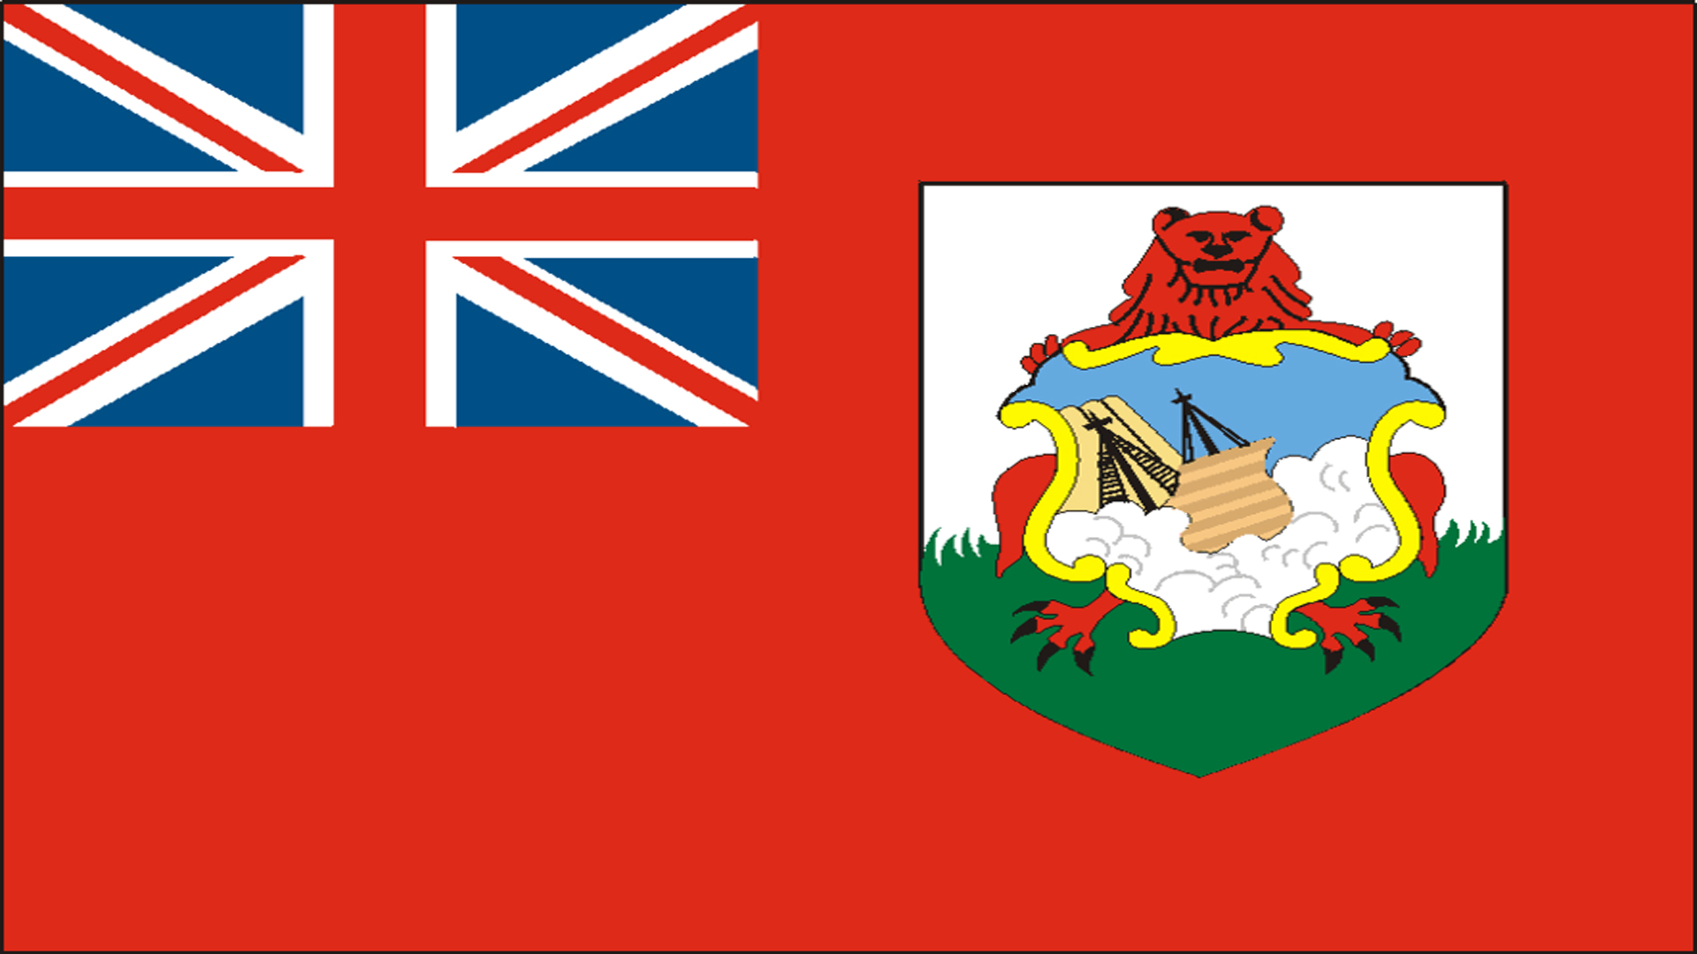
A.N.
General Knowledge Quiz
Which country features a shipwreck on its national flag?
Bermuda
The British ship Sea Venture, carrying some 150 colonists bound for Virginia, was shipwrecked on shoals off Bermuda during a hurricane in 1609. A stylization of the scene—in which a ship in raging seas appears to be crashing into a cliff—was incorporated into the island’s first coat of arms, granted in 1635.

Slide 12
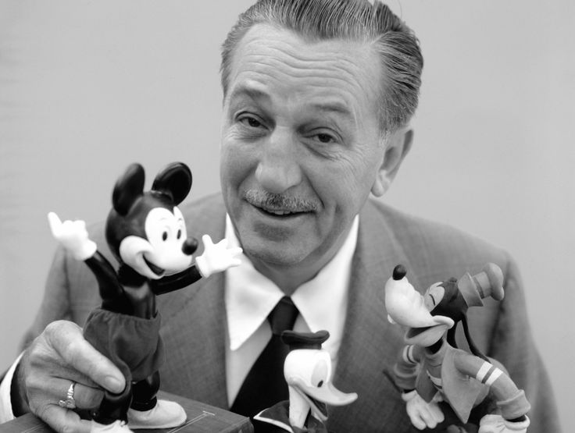
A.N.
General Knowledge Quiz
Who was the first Disney princess?
Snow White
"Snow White" is a German fairy tale, first written down in the early 19th century. The Brothers Grimm published it in 1812 in the first edition of their collection Grimms' Fairy Tales. The original German title was Sneewittchen; the modern spelling is Schneewittchen. Snow White and the Seven Dwarfs is a 1937 American animated film produced by Walt Disney Productions.

Slide 13
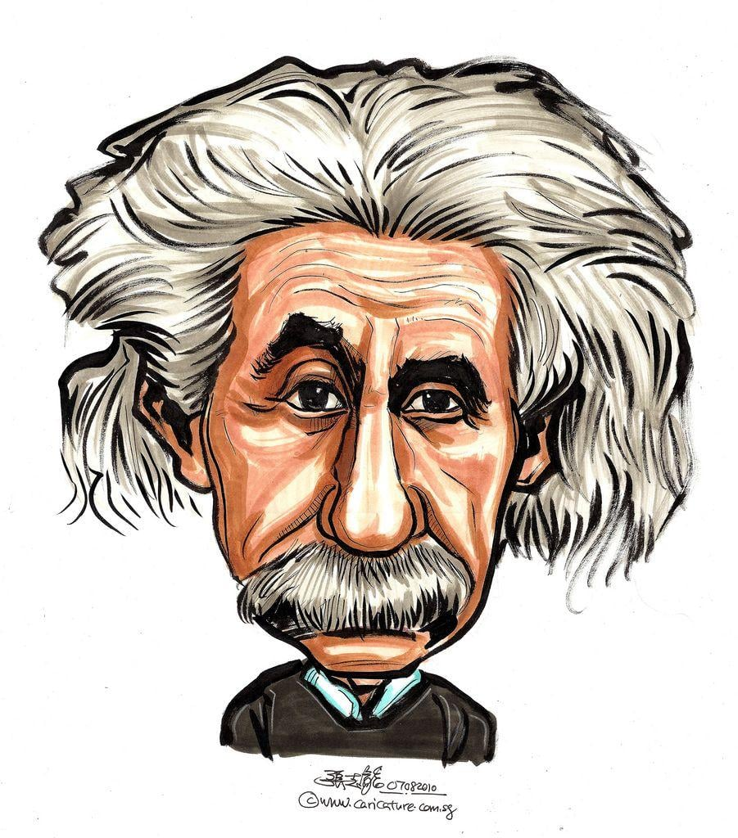
A.N.
General Knowledge Quiz
How are you doing?

Slide 14
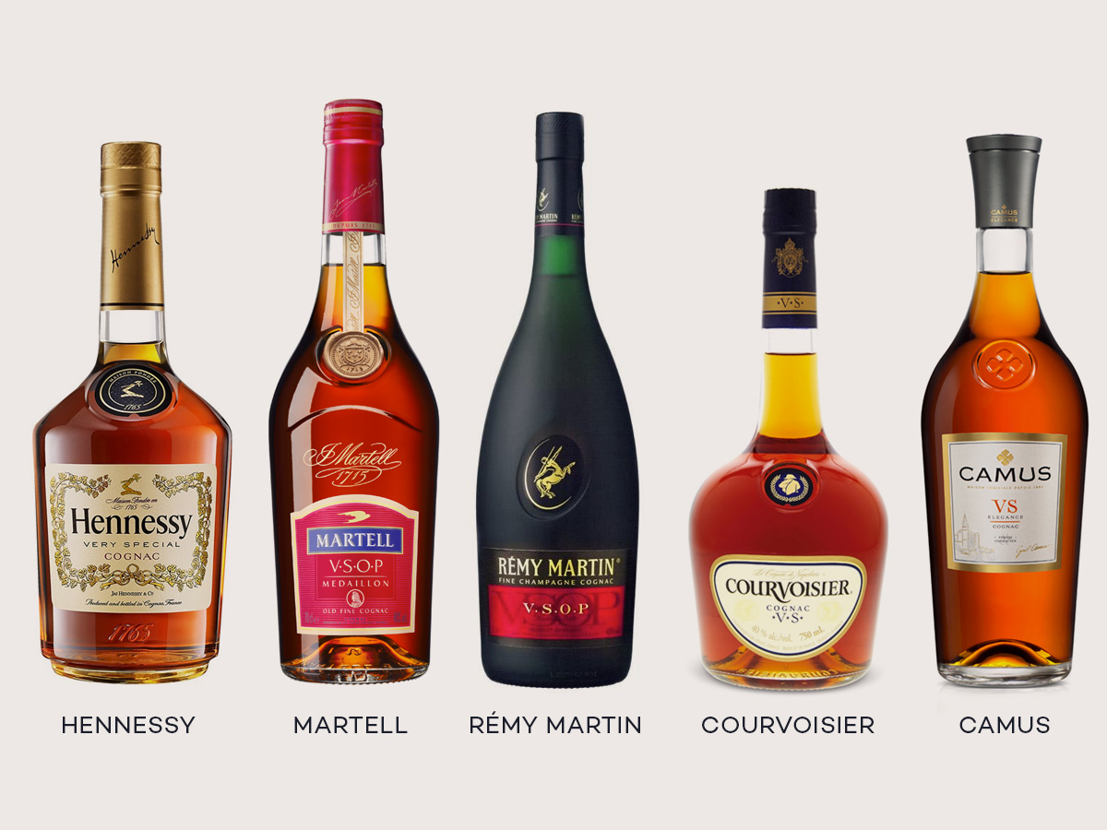
A.N.
General Knowledge Quiz
What is the difference between brandy and cognac?
Cognac must come from the Cognac region of France
Produced from white grapes grown across the Charente and Charente-Maritime departments of western France, cognac is a protected category of brandy that must meet the requirements of the appellation d’origine contrôllée (AOC) in order to bear the region’s name on its label.

Slide 15
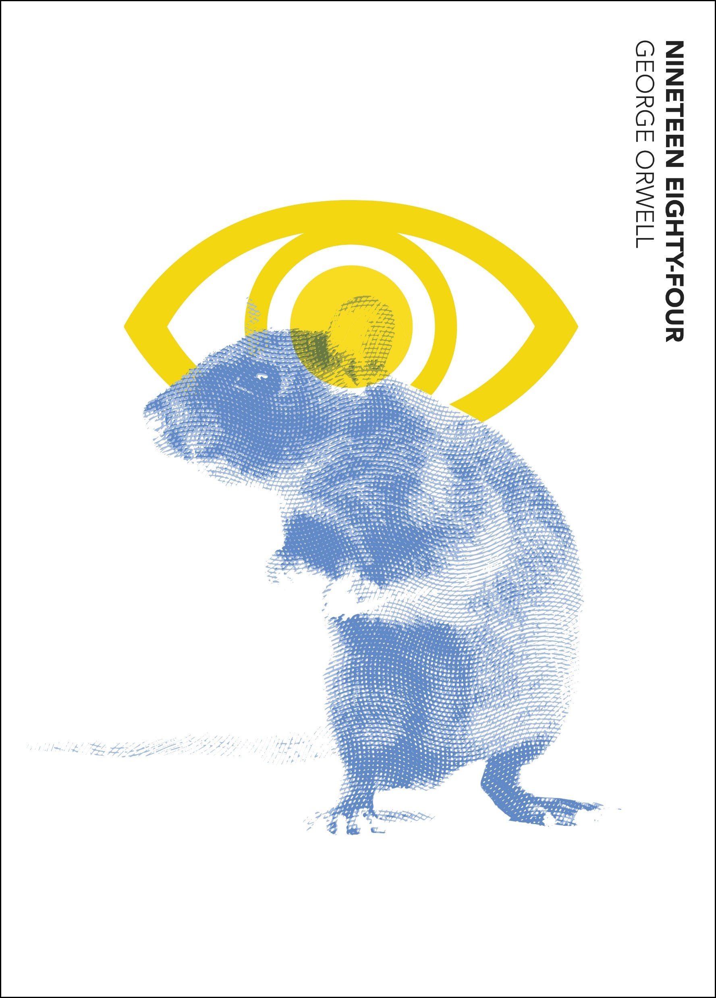
A.N.
General Knowledge Quiz
Who wrote the novel "1984"?
George Orwell
The book is set in 1984 in Oceania, one of three perpetually warring totalitarian states (the other two are Eurasia and Eastasia). Oceania is governed by the all-controlling Party, which has brainwashed the population into unthinking obedience to its leader, Big Brother.

Slide 16
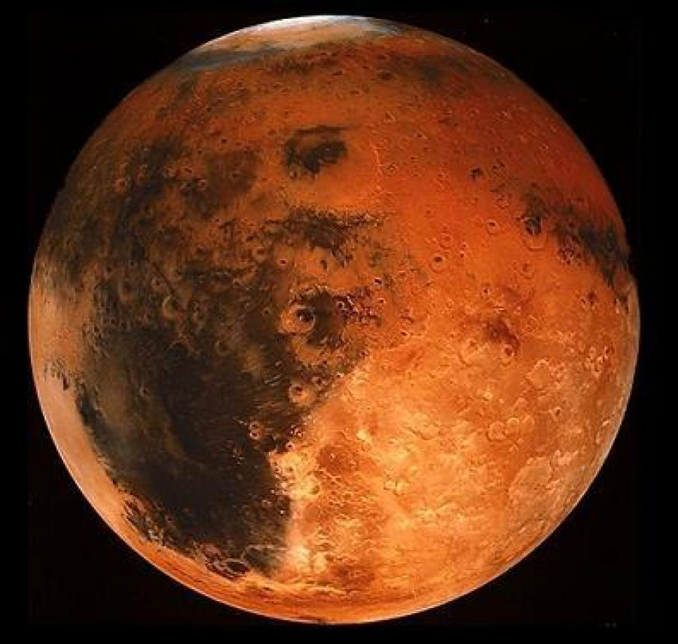
A.N.
General Knowledge Quiz
Which planet is known as the "Red Planet"?
Mars
Mars is the fourth planet from the Sun. The surface of Mars is orange-red because it is covered in iron oxide dust, giving it the nickname "the Red Planet". Mars is among the brightest objects in Earth's sky and its high-contrast albedo features have made it a common subject for telescope viewing.

Slide 17
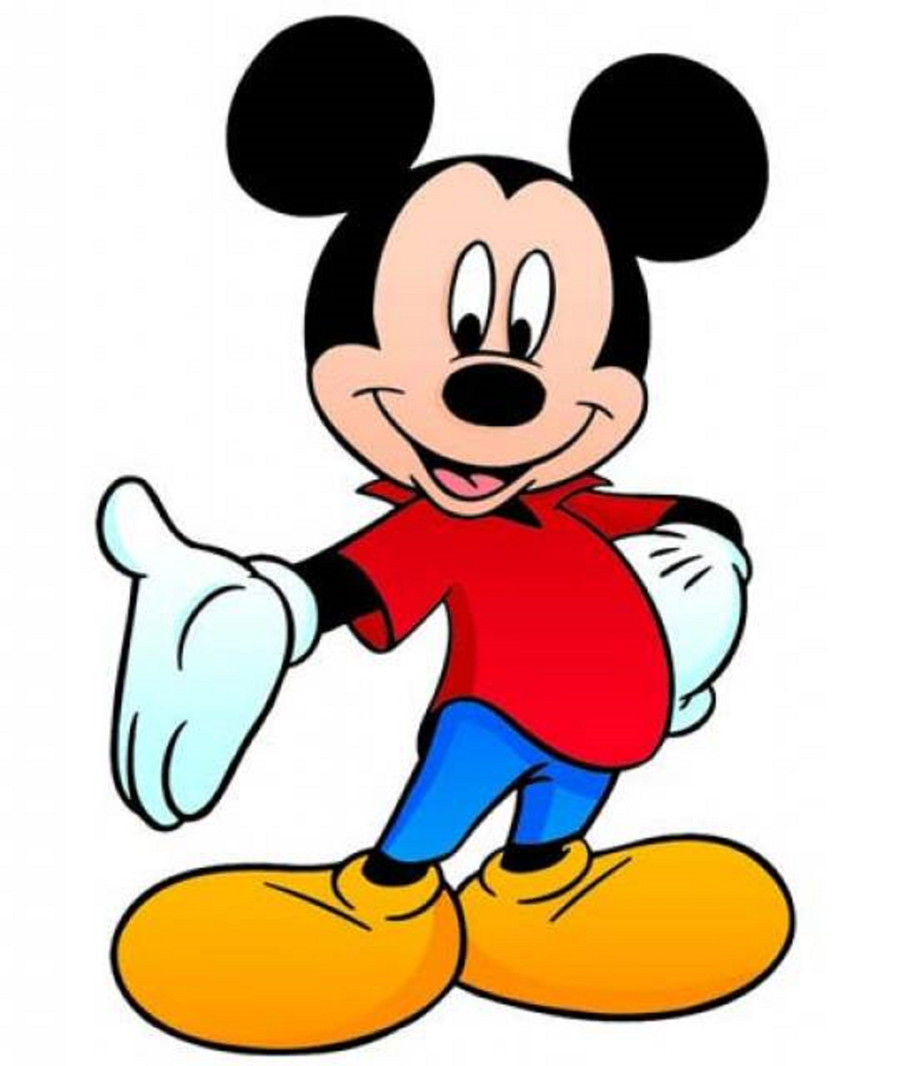
A.N.
General Knowledge Quiz
Mickey Mouse was originally named what?
Mortimer Mouse
Mortimer Mouse is an anthropomorphic mouse and Mickey Mouse's longtime rival. Portrayed as an arrogant, lecherous, yet charismatic shyster, Mortimer made his animated debut in the 1936 short Mickey's Rival, in which he vied for Minnie Mouse's affections against a jealous Mickey.

Slide 18
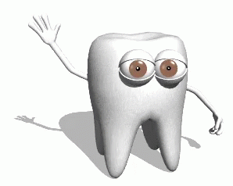
A.N.
General Knowledge Quiz
How many teeth does an adult human have? a) 28 b) 32
32
Teeth are made up of different layers — enamel, dentin, pulp, and cementum. Enamel, which is the hardest substance in the body, is on the outside of the tooth. The second layer is dentin, which is softer than enamel, and the deepest layer inside the tooth is pulp, which consists of nerves and blood vessels.

Slide 19
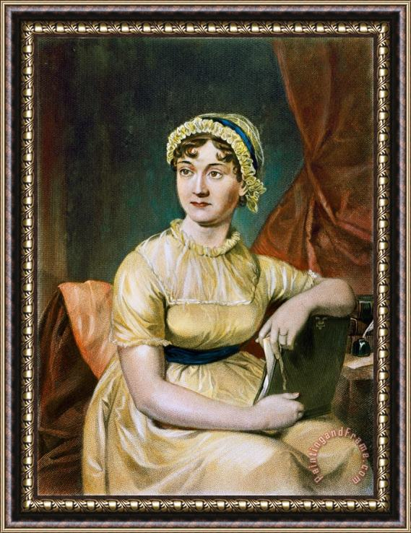
A.N.
General Knowledge Quiz
Who wrote the novel "Pride and Prejudice"?
Jane Austen
Jane Austen was an English novelist known primarily for her six novels, which implicitly interpret, critique, and comment upon the British landed gentry at the end of the 18th century. She was born in 1775 and died at age 41 years

Slide 20
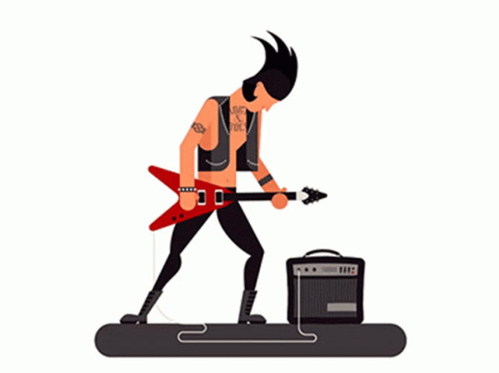
A.N.
General Knowledge Quiz
How many strings does a standard guitar have? Four; Six or Seven
Six
Well, a guitar typically has six strings, but there are also 12-string, 18-string, and even 21-string guitars.

Slide 21
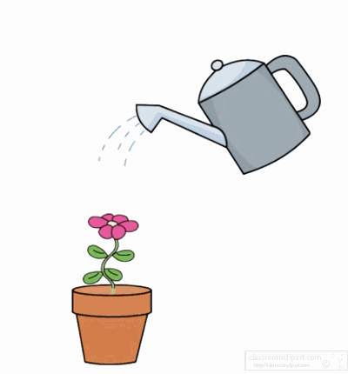
A.N.
General Knowledge Quiz
What is the biggest animal in the world? a) African Elephant b) Blue Whale c) Saltwater Croc d) White Rhino
Blue Whale
The blue whale is a marine mammal and a baleen whale. Reaching a maximum confirmed length of 29.9 meters and weighing up to 199 tonnes, it is the largest animal known ever to have existed.

Slide 22
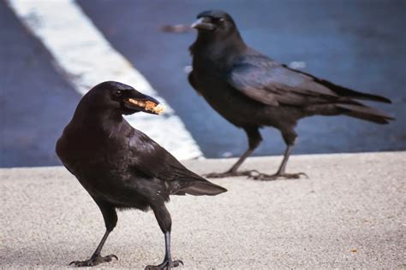
A.N.
General Knowledge Quiz
What is a group of
crows called? a) A pack b) A flock c) A murder d) A caw
A Murder
Crows are omnivorous scavengers and will eat just about anything — insects, seeds, fruits, eggs, and small animals. Historically, they would often appear on battlefields, in cemeteries, and after disasters to snack on the tasty carrion we humans left lying around.

Slide 23
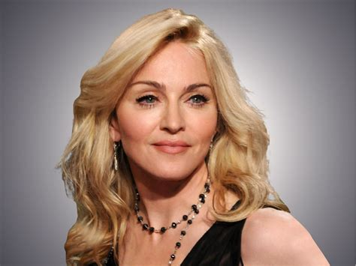
A.N.
General Knowledge Quiz
Who sang the 1980s hit
"Like a Virgin"? a) Madonna b) Cher c) Cyndi Lauper d) Tina Turner
Madonna
Madonna Louise Ciccone (born 1958) is an American singer, songwriter, and actress. Known as the "Queen of Pop", she has been widely recognized for her continual reinvention and versatility in music production, songwriting and visual presentation.

Slide 24
A.N.
General Knowledge Quiz
What word describes a word that spells the same backward and forwards? a) Homonym b) Synonym c) Palindrome
Palindrome
Derived from Greek roots that literally mean “running back” (palin is “again, back,” and dromos, “running.”) The word appears to have been created in English based on these roots in the early 1600s.

Slide 25
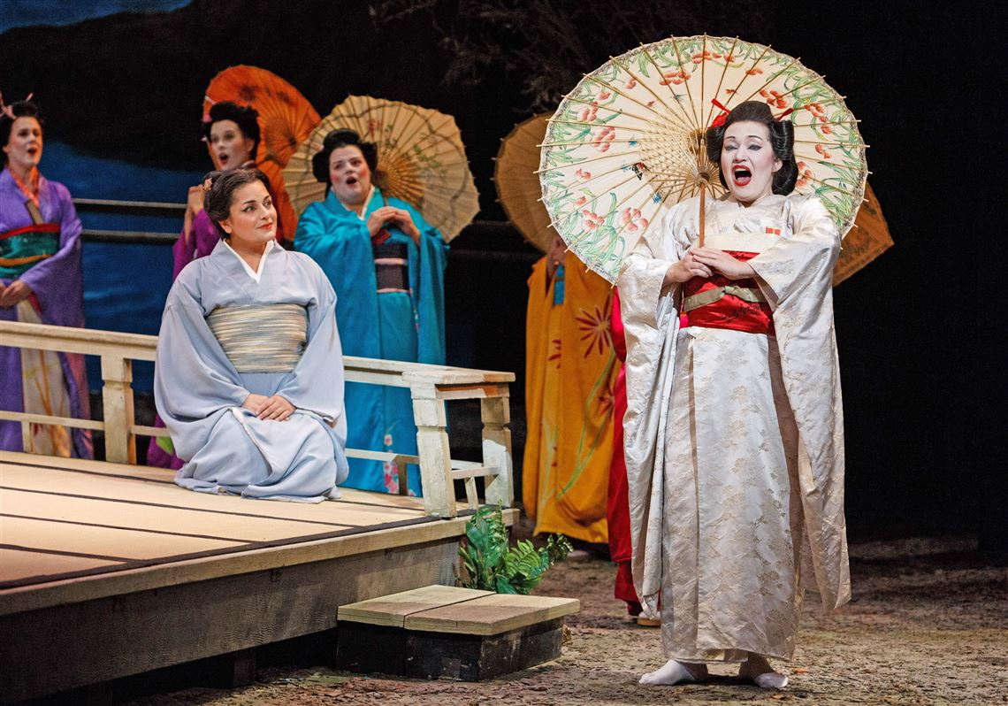
A.N.
General Knowledge Quiz
Who composed the opera "Madame Butterfly"? a) Mozart b) Beethoven c) Bach d) Puccini
Giacomo Puccini
Based on the short story "Madame Butterfly" by John Luther Long, which in turn was based on stories told to Long by his sister Jennie Correll and on the semi-autobiographical 1887 French novel Madame Chrysanthème by Pierre Loti.

Slide 26
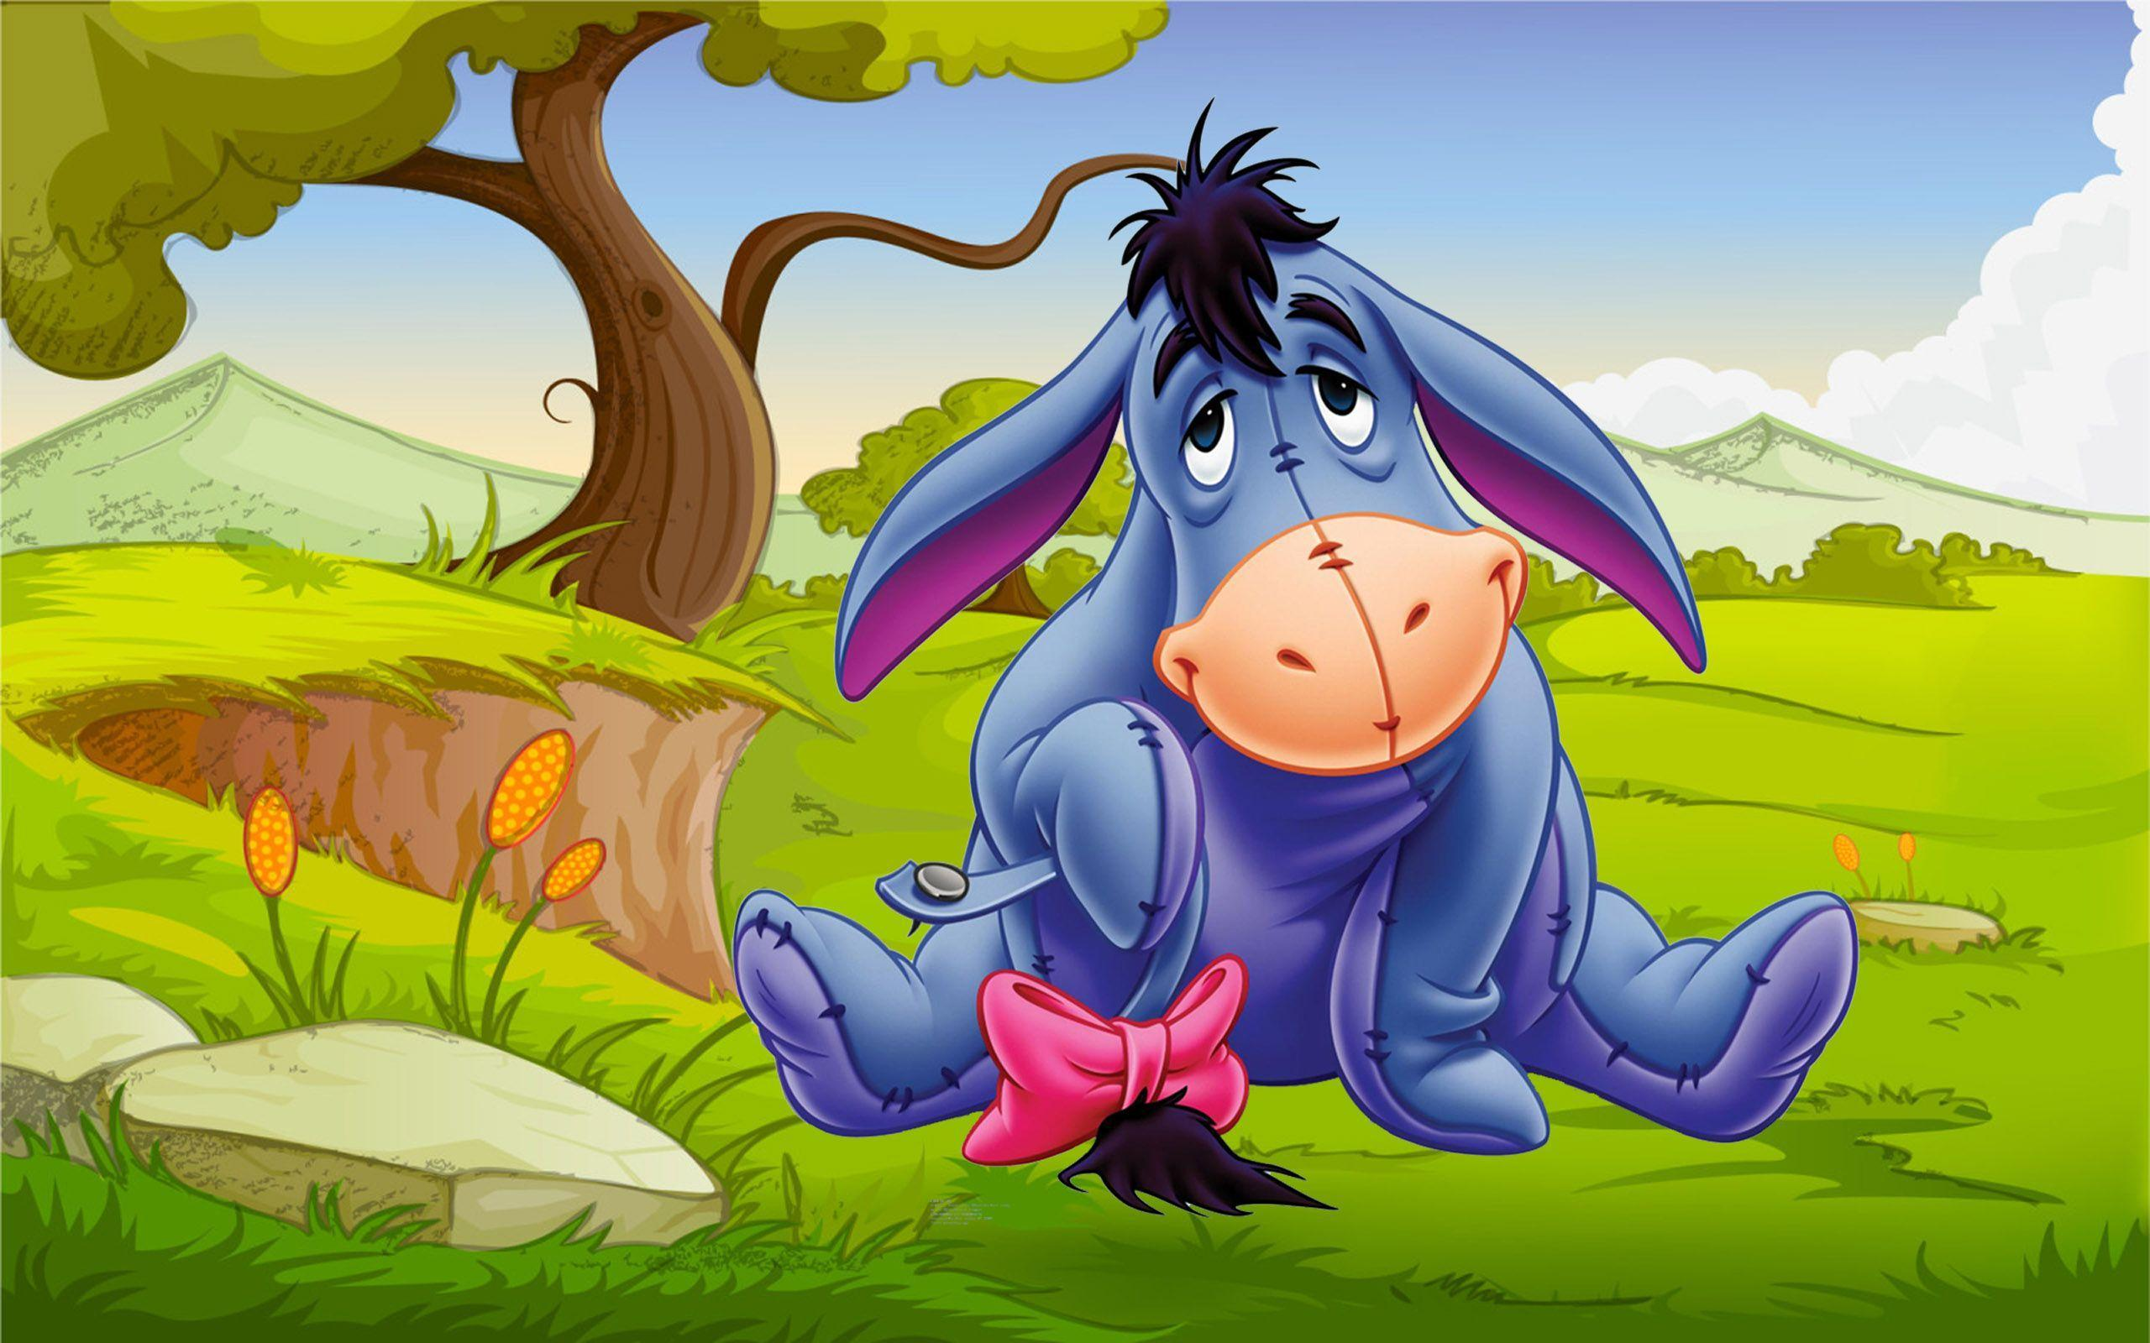
A.N.
General Knowledge Quiz
What is the name of the donkey in Winnie The Pooh?
Eeyore
Eeyore is a fictional character in the Winnie-the-Pooh books by A. A. Milne. He is generally characterized as a pessimistic, gloomy, depressed, anhedonic, old grey stuffed donkey who is a friend of the title character, Winnie-the-Pooh.

Slide 27
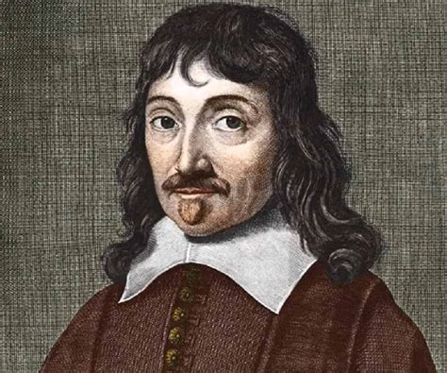
A.N.
General Knowledge Quiz
Who first said, "I think, therefore I am"?
a) Plato b) Aristotle
c) Descartes d) Socrates
Descartes
René Descartes March 1596 – February 1650 was a French philosopher, scientist, and mathematician,

Slide 28
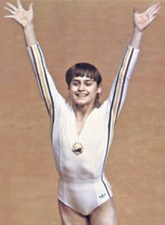
A.N.
General Knowledge Quiz
Who was the first gymnast to be awarded a perfect score of 10.0 at the Olympic Games?
Nadia Comăneci
Nadia Comăneci. Nadia Elena Comăneci Conner (born November 12, 1961) is a Romanian retired gymnast and a five-time Olympic gold medalist, all in individual events. In 1976, at the age of 14, Comăneci was the first gymnast to be awarded a perfect score of 10.0 at the Olympic Games.

Slide 29
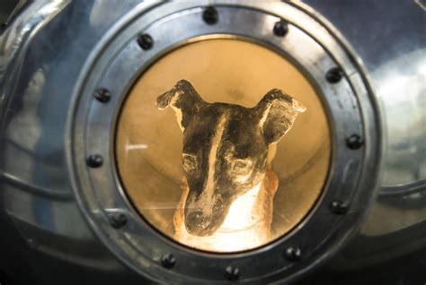
A.N.
General Knowledge Quiz
What was the name of the first dog in space?
Laika
Laika was a Soviet space dog who was one of the first animals in space and the first to orbit the Earth. A stray mongrel from the streets of Moscow, she flew aboard the Sputnik 2 spacecraft, launched into low orbit on 3 November 1957.

Slide 30
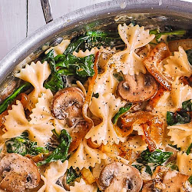
A.N.
General Knowledge Quiz
What type of pasta is shaped like a butterfly
Farfalle
commonly known as bow-tie pasta, ribbon pasta or butterfly pasta. The name is derived from the Italian word farfalle (butterflies).

Slide 31
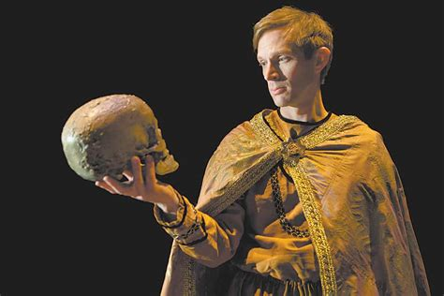
A.N.
General Knowledge Quiz
Which Shakespeare play features the line “To be, or not to be”?
Hamlet
To be, or not to be, that is the question:
Whether 'tis nobler in the mind to suffer
The slings and arrows of outrageous fortune, Or to take arms against a sea of troubles And by opposing end them. To die—to sleep,

Slide 32
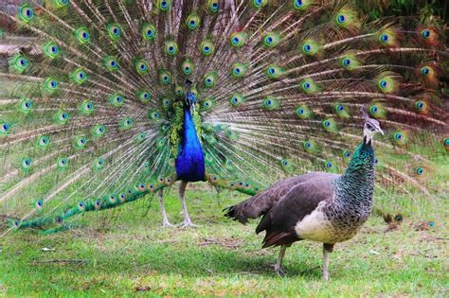
A.N.
General Knowledge Quiz
What is a female peacock called?
Peahens
Peafowl is a common name for two bird species. Male peafowl are referred to as peacocks, and female peafowl are referred to as peahens.

Slide 33
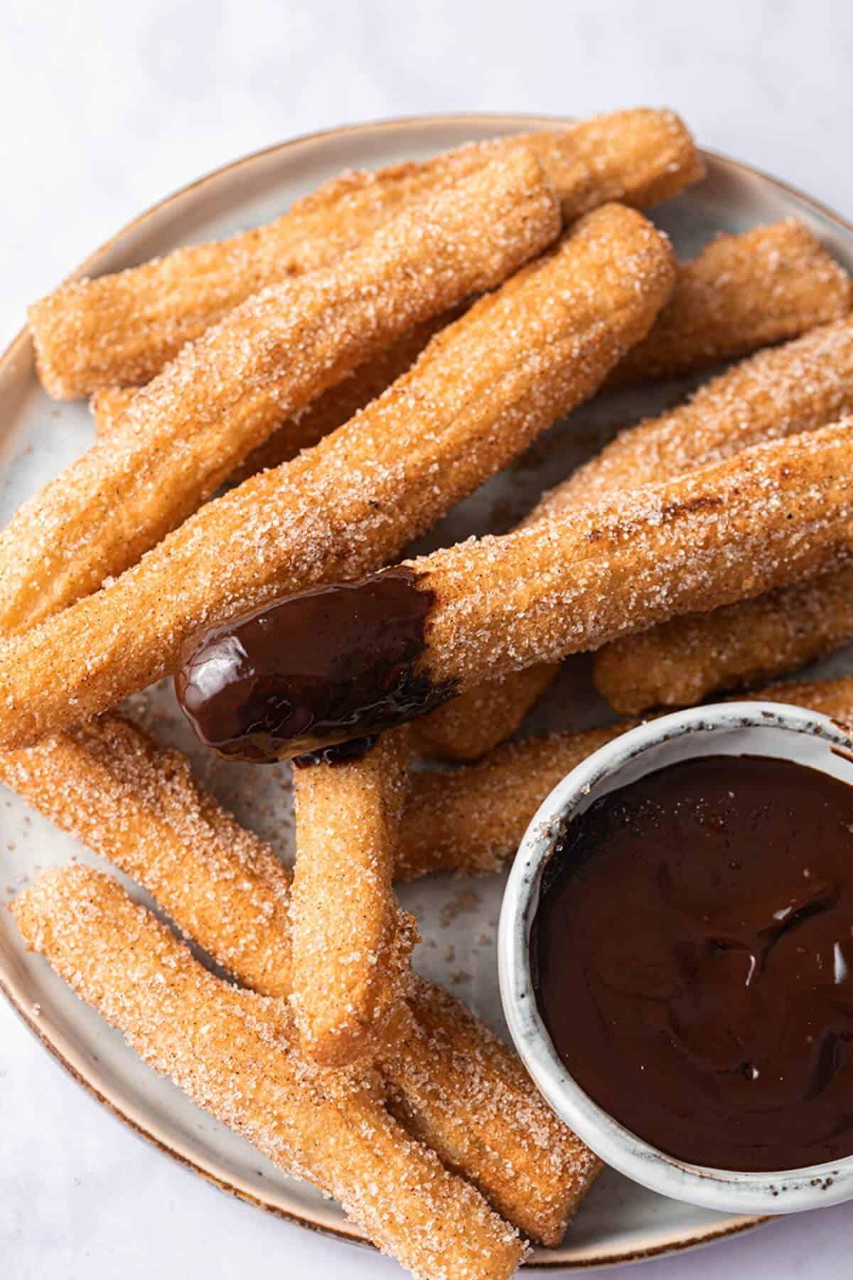
A.N.
General Knowledge Quiz
What type of deep fried dough sticks is particularly popular in Spain?
Churros
A churro is a type of fried dough from Spanish and Portuguese cuisine, made with choux pastry dough piped into hot oil with a piping bag and large closed star tip or similar shape.

Slide 34
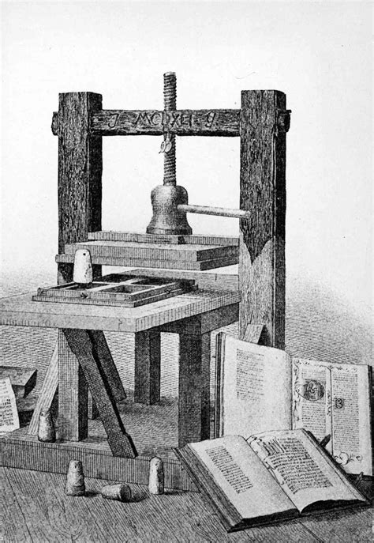
A.N.
General Knowledge Quiz
Who invented the printing press?
Johannes Gutenberg
Johannes Gensfleisch zur Laden zum Gutenberg was a German inventor and craftsman who introduced letterpress printing to Europe with his movable-type printing press.

Slide 35
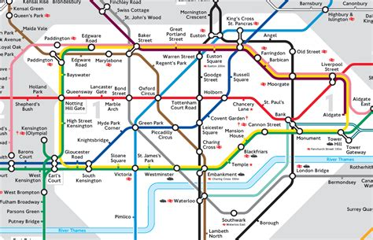
A.N.
General Knowledge Quiz
In which London train station is Platform 9 ¾ located in Harry Potter?
Kings Cross Station
King's Cross railway station, also known as London King's Cross, is a railway terminus in the London Borough of Camden, on the edge of Central London. It is in the London station group, one of the busiest stations in the United Kingdom.

Slide 36
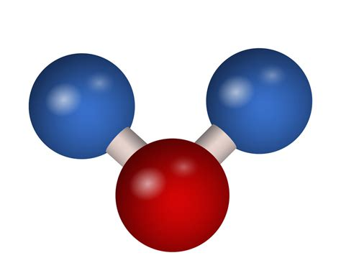
A.N.
General Knowledge Quiz
What gas is in sparkling water?
Carbon dioxide
Carbon dioxide is a chemical compound with the chemical formula CO₂. It is made up of molecules that each have one carbon atom covalently double bonded to two oxygen atoms.

Slide 37
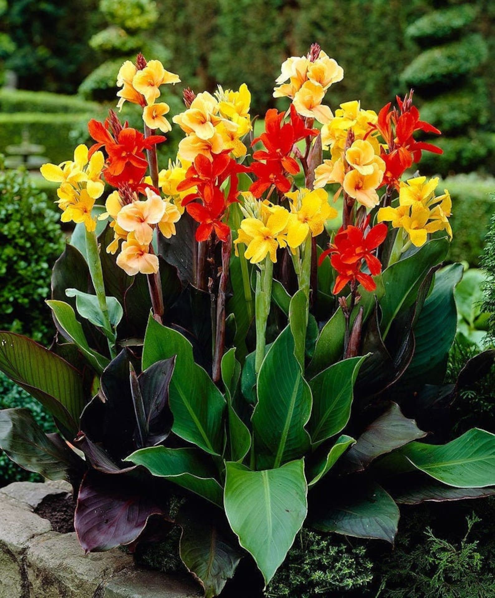
A.N.
General Knowledge Quiz
What is the name of this plant?
Canna Lillies
Cannas are perennials which grow from thick underground roots (or rhizomes). The flowers grow up through tightly furled leaf bases or ‘false stems’. The foliage may be green, blue-green, purple, burgundy, bronze or striped.

Slide 38
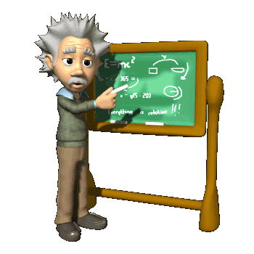
A.N.
General Knowledge Quiz
Still doing well?

Slide 39
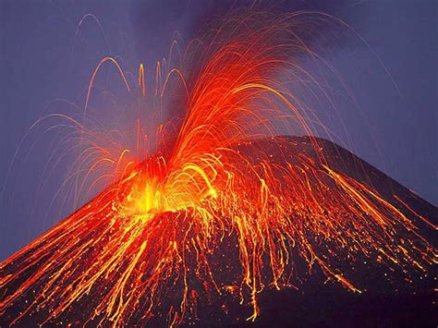
A.N.
General Knowledge Quiz
Which volcano erupted and destroyed Pompeii?
Mount Vesuvius
he city of Pompeii is famous because it was destroyed in 79 CE when a nearby volcano, Mount Vesuvius, erupted, covering it in at least 6 metres of ash and other volcanic debris. The city's quick burial preserved it for centuries before its ruins were discovered in the late 16th century.

Slide 40
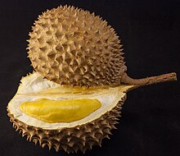
A.N.
General Knowledge Quiz
What is the name of this fruit
Durian
Named in some regions as the "king of fruits", the durian is distinctive for its large size, strong odour, and thorn-covered rind. The fruit can grow as large as 30 cm long and 15 cm in diameter, and it typically weighs 1 to 3 kg. The persistence of its odour, which may linger for several days, has led some hotels and public transportation services in Southeast Asia to ban the fruit.

Slide 41
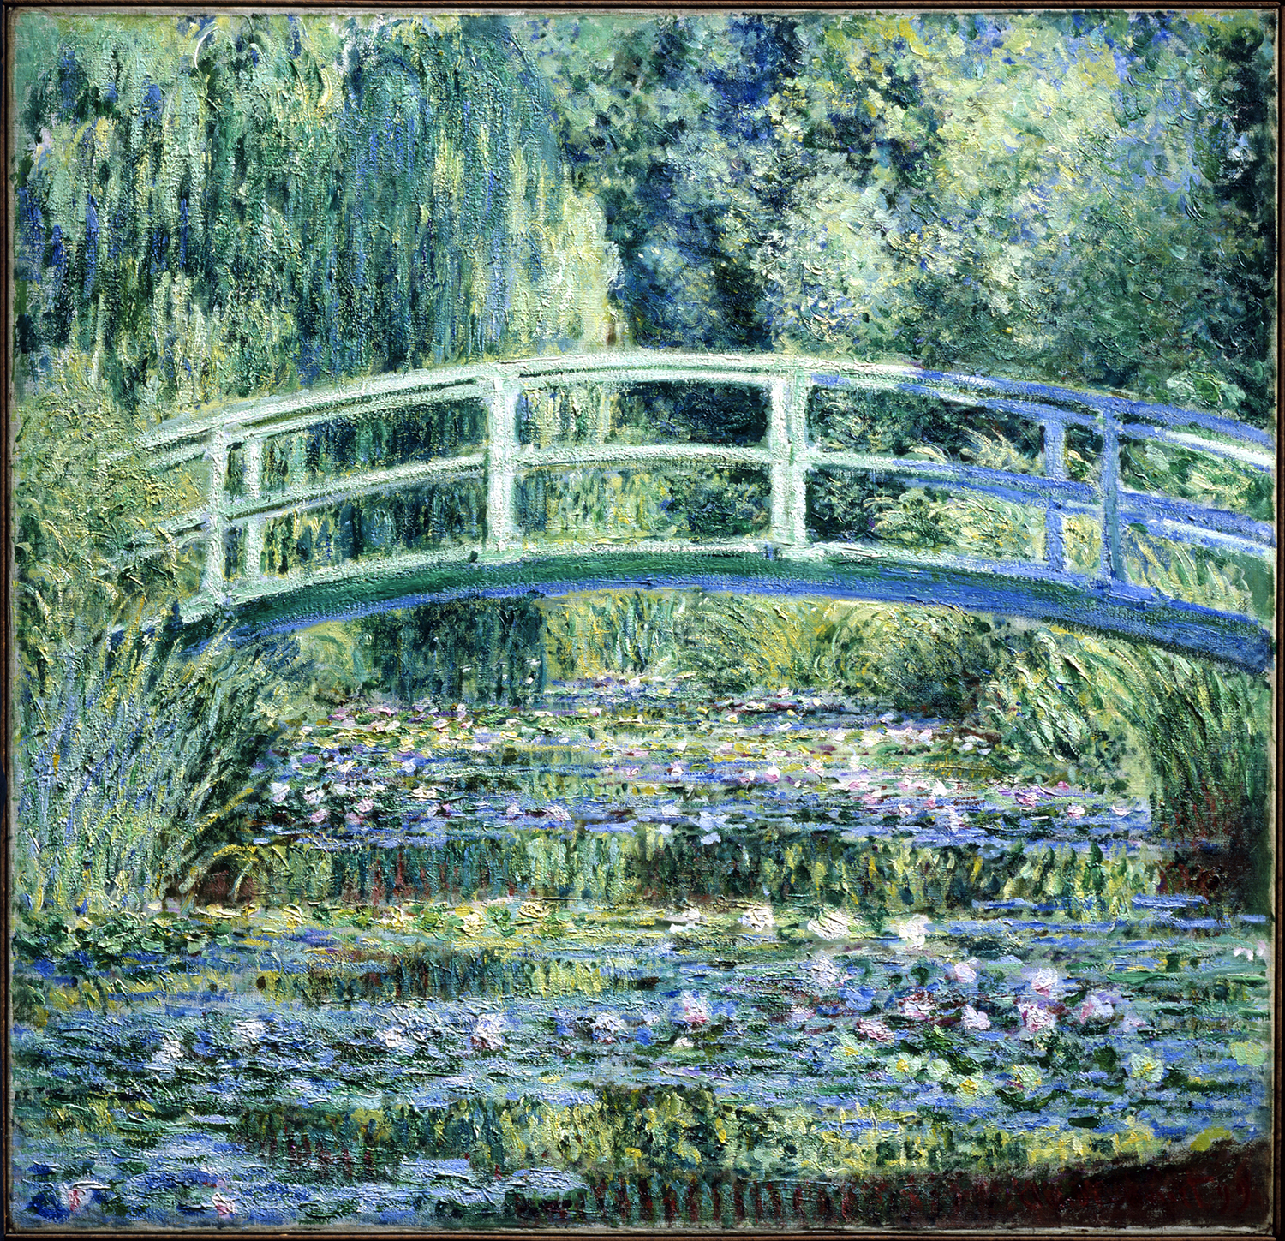
A.N.
General Knowledge Quiz
Which French artist is known for painting water lillies?
Claude Monet
Oscar-Claude Monet (1840-1926) was a French painter and founder of impressionist painting who is seen as a key precursor to modernism, especially in his attempts to paint nature as he perceived it.

Slide 42
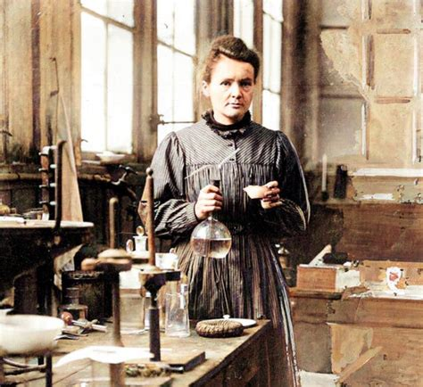
A.N.
General Knowledge Quiz
Who was the first woman to win a Nobel Prize?
Marie Curie
Polish and French physicist and chemist (1867–1934). Maria Salomea Skłodowska-Curie, known simply as Marie Curie, was a Polish and naturalised-French physicist and chemist who conducted pioneering research on radioactivity

Slide 43
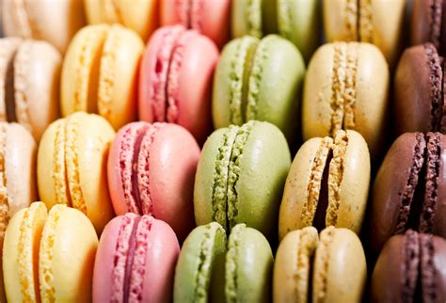
A.N.
General Knowledge Quiz
What country are Macarons from?
France
A macaron or French macaroon is a sweet meringue-based confection made with egg white, icing sugar, granulated sugar, almond meal, and often food colouring. Since the 19th century, a typical Parisian-style macaron is a sandwich cookie filled with a ganache, buttercream or jam.

Slide 44
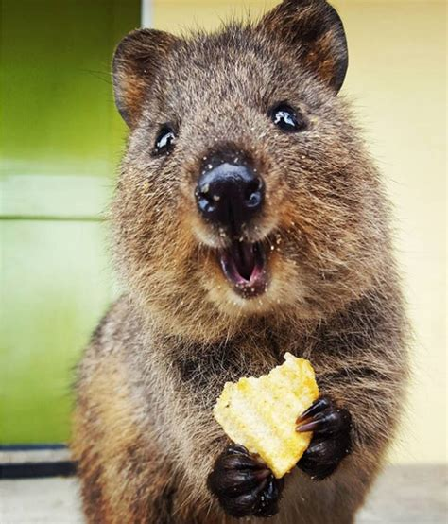
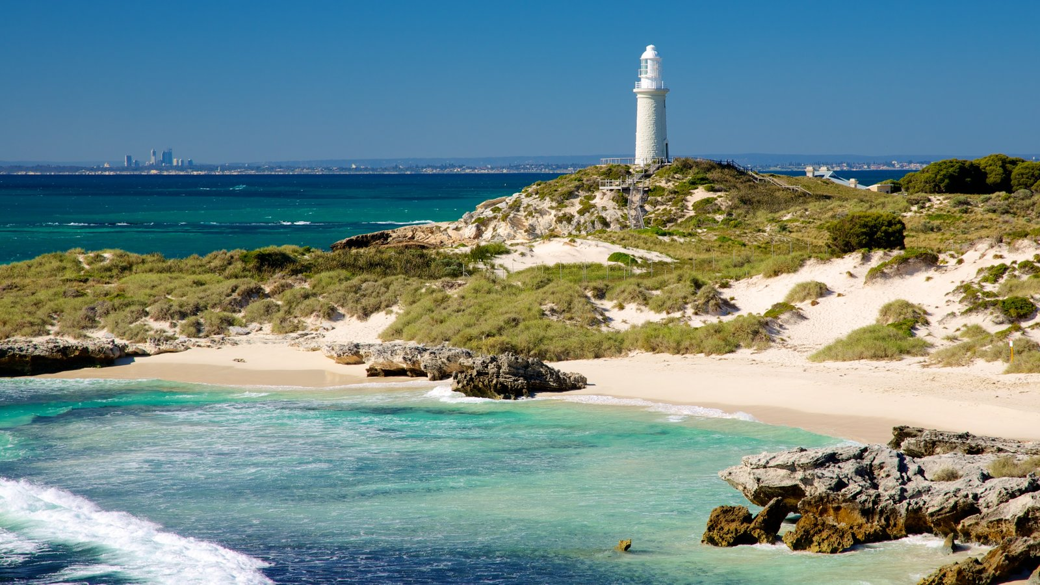
A.N.
General Knowledge Quiz
Which native Australian animal is Rottnest island known for?
Quokka
The quokka is a small macropod about the size of a domestic cat. Like other marsupials in the macropod family, the quokka is herbivorous and mainly nocturnal.

Slide 45
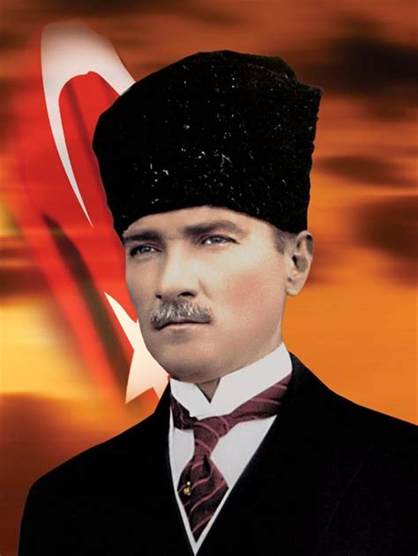
A.N.
General Knowledge Quiz
Who is the founding father of the Republic of Turkey?
Mustafa Kemal Ataturk
He was a Turkish field marshal, revolutionary statesman, author, and the founding father of the Republic of Turkey, serving as its first president from 1923 until his death in 1938. He undertook reforms, which modernized Turkey into a secular, industrializing nation.

Slide 46
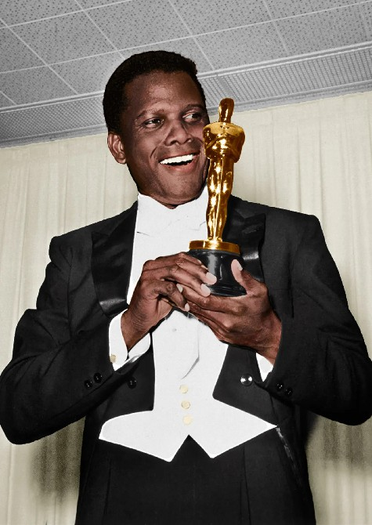
A.N.
General Knowledge Quiz
Who was the first African American to win an Oscar for Best Actor?
Sidney Poitier
Sidney Poitier (1927 – 2022) was a Bahamian and American actor, film director, and diplomat. In 1964, he was the first Black actor and first Bahamian to win the Academy Award for Best Actor.

Slide 47
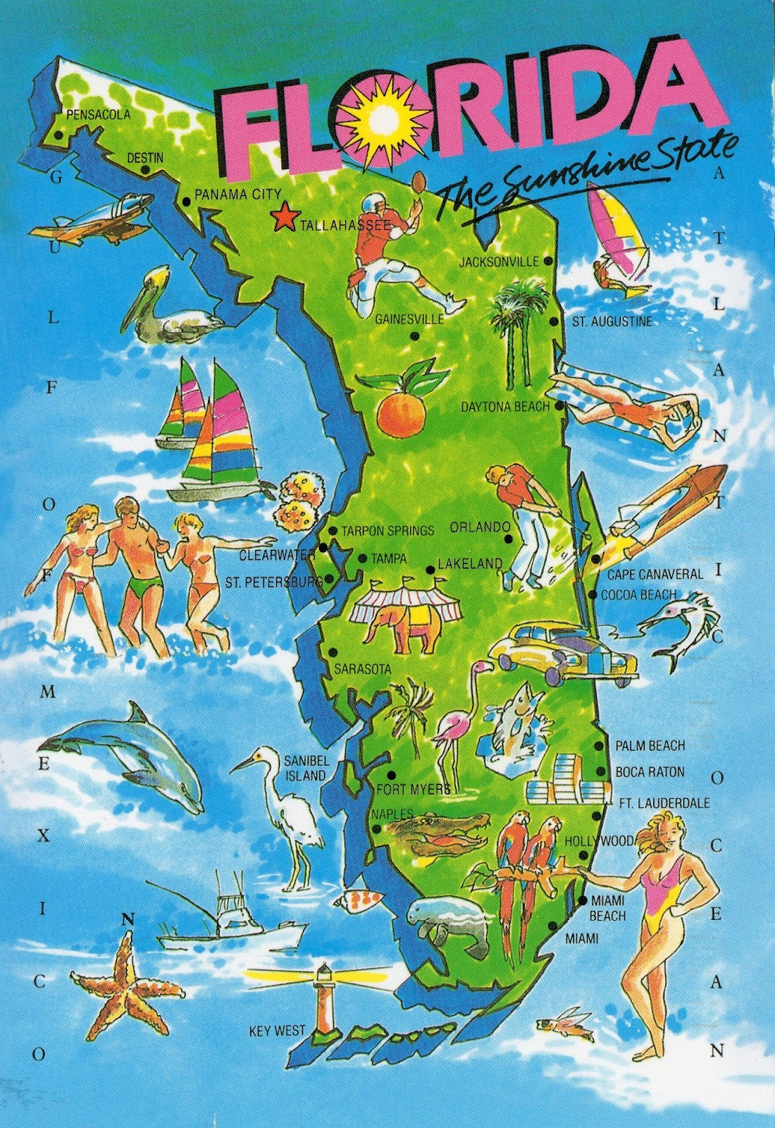
A.N.
General Knowledge Quiz
Melbourne is a city in Florida.
True or False
True
Melbourne is a city in Brevard County, Florida, USA. It is located 72 miles southeast of Orlando and 175 miles northwest of Miami. As of the 2020 Decennial Census, there was a population of 84,678.

Slide 48
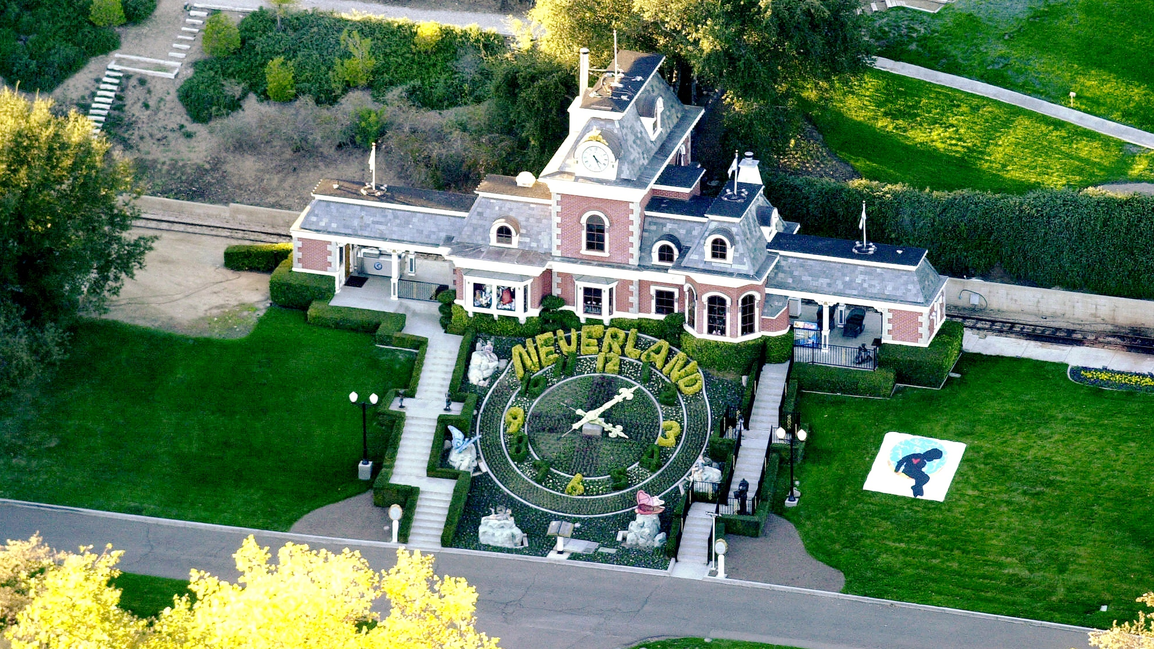
A.N.
General Knowledge Quiz
Which singer lived in a ranch called Neverland?
Michael Jackson
Sycamore Valley Ranch, formerly Neverland Ranch. From 1988 to 2005, it was the home and the private amusement park of the American singer Michael Jackson.

Slide 49
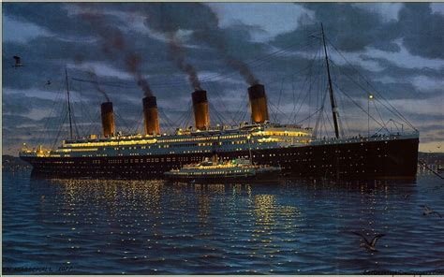
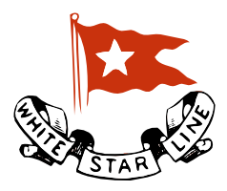
A.N.
General Knowledge Quiz
Which company operated the HMS Titanic?
White Star Line.
The White Star Line was a British shipping line. Founded out of the remains of a defunct packet company, it gradually rose up to become one of the most prominent shipping companies in the world, providing passenger and cargo services between the British Empire and the United States.

Slide 50
A.N.
General Knowledge Quiz
What is the name of this plant? Some species are edible
Nasturtium
Nasturtium is an annual flower that grows in beautiful bright orange and yellow, and with their flowing tendrils, make a great addition to any garden. Nasturtiums are also edible and makes a beautiful topping to a salad?

Slide 51
A.N.
General Knowledge Quiz
What was the name of Christopher Columbus’ ship when he discovered the New World?
Santa Maria
La Santa María de la Inmaculada Concepción, or La Santa María, originally La Gallega, was the largest of the three ships used by Christopher Columbus in his first voyage across the Atlantic Ocean in 1492.

Slide 52
A.N.
General Knowledge Quiz
In which city were the first Olympics in the Southern Hemisphere held?
Melbourne
The 1956 Summer Olympics, officially known as the Games of the XVI Olympiad, were an international multi-sport event held in Melbourne, Victoria, Australia, from 22 November to 8 December 1956, with the exception of the equestrian events, which were held in Stockholm, Sweden, in June 1956..

Slide 53
A.N.
General Knowledge Quiz
Which cheese from Cyprus is often described as squeaky?
Halloumi
A cheese, of Cypriot origin, made from a mixture of goat's and sheep's milk, and sometimes also cow's milk. Its texture is described as squeaky. It has a high melting point and so can easily be fried or grilled, a property that makes it a popular meat substitute.

Slide 54
A.N.
General Knowledge Quiz
Who wrote The Lord of the Rings?
J. R. R. Tolkien
The Lord of the Rings: The Fellowship of the Ring is a 2001 epic fantasy adventure film directed by Peter Jackson from a screenplay by Fran Walsh, Philippa Boyens, and Jackson, based on 1954's The Fellowship of the Ring, the first volume of the novel The Lord of the Rings by J. R. R. Tolkien.

Slide 55
A.N.
General Knowledge Quiz
The End

Slide 56
A.N.
General Knowledge Quiz
The End

