Slide 1
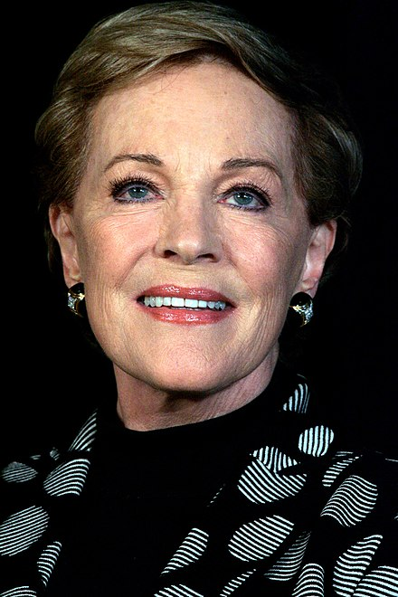
Are you a quiz wizz?
Who is this British actress?
Julie Andrews
English actress, singer, and author. She has garnered numerous accolades throughout her career spanning over seven decades.

Slide 2
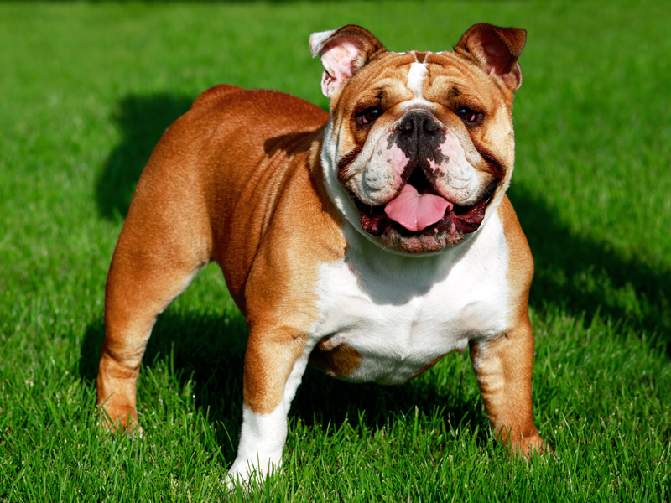
Are you a quiz wizz?
What kind of dog is this?
British Bulldog

Slide 3
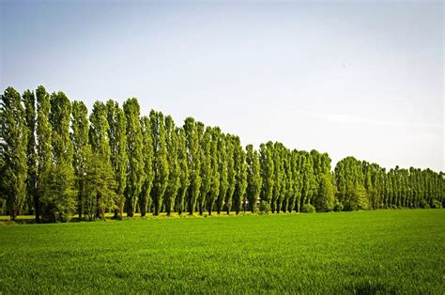
Are you a quiz wizz?
What kind of tree are these?
Poplar tree
Populus is a genus of 25–30 species of deciduous flowering plants in the family Salicaceae, native to most of the Northern Hemisphere.

Slide 4
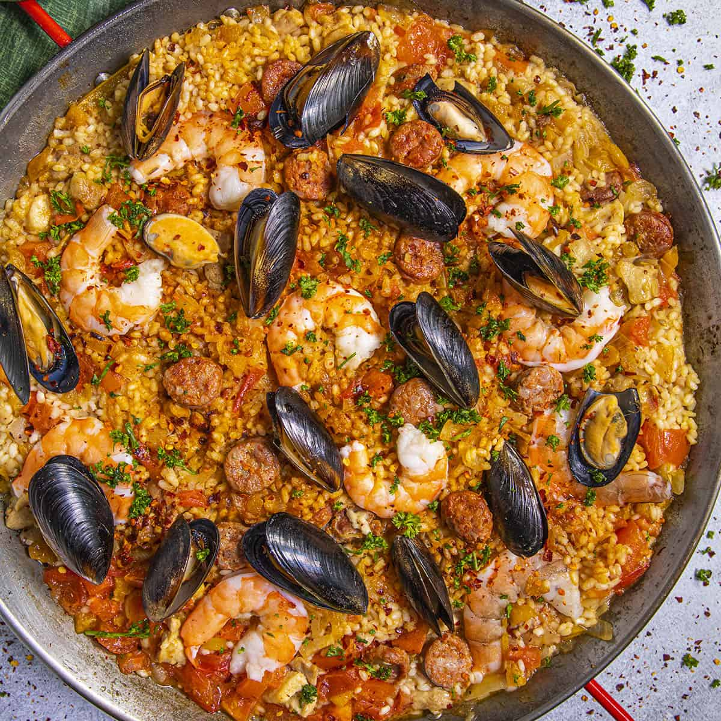
Are you a quiz wizz?
Paella is a popular dish of which European country?
Spain
Paella is a rice dish originally from the Valencian Community. Paella is regarded as one of the community's identifying symbols.

Slide 5
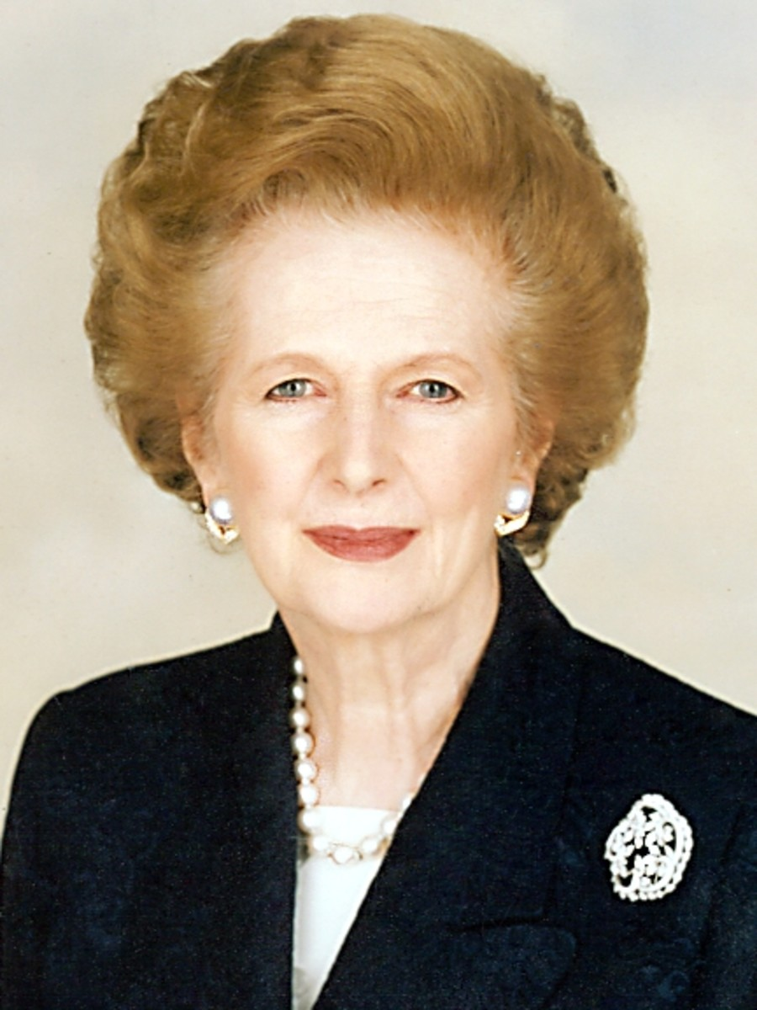
Are you a quiz wizz?
Who is this British Politician?
Margaret Thatcher
Conservative politician who served as Prime Minister of the United Kingdom from 1979 to 1990 and Leader of the Conservative Party from 1975 to 1990.

Slide 6
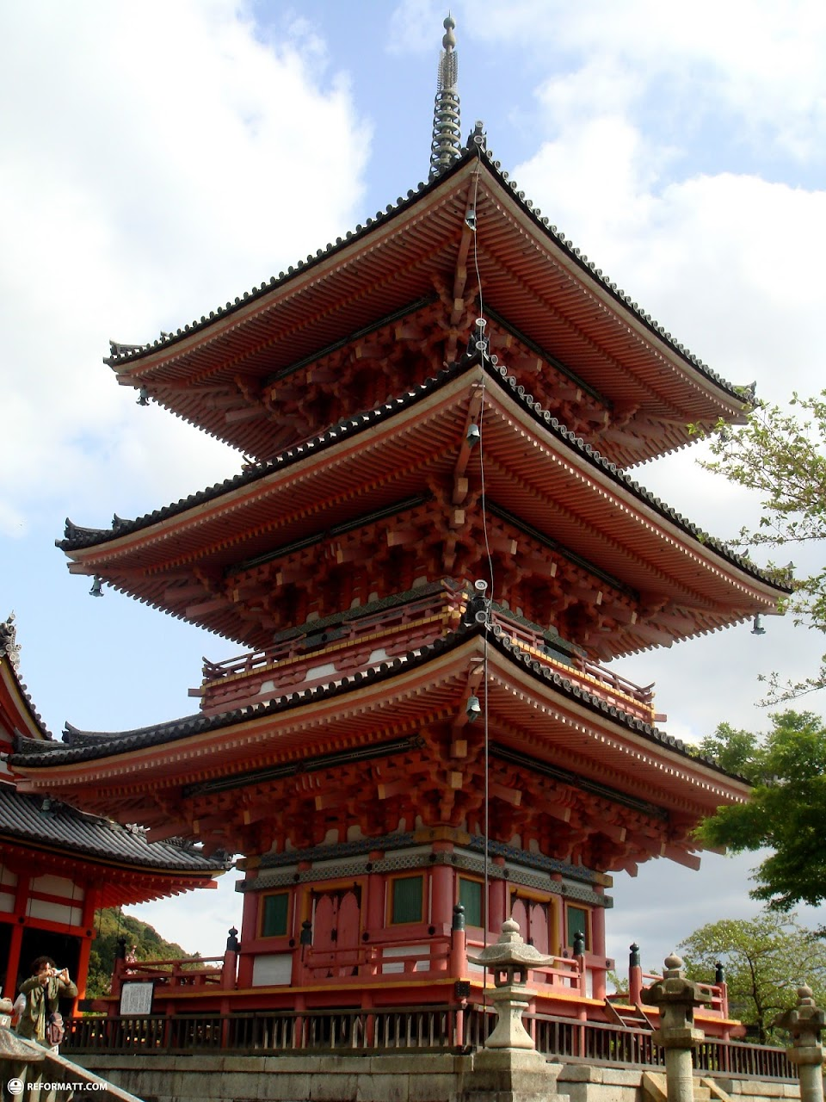
Are you a quiz wizz?
Kiyomizu Is The Most Famous Buddhist Temple In what country?
Japan
Buddist temple in eastern Kyoto which was founded in the year 778.

Slide 7
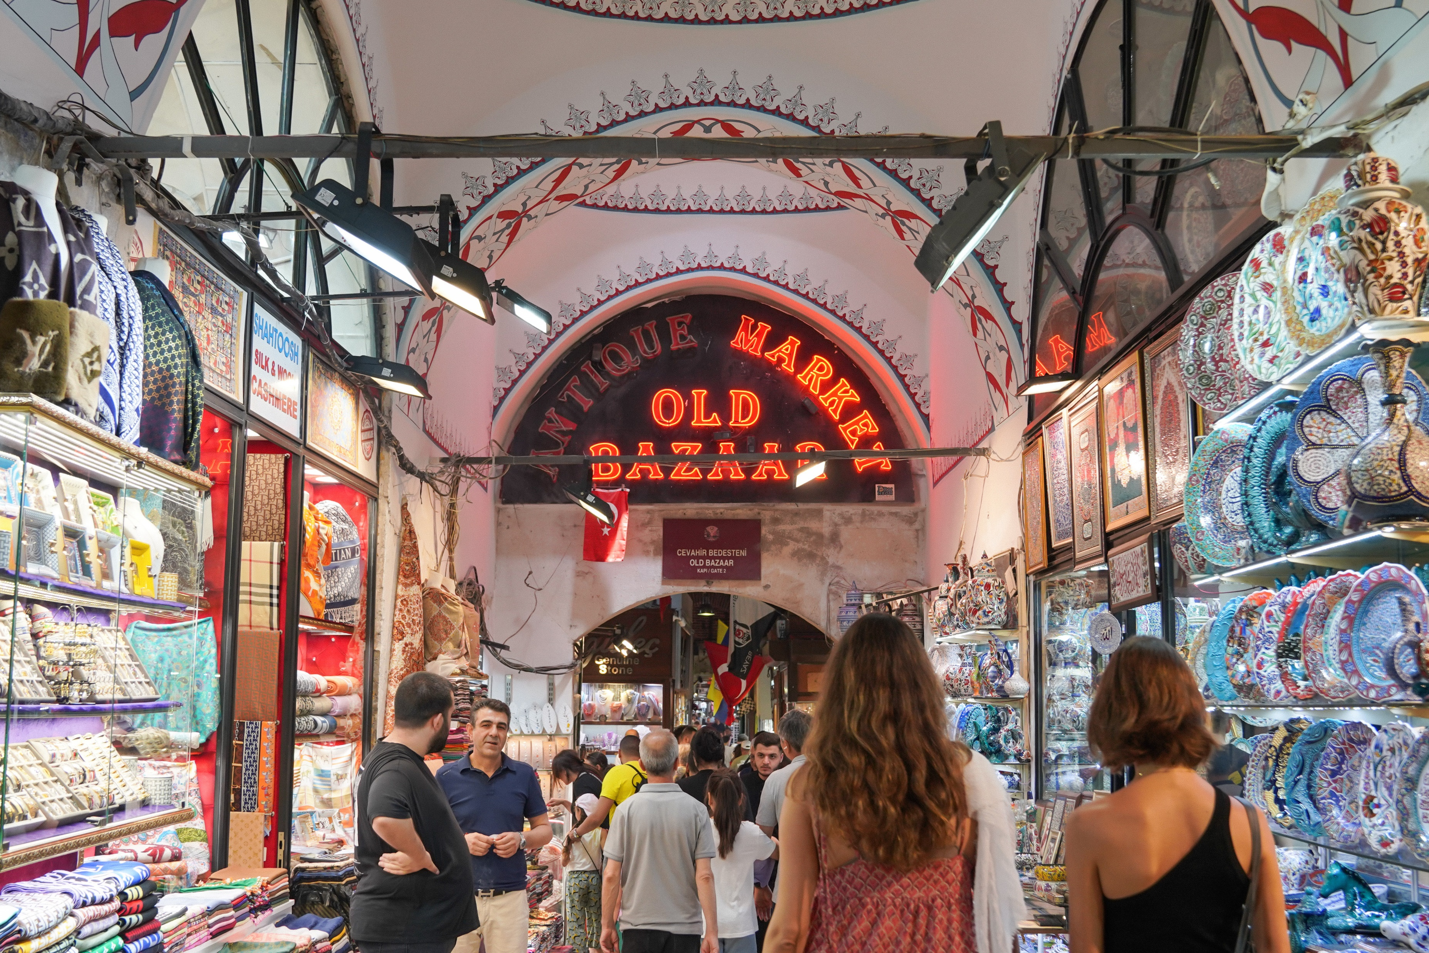
Are you a quiz wizz?
This is a famous market in which city?
Istanbul
One of the largest and oldest covered markets in the world, with 61 covered streets and over 4,000 shops.

Slide 8
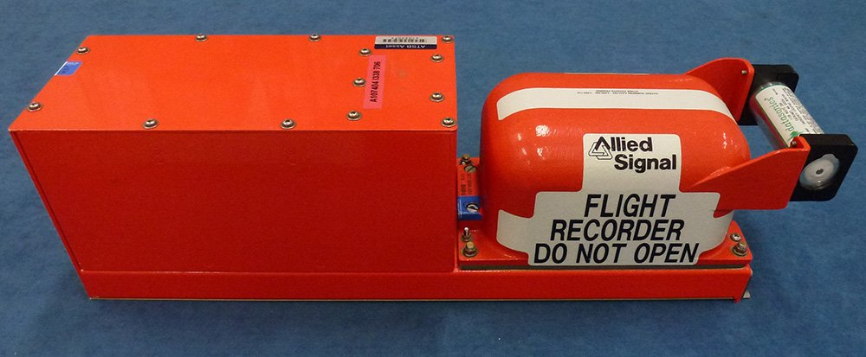
Are you a quiz wizz?
What was the nationality of the inventor of the aeroplane black box?
Australian
It was invented by Australian scientist Dr David Warren, who lost his own father to an aircraft tragedy in 1934 when the Miss Hobart crashed into the Bass Strait.

Slide 9
Are you a quiz wizz?
What international company is this the logo?
Starbucks
When Starbucks launched in 1971, the founders wanted a logo that evoked coffee's seductive aroma and lore. Inspired by an old Norse woodcut, they chose a two-tailed siren from Greek mythology.

Slide 10
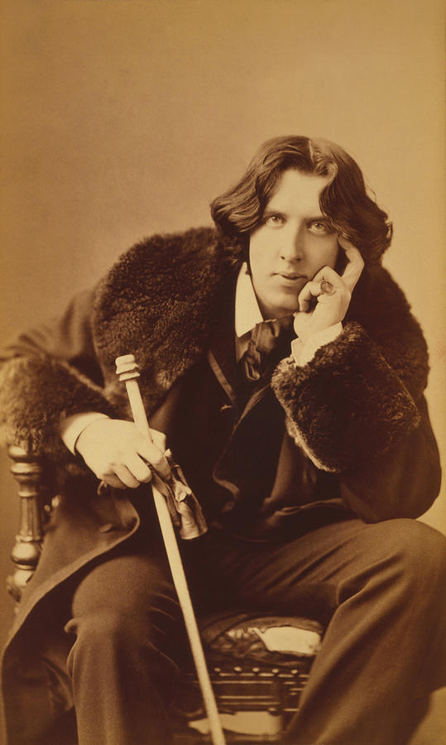
Are you a quiz wizz?
Who said:- “The only thing worse than being talked about is not being talked about.”
Oscar Wilde
Irish poet, playwright. (1854–1900)

Slide 11
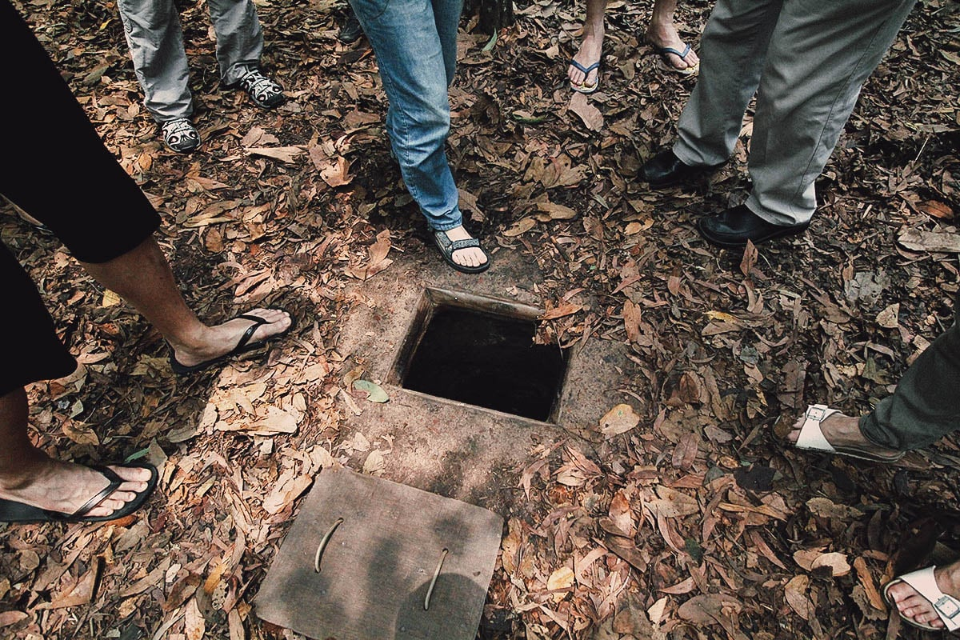
Are you a quiz wizz?
War tunnels are not unique to Gaza. Where is this tunnel built in the 1960’s?
Chu Chi tunnels - Vietnam
The tunnels of Củ Chi are a network of connecting tunnels located in the Củ Chi District of Ho Chi Minh City.

Slide 12
Are you a quiz wizz?
Who am I?
Mahatma Gandhi
Mohandas Karamchand Gandhi was an Indian lawyer, anti-colonial nationalist and political ethicist who employed nonviolent resistance to lead the successful campaign for India's independence from British rule.

Slide 13
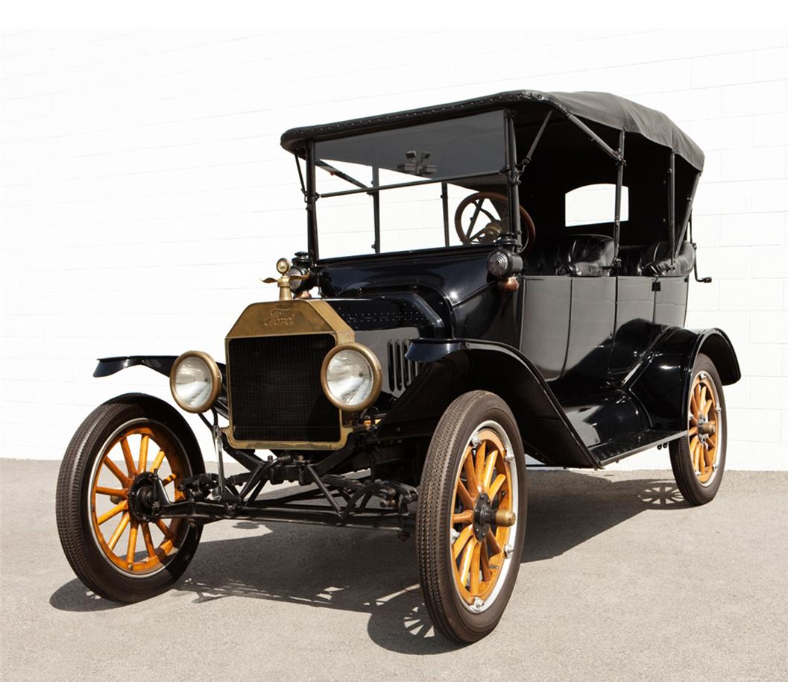
Are you a quiz wizz?
Who said “Any color the customer wants, as long as it’s black?”
Henry Ford
In My Life and Work (1922) Ford wrote:- "Any customer can have a car painted any colour that he wants so long as it is black”.

Slide 14
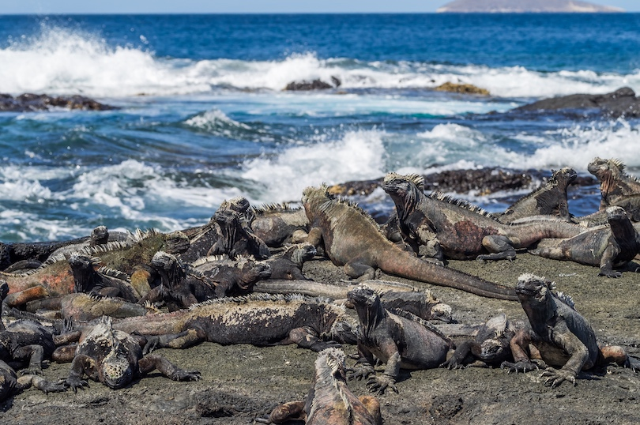
Are you a quiz wizz?
These islands were the impetus for Charles Darwin’s controversial 19th century book, On the Origin of Species.
Galapagos Island
Ecuador
This archipelago of 18 major islands, about 900 km (550 miles) off the coast of Ecuador, was formed – and are still being formed – by volcanic action.

Slide 15
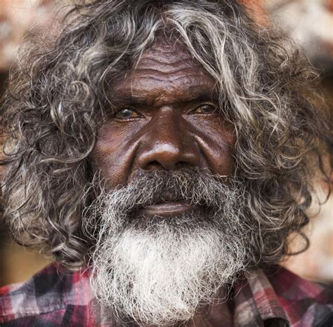
Are you a quiz wizz?
I was in the movie ‘Crocodile Dundee’. What’s my name?
David Gulpilil
Known for his roles in the films Walkabout, Storm Boy, The Last Wave, Crocodile Dundee, Rabbit-Proof Fence, The Tracker and Australia.

Slide 16
Are you a quiz wizz?
The smallest bone in the human body is in the ear. What is it called?
The Stirrup
There are three bones in each of the ears. Of these, the stirrup is the smallest bone in our body. It is as small as a grain of rice and is hollow. Its shape is like that of a stirrup.
The longest and strongest bone is the thigh bone or the femur.

Slide 17
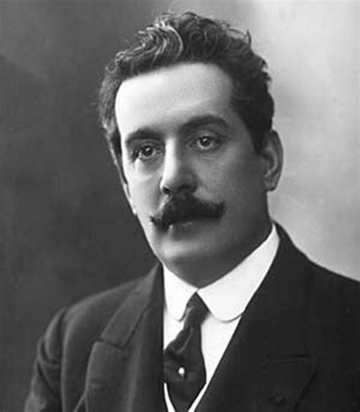
Are you a quiz wizz?
Left unfinished at the time of his composers death, Turandot has remained as one of the most recognisable pieces of opera. Inspired by a German play of the same name. Who was the composer?
Puccini
Giacomo Puccini (1858-1924) was an Italian composer best known for his operas La Bohème, Tosca, Madama Butterfly, and Turandot.

Slide 18
Are you a quiz wizz?
What are these?
Smarties
Smarties are color-varied, sugar-coated, dragée chocolate confectionery.
They have been manufactured since 1937, originally by H.I. Rowntree & Company in the United Kingdom, and now by Nestlé.

Slide 19
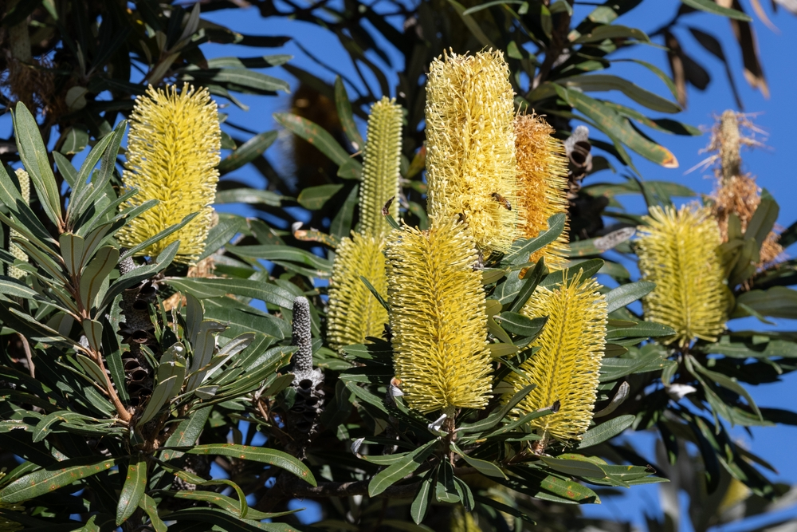
Are you a quiz wizz?
What is my name?
Banksia
One of the most iconic Australian native trees and shrubs and was discovered by Sir Joseph Banks in 1770, who was one of the first Europeans to collect specimens of these plants.

Slide 20
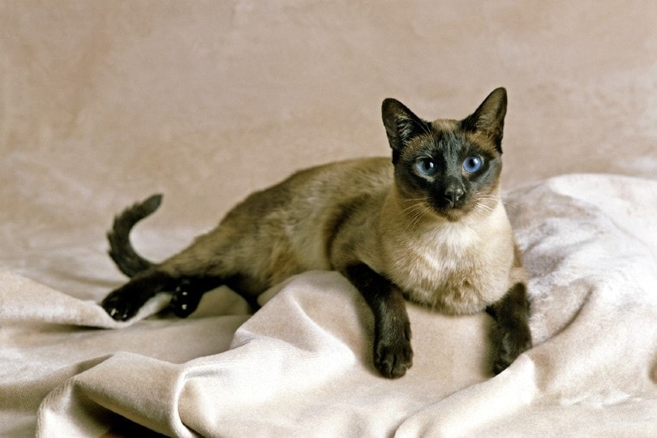
Are you a quiz wizz?
What is the name of this cat breed?
Siamese
The Siamese cat is a small and agile cat breed that weighs no more than 10 pounds. They have slender bodies with short coats and are considered to be an ancient cat breed.

Slide 21
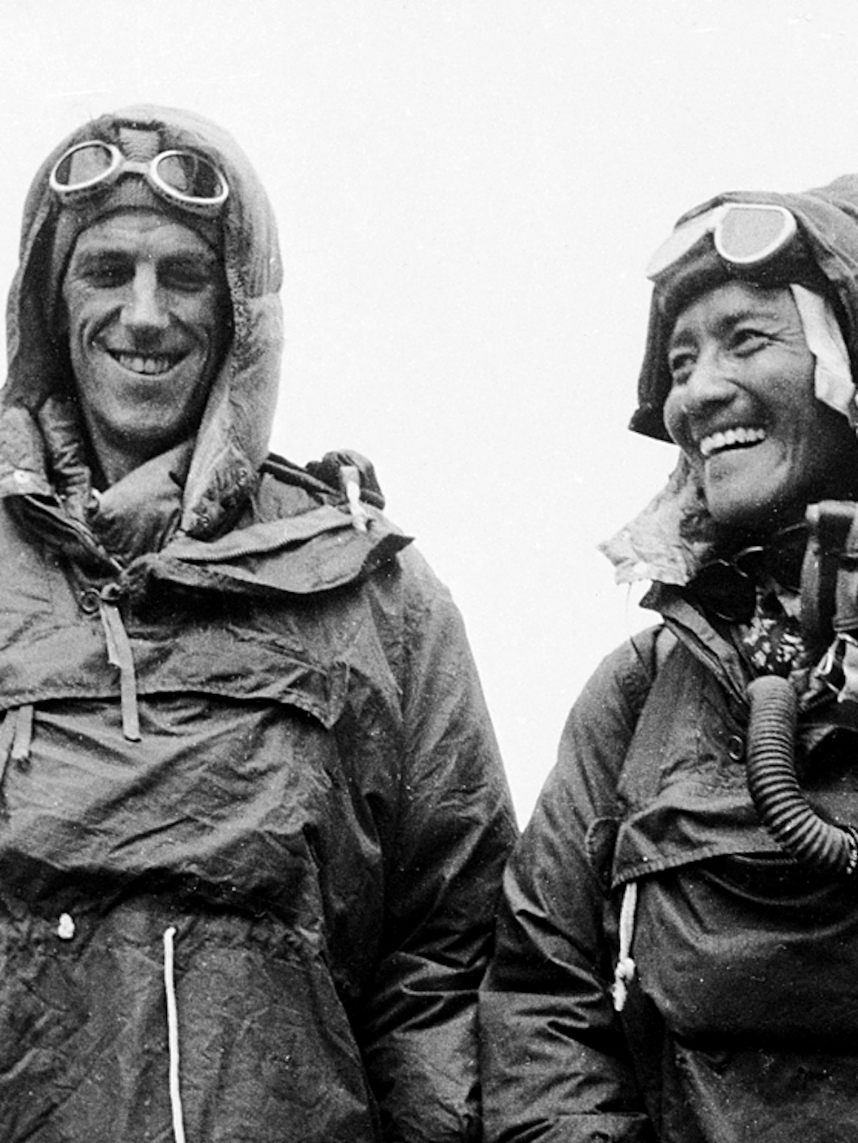
Are you a quiz wizz?
In 1953 we climbed the highest mountain. Who am I? (Either of us)
Edmund Hillary and Tenzing Norgay
Mount Everest is Earth's highest mountain above sea level, located in the Mahalangur Himal sub-range of the Himalayas. The China–Nepal border runs across its summit point. Its elevation of 8,848.86 m.

Slide 22
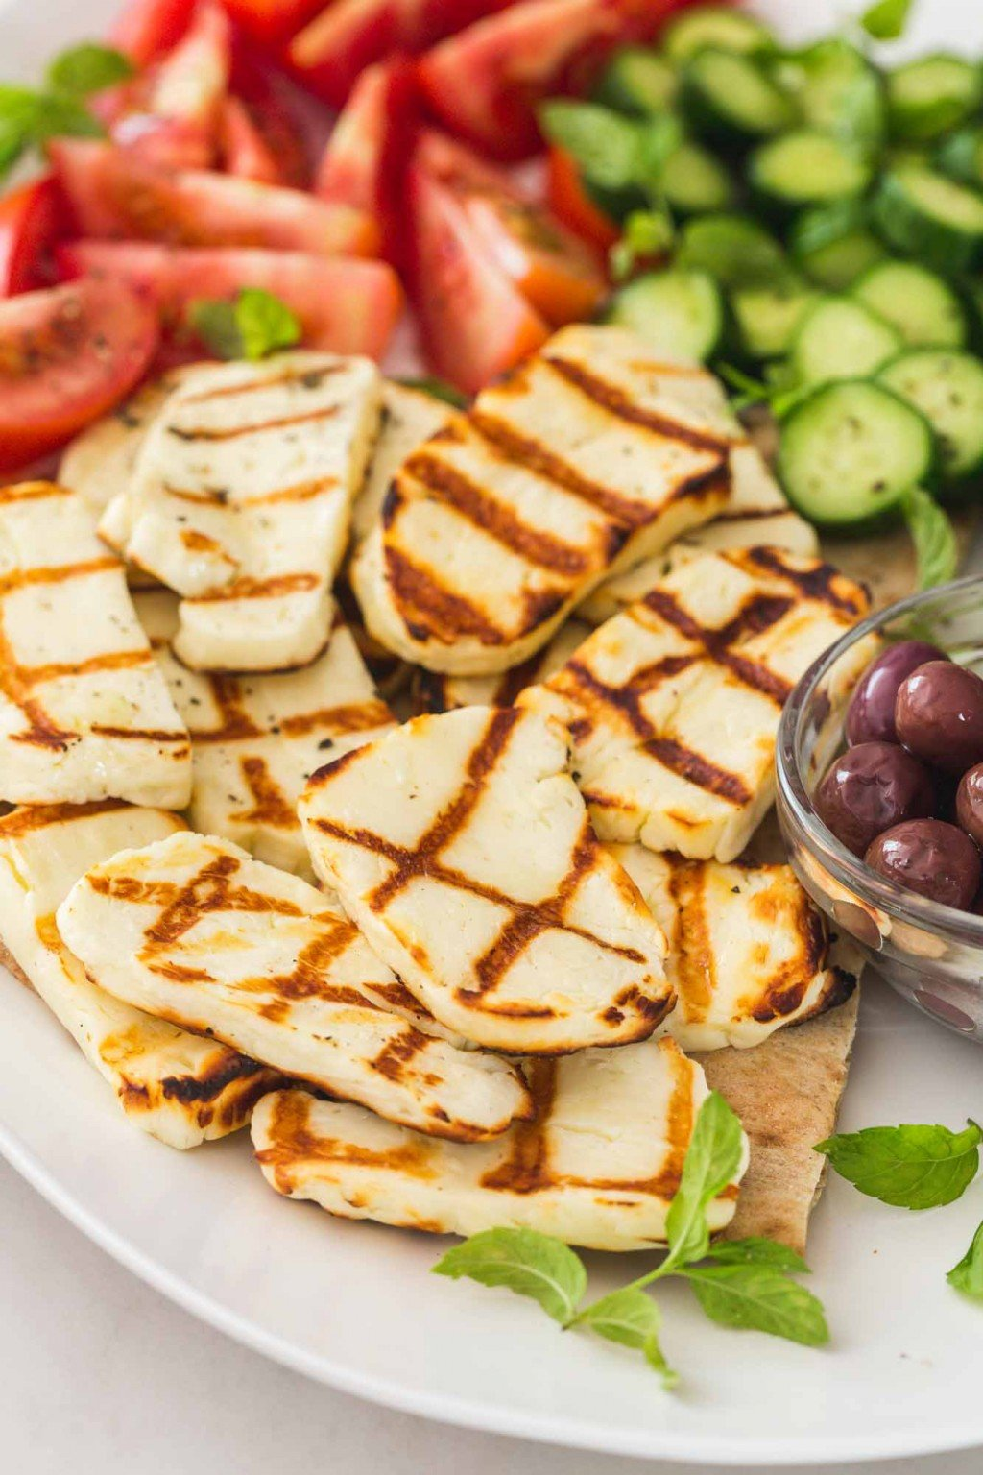
Are you a quiz wizz?
What sort of cheese is this?
Halloumi
Halloumi or haloumi is a cheese of Cypriot origin made from a mixture of goat's and sheep's milk, and sometimes also cow's milk. Its texture is described as squeaky.

Slide 23
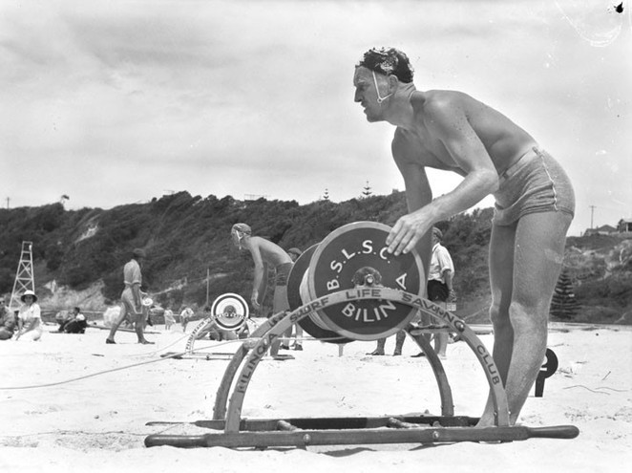
Are you a quiz wizz?
What famous beach was responsible for the development of the life saving reel?
Bondi
It was there in 1906 that surfer Lester Ormsby demonstrated his invention, a surf lifesaving reel. The reels were used until 1970 when they were replaced by rescue tubes.

Slide 24
Are you a quiz wizz?
What is the name of this cloud formation?
Cirrus
Cirrus clouds typically appear delicate and wispy with white strands. Cirrus are usually formed when warm, dry air rises, causing water vapor deposition onto rocky or metallic dust particles at high altitudes.

Slide 25
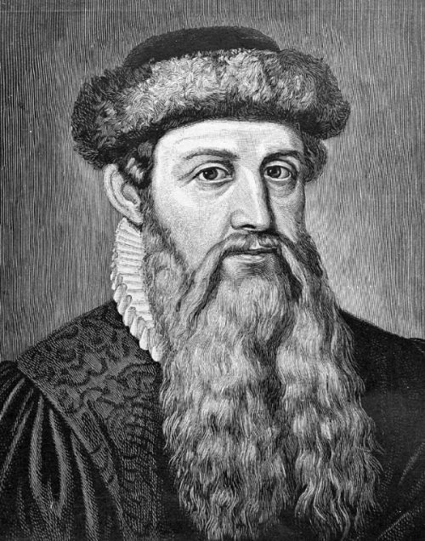
Are you a quiz wizz?
I invented the printing press. Who am I?
Johannes Gutenberg
Gutenberg invented the printing press, which later spread across the world. His work led to an information revolution and the unprecedented mass-spread of literature throughout Europe.

Slide 26
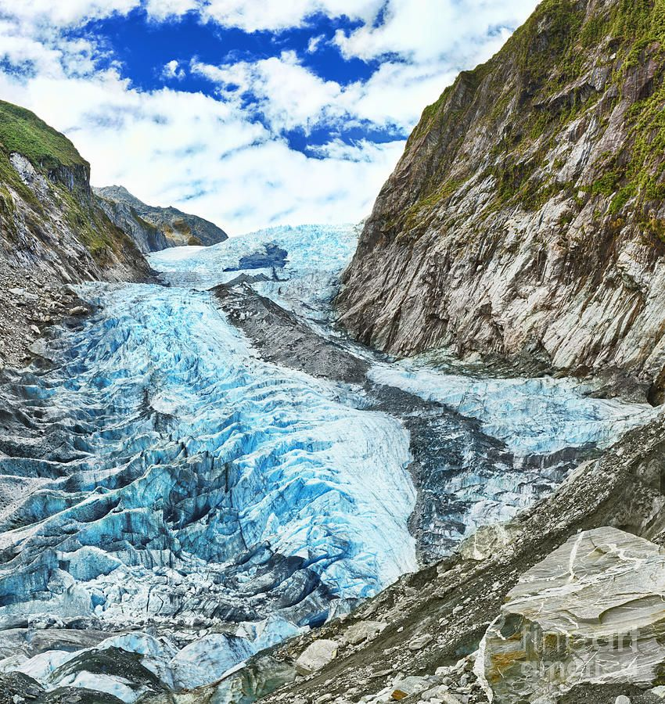
Are you a quiz wizz?
Where do you go to see the Franz Joseph Glacier?
New Zealand
A 12-kilometre-long temperate maritime glacier on the West Coast of New Zealand's South Island.

Slide 27
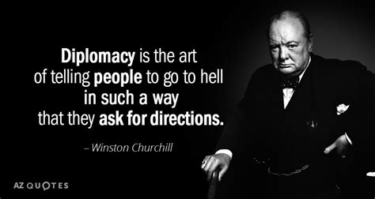
Are you a quiz wizz?
Who am I?
Winston Churchill
He also said – “Yes, I Am Drunk, But You Are Ugly. Tomorrow I Will Be Sober, And You Will Still Be Ugly”

Slide 28
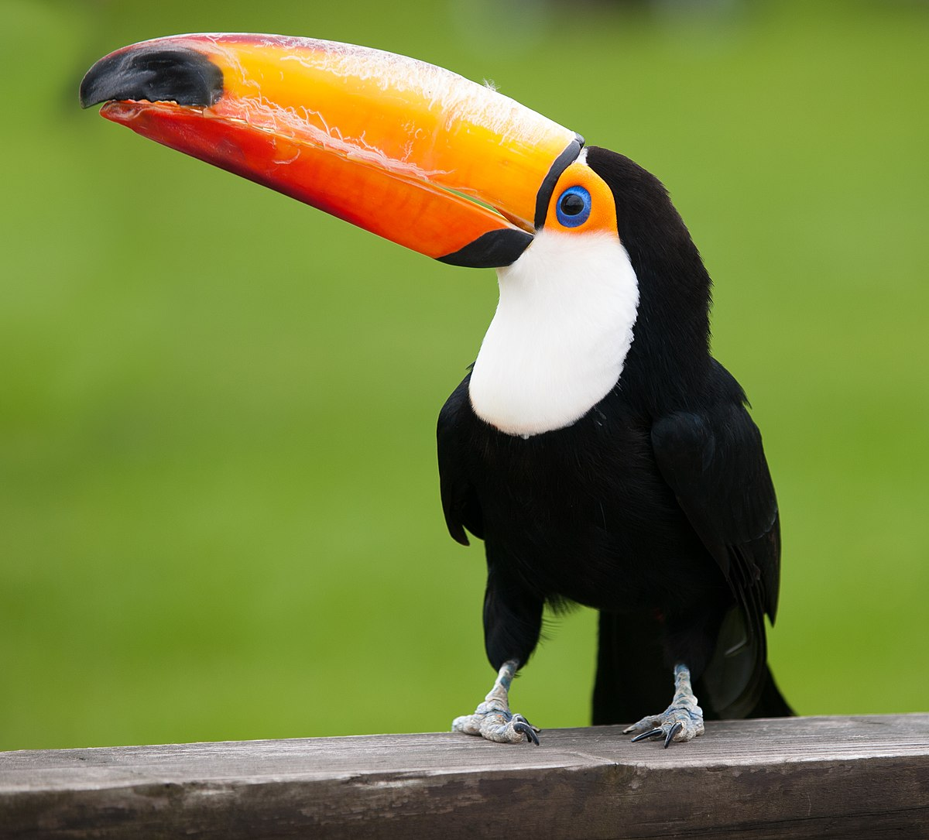
Are you a quiz wizz?
What sort of bird am I?
Toucan
We are brightly marked and have large, often colorful bills.

Slide 29
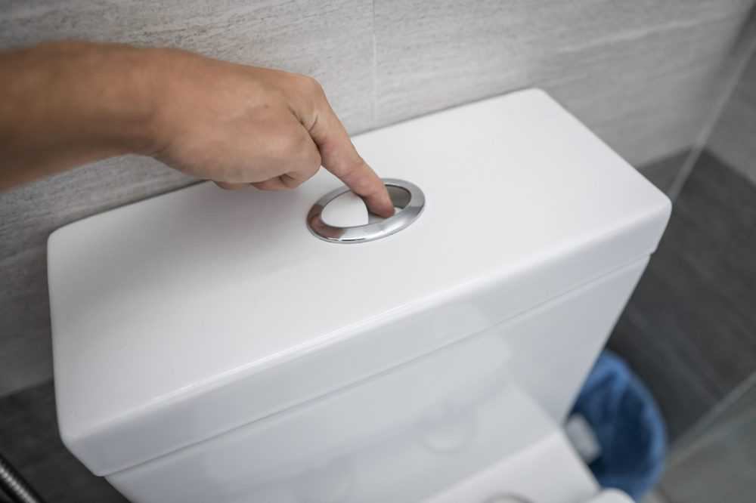
Are you a quiz wizz?
What Aussie company invented the dual flush toilet.
Caroma
What would a ‘dinky di’ Aussie quiz be without the mention of a dunny? The water saving dual flush toilet was invented by Caroma in 1981.

Slide 30
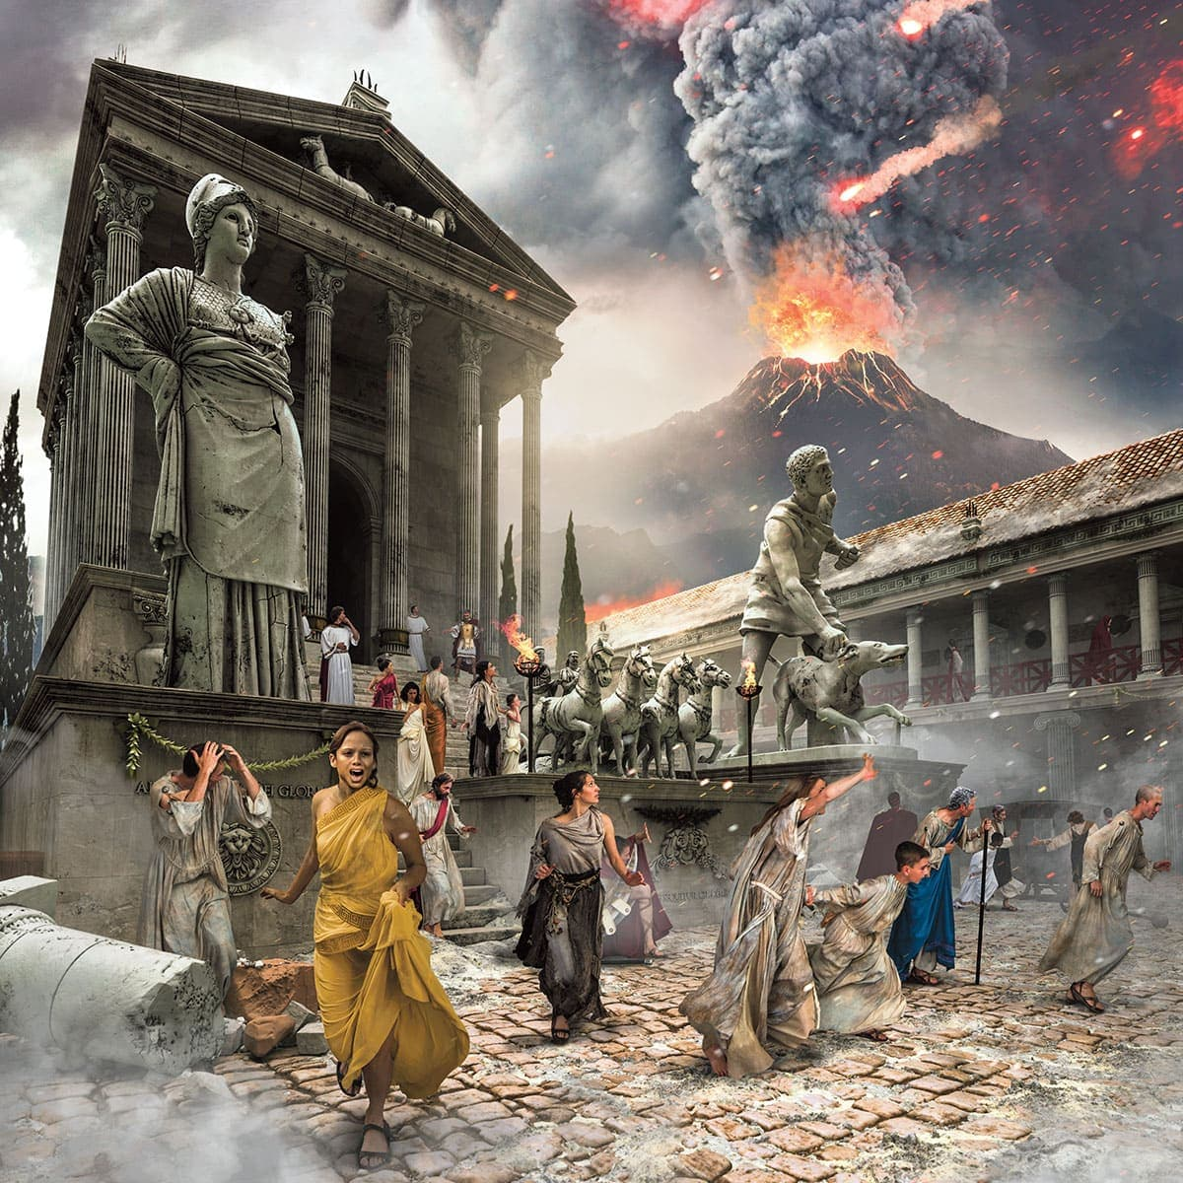
Are you a quiz wizz?
I am Italy’s most famous ‘buried’ city.
Pompeii
Pompeii was buried under meters of ash and pumice after the catastrophic eruption of Mount Vesuvius in 79 A.D.

Slide 31
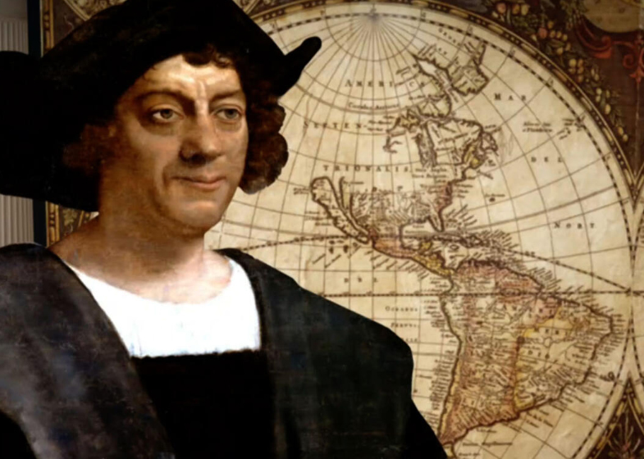
Are you a quiz wizz?
What was Christopher Columbus’ nationality?
Italian
Christopher Columbus was an Italian explorer and navigator from the Republic of Genoa who completed four Spanish-based voyages across the Atlantic Ocean sponsored by the Catholic Monarchs, opening the way for the widespread European exploration and European colonization of the Americas.

Slide 32
Are you a quiz wizz?
A sunset is nothing more and nothing less than the backside of a sunrise.
– Craig D. Lounsbrough
And this is the end

