Slide 1
Are you a quiz wizz?

Slide 2
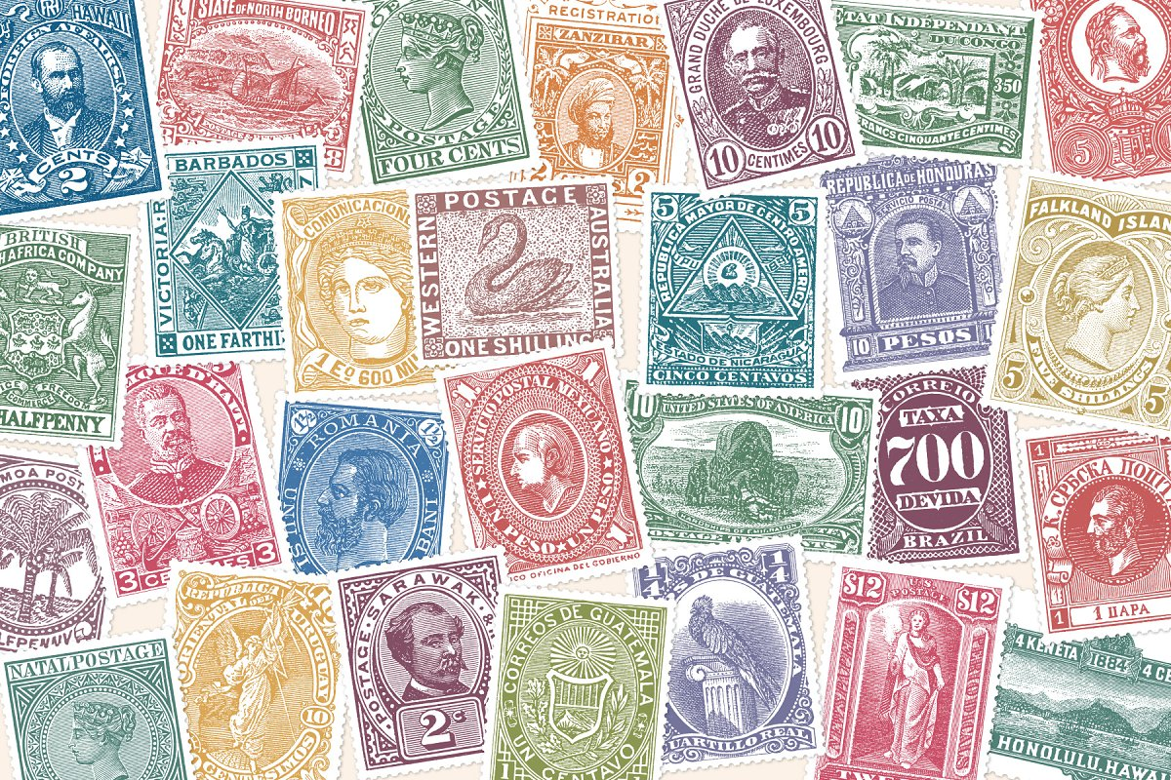
Are you a quiz wizz?
Sir Rowland Hill, in 1838, proposed the first pre-paid postage service. Where was it first adopted?
NSW. Australia
His ideas were denounced by the Postmaster in the House of Lords, but in November 1838, Australian postmaster James Raymond implemented Rowland's idea, introducing the first pre-paid postage.
England introduced it 18 months later, in May of 1840.

Slide 3
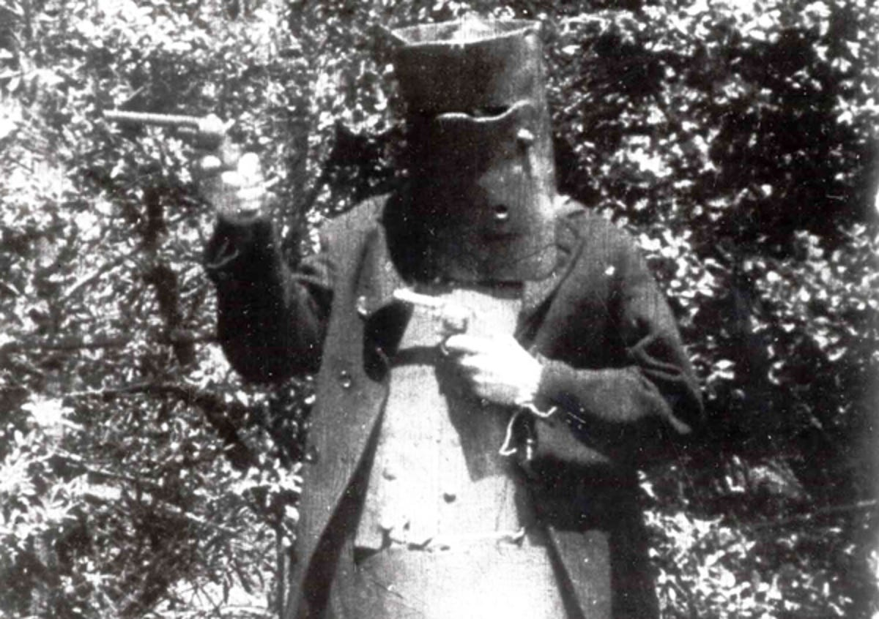
Where and by whom was the first full length feature film made?
Are you a quiz wizz?
Charles Tait, Geelong, Australia
The Story of the Kelly Gang was written and directed by Charles Tait, and co-starred his wife, children and brothers. It ran to just over 60 minutes and cost only £1000 to make. It was deemed a commercial success, bringing in around £25,000 to its four producers.

Slide 4
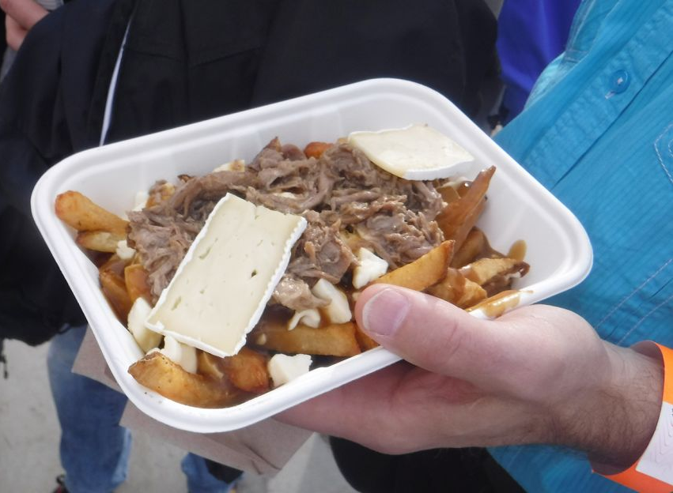
Are you a quiz wizz?
You are craving a plate of Poutine. Where must you travel to for an authentic platter?
Canada
French fries smothered in cheese curds and brown gravy.

Slide 5
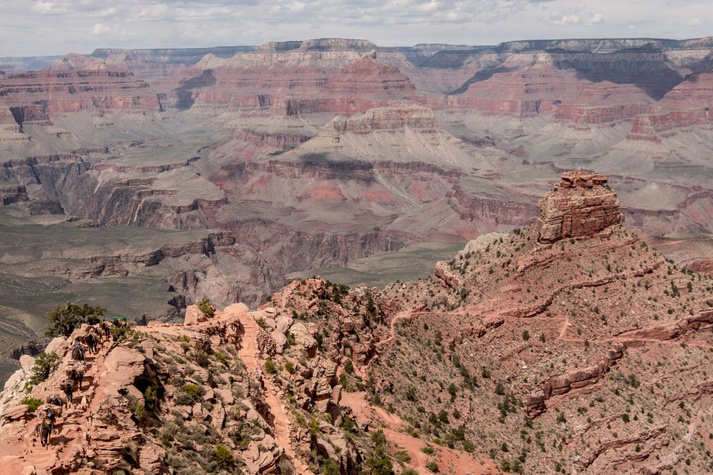
Are you a quiz wizz?
I am meeting you in the South Kaibab Trail. Where must you travel to?
Grand Canyon, Arizona, USA
Built by the National Park Service in 1924, the South Kaibab Trail takes you to the wonderfully named “Ooh Ah Point”

Slide 6
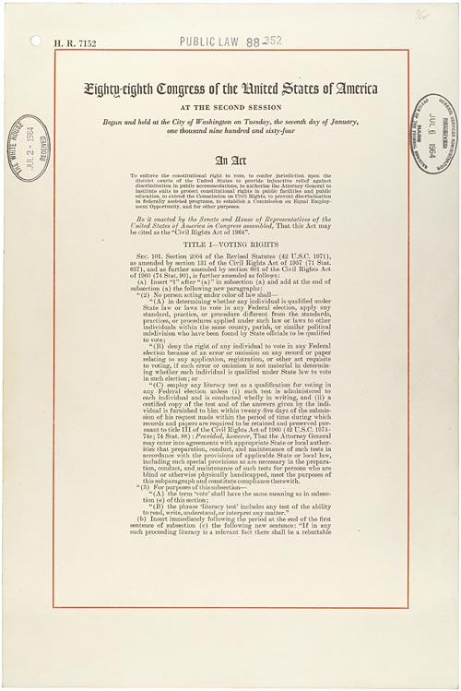
Are you a quiz wizz?
In 1964 the Civil Rights Act was passed in the USA. Which president signed it?
Lyndon Johnson
It prohibited discrimination in public places, provided for the integration of schools and other public facilities, and made employment discrimination illegal.

Slide 7
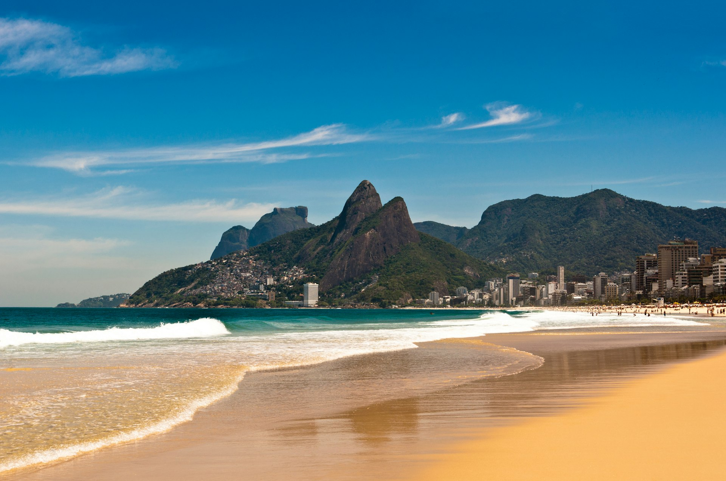
Are you a quiz wizz?
This beach is a famous beach in Rio.
What is its name?
Ipanema Beach
Ipanema Beach is the little sister to Copacabana but is within easy walking distance. While Copacabana is lined with hotel Ipanema is lined with Apartments and residences.

Slide 8
Are you a quiz wizz?
What movie is this quote from?
Braveheart 1995
American epic historical drama film directed and produced by Mel Gibson, who also portrays its central character, Sir William Wallace, a late-13th century Scottish warrior who led the
Scots in the First War of Scottish Independence against King Edward I of England.

Slide 9
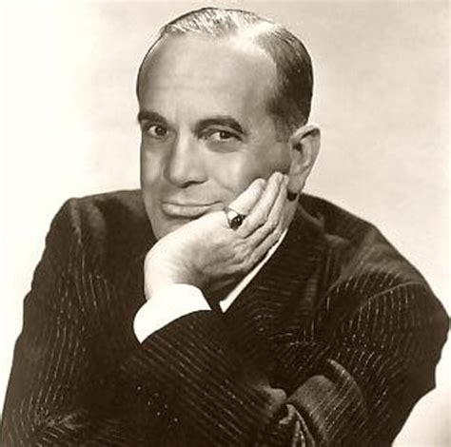
Who starred in the first ‘talkie’ movie – The Jazz Singer
Are you a quiz wizz?
Al Jolson
On October 6, 1927, Warner Bros. released The Jazz Singer, the first feature-length film to incorporate synchronized sound for sequences of dialogue. Though these sequences were limited and brief, hearing the voices of the film's stars was a revelation for audiences.

Slide 10
Who, in 1911, invented the rotary clothes line, and where was he from?
Are you a quiz wizz?
Gilbert Toyne - Melbourne
Lance Hill patented the exact same design in 1948, after Toyne's patent had expired.

Slide 11
Are you a quiz wizz?
If modern art is your ‘thing’, you should be here – but where is here?
Tate Modern, London
Housed in a former power station on London’s Southbank, the cavernous galleries house a vast permanent collection and blockbuster exhibitions that pull in the crowds. .

Slide 12
Are you a quiz wizz?
Called “a miniature kingdom unto itself”, this Mall is the world’s largest mall in total area. Where is it?
Dubai
It has theme parks, a waterfall, Olympic-sized ice rink, aquarium, indoor souk and malls within the mall, such as the Galeries Lafayette from France and the first Bloomingdale’s outside the United States.

Slide 13
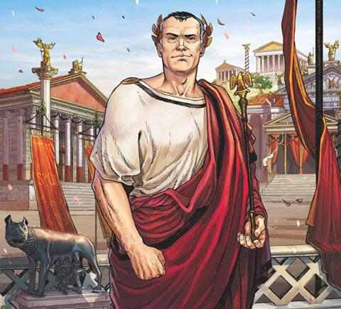
Are you a quiz wizz?
Who said: “I came, I saw, I conquered”
Julius Caesar
Gaius Julius Caesar was a Roman general and statesman. A member of the First Triumvirate, Caesar led the Roman armies in the Gallic Wars before defeating his political rival Pompey in a civil war. He became dictator from 49 BC until his assassination in 44 BC

Slide 14
Are you a quiz wizz?
You are craving a bowl of Pho Bo.
Where must you travel to for your meal?
Vietnam
Phở or Pho is a Vietnamese soup dish consisting of broth, rice noodles, herbs, and meat, sometimes chicken.

Slide 15
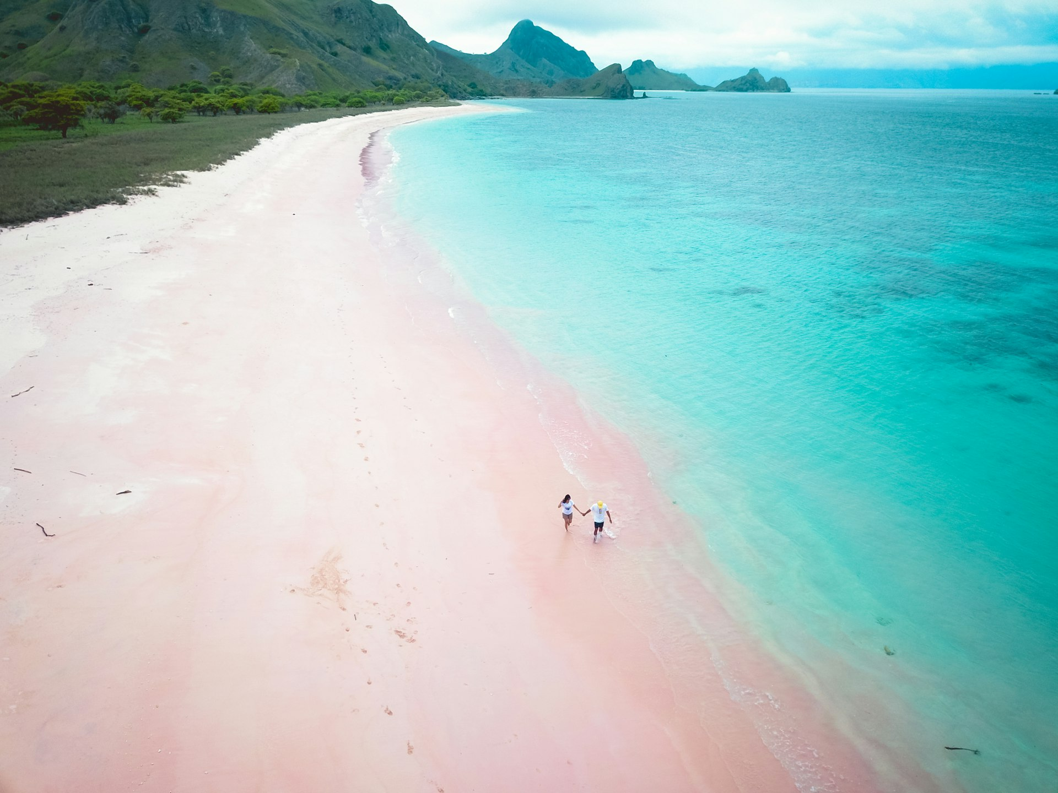
Are you a quiz wizz?
No prizes for guessing where Pink Beach Indonesia gets its name, but where is it?
Komodo National Park, Indonesia
Its distinctive hue comes from deep red organ pipe corals that have broken down offshore over centuries and mixed with the fine white sand grains to produce the soft, pink shoreline.

Slide 16
Are you a quiz wizz?
What is the worlds deadliest animal?
Mosquito
Not me
Acording to the World Health Organization, 725,000 people are killed each year from mosquito-borne diseases, such as Malaria, dengue fever and yellow fever.

Slide 17
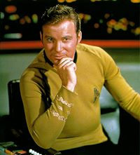
Are you a quiz wizz?
Captain James Tiberius Kirk was from what movie?
Star Trek
Originally played by Canadian actor William Shatner, Kirk first appeared in Star Trek serving aboard the starship USS Enterprise as captain.

Slide 18
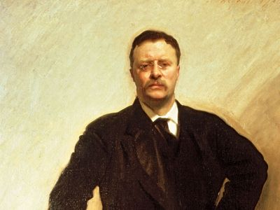
Are you a quiz wizz?
Who said: “Do what you can, with what you have, where you are”.
Theodore Roosevelt
Theodore Roosevelt Jr., often referred to as Teddy or by his initials, T. R., was an American politician, statesman, conservationist, naturalist, and writer who served as the 26th president of the United States from 1901 to 1909.

Slide 19
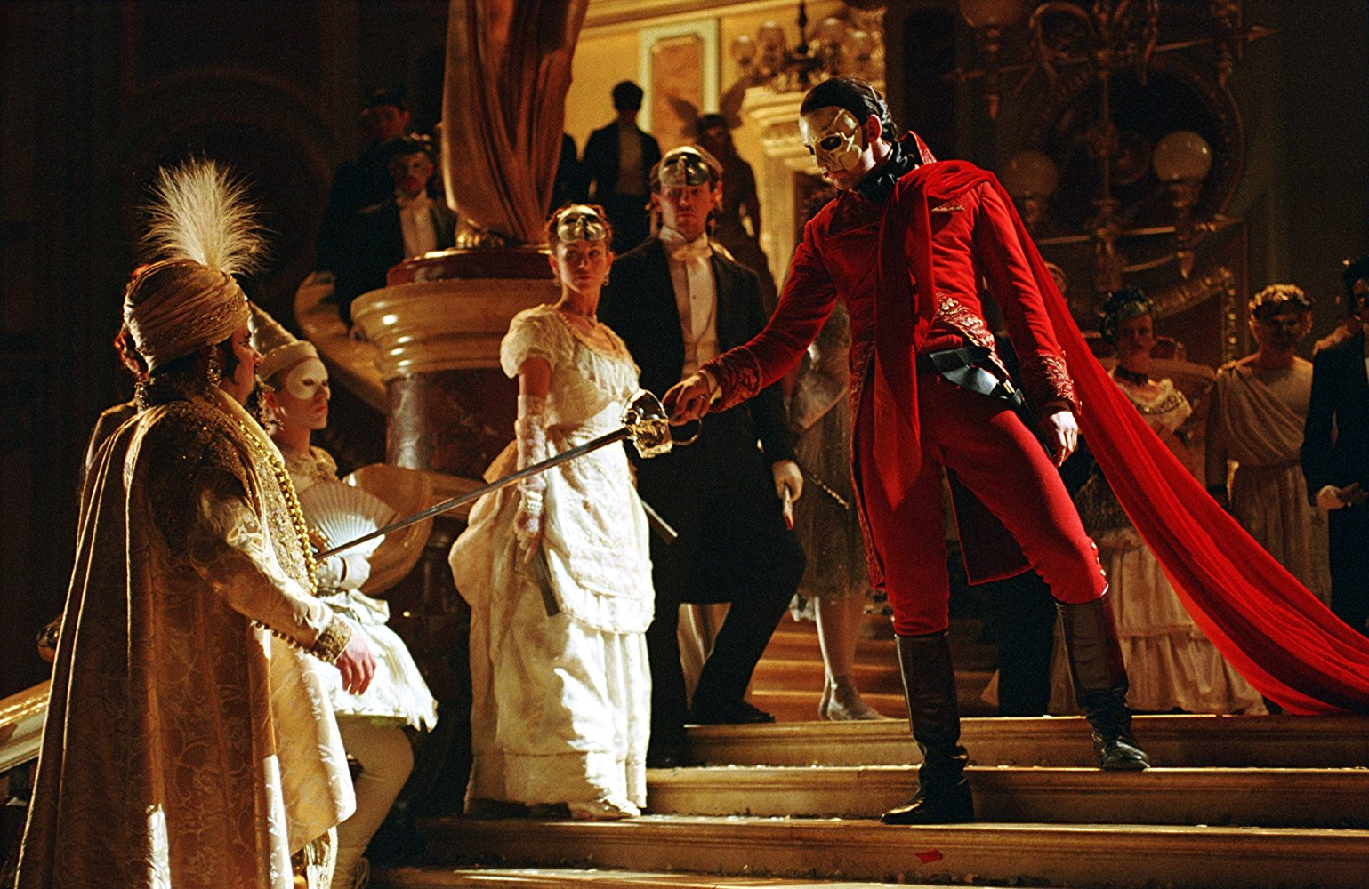
Are you a quiz wizz?
What is the longest running musical on Broadway?.
Phantom of the Opera
A musical with music by Andrew Lloyd Webber, and lyrics by Charles Hart and Richard Stilgoe. It opened in the West End in 1986 and on Broadway in New York in 1988. It is based on the 1910 French novel of the same name by Gaston Leroux

Slide 20
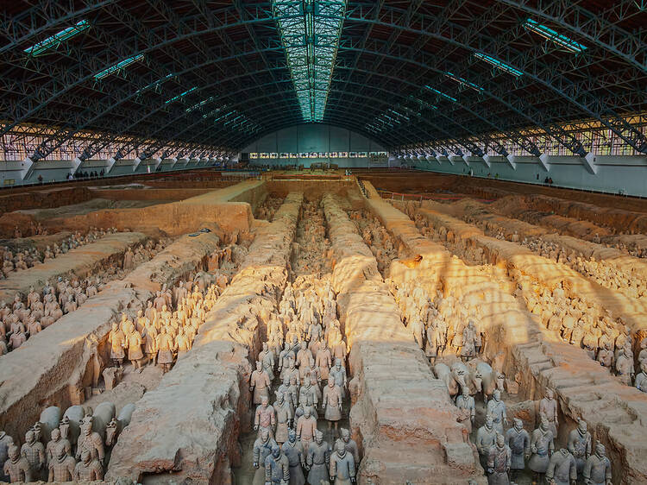
Are you a quiz wizz?
Where would you have to go to meet these warriors?
Terracotta Warriors and Horses Museum Xi An, China
Discovered in 1974, Terracotta Warriors and Horses, officially named Emperor Qinshihuang's Mausoleum Site Museum, is one of the greatest archeo-logical finds in 20th century,

Slide 21
Are you a quiz wizz?
This park has established a thriving side business as a film set for Hollywood sci-fi movies, including The Martian, Prometheus and Rogue One: A Star Wars Story. Where is it?
Wadi Rum. Jordan
You can visit Bedouin camps in sheltered rocky gorges, pore over ancient rock art inscriptions and learn about the period during WWI when locals joined the Arab Revolt alongside Lawrence of Arabia.

Slide 22
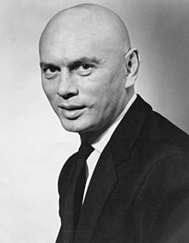
Are you a quiz wizz?
I am a Russian born actor that starred in “The King and I?”
Yul Brynner
known for his portrayal of King Mongkut in the Rodgers and Hammerstein stage musical The King and I, for which he won two Tony Awards, and later an Academy Award for Best Actor for the film adaptation.

Slide 23
Are you a quiz wizz?
Complete this Spice Girls lyric: "If you wanna be my [BLANK], you gotta get with my friends".
Lover
From the song Wannabe

Slide 24
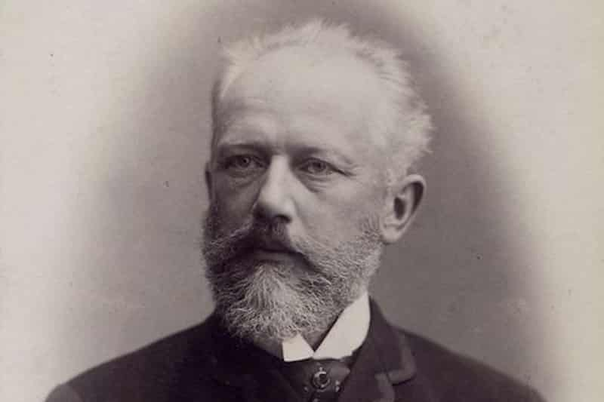
Are you a quiz wizz?
This famous Russian composer first names were Pyotr Ilyich. What was his name?
Tchaikovsky
Pyotr Ilyich Tchaikovsky was a Russian composer who began taking piano lessons at 5 years old.
He studied to become a civil servant rather, but he has come to be revered in classic ballet circles.

Slide 25
Are you a quiz wizz?
What creature has the shortest life span?
Mayfly
The Mayfly reproduces and then dies, during that short 24hr period of life. Some species of Mayfly only live for 8-10 hours. Although they have the shortest adult lifespan, they actually exist as a nymph in water from 3-7 years, depending on species.

Slide 26
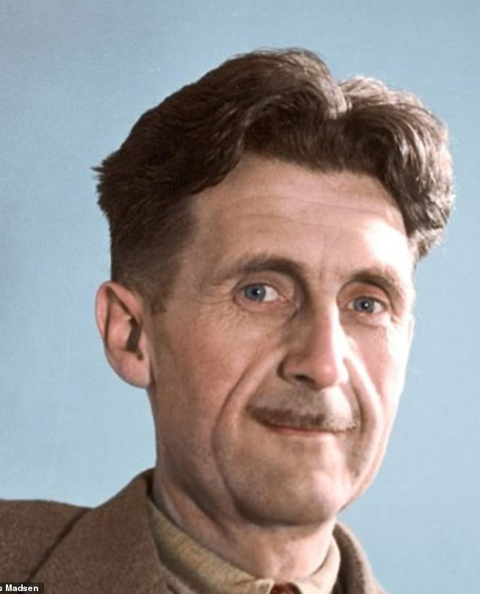
Are you a quiz wizz?
Who said; “Big Brother is watching you?”
George Orwell
Eric Arthur Blair was an English novelist, poet, essayist, journalist, and critic. He was Born in India, Blair was raised and educated in England from the age of one. After school he became an Imperial policeman in Burma, before returning to England, where he began his writing career as George Orwell.

Slide 27
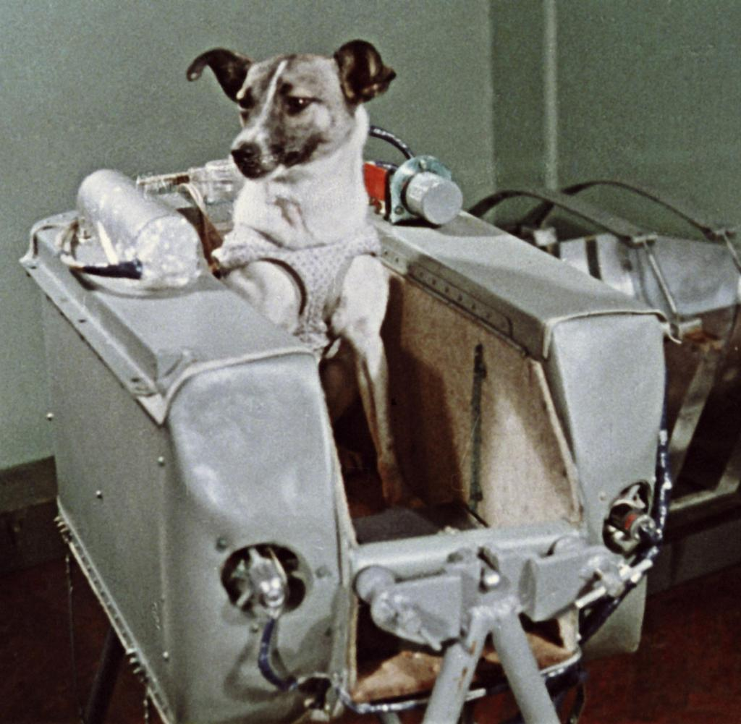
Are you a quiz wizz?
The first animal in space was a Russian dog. What was his name?
Laika
A stray mongrel from the streets of Moscow, she flew aboard the Sputnik 2 spacecraft, launched into low orbit on 3 November 1957.

Slide 28
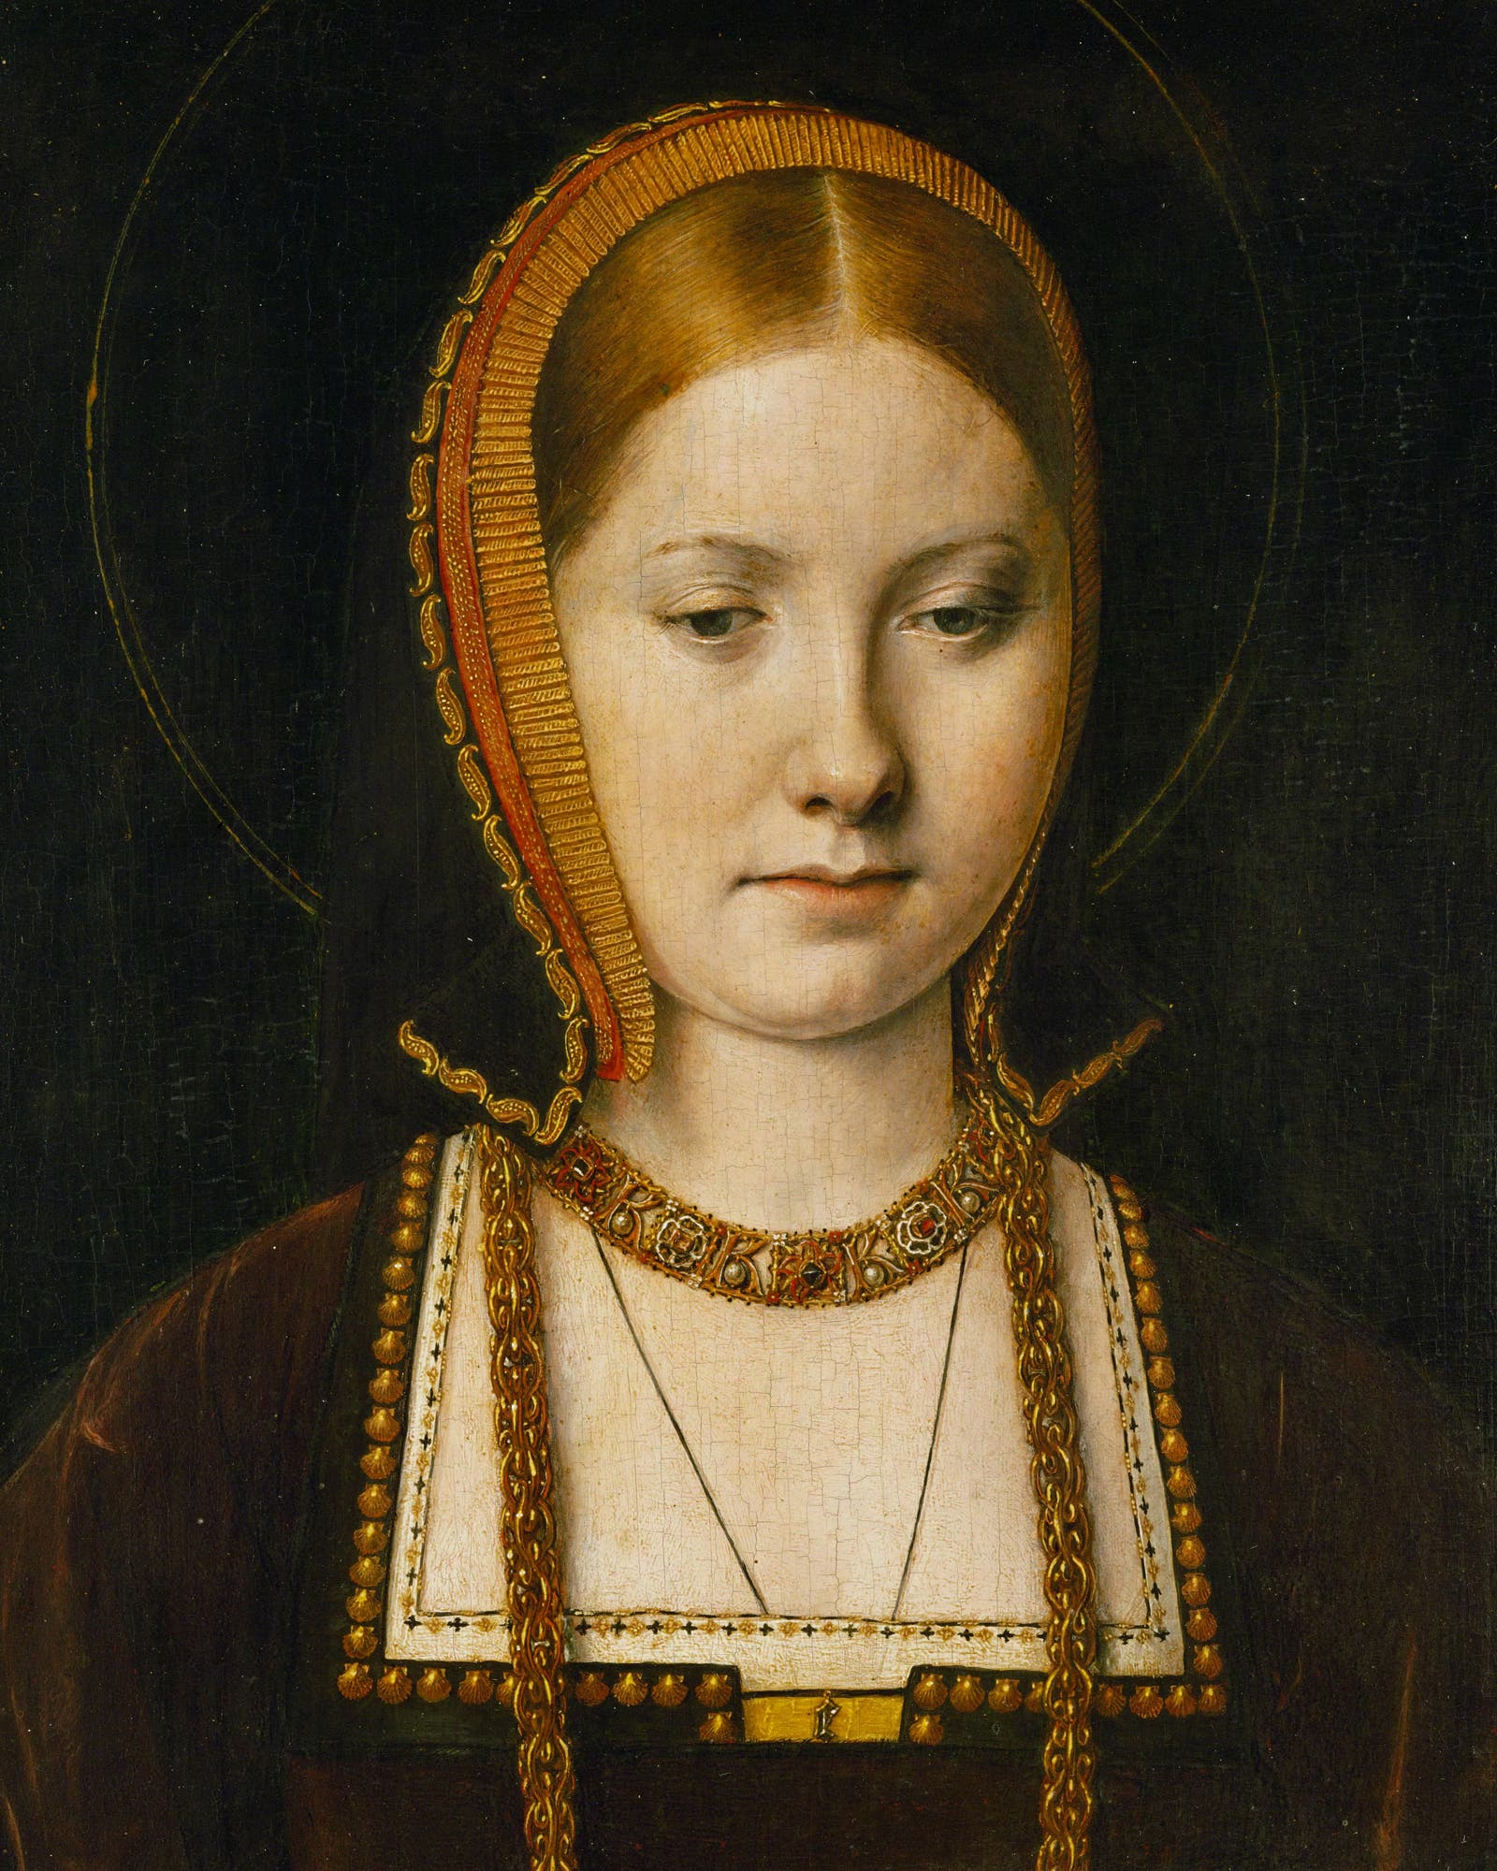
Are you a quiz wizz?
How many of Henry VIII's wives were called Catherine?
Three
Katherine of Aragon
Anne Boleyn
Jane Seymour
Anne of Cleves
Katherine Howard
Katherine Parr

Slide 29
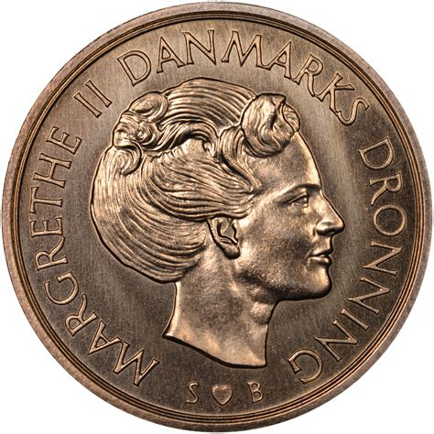
Are you a quiz wizz?
What is the currency of Denmark?
Krone
The krone is the official currency of Denmark, Greenland, and the Faroe Islands, introduced in 1875. Historically, krone coins have been minted in Denmark since the 17th century

Slide 30
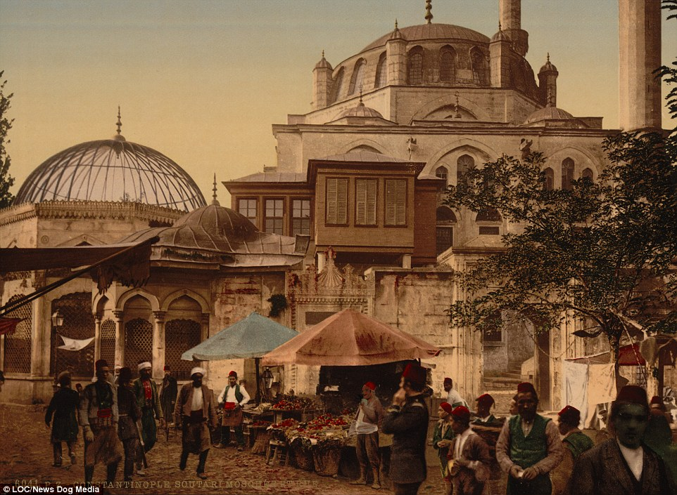
Are you a quiz wizz?
What was the Turkish city of Istanbul called before 1930?
Constantinople
The modern Turkish name for the city, Istanbul, derives from the Greek phrase ‘eis tin Polin’ , meaning '(in)to the city’.
Life in the 1890’s

Slide 31
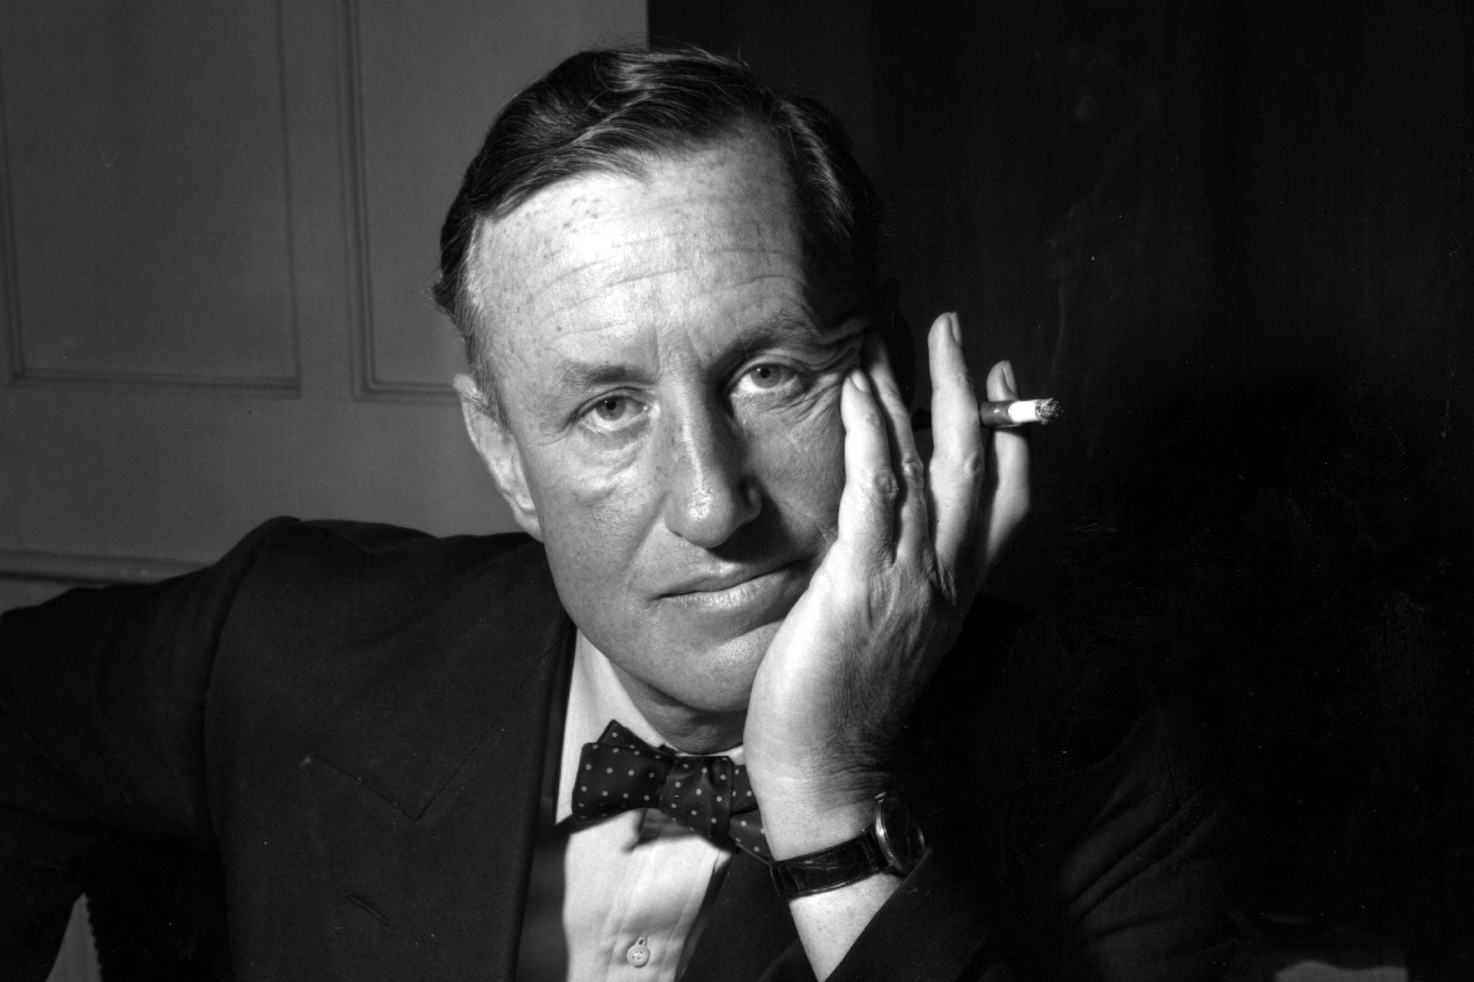
Are you a quiz wizz?
Who wrote the book Chitty-Chitty-Bang-Bang: The Magical Car?
Ian Fleming
British writer, best known for his postwar James Bond series of spy novels. Fleming came from a wealthy family connected to the merchant bank Robert Fleming & Co., and his father was the Member of Parliament (MP) for Henley from 1910 until his death on the Western Front in 1917.

Slide 32
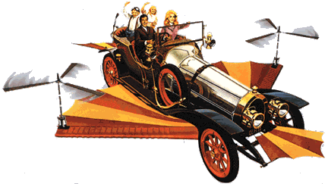
Are you a quiz wizz?
The End

