Slide 1
Are you a quiz wizz?

Slide 2
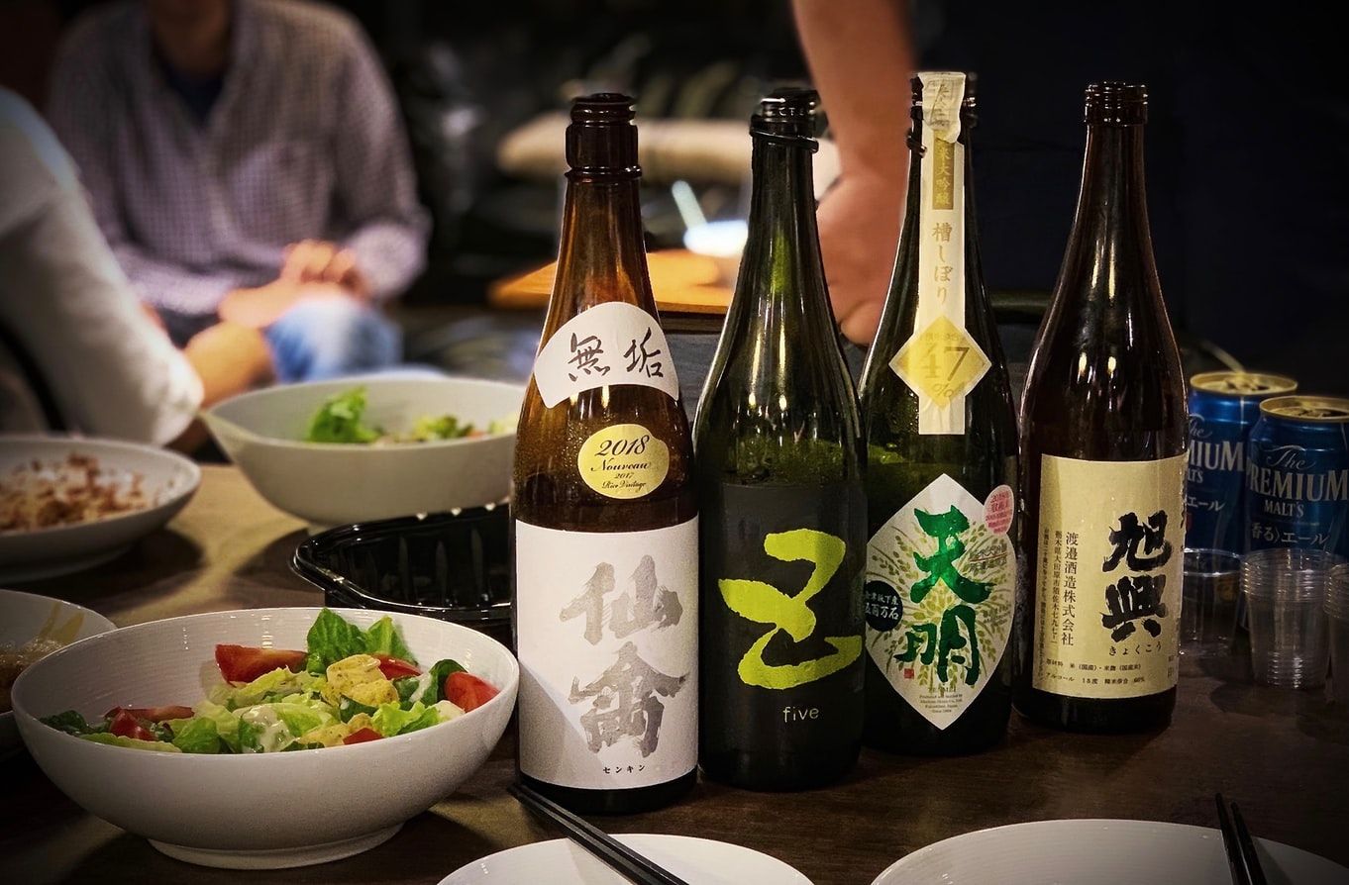
Are you a quiz wizz?
From what grain is the Japanese spirit Sake made?
Rice
Sake or saké, also referred to as Japanese rice wine, is an alcoholic beverage of Japanese origin made by fermenting rice that has been polished to remove the bran.

Slide 3
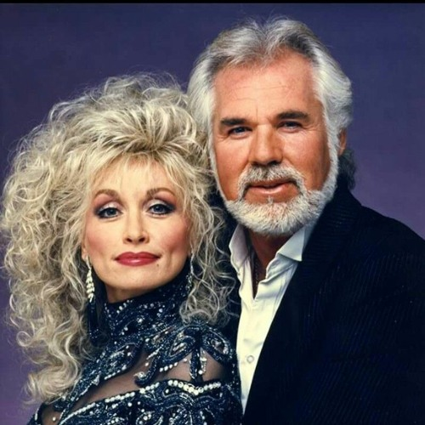
Are you a quiz wizz?
Which two country singers famously sang together on 1983 song Islands in the Stream?
Kenny Rogers and Dolly Parton
Written by the Bee Gees and recorded by American country music artists Kenny Rogers and Dolly Parton. It was released in August 1983

Slide 4
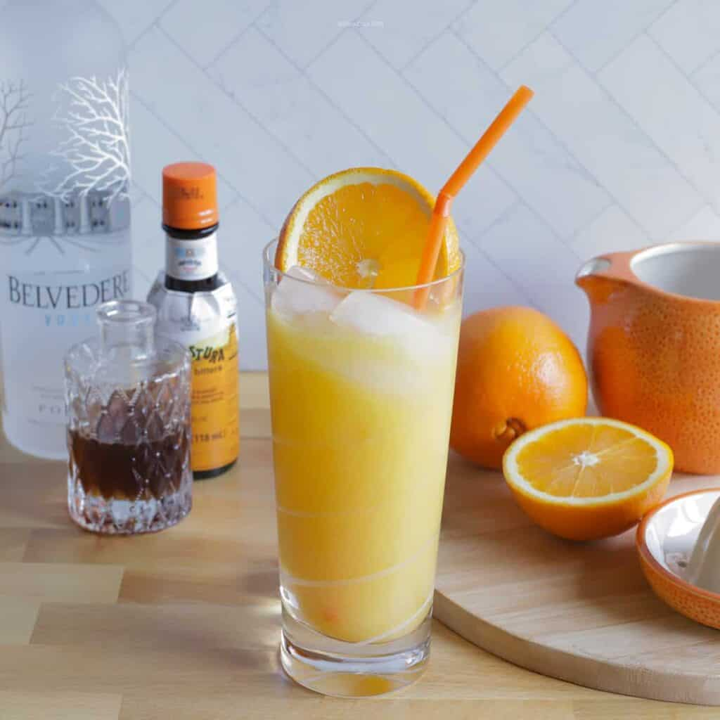
Are you a quiz wizz?
A screwdriver cocktail is orange juice, ice and which spirit?
Vodka
In the UK, it is referred to as a "vodka and orange". While the basic drink is simply the two ingredients, there are many variations. Many of the variations have different names in different parts of the world.

Slide 5
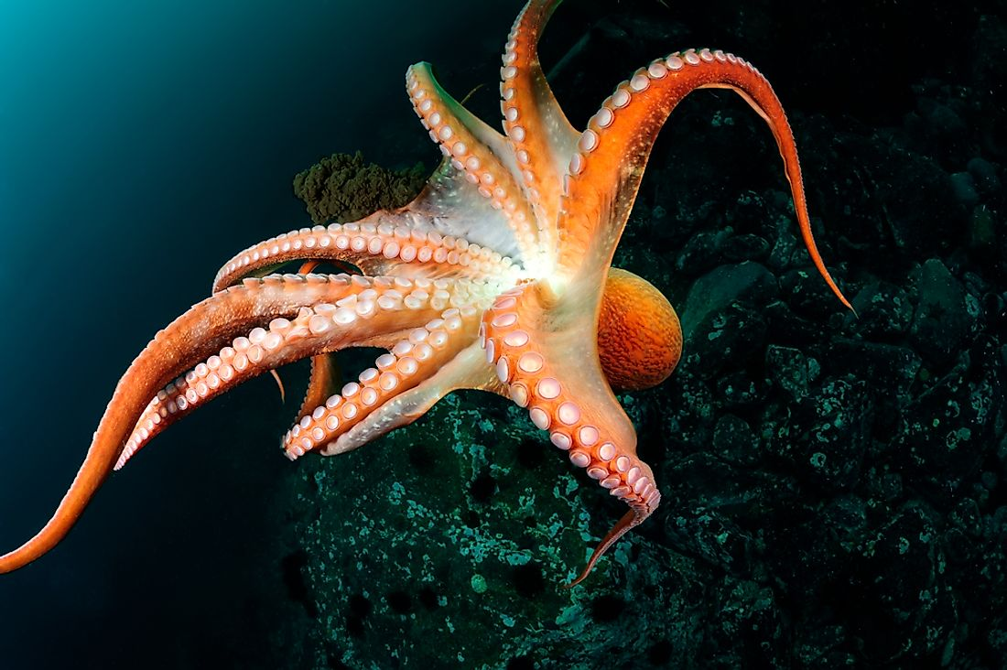
Are you a quiz wizz?
How many hearts does an octopus have?
Three
Their two peripheral hearts pump blood through the gills, where it picks up oxygen. A central heart then circulates the oxygenated blood to the rest of the body to provide energy for organs and muscles.

Slide 6
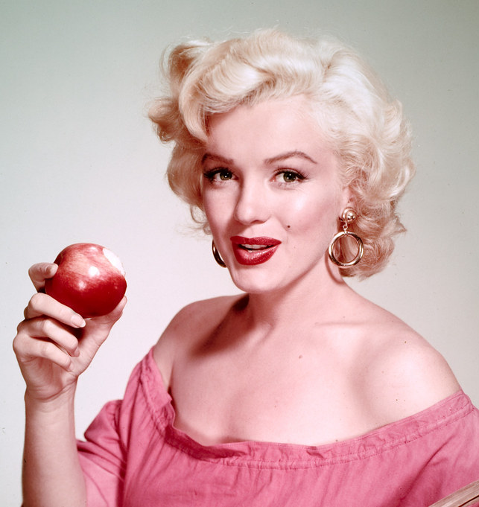
Are you a quiz wizz?
What was the better-known name of the actress born Norma Jeane Mortenson?
Marilyn Monroe
Known for playing comic "blonde bombshell" characters, she became one of the most popular sex symbols of the 1950s and early 1960s, as well as an emblem of the era's sexual revolution. She was a top-billed actress for a decade, and her films grossed $200 million by the time of her death in 1962.

Slide 7
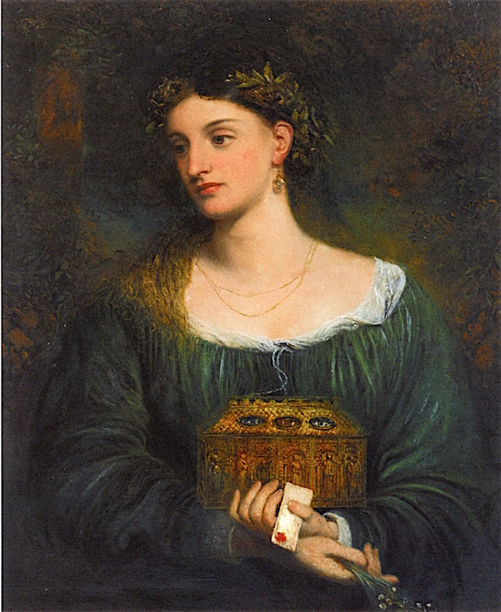
Are you a quiz wizz?
According to Greek mythology, who was the first woman on earth?
Pandora
Pandora was the first human woman created by Hephaestus on the instructions of Zeus. As Hesiod related it, each god cooperated by giving her unique gifts.

Slide 8
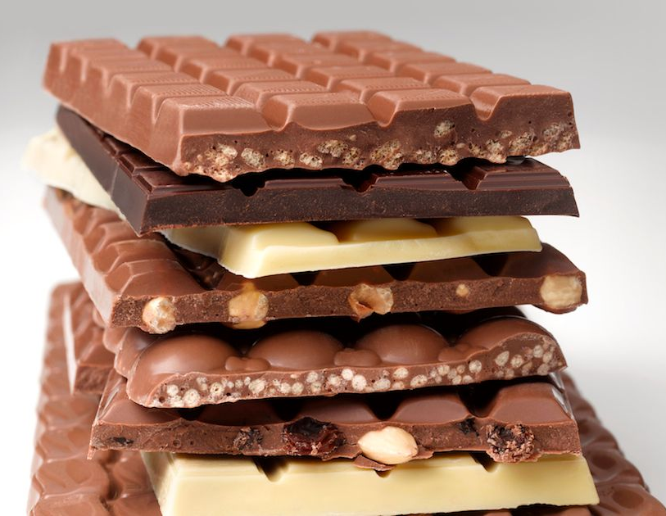
Which country consumes the
most chocolate
per capita?
Switzerland
The top four countries responsible for the production of the world's chocolate are Germany, Belgium, Italy, and Poland. These four countries account for over 40% of the world's total chocolate exports.

Slide 9
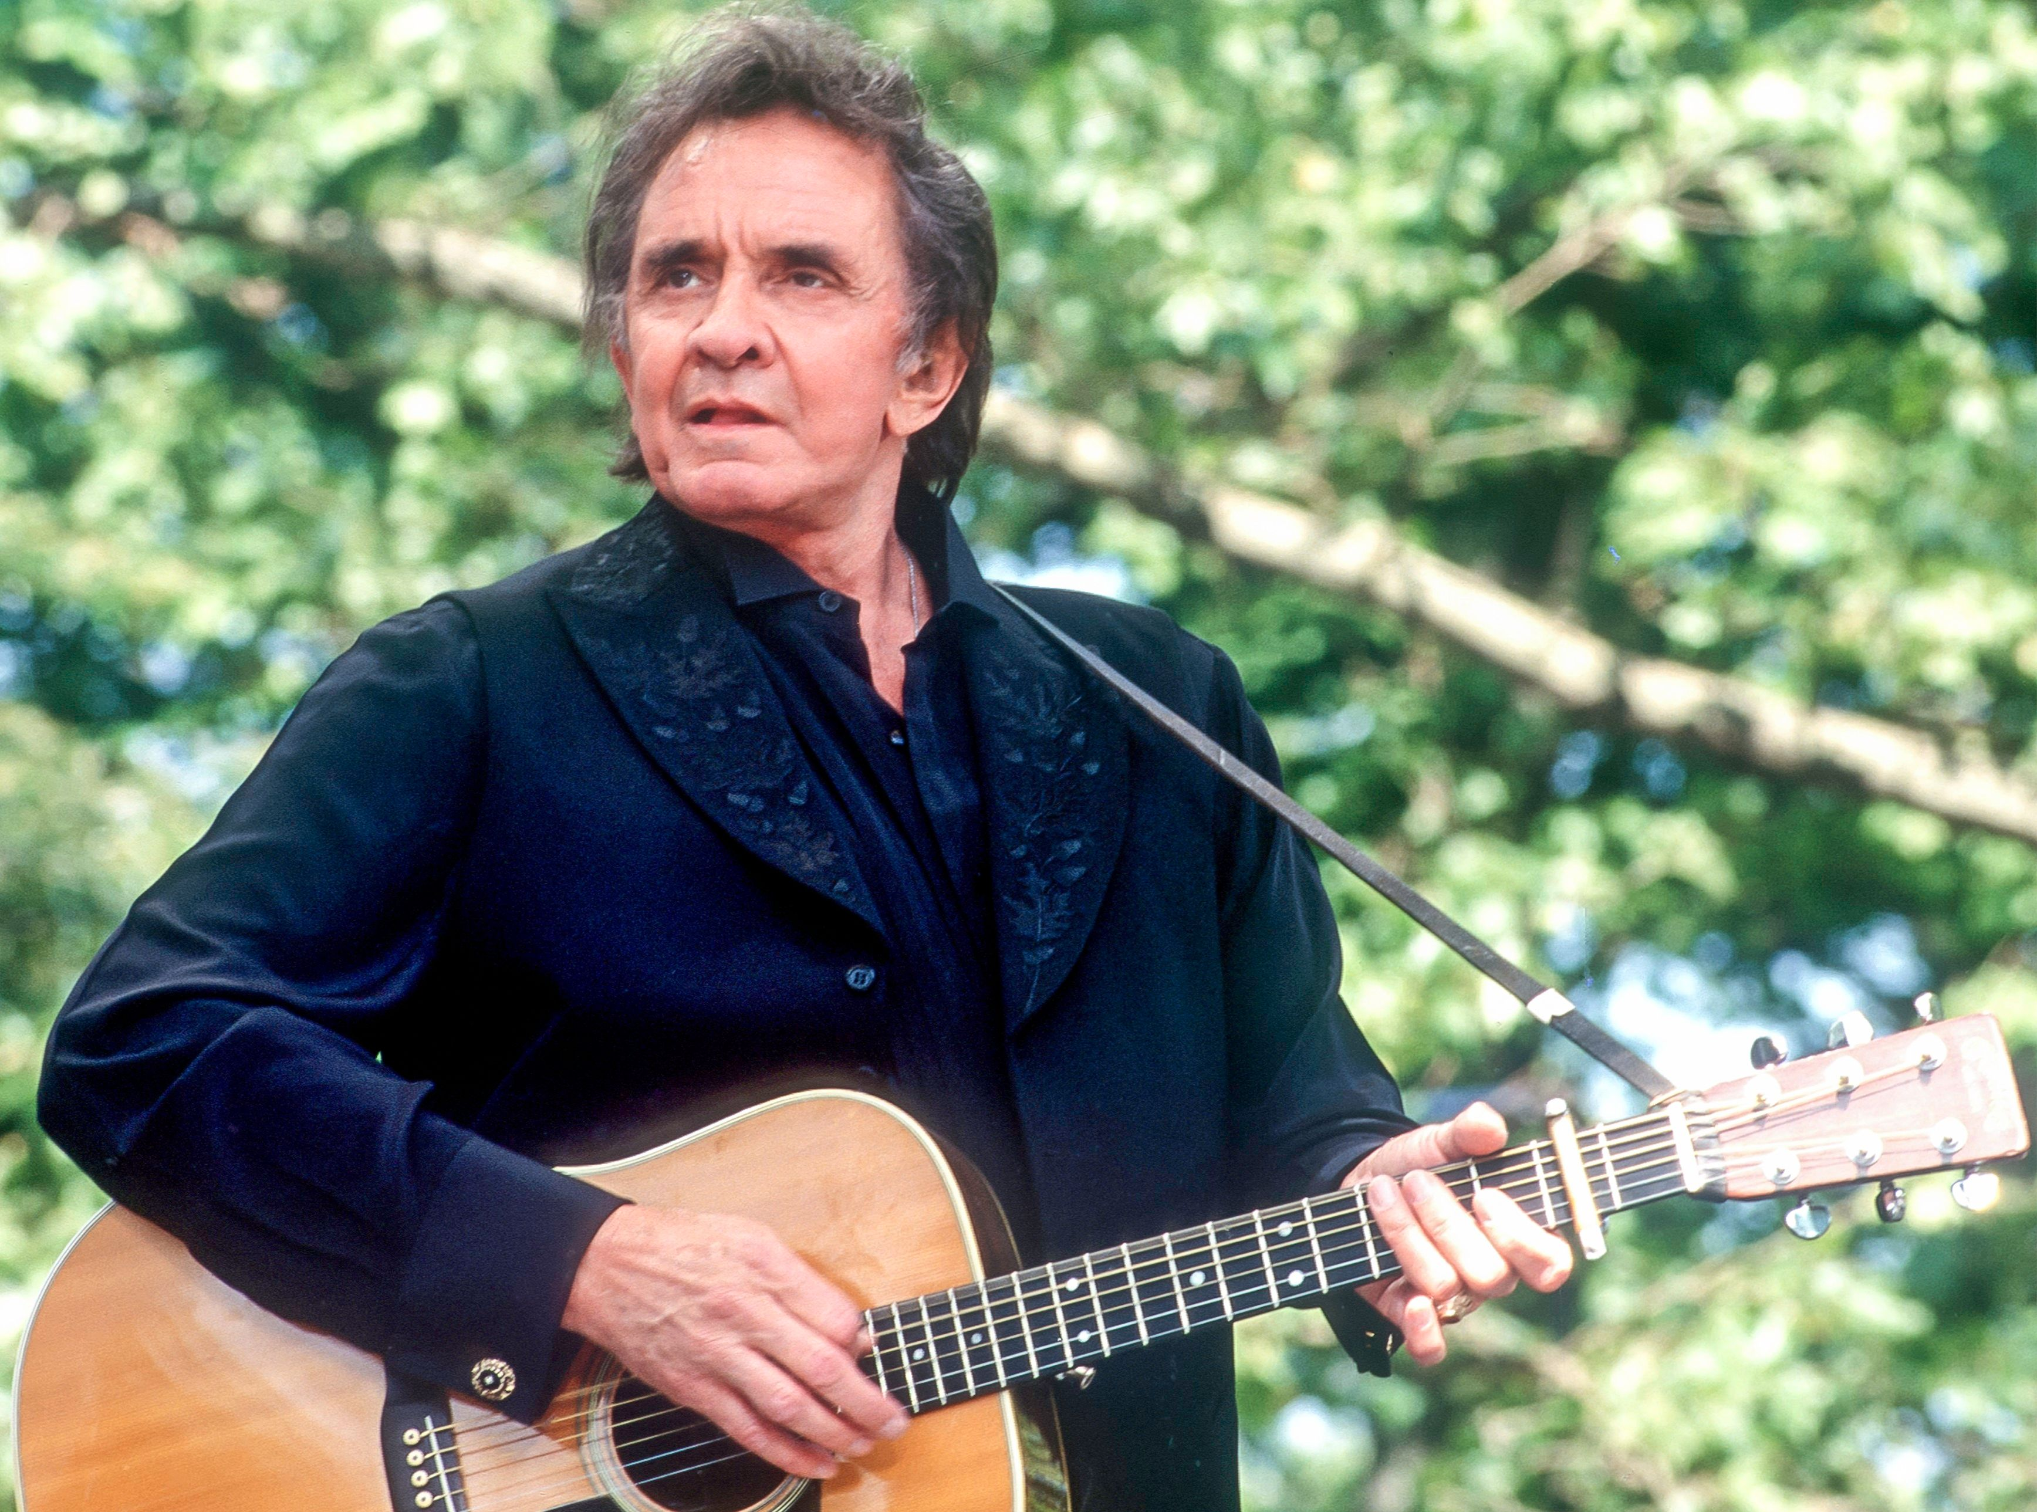
Are you a quiz wizz?
Which American singer-songwriter sang of falling into a Ring Of Fire in the 60’s?
Johnny Cash
Most of Cash's music contains themes of sorrow, moral tribulation, and redemption, especially songs from the later stages of his career.

Slide 10
Are you a quiz wizz?
What is Tiger Woods' real first name?
Eldrick
Eldrick Tont “Tiger” Woods was born December 30, 1975

Slide 11
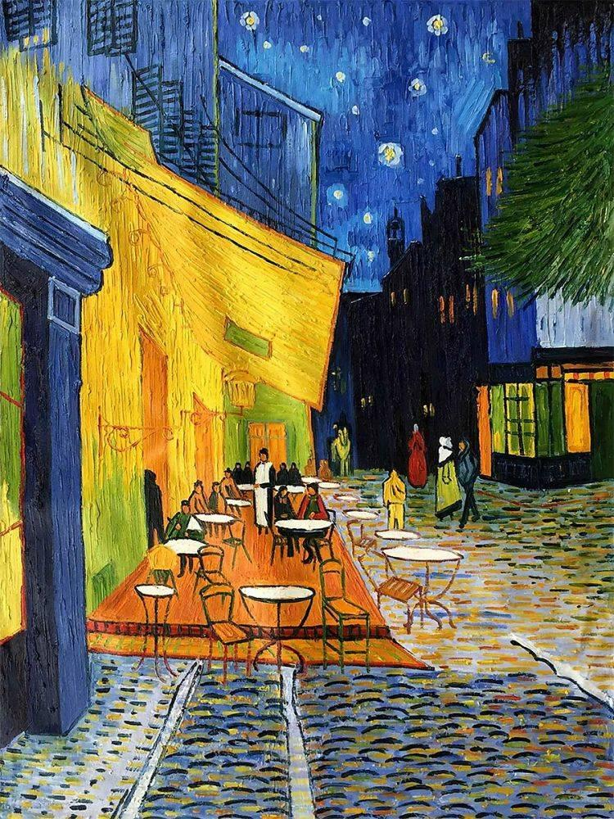
Are you a quiz wizz?
Café Terrace at Night is an 1888 oil painting by which Dutch master?
Van Gogh
Colours look different during the day and at night. That's why Vincent van Gogh wanted to make a night painting. That painting became Terrace of a Café at Night (1888).

Slide 12
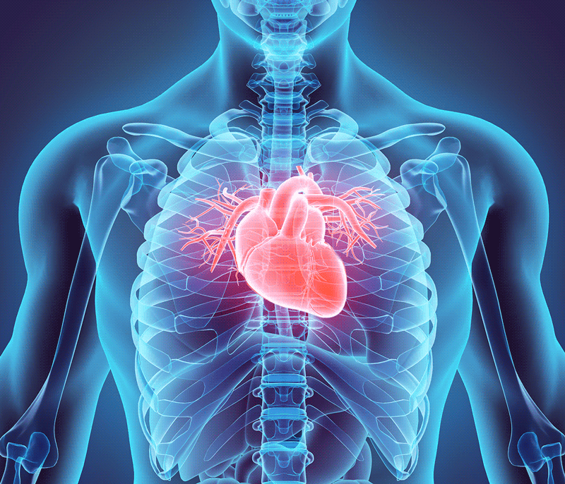
Are you a quiz wizz?
Which chamber of the heart pumps deoxygenated blood to the lungs?
Right ventricle
The blood pumped by a ventricle is supplied by an atrium, an adjacent chamber in the upper heart that is smaller than a ventricle.

Slide 13
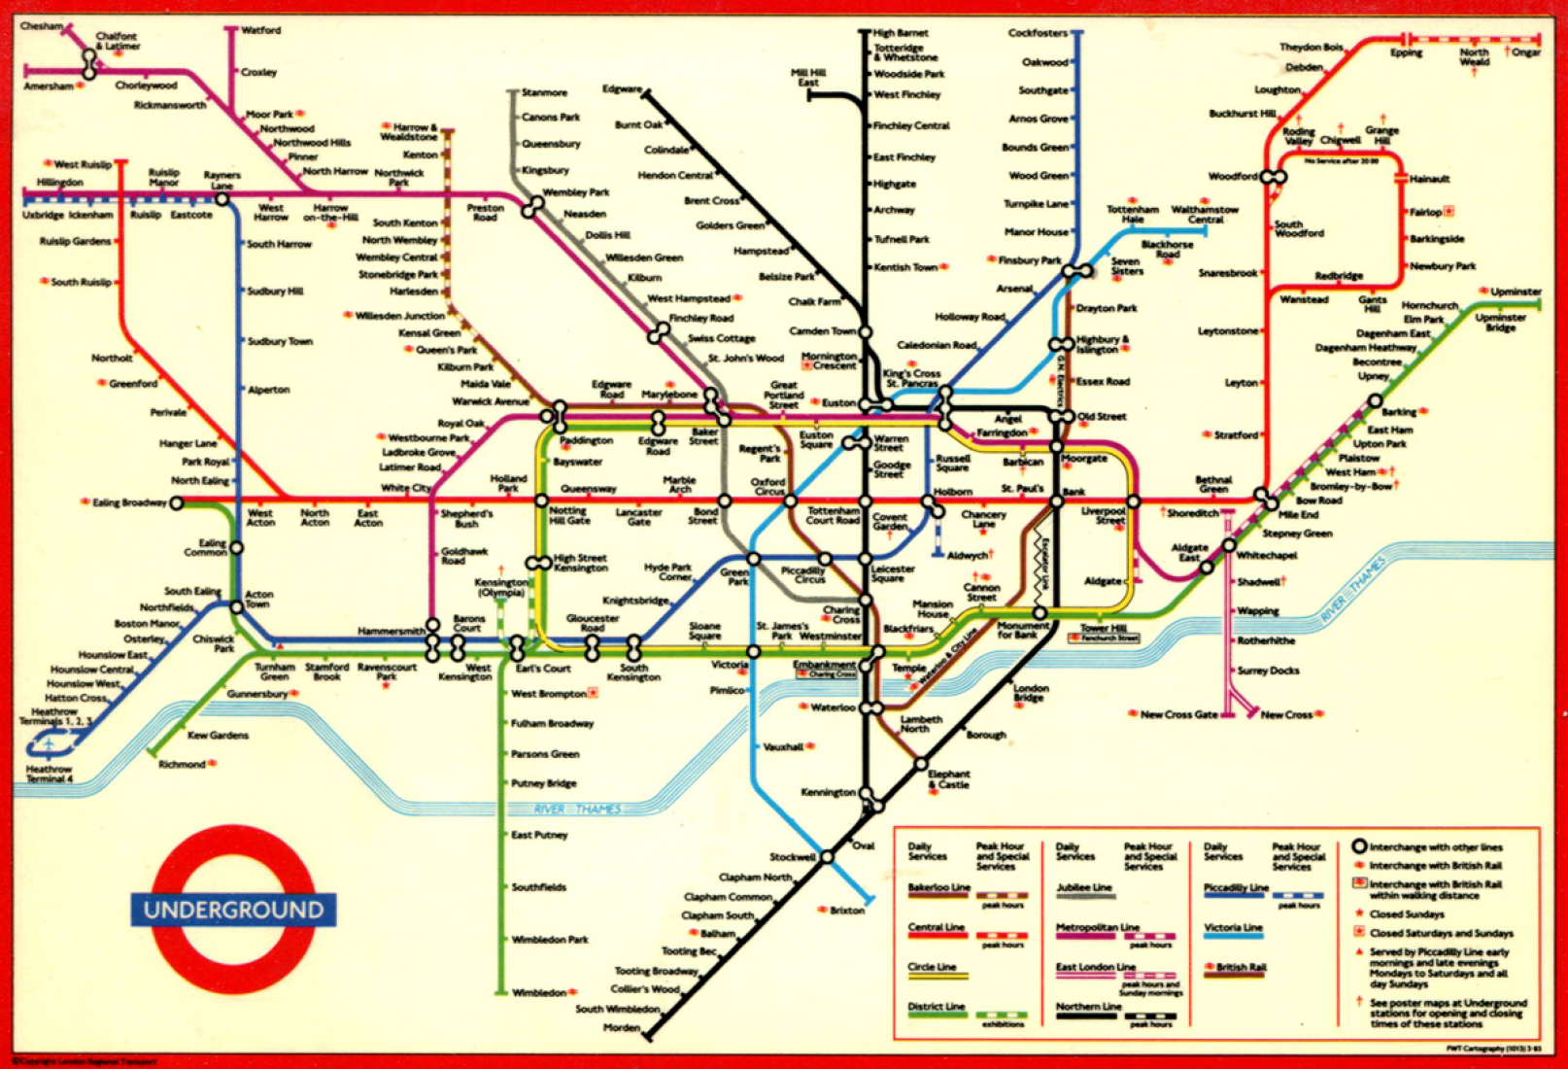
Are you a quiz wizz?
When did the London underground open? 1853; 1863; 1873; 1883
1863
On 10 January, The Metropolitan Railway opens the world's first underground railway, between Paddington (then called Bishop's Road) and Farringdon Street

Slide 14
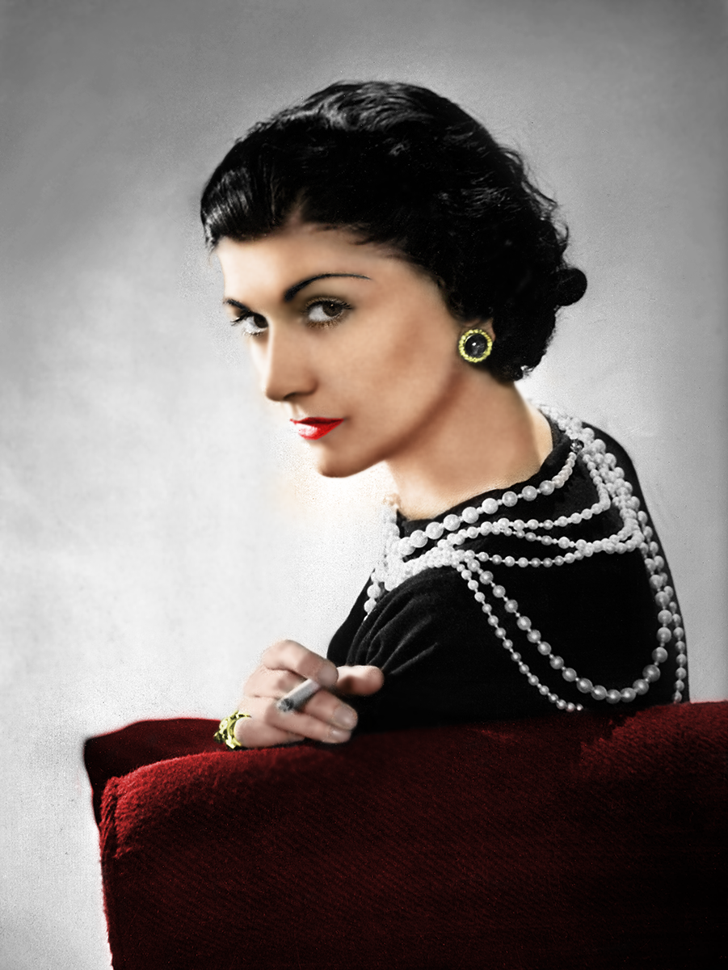
Are you a quiz wizz?
Who invented the iconic Little Black Dress?
Coco Chanel, 1920s
Gabrielle Bonheur "Coco" Chanel (B 1883) was a French fashion designer and businesswoman. The founder and namesake of the Chanel brand, she was credited in the post–World War I era with popularizing a sporty, casual chic as the feminine standard of style.

Slide 15
Are you a quiz wizz?
What happened on July 20th, 1969?
Apollo 11 landed on the Moon
American astronauts Neil Armstrong (1930-2012) and Edwin "Buzz" Aldrin (1930-) became the first humans ever to land on the moon. About six-and-a-half hours later, Armstrong became the first person to walk on the moon.

Slide 16
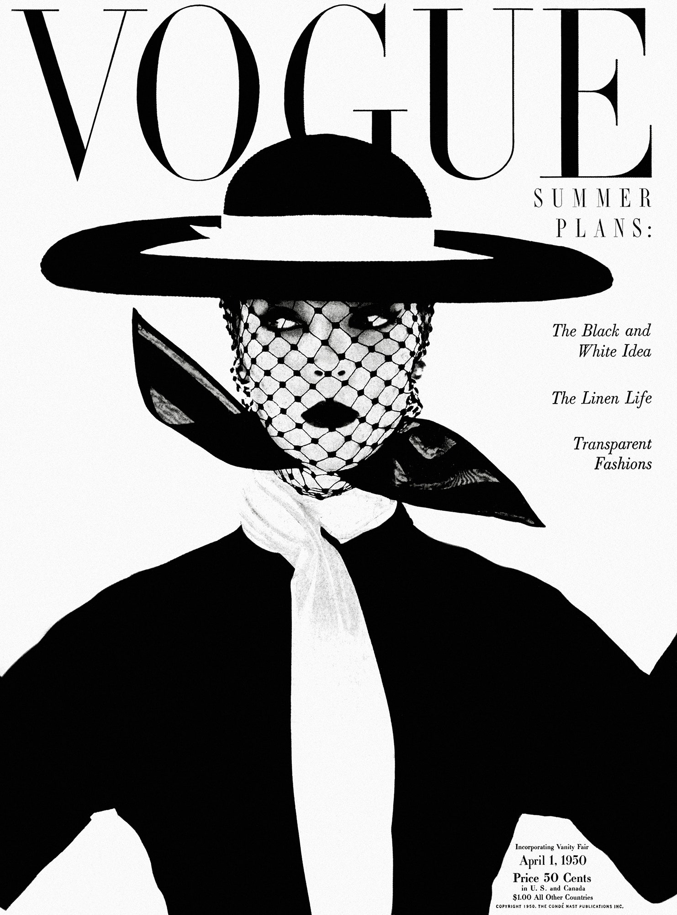
Are you a quiz wizz?
When was the first issue of Vogue published: 1892, 1932, 1952?
1892
On December 17, 1892, Arthur Baldwin Turnure first publishes a new magazine, dedicated to “the ceremonial side of life” and targeted at “the sage as well as the debutante, men of affairs as well as the belle.” A product of the Gilded Age, Vogue has chronicled and influenced high society, fashion and culture ever since.

Slide 17
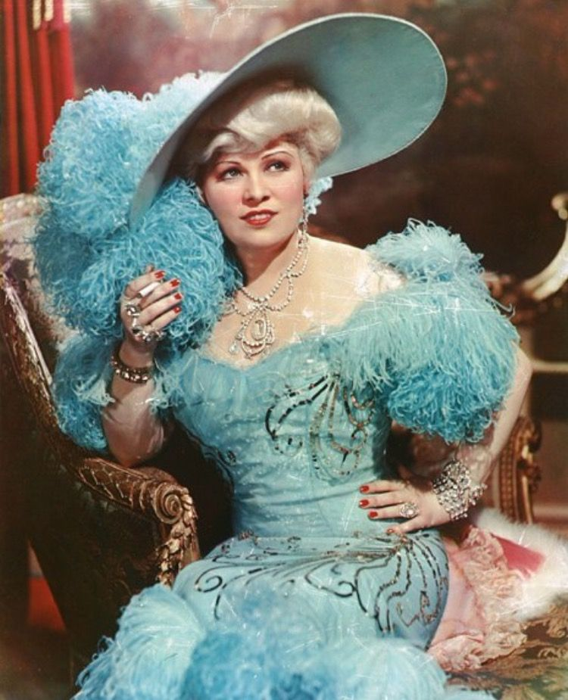
Are you a quiz wizz?
What iconic Old Hollywood actress is famous for saying "when I'm good, I'm very good, but when I'm bad, I'm better”?
Mae West
Mae West. Mary Jane “Mae” " West (1893 - 1980) was an American actress, singer, comedian, screenwriter, and playwright whose career spanned over seven decades.
Considered a sex symbol, she was known for her breezy sexual independence and her lighthearted bawdy double entendres

Slide 18
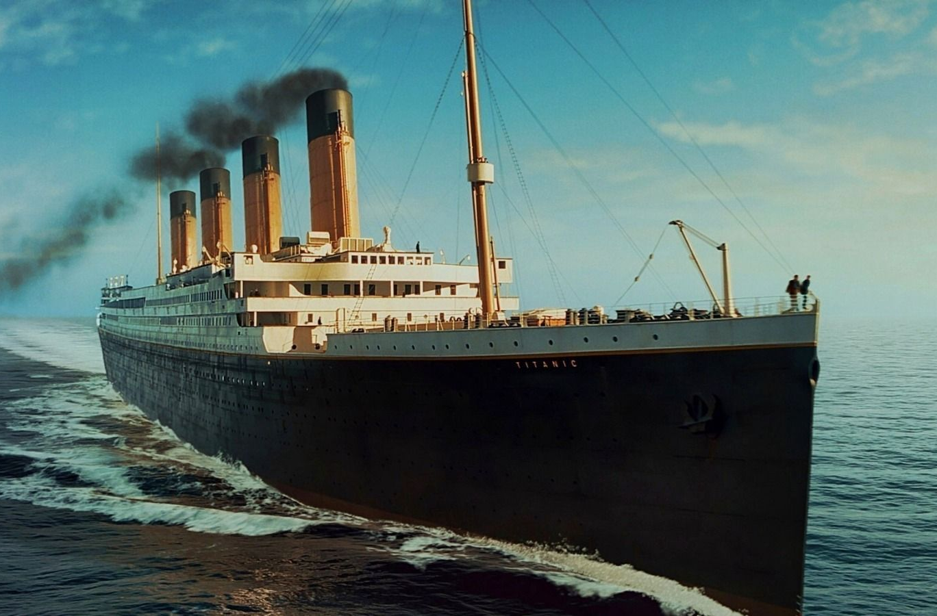
What is the name of the ship that rescued Titanic passengers hours after the “unsinkable” ship went down?
Are you a quiz wizz?
The Carpathia
The Carpathia made her maiden voyage in 1903 from Liverpool to Boston and continued on this route before being transferred to Mediterranean service in 1904. In April 1912, she became famous for rescuing survivors of the rival White Star Line's RMS Titanic

Slide 19
Are you a quiz wizz?
Which word in the English language is spelled incorrectly in every dictionary?
Incorrectly
This is the only dad joke.
I promise.

Slide 20
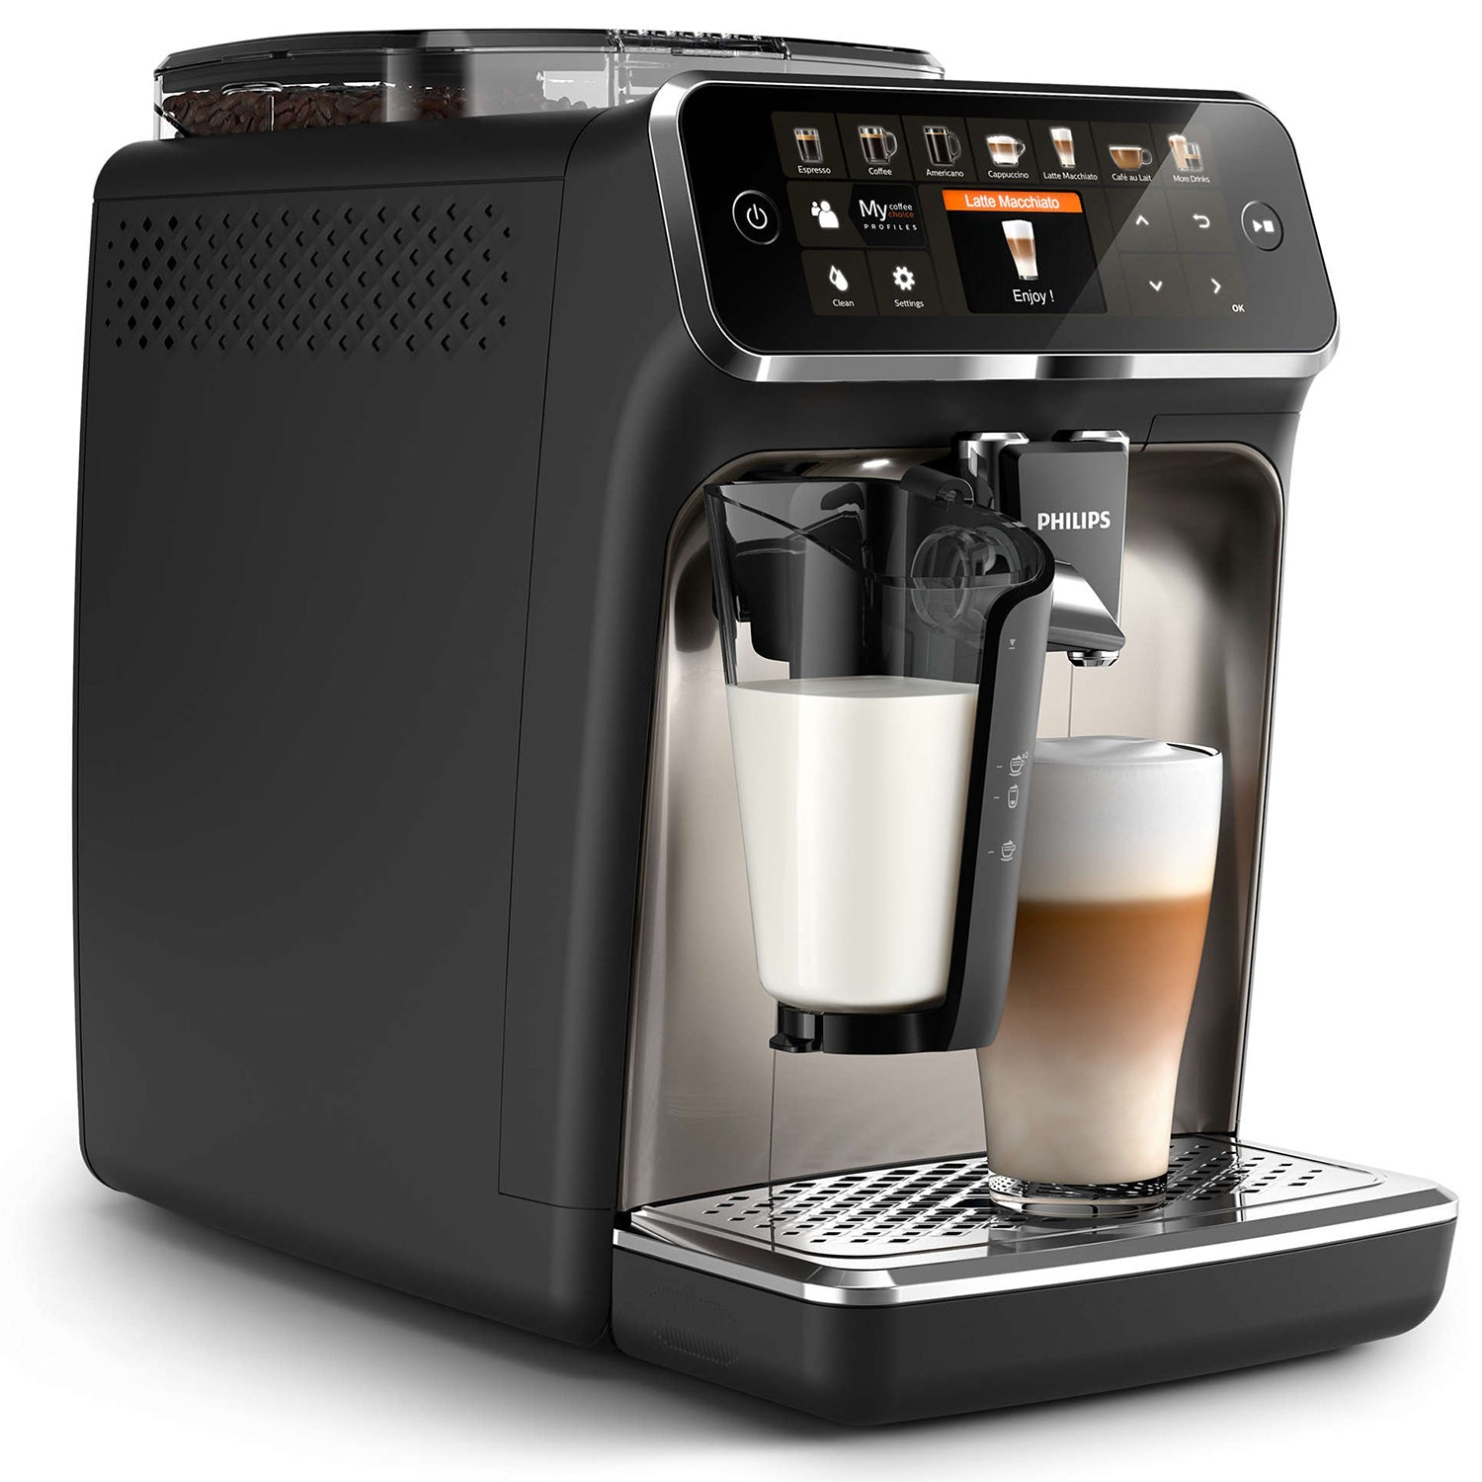
Are you a quiz wizz?
Where was coffee invented, according to most researchers as well as a popular legend about a goat herder?
Ethiopia
In the 15th century, Sufi monasteries in Yemen employed coffee as an aid to concentration during prayers. Coffee later spread to the Levant in the early 16th century.

Slide 21
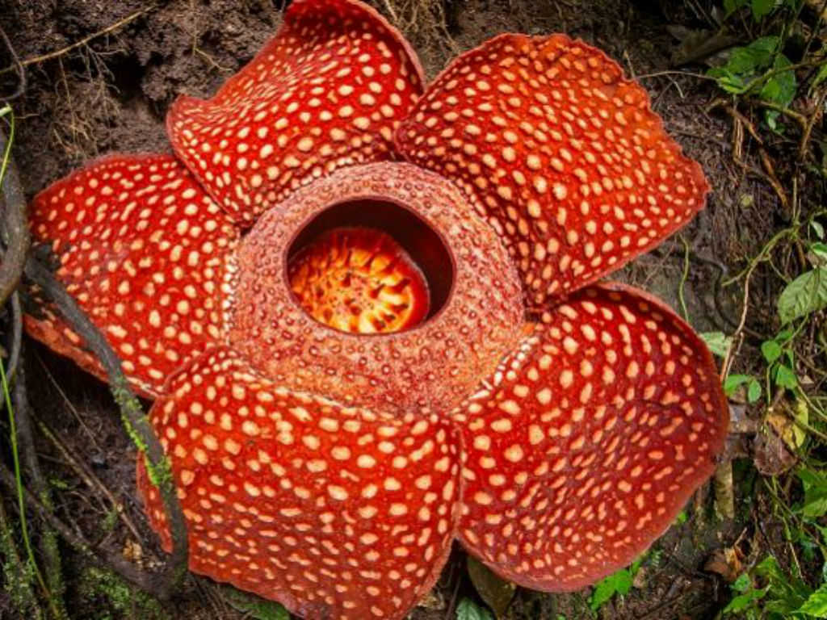
Are you a quiz wizz?
What is the world's largest flower?
Rafflesia arnoldii
Also known as the “corpse flower” due to it smelling like, well, a corpse. It is native to the rainforests of Sumatra and Borneo. It grows to more than 1m across

Slide 22
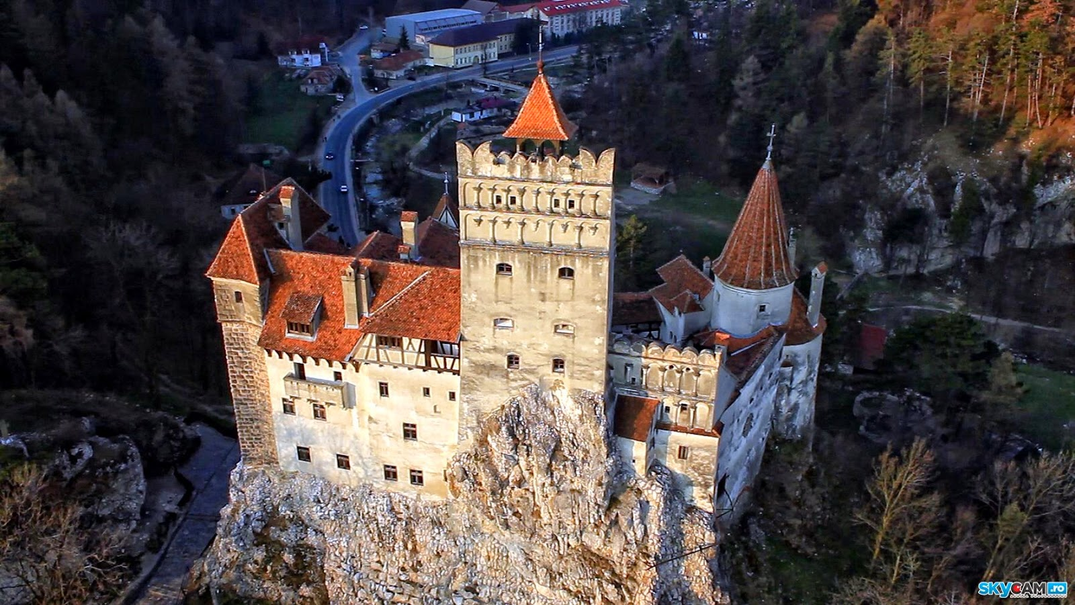
Are you a quiz wizz?
Although Bram Stoker’s character draws inspiration from multiple sources, including folklore, who in history is thought to be the primary real-life template for Dracula?
Vlad the Impaler
Bran Castle is a castle in Bran, 25K southwest of Brașov and was built by Saxons in 1377 who were given the privilege by Louis I of Hungary.

Slide 23
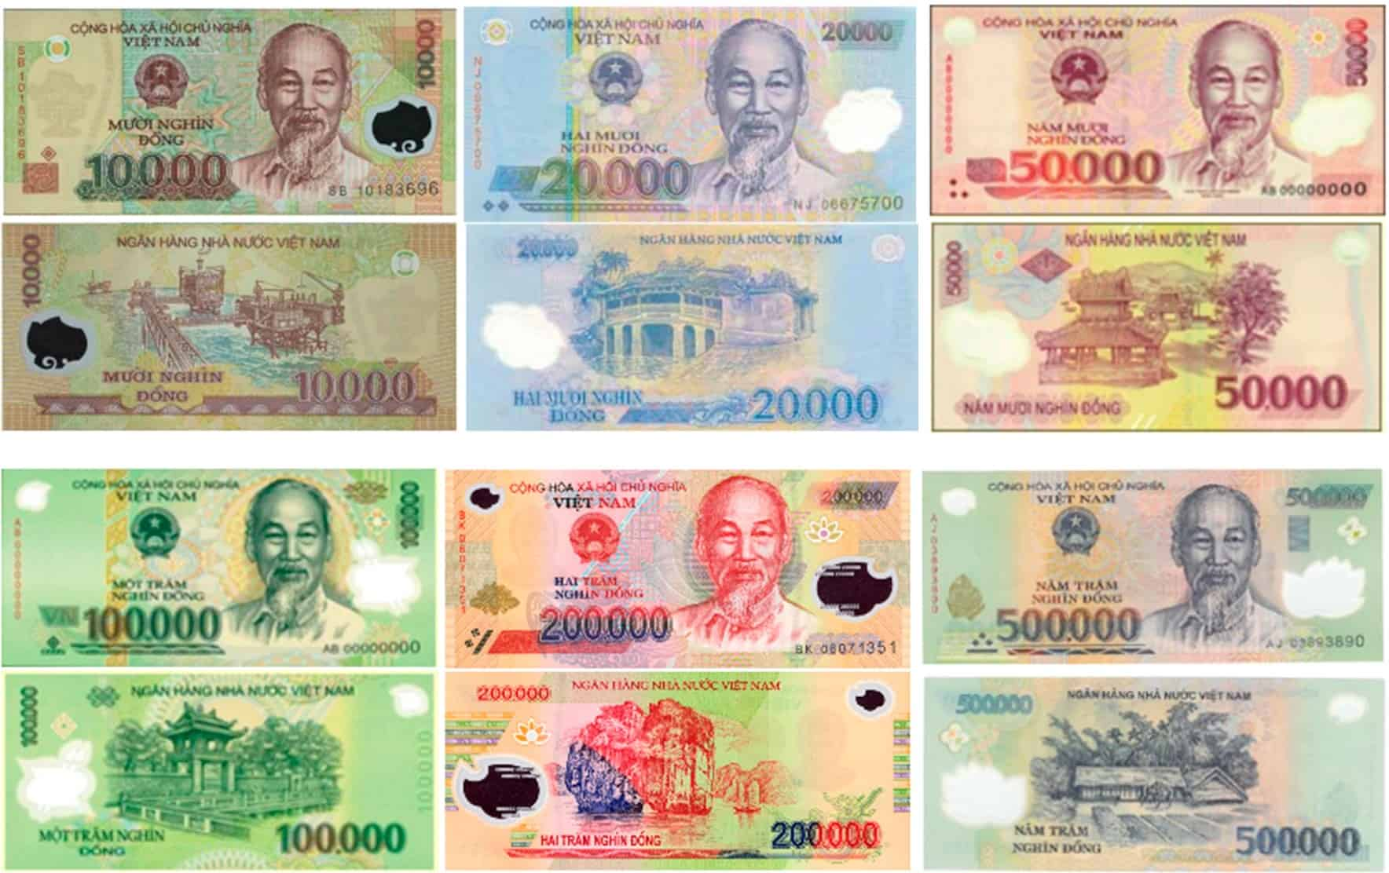
Are you a quiz wizz?
What is the currency of Vietnam?
Vietnamese dong
AU$1 is about 16,000 dong

Slide 24
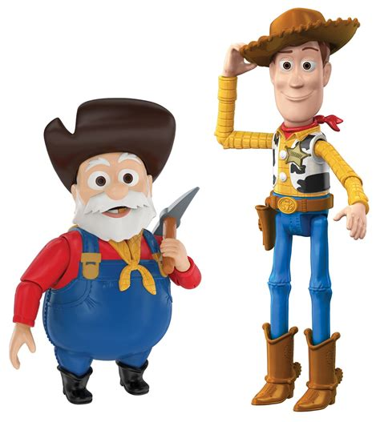
Are you a quiz wizz?
What’s the name of the cowboy in Toy Story?
Woody
Toy Story is a 1995 American animated comedy film produced by Pixar Animation Studios for Walt Disney Pictures. The first installment in the franchise of the same name, it was the first entirely computer-animated feature film, as well as the first feature film from Pixar.

Slide 25
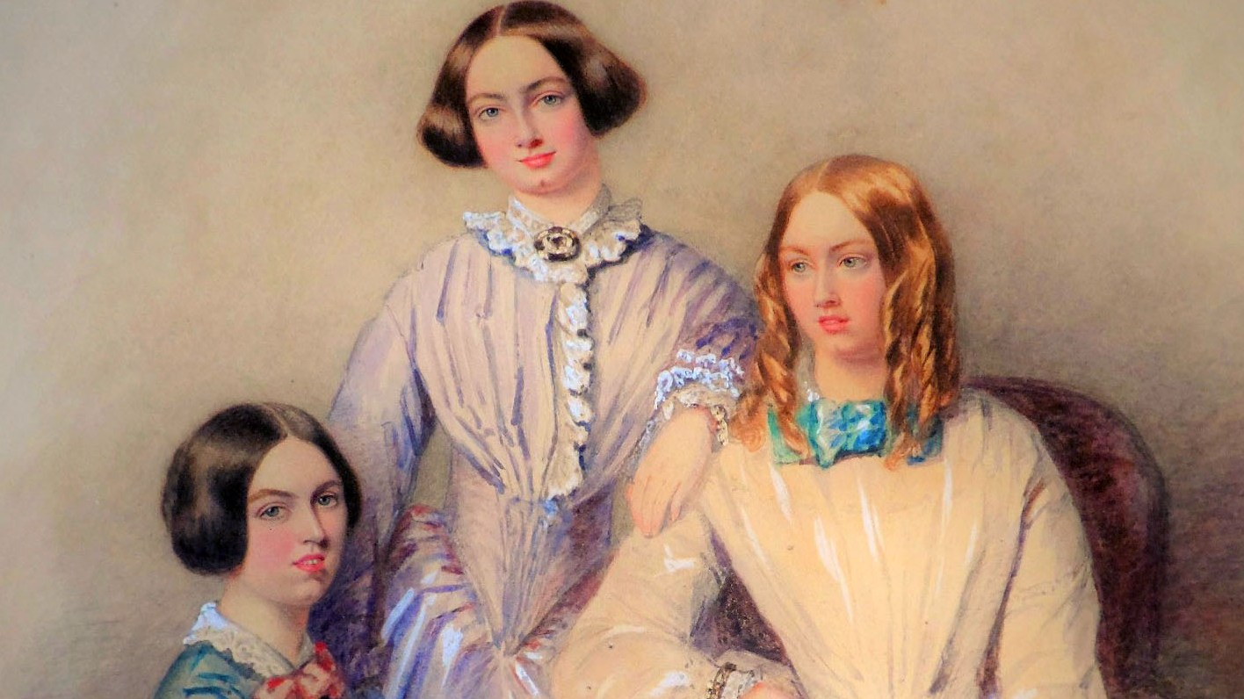
Are you a quiz wizz?
Name 3 of the 5 Bronte sisters?
Emily, Elizabeth, Charlotte, Anne and Maria
The Brontës were a nineteenth-century literary family, born in the village of Thornton and later associated with the village of Haworth.

Slide 26
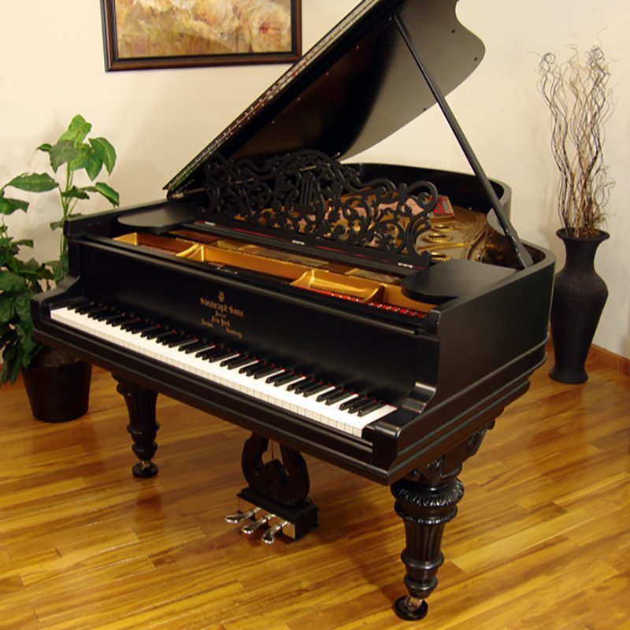
Are you a quiz wizz?
How many keys are on a modern, standard-sized piano?
88
52 white keys and 36 black keys.

Slide 27
Are you a quiz wizz?
What’s the most-consumed beverage in the world excluding water?
Tea
The Chinese have enjoyed tea for millennia. Scholars hailed the brew as a cure for a variety of ailments; the nobility considered the consumption of good tea as a mark of their status, and the common people simply enjoyed its flavour.

Slide 28
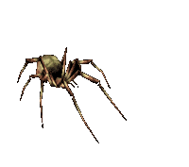
Are you a quiz wizz?
What is the term for the fear of spiders?
Arachnophobia
Though most arachnids are harmless, a person with arachnophobia may still panic or feel uneasy around one. Sometimes, even an object resembling a spider can trigger a panic attack in an arachnophobic individual.

Slide 29
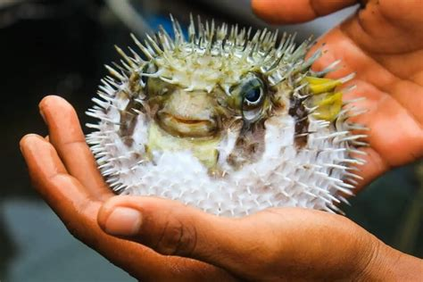
Are you a quiz wizz?
In Japan, what is the name for the edible pufferfish, notorious for its potentially lethal toxins if not prepared correctly?
Fugu
The Japanese delicacy fugu, or blowfish, is so poisonous that the smallest mistake in its preparation could be fatal.

Slide 30
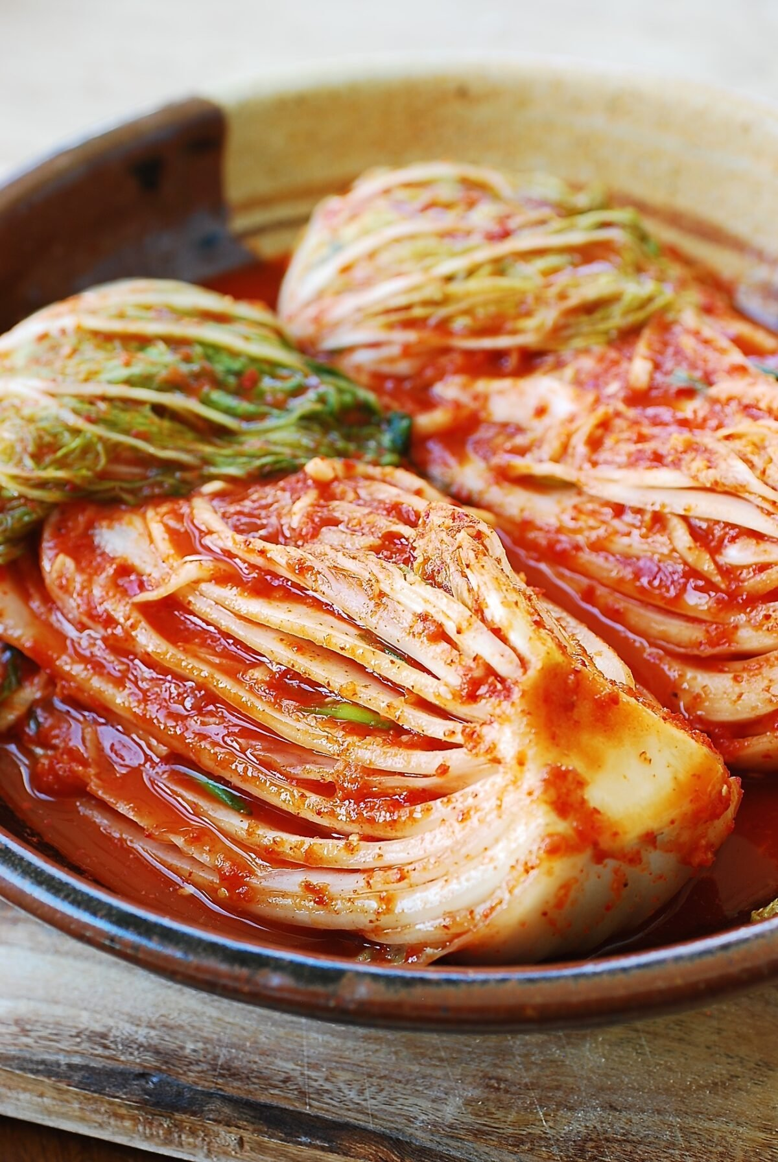
Are you a quiz wizz?
What is the name of the fermented cabbage dish that’s a staple in Korean cuisine?
Kimchi
Side dish consisting of salted and fermented vegetables, most often napa cabbage or Korean radish. A wide selection of seasonings are used, including gochugaru, spring onions, garlic, ginger, and jeotgal, etc. Kimchi is also used in a variety of soups and stews.

Slide 31
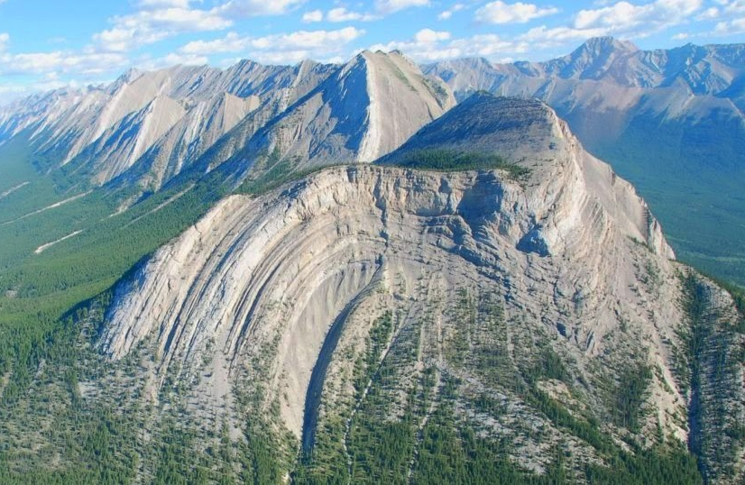
Are you a quiz wizz?
Fissures, vents, and plugs are all associated with which geological feature?
Volcanos
Australia is the only continent without any current volcanic activity. However, it does have one of the world's largest extinct volcanoes, the Tweed Volcano, which was active around 20 million years ago.

Slide 32
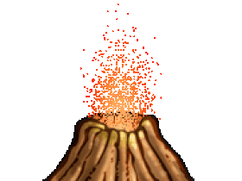
The End

