Slide 1
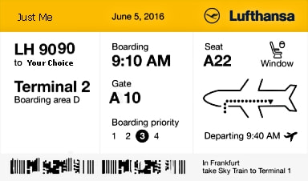
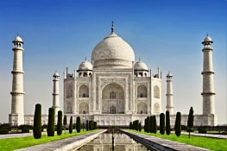
Travel Quiz
I am an ivory-white marble mausoleum commissioned in 1632 by the Mughal emperor, Shah Jahan to house the tomb of his favourite wife, Mumtaz Mahal. Where would you go to visit me?
A) Khandari B) Agra C) Sikandra
D) Delhi
B) Agra
I am the Taj Mahal
A.N.

Slide 2
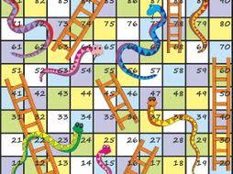
Travel Quiz
The board game, known by the name Mokshapat or Moksha Patamu was developed in India. Some believe the game was played at a time as early as 2nd century BC.
What is it now known as? ​A) Chess B) Snakes and Ladders C) Draughts
B) Snakes and Ladders
The game had its origin in India and was called Moksha Patam or Parama Padam or Mokshapat. It was used to teach Hindu Dharma and Hindu values to children. The British renamed it as Snakes and Ladders. ​
A.N.

Slide 3
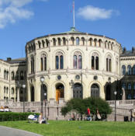
Travel Quiz
C) Norway ​
The Storting is the supreme legislature of Norway, established in 1814 by the Constitution of Norway. It is located in Oslo. The unicameral parliament has 169 members and is elected every.
The Storting is the parliament of which country? A) Sweden B) Denmark C) Norway
D) Netherlands
A.N.

Slide 4
Travel Quiz
Which island in the South Atlantic is named after the Portuguese navigator who first sighted it in 1506? A) Tristan da Cunha B) Isle de Gama C) Fernando de Noronha
D) Robbin Island
A) Tristan da Cunha ​
Both a remote group of volcanic islands in the south Atlantic Ocean and the main island of that group. ​It is the most remote inhabited archipelago in the world, 2,400 kilometres (1,500 mi) from the nearest inhabited land, Saint Helena.
A.N.

Slide 5
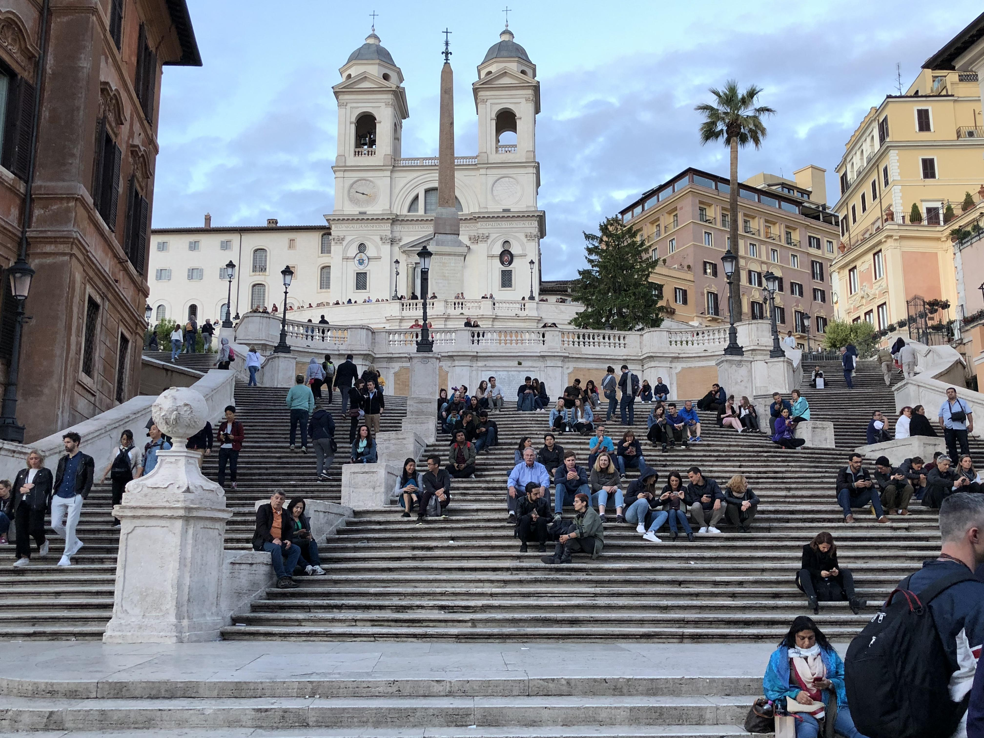
Travel Quiz
B) Rome
Between the Piazza di Spagna at the base and Piazza Trinità dei Monti, dominated by the Trinità dei Monti church at the top.
The name of the steps eventually took the name “The Spanish Steps” but only really in English. In Italian, they simply refer to them as la Scalinata which derives from their proper name, “La Scalinata di Trinita dei Monti.” French and Spanish would follow similarly.
The Spanish Steps are found in which city? A) Madrid B) Rome C) London
D) Paris
A.N.

Slide 6
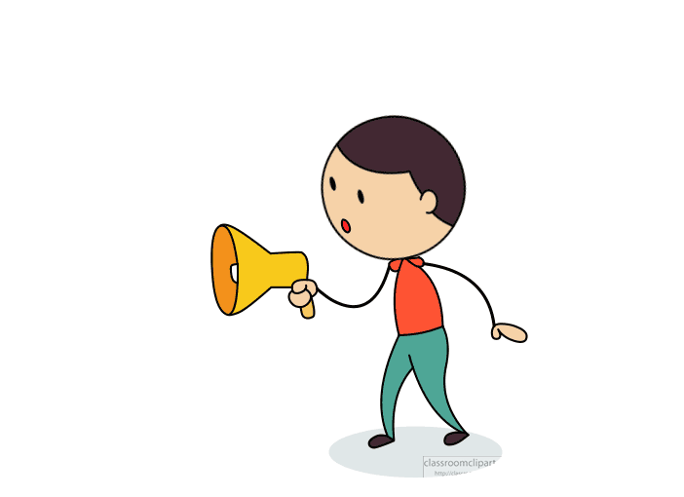
Travel Quiz
Did you know?
Jet lag feels worse when you travel from west to east, because traveling from west to east makes our day shorter.
Because our sleep/wake cycles are slightly longer than 24 hours, traveling from east to west, which makes our days longer, is easier for our brain to adapt to.​
A.N.

Slide 7
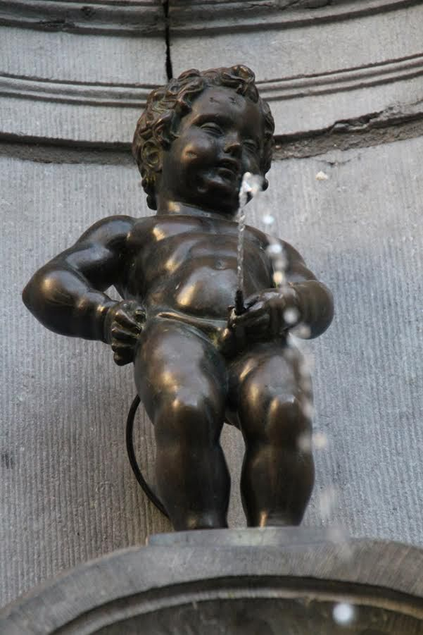
Travel Quiz
B) Brussels
Manneken Pis is a landmark 55.5 cm bronze fountain sculpture in central Brussels, Belgium, depicting a puer mingens; a naked little boy urinating into the fountain's basin. Though its existence is attested as early as the mid-15th century, Manneken Pis was redesigned by the Brabantine sculptor Jérôme Duquesnoy the Elder and put in place in 1618 or 1619
A small bronze sculpture depicting a naked little boy urinating into a fountain's basin is a tourist attraction in what city? A) Rome B) Brussels C) Amsterdam
D) Helsinki ​
A.N.

Slide 8
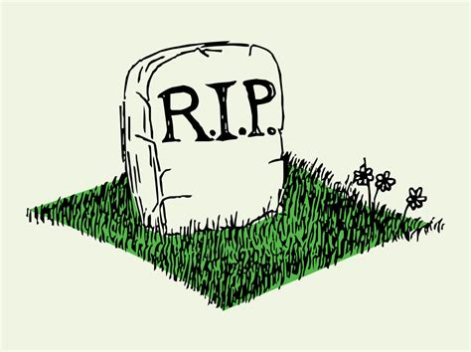
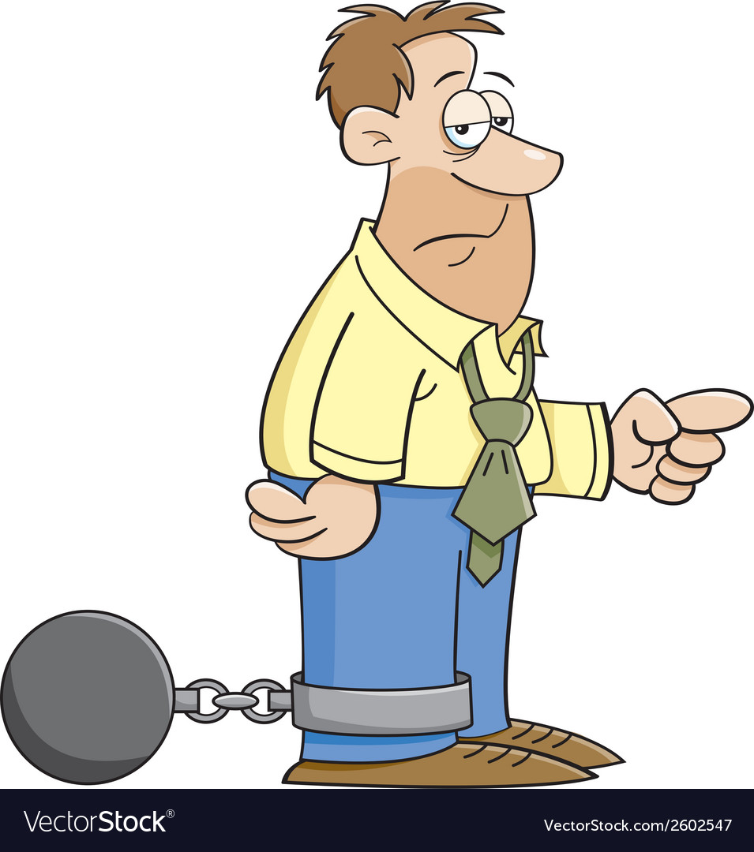
Travel Quiz
A) Houses of Parliament
What is the penalty?
Death by hanging or
transport to Australia?
Where in London is it illegal to die? A) Houses of Parliament B) Tower of London C) London Bridge
D) Buckingham Palace ​
A.N.

Slide 9
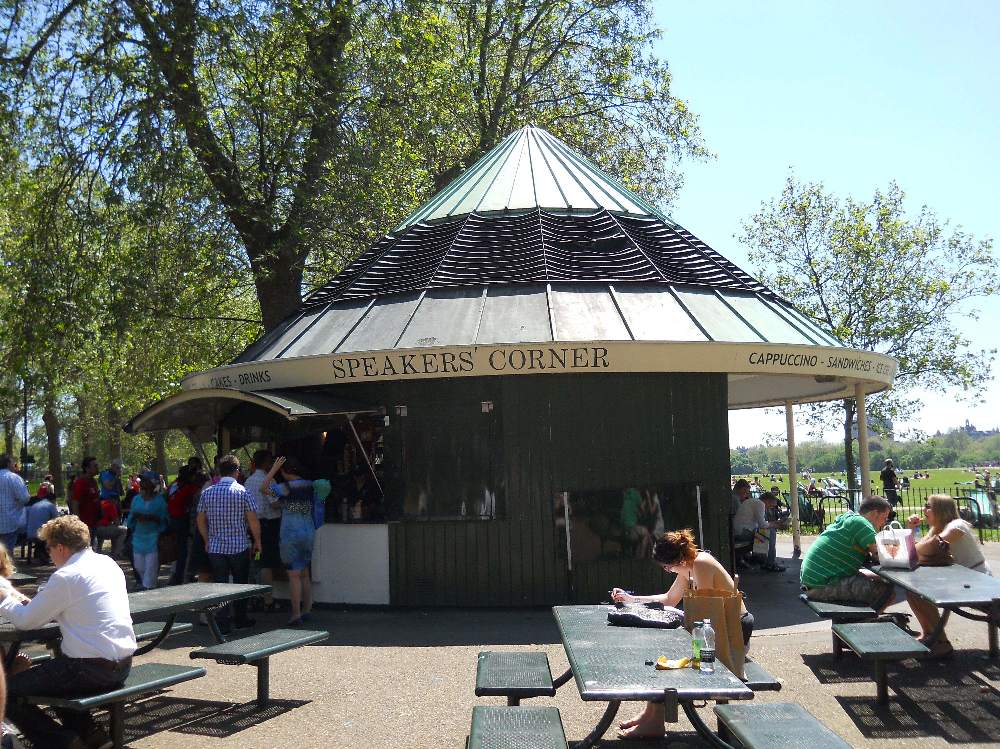
Travel Quiz
Speaker's Corner in London is on the corner of which park? A) St James Park B) Hyde Park C) The Regent’s Park ​
B) Hyde Park
Located on the north-east, nearest Marble Arch and Oxford Street. Historic figures such as Karl Marx, Vladimir Lenin and George Orwell were known to often use the area to demonstrate free speech
A.N.

Slide 10
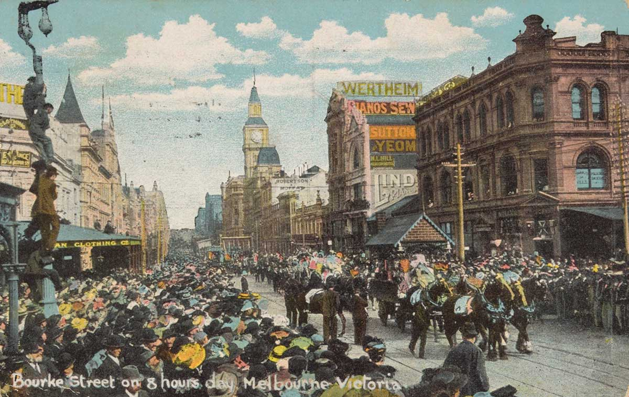
Travel Quiz
Action taken by stonemasons on 21 April 1856 led to the establishment and maintenance of {WHAT}.
This was recognised internationally as a world first. A) Overtime B) Paid sick leave C) The 8 hour work day​
C) The 8 hour work day
Did you work overtime to get this one?
A.N.

Slide 11
Travel Quiz
Did you know?
Couples who travel together tend to have stronger relationships. Humans naturally bond when they need to trust one another in new situations and circumstances.
A.N.

Slide 12
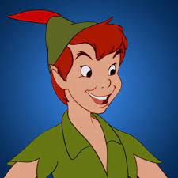
Travel Quiz
Great Ormond Street Hospital, off Russell Square, owns the copyright to what book?
The author gifted the rights to the hospital in 1929 A) Winnie the Poo B) The Secret Garden C) Peter Pan ​
C) Peter Pan
JM Barrie (The author) was approached to take part in a Great Ormond Street Hospital committee to buy land for a badly needed new medical wing. Two months later, the hospital board discovered that the Scottish author had given over all rights to Peter Pan for Great Ormond Street’s use, so beginning the long association of the work with London’s most renowned children’s hospital.
A.N.

Slide 13
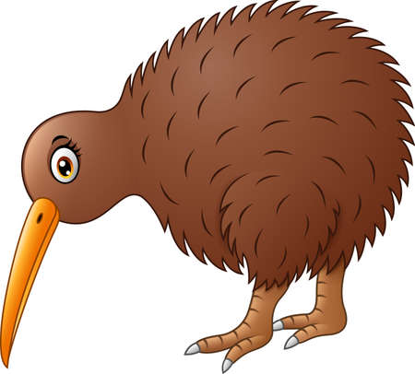
Travel Quiz
Option C:- A bird
A flightless New Zealand bird with hair-like feathers, having a long down-curved bill with sensitive nostrils at the tip.
What is a Kiwi? A) A glow worm B) A type of Frog C) A Bird
D) A Town ​
A.N.

Slide 14
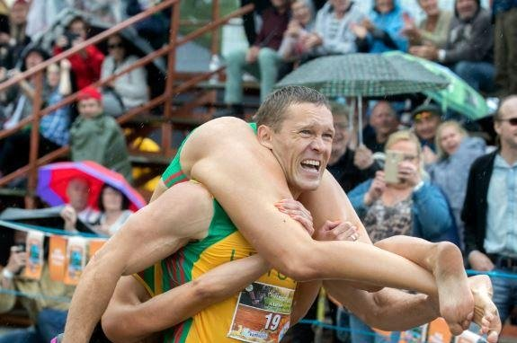
Travel Quiz
Sonkajärvi in Finland is known for an unusual competition.
What is it? a) Running of the bulls; b) Penguin races; c) Wife carrying races
d) Beer swilling ​
Option C:- Wife carrying races ​Finland’s Wife Carrying Competition requires male competitors to carry their wives along a 250-meter course that includes land and water obstacles. Drop your better half and incur a 15-second penalty- and you had better find yourself a good hotel for the night.
A.N.

Slide 15
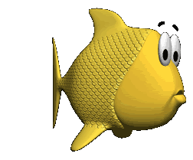
Travel Quiz
Rotting fish is a delicacy in what country A) Finland B) Denmark C) Iceland
D) Scotland
Option C:- Iceland Hákarl. The rotting carcass of a Greenland or basking (Somniosidae) shark. It’s buried underground in a shallow pit and pressed with stones so the poisonous internal fluids that allow it to live in such cold waters can be drained out making the meat safe to eat.
After this it’s hung out to dry before being cut into strips and served. With a smell that’s described as ammonia-rich and a strong ‘fishy-flavour’, .
A.N.

Slide 16
Travel Quiz
Did you know?
Originally built as a fortress in the late 12th century, the Louvre Museum is the most visited museum in the world.
Over nine million visitors annually.
A.N.

Slide 17
Travel Quiz
The name of this place translates into English as "The Land of Fire". Where is it. A) Tip of South America B) New Zealand North Island C) In the Bermuda triangle
D) Madagascar
Option A:- Tip of South America Tierra del Fuego Spanish for "Land of Fire") is an archipelago off the southernmost tip of the South American mainland, across the Strait of Magellan.
A.N.

Slide 18
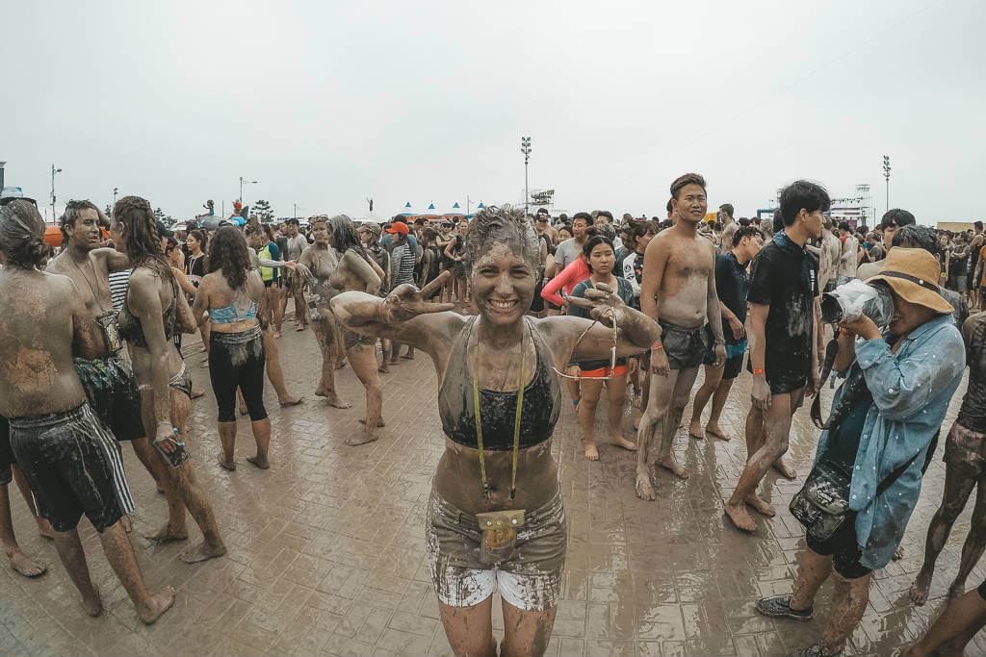
Travel Quiz
Boryeong in South Korea have a festival, now in its 20th year that started to promote a local cosmetic. What is the main ingredient of that cosmetic? a) Chicken eggs; b) Mud; c) Fermented figs
d) Roses
Option B:- Mud​ This annual festival occurs in July in the village of Boryeong, 200 kilometers south of Seoul. The first one took place in 1998 and it was originally created as a marketing event for Boryeong mud cosmetics. The mud from the Boryeong mud flats is considered rich in natural minerals and is used to make beauty products.
A.N.

Slide 19
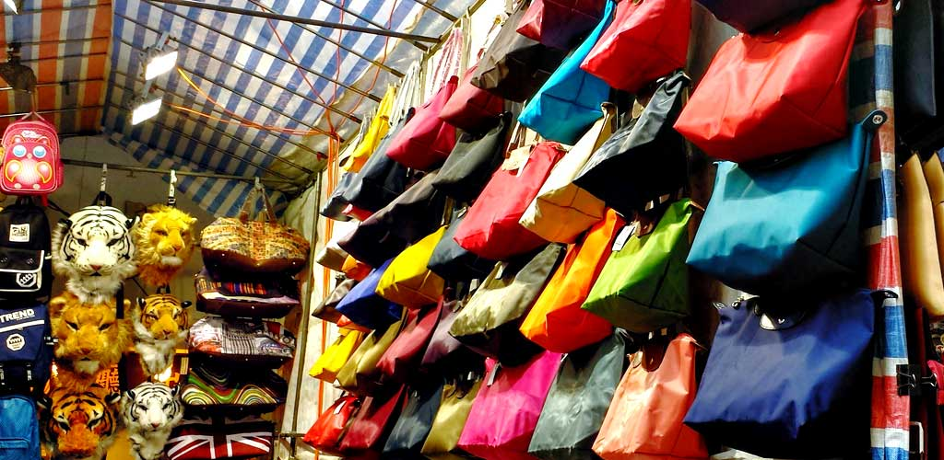
Travel Quiz
This city is home to 'The Ladies Market', Stanley Market' and the 'Cat Street Market. What city? A) Beijing B) Taipei C) Hong Kong
D) Hanoi
Option C):- Hong Kong
A.N.

Slide 20
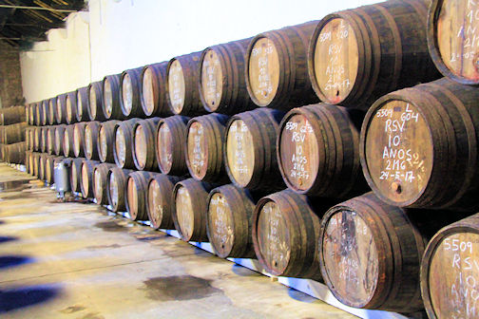
Travel Quiz
What is the Douro valley in Portugal famous for? ​ A) Cork for bottles B) Health spa's C) Port wine
D) Tarts
Option C: Port Boundaries were determined for the Douro Valley’s vineyards in 1756, making it the oldest demarcated wine region in the world. Grape harvest and wine production goes back 2,000 years, however, and the support of the people led to the vineyards’ recognition as a UNESCO World Heritage Site.
A.N.

Slide 21
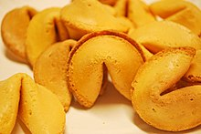
Travel Quiz
The Chinese fortune cookie was first created at a Chinatown bakery in which city?​ ​
Hong Kong
Paris
San Francisco
Ho Chi Minh City
Option C: San Francisco
The exact origin of fortune cookies is believed to be from in California. They claim to have popularized them in the early 20th century. They most likely originated from cookies made by Japanese immigrants to the United States in the late 19th or early 20th century. The Japanese version did not have the Chinese lucky numbers and were eaten with tea.
A.N.

Slide 22
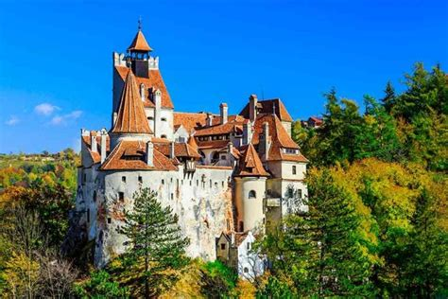
Travel Quiz
Bran Castle, Commonly known as “Dracula’s Castle“ is in what country? A) Hungary B) Romania C) Bulgaria
D) Croatia ​
Option B) Romania
Bram Stoker’s character, Dracula, is a Transylvanian Count with a castle located high above a valley perched on a rock with a flowing river below in the Principality of Transylvania.
A.N.

Slide 23
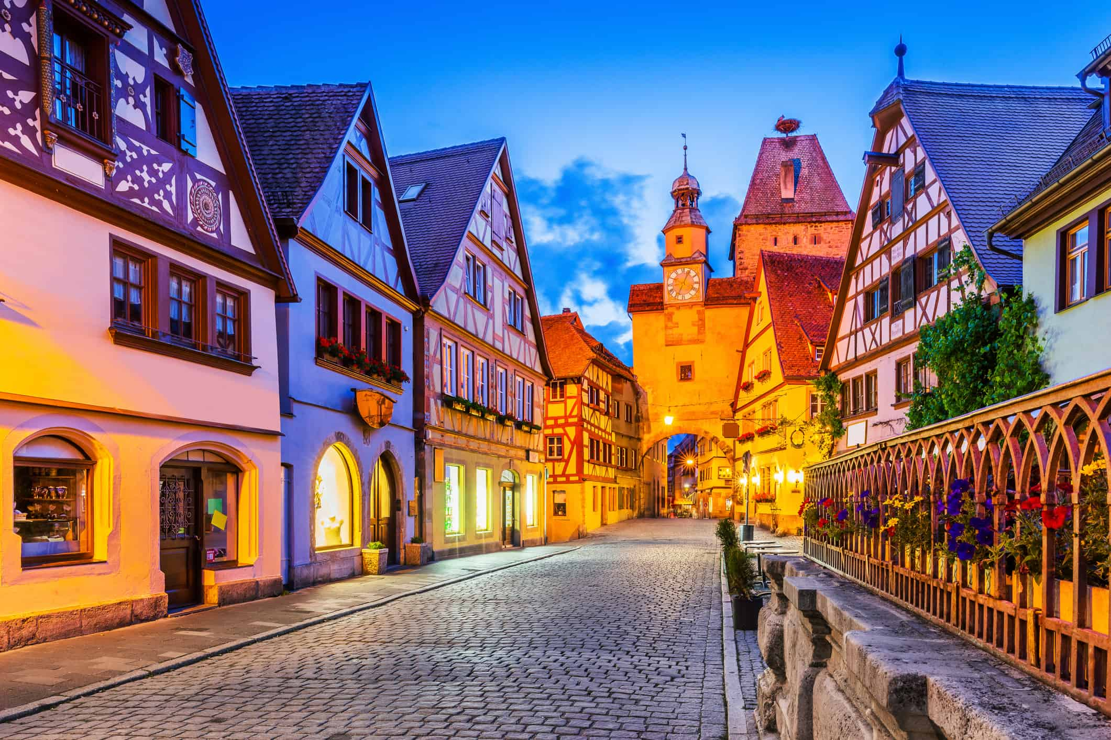
Travel Quiz
Your self-drive travel guide tells you that you are driving along the "Romantic Road".
In what country are you? A) Germany B) Switzerland ​ C) Italy
D) France ​
Option A) Germany
Southern Germany’s Romantic Road (Romantische Straße) is a picturesque 350km route through the forests and mountains of Bavaria and Baden-Württemberg.
A.N.

Slide 24
Travel Quiz
Did you know?
A "xenophobe" is someone who fears travelers from a foreign land.
A.N.

