Slide 1
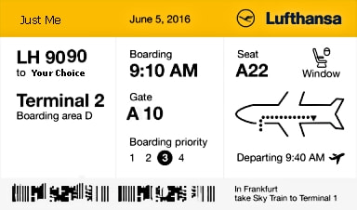
Travel Quiz
If someone says Konnichiwa to you, what are they saying and where are you? ​
Hello in Japan
Konnichiwa is the general, widely-used term to say “hello” in Japanese. You can use it at any time during the day or night, and it would be appropriate for both formal and informal settings.
‘Hello’ in Vietnam
‘Goodbye’ in Zimbabwe
‘Cheers’ in Sweeden
‘Hello’ in Japan
A.N.

Slide 2
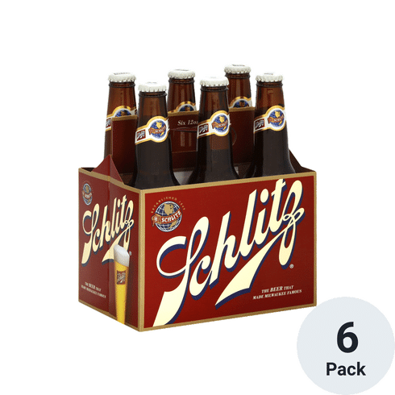
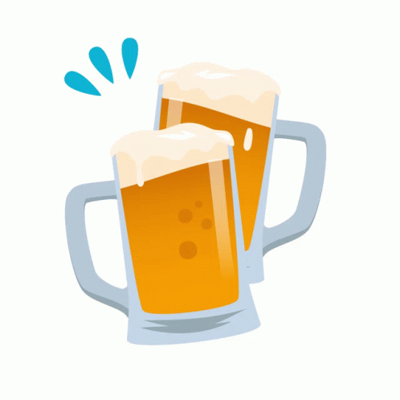
Travel Quiz
You are doing a beer tour of the USA visiting the original home of Pabst, Schlitz and Blatz Beer. What city are you visiting? a) Chicago b) Detroit c) Minneapolis d) Milwaukee ​
D) Milwaukee Some history:- Although the brewery was born in 1849, it was in the wake of the Great Chicago Fire that Schlitz got its nickname “the beer that made Milwaukee famous.” The fire wiped out five of Chicago’s breweries, along with its water infrastructure, leaving no water or supplies to brew beer.
It was Schlitz to the rescue, sending thousands of barrels of their beer south to wet the whistles of the beer-deprived Chicagoans who were so thankful to Schlitz that they became brand loyalists.
A.N.

Slide 3
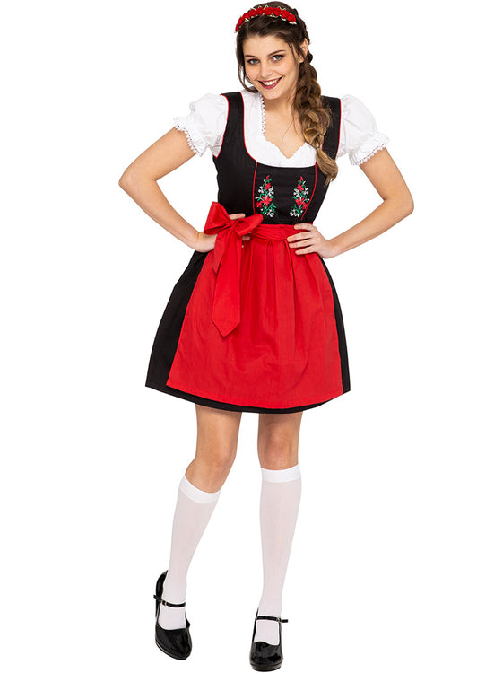
Travel Quiz
A 'Dirndl' is a traditional ladies dress, usually comprising bodice, blouse, full skirt an apron. Where would you expect to see a lady wearing a Drindl a) Ethopia b) Mongolia c) Japan ​ d) Austria ​
d) Austria.
Also Germany and Switzerland
A.N.

Slide 4
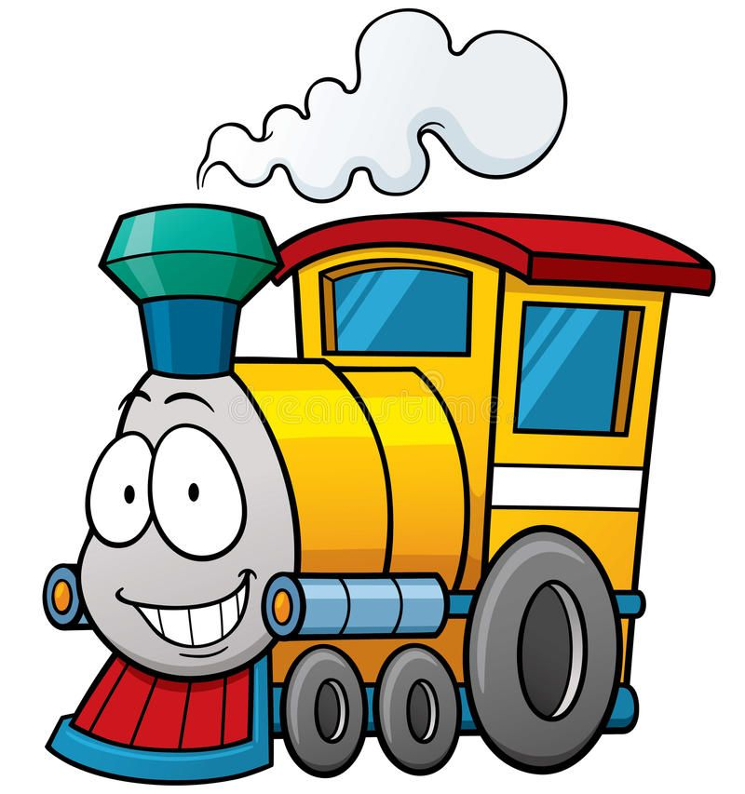
Travel Quiz
If you were catching a train to FD Roosevelt, Stalingrad and Louis Blanc, What city would you be in? ​ A) Rome B) Paris C) Madrid
D) Moscow ​
Option B:- Paris:
They are stations on the Paris Metro.
A.N.

Slide 5
Travel Quiz
What makes the city of La Paz in Bolivia safe from fire? A) Volunteer fire fighters B) Wet weather C) Altitude
D) Govt Regulations
Option C:- Altitude Too high in altitude - Not enough air to burn.
A.N.

Slide 6
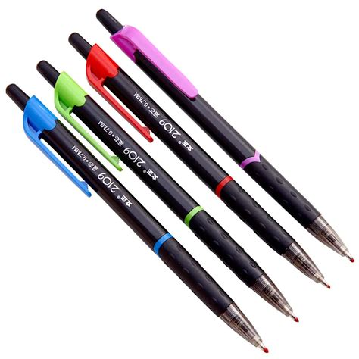
Did you know?
Buenos Aires, Argentina
The ballpoint pen, an office tool that is now used all around the world in just about every place imaginable, was invented there.
A.N.

Slide 7
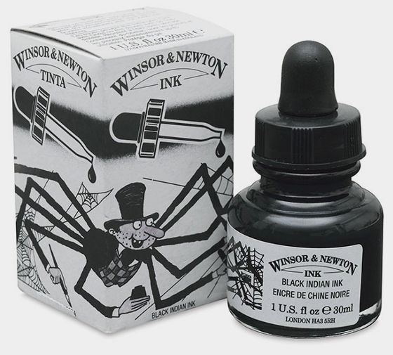
Travel Quiz
India ink or Indian Ink; is a simple black or colored ink. In what country did it originate A) India B) Pakistan C) China
D) Mongolia ​
Option C:- China It is believed that the process of making India ink was known in China as early as the middle of the 3rd millennium BC
A.N.

Slide 8
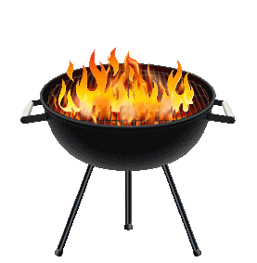
Travel Quiz
The English word "barbecue" and its cognates in other languages come from the word ‘barbacoa’. What language is it from? A) North American Cherokee B) Canadian Inuit C) Spanish
D) Xhosa ​
Option C):- Spanish ​ Originally a barbacoa wasn't a way of cooking food but the name of a wooden structure used by Taino Indians to smoke their food.
A.N.

Slide 9
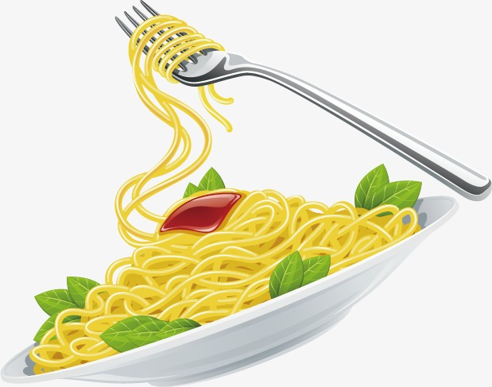
Travel Quiz
Marco Polo brought pasta back to Italy from Brazil. True or False?
True
False ​
b) False
Or perhaps half true.
Marco Polo who is believed to have brought pasta to Italy after a trip to China. Marco Polo was born in the year 1254 in Venice, Italy.
Right guy, wrong country
A.N.

Slide 10
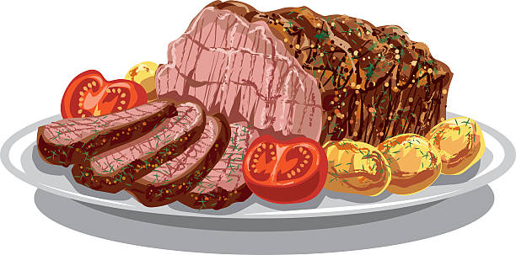
Travel Quiz
Who, What or Where is Seminyak A) A meat dish made from Yak meat, boiled in a spicy mixture B) A beach in Bali ​c) A cocktail made from rice wine.
Option B:- A beach in Bali ​ An extension to the north of the surf, sand and sunsets of Kuta and Legian.
A.N.

Slide 11
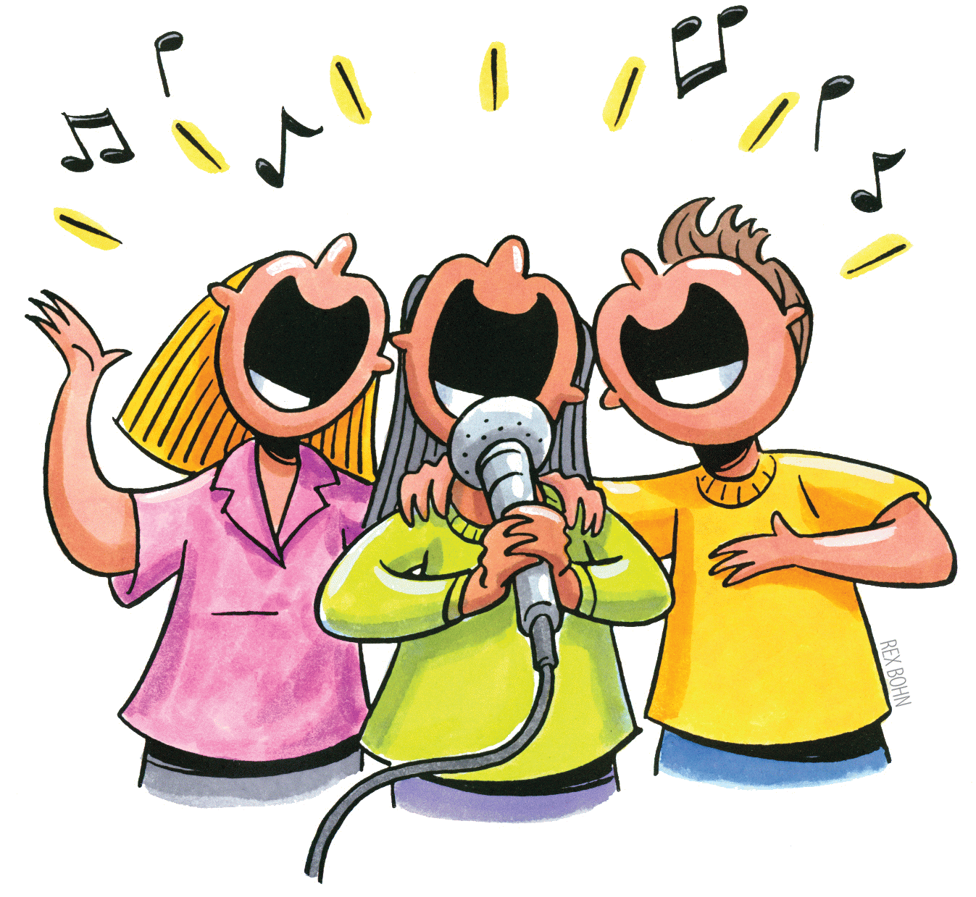
Travel Quiz
What does the Japanese word 'Karaoke' mean? ​ A:- Empty orchestra B:- .Singing Solo ​ C:- Beautiful voice
Option A: Empty Orchestra Kara means 'empty or void' and okesutora - short oke - means orchestra and is an English loan word in the Japanese language.
So karaoke is a kind of double and reversed borrowed English-Japanese loan word, actually meaning 'empty orchestra'!
A.N.

Slide 12
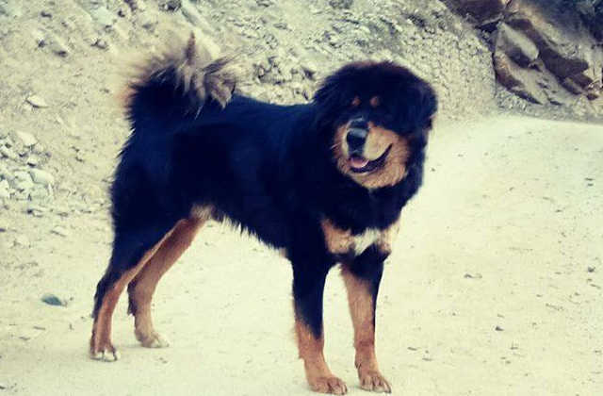
Travel Quiz
What or where is a Gaddi Kutta ​ a) Dog breed; b) Cheese from Southern India c) Mountain peak in the Himalayas.
Option A:- Dog breed. It is a mastiff-type mountain dog found in northern India, especially states in the western Himalayas region and in Himachal Pradesh. They are also called the Himalayan Sheepdog, Indian Panther Hound, as well as Mahidant Mastiff and Bhutia, the former pointing to the breed’s skills and the latter to its origins.
A.N.

Slide 13
Did you know?
In Amsterdam there are 880,000 bicycles in comparison to a population of 800,000 city inhabitants, which means Amsterdam has more bicycles than people.
A.N.

Slide 14
Travel Quiz
What is a Gho a) Meal made from roast chicken. b) Article of clothing c) Beverage made from fermented rice.
d) a form of transport
Article of clothing ​It is a knee-length robe tied at the waist by a cloth belt known as the kera and is the traditional and national dress for men in Bhutan. Introduced in the 17th century by to give the Ngalop people a more distinctive identity.
A.N.

Slide 15
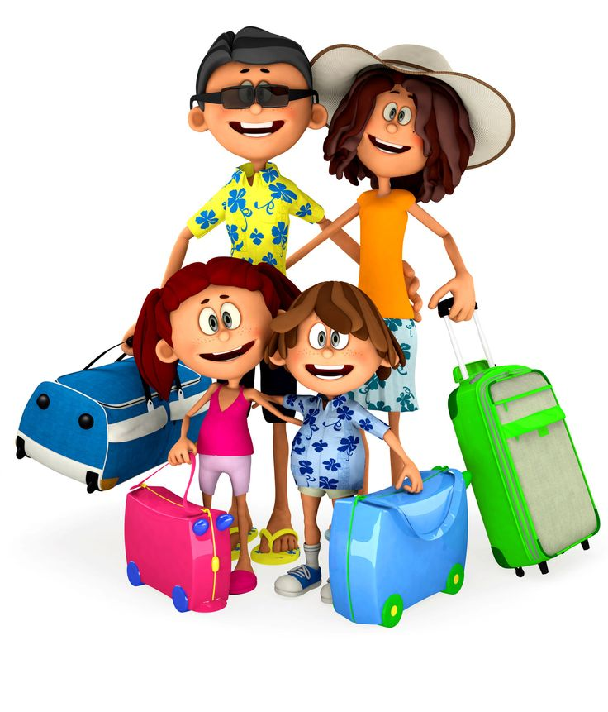
Travel Quiz
If you are going to Pee Pee, where are you likely to be? (and it is not in the loo) a) Australia, b) New Zealand c) USA
d) Vietnam
Option C:- USA ​ ​Pee Pee Township is one of the fourteen townships of Pike County, Ohio, United States. Pee Pee Township took its name from Pee Pee Creek; which was so named when an early settler inscribed his initials P. P. on a tree along its banks. ​​
A.N.

Slide 16
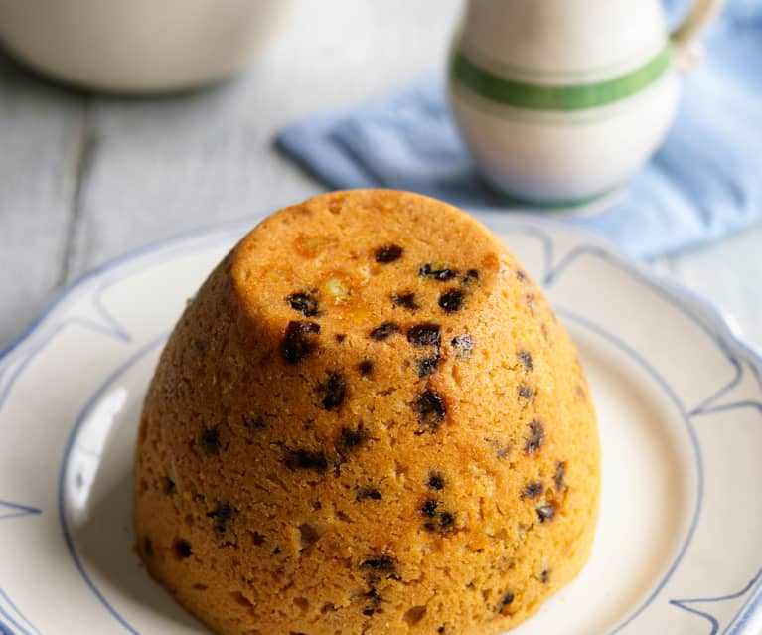
Travel Quiz
What or Where is a Spotted dick a) A lake in Canada, b) A dog breed, c) A dessert
d) An Irish delicacy
Option C:- Dessert ​Spotted Dick is also known as "spotted dog" or "railway cake" and is a British pudding, traditionally made with suet and dried fruit, usually currants and raisins, and often served with custard. However it is now most commonly made without suet, rather other fats (such as butter) and egg, more similar to a sponge cake.
A.N.

Slide 17
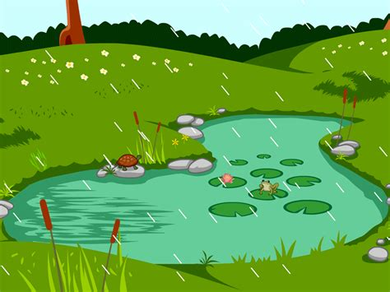
Travel Quiz
On a theme of spots, Where is spotted lake? a) British Columbia, Canada; b) Lake District, England; c) Mpumalanga, South Africa
d) Cambodia
Qption A:- Canada In winter and spring, the lake located northwest of Osoyoos in British Columbia’s Okanagan Valley looks just like any other body of water. But as most of the water starts to evaporate in summer, hundreds of huge briny pools are left behind, leaving a polka-dotted landscape of yellow, green and blue spots.
A.N.

Slide 18
Did you know?
Munich, Germany
The famous German fall festival, Oktoberfest, actually begins the month before. It’s two to three weeks long and begins half-way through September.
A.N.

Slide 19
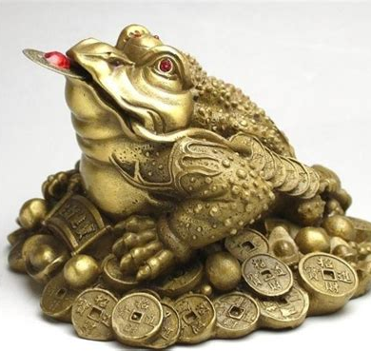
Travel Quiz
Leaving the subject of spots, What is a Jin Chan a) A breed of dog; b) An alcoholic beverage made from rice; c) A Frog
d) A national food
Option C:- A Frog ​ Most most commonly translated as "Money Toad" or "Money Frog". It represents a popular Feng Shui charm for prosperity. This mythical creature is said to appear during the full moon, near houses or businesses that will soon receive good news (most of the time, the nature of this good news is understood to be wealth-related). ​
A.N.

Slide 20
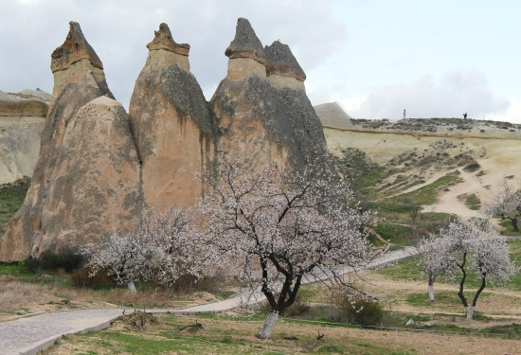
Travel Quiz
Where would you go to see a Fairy Chimney? a) Ningyocho, Tokyo; b) Cappadocia, Turkey; ​ c) Rutherford County, USA
d) Cuba
Option B:- Cappadocia, Turkey ​These strange conical spires are found in the Cappadocia region of Turkey. Several million years ago, active volcanoes spewed volcanic ash that covered the ground. Rainwater and wind eroded the soft compressed volcanic ash, leaving behind the harder overlying basalts, forming the fairy chimneys.
A.N.

Slide 21
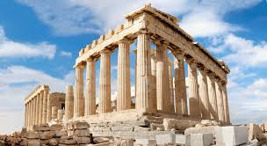
Travel Quiz
My hotel is in the Plaka district of this large city. What city am I visiting? A) Athens, Greece B) Lisbon, Portugal C) Rome, Italy
D) Tirana, Albania
Option A:- Athens, Greece ​In the shadow of the Acropolis and its ancient temples, hillside Plaka has a village feel, with narrow cobblestone streets lined with tiny shops selling jewelry, clothes and local ceramics.
A.N.

Slide 22
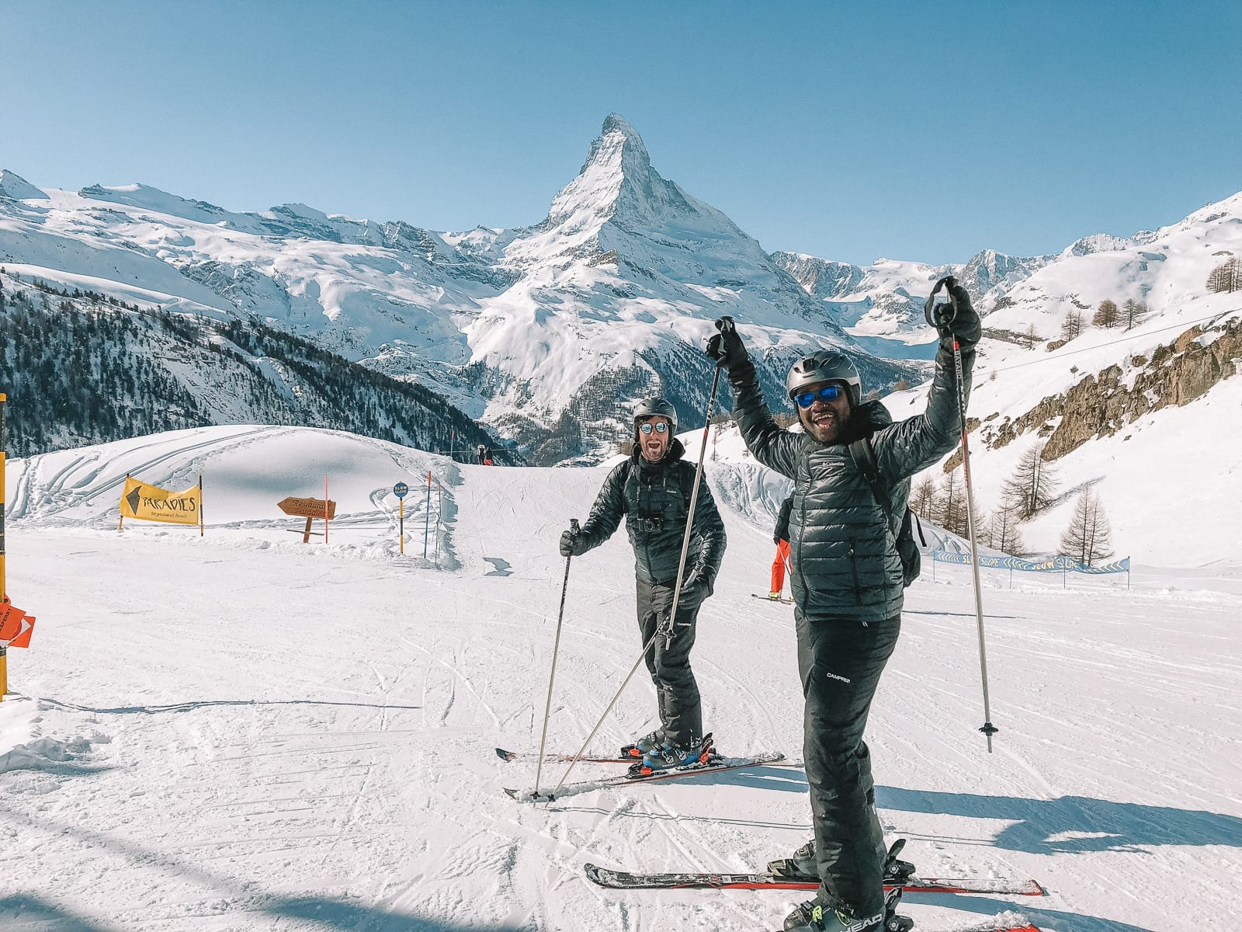
Travel Quiz
​Who, What or Where is Zermatt? ​ A) Swiss Ski Resort B) Parisian Fashion house ​ C) Alcoholic beverage made from Potatoes
D) A brand of men’s sport shoes
Option A):- Swiss Ski Resort ​The highest winter sports area in the Alps, with ski terrain at altitudes between 2,500 and 3,900 meters and more than 2,133 meters of vertical drop.
A.N.

Slide 23
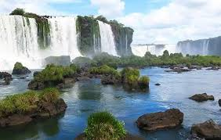
Travel Quiz
​Iguazu Falls aka Iguassu Falls or Iguaçu Falls, are waterfalls of the Iguazu River and forms the boundary between two countries. Brazil is the one country, but what is the other? A) Paraguay B) Argentina C) Uruguay.
D) Chile
Option B):- Argentina The Iguazú Falls on the Iguazu River form the border of the Argentine province of Misiones and the Brazilian state of Paraná. Together, they make up the largest waterfall system in the world. ​ The falls divide the river into the upper and lower Iguazu.
A.N.

