Slide 1


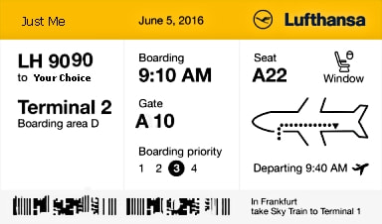

Travel Quiz
In South America, who, what or where is Chacarera
A)- Style of music / dance
B)- Argentinian equivalent of a BBQ
​ C)- Traditional dress worn by Bolivian women.
D) Dog breed
Option A: Style of music / dance
The original development of the music used soft Spanish guitar and upbeat drum rhythms to create a lively and distinctive style. The origin is unknown, but the dance became particularly common in rural, farmland areas of Argentina's Northwest region,
​The idea is to dance in groups around a square.
A.N.

Slide 2
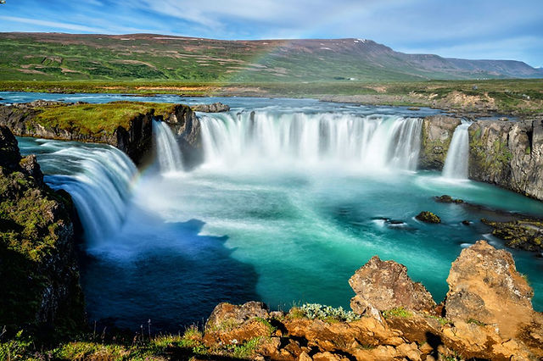
Travel Quiz
While we are talking waterfalls, In what country is the Gullfoss waterfall
​​
A) Alaska
B) Norway
C) Iceland
D) Brazil
Option C: Iceland
Located in Borgarfjörður in west Iceland, and are formed by rivulets flowing at the edge of the Hallmundarhraun lava field, pouring into the glacier river Hvíta
A.N.

Slide 3
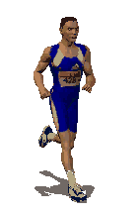
Travel Quiz
When was the Comrades marathon first run. The Comrades Marathon is an ultramarathon of approximately 88 kilometres which is run annually in the KwaZulu-Natal province of South Africa between the cities of Durban and Pietermaritzburg. It is the world's largest and oldest ultramarathon race.
​​
A) 1901
B) 1921
C) 1941
D) 1961
Option B: 1921
The 55-mile race was founded by a World War I veteran, Vic Clapham. Nearly 15,000 runners finished the June 2023 race.
A.N.

Slide 4
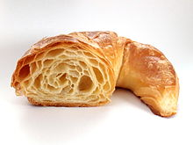
Travel Quiz
Which city do croissants originate from?
​​
A) Dijon, France
B) Vienna
C) Prague
D) Florence
Option B: Vienna
A croissant is a buttery, flaky, viennoiserie pastry inspired by the shape of the Austrian kipferl but using the French yeast-leavened laminated dough. Croissants are named for their historical crescent shape.
A.N.

Slide 5

Travel Quiz
How many American states start with the word, “new”?
​​
A) 3
B) 4
C) 5
D) 6
Option B: 4
New Hampshire,
New Jersey,
New Mexico,
New York
A.N.

Slide 6
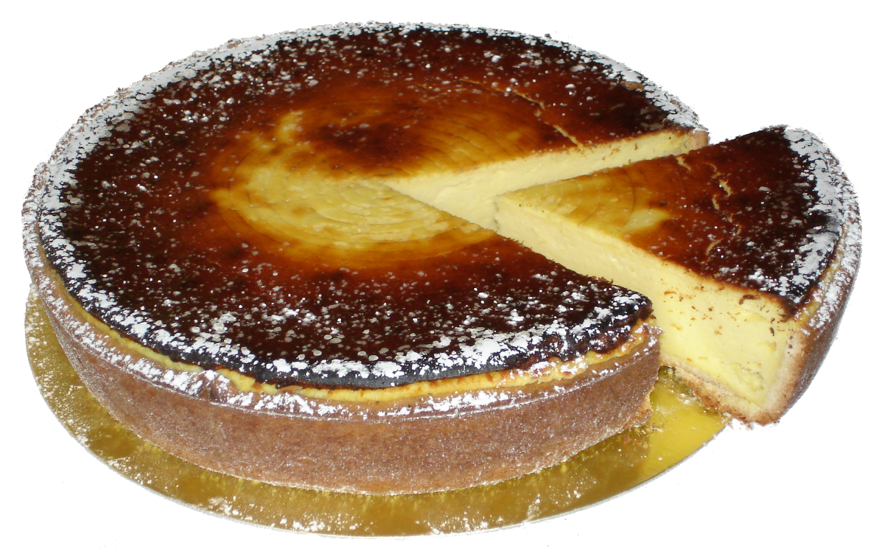
Travel Quiz
In which country did cheesecake originate?
​​
A) USA (New York)
B) France
C) Portugal
D) Greece
Option D: Greece
An ancient form of cheesecake may have been a popular dish in ancient Greece even prior to Romans' adoption of it with the conquest of Greece. The earliest attested mention of a cheesecake is by the Greek physician Aegimus (5th century BCE), who wrote a book on the art of making cheesecakes (πλακουντοποιικόν σύγγραμμα—plakountopoiikon sungramma).
A.N.

Slide 7

Travel Quiz
Fiumicino International Airport is named after a famous artist. Which one?
A) Rembrandt
B) Leonardo Da Vinci
C) Claude Monet
D) Pablo Picasso
Option B: 4 Leonardo Da Vinci
Fiumicino International Airport (FCO) "Leonardo da Vinci", commonly known as Leonardo da Vinci–Fiumicino Airport, is an international airport in Fiumicino, Italy, serving Rome. It is the busiest airport in the country,
A.N.

Slide 8

Travel Quiz
Where would you go to see the Big Banana?
A) Cairns
B) Kingston
C) Byron Bay
D) Coffs Harbour
Option D: Coffs Harbour
It was one of the first “Big Things” built in Australia back in 1964. The region was well known for its banana plantations, so it was only natural for the Big Banana to be set amongst a local banana plantation and feature a walk-through banana.
The Big Banana really started the trend of Australia’s love of the “Big Things” but was originally never set up to be what it is today.
A.N.

Slide 9

Travel Quiz
In the movie ‘Finding Nemo’ where are Marlin and Nemo swimming towards?
A) Sydney
B) Auckland
C) Byron Bay
D) Colombo
Option A: Sydney
Marlin and Dory are swimming along looking for P. Sherman, 42 Wallaby Way, Sydney.
A.N.

Slide 10

Travel Quiz
Did you know?
Russia only classified beer as an alcoholic drink in 2011
Remarkably before then any drink with less than 10% alcohol was considered a ‘foodstuff’.
A.N.

Slide 11
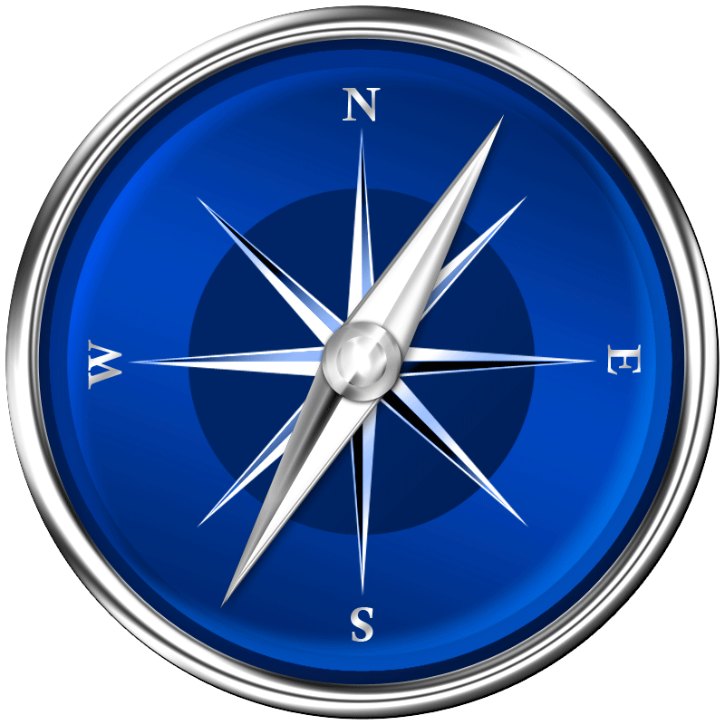
Travel Quiz
Option A: Reykjavik
Reykjavík is the capital and largest city of Iceland. It is located in southwestern Iceland, on the southern shore of Faxaflói bay. Its latitude is 64°08' N, making it the world's northernmost capital of a sovereign state.
What is the most Northern Capital City?
A) Stockholm
B) Ottawa
C) Reykjavik
D) Copenhagen
A.N.

Slide 12

Travel Quiz
In 1934 I was converted into a notorious prison. There is water all around me. Who am I?
A) Robben Island
B) Alcatraz
C) Devil's Island
D) Port Arthur
Option B: Alcatraz
Alcatraz Island is a small island 2.01 km offshore from San Francisco. The island was developed in the mid-19th century with facilities for a lighthouse, a military fortification, and a military prison. In 1934, the island was converted into a federal prison, Alcatraz Federal Penitentiary.
A.N.

Slide 13
Travel Quiz
Option D: Volcano
Stromboli is an island in the Tyrrhenian Sea, off the north coast of Sicily, containing Mount Stromboli, one of the four active volcanoes in Italy.
Stromboli is also a type of baked turnover filled with various Italian cheeses
What or where is Stromboli
A) National food of Crete
B) A river in Brazil
C) A mountain in Norway
D) A volcano in Italy
A.N.

Slide 14
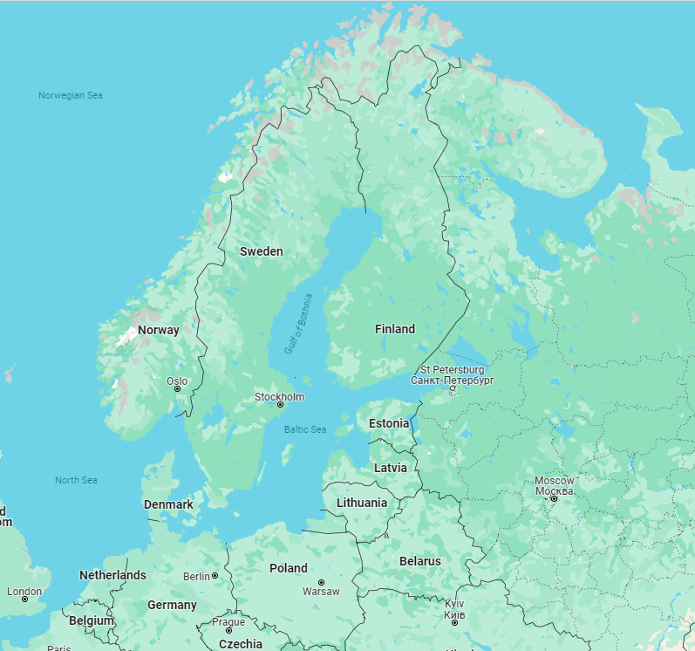
Travel Quiz
Which of these countries is not part of Scandinavia?
Norway
Sweden
Denmark
Finland
Option D: Finland
Scandinavia is a subregion of Northern Europe, with strong historical, cultural, and linguistic ties between its constituent peoples. Scandinavia most commonly refers to Denmark, Norway, and Sweden.
A.N.

Slide 15

Travel Quiz
In the 2007 movie “The Bucket List,” what two countries do the main characters travel to?
A) France and China
B) France and Korea
C) Portugal and China
D) Spain and Japan
Option A: France and China
The main plot follows two terminally ill men on their road trip with a wish list of things to do before they "kick the bucket".
A.N.

Slide 16
Travel Quiz
Did you know?
Pilots and co-pilots do not eat the same meal before a flight.
As part of standard convention, pilots and co-pilots do not eat the same food before a flight in case of food poisoning (or worse). If one of the pilots is incapacitated (unable to leave the bathroom) then the other pilot can take over.
A.N.

Slide 17
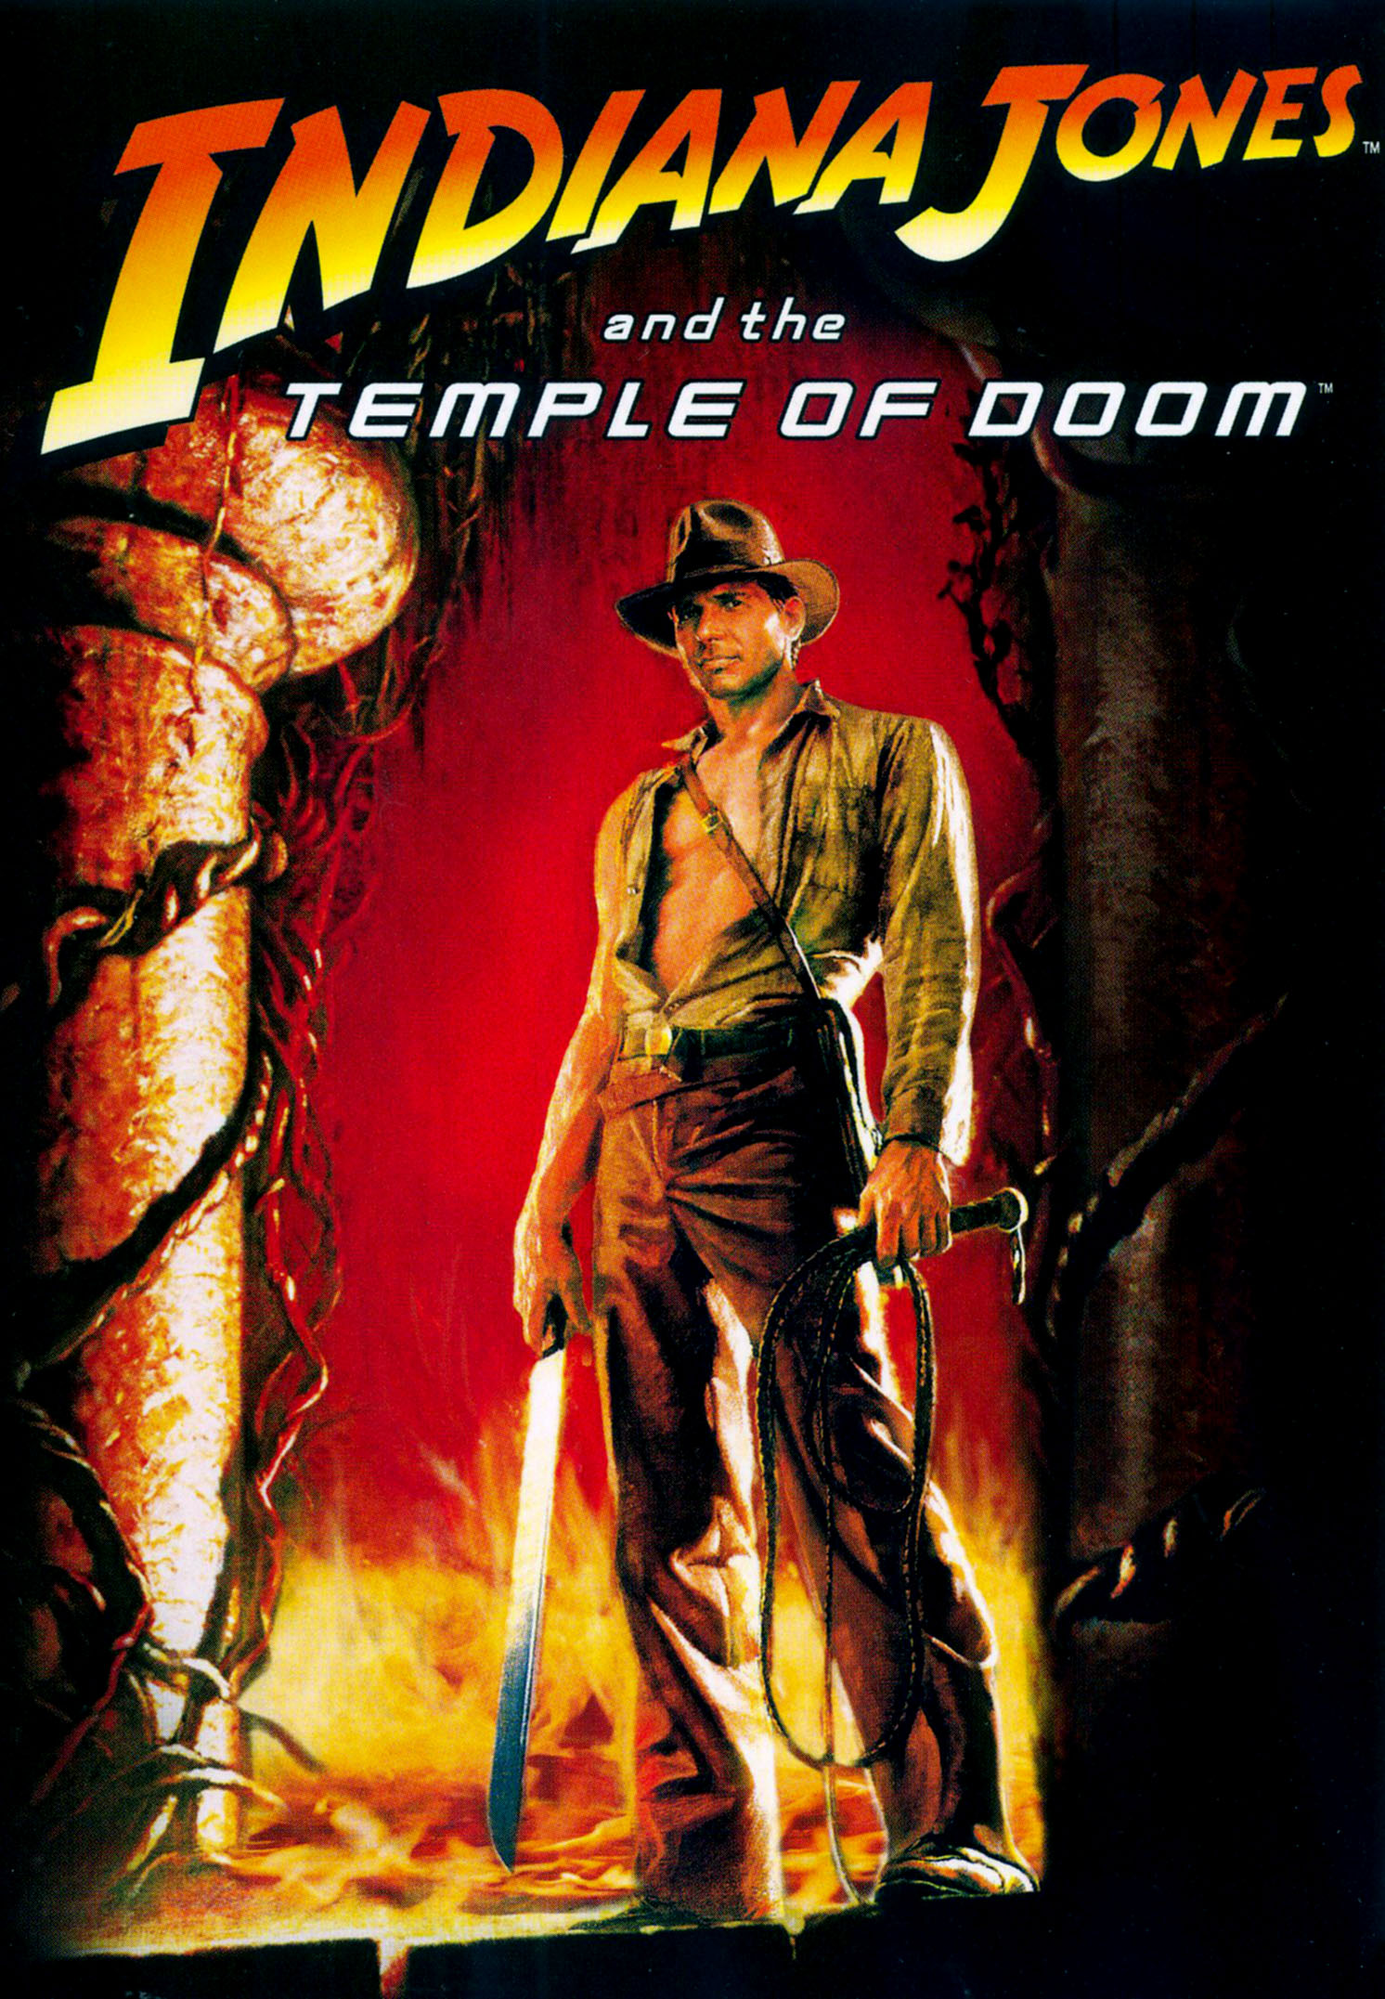
Travel Quiz
While at the movies, In the movie “Indiana Jones and the Temple of Doom,” what country does Indiana Jones travel to?
India
Argentina
Thailand
Sri Lanka
Option A: India
Indiana Jones and the Temple of Doom was released on May 23, 1984, to financial success, grossing $333.1 million worldwide, making it the highest-grossing film of 1984.
A.N.

Slide 18
Travel Quiz
The Liberty Bell is located in which US city?
Los Angeles
B. Houston
C. Washington
D. Philadelphia
Option D: Philadelphia
The Liberty Bell, previously called the State House Bell or Old State House Bell, is an iconic symbol of American independence located in Philadelphia. Originally placed in the steeple of the Pennsylvania State House.
A.N.

Slide 19
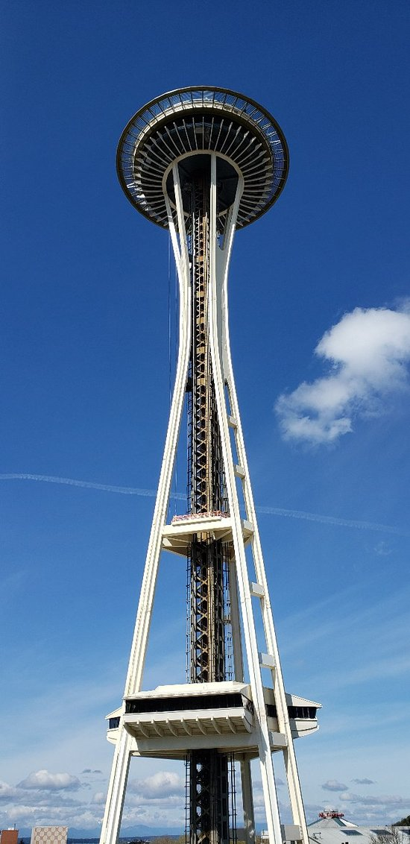
Travel Quiz
You want to visit the space needle. What city must you visit.
Los Angeles
B. Seattle
C. Washington
D. Philadelphia
Option B: Seattle
The Space Needle is an observation tower in Seattle, Washington, United States. Considered to be an icon of the city, it has been designated a Seattle landmark. Located in the Lower Queen Anne neighborhood, it was built in the Seattle Center for the 1962 World's Fair.
A.N.

Slide 20
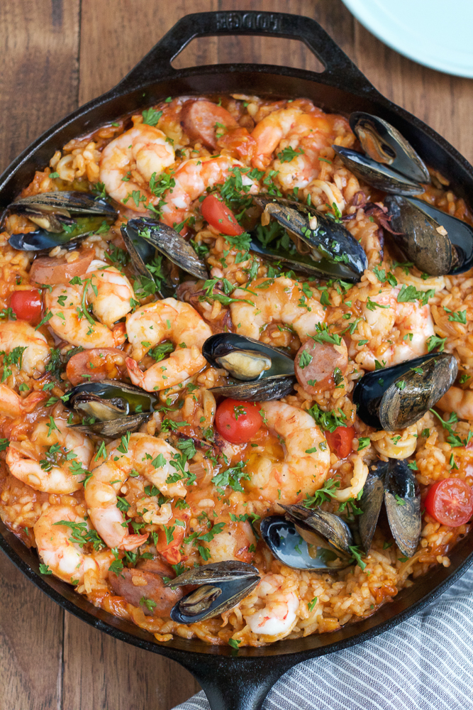
Travel Quiz
In which European city can you savor authentic paella, rice dish cooked with saffron and various ingredients such as seafood, chicken, or vegetables?
Paris, France
Madrid, Spain
Rome, Italy
Athens, Greece
Option B: Madrid, Spain
Paella is a rice dish originally from the Valencian Community. Paella is regarded as one of the community's identifying symbols. It is one of the best-known dishes in Spanish cuisine. The dish takes its name from the wide, shallow traditional pan used to cook the dish on an open fire, paella being the word for a frying pan in Valencian/Catalan language.
A.N.

Slide 21
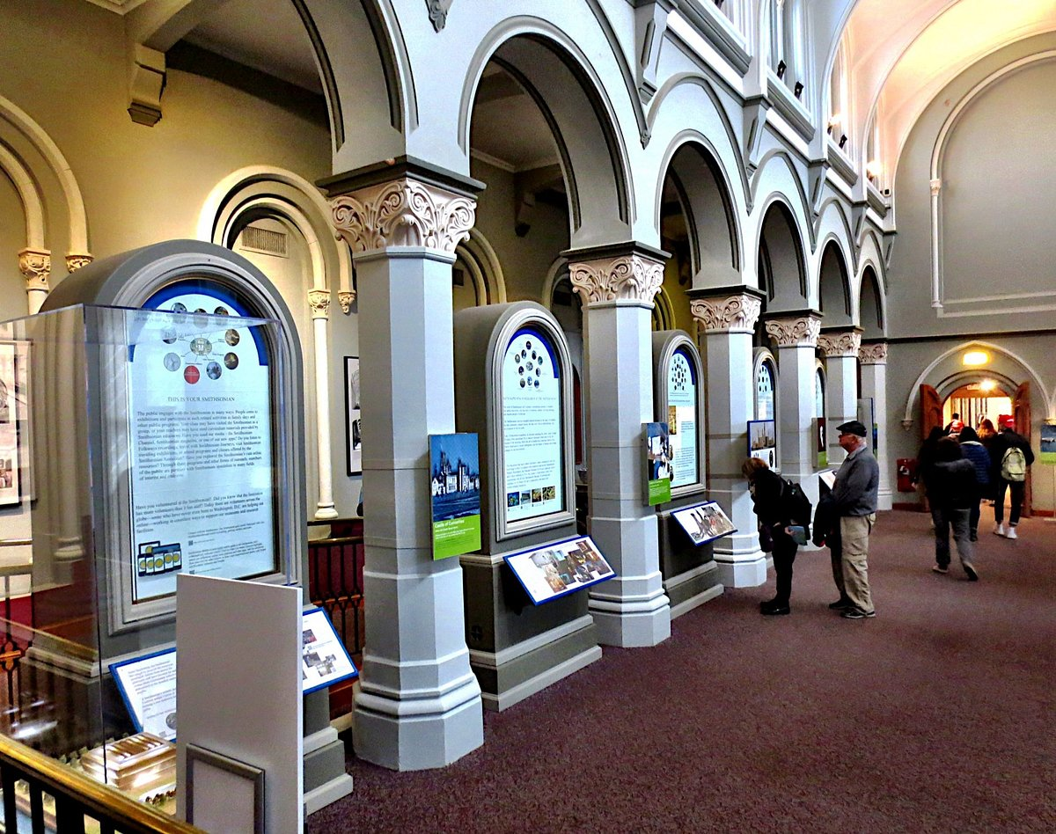
Travel Quiz
You have spent the whole day exploring the Smithsonian Institution. What city are you in?
A) Chicago
B) London
C) Washington
D) Belfast
C) Washington
The Smithsonian Institution, or simply the Smithsonian, is a group of museums, education and research centers, the largest such complex in the world, created by the U.S. government "for the increase and diffusion of knowledge." It was founded in 1846,
A.N.

Slide 22
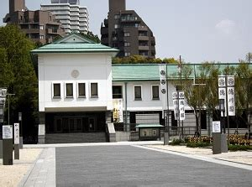
Travel Quiz
Japan
The Tokugawa Art Museum is a private art museum, located on the former Ōzone Shimoyashiki compound in Nagoya, central Japan. Its collection contains more than 12,000 items, including swords, armor, Noh costumes and masks, lacquer furniture, Chinese and Japanese ceramics, calligraphy, and paintings from the Chinese Song and Yuan dynasties.
You are visiting the Tokugawa Art Museum. What city or country are you in?​
​ A) Japan
B) Korea
C) Sri Lanka
D) Vietnam
A.N.

Slide 23
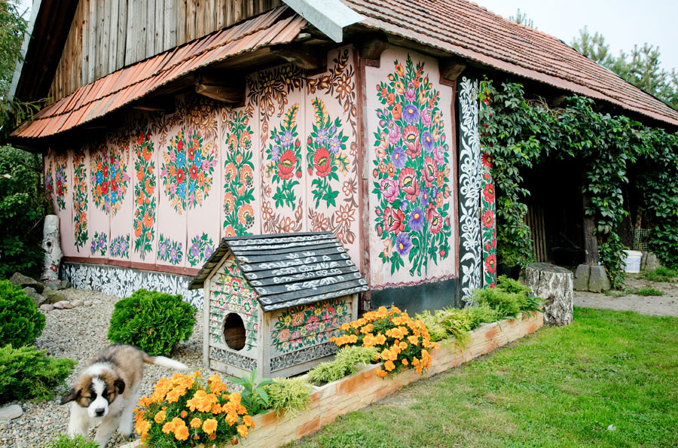
Travel Quiz
Did you know?
Zalipie is a village in Poland where all the buildings are decorated with painted flowers.
A.N.

Slide 24
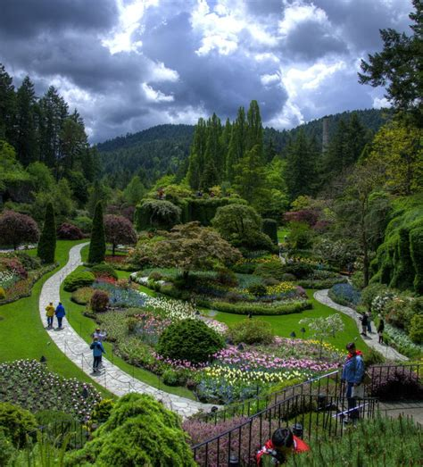
Travel Quiz
Canada
The Butchart Gardens is a group of floral display gardens in Brentwood Bay, British Columbia, Canada, located near Victoria on Vancouver Island. The gardens receive over a million visitors each year. The gardens have been designated a National Historic Site of Canada.
The ButchartGardens Gardens, vision of Jenny Butchart, wife of a cement magnate are found in what country
​A) Canada
B) USA
C) Australia
D) Netherlands
A.N.

Slide 25
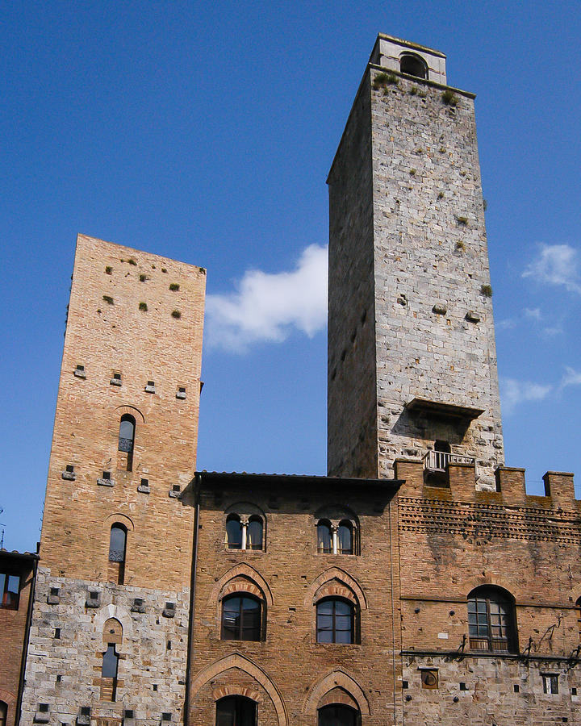
Travel Quiz
This Italian city, centered on Piazza della Cisterna, is noted for its many towers built by the early residents as a show of wealth?
A) Lucca
B) San Gimignano
C) Bologna
D) Pisa
B) San Gimignano
San Gimignano is a small walled medieval hill town in the province of Siena, Tuscany, north-central Italy. Known as the Town of Fine Towers, San Gimignano is famous for its medieval architecture, unique in the preservation of about a dozen of its tower houses.
A.N.

Slide 26
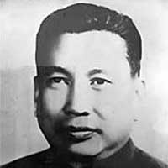
Travel Quiz
Saloth Sar, touted as one of the world’s most infamous dictators, was appointed as the party’s secretary and leader in 1963. By what name was he generally known?
A) Pol Pot.
B) Saddam Hussain.
C) Ho Chi Minh.
D) Kim Jong-un
A) Pol Pot - of Cambodia
Prime minister of Democratic Kampuchea from 1975 and 1979. Widely considered a totalitarian dictator, Pol Pot was responsible for the Cambodian genocide, which resulted in the death of 1.5 to 2 million people.
A.N.

Slide 27

Travel Quiz
Did you know?
Researchers suspect that fish communicate through the noise of their farts, just like some teenage boys.
No comment. I am not communicating
A.N.

Slide 28
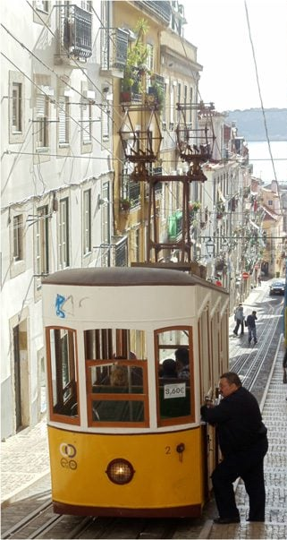
Travel Quiz
Which city is known as the “City of Seven Hills”?
A) Rome
B) Lisbon
C) Athens
D) Barcelona
B) Lisbon
These hills were São Roque, São Jorge, São Vicente, Santo André, Santa Catarina, Chagas and Sant'Ana. These hills are still important points of the city today, integrating several poems and songs that talk about the Portuguese capital.
A.N.

Slide 29
Travel Quiz
These South American birds have larger bills, in comparison to the size of their body, than any other bird in the world. The large bill helps them keep cool in the hot environment in which they live.
A) Amazon Kingfisher
B) Plumbeous Ibis
C) Toucan
C) Toucan
This adaptation is one of the best heat regulating systems in the entire animal kingdom. Arteries in their bills expand when the bird gets hot; and release heat. Their bill is made of a spongy substance called keratin.
A.N.

