Slide 1
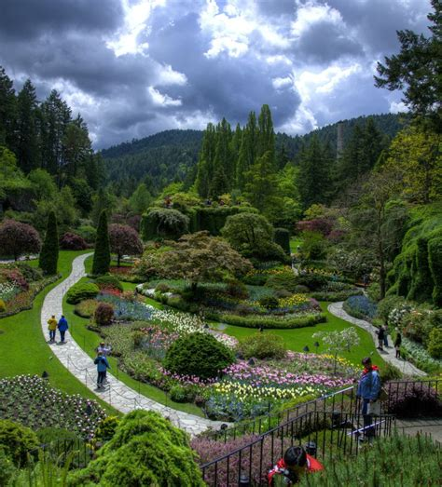
Travel Quiz
Canada
The Butchart Gardens is a group of floral display gardens in Brentwood Bay, British Columbia, Canada, located near Victoria on Vancouver Island. The gardens receive over a million visitors each year.
The Butchart Gardens, vision of Jenny Butchart, wife of a cement magnate are found in what country ​A) Canada B) USA C) Australia
D) Netherlands
A.N.

Slide 2
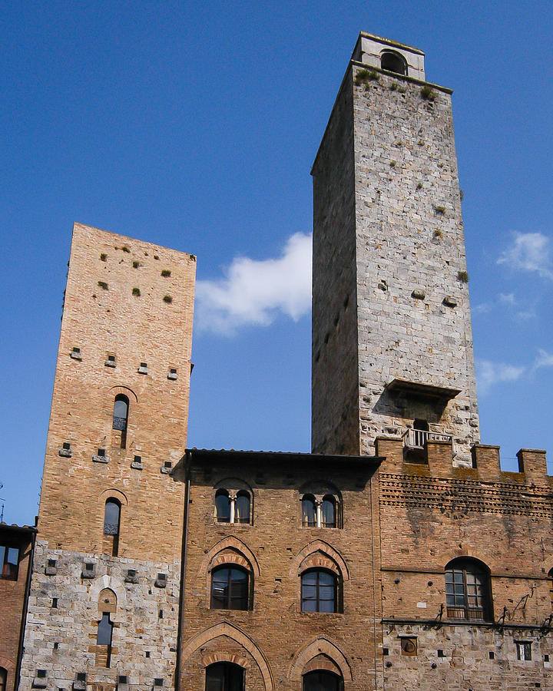
Travel Quiz
B) San Gimignano
San Gimignano is a small walled medieval hill town in the province of Siena, Tuscany, north-central Italy. Known as the Town of Fine Towers, San Gimignano is famous for its medieval architecture, unique in the preservation of about a dozen of its tower houses.
This Italian city, centered on Piazza della Cisterna, is noted for its many towers built by the early residents as a show of wealth? A) Lucca B) San Gimignano C) Bologna
D) Pisa
A.N.

Slide 3
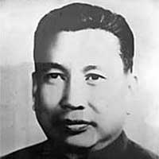
Travel Quiz
Saloth Sar, touted as one of the world’s most infamous dictators, was appointed as the party’s secretary and leader in 1963. By what name was he generally known?
A) Pol Pot. B) Saddam Hussain. C) Ho Chi Minh.
D) Kim Jong-un
A) Pol Pot - of Cambodia
Prime minister of Democratic Kampuchea from 1975 and 1979. Widely considered a totalitarian dictator, Pol Pot was responsible for the Cambodian genocide, which resulted in the death of 1.5 to 2 million people.
A.N.

Slide 4
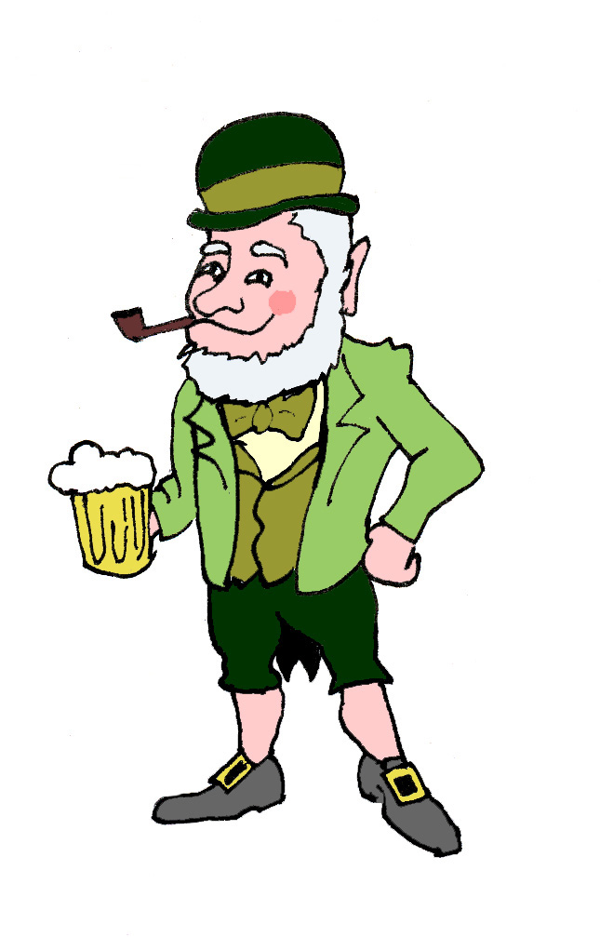
Travel Quiz
Did you know?
The "O" before an Irish name, such as "O'Reilly," means "descendant of.
The barman says to Paddy “Your glass is empty, fancy another one?”
Lookin’ puzzled Paddy says “Why know would I be needed two empty feckin glasses?
A.N.

Slide 5
Travel Quiz
Which city is known as the “City of Seven Hills”?
A) Paris
B) Lisbon
C) Athens
D) Barcelona
B) Lisbon
These hills were São Roque, São Jorge, São Vicente, Santo André, Santa Catarina, Chagas and Sant'Ana. These hills are still important points of the city today, integrating several poems and songs that talk about the Portuguese capital.
A.N.

Slide 6
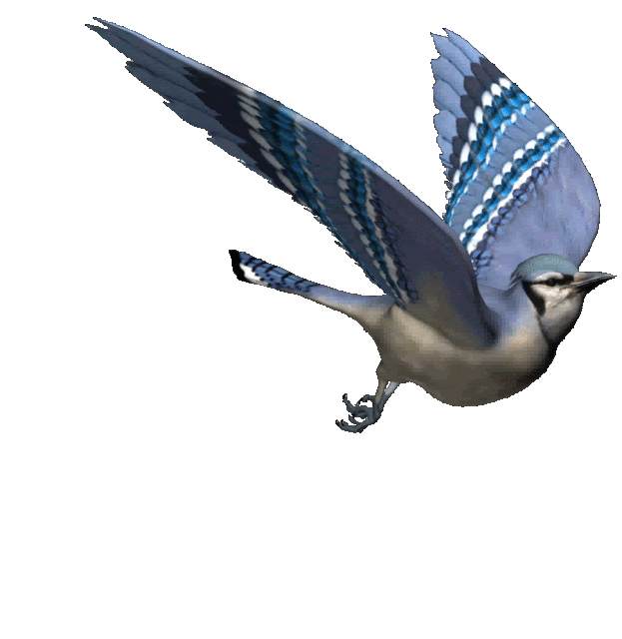
Travel Quiz
C) Toucan
This adaptation is one of the best heat regulating systems in the entire animal kingdom. Arteries in their bills expand when the bird gets hot; and release heat. Their bill is made of a spongy substance called keratin.
These South American birds have larger bills, in comparison to the size of their body, than any other bird in the world. The large bill helps them keep cool in the hot environment in which they live. A) Amazon Kingfisher B) Plumbeous Ibis C) Toucan
A.N.

Slide 7
Travel Quiz
C) To get rid of garbage
The song of the trash truck is a musical call to action. A tune (traditionally Für Elise or The Maiden's Prayer) to remind you to bring your waste to the curb. It needs to be done. Taiwan has a population density of 1,742 people per square mile.
When residents hear Beethoven’s “Für Elise” playing in the streets of Taipei, the whole neighborhood rushes outside. Why A) Mobile ice cream vendor nearby. B) Emergency signal. C) To get rid of garbage
A.N.

Slide 8
Travel Quiz
Did you know?
The shortest commercial flight takes less than two minutes.
Incredibly, the shortest commercial flight, operating between the neighbouring islands of Westray and Papa Westray in Scotland’s Orkney islands, takes around one and a half minutes. With the fastest recorded flight taking less than 50 seconds.
A.N.

Slide 9
Travel Quiz
C) Durian
Despite being a delicacy, the fruit is banned for transportation in countries like Thailand, Japan, Singapore and Hong Kong. In fact, 'No Durians' signs are plastered all across airports and hotels in these countries, thanks to its peculiar and pungent smell which can linger for days.
This spiky fruit native to Southeast Asia. It’s famous for its pungent aroma and savory smell that is sometimes described as fried onions A) Jackfruit B) Dragon Fruit C) Durian
A.N.

Slide 10
Travel Quiz
C) Russian Rouble
Domodedovo Airport, formally Domodedovo Mikhail Lomonosov International Airport, is an international airport serving Moscow.
Your aircraft is about to land at an airport DME. What currency should you have in your pocket after landing A):- Djibouti Frank B):- Danish Krone C):- Russian Rouble
A.N.

Slide 11
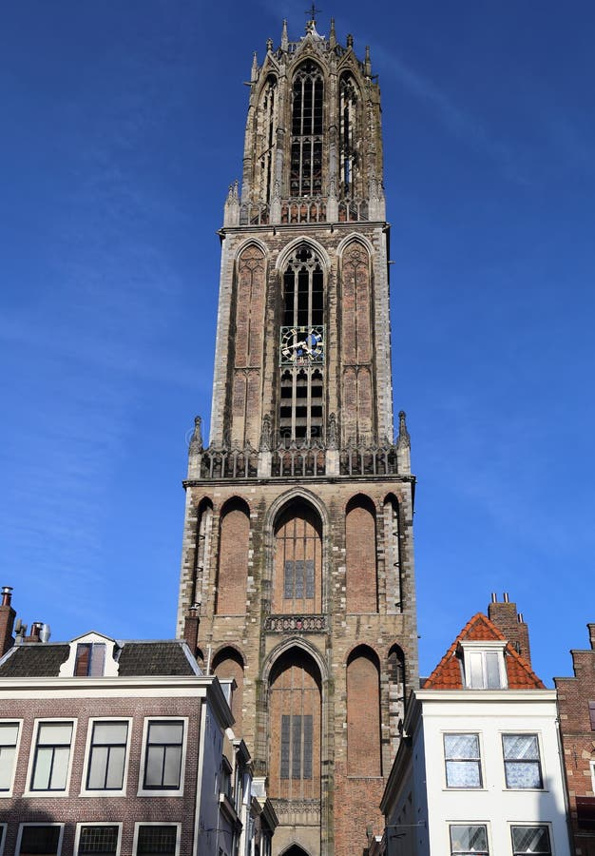
Travel Quiz
Dom Tower stands at 112.32 meters tall and is over 600 years old. In which European city is Dom Tower A) Brugge, Brussels B) Uitrecht, Netherlands C) Lucca, Italy
D) San Gimignano, Italy
B) Uitrecht, Netherlands
Built between 1321 and 1382 , The tower was part of St. Martin's Cathedral, also known as the Dom Church,
A.N.

Slide 12
Travel Quiz
Did you know?
Japanese railways hand out ‘certificates’ for delays of more than five minutes.
Japanese trains, reputedly the most punctual in the world, issue passengers with a ‘delay certificate’ if a train is running more than five minutes behind schedule. The documents can be shown to bosses or teachers to explain a passenger’s lateness.
A.N.

Slide 13
Travel Quiz
B) Russia
It is in western Siberia; and together with Irtysh forms the world's seventh-longest river system, at 5,410 kilometres.
If you are paddling your canoe down the Ob River, in what country would you be ​A) Canada
B) Russia C) Norway
D) India
A.N.

Slide 14
Travel Quiz
D: Vietnam
Hanoi is the capital but Ho Chi Minh City is the largest city.
Hanoi is the capital of which country?
A: Cambodia B: Laos C: Thailand D: Vietnam
A.N.

Slide 15
Travel Quiz
D: Spain
The Canary Islands are a Spanish autonomous community and archipelago in Macaronesia in the Atlantic Ocean.
At their closest point to the African mainland, they are 100 kilometres west of Morocco.
Which country are the Canary Islands part of?
A: France B: Italy C: UK D: Spain
A.N.

Slide 16
Travel Quiz
Did you know?
Researchers suspect that fish communicate through the noise of their farts, just like some teenage boys.
No comment. I am not communicating
A.N.

Slide 17
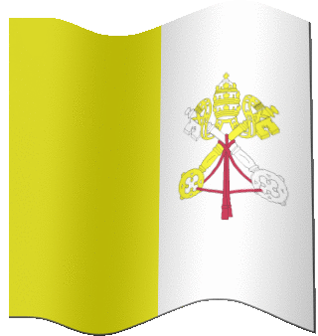
Travel Quiz
B: Vatican City
It became independent from Italy in 1929 with the Lateran Treaty, and it is a distinct territory under "full ownership, exclusive dominion, and sovereign authority and jurisdiction" of the Holy See, itself a sovereign entity under international law.
What is the smallest country in Europe?
A: Andorra B: Vatican City C: Liechtenstein D: Monaco
A.N.

Slide 18
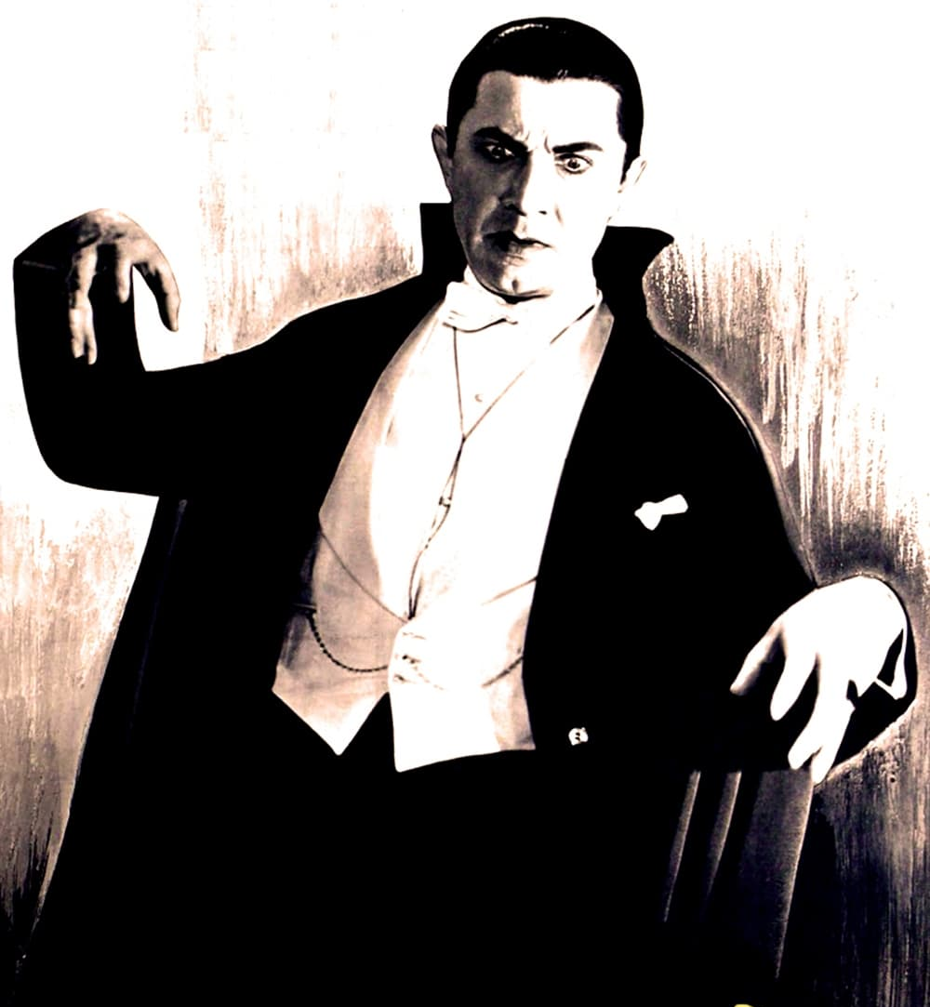
Travel Quiz
B: Bran Castle
5 Kilometres southwest of Brașov. The castle was built by Saxons in 1377 who were given the privilege by Louis I of Hungary.
It is a national monument and landmark in Transylvania.
There’s a castle in Romania that is famously connected to the Dracula novels. What is the name of it?
A: Bodiam Castle B: Bran Castle C: Glamis Castle D: Corvin Castle
A.N.

Slide 19
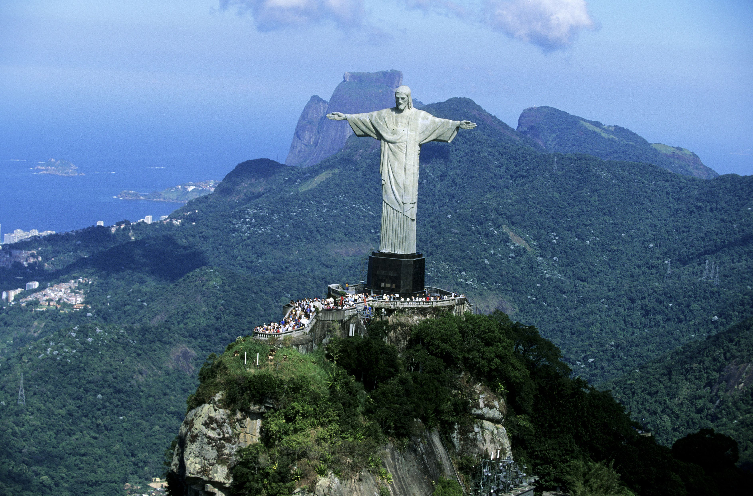
Travel Quiz
A: Rio de Janeiro
Created by French sculptor Paul Landowski and built by Brazilian engineer Heitor da Silva Costa, in collaboration with French engineer Albert Caquot. Romanian sculptor Gheorghe Leonida sculpted the face. Constructed between 1922 and 1931
Which South American city will you find the “Christ the Redeemer” monument?
A: Rio de Janeiro B: Santiago C: Buenos Aires D: Salvador
A.N.

Slide 20
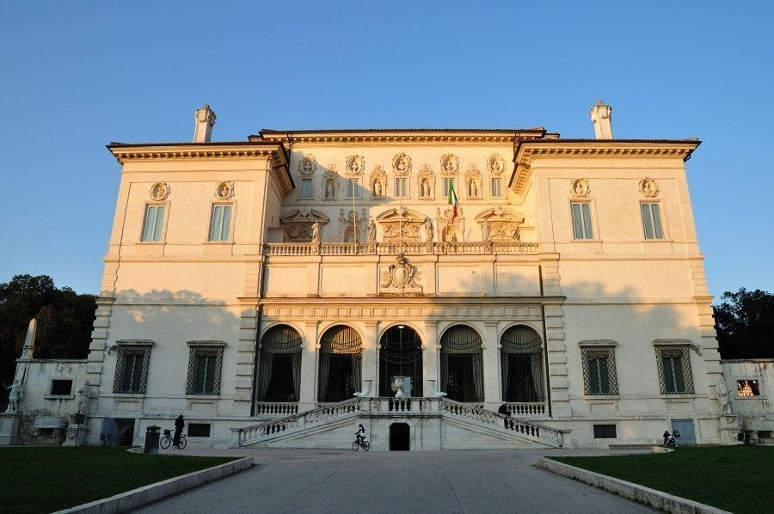
Travel Quiz
D: Rome
Galleria Borghese, also known in English as Borghese Gallery, is housed in the Villa Borghese, a beautiful and elegant mansion. It is one of the most renowned art museums in the world. The building’s gardens are also a popular attraction and the third largest park in Rome.
Where would you be if you were visiting the Galleria Borghese
A: Paris B: Madrid C: Zurich D: Rome
A.N.

Slide 21
Travel Quiz
Did you know?
Alaska is both the westernmost and easternmost state in the USA.
Alaska’s Aleutian Islands are actually located west of the 180th Meridian (the line that divides the eastern and western hemisphere), making it the only US state to be partly located in the eastern hemisphere.
A.N.

Slide 22
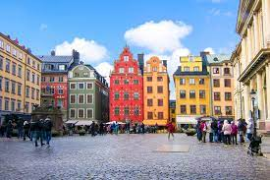
Travel Quiz
B) Stockholm (Sweden)
The city is sometimes referred to as 'Venice of the North', thanks to its beautiful buildings and exquisite architecture, abundant open water and numerous parks. The total absence of heavy industry makes Stockholm one of the world's cleanest metropolises.
Which European capital was built on 14 islands?
A) Tirana (Albania)
B) Stockholm (Sweden)
C) Tallinn (Estonia)
D) Oslo (Norway)
A.N.

Slide 23
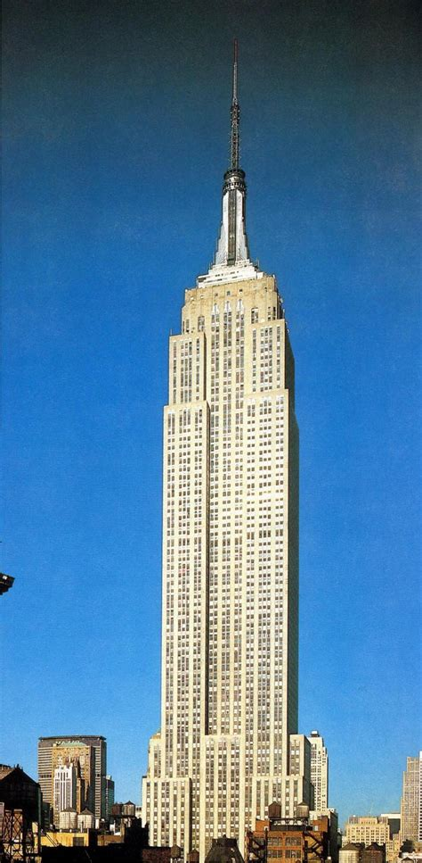
Travel Quiz
B) 102
There should be a sign outside the lift:- “In case of fire, consult your cardiologist before using the stairs”
How many floors are in the Empire State Building?
82
102
122
142
A.N.

Slide 24
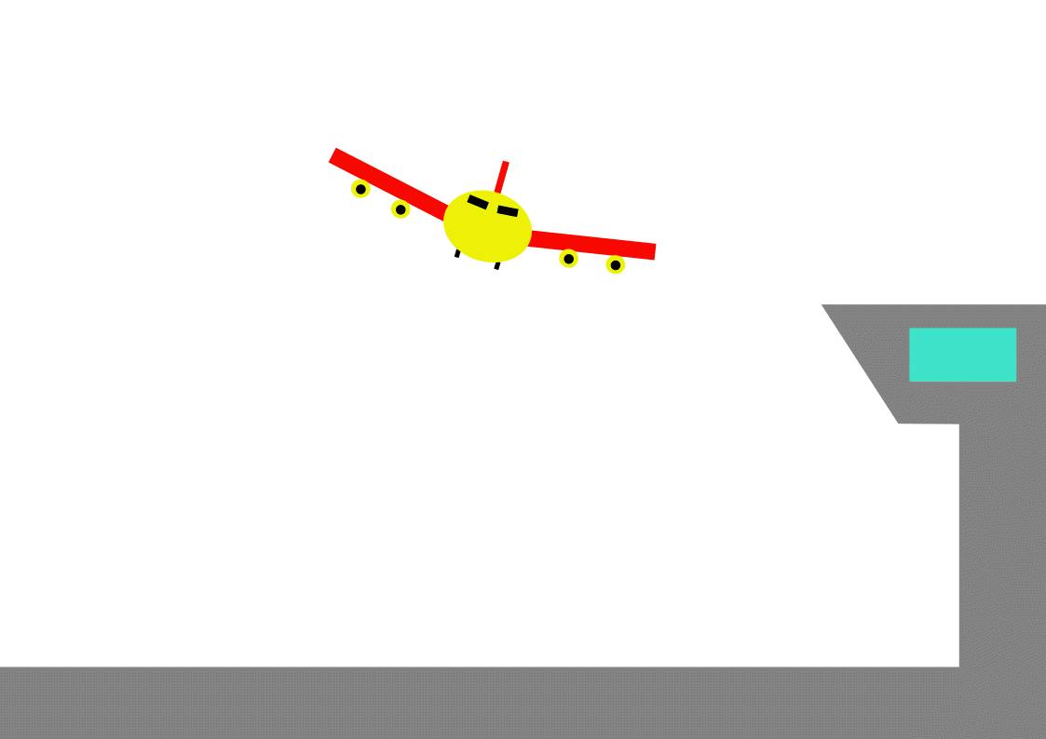
Travel Quiz
B) Liverpool
John Lennon Airport
Originally called Speke Airport, It was renamed after Liverpudlian musician John Lennon of the Beatles in 2001.
Where in the UK is there an airport is named after one of the members of the Beatles?
A) Manchester
B) Liverpool
C) Dublin
D) Leeds
A.N.

Slide 25
Travel Quiz
Did you know?
Germany's Famous Oktoberfest Is Actually in September
Prince Ludwig married in October 1810. He threw a party and party became an annual event known simply as Oktoberfest.
However, with warmer temperatures in September making for a better party atmosphere, the event was pushed back into September.
It ends on the first Sunday of “Oktober” to keep the name in place.
A.N.

Slide 26
Travel Quiz
A) Tokyo
It is a popular upscale shopping area of Tokyo, with numerous internationally renowned department stores, boutiques, restaurants and coffeehouses located in its vicinity. It is considered to be one of the most expensive, elegant, and luxurious city districts in the world.
You have decided to get some retail therapy - shopping in the Ginza district. What city are you visiting? A) Tokyo B) Chicago C) Paris
D) Moscow
A.N.

Slide 27
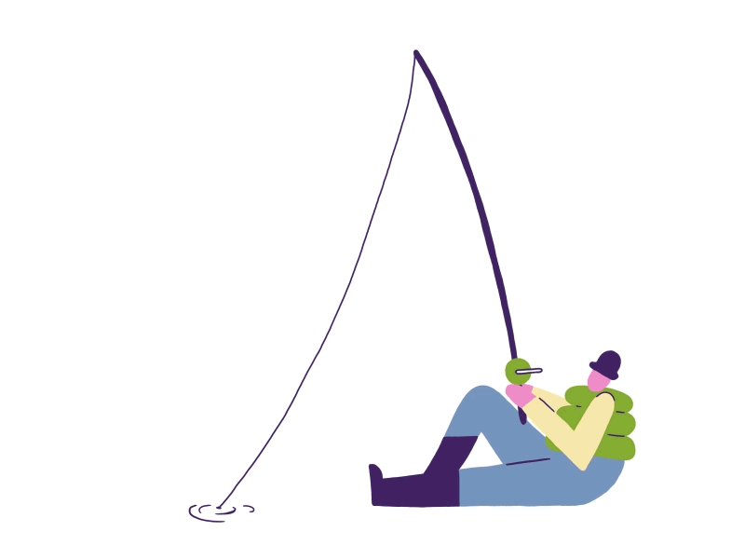
Travel Quiz
C. Pufferfish
The Japanese dish, fugu, is deadly if not made properly. What fish is it made from?
Electric eel
B. Killer shark
C. Pufferfish
Tetraodontidae is a family of primarily marine and estuarine fish ofthe order Tetraodontiformes. The family includes many familiar species variously called pufferfish, puffers, balloonfish, blowfish, blowers, blowies, bubblefish and more.
A.N.

Slide 28
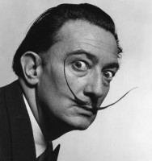
Travel Quiz
A. Figueres Spain
Where would you find the Salvadore Dali museum and gallery
Figueres, Spain
B. Madrid, Spain
C. Lisbon, Portugal
D. Gerona, Spain
Salvadore Dali was born in Figueres, Catalonia in 1904. Although his childhood home was in Figueres, he spent much of his childhood at his family’s nearby summer home in the small coastal village of Cadaques on the Costa Brava. Today, the Dali Theatre-Museum in Figueres houses a collection of works from this eccentric icon.
A.N.

Slide 29
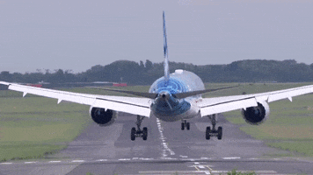
Travel Quiz
The End
A.N.

