Slide 1
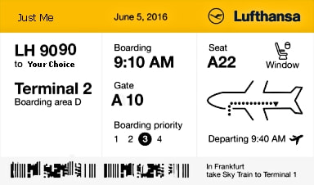
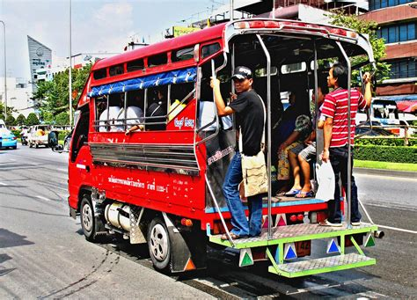
Travel Quiz
A Songthaew, Meaning ‘two rows’ in the local language, is a form of transport in what country?
A) Sri Lanka
B) Thailand
C) Indonesia
D) Philippines
B) Thailand
Songthaews are covered pickup trucks with rows of seats in the back that transport people along set routes in Thailand, and they are a common way to get around.
A.N.

Slide 2
Travel Quiz
Did you know?
Did you know that South America is high
It has the highest capital in the world - La Paz in Bolivia.
Venezuela has the highest waterfall in the world – Angel Falls.
Lake Titicaca is the highest navigable lake in the world.
Mount Aconcagua is the Highest Mountain In The Western Hemisphere.
And there are drug cartels that try to keep us all “high”
A.N.

Slide 3
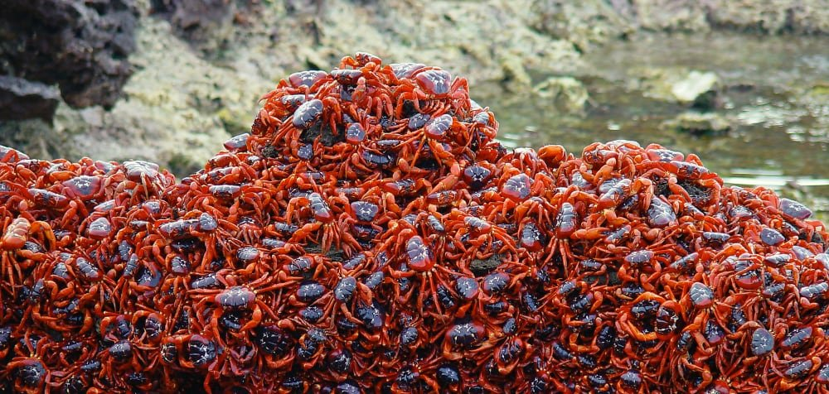
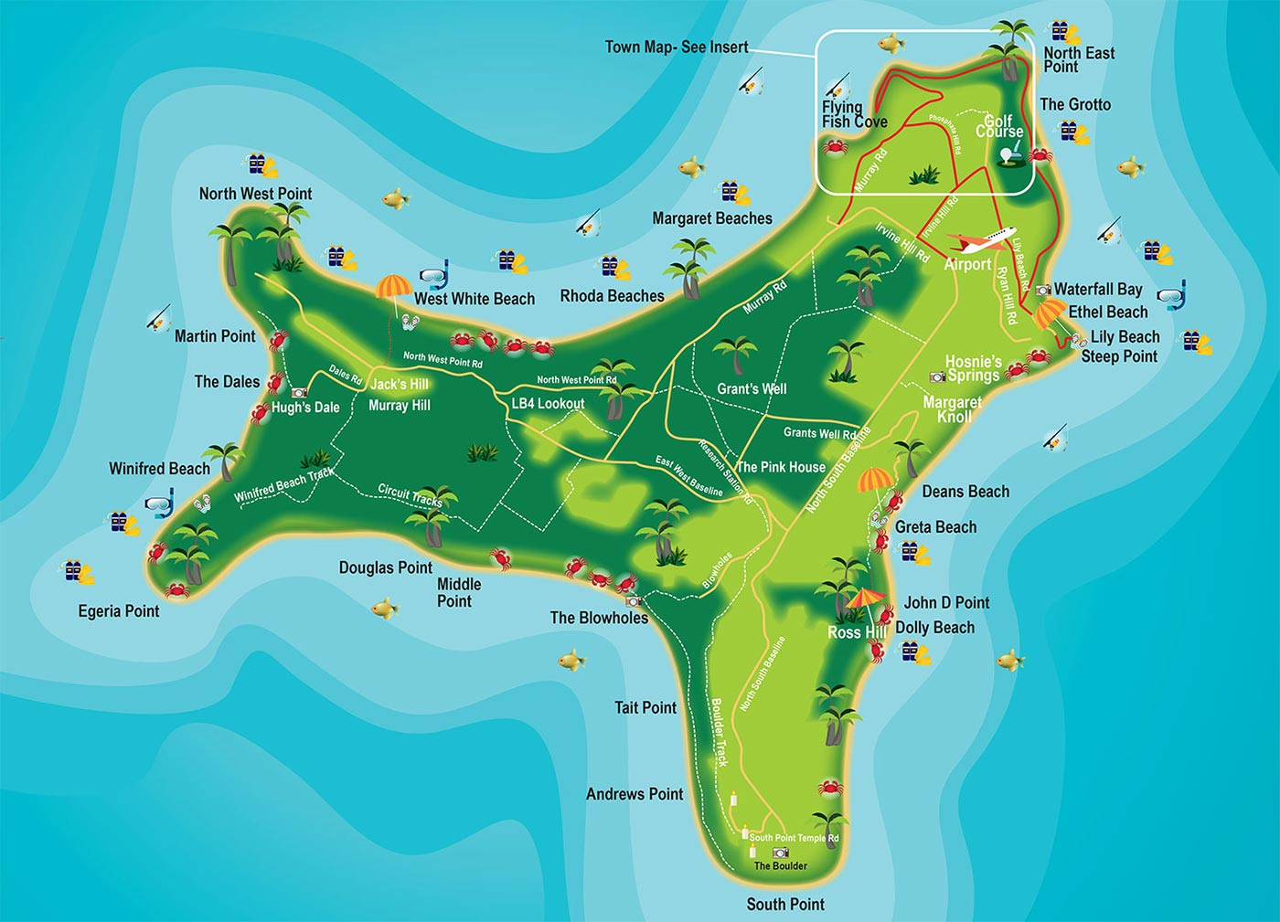
Travel Quiz
Christmas Island in the Indian Ocean is famous for its annual mass migration of what animal?
Monarch butterflies
Swifts
Red crabs
Penguins
C) Red Crabs
Every year, millions of these large crabs emerge from the forest and make their way to the ocean to breed, swarming across roads, streams, rocks and beaches.
A.N.

Slide 4
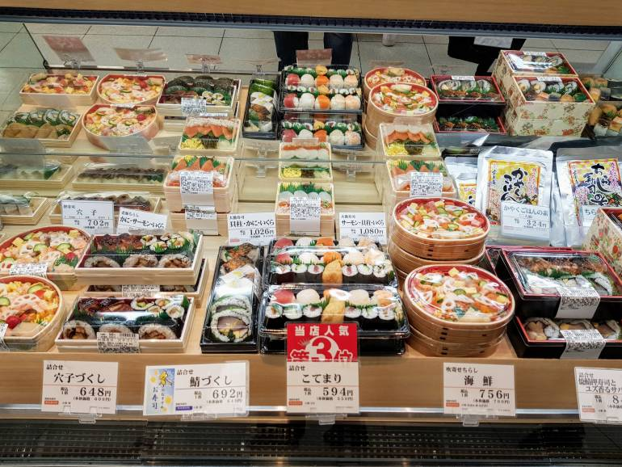
Travel Quiz
B) depachika
These depachika are massive -- an average one stocks about 30,000 items -- and feature high-end restaurants, bakeries, retailers and food stalls.
In Tokyo, department stores' basement floors are devoted to food markets known as what?
A) depato
B) depachika
C) dechapik
A.N.

Slide 5
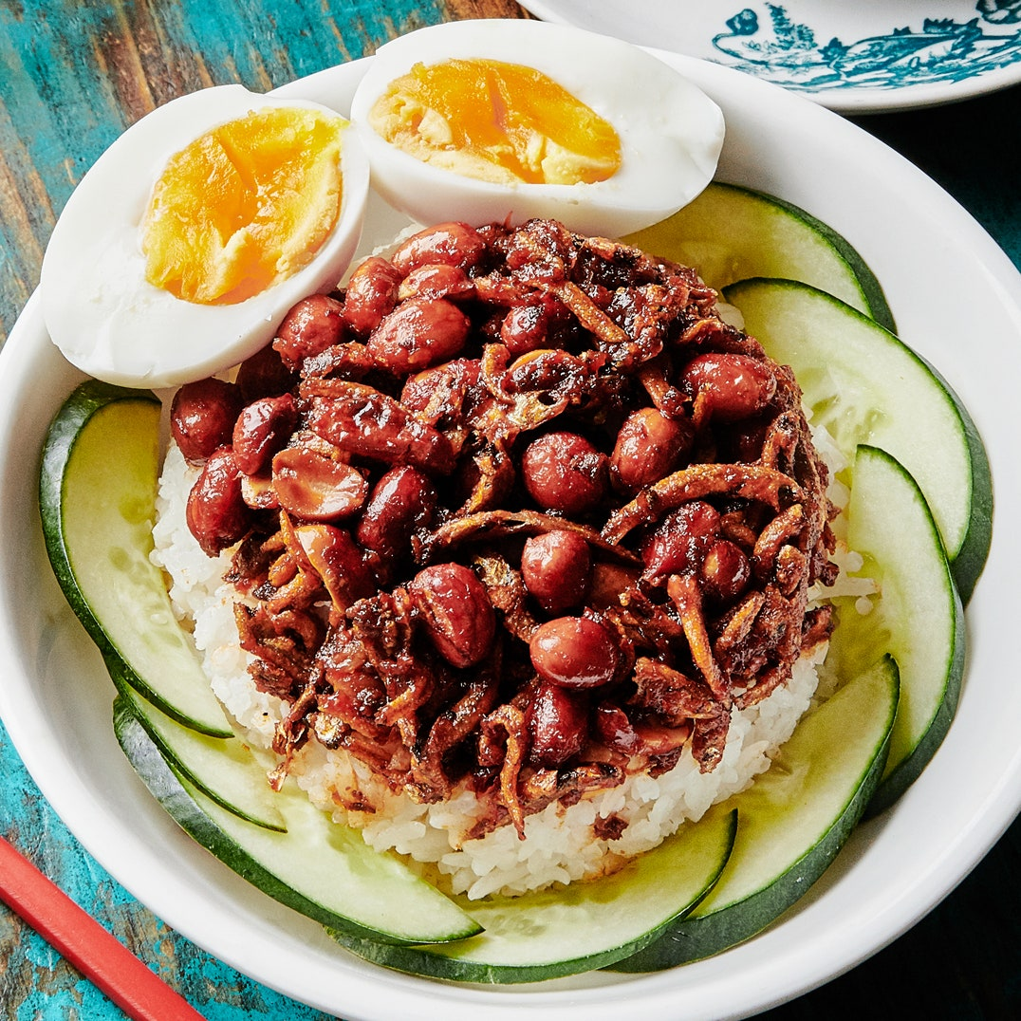
Travel Quiz
Nasi lemak is the national dish of this country, so expect to find it everywhere.
A) Malaysia
B) Cambodia
C) Vietnam
A) Malaysia
Nasi lemak is a coconut rice dish that's often wrapped in a banana leaf. It's the national dish of Malaysia.
.
A.N.

Slide 6
Travel Quiz
Did you know?
10 Villages in Scandinavia Have the Shortest City Names — Just One Letter Long
The city name Å, which means "small brook or river" in all Scandinavian languages, is found nine times throughout the countries. Ö, which means "island," can be found in Sweden.
A.N.

Slide 7
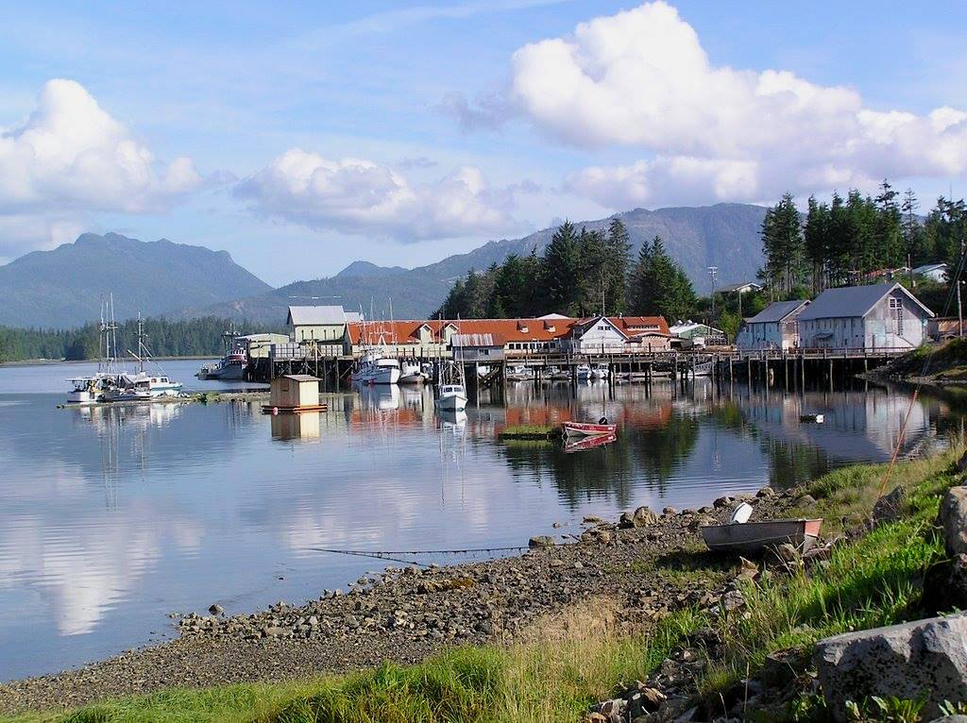
Travel Quiz
In which body of water will you find Prince of Wales Island and Horn Island.
Torres Strait
Bass Strait
Coral Sea
Timor Sea
A) Torres Strait
Also in the Torres Strait are:-
Wednesday Island, Thursday Island &
Friday Island
A.N.

Slide 8
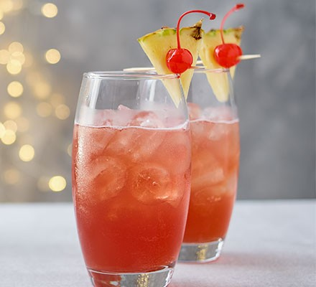
Travel Quiz
Ngiam Tong Boon, a bartender at the Raffles Hotel, created a cocktail in 1915. What was it called?
Singapore Sling
Manhattan
Bellini
Margarita
A) Singapore Sling
The Singapore sling is a gin-based sling cocktail. It was originally called a Gin Sling
A.N.

Slide 9
Travel Quiz
Did you know?
Germany's Famous Oktoberfest Is Actually in September
Prince Ludwig married in October 1810. He threw a party and party became an annual event known simply as Oktoberfest.
However, with warmer temperatures in September making for a better party atmosphere, the event was pushed back into September.
It ends on the first Sunday of “Oktober” to keep the name in place.
A.N.

Slide 10
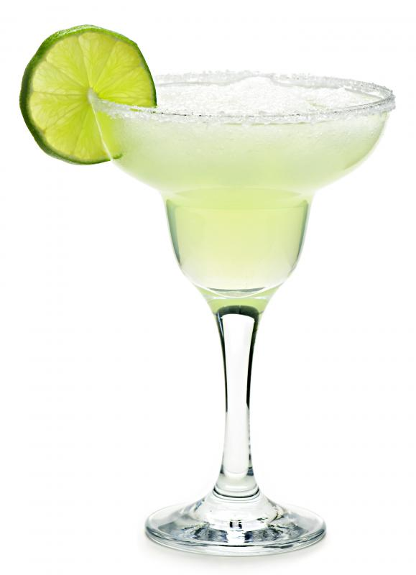
Travel Quiz
What is the basic ingredient of a Margarita cocktail
A) Lime Juice
B) Orange Juice
C) Soda Water
D) Melon juice
Lime Juice
The Original Margarita was created when Margarita Sames mixed her two favorite spirits, Cointreau and tequila, together with lime juice.
A.N.

Slide 11
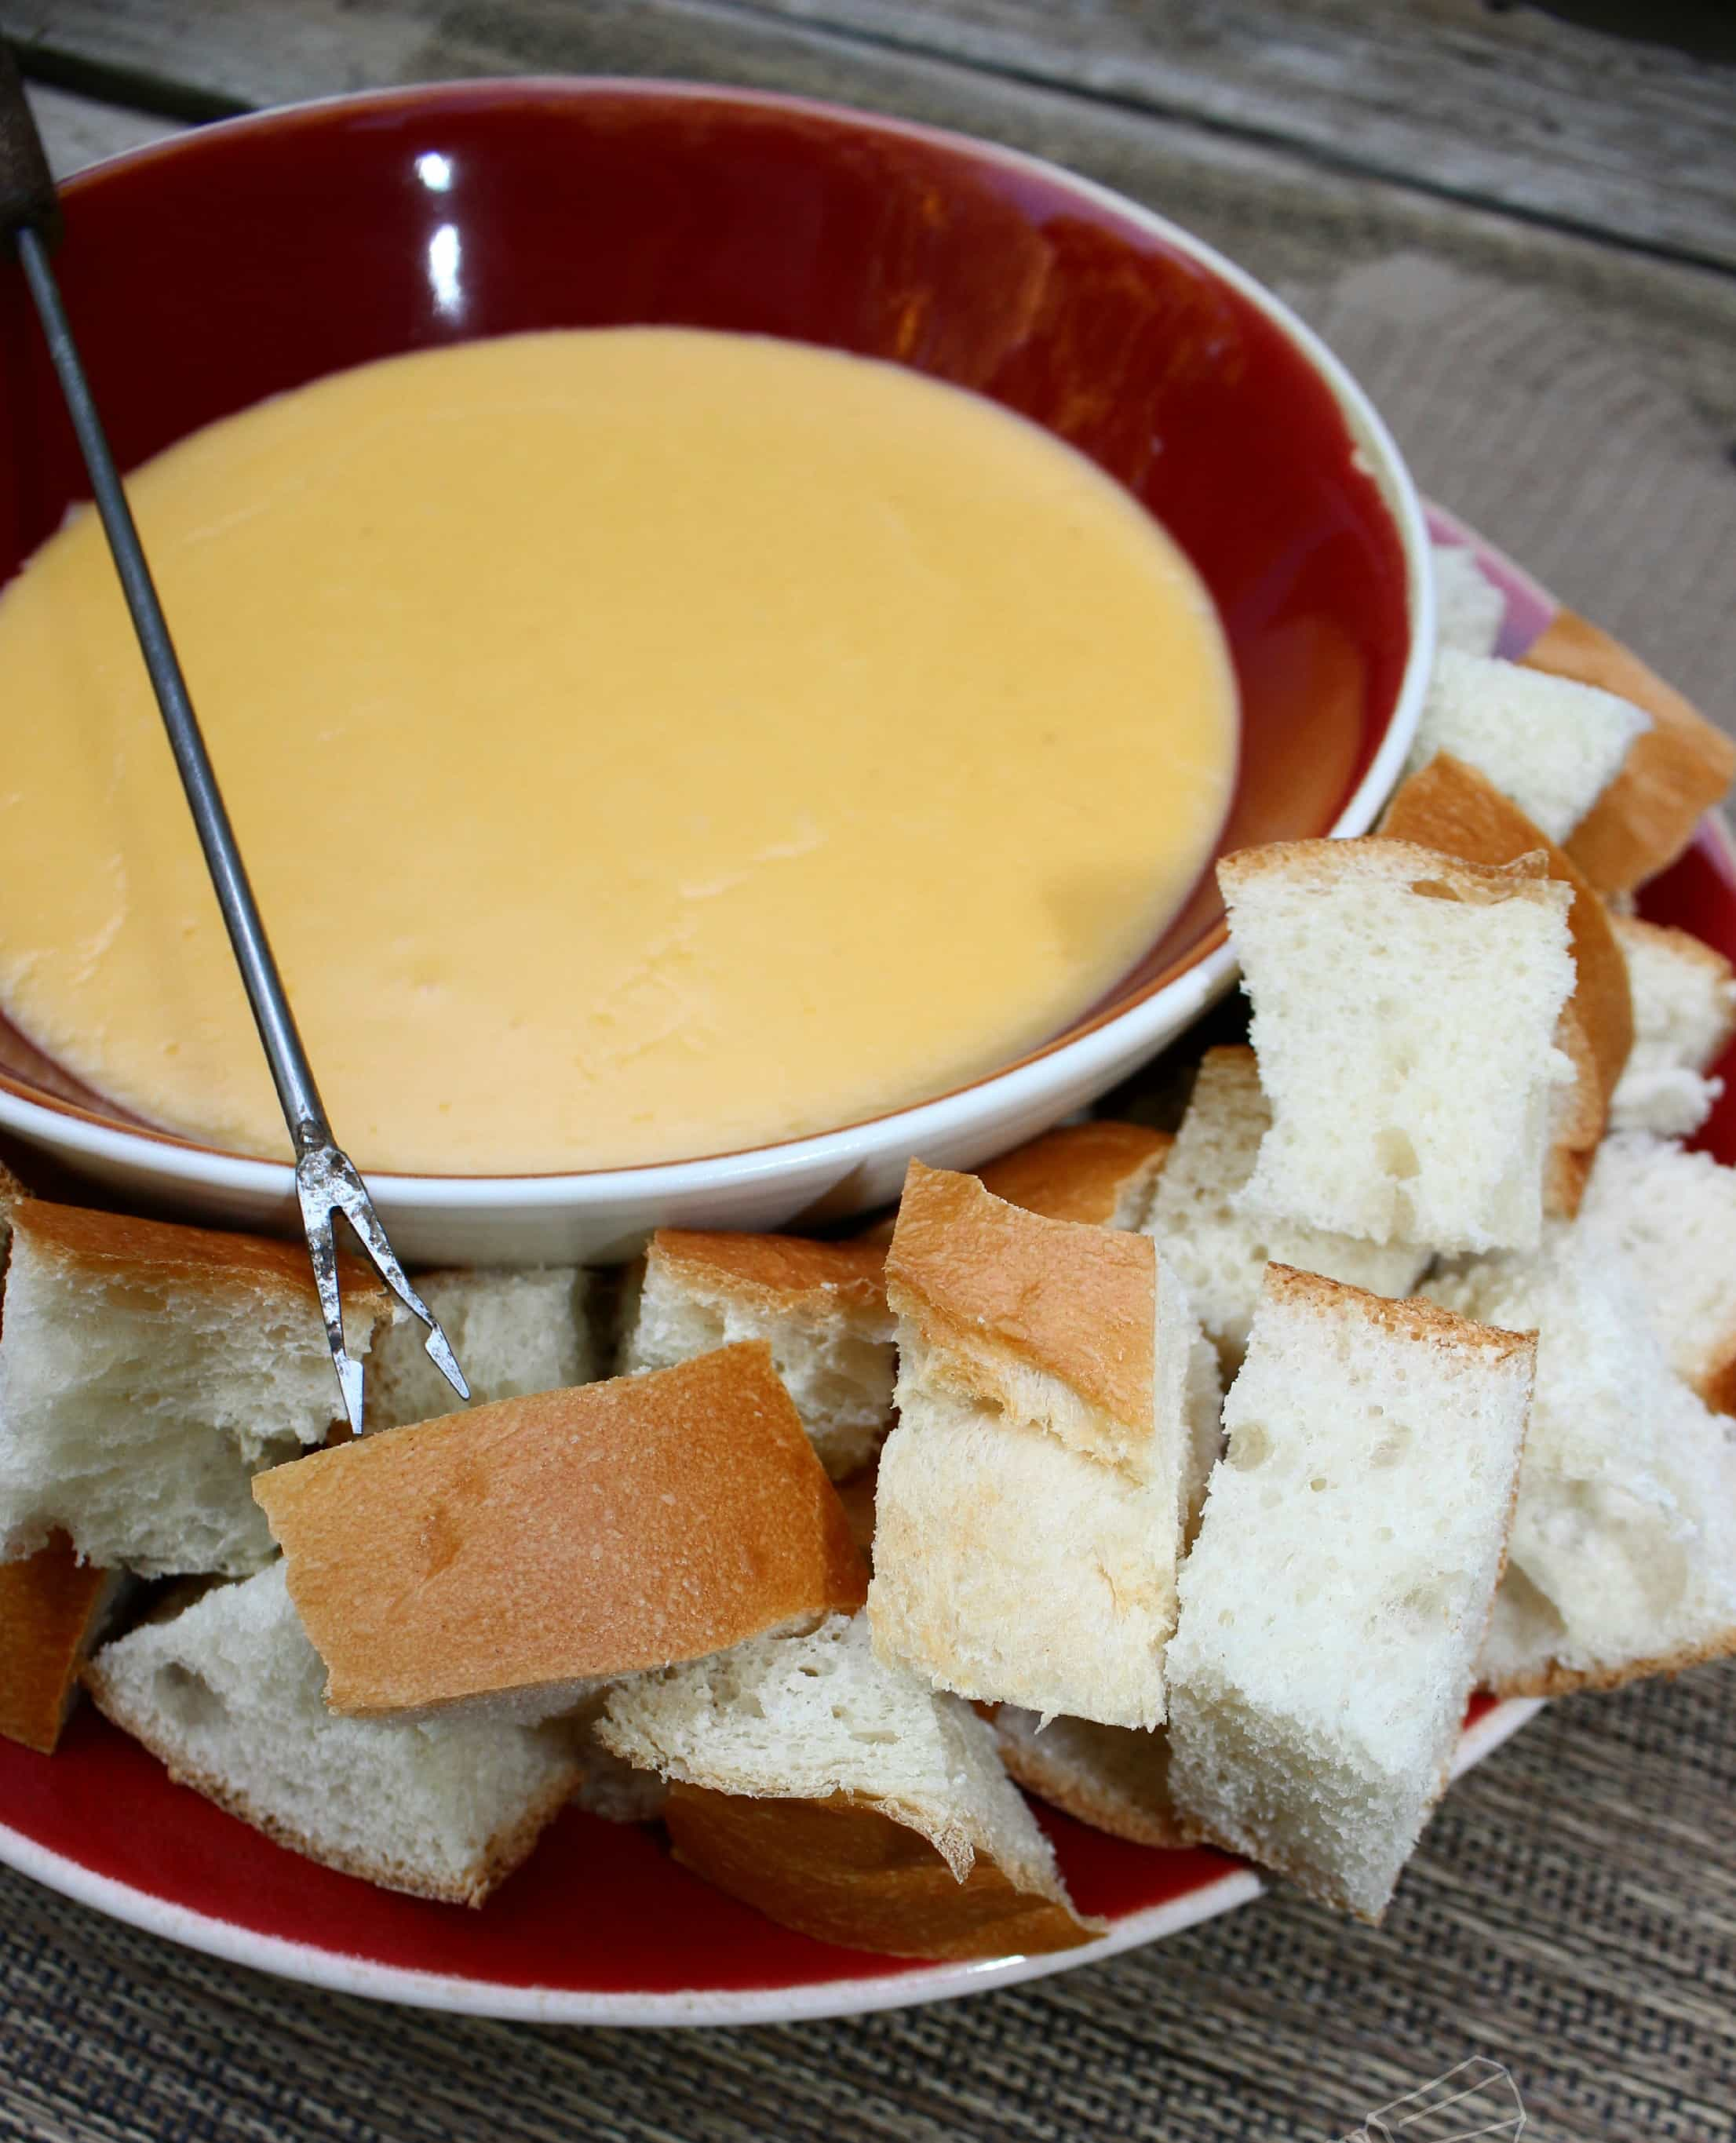
Travel Quiz
Can you name the country that invented this melted cheese dish called fondue?
A) New Zealand
B) Argentina
C) Switzerland
D) Belgium
C) Switzerland
A massive pot of bubbling cheese that people dip bread into and eat. The word "fondue" can mean any melted substance (like chocolate) that people dip food into, but it is the official name of this Swiss national dish.
A.N.

Slide 12
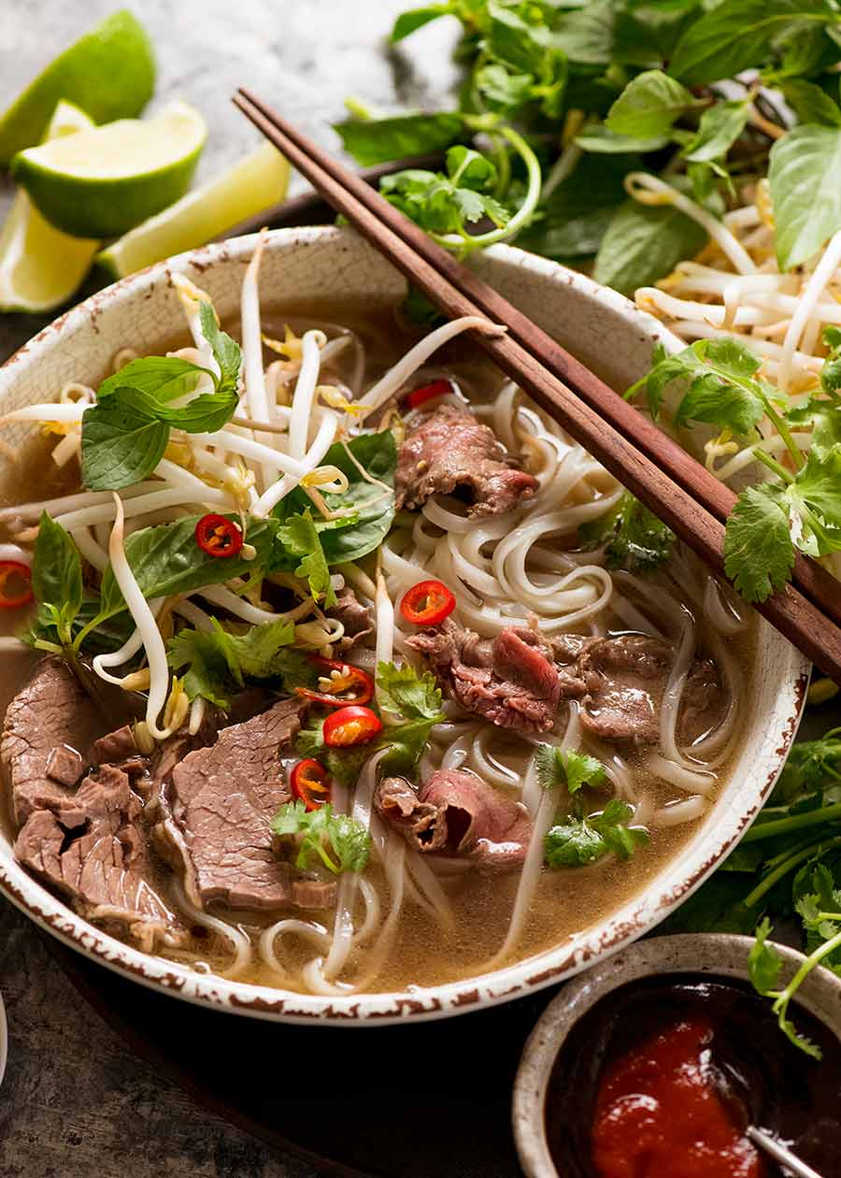
Travel Quiz
Pho is the most popular food in which country?
A) Australia
B) China
C) Vietnam
D) Singapore
C) Vietnam
A Vietnamese soup dish consisting of broth, rice noodles (bánh phở), herbsand meat,usually beef
(phở bò).
A.N.

Slide 13
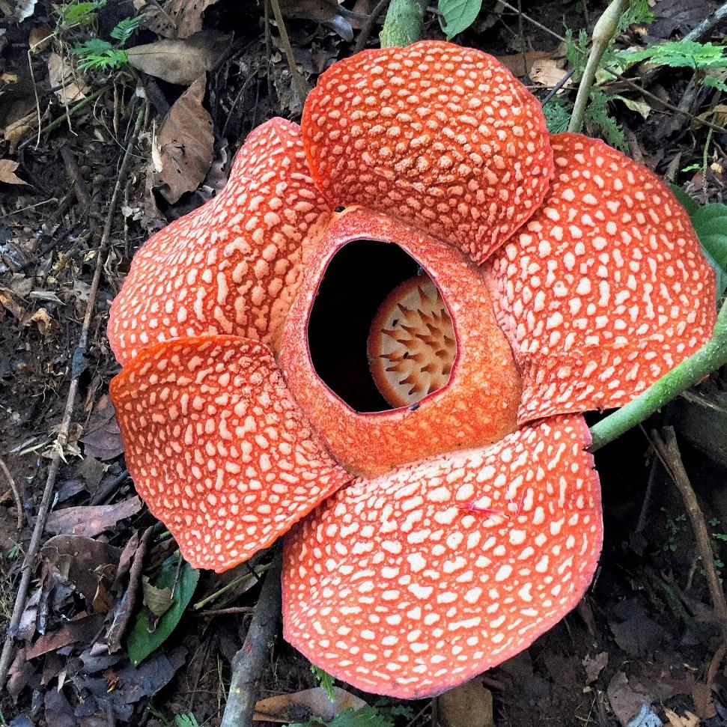
Travel Quiz
Did you know?
The Rafflesia Arnoldii is the world’s biggest flower
It is native to the jungles of Sumatra and Borneo, Indonesia. When it blooms, the flower (which can reach a diameter of one metre) is said to smell like rotting flesh.
A.N.

Slide 14
Travel Quiz
The Striezelmarkt, established in 1434, is considered the first of Europe’s Christmas markets. In which city?
A) Dresden, Germany B) Stockholm, Sweden C) Innsbruck, Austria
D) Prague, Czech Republic
A) Dresden Its 240 stands attract about 3 million visitors from all over the world. The annual market lasts throughout the Advent season until Christmas Eve
A.N.

Slide 15
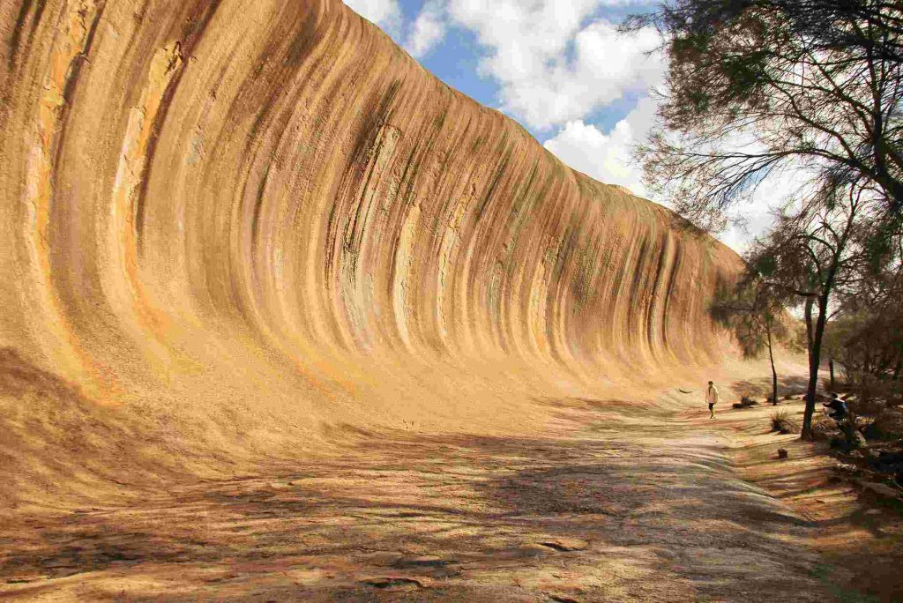
Travel Quiz
Located near the town of Hyden, in which state will you find Wave Rock?
A) Western Australia
B) Queensland
C) Tasmania
D) Victoria
Western Australia
The "wave" is about 15 m high and around 110 m long. It forms the north side of a solitary hill, which is known as "Hyden Rock".
A.N.

Slide 16
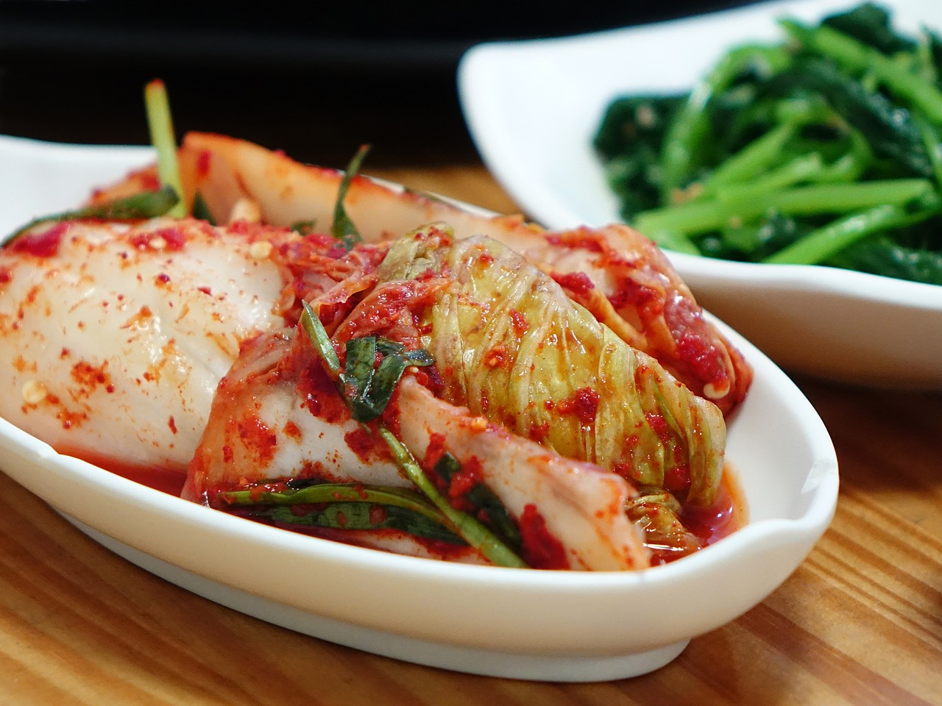
Travel Quiz
A) Korea
Kimchi is a traditional Korean banchan consisting of salted and fermented vegetables, most commonly using napa cabbage or Korean radish.
Pickled and seasoned vegetables (aka kimchi) is the national food of what country?
A) Korea
B) Brazil
C) India
D) China
A.N.

Slide 17
Travel Quiz
Did you know?
The Galapagos Islands inspired Charles Darwin’s Theory of Evolution
Sitting off the coast of mainland Ecuador lies the Galapagos Islands. A hub of biodiversity, these islands were at the core of Darwin’s research when he was formulating his famous Theory of Evolution.
A.N.

Slide 18
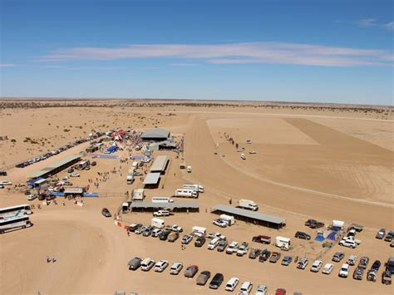
Travel Quiz
Birdsville can be found in which state or territory?
A) Vic.
B) NSW.
C) QLD
D) NT.
C) QLD
The town is situated 10 kilometres north of the South Australian border.
A.N.

Slide 19
Travel Quiz
C) Poland
Pierogi are filled dumplings, made by wrapping unleavened dough around a filling, and occasionally flavored with a savory or sweet garnish and cooking in boiling water.
What country lists these European dumplings known as pierogis as a national dish?
A) Italy
B) France
C) Poland
D) Germany
A.N.

Slide 20
Travel Quiz
Christ the Redeemer, a 30-metre-tall, 635-tonne statue on Corcovado mountain, watches over what city?
A) Manila
B) Rio de Janeiro
C) Cape Town
D) Zurich
B) Rio de Janeiro
Constructed between 1922 and 1931, by French-Polish sculptor Paul Landowski and built by Brazilian engineer Heitor da Silva Costa.
A.N.

Slide 21
Travel Quiz
Did you know?
Did you know that South America is high
It has the highest capital in the world - La Paz in Bolivia.
Venezuela has the highest waterfall in the world – Angel Falls.
Lake Titicaca is the highest navigable lake in the world.
Mount Aconcagua is the Highest Mountain In The Western Hemisphere.
And there are drug cartels that try to keep us all “high”
A.N.

Slide 22
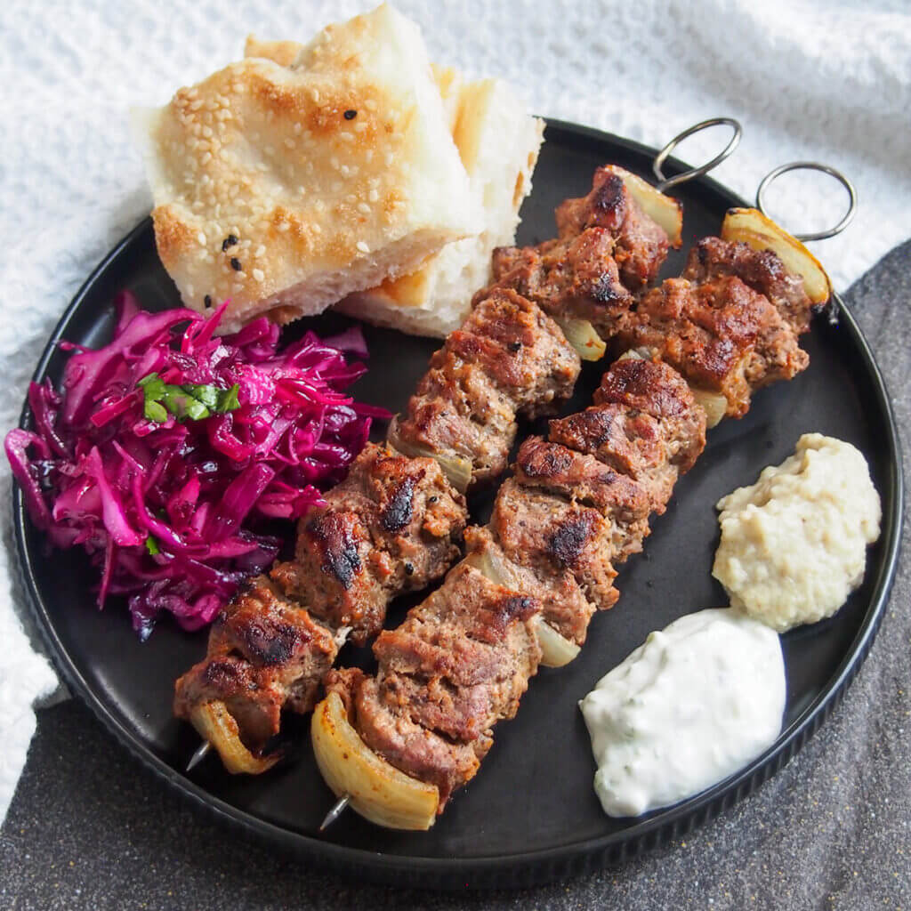
Travel Quiz
What country invented the doner kebab?
A) India
B) Sri Lanka
C) Egypt
D) Turkey
D) Turkey
Originating in Turkey during the Ottoman Empire, and now this vertical stack of meat can be found in major cities all over the world.
A.N.

Slide 23
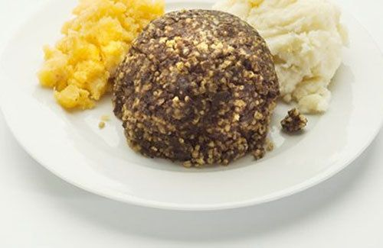
Travel Quiz
Haggis, a dish consisting of minced sheep heart, lungs, and liver mixed with onions and oatmeal, is a national dish of which European country?
A) Wales
B) Albania
C) Scotland
D) Belgium
C) Scotland
Traditionally encased in the animal’s stomach, now an artificial casing is often used instead.
A.N.

Slide 24
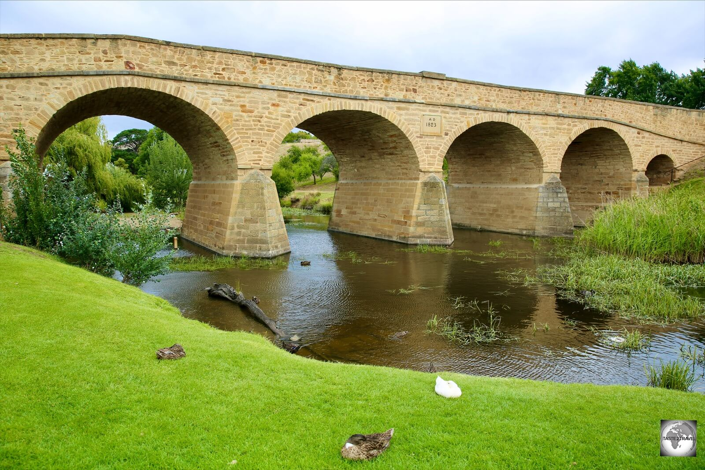
Travel Quiz
Built in 1823, Australia's oldest bridge, the Richmond Bridge, is located in which state?
A) NSW
B) TAS
C) QLD
D) SA
B) TAS
Located on the B31 in Richmond, 25 km north of Hobart in Tasmania. It is the oldest stone span bridge in Australia.
A.N.

Slide 25
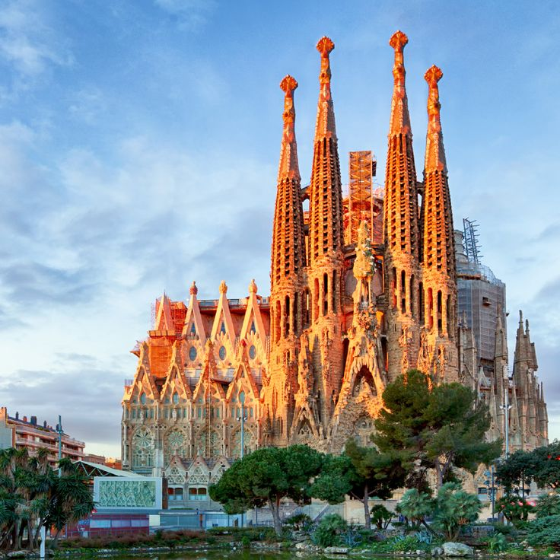
Travel Quiz
Did you know?
Barcelona's Sagrada Familia is Taking Longer to Build Than the Pyramids.
The ancient pyramids of Egypt were constructed between 2589 and 2504 BC — 85 years. Antoni Gaudi's masterpiece, the Sagrada Familia, began construction in 1882, and has remained under construction every day following.
A.N.

Slide 26
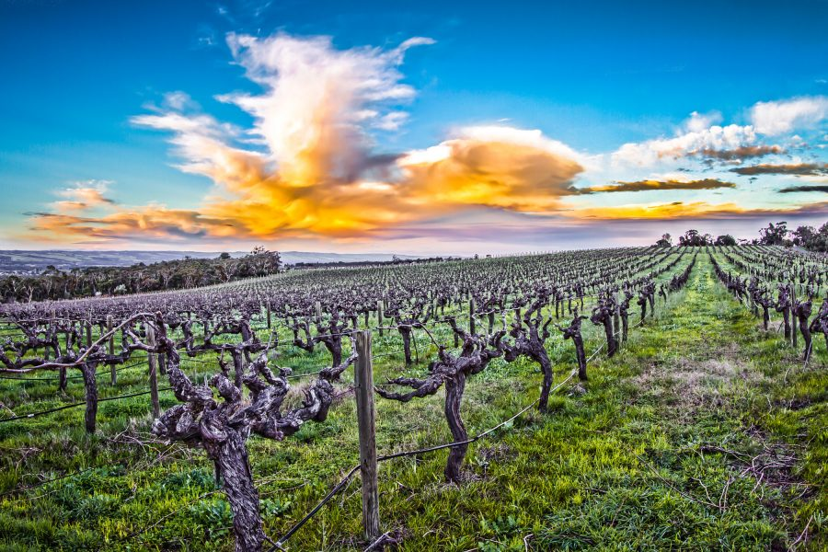
Travel Quiz
A) SA
McLaren Vale is located about 33 kilometres south of Adelaide. The township was formed in 1923 from a merging of the two original villages of Gloucester and Bellevue, which were established in the 1840s
The wine-producing region of McLaren Vale is located in which state?
A) SA
B) VIC
C) WA
D) NSW
A.N.

Slide 27
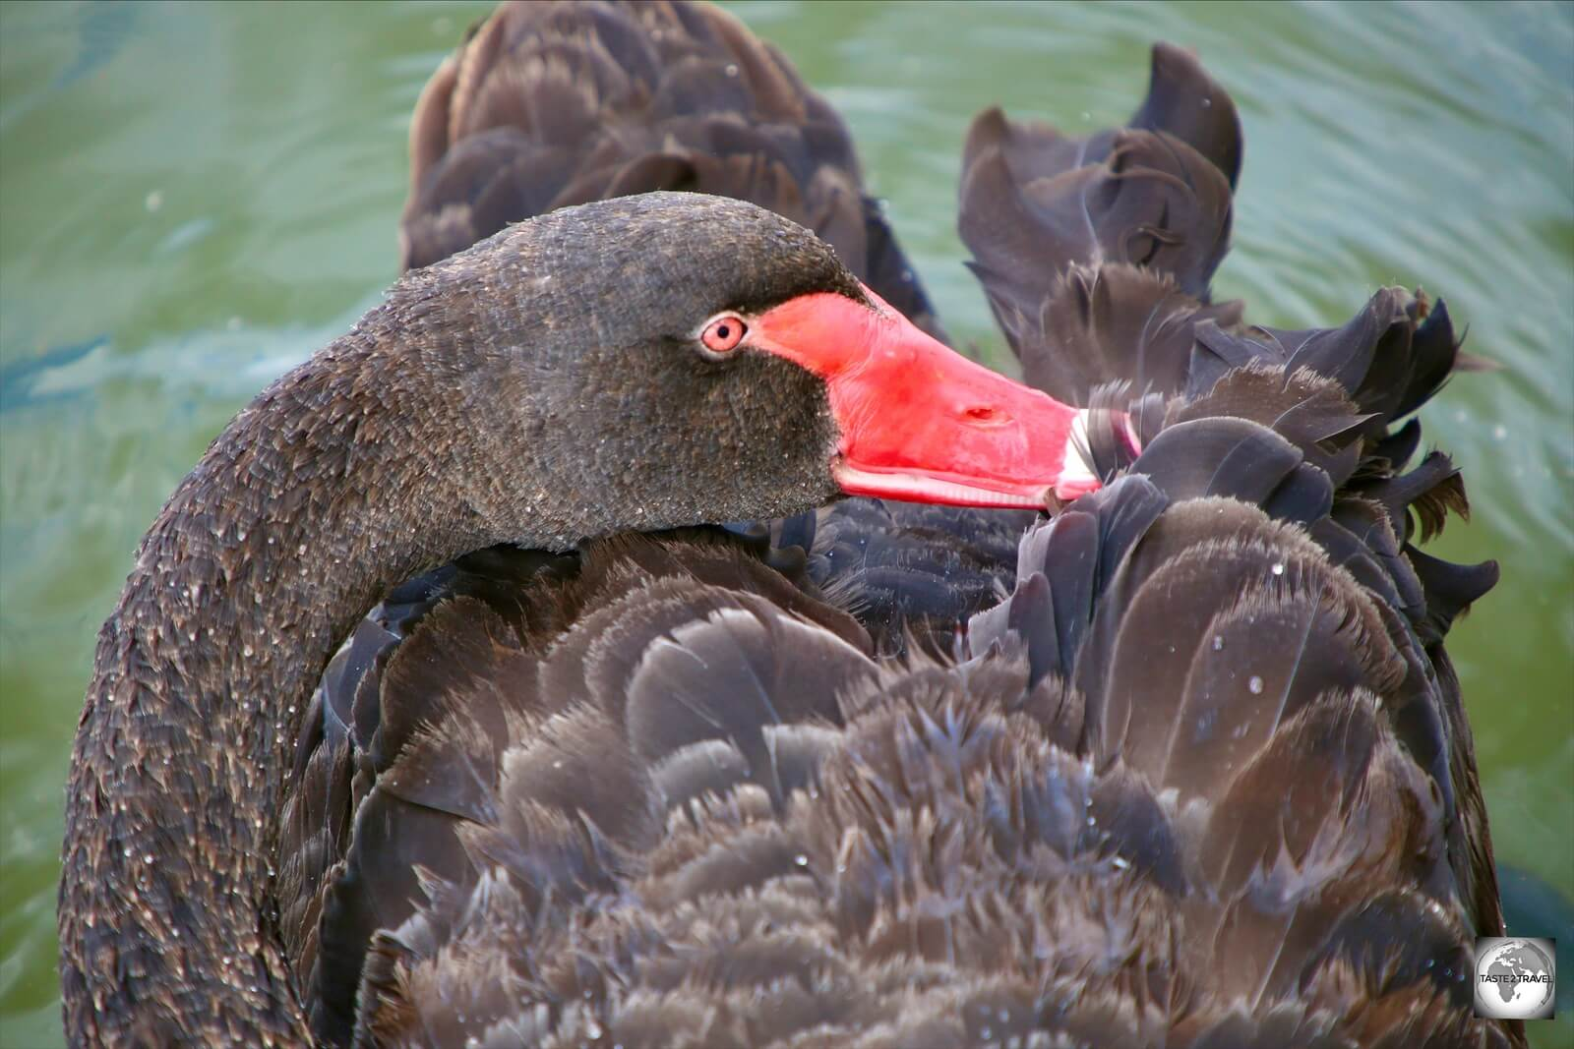
Travel Quiz
The black swan is the bird emblem of which state?
A) SA
B) VIC
C) WA
D) NSW
C) WA
Although the Black Swan is found in wetlands throughout Australia, this graceful bird has had a special association with WA from the earliest times. Aboriginal lore tells how Australians living in the south west of the State, were once Black Swans who became men.
A.N.

Slide 28
Travel Quiz
Did you know?
In Vietnam, your age is based on the year you were born, and changes at new year.
If you were born 1 week before new year, you would turn 1 on the new year.
A.N.

