Slide 1
Travel Quiz
Do you know what Bumba-meu-boi is in Brazil?
A type of dance A Brazilian dessert
Brazilian theatre A Brazilian festival
A.N.

Slide 2
Travel Quiz
Do you know what Bumba-meu-boi is in Brazil?
A type of dance A Brazilian dessert
Brazilian theatre A Brazilian festival
Bumba Meu Boi is an interactive play celebrated in Brazil. It originated in the 18th century. It is a form of social criticism. Lower class Brazilians mock and criticize those of higher social status through a comedic Folklore story told in song and dance. Though not as well known internationally as Carnival and other Brazilian festivals.
A.N.

Slide 3
Travel Quiz
The national drink of Brazil is ‘Caipirinha’. What is it made with?
a) Water, apples and lime b) Lemon, soda, brown sugar
c) Cachaça, brown sugar, and lime d) Rum and lime
A.N.

Slide 4
Travel Quiz
The national drink of Brazil is ‘Caipirinha’. What is it made with?
a) Water, apples and lime b) Lemon, soda, brown sugar
c) Cachaça, brown sugar, and lime d) Rum and lime
The drink is prepared by mixing the fruit and the sugar together, then adding the liquor. This can be made in a single large glass to be shared among people, or in a larger jar, from which it is served in individual glasses.
Cachaça is a distilled spirit made from fermented sugarcane juice.
A.N.

Slide 5
Travel Quiz
What is the name of the famous rum brand in Cuba?
a) Equiano b) The Kraken
c) Admiral Vernons d) Havana Club
A.N.

Slide 6
Travel Quiz
What is the name of the famous rum brand in Cuba?
a) Equiano b) The Kraken
c) Admiral Vernons d) Havana Club
Havana Club is a brand of rum created in Cuba in1934. Originally produced in Cárdenas, Cuba, by family-owned José Arechabala S.A., the brand was nationalized after the Cuban Revolution of 1959.
A.N.

Slide 7
Travel Quiz
If you order “Hákarl” in a restaurant in Iceland, what will you get? A) Fermented shark B) A huge cheeseburger C) Smoked lamb D) Fish & Chips
A.N.

Slide 8
Travel Quiz
If you order “Hákarl” in a restaurant in Iceland, what will you get? A) Fermented shark B) A huge cheeseburger C) Smoked lamb D) Fish & Chips
Hákarl, referred to by the translation fermented shark in English, is a national dish of Iceland consisting of Greenland shark or other sleeper shark that has been cured with a particular fermentation process and hung to dry for four to five months. It has a strong ammonia-rich smell and fishy taste.
A.N.

Slide 9
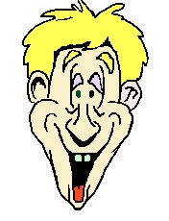
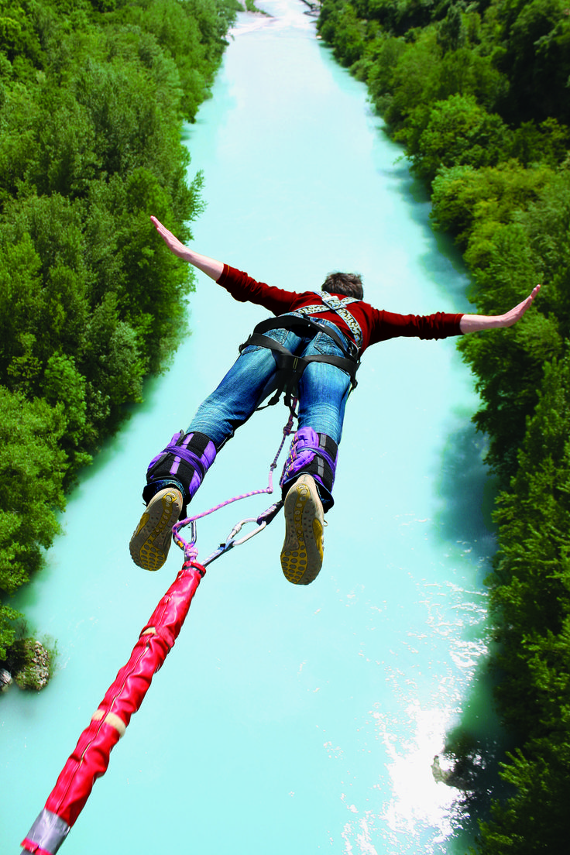
Travel Quiz
No multiple choice
In 1986, New Zealander A.J. Hackett took a (literal) leap from Greenhithe Bridge in Auckland and shortly thereafter founded the commercial industry around what thrill-seeking activity?
Bungee jumping
A.N.

Slide 10
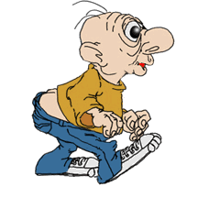
Travel Quiz
It has been tweeted
“Do not follow where the path may lead. Go instead where there is no path and leave a trail.” – Ralph Waldo Emerson
A.N.

Slide 11
Travel Quiz
In 2012 a NZ weatherman used what language for the first time in a broadcast?
A) Maori B) Elvish
C) Estonian D) Greek
A.N.

Slide 12
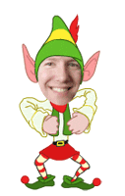
Travel Quiz
In 2012 a NZ weatherman used what language for the first time in a broadcast?
A) Maori B) Elvish
C) Estonian D) Greek
Elvish languages are constructed languages used by Elves in a fantasy setting. The philologist and fantasy author J. R. R. Tolkien created the first of these languages, including Quenya and Sindarin.
A.N.

Slide 13
Travel Quiz
The largest volcanic lake in the world is found in Indonesia, what’s its name?
A) Lake Poso B) Lake Toba
C) Lake Segara Anak D) Lake Matano
A.N.

Slide 14
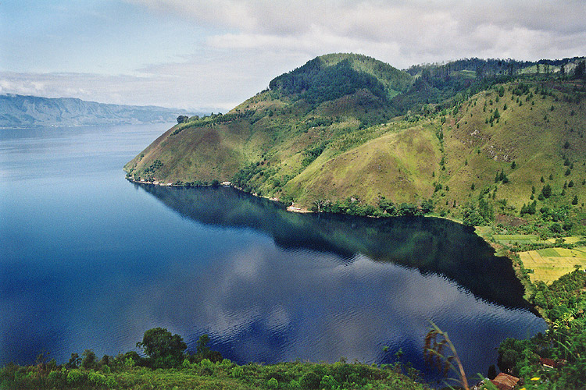
Travel Quiz
The largest volcanic lake in the world is found in Indonesia, what’s its name?
A) Lake Poso B) Lake Toba
C) Lake Segara Anak D) Lake Matano
Scientists believe that Toba erupted around 75,000 years ago and caused a volcanic winter for 10 years.
A.N.

Slide 15
Travel Quiz
In Vietnam, dating back to the 15th century, what art form was devised as a form of entertainment and relaxation by farmers after the harvest?
A) Silk Weaving B) Calligraphy
C) Water Puppets C) Dragon Dance
A.N.

Slide 16
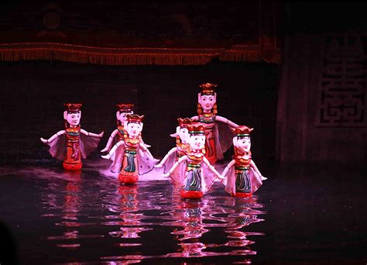
Travel Quiz
In Vietnam, dating back to the 15th century, what art form was devised as a form of entertainment and relaxation by farmers after the harvest?
A) Silk Weaving B) Calligraphy
C) Water Puppets C) Dragon Dance
It originated in the villages of the Red River Delta area of northern Vietnam. Today's Vietnamese water puppetry is a unique variation on the ancient Asian puppet tradition. The puppets are made out of wood and then lacquered. The shows are performed in a waist-deep pool.
A.N.

Slide 17
Travel Quiz
Which of the following Aus. native animals is a ‘monotreme’?
A) Platypus B) Koala
C) Tasmanian Devil D) Wombat
A.N.

Slide 18
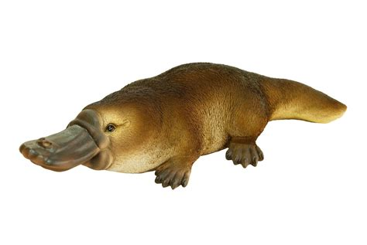
Travel Quiz
Which of the following native animals is a ‘monotreme’?
A) Platypus B) Koala
C) Tasmanian Devil D) Wombat
Monotremes are mammals of the order Monotremata. They are the only group of living mammals that lay eggs, rather than bearing live young. The extant monotreme species are the platypus and the four species of echidnas.
A.N.

Slide 19
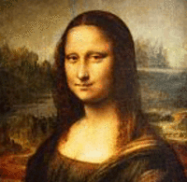
Travel Quiz
It has been tweeted
You should definitely visit the Louvre, a world-famous art museum where you can view, at close range, the backs of thousands of other tourists trying to see the Mona Lisa.”
— Dave Barry, American comedian
A.N.

Slide 20
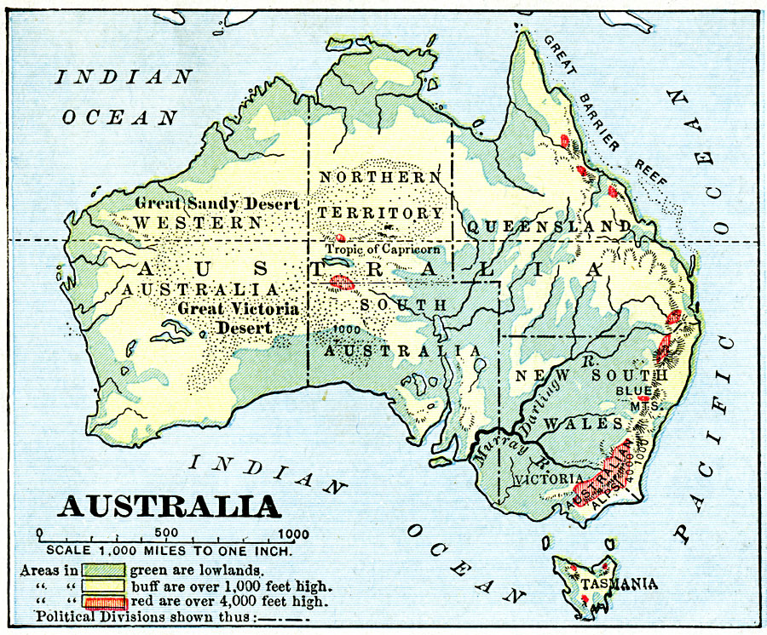
Travel Quiz
No multiple choice
What is the tallest mountain in Australia?
Mount Kosciuszko
Mount Kosciuszko, is mainland Australia's tallest mountain, at 2,228 metres above sea level. It is located on the Main Range of the Snowy Mountains in Kosciuszko National Park, part of the Australian Alps National Parks and Reserves, in New South Wales,
A.N.

Slide 21
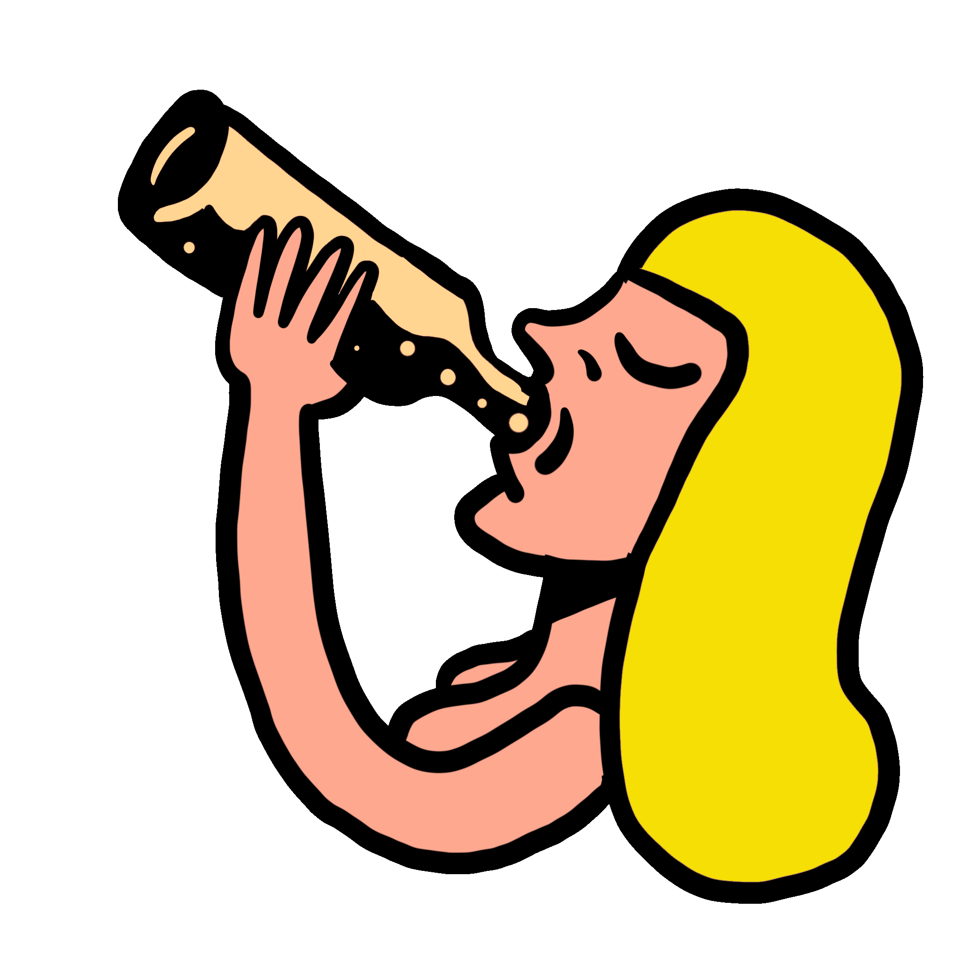
Travel Quiz
Which Australian state is known for its stunning wine regions, including the Barossa Valley?
A) Queensland B) South Australia
C) Victoria D) New South Wales
A.N.

Slide 22
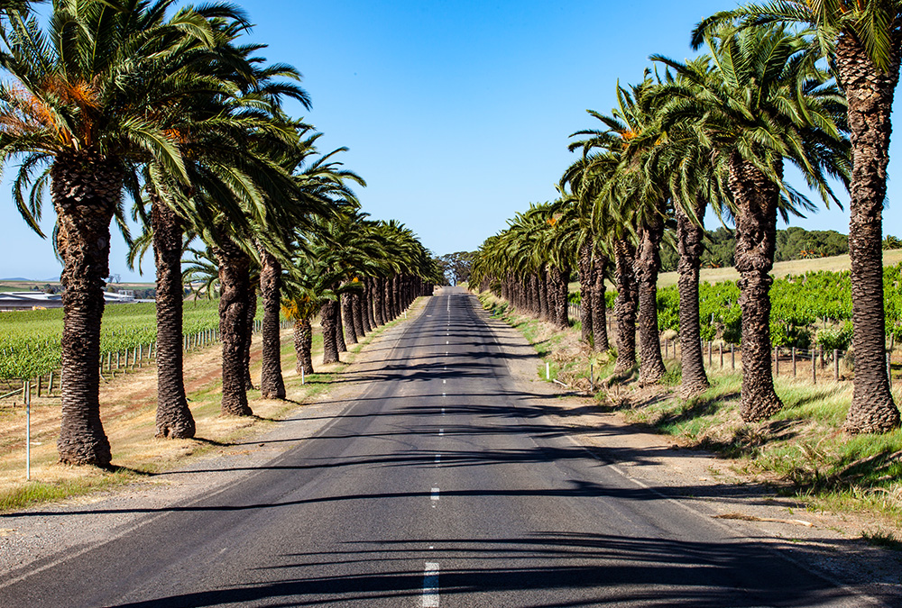
Travel Quiz
Which Australian state is known for its stunning wine regions, including the Barossa Valley?
A) Queensland B) South Australia
C) Victoria D) New South Wales
Just a 50 minute drive north east of Adelaide, the Barossa is an internationally-acclaimed wine region encompassing the towns of Tanunda, Angaston and Nuriootpa.
A.N.

Slide 23
Travel Quiz
What is the currency of Cambodia?
A) Baht B) Taka
C) Shekel D) Riel
A.N.

Slide 24
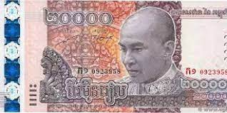
Travel Quiz
What is the currency of Cambodia?
A) Baht B) Taka
C) Shekel D) Riel
The riel is the currency of Cambodia. There have been two distinct riel, the first issued between 1953 and May 1975. Between 1975 and 1980, the country had no monetary system. A second currency, also named "riel", has been issued since 20 March 1980.
A.N.

Slide 25
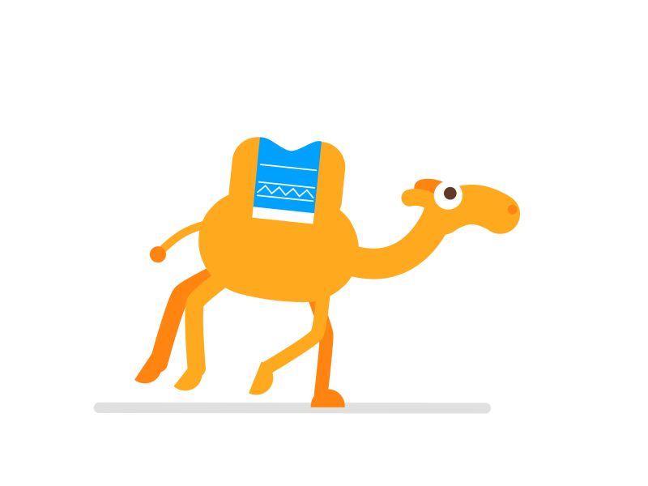
Travel Quiz
No multiple choice
What is the name of the train that runs from Adelaide to Darwin?
The Ghan
An abbreviation of Afghan Express. It is reputed to have been bestowed in 1923 by one of its crews and honours Afghan camel drivers who arrived in Australia in the late 19th century. It was suggested that the Afgan Express was as unreliable as the Afgan camel drivers.”
A.N.

Slide 26
Travel Quiz
Due to its shape, what is the New Zealand Parliamentary building commonly called?
A) Beehive B) Birds Nest
C) Cake Tin D) Bird Box
A.N.

Slide 27
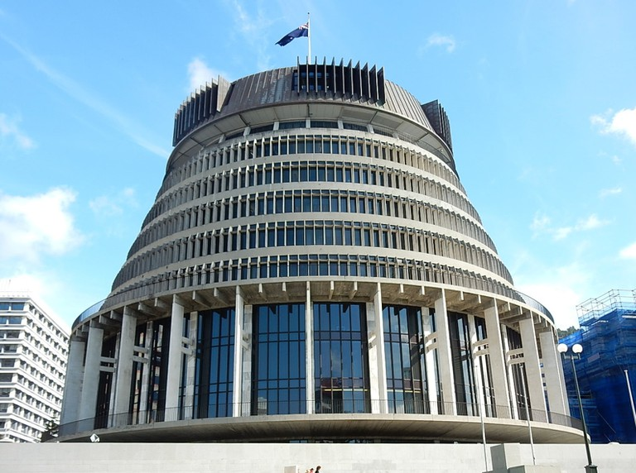
Travel Quiz
Due to its shape, what is the New Zealand Parliamentary building commonly called?
A) Beehive B) Birds Nest
C) Cake Tin D) Bird Box
It is so-called because its shape is reminiscent of that of a traditional woven form of beehive known as a skep.
A.N.

Slide 28
Travel Quiz
Thailand was called Siam for more than 800 years. In what year did it change to Thailand?
A) 1898 B) 1939
C) 1956 D) 1981
A.N.

Slide 29
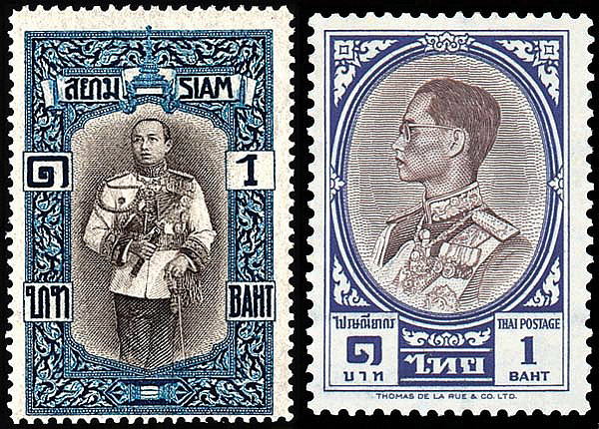
Travel Quiz
Thailand was called Siam for more than 800 years. In what year did it change to Thailand?
A) 1898 B) 1939
C) 1956 D) 1981
People speaking one of the Tai group of languages settled in what is now Thailand around 1,000 years ago. The name Siam came from a Sanskrit word, syam. In 1938 Phibun, the coup leader took charge as dictator. A forceful nationalist and moderniser, he changed the country’s name to Thailand.
A.N.

Slide 30
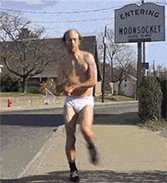
Travel Quiz
It has been tweeted
“Only the people you don’t know well enough seem normal. Every person you know well enough is odd, weird, and different. This is called friendship!”
A.N.

Slide 31
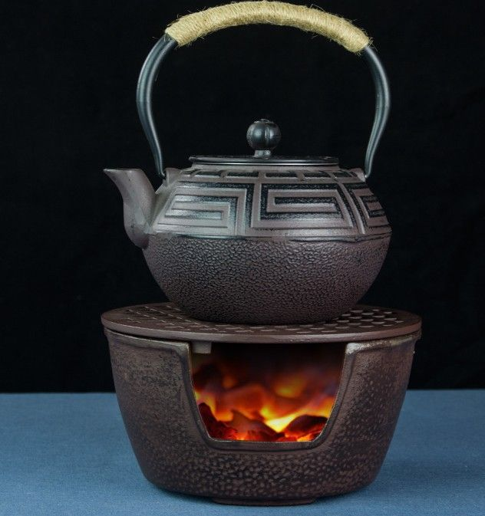
Travel Quiz
No multiple choice
What is the meaning of the Aussie slang word “Billy”?
Teapot.
The most important object in any kitchen, a billy is a teapot.
A.N.

Slide 32
Travel Quiz
Where is considered the whale watching capital of New Zealand?
A) Picton B) Bluff
C) Kaikōura D) Raglan
A.N.

Slide 33
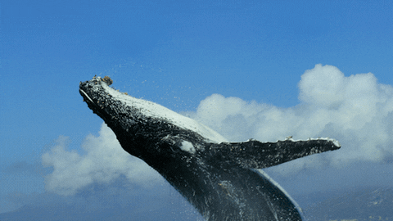
Travel Quiz
Where is considered the whale watching capital of New Zealand?
A) Picton B) Bluff
C) Kaikōura D) Raglan
Kaikoura is a town on the east coast of the South Island of New Zealand. It is located on State Highway 1, 180 km north of Christchurch. The town has an estimated permanent resident population of 2,150.
A.N.

Slide 34
Travel Quiz
The Indonesian Pasola Festival famously includes what tradition?
A) A spearfishing competition B) An archery competition
C) A spear battle D) A sword fight
A.N.

Slide 35
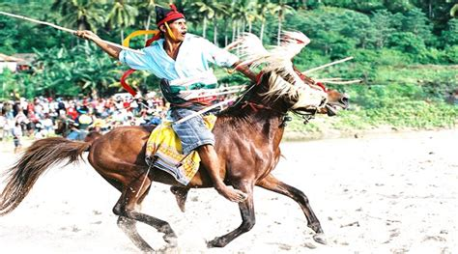
Travel Quiz
The Indonesian Pasola Festival famously includes what tradition?
A) A spearfishing competition B) An archery competition
C) A spear battle D) A sword fight
During the festival, rival clans launch spears at each other to enrich the soil with blood. The spears used today are a little less deadly though.
A.N.

Slide 36
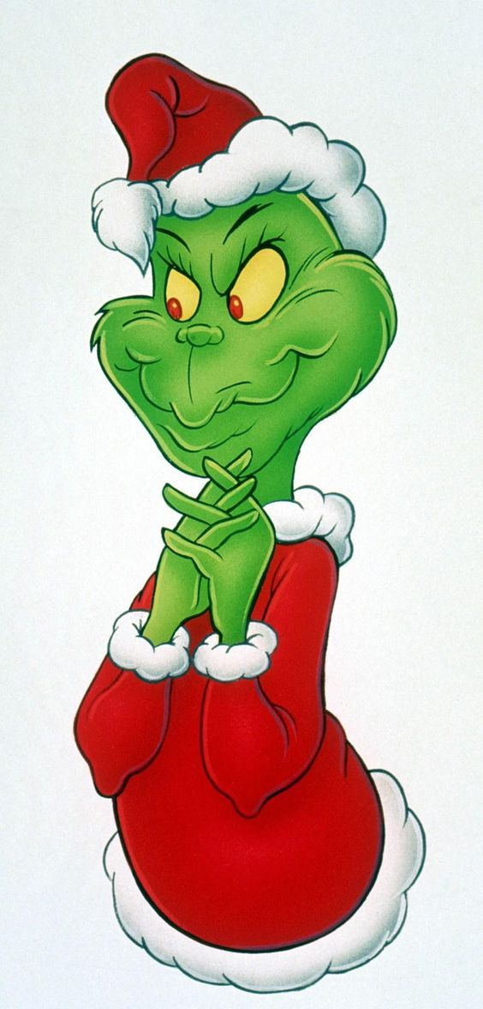
Travel Quiz
No multiple choice
Who tries to stop Christmas from coming, by stealing all things of Christmas from “the Who’s”?
The Grinch
A.N.

Slide 37
Travel Quiz
It has been tweeted
How do you say “no” in Russian?
Nietflix
A.N.

Slide 38
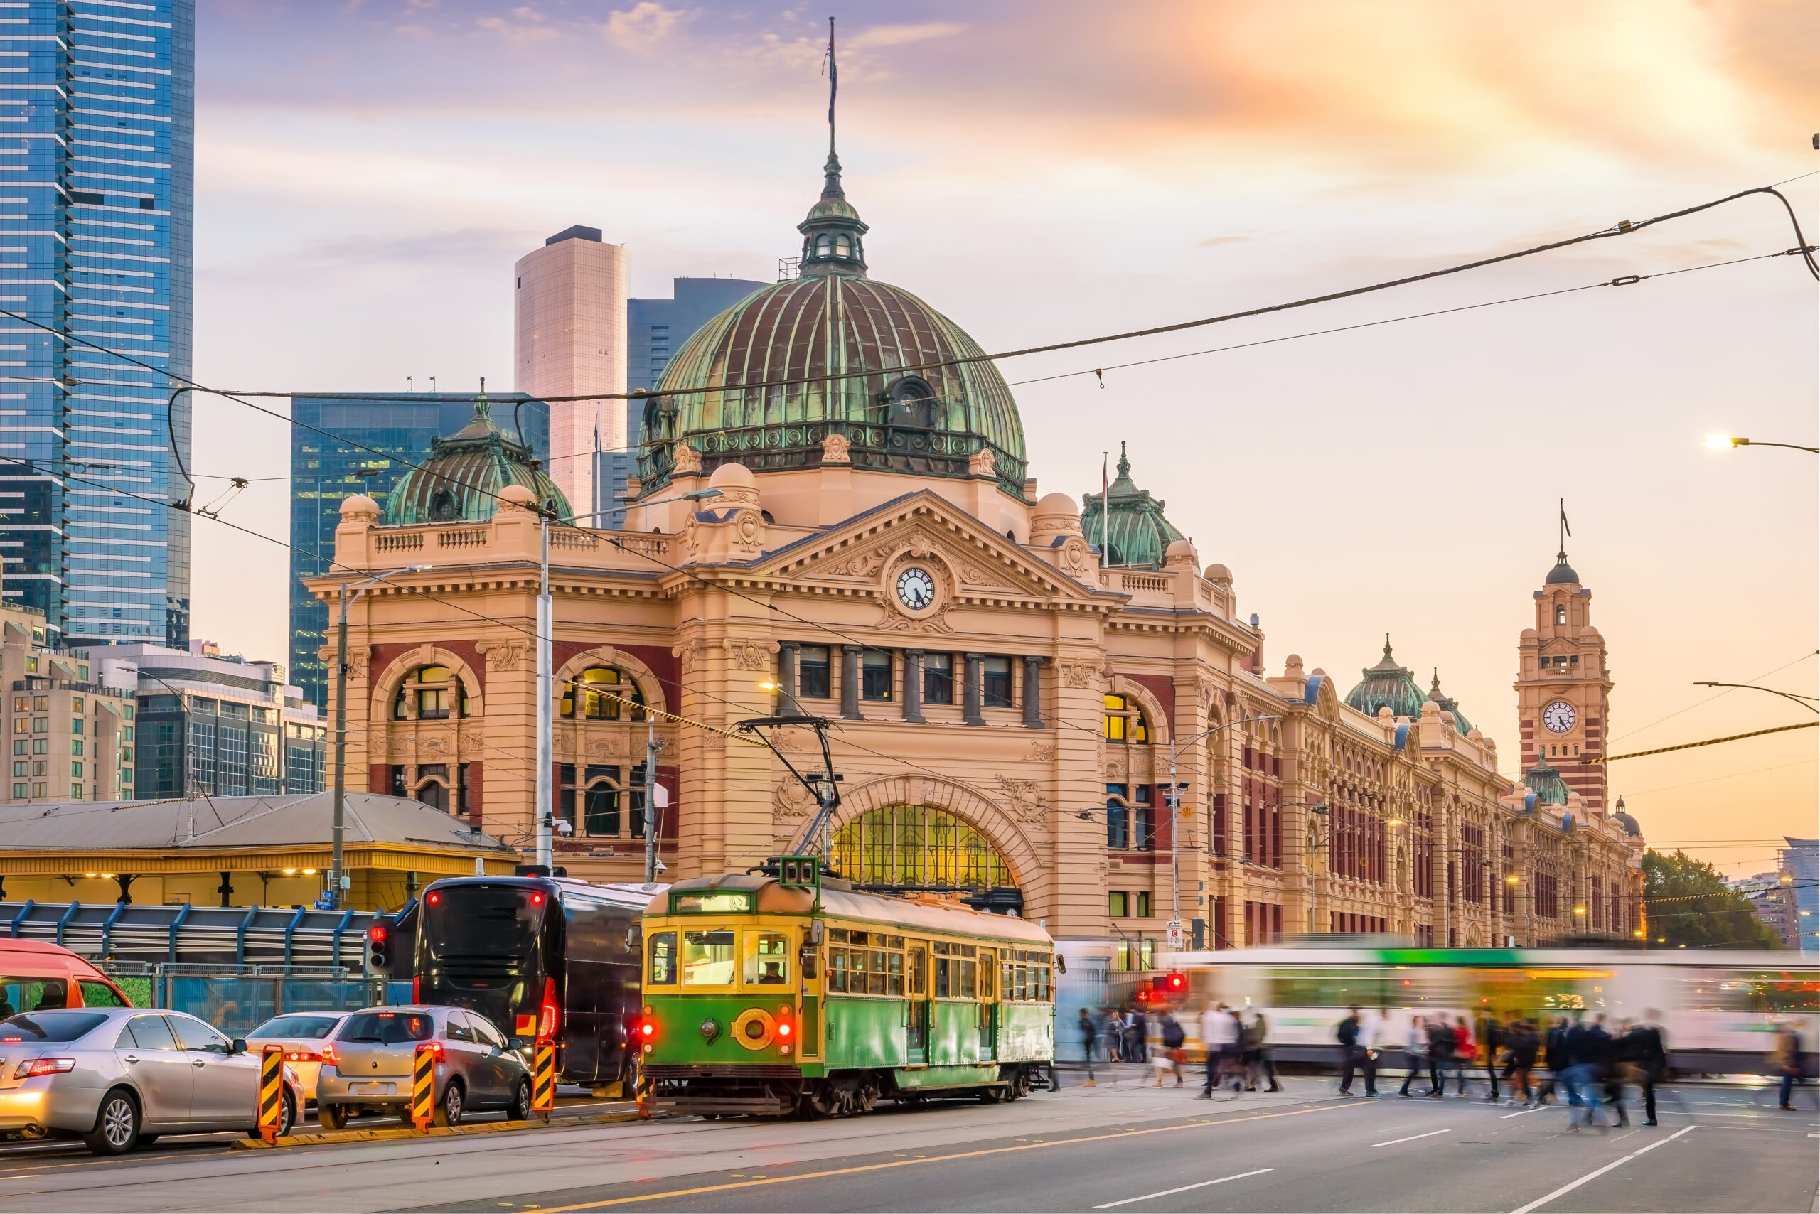
Travel Quiz
No multiple choice
True or false, Sydney is the most populous city in Australia?
True False
False
In April 2023, Melbourne officially overtook the harbour city as Australia's largest city, population-wise.
A.N.

Slide 39
Travel Quiz
The Ningaloo Reef, known for its marine biodiversity, is located off the coast of which Aus. state or territory?
A) Western Australia B) Queensland
C) New South Wales D) Northern Territory
A.N.

Slide 40
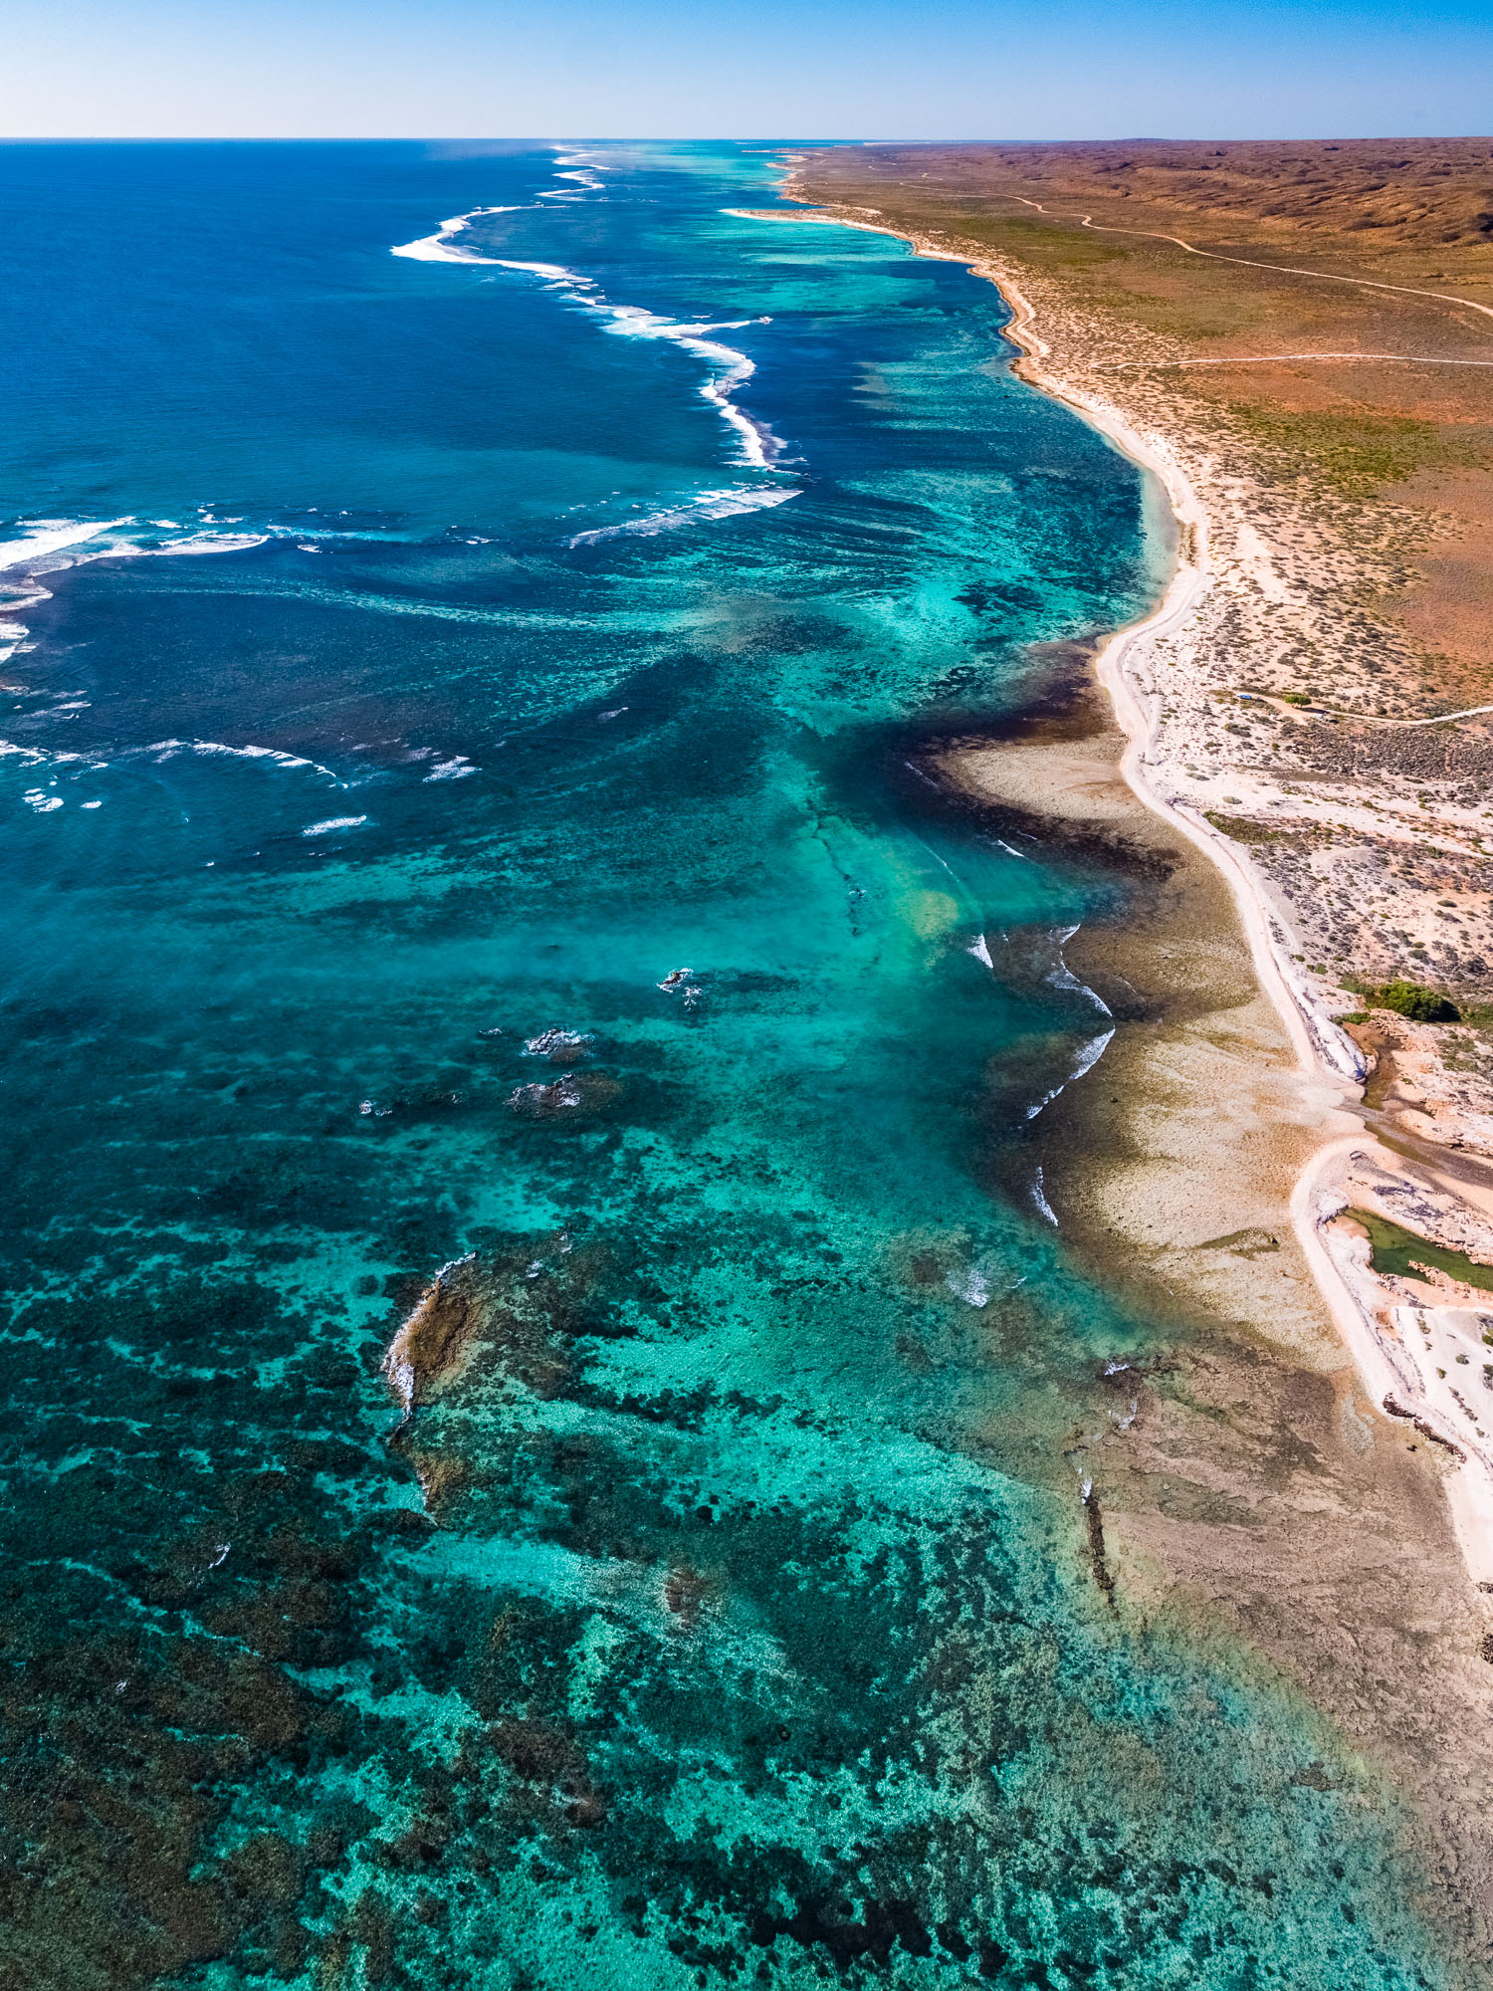
Travel Quiz
The Ningaloo Reef, known for its marine biodiversity, is located off the coast of which Aus. state or territory?
A) Western Australia B) Queensland
C) New South Wales D) Northern Territory
About 1,200km north of Perth. A UNESCO World Heritage-listed fringing reef, it's a hub for outdoor enthusiasts. Notably, it hosts one of the world's largest gatherings of whale sharks, inviting swimming opportunities with these giants.
A.N.

Slide 41
Travel Quiz
Located in Queensland, Australia, which of the following is the world’s largest sand island?
A) Kangaroo Island
B) Magnetic Island
C) K'gari (Fraser Island)
D) Phillip Island
A.N.

Slide 42
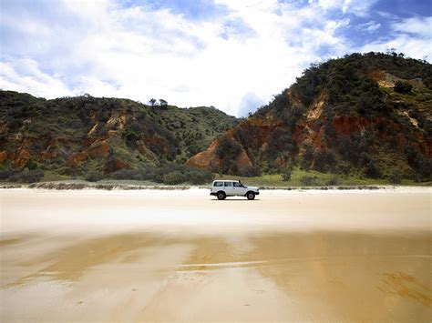
Travel Quiz
Located in Queensland, Australia, which of the following is the world’s largest sand island?
A) Kangaroo Island
B) Magnetic Island
C) K'gari (Fraser Island)
D) Phillip Island
K’gari (Fraser Island), recognised as a World Heritage site, holds the title of being the world's largest sand island, spanning 123 kilometres in length and reaching a width of 22 kilometres at its broadest point.
A.N.

Slide 43
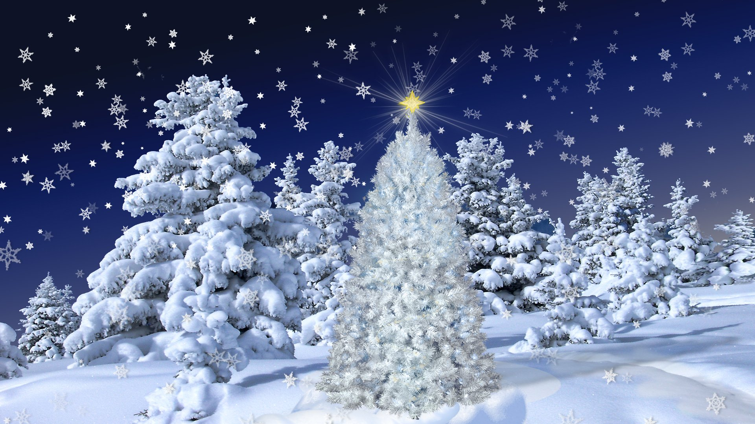
Travel Quiz
No multiple choice
What Bing Cosby song is the best-selling single ever?
White Christmas
A.N.

Slide 44
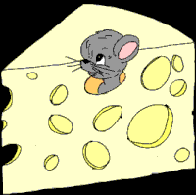
Travel Quiz
It has been tweeted
“How can anyone govern a country that has 246 varieties of cheese?” - Charles de Gaulle
Original Quote in French: “Comment voulez-vous gouverner un pays où il existe 246 variétés de fromage ?” — Charles de Gaulle
A.N.

Slide 45
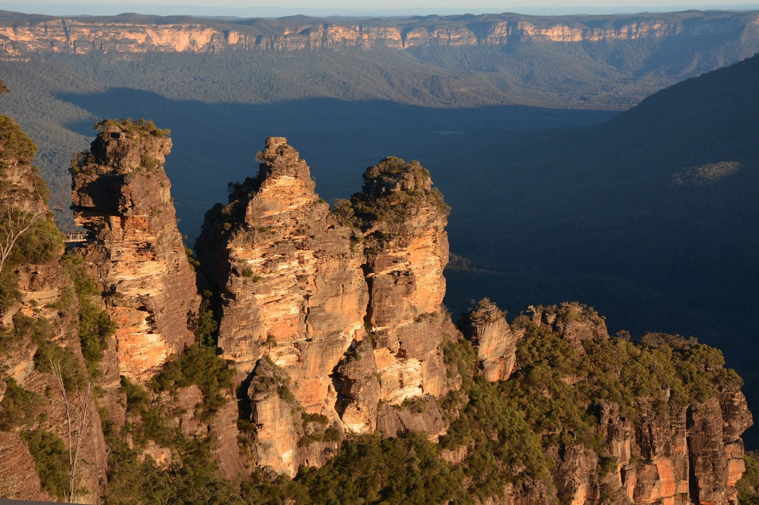
Travel Quiz
No multiple choice
Where would you find Meehni, Wimlah and Gunnedoo.
Three Sisters near Katoomba, NSW
The Three Sisters play an important part in Aboriginal history. The sisters fell in love with three brothers in the neighbouring tribe– something that was forbidden under tribal law.
A.N.

Slide 46
Travel Quiz
What is the name of the epic train journey in New Zealand, going from Christchurch to Greymouth?
A) Northern Explorer
B) The Ghan
C) Coastal Pacific
D) TranzAlpine
A.N.

Slide 47
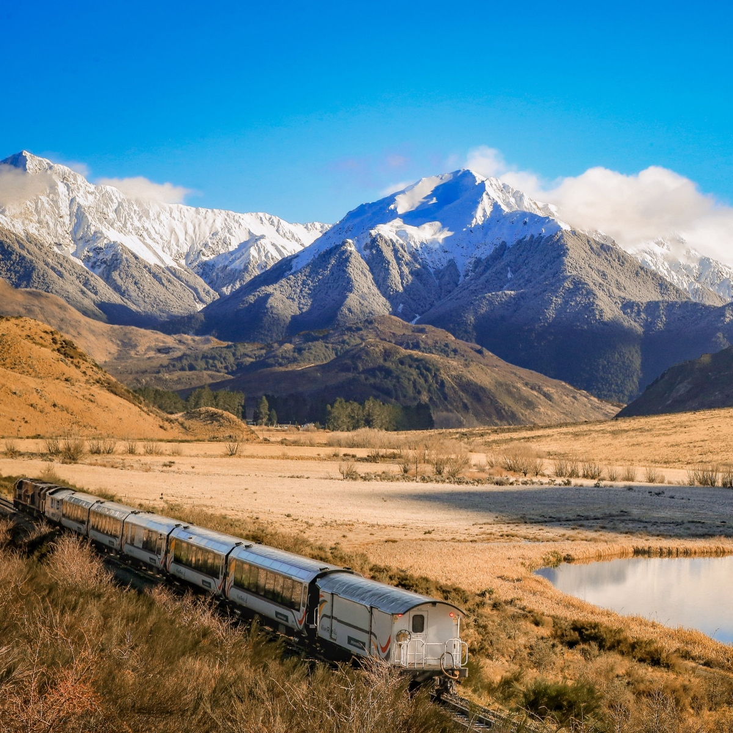
Travel Quiz
What is the name of the epic train journey in New Zealand, going from Christchurch to Greymouth?
A) Northern Explorer
B) The Ghan
C) Coastal Pacific
D) TranzAlpine
The TranzAlpine is a passenger train operated by the Great Journeys New Zealand division of KiwiRail in the South Island of New Zealand over the Midland Line; The journey is 223 kilometres one-way, taking almost five hours. There are 16 tunnels and four viaducts, with the Staircase Viaduct elevated as much as 75 metres
A.N.

Slide 48
Travel Quiz
In which month is Songkran (Thailand's New Year) celebrated?
A) January
B) February
C) March
D) April
A.N.

Slide 49
Travel Quiz
In which month is Songkran (Thailand's New Year) celebrated?
A) January
B) February
C) March
D) April
C: April: Songkran is a term derived from the Sanskrit word, saṅkrānti and used to refer to the traditional New Year for Buddhist calendar celebrated by Bengalis, Cambodia, Laos, Myanmar, Sri Lanka, Thailand, parts of northeast India, parts of Vietnam and Xishuangbanna, China. It begins when the sun transits the constellation of Aries, the first astrological sign in the Zodiac, as reckoned by sidereal astrology.
A.N.

Slide 50
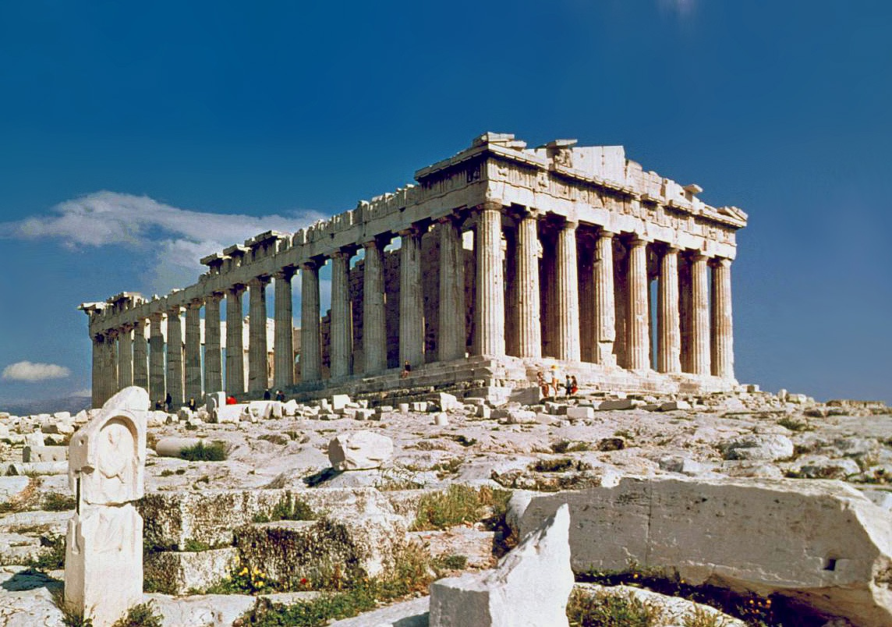
Travel Quiz
No multiple choice
In which capital city can you find the Parthenon?
Athens
A.N.

Slide 51
Travel Quiz
Still with New Year, when do most Vietnamese locals celebrate their New Year, known as Tet?
A) January
B) February
C) March
D) April
A.N.

Slide 52
Travel Quiz
Still with New Year, when do most Vietnamese locals celebrate their New Year, known as Tet?
A) January
B) February
C) March
D) April
Tết, short for Tết Nguyên Đán, is the most important celebration in Vietnamese culture. Tết celebrates the arrival of spring based on the Vietnamese calendar, which is mostly based on the lunisolar Chinese calendar and usually has the date in February in the Gregorian calendar.
A.N.

Slide 53
Travel Quiz
In which month is Songkran (Thailand's New Year) celebrated?
A) January
B) February
C) March
D) April
A.N.

Slide 54
Travel Quiz
In which month is Songkran (Thailand's New Year) celebrated?
A) January
B) February
C) March
D) April
C: April: Songkran is a term derived from the Sanskrit word, saṅkrānti and used to refer to the traditional New Year for Buddhist calendar celebrated by Bengalis, Cambodia, Laos, Myanmar, Sri Lanka, Thailand, parts of northeast India, parts of Vietnam and Xishuangbanna, China. It begins when the sun transits the constellation of Aries, the first astrological sign in the Zodiac, as reckoned by sidereal astrology.
A.N.

Slide 55
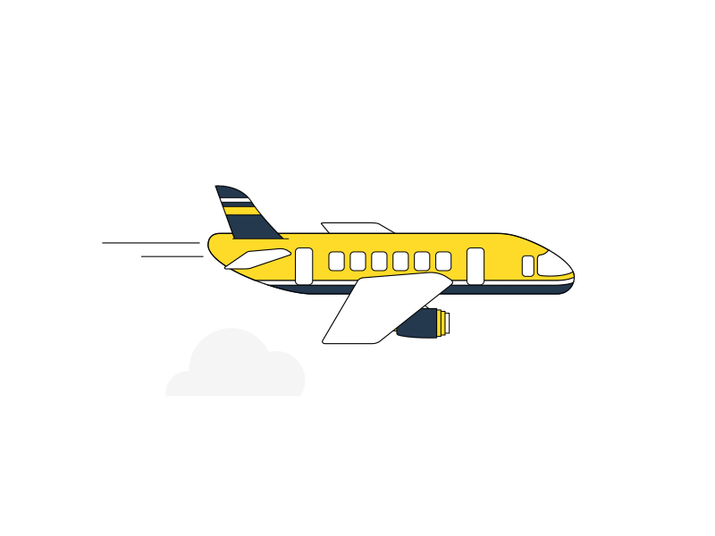
Travel Quiz
It has been tweeted
“A child on a farm sees a plane fly overhead and dreams of a faraway place. A traveler on the plane sees the farmhouse and dreams of home.” – Carl Burns
A.N.

Slide 56
Travel Quiz
Just 90 minutes from Bangkok, which floating market is the largest and most popular?
A) Damnoen Saduak Floating Market
B) Tha Kha Floating Market
C) Amphawa Floating Market
D) Taling Chan Floating Market
A.N.

Slide 57
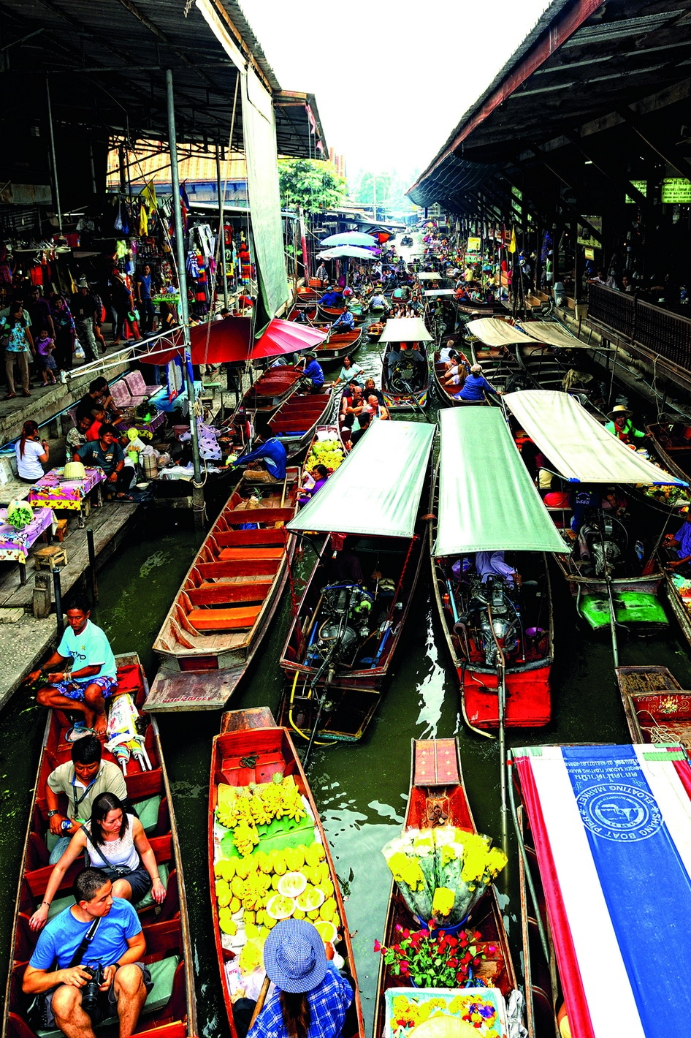
Travel Quiz
Just 90 minutes from Bangkok, which floating market is the largest and most popular?
A) Damnoen Saduak Floating Market
B) Tha Kha Floating Market
C) Amphawa Floating Market
D) Taling Chan Floating Market
About 100 kilometres southwest of Bangkok, Thailand. It has become primarily a tourist attraction, attracting domestic and foreign tourists. It is often considered the most famous floating market.
A.N.

Slide 58
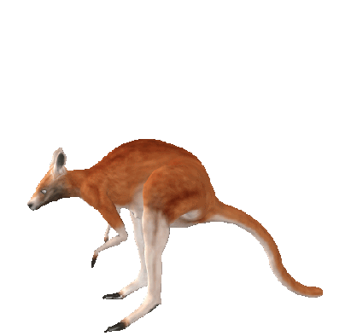
Travel Quiz
No multiple choice
What is the meaning of the Aussie Phrase:-”Kangaroos loose in the top paddock”
Someone is not very bright, eccentric, or foolish.
“As far as I’m concerned, anyone who believes the news about the UFO has kangaroos loose in the top paddock.”
A.N.

Slide 59
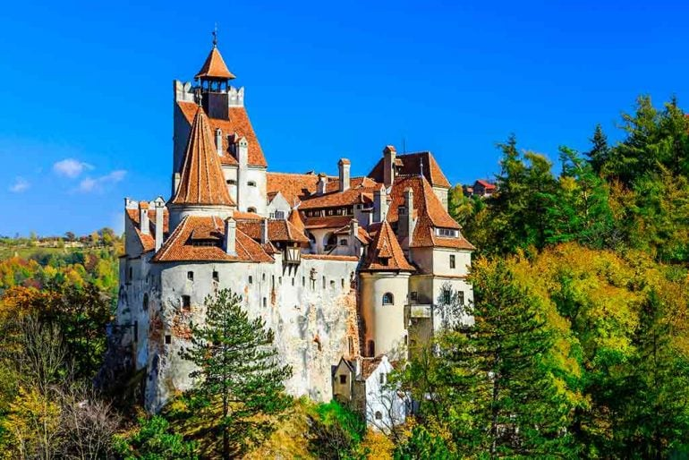
Travel Quiz
No multiple choice
We call It Dracula's Castle but the real name of it is Bran Castle.
What country is it in?.
Romania
25 kilometres southwest of Brașov. The castle was built by Saxons in 1377 who were given the privilege by Louis I of Hungary. It is a national monument and landmark in Transylvania
A.N.

