Slide 2
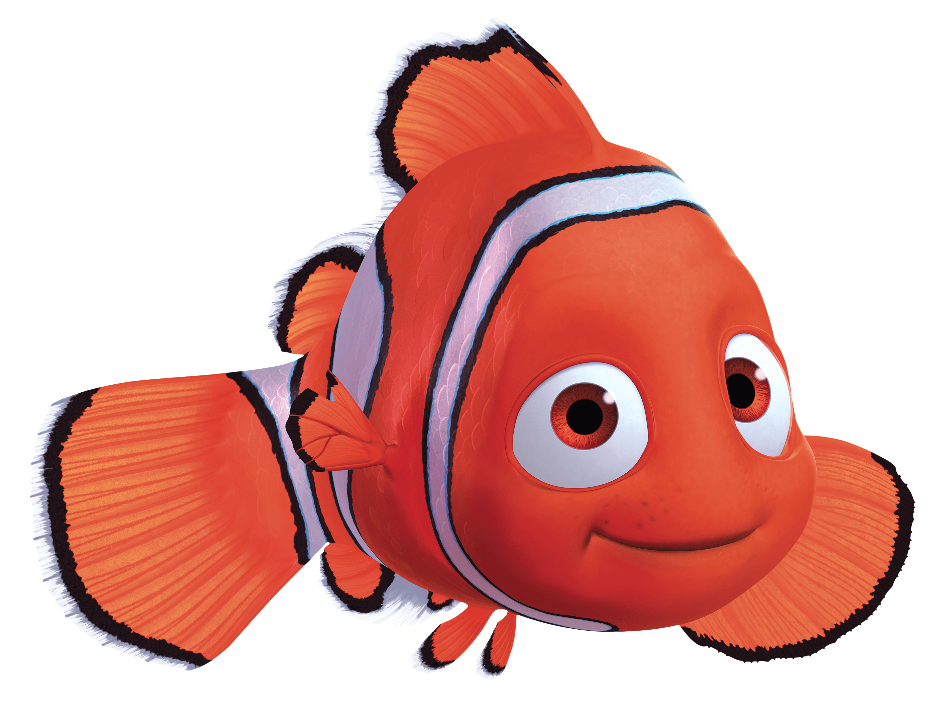
Travel Quiz
In the movie ‘Finding Nemo’ where are Marlin and Nemo swimming towards?
A) Sydney
B) Auckland C) Byron Bay
D) Colombo
Option A: Sydney
Marlin and Dory are swimming along looking for P. Sherman, 42 Wallaby Way, Sydney.
A.N.

Slide 3
Option A: Sydney
Travel Quiz
Mamungkukumpurangkuntjunya Hill
What is the longest place name in Australia.
(only the first 10 letters of the name is shown)
A) Mamungkuku
B) Abracadabr C) Mancalabay
D) didjiradoo
is officially the longest place name in Australia. Located in the Indigenous Anangu Pitjantjatjara Yankunytjatjara lands in the north of the state of South Australia, the name is derived from ‘where the devil urinates’ in regional Pitjantjatjara language.
A.N.

Slide 4
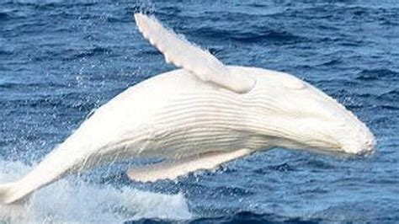
Travel Quiz
What is the name of the only known white albino whale?
A) Abaroo
B) Migaloo C) Bangaloo
D) Colombo
Option B: Migaloo
The world’s only white whale – they call him – ‘Migaloo’ can be seen in Australia.
A.N.

Slide 5
Travel Quiz
In the movie ‘Finding Nemo’ where are Marlin and Nemo swimming towards?
A) Sydney
B) Auckland C) Byron Bay
D) Colombo
Option A: Sydney
Marlin and Dory are swimming along looking for P. Sherman, 42 Wallaby Way, Sydney.
A.N.

Slide 6
Travel Quiz
In the movie ‘Finding Nemo’ where are Marlin and Nemo swimming towards?
A) Sydney
B) Auckland C) Byron Bay
D) Colombo
Option A: Sydney
Marlin and Dory are swimming along looking for P. Sherman, 42 Wallaby Way, Sydney.
A.N.

Slide 7
Travel Quiz
In the movie ‘Finding Nemo’ where are Marlin and Nemo swimming towards?
A) Sydney
B) Auckland C) Byron Bay
D) Colombo
Option A: Sydney
Marlin and Dory are swimming along looking for P. Sherman, 42 Wallaby Way, Sydney.
A.N.

Slide 8
Travel Quiz
In the movie ‘Finding Nemo’ where are Marlin and Nemo swimming towards?
A) Sydney
B) Auckland C) Byron Bay
D) Colombo
Option A: Sydney
Marlin and Dory are swimming along looking for P. Sherman, 42 Wallaby Way, Sydney.
A.N.

Slide 9
Travel Quiz
In the movie ‘Finding Nemo’ where are Marlin and Nemo swimming towards?
A) Sydney
B) Auckland C) Byron Bay
D) Colombo
Option A: Sydney
Marlin and Dory are swimming along looking for P. Sherman, 42 Wallaby Way, Sydney.
A.N.

