Slide 1
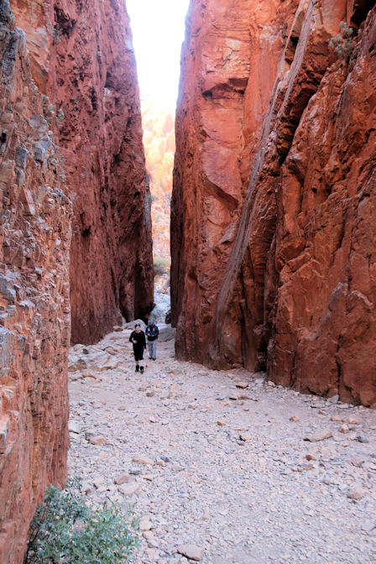
Where am I?
Australasia
1) Simpsons Gap. NT - AU. 2) Horrocks Pass, South Australia 3) Karangahake Gorge - NZ ​4) The Kings Highway - NSW - AU
A.N.
1) Simpsons Gap. NT - AU.
Simpsons Gap is one of the gaps in the West MacDonnell Ranges in Australia's Northern Territory. It is located 18km west from Alice Springs, on the Larapinta Trail.
A.N.

Slide 2
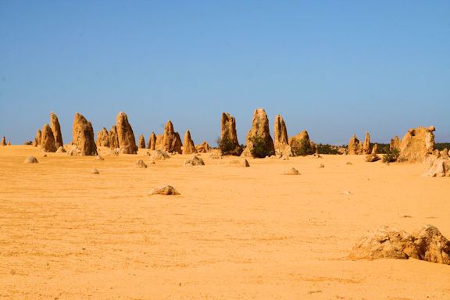
Where am I?
Australasia
1) Bald Rock - NSW 2) Pinnacles- WA - AU 3) Remarkable Rocks - Kangaroo Island - AU ​4) Rotorua NZ.
2) Pinnacles- WA - AU About 200km north of Perth. These amazing natural limestone structures, some standing as high as five metres, were formed approximately 25,000 to 30,000 years ago, after the sea receded and left deposits of sea shells.
Over time, coastal winds removed the surrounding sand, leaving the pillars exposed to the elements.
A.N.

Slide 3
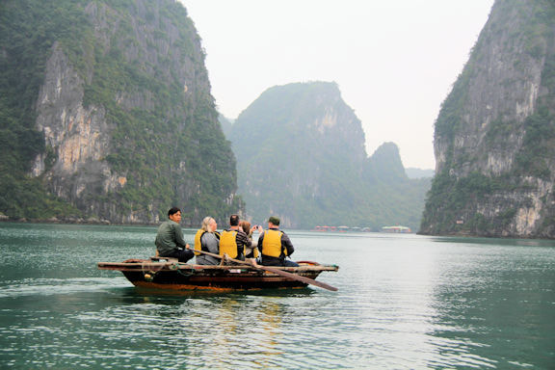
Where am I?
S.E.Asia
1) Guilin - China 2) Halong Bay - Vietnam 3) Agra - India. ​4) Pinnawala - Sri Lanka
2) Halong Bay - Vietnam
Hạ Long Bay, in northeast Vietnam, is known for its thousands of towering limestone islands topped by rainforests.
The region is also popular for scuba diving, rock climbing and hiking.
A.N.

Slide 4
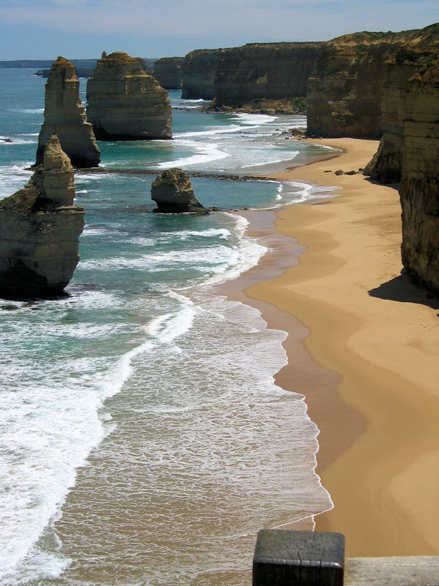
Where am I?
Australasia
1) Twelve Apostles - Victoria - AU. 2) Moeraki Boulders -Otago - NZ. 3) Three Sisters- Katoomba - AU. ​4) Rapanui, or "Shag Rocks" -Christchurch - NZ
1) Twelve Apostles - Victoria - AU. ​
The Twelve Apostles is a collection of limestone stacks off the shore of Port Campbell National Park, by the Great Ocean Road in Victoria, Australia.
A.N.

Slide 5
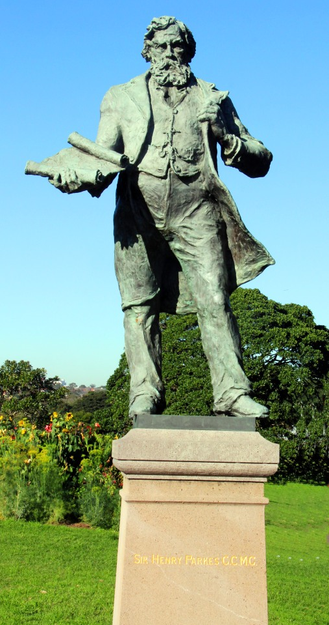
When was I
Australasia
Sir Henry Parkes founded Centennial park in:-?
1) 1868
1878
1888
1898
3) 1888. ​
Sir Henry Parkes served as Premier of NSW for five separate occasions from 1872 to 1891.
A.N.

Slide 6
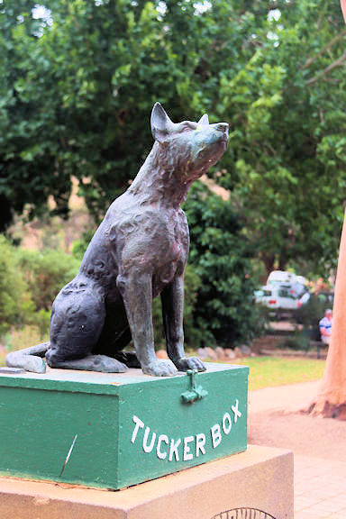
Where am I?
Australasia
1) Dunedin - NZ. 2) Whyalla Stuart - SA - AU. 3) Gundagai - NSW - AU. ​4) Lake Tekapo - NZ.
3) Gundagai - NSW - AU. The inspiration for the statue has been traced to a doggerel poem, "Bullocky Bill", published anonymously by "Bowyang Yorke" in 1857 (other references have 1880 in the Gundagai Times). ​
The poem humorously describes a series of misfortunes faced by a bullock driver, culminating in his dog either sitting on or spoiling the food in his tucker-box.
A.N.

Slide 7
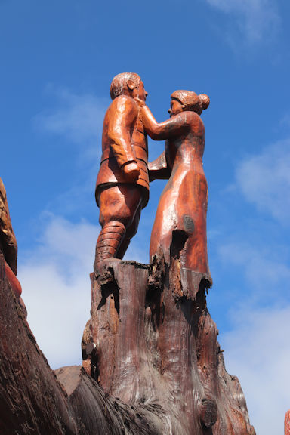
Where am I?
Australasia
1) Gold Coast - QLD - AU. 2) Christchurch - NZ. 3) Ledgerwood - TAS - AU ​4) Sheffield - TAS - AU.
3) Ledgerwood - TAS - AU
In October 1918, the families of nine fallen soldiers planted trees along the main street of town. More than 80 years later the trees were deemed dangerous.
After a year of fundraising, the Legerwood Hall and Reserves Committee employed Ross ‘chainsaw carver’ Eddie Freeman to sculpt the trees into a likeness of the men they were planted for.
A.N.

Slide 8
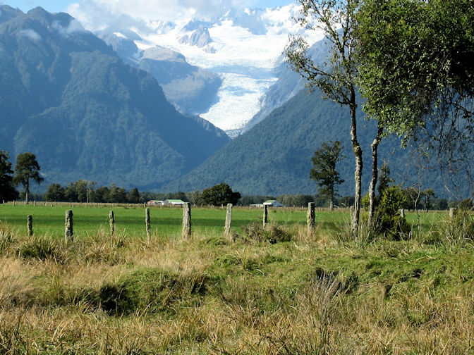
Where am I?
Australasia
1) Mount Buller - AU 2) Glacier district, South Island - NZ. 3) Barossa Valley - AU. ​4) Whakapapa, Nth Island - NZ
2) Glacier district, South Island, NZ ​
Fox Glacier and Franz Josef glaciers on the west coast of the South Island.
Don't miss a helicopter ride to the top of Fax Glacier.
A.N.

Slide 9
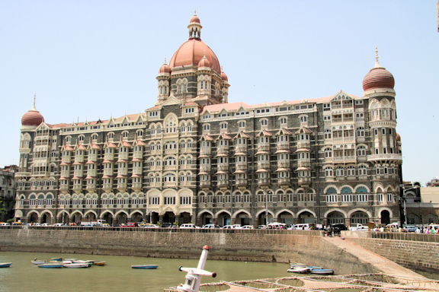
Where am I?
S.E. Asia
1) Mumbai - India 2) Kandy - Sri Lanka. 3) Hoi An - Vietnam ​4) Ho Chi Minh City- Vietnam
1) Mumbai - India
The Taj Mahal Palace Hotel, is a heritage, five-star, luxury hotel in the Colaba of Mumbai.
Historically it was known as the "Taj Mahal Hotel"
A.N.

Slide 10
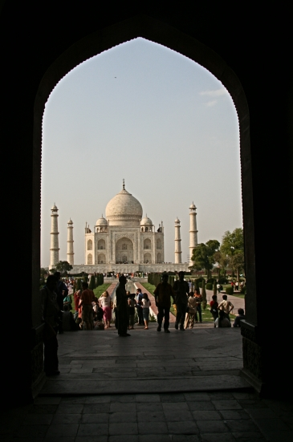
Where am I?
S.E. Asia
1) Singapore 2) Hue, Vietnam 3) Agra, India ​4) Kandy, Sri Lanka
3) Agra, India The Taj Mahal is an ivory-white marble mausoleum on the south bank of the Yamuna river in the Indian city of Agra. It was commissioned in 1632 by the Mughal emperor Shah Jahan to house the tomb of his favourite wife, Mumtaz Mahal; it also houses the tomb of Shah Jahan himself.
The Taj Mahal was a UNESCO World Heritage site in 1983
A.N.

Slide 11
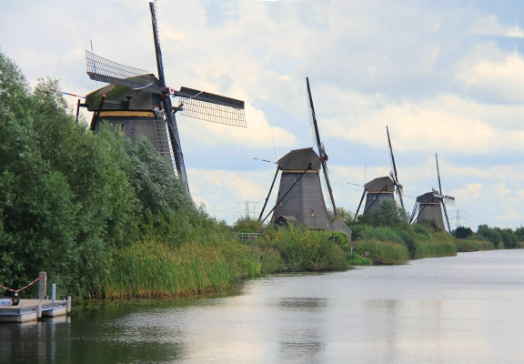
Where am I?
Europe
1) Rhodes, Greece 2) La Mancha, Spain 3) Mykonos, Greece
4) Kinderdijk, Netherlands
4) Kinderdijk, The Netherlands.
Kinderdijk is a village in the Netherlands' South Holland province, known for its iconic 18th-century windmills. Its water-management network features 19 mills and 3 pumping stations, plus dikes and reservoirs that control flooding in the polder (low-lying land).
A.N.

Slide 12
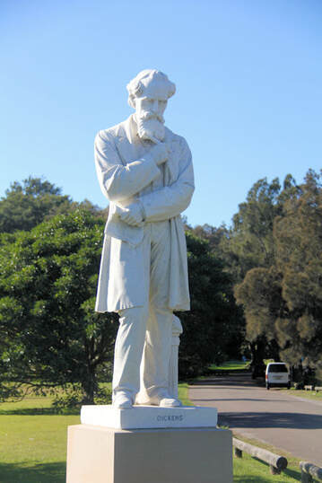
Where am I?
Australia
1) Centennial Park, Sydney 2) City Park, Launceston - TAS 3) George Brown Botannical Gdns, Darwin 4) The Australian National Botanic Gdns​
Statue of Charles Dickens - one of very few in the world.
1) Centennial Park, Sydney The statue is one of only three known life-size representations of Charles Dickens in the world. The rarity of statuary representing Dickens is due to injunction in his will requesting that no public memorials be erected in his honour.
A.N.

Slide 13
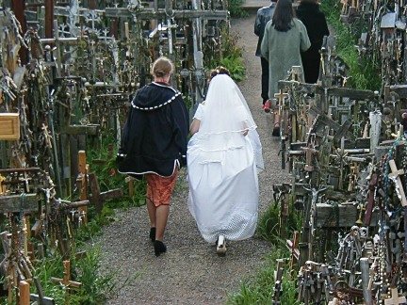
Where am I?
The World
1) France 2) Brazil 3) Austria ​4) Lithuania
Lithuania
The Hill of Crosses is a site of pilgrimage about 12 km north of the city of Siauliai, in northern Lithuania. The precise origin of the practice of leaving crosses on the hill is uncertain.
A.N.

Slide 14
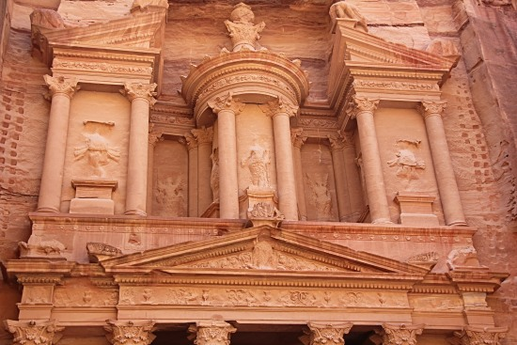
Where am I?
The World
1) Petra, Jordan 2) Jerusaalem, Israel, 3) Cappadocia, Turkey ​4) Bogota, Columbia
Petra, Jordan.
Al-Khazneh, is one of the most elaborate temples in the ancient Arab Nabatean Kingdom city of Petra. As with most of the other buildings in this ancient town, including the Monastery, this structure was carved out of a sandstone rock face.
A.N.

Slide 15
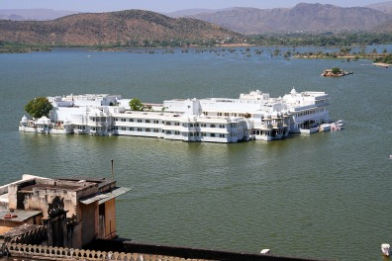
Where am I?
The World
1) Udaipur, India 2) Phnom Penh, Cambodia 3) Milwaukee, USA 4) Beunos Aires, Argentina
Udaipur, India
Lake Pichola, situated in Udaipur city in the Indian state of Rajasthan, is an artificial fresh water lake, created in the year 1362 AD, named after the nearby Picholi village.
A.N.

Slide 16
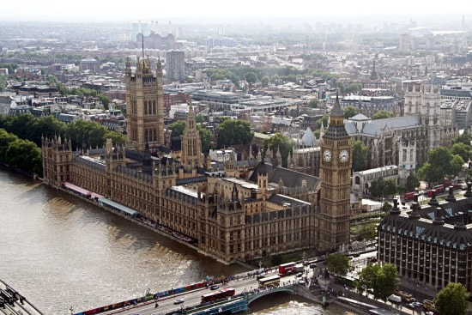
Where am I?
Europe
1) London 2) Paris 3) Budapest 4) Czechia
London, England.
Big Ben is the nickname for the Great Bell of the clock at the north end of the Palace of Westminster in London and is usually extended to refer to both the clock and the clock tower.
A.N.

Slide 17
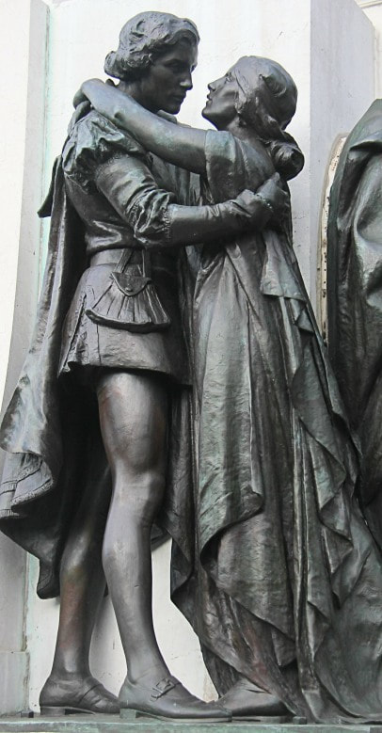
Where am I?
Australia
1) Perth 2) Sydney 3) Nelson Bay 4) Port Arthur
Romeo and Juliet
Sydney
Unveiled in 1926 by Sculptor Sir Edgar Bertram Mackennal (1863-1931) whu was the most successful Australian artist of his time. Located opposite the state library of NSW.
A.N.

Slide 18
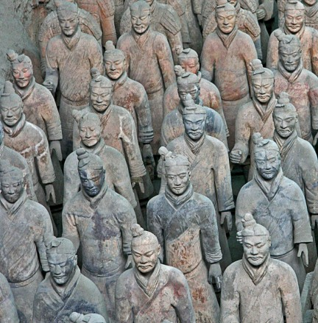
Where am I?
The East
1) India 2) Japan 3) Sri Lanka ​4) China
Xi'an, China
The Terracotta Army is a collection of terracotta sculptures depicting the armies of Qin Shi Huang, the first Emperor of China.
A.N.

Slide 19
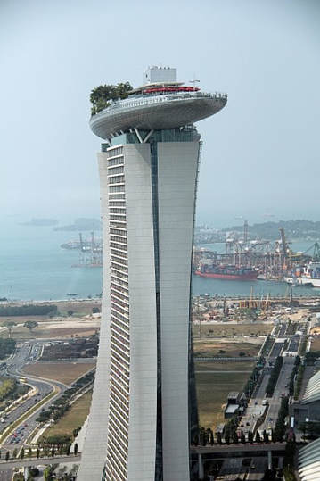
Where am I?
The World
1) Los Angeles, USA 2) Naples, Italy
​3) Singapore 4) Barcelona, Spain ​
3) Singapore ​
Marina Bay Sands is an integrated resort fronting Marina Bay in Singapore. At its opening in 2010, it was billed as the world's most expensive standalone casino property at US$8 billion, including the land cost.
A.N.

Slide 20
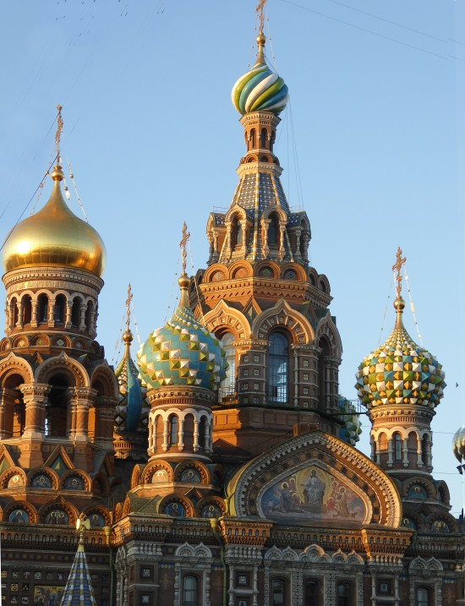
Where am I?
Europe
1) Sydney, Australia 2) Hong Kong 3) Moscow, Russia ​4) St Petersburg, Russia
4) St Petersburg, Russia Cathedral of the Resurrection of Christ (commonly known as Church of the Saviour on Spilled Blood).
A.N.

Slide 21
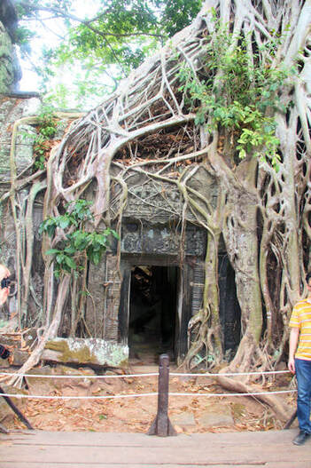
Where am I?
S.E.Asia
1) Banteay Srei, Angkor, Cambodia 2) Sri Ponnambalam Vanesar Kovil, Colombo, Sri Lanka 3) Ta Prohm temple, Siem Reap,Cambodia ​4) Jhandewalan Temple, Delhi, India
3) Ta Prohm temple, Siem Reap, Cambodia Ta Prohm is the modern name of the temple in Siem Reap, built in the 12th and early 13th centuries and originally called Rajavihara
A.N.

Slide 22
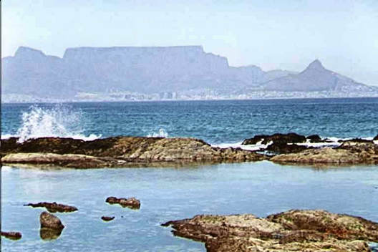
Where am I?
Africa
1) Durban 2) Cape Town 3) Dakar ​4) Tunis
Q 2) Cape Town - South Africa ​
Table mountain from Blauberg, across Table Bay
A.N.

Slide 23
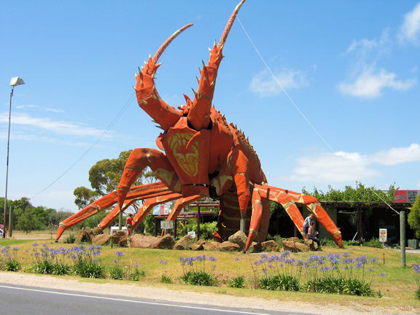
Where am I?
Australia
1) Coffs Harbour - NSW - AU 2) Kingston - SA - AU. 3) Te Puke, Bay of Plenty - NZ ​4) Young - NSW - AU
2) Kingston - SA - AU. The Big Lobster, as the name suggests, is a popular sculpture of a huge red coloured spiny lobster and is located near the entrance of Kingston SE, a renowned fishing town of South Australia. The Big Lobster, known by the locals as “Larry”, is a very popular tourist attraction.
A.N.

Slide 24
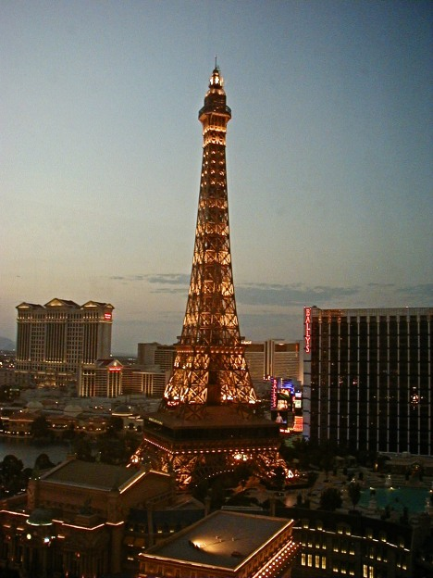
Where am I?
The World
1) Paris 2) Rome 3) Melbourne ​4) Las Vegas
Las Vegas, USA I bet you said Paris, France. ​Paris Las Vegas is a hotel and casino located on the Las Vegas Strip in Paradise, Nevada.
A.N.

Slide 25
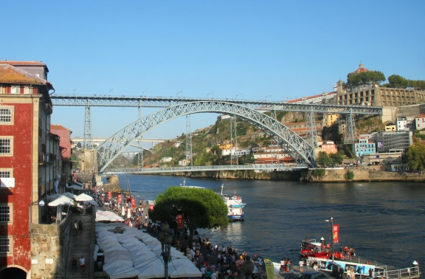
Where am I?
The World
1) Porto, Portugal 2) Prague, Czechia 3) Auckland, New Zealand 4) Ho Chi Minh City, Vietnam
Porto, Portugal The Maria Pia Bridge is a railway bridge built in 1877, and attributed to Gustave Eiffel, situated over the Portuguese northern municipalities of Porto and Vila Nova de Gaia
A.N.

Slide 26
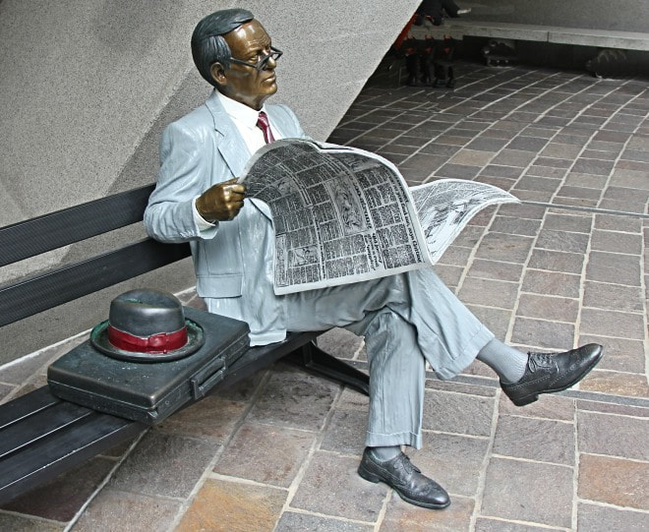
Where am I?
Australia
1) Bundaberg 2) Launceston 3) Melbourne 4) Sydney
4) Sydney – Australia Sq. A public art sculpture by John Seward Johnson II, the grandson of Robert Wood Johnson I who co-founded Johnson & Johnson, placed in Australia Square in 1988, Australia's bicentennial year. Johnson's bronze statues depict real people of their time in everyday activities.
A.N.

Slide 27
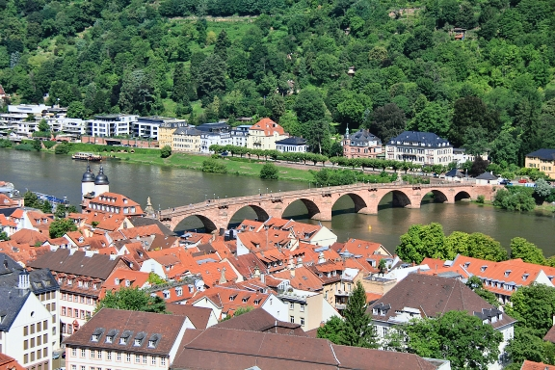
Where am I?
Europe
1) Heidelberg, Germany 2) Antwerp, Belgiun 3) Amsterdam,Holland. ​4) Gdansk, Poland
Heidelberg, Germany
The Karl Theodor Bridge, commonly known as the Old Bridge, is an arch bridge in Heidelberg that crosses the Neckar river. It connects the Old City with the eastern part of the Neuenheim district of the city on the opposite bank
A.N.

Slide 28
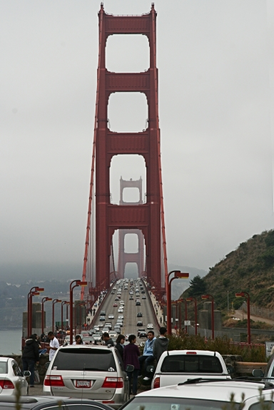
Where am I?
The World
1) France 2) Portugal 3) Brazil ​4) USA
San Francisco, USA The Golden Gate Bridge is a suspension bridge spanning the Golden Gate, the one-mile-wide strait connecting San Francisco Bay and the Pacific Ocean.
Construction started 1933
A.N.

Slide 29
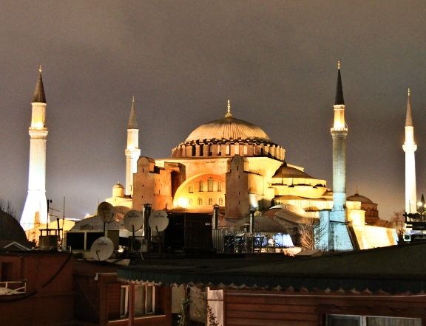
Where am I?
Europe
1) Israel 2) Lebanon 3) Turkey 4) Greece
Istanbul, Turkey ​Hagia Sophia is a former Greek Orthodox Christian patriarchal basilica, later an Ottoman imperial mosque and now a museum in Istanbul, Turkey. Built in 537 AD at the beginning of the Middle Ages, it was famous in particular for its massive dome.
A.N.

Slide 30
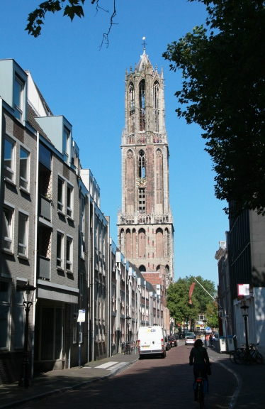
Where am I?
Europe
1) Pisa, Italy 2) Porto, Portugal 3) Utrecht, Netherlands 4) Venice, Italy
3) Utrecht, the Netherlands The Dom Tower of Utrecht is the tallest church tower in the Netherlands, at 112.5 metres in height. The Gothic-style tower is the symbol of the city.
A.N.

Slide 31
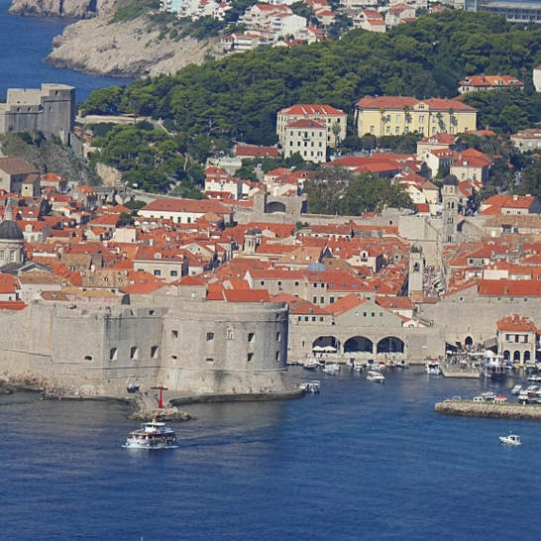
Where am I?
Europe
1) Genoa, Italy 2) Marseille, France 3) Dubrovnik, Croatia 4) Valencia, Spain
Dubrovnik - Croatia. Dubrovnik Old Town, encircled with massive stone walls completed in the 16th century. Its well-preserved buildings range from baroque St. Blaise Church to Renaissance Sponza Palace and Gothic Rector’s Palace, now a history museum.
A.N.

Slide 32
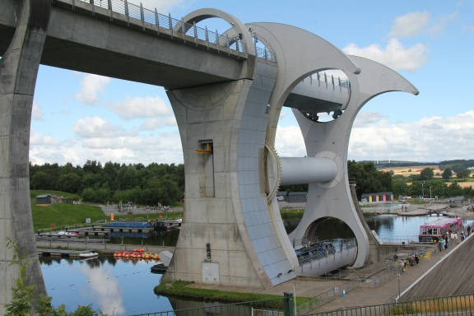
Where am I?
1) Scotland. 2) Denmark. 3) Mumbai. ​4) New Zealand
1 ) Country = Scotland Town = Falkirk The Falkirk Wheel is a rotating boat lift in central Scotland, connecting the Forth and Clyde Canal with the Union Canal. The lift is named after Falkirk, the town in which it is located. It reconnects the two canals for the first time since the 1930s.
- 1 point for the country, an extra point if you know the name of the place?
A.N.

Slide 33
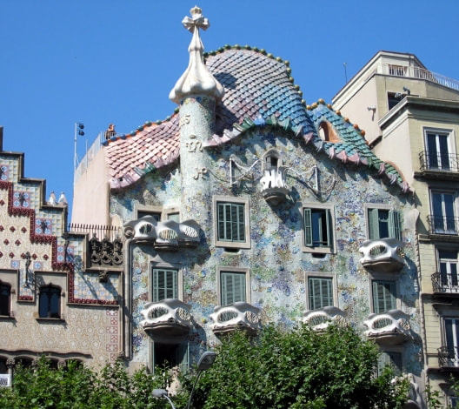
Where am I?
1) Disneyland, Hong Kong 2) Brussels, Belgium 3) Barcelona, Spain ​4) Durban, South Africa
2) Barcelona, Spain ​Casa Batllo, a modernist building by Antoni Gaudi, UNESCO World Heritage Site, on Passeig de Gracia, Barcelona, Spain.
A.N.

Slide 34
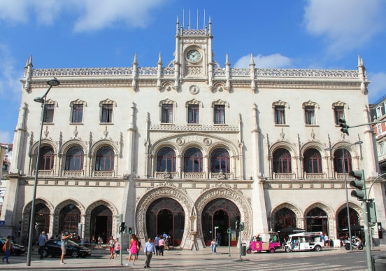
Where am I?
Europe
1) Florence, Italy 2) Brussels, Belgium 3) London, UK ​4) Lisbon, Portugal
4) Lisbon, Portugal, Rossio Station in central Lisbon. The late 19th century building complete with horseshoe shaped arches and ornamental clock was designed by José Luís Monteiro and is the main rail gateway to Sintra. ​ It is close to the metro stations of Rossio and Restauradores with the latter station having pedestrian connections to Rossio Station.
Clue:- Visiting another capital city, you possibly used this. The horse shoe entrance is the clue.
A.N.

Slide 35
Where am I?
Europe
1) Mostar, Bosnia and Heregovina 2) Heidelberg, Germany 3) Alcantra, Spain 4) Prague, Czech Republic
Heidelberg, Germany ​ The Karl Theodor Bridge, commonly known as the Old Bridge (Alte Brücke), in Heidelberg that crosses the Neckar river. It connects the Old City with the eastern part of the Neuenheim district of the city on the opposite bank.
A.N.

Slide 36
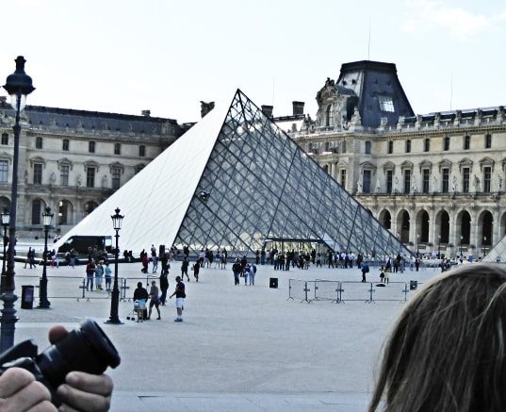
Where am I?
1) Cairo, Egypt 2) Paris, France 3) Lima, Peru ​4) Bogota, Columbia
Paris, France The Louvre Pyramid is a large glass and metal pyramid designed by Chinese-American architect I.M. Pei, surrounded by three smaller pyramids, in the main courtyard of the Louvre Palace in Paris.
A.N.

Slide 37
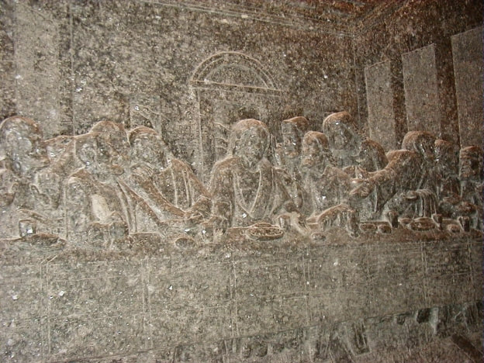
Where am I?
Europe
1) Jerusalem, Israel 2) Wieliczka, Poland 3) Nuremberg, Germany 4) Zagreb, Croatia
2) Wieliczka, Poland The Wieliczka Salt Mine, in southern Poland. Opened in the 13th century. The mine is currently one of Poland's official national Historic Monuments, whose attractions include dozens of statues and four chapels carved out of the rock salt by the miners.
Clue:- The Last Supper carved in salt
A.N.

Slide 38
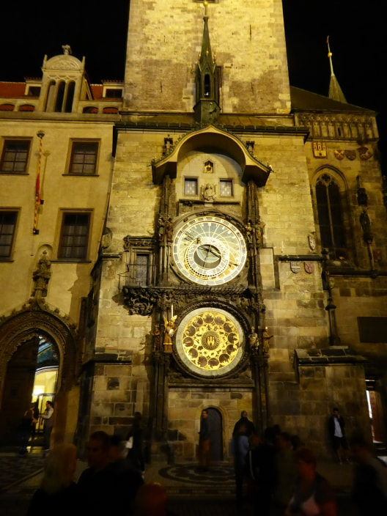
Where am I?
Clue:- A well known time
Europe
1) Dubrovnik 2) Prague 3) Amsterdam ​4) London
2) Prague, Czech Republic. ​ The Prague astronomical clock, or Prague orloj, is a medieval astronomical clock located in Prague, the capital of the Czech Republic. The Orloj is mounted on the southern wall of Old Town Hall in the Old Town Square. The clock mechanism itself has three main components: the astronomical dial, representing the position of the sun and moon in the sky and displaying various astronomical details.
A.N.

Slide 39
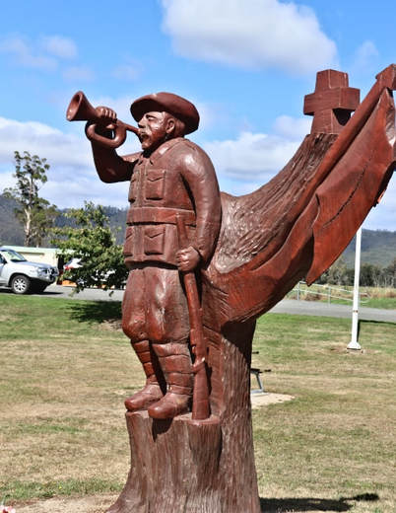
Where am I?
Oz
1) Holbrook, NSW 2) Mount Barker, SA 3) Legerwood, Tas 4) Wellington, NZ
3) Legerwood Tas. Legerwood Carved Memorial Trees are trees sculpted into World War One soldiers in Dorset, Tasmania. The 25 statues depict the fallen men they were planted for in 1918. ​In 2001, a report indicated that the trees were no longer safe and the community were devastated that the memorials would be lost. By 2004, it was decided that each of the stumps would be carved into the likeness of each soldier. A chainsaw carver, Eddie Freeman of Ross, was asked by the Legerwood Hall and Reserves Committee to sculpt the masterpieces. Various scenes depicting world War One were also carved.
A.N.

Slide 40
Where am I?
1) Jaipur, India 2) Nuware Eliya, Sri Lanka 3) Kandy, Sri Lanka 4) Mumbai, India
4) Mumbai, India
The Taj Mahal Palace Hotel is a heritage five-star hotel in the Colaba region of Mumbai. Historically it was known as the "Taj Mahal Hotel" or the "Taj Palace Hotel" or simply "the Taj".
A.N.

Slide 41
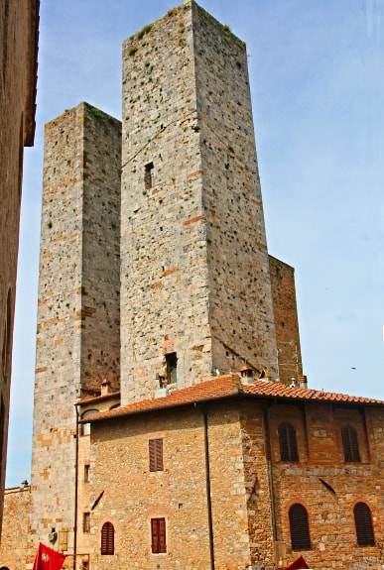
Where am I?
Europe
1) Genoa, Italy 2) Marseille, France 3) Dubrovnik, Croatia 4) Valencia, Spain
San Gimignano - Italy San Gimignano holds its fame in Tuscany due to its numerous towers that form a skyline that can be seen for miles from the surrounding towns and countryside. Most of the towers are constructed during the Medieval Age and a lot of Gothic and Romanesque architecture can also be found here. A dispute started between two economically powerful families living in San Gimignano, namely the Guelphs and Ghibellines. As a result of this rivalry, each family built better and higher towers to show its economical stability and power. "Whatever you can do, I can do better".
A.N.

Slide 42
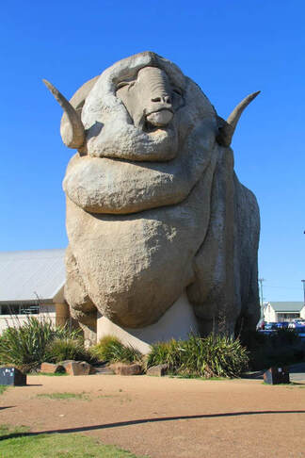
Where am I?
Australasia
1) Goulburn. NSW. - AU. 2) Te Anu. - NZ. 3) Gold Coast. QLD. - AU. ​4) Tamworth. NSW. - AU
​1) Goulburn
The Big Merino was built in 1985 and is a monument to Goulburn and the surrounding district’s wool industry. It stands 15.2 meters high, 18 meters long and weighing 97 tones. He is a life-like model of Rambo, a stud Ram from a local property, “Bullamallita”
A.N.

Slide 43
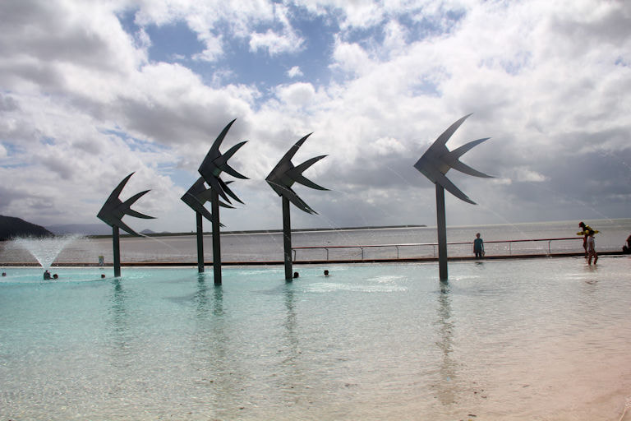
Where am I?
Australia
​1) Coffs Harbour - NSW 2) Killarney Glen, QLD 3) Sawtell Memorial Pool - NSW ​4) Cairns - QLD - AU
​4) Cairns - QLD - AU Created for the Esplanade redevelopment in 2003. The Woven Fish are large sculptures located in the Lagoon. The fish are interpretations of the smaller woven fish forms that are often woven in palm leaves.
A.N.

Slide 44
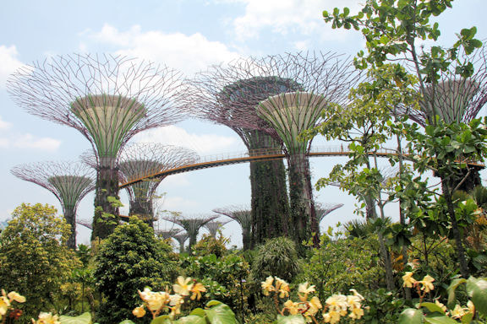
Where am I?
Europe
1) The Gardens by the Bay, Singapore 2) Botanical Gardens, Kandy, Sri Lanka 3) Koraku-en, Japan ​4) Hanoi Botanical Garden, Vietnam
1) The Gardens by the Bay, Singapore The Gardens by the Bay is a nature park spanning 101 hectares in the Central Region of Singapore, adjacent to the Marina Reservoir. The park consists of three waterfront gardens: Bay South Garden, Bay East Garden and Bay Central Garden. Gardens by the Bay was part of the nation's plans to transform its "Garden City" to a "City in a Garden", with the aim of raising the quality of life by enhancing greenery and flora in the city. First announced by the Prime Minister in 2005
A.N.

Slide 45
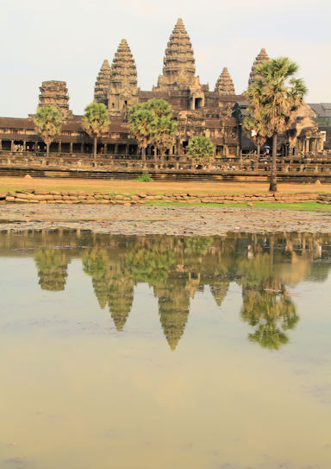
Where am I?
S.E.Asia
1) Beng Mealea 2) Koh Ker 3) Tran Quoc Pagoda ​4) Angkor Wat
4) Angkor Wat . Angkor Wat is a Buddhist temple complex in Cambodia and is the largest religious monument in the world, on a site measuring 162.6 hectares. It was originally constructed as a Hindu temple dedicated to the god Vishnu for the Khmer Empire, it was gradually transformed into a Buddhist temple towards the end of the 12th century.
A.N.

Slide 46
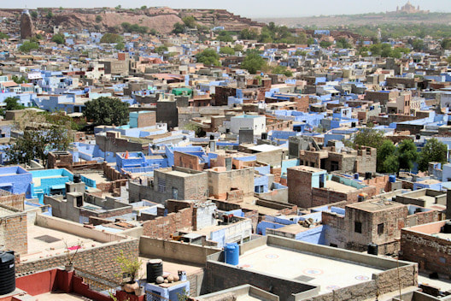
Where am I?
S.E.Asia
1) Little India, Singapore 2) Jodphur, india 3) Nuwara Eliya, Sri Lanka ​4) Hoi An, Vietnam
2) Jodphur The “Blue City” of Jodphur is the second largest city in the state on Rajasthan.. A blue pigment coating on a house used to indicate that a Brahmin,—the priests of the Indian caste system,—dwelled there, but over time the color became a badge of identity for non-Brahmins, too. It’s also said to have insect-repelling abilities
The Blue City
A.N.

Slide 47
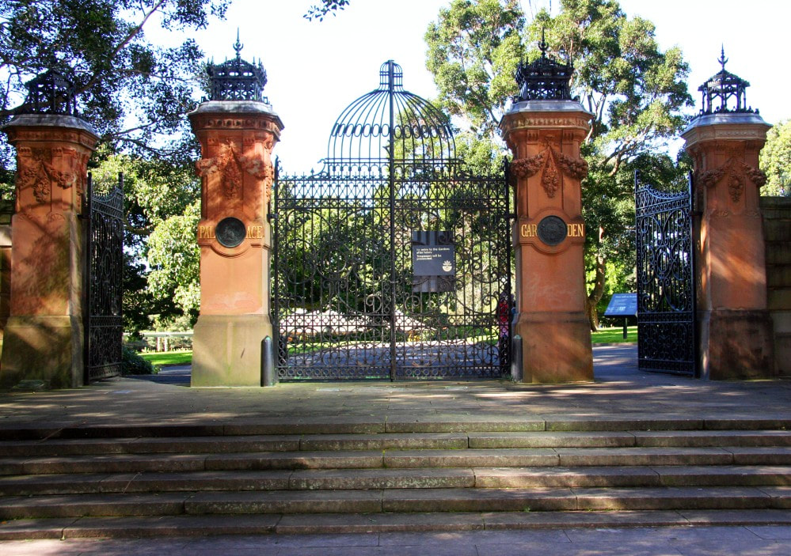
Where am I?
Australia
1) Sydney 2) Hobart 3) Melbourne
​4) Brisbane
1) Sydney
Gates to what was the ‘Palace Garden’, now the botanic garden’s. The Garden Palace was a large, purpose-built exhibition building constructed to house the Sydney International Exhibition in 1879 in Sydney. It was destroyed by fire in 1882
Clue
Gates to what was the ‘Palace Garden’
A.N.

Slide 48
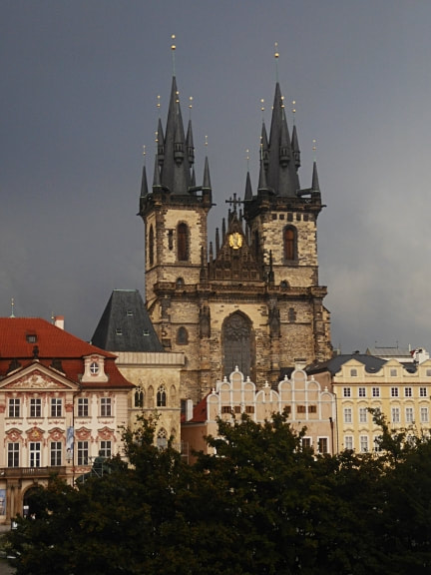
Where am I?
Europe
1) Dubrovnik 2) Zagreb 3) Prague 4) Bratislava
3) Prague
Old Town Square is a historic square in the Old Town quarter of Prague, the capital of the Czech Republic. Shown here is The Church of Our Lady. One of the most impressive Gothic religious buildings in Prague, it was built from the mid-14th to the early 16th centuries.
A.N.

Slide 49
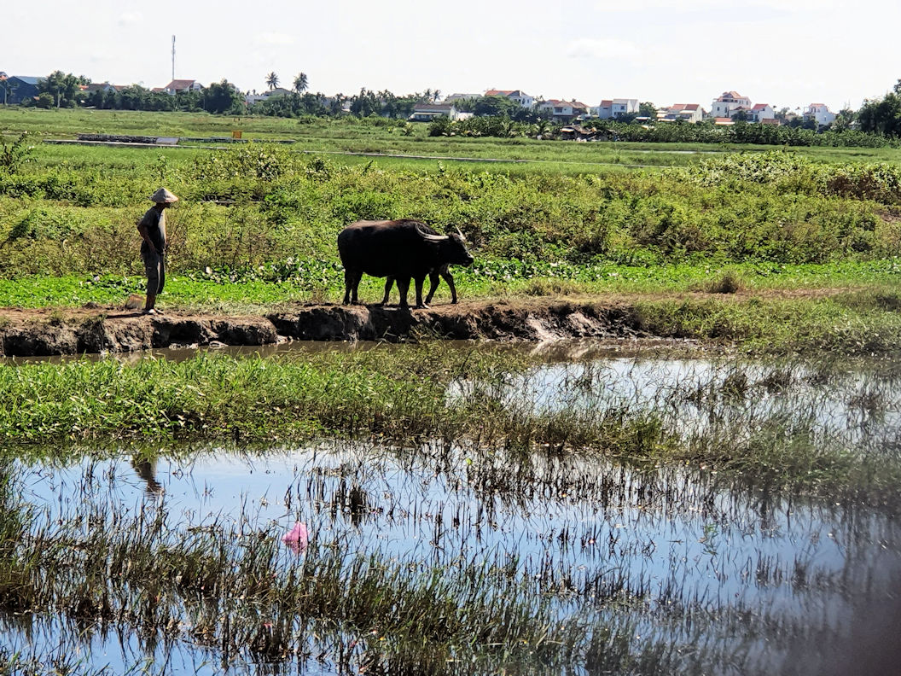
Where am I?
S.E. Asia
1) Vietnam 2) Sri Lanka 3) India 4) Thailand
1) Vietnam
Vietnam hats have existed for a very long time. The first image of this Vietnamese kind of conical hat was first engraved on Ngoc Lu bronze drum, Dao Thinh bronze drum, Dong Son bronze drum in 2500-3000 B.C..
A.N.

Slide 50
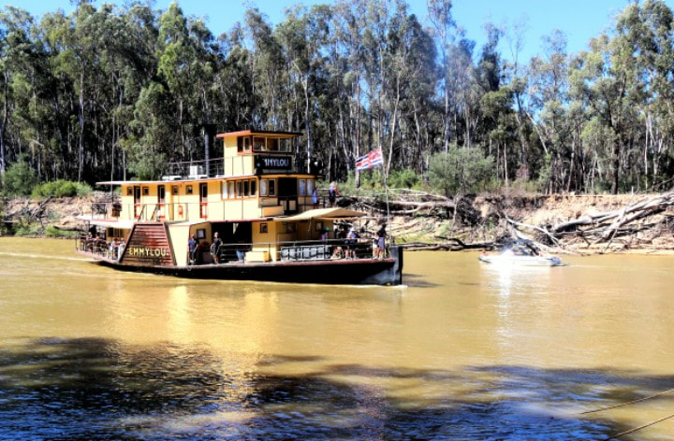
Where am I?
Australia
1) Mannum, SA 2) Renmark, SA 3) Echuca, Vic 4) Bourke, NSW
3) Echuca, Vic
The majestic PS Emmylou built in 1853 is one of the most recognisable and iconic Paddle steamers in Australia. It was Named after the American country singer Emmylou Harris. The Emmylou is now the only wood fired Paddle steamer in the world offering regular scheduled accommodated river cruises.
A.N.

Slide 51
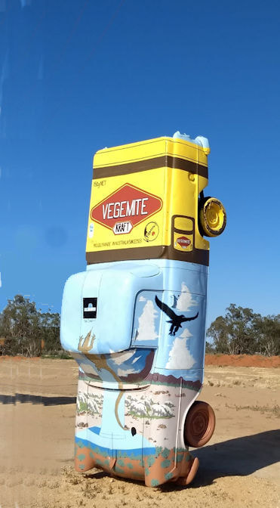
Where am I?
Australia
1) Yarram, Vic 2) Sheffield, Tas 3) Condoblin, NSW 4) Yeppoon, QLD
3) Condoblin
Condobolin’s Utes in the Paddock is a unique and quirky Australian exhibition that is gaining increased national attention.
While travelling Route 66 on a trip across the United States, Graham Pickles and his wife Jana were drawn to an unusually popular attraction named “Cadillac Ranch”, located in west Texas near Amarillo.
In 2020, Condobolin’s popular Utes in the Paddock were named "Best Sculpture Park or Trail" at the Australian Street Art Awards.
A.N.

Slide 52
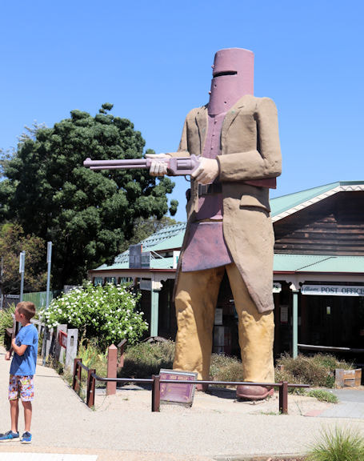
Where am I?
Australia
Glenrowan, Vic
Gundagai, NSW
3) Subiaco, WA 4) Adelaide, SA
1) Glenrowan A six metre statue commemorates the bushranger, Ned Kelly. Glenrowan is the place of the last siege of the Kelly Gang and the deaths of three of its members.
On 28 June 1880 Ned Kelly led Joe Byrne, Dan Kelly and Steve Hart in a final confrontation against eight Victoria Police Officers and five Aboriginal trackers from Queensland.
A.N.

Slide 53
Where am I?
Asia
1) Ranakpur, India 2) Guilin, China 3) Kyoto, Japan 4) Angkor Wat, Cambodia
2) Guilin, China
The Sun and Moon Pagodas stand erect in the water of central Fir Lake (Shanhu). They are also known as Gold and Silver Pagodas because of their colors at night.
A.N.

Slide 54
Where am I?
Europe
1) Kolkata, India 2) Kandy, Sri Lanka 3) Hanoi, Vietnam 4) Siem Reap, Cambodia
4) Siem Reap, Cambodia
The famous Pub Street started off as a small, 3-restaurant establishment on a humble stretch of dirt road in the heart of the city. The Angkor WHAT? Bar was the first club to open its doors on the street in 1998, closely followed in August of 2000 by the already closed “Singaporean Asian Rooftop” restaurant, and the Red Piano Restaurant.
A.N.

Slide 55
Where am I?
Australia
1) Cairns, QLD 2) Perth, WA 3) Brisbane, QLD 4) Sydney, NSW
4) Sydney, NSW 1938 Rose Bay became home to Sydney’s first international airport, servicing the mighty flying boats – large, luxurious, four-engine aircraft that alighted on water.
Sydney operated the last major flying boat base in the world until 1974.
A.N.

Slide 56
Where am I?
Australia
NSW
WA
Tas
SA
4) SA d'Arenberg winery, McLaren Vale
The idea to build the d'Arenberg Cube came to Chester Osborn, Chief Winemaker, in 2003.
Inspired by the complexities and puzzles of winemaking, Chester created the idea of a cube-shaped building. Each of the five levels have been carefully designed to entice and excite the senses, including features such as a wine sensory room, a virtual fermenter, a 360degree video room, and many other tactile experiences
A.N.

Slide 57
Where am I?
Australia
Sydney, NSW
Melbourne, Vic
Brisbane, QLD
Perth, WA
1) Sydney, NSW The Archibald Fountain in Hyde Park.
In 1919, a bequest in the will of J. F. Archibald, founding editor of the Bulletin, provided for the erection in Sydney of a symbolic, open-air memorial.
A.N.

Slide 58
Where am I?
Australia
Sydney, NSW
Melbourne, Vic
Brisbane, QLD
Perth, WA
Sydney Il Porcellino, meaning ‘the little pig’, is a larger than life-sized bronze wild boar, anatomically realistic and resting on its left haunch and front legs.
It is located outside the Sydney’s oldest hospital, Sydney Hospital, facing Macquarie Street. The sculpture is an exact replica of an original by Pietro Tacca which has stood in Florence, Italy, since circa 1633, and is given the local Florentine nickname il porcellino.
A.N.

Slide 59
Where am I?
The World
When you have hats like ours, they don’t look at your shoes
Turkey
Jordan
Australia
Colombia
Turkey - Cappadocia
Cappadocia is a geological oddity of honeycombed hills and towering boulders of otherworldly beauty. The fantastical topography is matched by the human history here.
A.N.

Slide 60
Where am I?
The World
France
Jordan
India
China
India - Jaipur
The Jantar Mantar, Jaipur is a collection of 19 astronomical instruments built by the Rajput king Sawai Jai Singh, the founder of Jaipur, Rajasthan. The monument was completed in 1734
A.N.

Slide 61
Where am I?
The World
Sri Lanka
China
Brazil
Vietnam
4) Vietnam - Halong Bay
Halong Bay owns a complex of limestone islands located within the Gulf of Tonkin, in the city of Halong, Quang Ninh province, which is about 170km from Hanoi.
A.N.

Slide 62
Where am I?
The World
Barletta, Italy
Valencia, Spain
Dubrovnik, Croatia
Gdansk, Poland
3) Dubrovnik The history of the city probably dates back to the 7th century, when the town known as Ragusa was founded by refugees from Epidaurum.
Over the past decade, Dubrovnik in Croatia has gained a lot of popularity as a dream wedding destination amongst foreign couples wishing to tie the knot in a beautiful romantic location.
A.N.

Slide 63
Where am I?
Australia
The footballer “We won”
The GABBA
The MCG
Sydney Football stadium
Centennial park
Also known as “The Footballer,” was sculptured by the sculptor Tommaso Sani who was well-known in Sydney in the 1880s. The life-sized figure, dressed in a woollen cap, sweater and tight knee-length trousers worn by football players of the day contrasts with the serene and idealised Neoclassical face of Apollo.
A.N.

Slide 64
Did you know
Thailand has a festival to appreciate their monkeys
Every last Sunday of November, this festival in Lopburi celebrates the Monkeys in a Monkey Buffet Festival.
According to Sanskrit folklore, a heroic Monkey helped Prince Rama save his bride-to-be from the clutches of a ten-headed demon.
A.N.

Slide 65
Did you know
New Zealand has the steepest residential area in the world
The residential street in Dunedin won the Guinness World Record with its 38° slope. The sharp incline makes all the houses look like they’re sunken into the ground.
A.N.

Slide 66
Did you know
Whales and dolphins take being “right-brained” or “left-brained” to the extreme. Getting a nap in the ocean requires them to let one-half of their brains sleep at a time, while the other half keeps them conscious.
Doh
A.N.

Slide 67
Did you know
Researchers suspect that fish communicate through the noise of their farts, just like some teenage boys
No comment. I am not communicating
A.N.

Slide 68
Did you know
In 1992, Singapore banned chewing gum.
This fell in line with the country’s strict laws against litter, graffiti, jaywalking, spitting, and other untidy habits.
A.N.

Slide 69
Did you know
The Great Barrier Reef is the only living thing visible from space
The Great Barrier Reef is larger than the Great Wall of China. It’s so large that it can be seen from space, the only living thing visible from that far away.
A.N.

Slide 70
Did you know
The "O" before an Irish name, such as "O'Reilly," means "descendant of.
The barman says to Paddy “Your glass is empty, fancy another one?”
Lookin’ puzzled Paddy says “Why know would i be needed two empty feckin glasses?
A.N.

Slide 71
Did you know
The seagulls in the Alfred Hitchcock movie "The Birds" (1963) were fed a mixture of wheat and whisky so they would stand around and not fly too much
How do you get an audition to play a bird?
A.N.

Slide 72
Did you know
Antarctica is the only continent without native species of ants.
And I can’t think of a single reason why you would want to know that.
A.N.

Slide 73
Did you know
Barcelona's Sagrada Familia is Taking Longer to Build Than the Pyramids.
The ancient pyramids of Egypt were constructed between 2589 and 2504 BC — 85 years. Antoni Gaudi's masterpiece, the Sagrada Familia, began construction in 1882, and has remained under construction every day following.
A.N.

Slide 74
Did you know
10 Villages in Scandinavia Have the Shortest City Names — Just One Letter Long
The city name Å, which means "small brook or river" in all Scandinavian languages, is found nine times throughout the countries. Ö, which means "island," can be found in Sweden.
A.N.

Slide 75
Did you know
Red Wine Flows From a Fountain in Italy
In the town of Caldari di Ortona in northern Italy, a local vineyard installed a fountain that spills red wine instead of water 24 hours a day.
The fountain is actually meant for the pilgrims following the Cammino di San Tommaso, a 196-mile route from Rome to Ortona to follow in the footsteps of St. Thomas the Apostle.
A.N.

Slide 76
Did you know
More Chocolate Is Bought at Brussels Airport Than Any Other Place in the World
There are 24.8 million flights through Brussels, and 67,900 passengers per day. Even if only 10 percent purchased chocolate, that's a lot of sweetness being sold!
A.N.

Slide 77
Did you know
Germany's Famous Oktoberfest Is Actually in September
Prince Ludwig married in October 1810. He threw a party and party became an annual event known simply as Oktoberfest.
However, with warmer temperatures in September making for a better party atmosphere, the event was pushed back into September.
It ends on the first Sunday of “Oktober” to keep the name in place.
A.N.

Slide 78
Did you know
Did you know that South America is high
It has the highest capital in the world - La Paz in Bolivia.
Venezuela has the highest waterfall in the world – Angel Falls.
Lake Titicaca is the highest navigable lake in the world.
Mount Aconcagua is the Highest Mountain In The Western Hemisphere.
And there are drug cartels that try to keep us all “high”
A.N.

Slide 79
Did you know
The Galapagos Islands inspired Charles Darwin’s Theory of Evolution
Sitting off the coast of mainland Ecuador lies the Galapagos Islands. A hub of biodiversity, these islands were at the core of Darwin’s research when he was formulating his famous Theory of Evolution.
A.N.

Slide 80
Did you know
The Rafflesia Arnoldii is the world’s biggest flower
It is native to the jungles of Sumatra and Borneo, Indonesia. When it blooms, the flower (which can reach a diameter of one metre) is said to smell like rotting flesh.
A.N.

Slide 81
Did you know
In Vietnam, your age is based on the year you were born, and changes at new year.
If you were born 1 week before new year, you would turn 1 on the new year.
A.N.

Slide 82
Ironing boards are surfboards that gave up their dreams and got a boring job. Don’t be an ironing board.
A.N.

