Slide 1
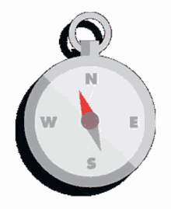
Where am I
Photo Quiz
A.N.

Slide 2
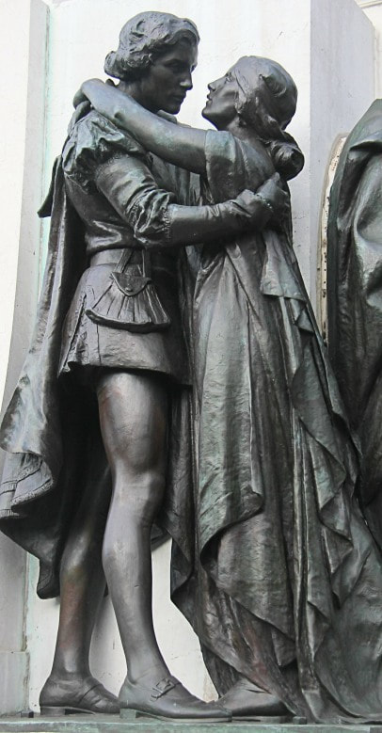
Where am I?
Australia
1) Perth 2) Sydney 3) Nelson Bay 4) Port Arthur
Romeo and Juliet
Sydney
Unveiled in 1926 by Sculptor Sir Edgar Bertram Mackennal (1863-1931) who was the most successful Australian artist of his time. Located opposite the state library of NSW.
A.N.

Slide 3
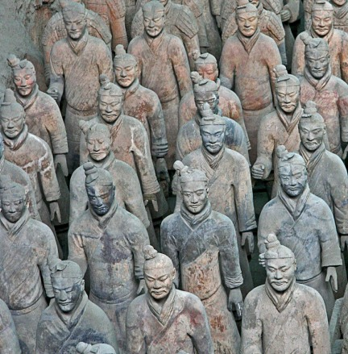
Where am I?
The East
1) India 2) Japan 3) Sri Lanka ​4) China
Xi'an, China
The Terracotta Army is a collection of terracotta sculptures depicting the armies of Qin Shi Huang, the first Emperor of China.
A.N.

Slide 4
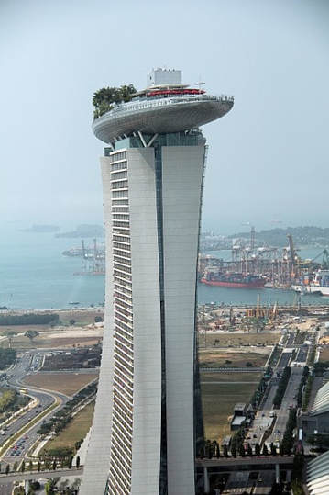
Where am I?
The World
1) Los Angeles, USA 2) Naples, Italy
​3) Singapore 4) Barcelona, Spain ​
3) Singapore ​
Marina Bay Sands is an integrated resort fronting Marina Bay in Singapore. At its opening in 2010, it was billed as the world's most expensive standalone casino property at US$8 billion, including the land cost.
A.N.

Slide 5
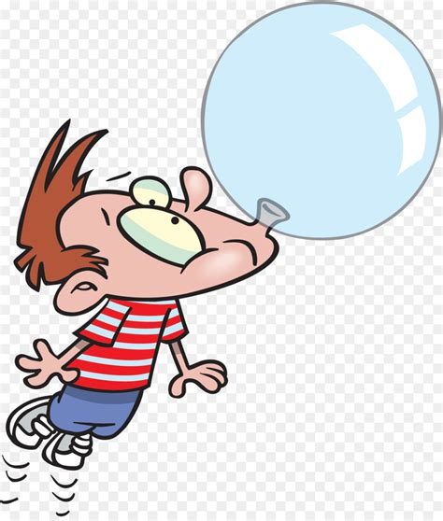
Did you know
In 1992, Singapore banned chewing gum.
This fell in line with the country’s strict laws against litter, graffiti, jaywalking, spitting, and other untidy habits.
A.N.

Slide 6
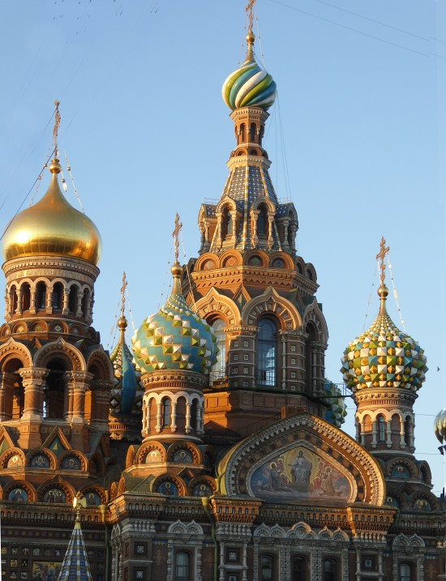
Where am I?
The World
1) Sydney, Australia 2) Hong Kong 3) Moscow, Russia ​4) St Petersburg, Russia
4) St Petersburg, Russia Cathedral of the Resurrection of Christ (commonly known as Church of the Saviour on Spilled Blood).
A.N.

Slide 7
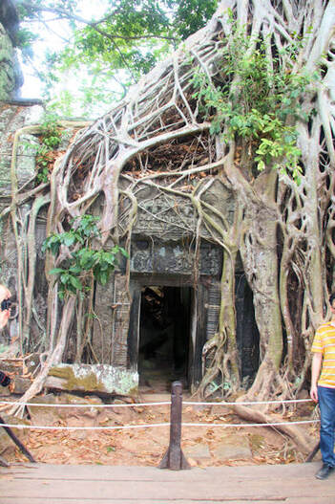
Where am I?
S.E.Asia
1) Banteay Srei, Angkor, Cambodia 2) Sri Ponnambalam Vanesar Kovil, Colombo, Sri Lanka 3) Ta Prohm temple, Siem Reap,Cambodia ​4) Jhandewalan Temple, Delhi, India
3) Ta Prohm temple, Siem Reap, Cambodia Ta Prohm is the modern name of the temple in Siem Reap, built in the 12th and early 13th centuries and originally called Rajavihara
A.N.

Slide 8
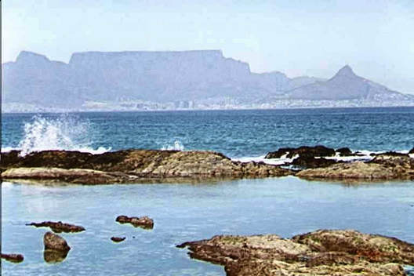
Where am I?
Africa
1) Durban 2) Cape Town 3) Dakar ​4) Tunis
Q 2) Cape Town - South Africa ​
Table mountain from Blauberg, across Table Bay
A.N.

Slide 9
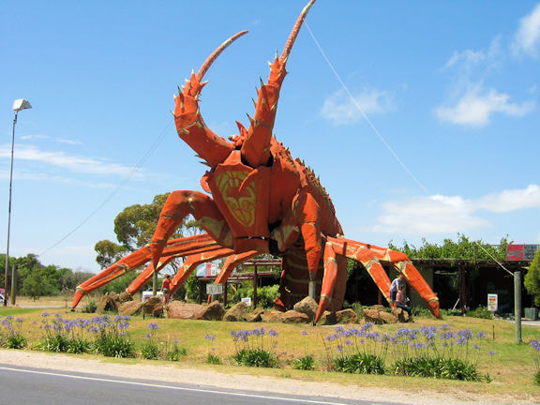
Where am I?
Australasia
1) Coffs Harbour - NSW - AU 2) Kingston - SA - AU. 3) Te Puke, Bay of Plenty - NZ ​4) Young - NSW - AU
2) Kingston - SA - AU. The Big Lobster, as the name suggests, is a popular sculpture of a huge red coloured spiny lobster and is located near the entrance of Kingston SE, a renowned fishing town of South Australia. The Big Lobster, known by the locals as “Larry”, is a very popular tourist attraction.
A.N.

Slide 10
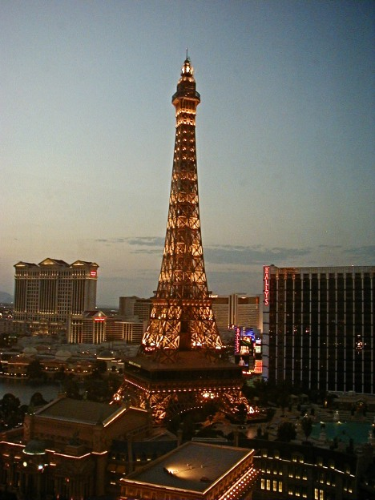
Where am I?
The World
1) Paris 2) Rome 3) Melbourne ​4) Las Vegas
Las Vegas, USA I bet you said Paris, France. ​Paris Las Vegas is a hotel and casino located on the Las Vegas Strip in Paradise, Nevada.
A.N.

Slide 11
Did you know
Researchers suspect that fish communicate through the noise of their farts, just like some teenage boys
No comment. I am not communicating
A.N.

Slide 12
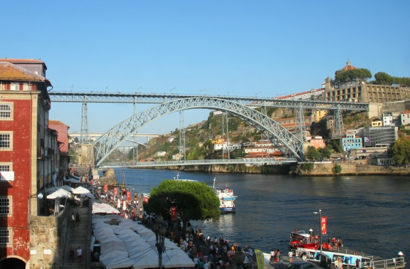
Where am I?
The World
1) Porto, Portugal 2) Prague, Czechia 3) Auckland, New Zealand 4) Ho Chi Minh City, Vietnam
Porto, Portugal The Maria Pia Bridge is a railway bridge built in 1877, and attributed to Gustave Eiffel, situated over the Portuguese northern municipalities of Porto and Vila Nova de Gaia
A.N.

Slide 13
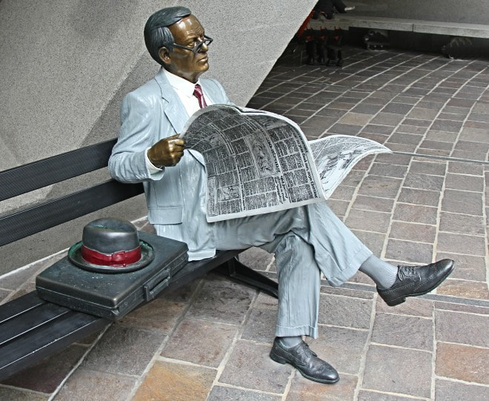
Where am I?
Australia
1) Bundaberg 2) Launceston 3) Melbourne 4) Sydney
4) Sydney – Australia Sq. A public art sculpture by John Seward Johnson II, the grandson of Robert Wood Johnson I who co-founded Johnson & Johnson, placed in Australia Square in 1988, Australia's bicentennial year. Johnson's bronze statues depict real people of their time in everyday activities.
A.N.

Slide 14
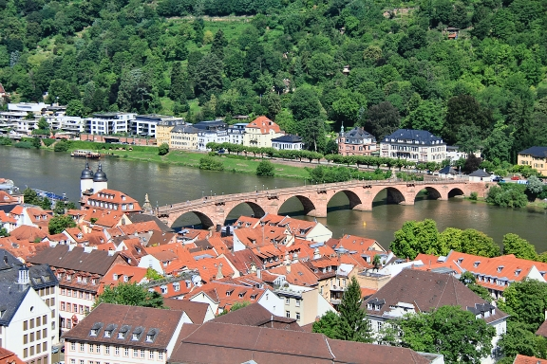
Where am I?
Europe
1) Heidelberg, Germany 2) Antwerp, Belgiun 3) Amsterdam,Holland. ​4) Gdansk, Poland
Heidelberg, Germany
The Karl Theodor Bridge, commonly known as the Old Bridge, is an arch bridge in Heidelberg that crosses the Neckar river. It connects the Old City with the eastern part of the Neuenheim district of the city on the opposite bank
A.N.

Slide 15
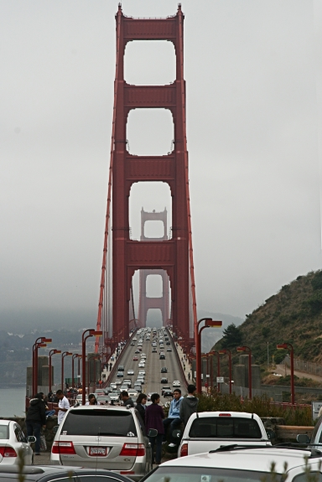
Where am I?
The World
1) France 2) Portugal 3) Brazil ​4) USA
San Francisco, USA The Golden Gate Bridge is a suspension bridge spanning the Golden Gate, the one-mile-wide strait connecting San Francisco Bay and the Pacific Ocean.
Construction started 1933
A.N.

Slide 16
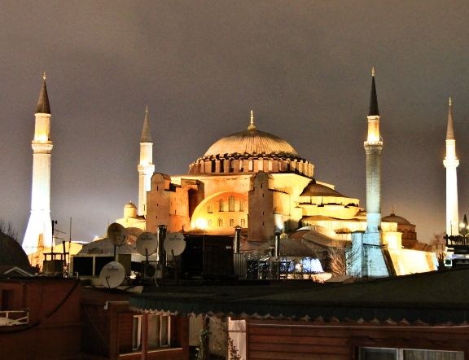
Where am I?
Europe
1) Israel 2) Lebanon 3) Turkey 4) Greece
Istanbul, Turkey ​Hagia Sophia is a former Greek Orthodox Christian patriarchal basilica, later an Ottoman imperial mosque and now a museum in Istanbul, Turkey. Built in 537 AD at the beginning of the Middle Ages, it was famous in particular for its massive dome.
A.N.

Slide 17
Did you know
The Great Barrier Reef is the only living thing visible from space
The Great Barrier Reef is larger than the Great Wall of China. It’s so large that it can be seen from space, the only living thing visible from that far away.
A.N.

Slide 18
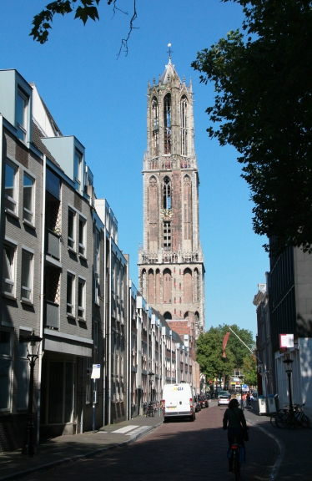
Where am I?
Europe
1) Pisa, Italy 2) Porto, Portugal 3) Utrecht, Netherlands 4) Venice, Italy
3) Utrecht, the Netherlands The Dom Tower of Utrecht is the tallest church tower in the Netherlands, at 112.5 metres in height. The Gothic-style tower is the symbol of the city.
A.N.

Slide 19
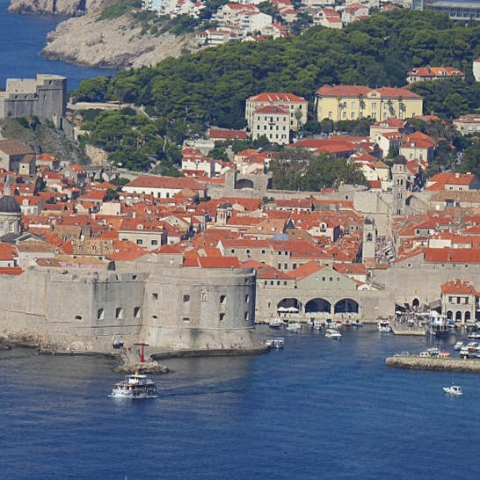
Where am I?
Europe
1) Genoa, Italy 2) Marseille, France 3) Dubrovnik, Croatia 4) Valencia, Spain
Dubrovnik - Croatia. Dubrovnik Old Town, encircled with massive stone walls completed in the 16th century. Its well-preserved buildings range from baroque St. Blaise Church to Renaissance Sponza Palace and Gothic Rector’s Palace, now a history museum.
A.N.

Slide 20
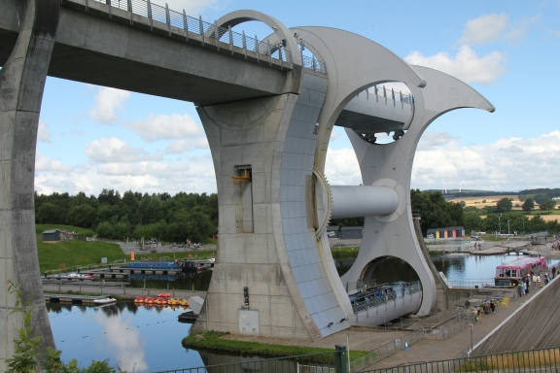
Where am I?
1) Scotland. 2) Denmark. 3) Mumbai. ​4) New Zealand
1 ) Country = Scotland Town = Falkirk The Falkirk Wheel is a rotating boat lift in central Scotland, connecting the Forth and Clyde Canal with the Union Canal. The lift is named after Falkirk, the town in which it is located. It reconnects the two canals for the first time since the 1930s.
- 1 point for the country, an extra point if you know the name of the place?
A.N.

Slide 21
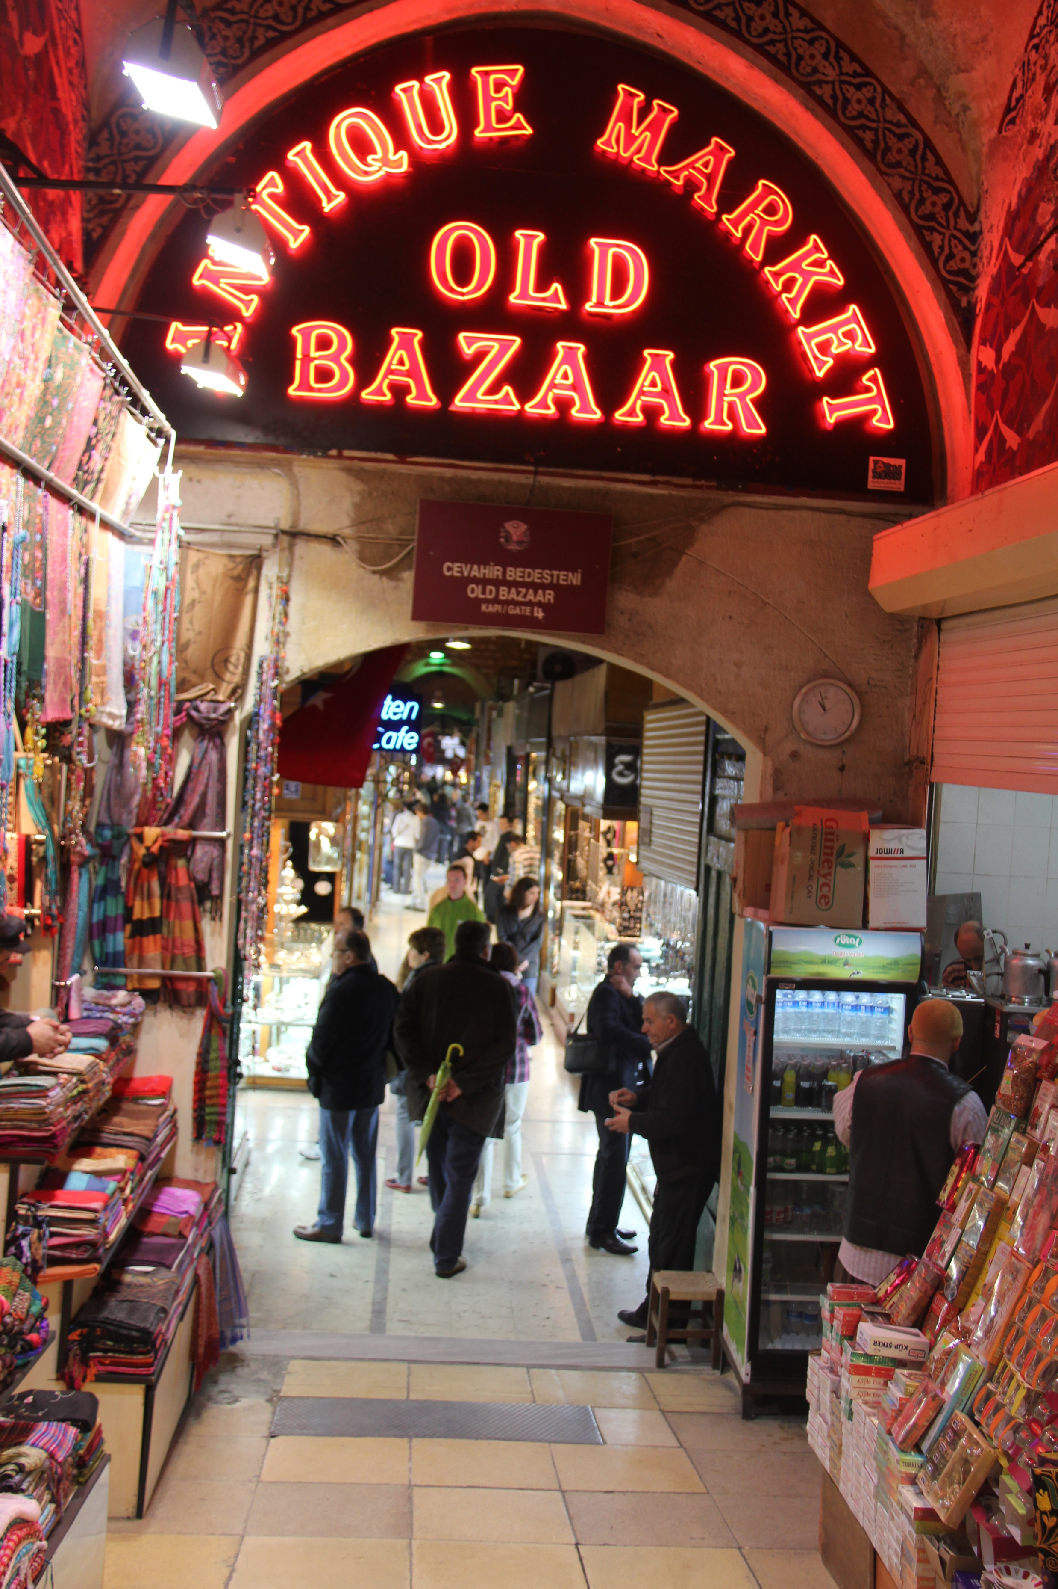
Where am I?
1) Jerusalem 2) Hong Kong 3) Mumbai. ​4) Istanbul
4 ) Istanbul The Grand Bazaar in Istanbul is one of the largest and oldest covered markets in the world, with 61 covered streets and over 4,000 shops on a total area of 30,700 m², attracting between 250,000 and 400,000 visitors daily.
If they don’t have the antique in stock, they will get it for you from the factory.
A.N.

Slide 22
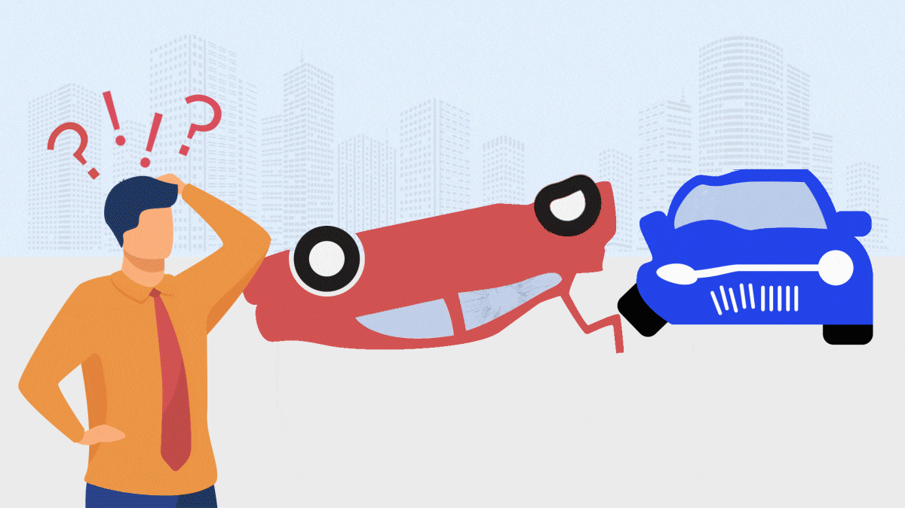
Where am I?
The End
A.N.

