Slide 1
Where am I
Travel Quiz
A.N.

Slide 2
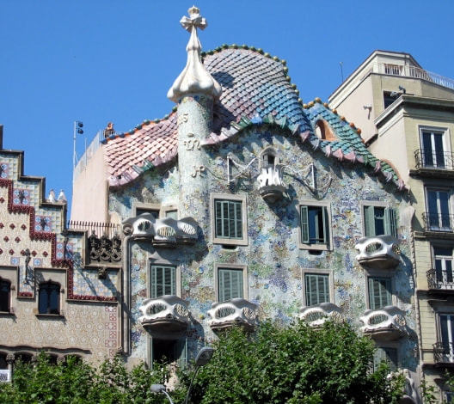
Where am I?
1) Disneyland, Hong Kong 2) Brussels, Belgium 3) Barcelona, Spain ​4) Durban, South Africa
2) Barcelona, Spain ​Casa Batllo, a modernist building by Antoni Gaudi, UNESCO World Heritage Site, on Passeig de Gracia, Barcelona, Spain.
A.N.

Slide 3
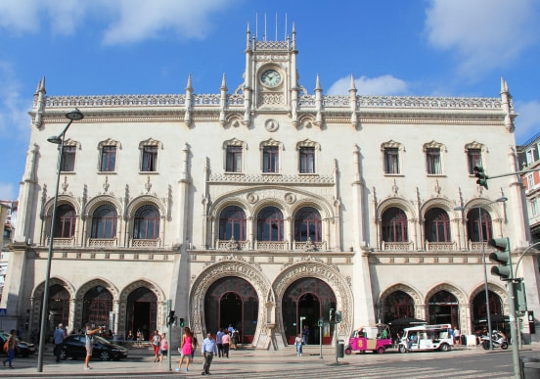
Where am I?
Europe
1) Florence, Italy 2) Brussels, Belgium 3) London, UK ​4) Lisbon, Portugal
4) Lisbon, Portugal, Rossio Station in central Lisbon. The late 19th century building complete with horseshoe shaped arches and ornamental clock was designed by José Luís Monteiro and is the main rail gateway to Sintra. ​ It is close to the metro stations of Rossio and Restauradores with the latter station having pedestrian connections to Rossio Station.
Clue:- Visiting another capital city, you possibly used this. The horse shoe entrance is the clue.
A.N.

Slide 4
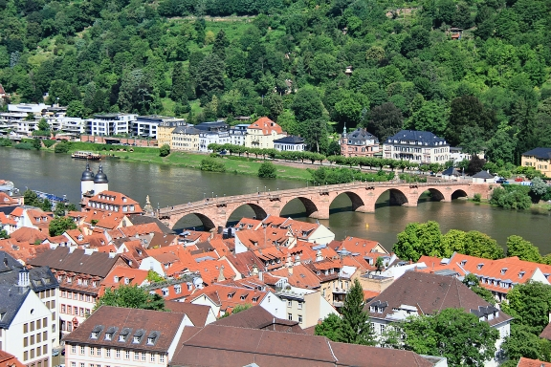
Where am I?
Europe
1) Mostar, Bosnia and Heregovina 2) Heidelberg, Germany 3) Alcantra, Spain 4) Prague, Czech Republic
Heidelberg, Germany ​ The Karl Theodor Bridge, commonly known as the Old Bridge (Alte Brücke), in Heidelberg that crosses the Neckar river. It connects the Old City with the eastern part of the Neuenheim district of the city on the opposite bank.
A.N.

Slide 5
Did you know
The seagulls in the Alfred Hitchcock movie "The Birds" (1963) were fed a mixture of wheat and whisky so they would stand around and not fly too much.
How do you get an audition to play a bird?
A.N.

Slide 6
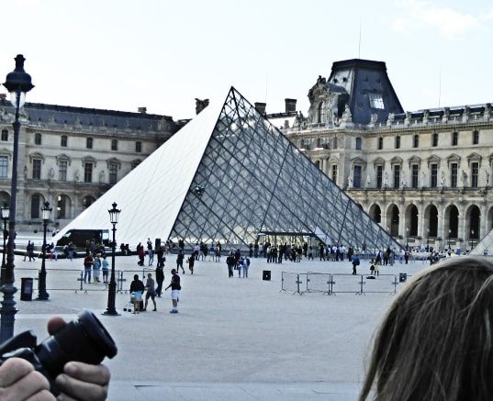
Where am I?
1) Cairo, Egypt 2) Paris, France 3) Lima, Peru ​4) Bogota, Columbia
Paris, France The Louvre Pyramid is a large glass and metal pyramid designed by Chinese-American architect I.M. Pei, surrounded by three smaller pyramids, in the main courtyard of the Louvre Palace in Paris.
A.N.

Slide 7
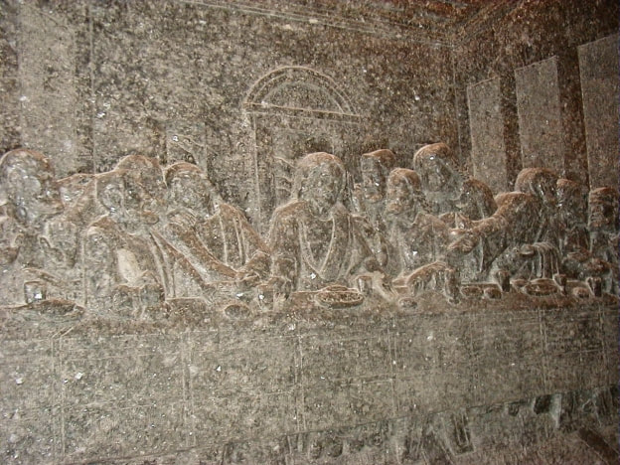
Where am I?
Europe
1) Jerusalem, Israel 2) Wieliczka, Poland 3) Nuremberg, Germany 4) Zagreb, Croatia
2) Wieliczka, Poland The Wieliczka Salt Mine, in southern Poland. Opened in the 13th century. The mine is currently one of Poland's official national Historic Monuments, whose attractions include dozens of statues and four chapels carved out of the rock salt by the miners.
Clue:- The Last Supper carved in salt
A.N.

Slide 8
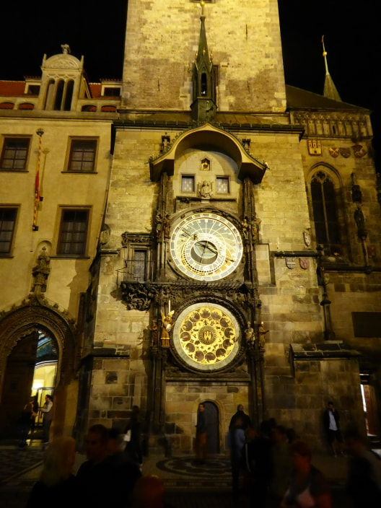
Where am I?
Clue:- A well known time
Europe
1) Dubrovnik 2) Prague 3) Amsterdam ​4) London
2) Prague, Czech Republic. ​ The Prague astronomical clock, or Prague orloj, is a medieval astronomical clock located in Prague, the capital of the Czech Republic. The Orloj is mounted on the southern wall of Old Town Hall in the Old Town Square. The clock mechanism itself has three main components: the astronomical dial, representing the position of the sun and moon in the sky and displaying various astronomical details.
A.N.

Slide 9
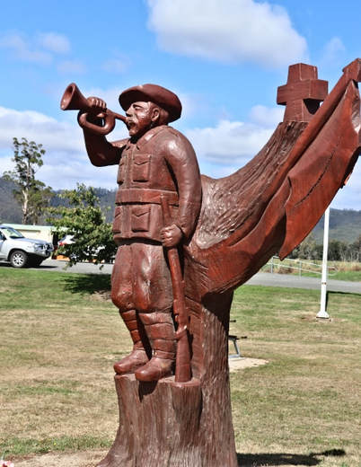
Where am I?
Oz
1) Holbrook, NSW 2) Mount Barker, SA 3) Legerwood, Tas 4) Wellington, NZ
3) Legerwood Tas. Legerwood Carved Memorial Trees are trees sculpted into World War One soldiers in Dorset, Tasmania. The 25 statues depict the fallen men they were planted for in 1918. ​In 2001, a report indicated that the trees were no longer safe and the community were devastated that the memorials would be lost. By 2004, it was decided that each of the stumps would be carved into the likeness of each soldier. A chainsaw carver, Eddie Freeman of Ross, was asked by the Legerwood Hall and Reserves Committee to sculpt the masterpieces. Various scenes depicting world War One were also carved.
A.N.

Slide 10
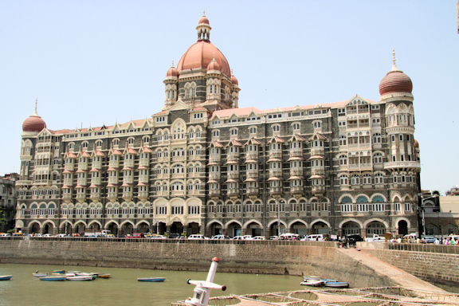
Where am I?
1) Jaipur, India 2) Nuware Eliya, Sri Lanka 3) Kandy, Sri Lanka 4) Mumbai, India
4) Mumbai, India
The Taj Mahal Palace Hotel is a heritage five-star hotel in the Colaba region of Mumbai. Historically it was known as the "Taj Mahal Hotel" or the "Taj Palace Hotel" or simply "the Taj".
A.N.

Slide 11
Did you know
Antarctica is the only continent without native species of ants.
And I can’t think of a single reason why you would want to know that.
A.N.

Slide 12
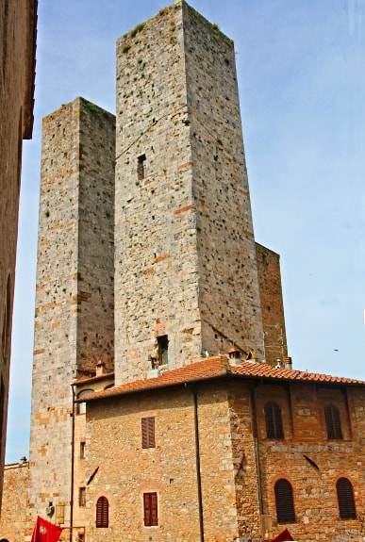
Where am I?
Europe
1) San Gimignano , Italy 2) Marseille, France 3) Dubrovnik, Croatia 4) Valencia, Spain
San Gimignano - Italy San Gimignano holds its fame in Tuscany due to its numerous towers that form a skyline that can be seen for miles from the surrounding towns and countryside. Most of the towers are constructed during the Medieval Age and a lot of Gothic and Romanesque architecture can also be found here. A dispute started between two economically powerful families living in San Gimignano, namely the Guelphs and Ghibellines. As a result of this rivalry, each family built better and higher towers to show its economical stability and power. "Whatever you can do, I can do better".
A.N.

Slide 13
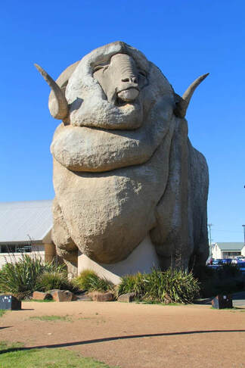
Where am I?
Australasia
1) Goulburn. NSW. - AU. 2) Te Anu. - NZ. 3) Gold Coast. QLD. - AU. ​4) Tamworth. NSW. - AU
​1) Goulburn
The Big Merino was built in 1985 and is a monument to Goulburn and the surrounding district’s wool industry. It stands 15.2 meters high, 18 meters long and weighing 97 tones. He is a life-like model of Rambo, a stud Ram from a local property, “Bullamallita”
A.N.

Slide 14
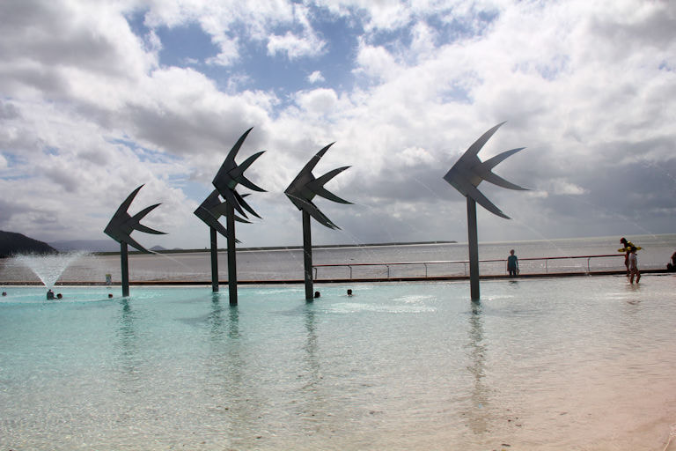
Where am I?
Australia
​1) Coffs Harbour - NSW 2) Killarney Glen, QLD 3) Sawtell Memorial Pool - NSW ​4) Cairns - QLD - AU
​4) Cairns - QLD - AU Created for the Esplanade redevelopment in 2003. The Woven Fish are large sculptures located in the Lagoon. The fish are interpretations of the smaller woven fish forms that are often woven in palm leaves.
A.N.

Slide 15
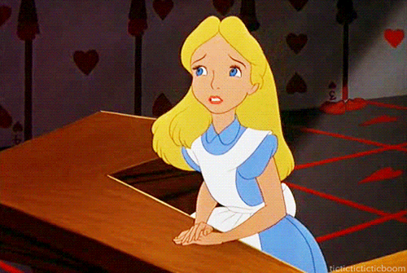
Did you know
You’re never more than 30 steps away from a trash can in Disneyland.
The story goes that Walt Disney used to observe visitors in the park and see how many steps they took before littering, as a result a litter bin is never more than 30 steps away in any Disney park.
A.N.

Slide 16
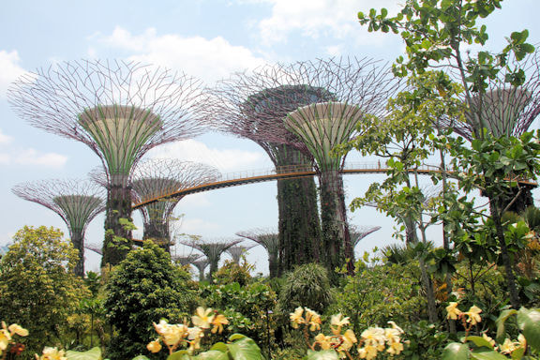
Where am I?
Asia
1) The Gardens by the Bay, Singapore 2) Botanical Gardens, Kandy, Sri Lanka 3) Koraku-en, Japan ​4) Hanoi Botanical Garden, Vietnam
1) The Gardens by the Bay, Singapore The Gardens by the Bay is a nature park spanning 101 hectares in the Central Region of Singapore, adjacent to the Marina Reservoir. The park consists of three waterfront gardens: Bay South Garden, Bay East Garden and Bay Central Garden. Gardens by the Bay was part of the nation's plans to transform its "Garden City" to a "City in a Garden", with the aim of raising the quality of life by enhancing greenery and flora in the city. First announced by the Prime Minister in 2005
A.N.

Slide 17
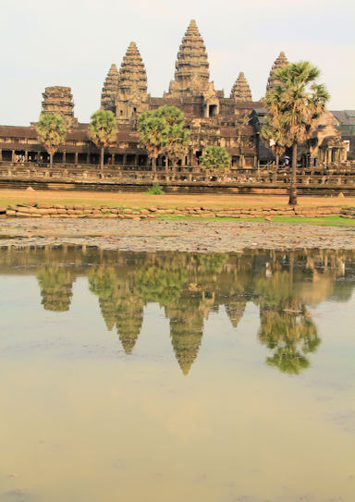
Where am I?
S.E.Asia
1) Beng Mealea 2) Koh Ker 3) Tran Quoc Pagoda ​4) Angkor Wat
4) Angkor Wat . Angkor Wat is a Buddhist temple complex in Cambodia and is the largest religious monument in the world, on a site measuring 162.6 hectares. It was originally constructed as a Hindu temple dedicated to the god Vishnu for the Khmer Empire, it was gradually transformed into a Buddhist temple towards the end of the 12th century.
A.N.

Slide 18
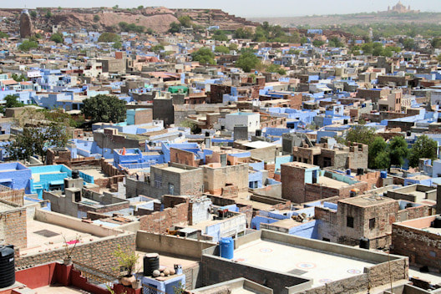
Where am I?
S.E.Asia
1) Little India, Singapore 2) Jodphur, india 3) Nuwara Eliya, Sri Lanka ​4) Hoi An, Vietnam
2) Jodphur The “Blue City” of Jodphur is the second largest city in the state on Rajasthan.. A blue pigment coating on a house used to indicate that a Brahmin,—the priests of the Indian caste system,—dwelled there, but over time the color became a badge of identity for non-Brahmins, too. It’s also said to have insect-repelling abilities
The Blue City
A.N.

Slide 19
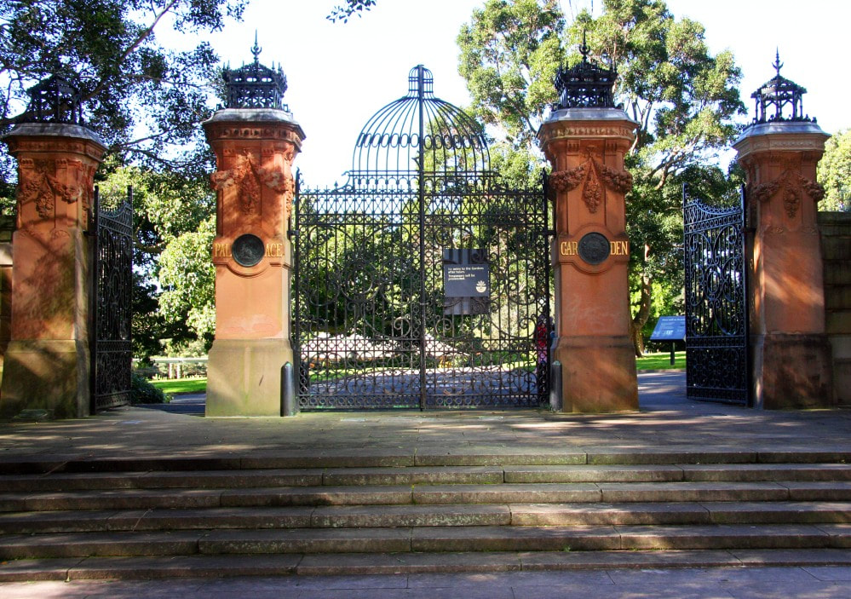
Where am I?
Australia
1) Sydney 2) Hobart 3) Melbourne
​4) Brisbane
1) Sydney
Gates to what was the ‘Palace Garden’, now the botanic garden’s. The Garden Palace was a large, purpose-built exhibition building constructed to house the Sydney International Exhibition in 1879 in Sydney. It was destroyed by fire in 1882
Clue
Gates to what was the ‘Palace Garden’
A.N.

Slide 20
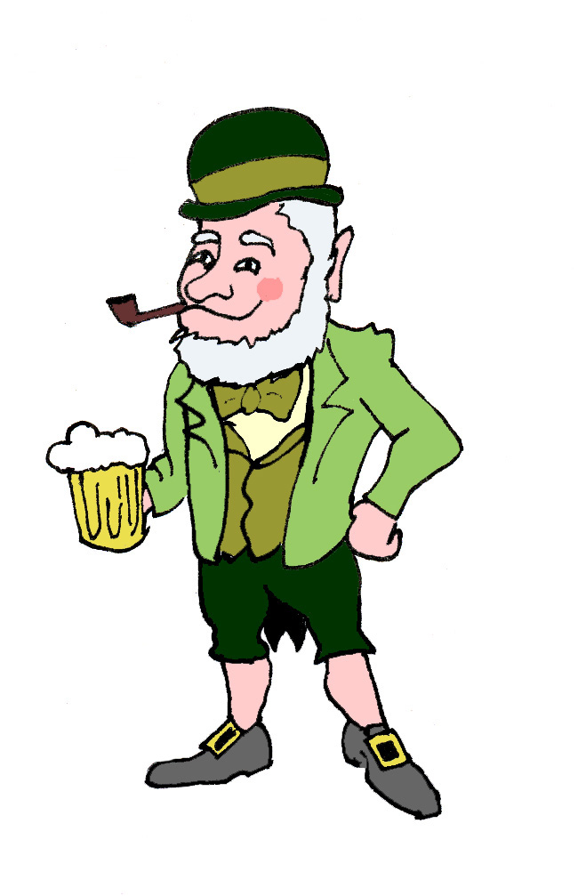
Did you know
The "O" before an Irish name, such as "O'Reilly," means "descendant of”.
The barman says to Paddy “Your glass is empty, fancy another one?”
Lookin’ puzzled Paddy says “Why know would I be needed two empty feckin glasses?
A.N.

Slide 21
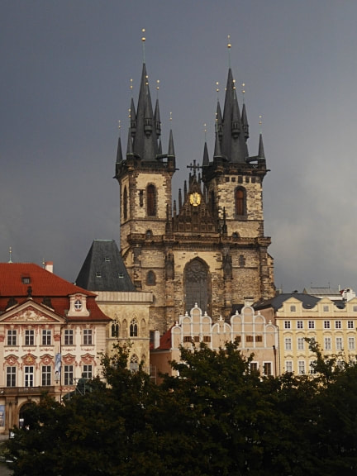
Where am I?
Europe
1) Dubrovnik 2) Zagreb 3) Prague 4) Bratislava
3) Prague
Old Town Square is a historic square in the Old Town quarter of Prague, the capital of the Czech Republic. Shown here is The Church of Our Lady. One of the most impressive Gothic religious buildings in Prague, it was built from the mid-14th to the early 16th centuries.
A.N.

Slide 22
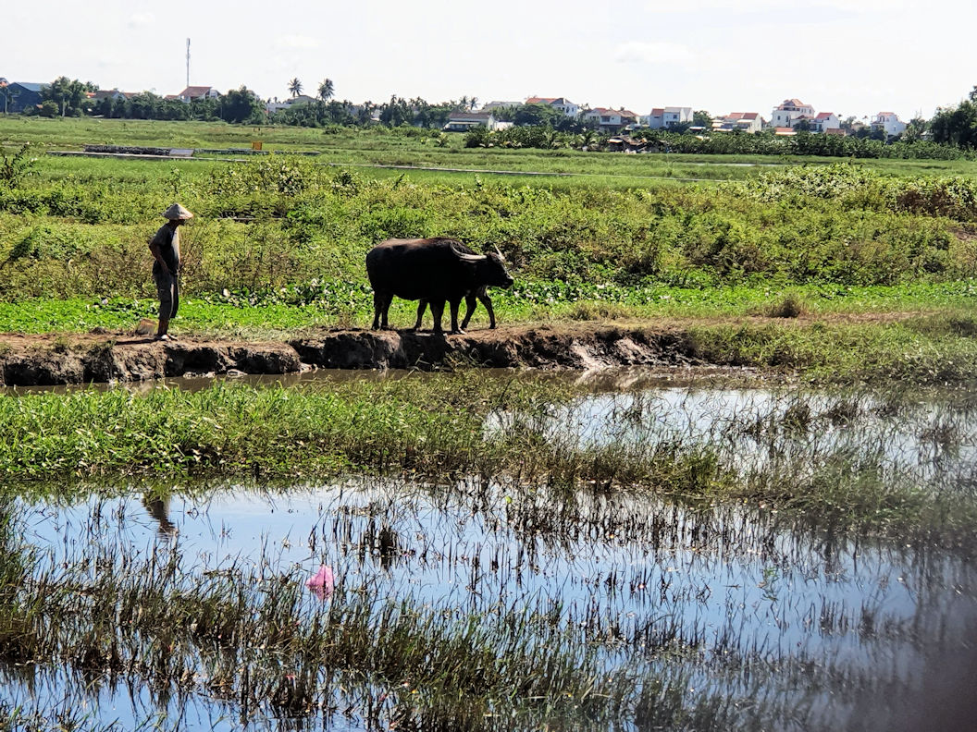
Where am I?
S.E. Asia
1) Vietnam 2) Sri Lanka 3) India 4) Thailand
1) Vietnam
Vietnam hats have existed for a very long time. The first image of this Vietnamese kind of conical hat was first engraved on Ngoc Lu bronze drum, Dao Thinh bronze drum, Dong Son bronze drum in 2500-3000 B.C..
A.N.

Slide 23
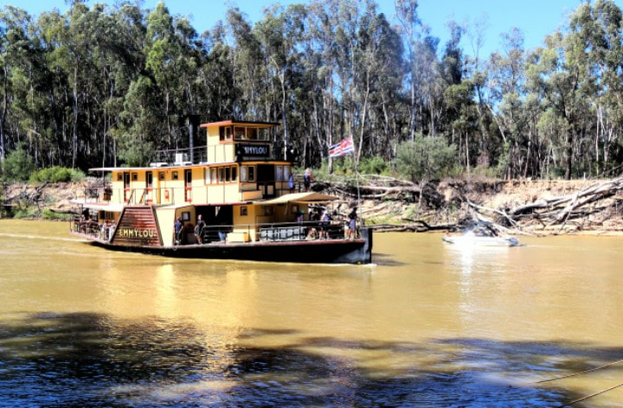
Where am I?
Australia
1) Mannum, SA 2) Renmark, SA 3) Echuca, Vic 4) Bourke, NSW
3) Echuca, Vic
The majestic PS Emmylou built in 1853 is one of the most recognisable and iconic Paddle steamers in Australia. It was Named after the American country singer Emmylou Harris. The Emmylou is now the only wood fired Paddle steamer in the world offering regular scheduled accommodated river cruises.
A.N.

Slide 24
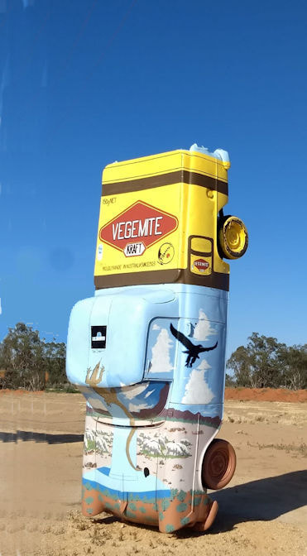
Where am I?
Australia
1) Yarram, Vic 2) Sheffield, Tas 3) Condoblin, NSW 4) Yeppoon, QLD
3) Condoblin
Condobolin’s Utes in the Paddock is a unique and quirky Australian exhibition that is gaining increased national attention.
While travelling Route 66 on a trip across the United States, Graham Pickles and his wife Jana were drawn to an unusually popular attraction named “Cadillac Ranch”, located in west Texas near Amarillo.
In 2020, Condobolin’s popular Utes in the Paddock were named "Best Sculpture Park or Trail" at the Australian Street Art Awards.
A.N.

Slide 25
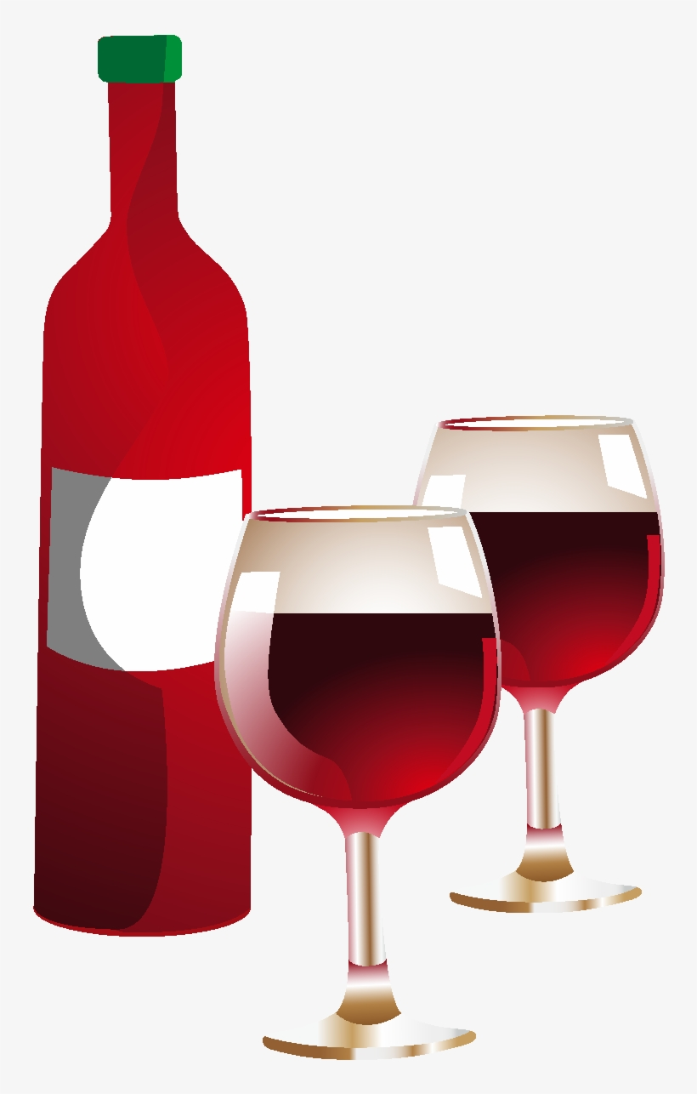
Did you know
Red Wine Flows From a Fountain in Italy.
In the town of Caldari di Ortona in northern Italy, a local vineyard installed a fountain that spills red wine instead of water 24 hours a day.
The fountain is actually meant for the pilgrims following the Cammino di San Tommaso, a 196-mile route from Rome to Ortona to follow in the footsteps of St. Thomas the Apostle.
A.N.

Slide 26
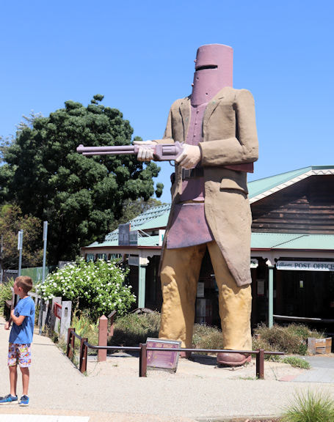
Where am I?
Australia
Glenrowan, Vic
Gundagai, NSW
3) Subiaco, WA 4) Adelaide, SA
1) Glenrowan A six metre statue commemorates the bushranger, Ned Kelly. Glenrowan is the place of the last siege of the Kelly Gang and the deaths of three of its members.
On 28 June 1880 Ned Kelly led Joe Byrne, Dan Kelly and Steve Hart in a final confrontation against eight Victoria Police Officers and five Aboriginal trackers from Queensland.
A.N.

Slide 27
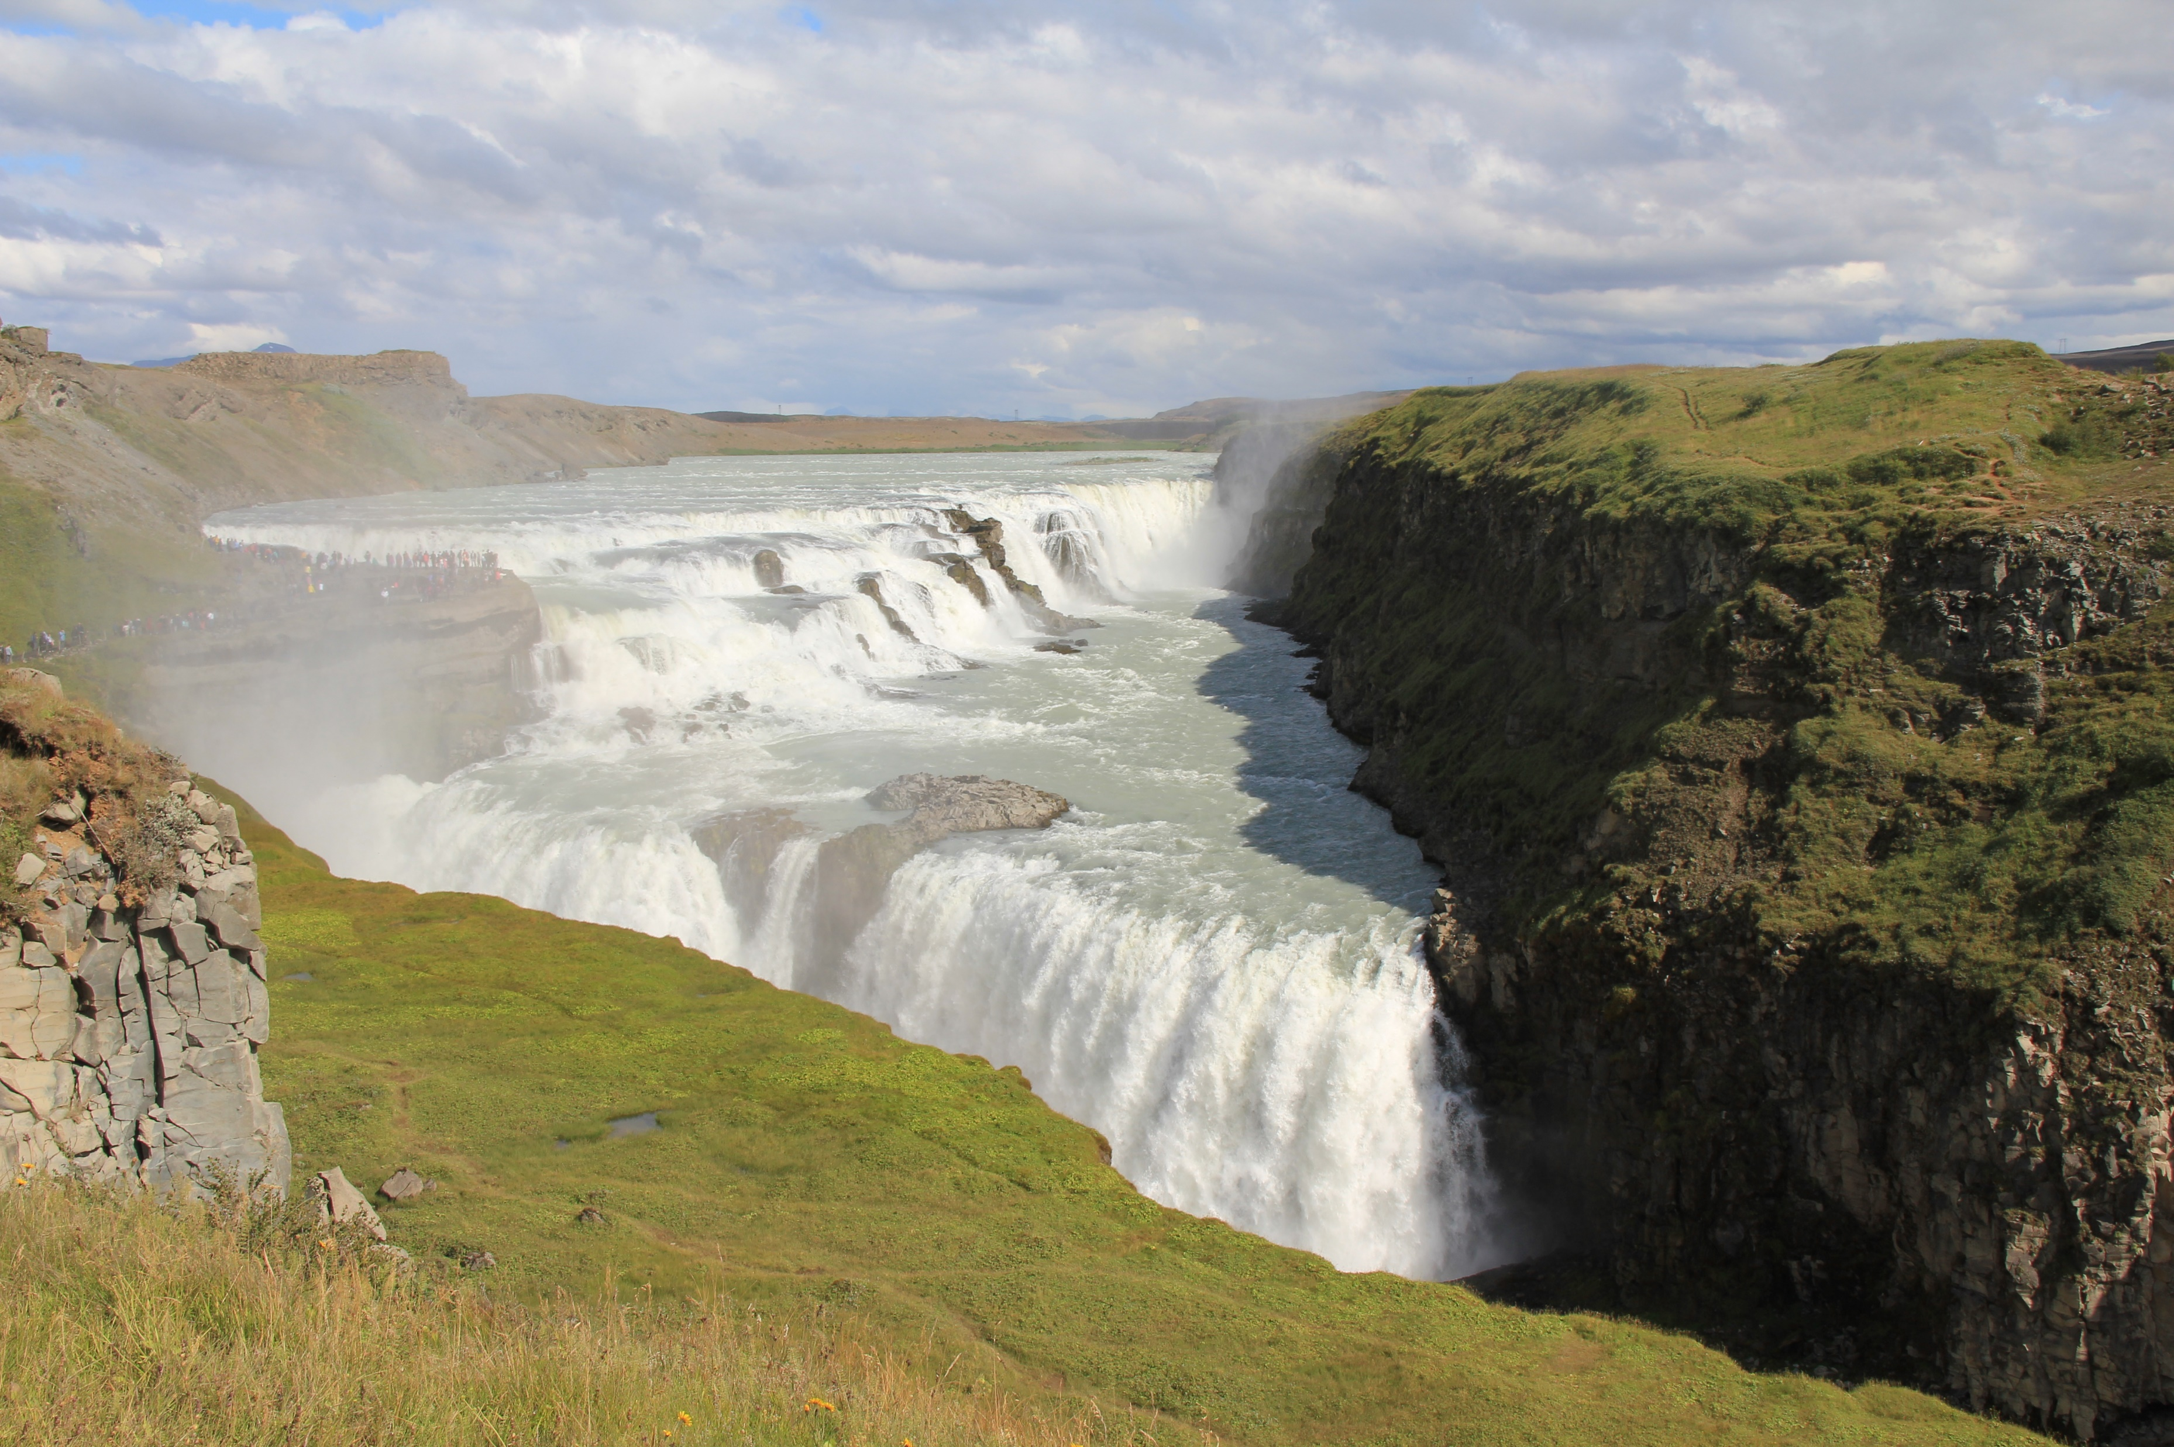
Where am I?
World
3) Iceland
Gullfoss (Golden Falls) is a massive waterfall on the river Hvita in western Iceland. The falls are considered one of Iceland's most treasured natural wonders, with a name inspired by the phenomenon when glacial sediment in the water turns the falls golden in the sunlight.
Sri Lanka
Canada
Iceland
New Zealand
A.N.

Slide 28
The End
Travel Quiz
A.N.

