Slide 1
Where am I
Travel Quiz
A.N.

Slide 2
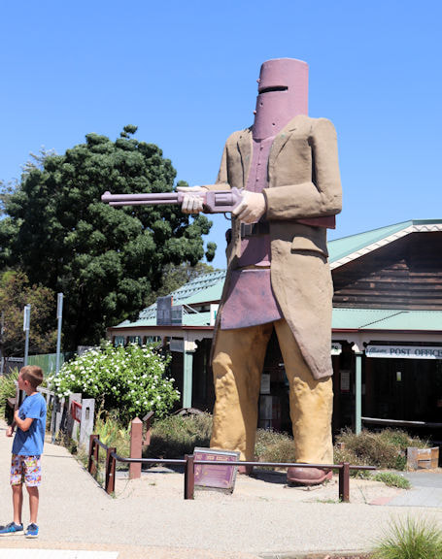
Where am I?
Australia
Glenrowan, Vic
Gundagai, NSW
3) Subiaco, WA 4) Adelaide, SA
1) Glenrowan A six metre statue commemorates the bushranger, Ned Kelly. Glenrowan is the place of the last siege of the Kelly Gang and the deaths of three of its members.
On 28 June 1880 Ned Kelly led Joe Byrne, Dan Kelly and Steve Hart in a final confrontation against eight Victoria Police Officers and five Aboriginal trackers from Queensland.
A.N.

Slide 3
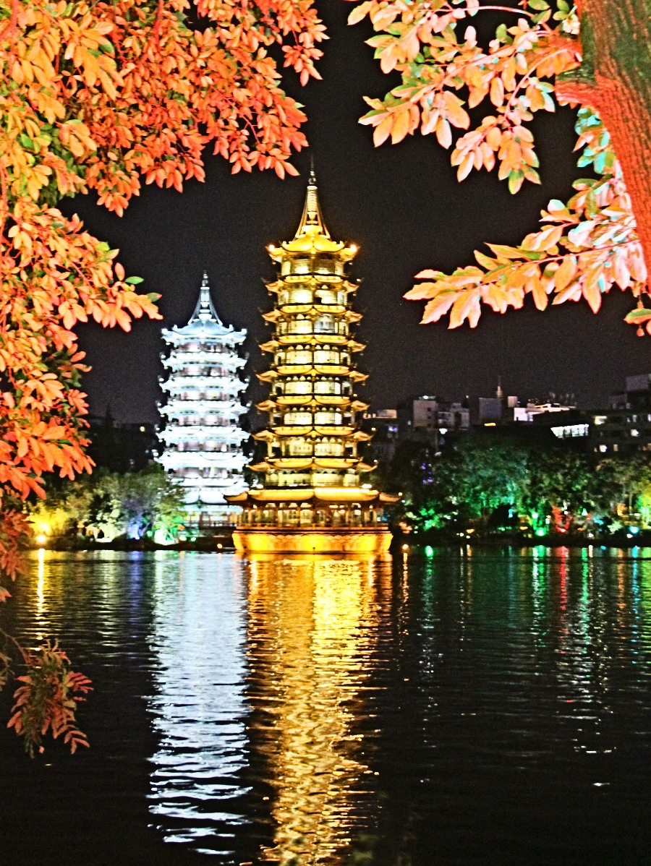
Where am I?
Asia
1) Ranakpur, India 2) Guilin, China 3) Kyoto, Japan 4) Angkor Wat, Cambodia
2) Guilin, China
The Sun and Moon Pagodas stand erect in the water of central Fir Lake (Shanhu). They are also known as Gold and Silver Pagodas because of their colors at night.
A.N.

Slide 4
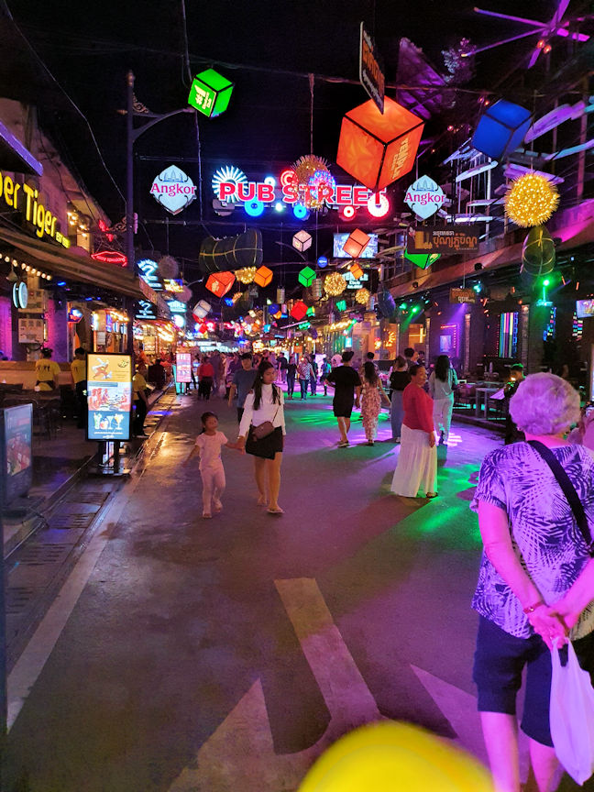
Where am I?
Asia
1) Kolkata, India 2) Kandy, Sri Lanka 3) Hanoi, Vietnam 4) Siem Reap, Cambodia
4) Siem Reap, Cambodia
The famous Pub Street started off as a small, 3-restaurant establishment on a humble stretch of dirt road in the heart of the city. The Angkor WHAT? Bar was the first club to open its doors on the street in 1998, closely followed in August of 2000 by the already closed “Singaporean Asian Rooftop” restaurant, and the Red Piano Restaurant.
A.N.

Slide 5
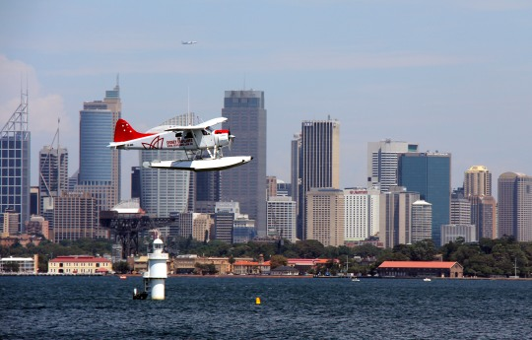
Where am I?
Australia
1) Cairns, QLD 2) Perth, WA 3) Brisbane, QLD 4) Sydney, NSW
4) Sydney, NSW 1938 Rose Bay became home to Sydney’s first international airport, servicing the mighty flying boats – large, luxurious, four-engine aircraft that alighted on water.
Sydney operated the last major flying boat base in the world until 1974.
A.N.

Slide 6
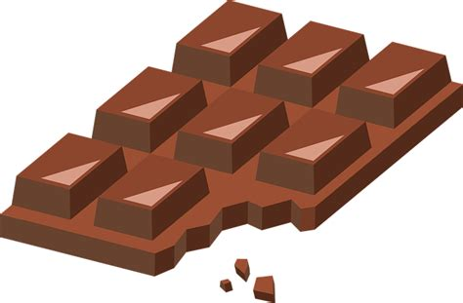
Did you know
More Chocolate Is Bought at Brussels Airport Than Any Other Place in the World
There are 24.8 million flights through Brussels, and 67,900 passengers per day. Even if only 10 percent purchased chocolate, that's a lot of sweetness being sold!
A.N.

Slide 7
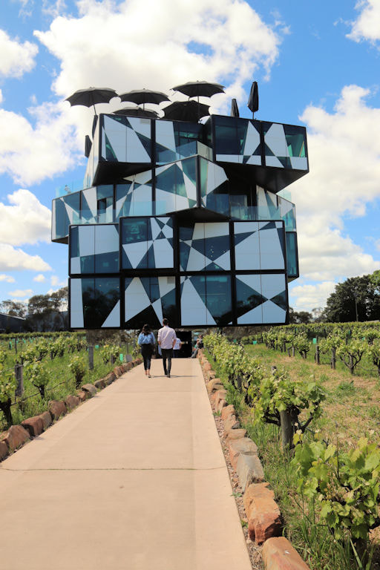
Where am I?
Australia
NSW
WA
Tas
SA
4) SA d'Arenberg winery, McLaren Vale
The idea to build the d'Arenberg Cube came to Chester Osborn, Chief Winemaker, in 2003.
Inspired by the complexities and puzzles of winemaking, Chester created the idea of a cube-shaped building. Each of the five levels have been carefully designed to entice and excite the senses, including features such as a wine sensory room, a virtual fermenter, a 360degree video room, and many other tactile experiences
A.N.

Slide 8
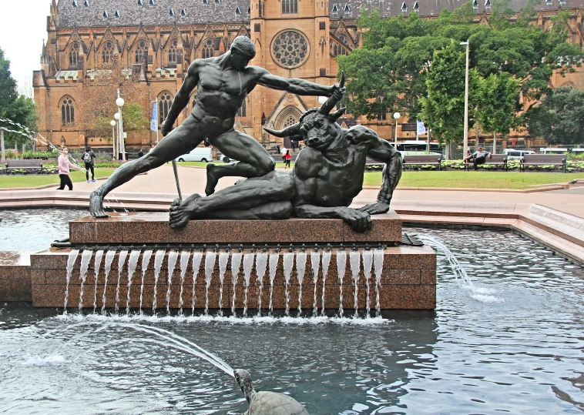
Where am I?
Australia
Sydney, NSW
Melbourne, Vic
Brisbane, QLD
Perth, WA
1) Sydney, NSW The Archibald Fountain in Hyde Park.
In 1919, a bequest in the will of J. F. Archibald, founding editor of the Bulletin, provided for the erection in Sydney of a symbolic, open-air memorial.
A.N.

Slide 9
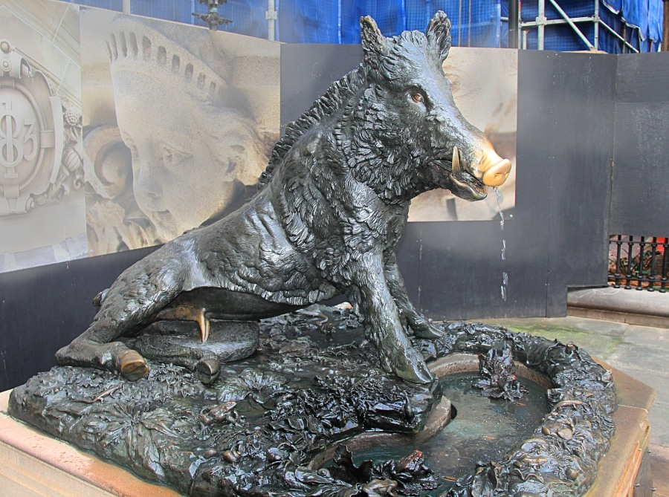
Where am I?
Australia
Sydney, NSW
Melbourne, Vic
Brisbane, QLD
Perth, WA
Sydney Il Porcellino, meaning ‘the little pig’, is a larger than life-sized bronze wild boar, anatomically realistic and resting on its left haunch and front legs.
It is located outside the Sydney’s oldest hospital, Sydney Hospital, facing Macquarie Street. The sculpture is an exact replica of an original by Pietro Tacca which has stood in Florence, Italy, since circa 1633, and is given the local Florentine nickname il porcellino.
A.N.

Slide 10
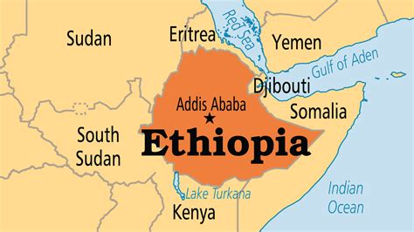
Did you know
In Ethiopia the current year is 2016.
Ethiopia maintains its own calendar, which, due to a difference in the perceived date of the Annunciation (the proclamation of the birth of Christ), is seven to eight years behind the Gregorian calendar (which is used as standard across most of the world). In Ethiopia the new year also begins on either August 29 or August 30.
A.N.

Slide 11
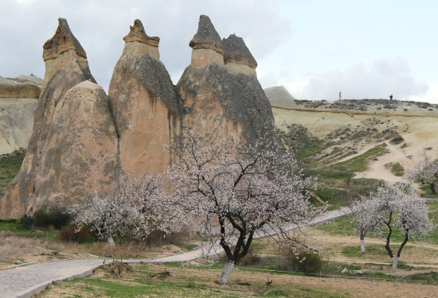
Where am I?
The World
When you have hats like ours, they don’t look at your shoes
Turkey
Jordan
Australia
Colombia
Turkey - Cappadocia
Cappadocia is a geological oddity of honeycombed hills and towering boulders of otherworldly beauty. The fantastical topography is matched by the human history here.
A.N.

Slide 12
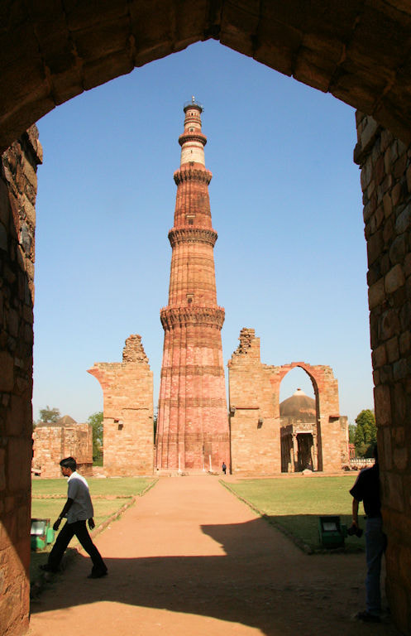
Where am I?
The World
France
Jordan
India
China
India - Jaipur
The Jantar Mantar, Jaipur is a collection of 19 astronomical instruments built by the Rajput king Sawai Jai Singh, the founder of Jaipur, Rajasthan. The monument was completed in 1734
A.N.

Slide 13
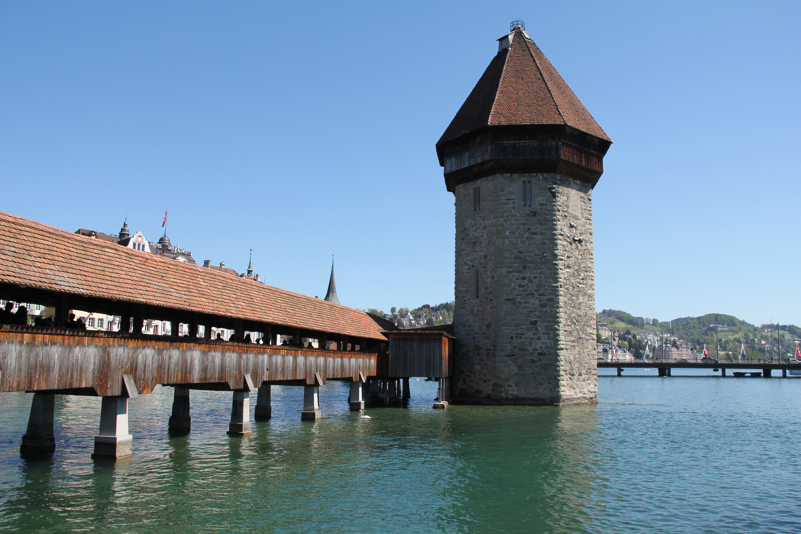
Where am I?
World
Spain
Switzerland
England
Germany
2) Switzerland
Chapel Bridge is Lucerne’s most famous landmark. Built initially as a way to link the Old Town on the north bank of the Ruess river to the new town perched on the south bank, Chapel Bridge is a one-of-a-kind wooden walkway serving as the symbol of Switzerland. It’s also Europe's oldest covered bridge.
A.N.

Slide 14
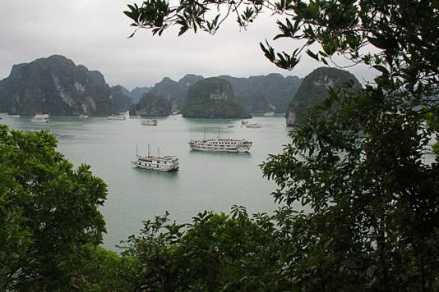
Where am I?
The World
Sri Lanka
China
Brazil
Vietnam
4) Vietnam - Halong Bay
Halong Bay owns a complex of limestone islands located within the Gulf of Tonkin, in the city of Halong, Quang Ninh province, which is about 170km from Hanoi.
A.N.

Slide 15
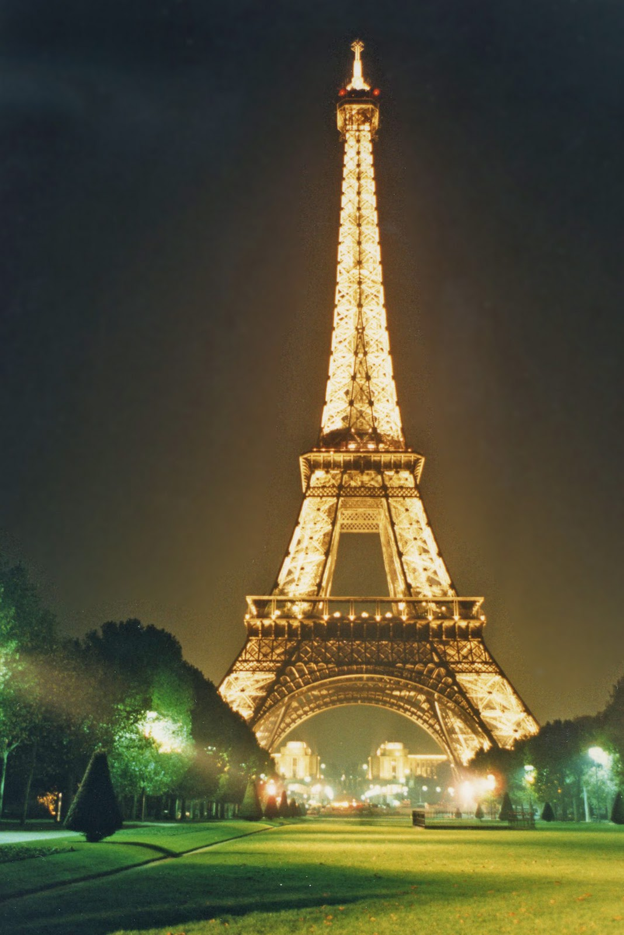
Did you know
Eiffel Tower’s size changes up to 6 inches (15.24 cm) over the seasons.
Eiffel Tower’s size increases 15 cm (6 inches) during summer time because the steel structure expands on higher temperatures!
A.N.

Slide 16
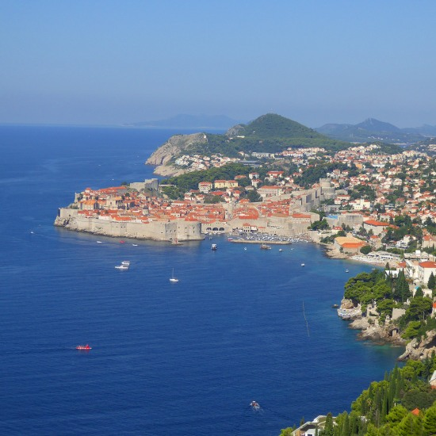
Where am I?
The World
Barletta, Italy
Valencia, Spain
Dubrovnik, Croatia
Gdansk, Poland
3) Dubrovnik The history of the city probably dates back to the 7th century, when the town known as Ragusa was founded by refugees from Epidaurum.
Over the past decade, Dubrovnik in Croatia has gained a lot of popularity as a dream wedding destination amongst foreign couples wishing to tie the knot in a beautiful romantic location.
A.N.

Slide 17
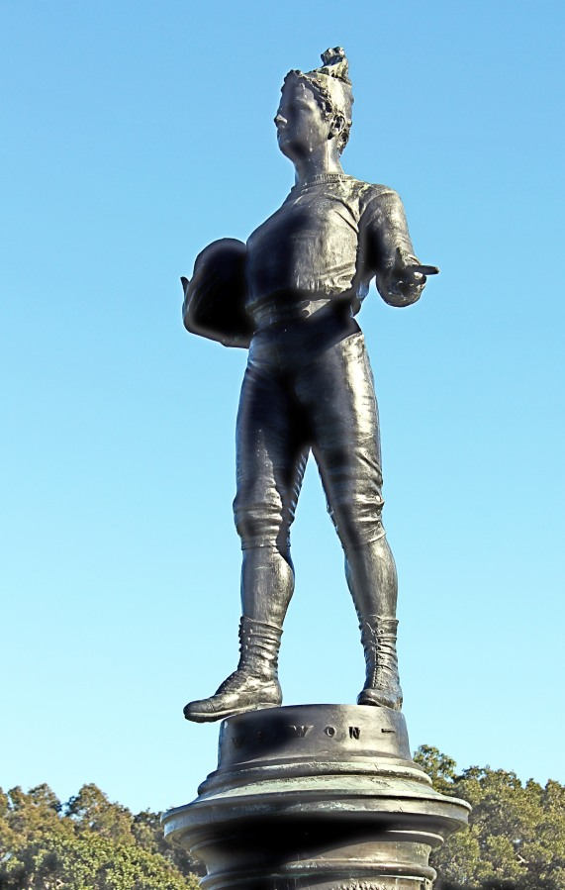
Where am I?
Australia
The footballer “We won”
The GABBA
The MCG
Sydney Football stadium
Centennial park
4) Centennial park
Also known as “The Footballer,” was sculptured by the sculptor Tommaso Sani who was well-known in Sydney in the 1880s. The life-sized figure, dressed in a woollen cap, sweater and tight knee-length trousers worn by football players of the day contrasts with the serene and idealised Neoclassical face of Apollo.
A.N.

Slide 18
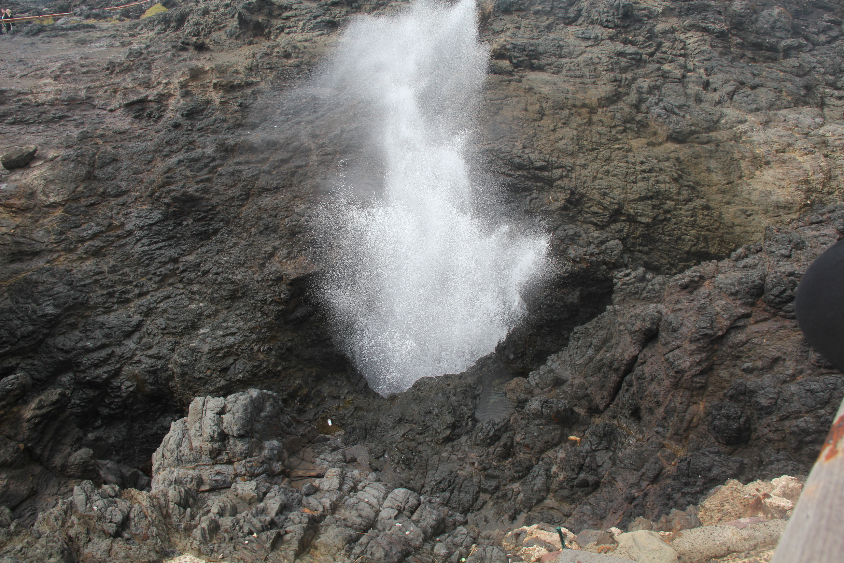
Where am I?
Australia
Kiama NSW
Forster NSW
Caloundra QLD
Denmark WA
1) Kiama Blowhole
Kiama Blowhole is a natural wonder where waves compress air and water 30 metres into the sky on the NSW South Coast. You can view it from Blowhole Point, a scenic headland with a museum, a pool and a lighthouse.
A.N.

Slide 19
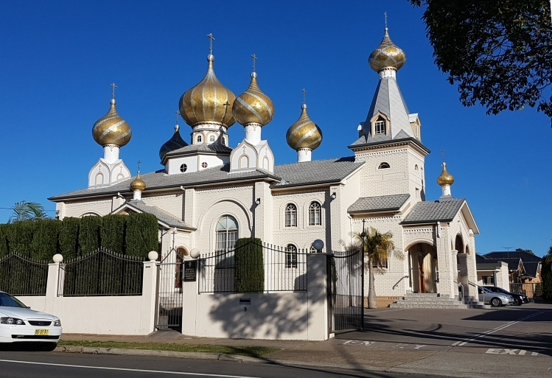
Where am I?
The World
Moscow, Russia
New York, USA
Lidcombe, Australia
Kaunas, Lithuania
3) Lidcombe, Australia
Russian Old Rite Orthodox Christian Church.
A.N.

Slide 20
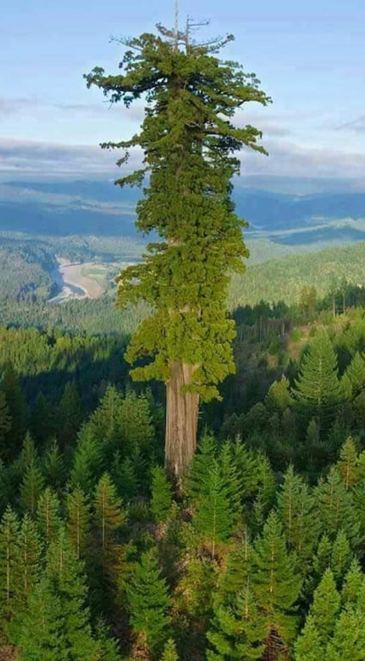
Did you know
The tallest tree in the world has a height of 380 ft or 115m.
The tallest tree in the world is located in the Redwood National Park in California. It’s called Hyperion and has a height of 380 ft or 115m. It’s about one third of the height of Eifel Tower.
A.N.

Slide 21
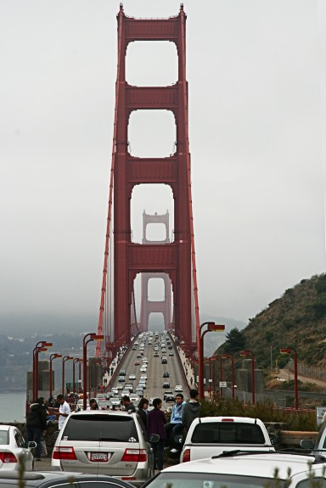
Where am I?
World
Porto, Portugal
Rio, Brazil
San Francisco, USA
Istanbul, Turkey
3) San Francisco, USA
The Golden Gate Bridge is a suspension bridge spanning the Golden Gate, the one-mile-wide strait connecting San Francisco Bay and the Pacific Ocean.
A.N.

Slide 22
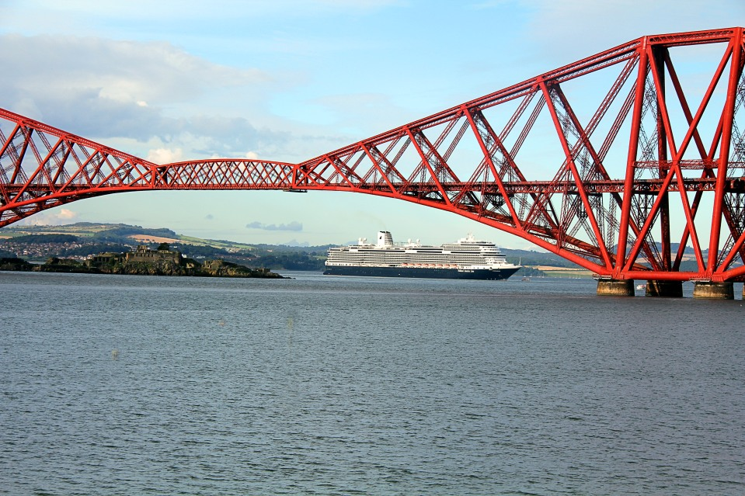
Where am I?
World
England
Wales
Ireland
Scotland
4) Scotland
The Forth Bridge is a cantilever railway bridge across the Firth of Forth in the east of Scotland, 9 miles west of central Edinburgh. Completed in 1890, it is considered a symbol of Scotland, and is a UNESCO World Heritage Site.
A.N.

Slide 23
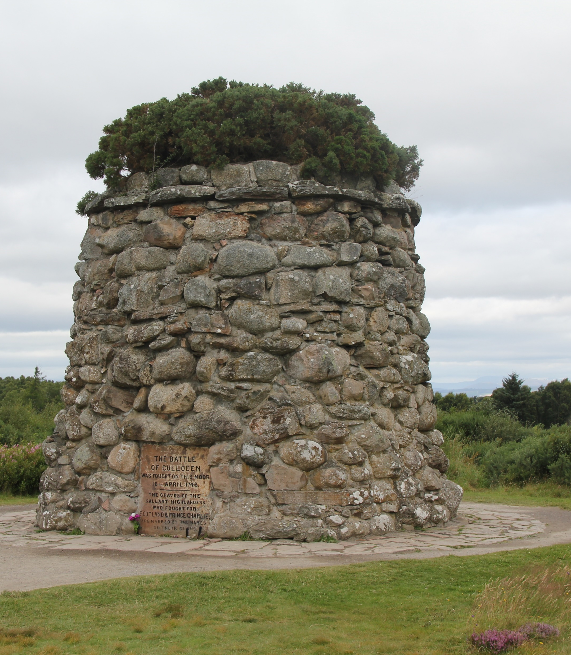
Where am I?
World
The battle of Culloden 1746
France
England
Germany
Scotland
4) Scotland
The Battle of Culloden was the final confrontation of the Jacobite rising of 1745. On 16 April 1746, the Jacobite army of Charles Edward Stuart was decisively defeated by a British government force under Prince William Augustus, Duke of Cumberland, on Drummossie Moor near Inverness in the Scottish Highlands.
A.N.

Slide 24
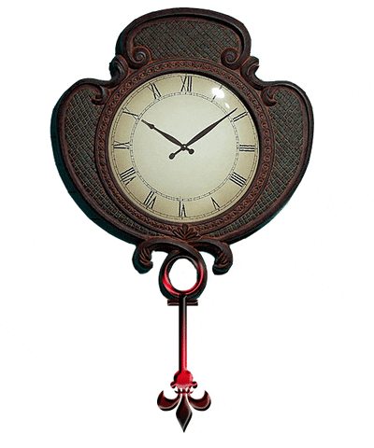
Did you know
France is a country with the most time zones in the world.
You will often see information that France is a country with most time zones – 12. The reason for this is because France still administers territories placed far away across the world. Russia and the USA cover 11 time zones.
A.N.

Slide 25
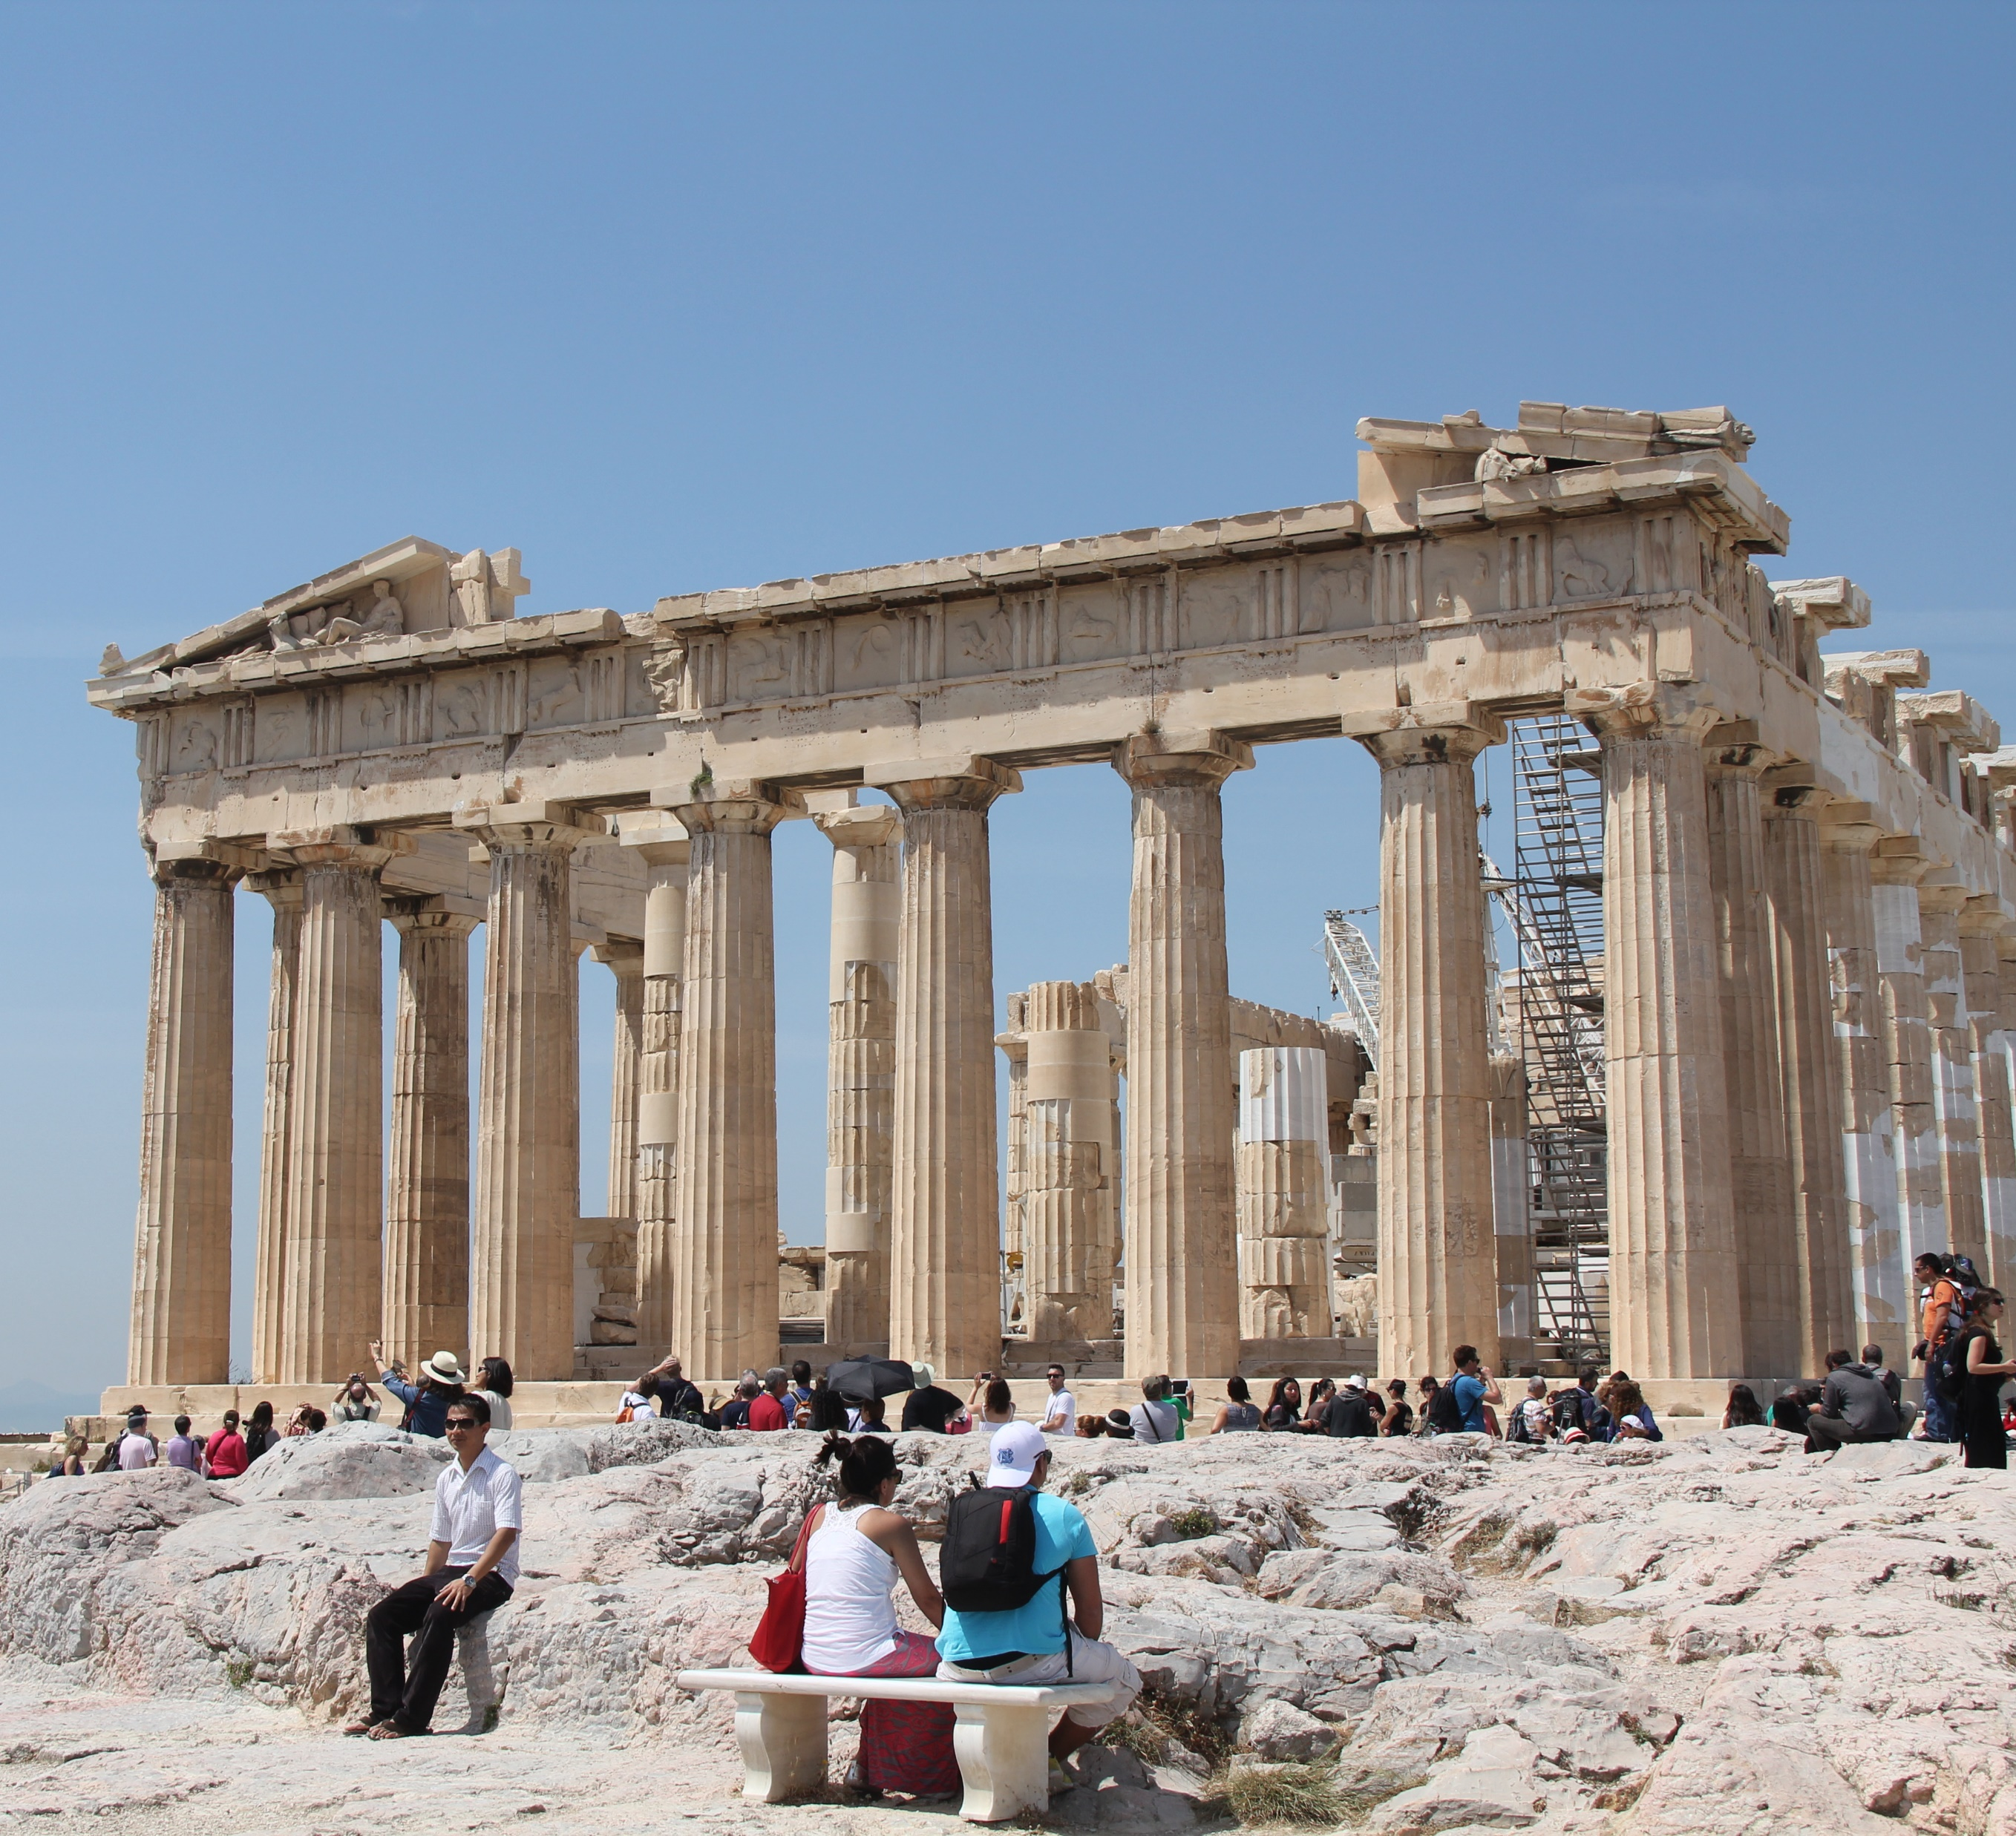
Where am I?
World
Rome
Athens
Turkey
Italy
2) Athens
The Parthenon is a former temple on the Athenian Acropolis, Greece, that was dedicated to the goddess Athena during the fifth century BC. Its decorative sculptures are considered some of the high points of classical Greek art, an enduring symbol of Ancient Greece, democracy and Western civilization.
A.N.

Slide 26
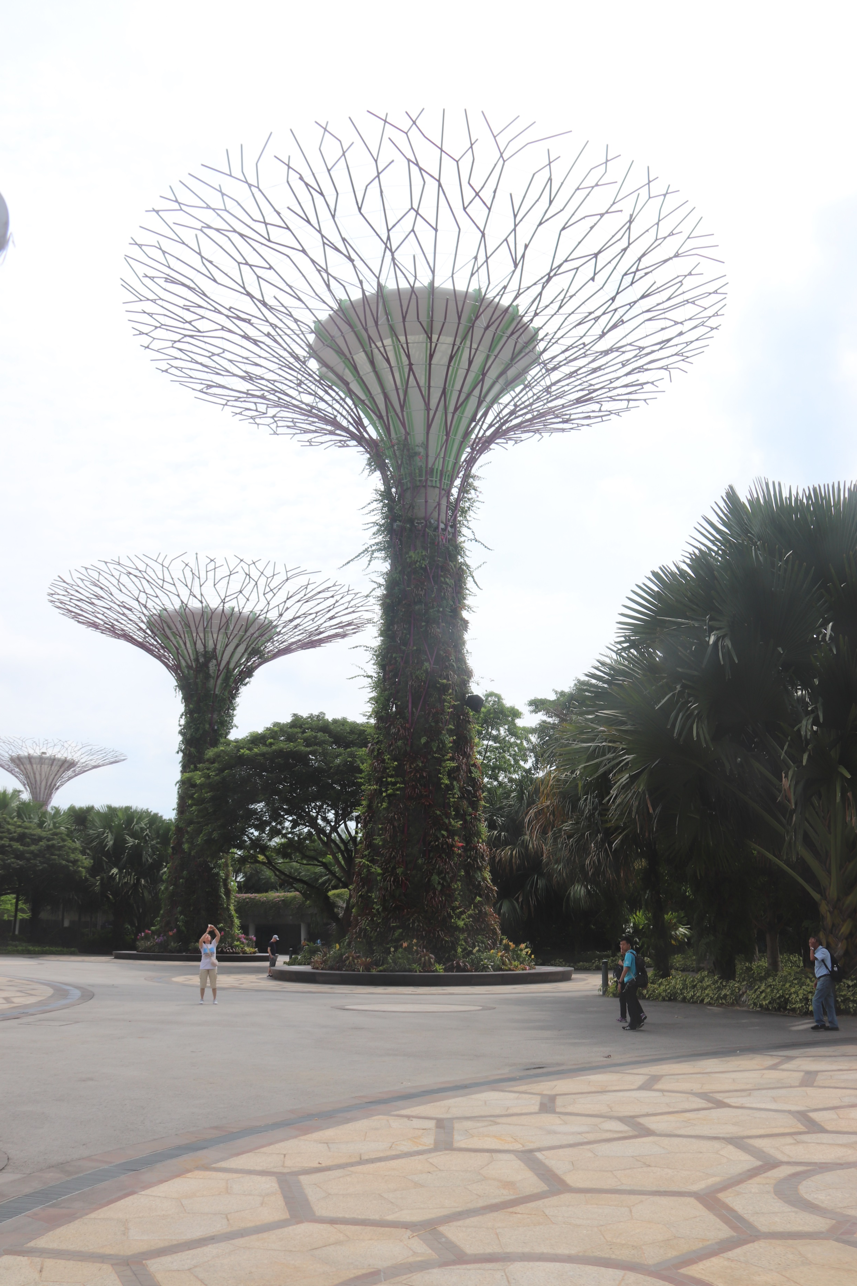
Where am I?
World
Vietnam
India
Hong Kong
Singapore
4) Singapore
Supertrees -The Gardens by the Bay – Singapore
This is a nature park spanning 101 hectares in the Central Region of Singapore, adjacent to the Marina Reservoir. The park consists of three waterfront gardens:
A.N.

Slide 27
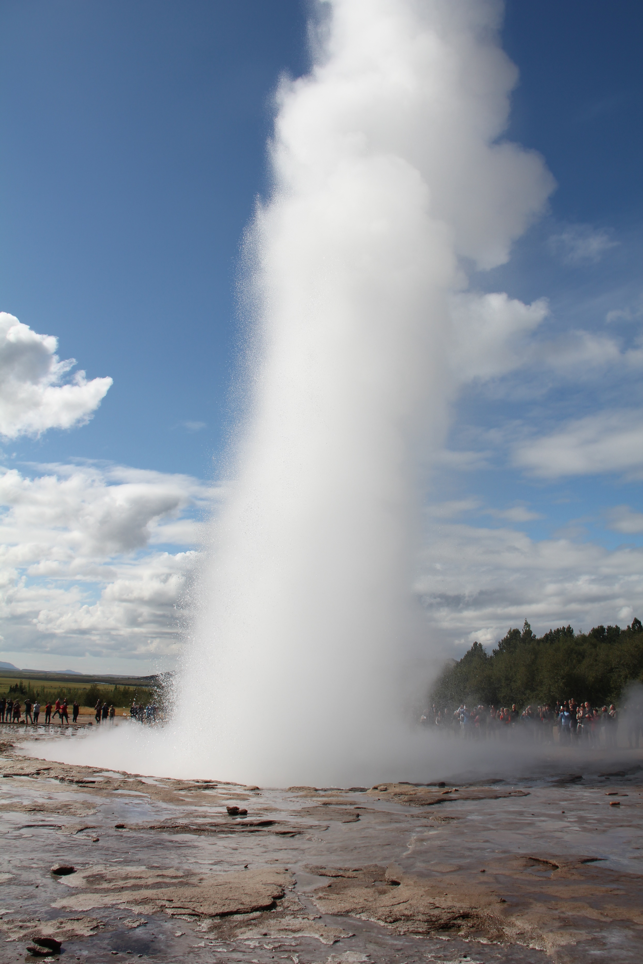
Where am I?
World
Vietnam
Iceland
Japan
USA
2) Iceland
Iceland is the motherland of some of the most famous geysers in the world. In fact, the word geyser itself stems from the Old Norse word “geysa” which means “to gush” or “to rush forth.” Today, it is estimated that there are between 20 and 29 active geysers in Iceland and over 38 locations with extinct or dormant and sealed geysers.
A.N.

Slide 28
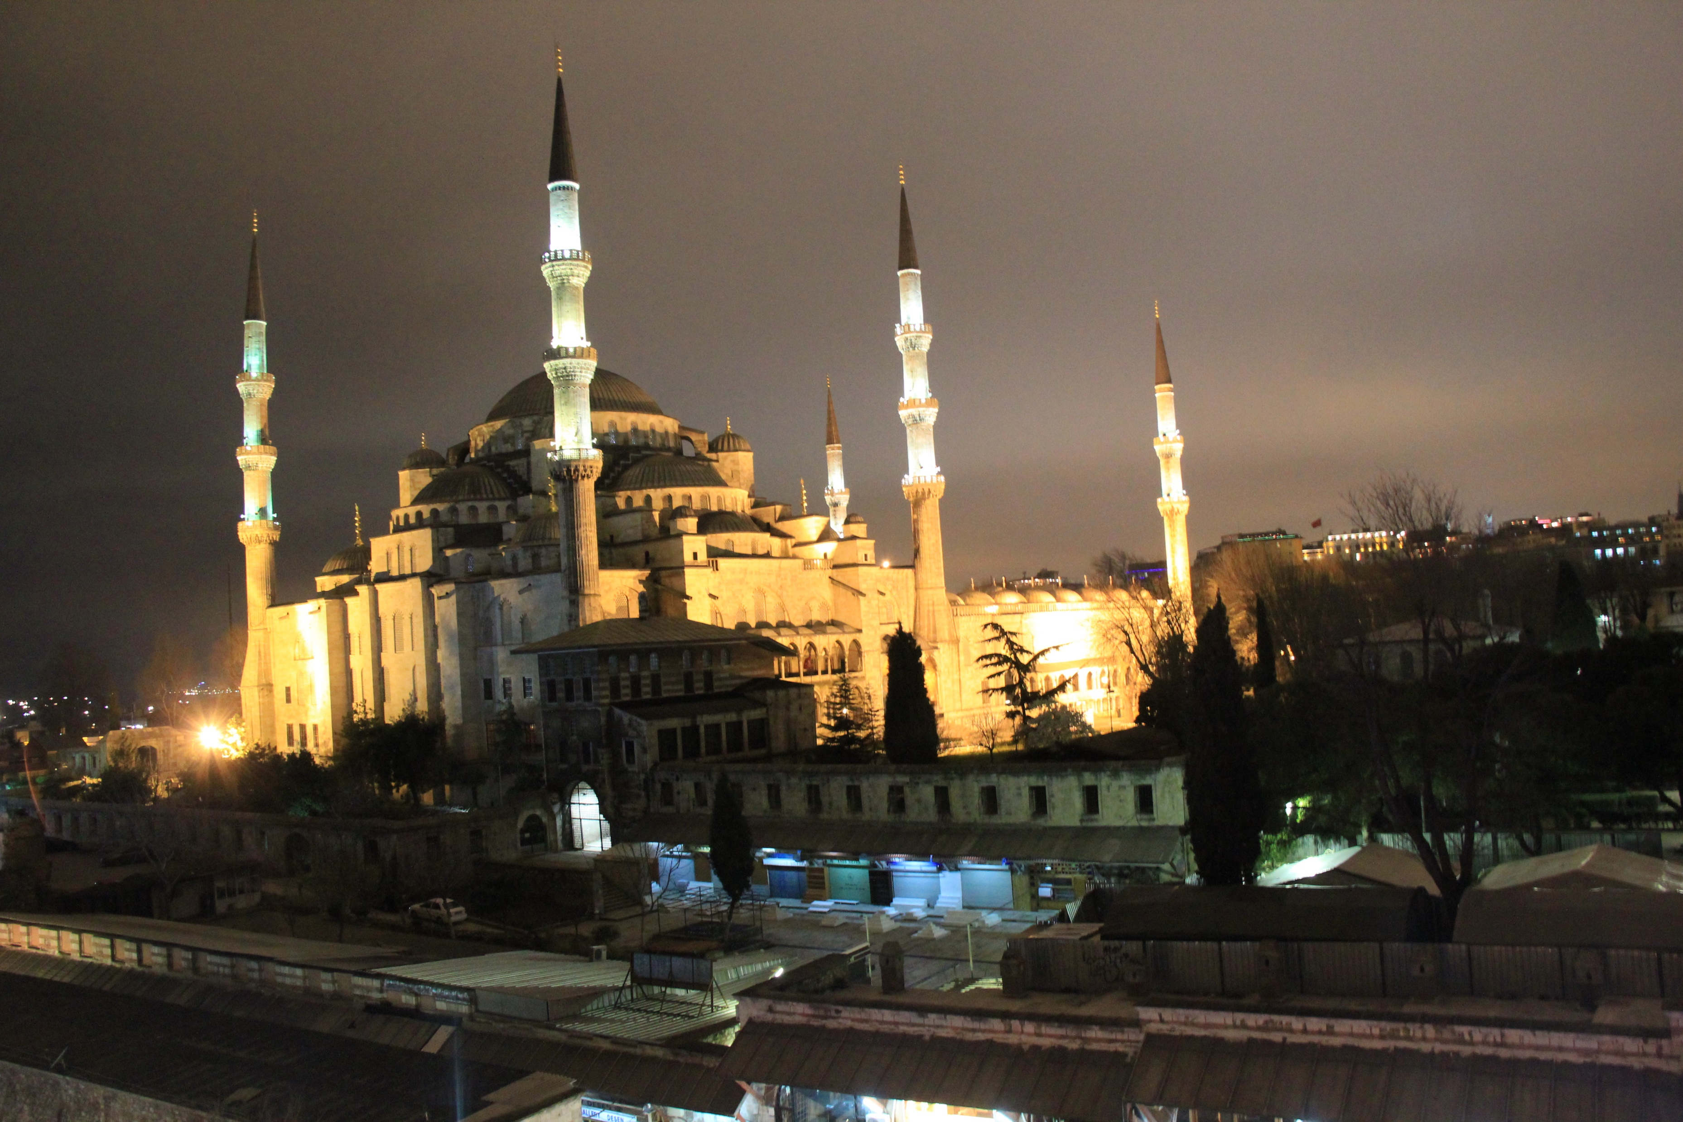
Where am I?
World
2) Istanbul
Hagia Sophia, officially the Hagia Sophia Grand Mosque, is a converted former church and mosque and a major cultural and historical site in Istanbul, Turkey. The last of three church buildings to be successively erected on the site by the Eastern Roman Empire, it was completed in 537 AD. The site was an Eastern Orthodox church from 360 AD to 1204, when it was converted to a Catholic church following the Fourth Crusade.
Jakarta
Istanbul
Ankara
Damascus
A.N.

